Slide 1

Avocado average prize predication
EDA and ML algorithm

Slide 2
Problem Statement
In this study, we can predict the Avocado’s Average Price based on different features. The features are different (Total Bags,Date,Type,Year,Region…).
The variables of the dataset are the following:
Categorical: ‘region’,’type’
Date: ‘Date’
Numerical:’Total Volume’, ‘4046’, ‘4225’, ‘4770’, ‘Total Bags’, ‘Small Bags’,’Large Bags’,’XLarge Bags’,’Year’
Target:‘AveragePrice’

Slide 3
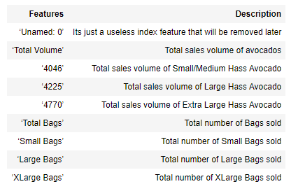
DATA IN DEPTH
The data dictionary describing the different columns in the dataset.

Slide 4
DATA IN DEPT (…)
There are a total of 18249 samples (rows) and 14 columns in the data frame.
There is no incorrect datatypes, missing value or duplicate value
The Feature "Unnamed:0" is just a representation of the indexes, so it's useless to keep it, remove it now !
Just over 2% of our dataset is organic and remaining 98% Conventional which is in more demand

Slide 5
WHAT DID I DO ? (Explore data)
Which type of Avocados are more in demand (Conventional or Organic)?
In which range Average price lies, what is distribution look like?
How Average price is distributed over the months for Conventional and Organic Types?
What are TOP 5 regions where Average price are very high?
What are TOP 5 regions where Average consumption is very high?
In which year and for which region was the Average price the highest?
How price is distributed over the date column?
How dataset features are correlated with each other?

Slide 6
EXPLORATION AND CONCLUSION

Slide 7
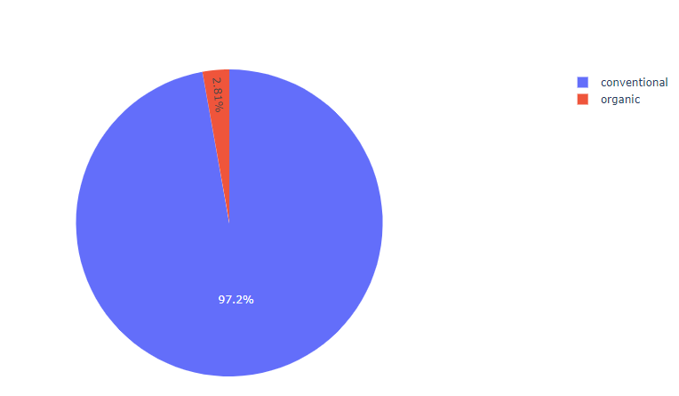
Sales percentage of Conventional vs Organic
Demands of different types of Avocados, 2.81% of organic and 97.2% conventional sold

Slide 8
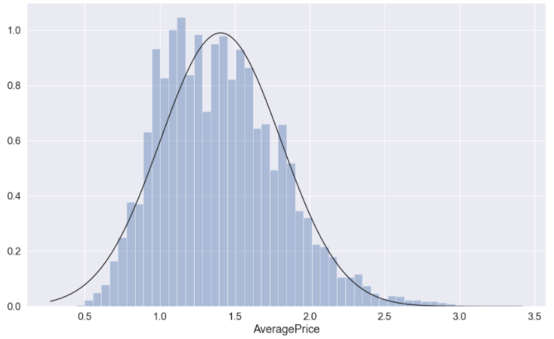
Total distribution of average prize
Average Price distribution shows that for most cases price of avocado is between 1.1, 1.4.

Slide 9
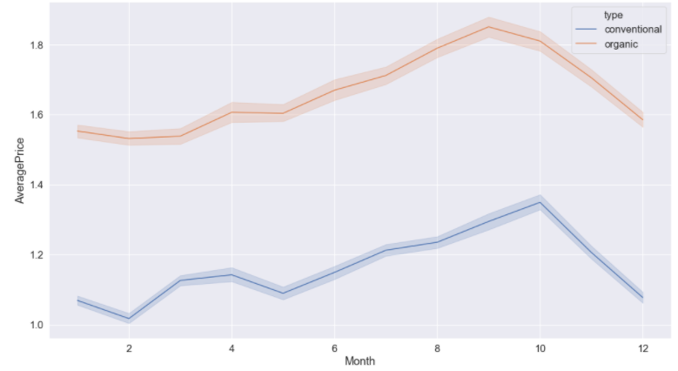
Average price is distributed over the months for Conventional and Organic
hike between months 8 – 10 for both Conventional and Organic type of Avocados prices.

Slide 10
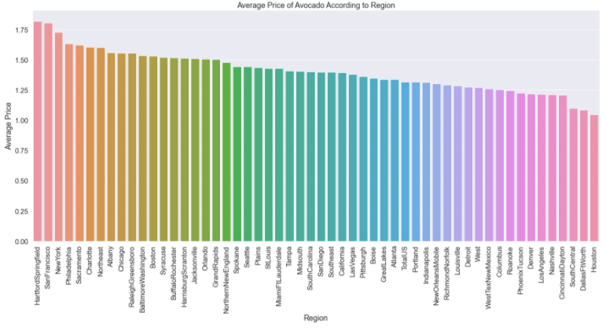
TOP 5 regions where Average price are very high
these region are where price is very high
HartfordSpringfield
SanFrancisco
NewYork
Philadelphia
Sacramento

Slide 11
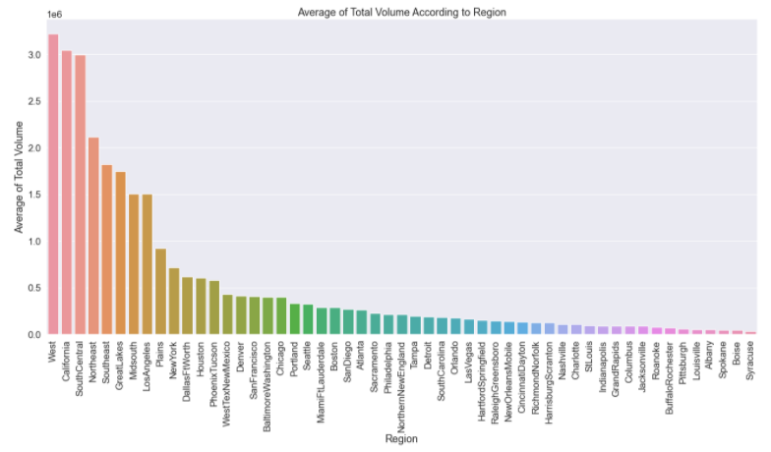
TOP 5 regions where Average consumption is very high
these region are where Consumption is very high
WestCalifornia
SouthCentral
Northeast
Southeast

Slide 12
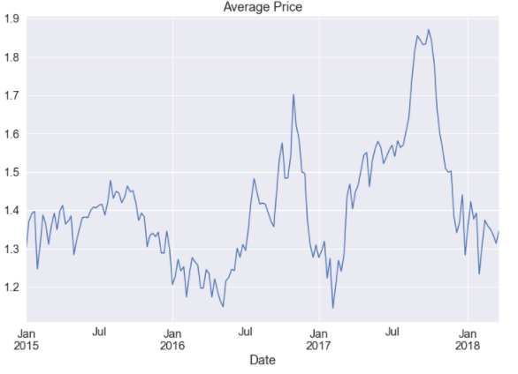
price is distributed over the date
This also shows there was a huge hike in prices after July 2017 and before Jan 2018Drama is the most popular among critics

Slide 13
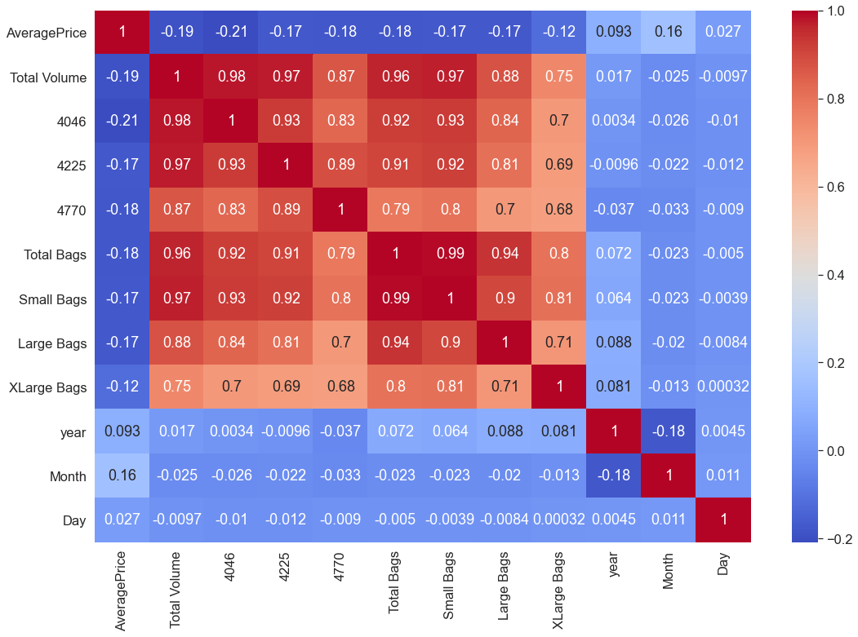
features are correlated with each other
all the Features are not correlated with the Average Price column, instead most of them are correlated with each other.

Slide 14
Feature Engineering and Model selecting

Slide 15
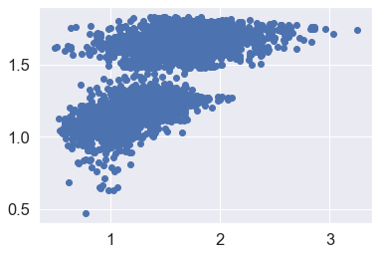
Model selection and Prediction
Linear Regression selected because our Target variable 'AveragePrice' is continuous
Module evaluated
MAE: 0.2329713329170077
MSE: 0.0910880280536491
RMSE: 0.3018079323902026

Slide 16
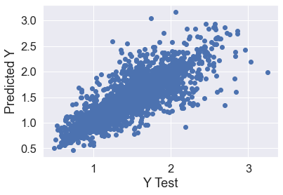
Decision Tree Regression
Model evaluate
MAE: 0.13646301369863012
MSE: 0.04481915068493151
RMSE: 0.2117053392924503.
RMSE is lower than the previous one we got with Linear Regression

Slide 17
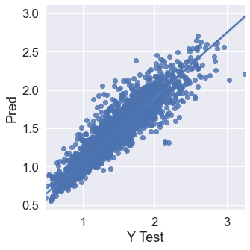
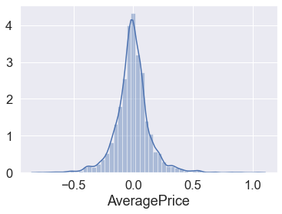
RandomForest Regression
Model evaluate
MAE: 0.10090912328767121
MSE: 0.021606730369863002
RMSE: 0.14699227996688466
RMSE is lower than the previous two we got with Linear Regression and decision tree, so the RandomForest Regressions the best model in this case.
Notice here that our residuals looked to be normally distributed and that's really a good sign which means that our model was a correct choice for the data.

Slide 18
THANKS
sonali_s_s@rediffmail.com

