Slide 1
Breakout Room Questions
Group 1: What are databases? Why/when do you use them? What are some challenges to using databases?
Group 2: What are some examples of databases? What company created/owns them? (Hint: MySQL is one example)
Group 3: What are relational databases? What are non-relational databases? What are advantages/disadvantages of each?
Group 4: What is SQL? What is it used for and when was it created?
Group 5: What are some different types of databases? (Hint: relational and non-relational are two types; what are other types?)
Bonus: What the heck is a data lake???

Slide 2
My Answers
Group 1: What are databases? Why/when do you use them? What are some challenges to using databases?
Databases are a method/physical way to organize and store large amounts of data. If implemented properly, they can scale based on the amount of data/need. We use them to consolidate, organize, analyze, and secure data. Some challenges can include hardware/scalability limitations, complexity, and data security.
Group 2: What are some examples of databases? What company created/owns them? (Hint: MySQL is one example)
SQL Server (Microsoft), OmniSci, Kinetica, Cassandra (Facebook), Oracle, Postgre, MongoDB
Group 3: What are relational databases? What are non-relational (NoSQL) databases? What are advantages/disadvantages of each?
Relational databases store data in a row-column format (like Excel) while non-relational databases do not. Non-relational databases store data in one of four ways: document-oriented, key-value stores, wide-column, graph stores.
Relational databases map out relationships between objects/entities.
https://www.logianalytics.com/relational-vs-non-relational-databases/
Group 4: What is SQL? What is it used for and when was it created?
Structured Query Language
SQL is a syntax used to communicate with a database in order to tell it how to do something. There are many built in commands that you use to build a query in order to retrieve data from or alter a database.
Group 5: What are some different types of databases? (Hint: relational and non-relational are two types; what are other types?)
Centralized ,Cloud, Commercial, Distributed, End-user, Graph, NoSQL, Object-oriented, Open-source, Operational, Personal, Relational
https://www.indeed.com/career-advice/career-development/types-of-databases
Bonus: What the heck is a data lake??? Datawarehouse??
https://www.confluent.io/learn/databases-data-lakes-and-data-warehouses-compared/

Slide 3
Relational DatabaseS

Slide 4
Relational Databases
A relational database is a digital database based on the relational model of data, as proposed by E. F. Codd in 1970. A software system used to maintain relational databases is a relational database management system. Many relational database systems have an option of using the SQL for querying and maintaining the database.
Think of a relational database as a place where sophisticated Excel documents are organized. Each Excel sheet represents a table (entity) that contains rows (tuples) and columns (attributes) of data. Each Excel document is a schema. So all of the entities and its tuples and attributes are all related to one another within a schema. A different schema will hold different data (just like different user directories).
Let’s look at an example:
Pets
Pet Food
Pet Dimensions

Slide 5
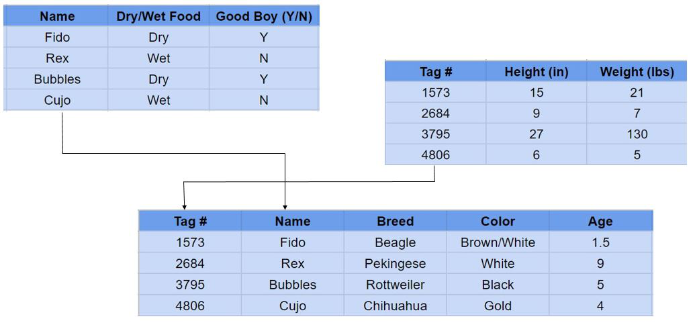
RELATIONAL DATABASE STRUCTURE
PET FOOD TABLE
PET DIMENSIONS TABLE
PET TABLE

Slide 6
RELATIONAL DATABASE STRUCTURE
PET FOOD TABLE
Attribute
PET DIMENSIONS TABLE
Tuple
PET TABLE

Slide 7
Relationships – Break Out
https://condor.depaul.edu/gandrus/240IT/accesspages/relationships.htm
What are the three types of relationships?
Choose a topic to model a database after.
Provide *organic* examples of the different types of relationships between what you are going to model.
Requirements: must contain at least 5 entities and at least 2 out of the 3 types of relationships.

Slide 8
Relationships – Discussion
One to one
One to many
Many to many
Students share examples
https://condor.depaul.edu/gandrus/240IT/accesspages/relationships.htm

Slide 9
Entity Relationship Diagram (ERD)
What is an ER diagram?
An Entity Relationship (ER) Diagram is a type of flowchart that illustrates how “entities” such as people, objects or concepts relate to each other within a system. ER Diagrams are most often used to design or debug relational databases in the fields of software engineering, business information systems, education and research.
Also known as ERDs or ER Models, they use a defined set of symbols such as rectangles, diamonds, ovals and connecting lines to depict the interconnectedness of entities, relationships and their attributes. They mirror grammatical structure, with entities as nouns and relationships as verbs.

Slide 10
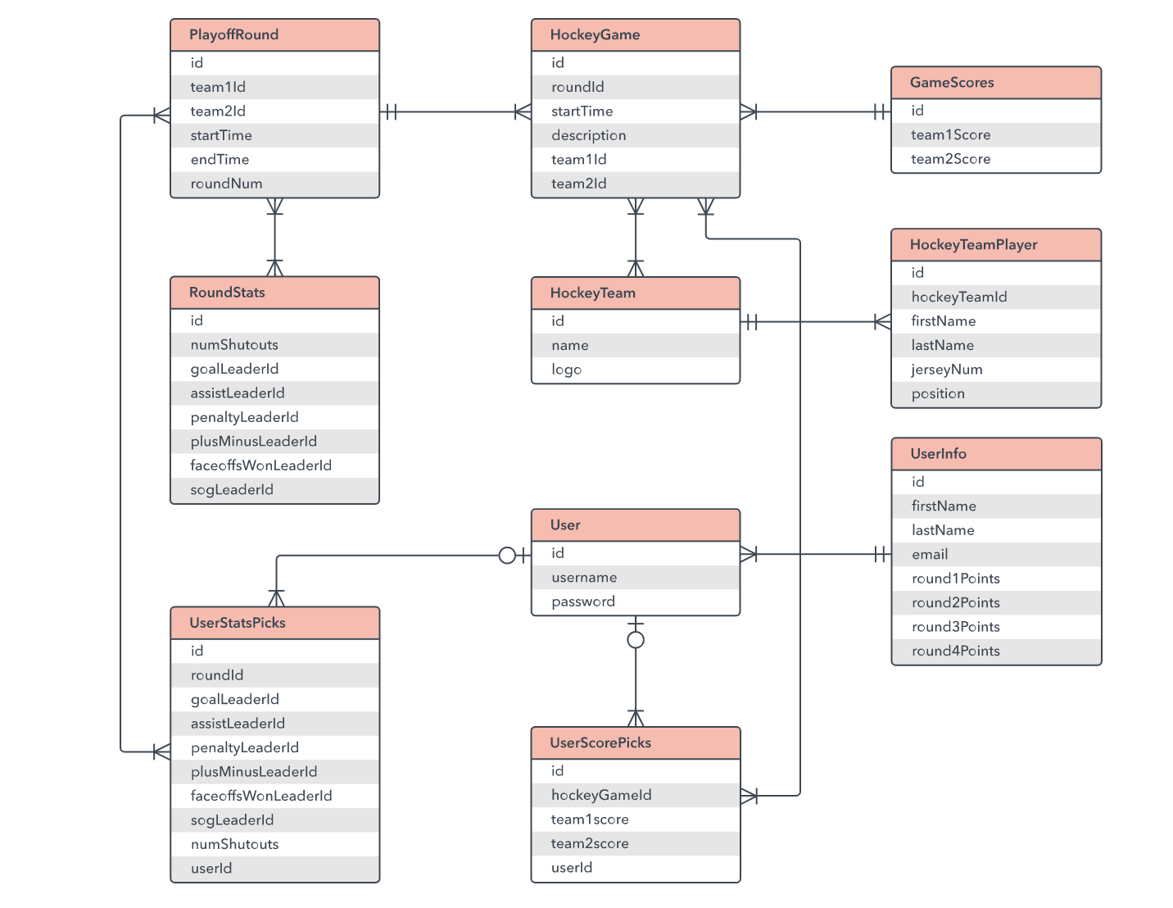
Entity Relationship Diagram (ERD)
Example:
https://www.lucidchart.com/pages/er-diagrams

Slide 11
Entity Relationship Diagram (ERD) - Breakout
Create your own ERD diagram for the example you created earlier.
Create a free account at Lucid chart.
Search the templates for an ERD diagram. Select create from an example.
Map out your ERD. Include the relationships between tables and add text boxes to describe the relationships.
https://www.lucidchart.com/pages/
Students share examples.

Slide 12
Primary and Foreign Keys
A primary key is a column or a set of columns in a table whose values uniquely identify a row in the table. A relational database is designed to enforce the uniqueness of primary keys by allowing only one row with a given primary key value in a table.
A foreign key is a column or a set of columns in a table whose values correspond to the values of the primary key in another table. In order to add a row with a given foreign key value, there must exist a row in the related table with the same primary key value.
Why use them??

Slide 13
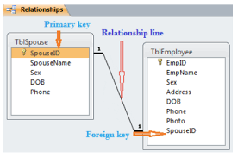
Primary and Foreign Keys Example
Primary Key Requirements:
It must contain a unique value for each row of data.
It cannot contain null values.
Every row must have a primary key value.
Primary Key ERD Syntax:
Underline the name of the field and add “PK” in front of the name (optional)

Slide 14
Primary and Foreign Keys - Breakout
Add Primary and foreign keys to your ERD.
Review with your group.
Share when we get back.

Slide 15
Further Topics
Database Normalization
https://www.lifewire.com/database-normalization-basics-1019735
https://www.guru99.com/database-normalization.html
Database Denormalization
https://www.geeksforgeeks.org/denormalization-in-databases/
https://searchdatamanagement.techtarget.com/definition/denormalization
Database Security/Access Control
Database Indexing
https://medium.com/@jimmyfarillo/the-basics-of-database-indexes-for-relational-databases-bfc634d6bb37
https://www.geeksforgeeks.org/indexing-in-databases-set-1/
Database Contraints
Database Locking
Database Optimization

Slide 16
Break

Slide 17
Lab
Installing MySQL and MySQL Workbench
Import the Sakila database that comes with the installation
https://dev.mysql.com/doc/sakila/en/sakila-structure.html
Submit screenshot of MySQL Workbench and the dataset inside

Slide 18
SQL

Slide 19
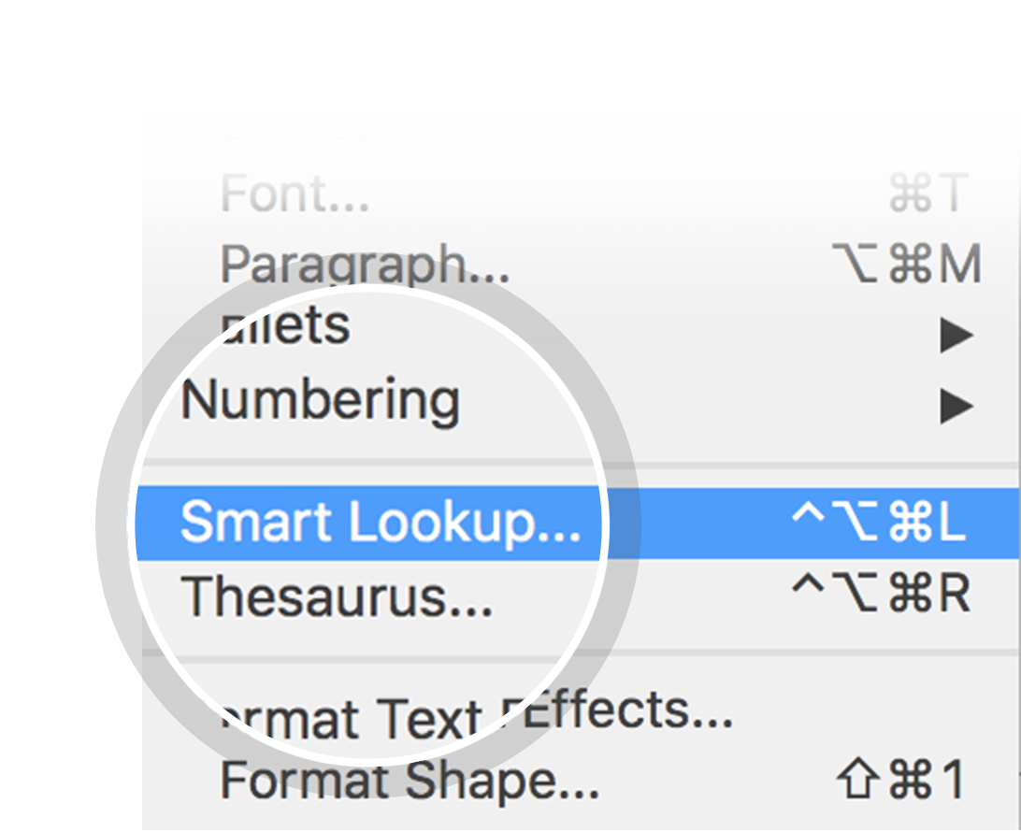
Related topics to research
SQL
Microsoft SQL Server
Edgar F. Codd
Object database
Oracle Database
Comparison of relational database management systems
Relational data stream management system
Data mart
Operational database
Cloud database
Use Smart Lookup to learn more
1
Highlight one of the related topics
Right-click on the topic
Choose "Smart Lookup"
2
3

