Slide 1
Pick n Click
With Fruit360 Datasets
Divya Shankar
Sonali Shintre

Slide 2
Introduction:
The main concept is to design the smart camera system for low power edge device
Classifier-Regressor pipeline is designed which predicts the frame with the least obstruction.
When it gets the best image, It triggers the high resolution camera to take the image

Slide 3
Implementation
Fruit360 dataset contains 95 different categories of the fruits each of size 100 by100.
Total no of images are 65000 images, that are divided into 49000 images in training and rest are testing
Each category of images have different features like shape, color, structure( hard or soft covering) etc.
From the each image 10 different frames with different size are created and placing it randomly.
Black box is created which moves around the image forming the obstruction.

Slide 4
Labeling the image dataset
Before labeling we need the check the percentage of obstruction on the image.
Coordinates of the images and black box are checked and % of overlap is noted.
% of overlap | label Class
50 or more | 4
25 to 50 | 3
12.5 to 25 | 2
6 to 12.5 | 1
6 or less | 0

Slide 5
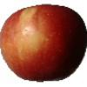
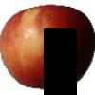
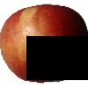
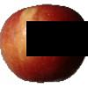
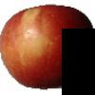
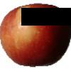
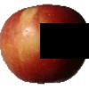
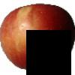
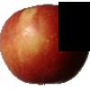
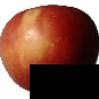
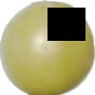
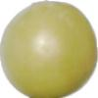
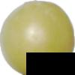
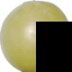
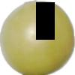
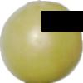
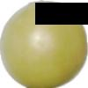
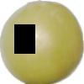
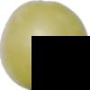
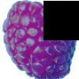
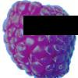
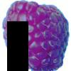
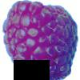
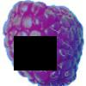
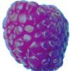
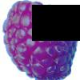
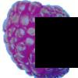
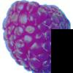
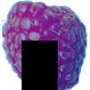
Some of the samples:

Slide 6
Classifier Part
Now we have training and test dataset.
We predict the image with least obstruction or the image with less overlap with the black box.
AS of now we have used
Logistic Regression
Random Forest
we got 19% of accuracy using Logistic Regression, as we have used only few images to predict.
In random forest we got accuracy of 75%, with n_estimator=50.

Slide 7
check for misclassification
Using confusion matrix we can check the misclassification
We observed that on training dataset there was no misclassifications, it fit perfectly.
accuracy score on train fit: 1.0
confusion matrix
[[6626 0 0 0 0 ]
[ 0 3272 0 0 0 ]
[ 0 0 9295 0 0 ]
[0 0 0 18642 0 ]
[ 0 0 0 0 14415 ]]

Slide 8
For the test dataset we can see some misclassification
Classifier gets confused and classifies some of the images on to the previous class or next class.
Accuracy score on test fit: 0.7533014354066986
confusion matrix
[[1169 32 94 37 0 ]
[176 77 303 59 1 ]
[ 82 37 1025 736 11]
[ 13 2 196 3130 384]
[ 0 0 0 415 2471]]

