Slide 1
PicknClick: A low-power Always-on Smart Camera System for Edge-devices
DSE I1020 Project Presentation
Divya Sankar, Sonali Shintre
Advisor: Prof. Michael Grossberg

Slide 2
Objective
Design a smart camera system for always-on edge devices
Energy consumption in edge devices is dominated by 2 components
Sensing energy – Continuously sense data from real world
Transmission energy – Processing on the cloud
Idea: Add machine learning on the edge device to minimize sensing and transmission energy
Sense data with low fidelity
Apply ML to understand its significance
Gauge when interesting events occur and selectively sense and transmit
We solve this problem for a specific context: Video stream containing an object of interest whose view is hindered by moving obstructions

Slide 3

PicknClick Design
Low resolution camera
scene
PicknClick camera system has sensors of 2 resolutions – low and high
Frames are sensed at low resolution and fed to a ML pipeline with 2 stages
Classifier Stage: Looks at the low resolution frame and predicts the degree of obstruction on the object of interest
Sequence Predictor Stage: Observe the degree of obstructions in successive frames and predict obstruction degree in the next frame
If the obstruction degree is predicted low, trigger the high resolution sensor to click and transmit the sensed data
Classifier
Sequence
predictor
High resolution camera

Slide 4
Realizing PicknClick
To realize PicknClick, we developed 3 key components:
Dataset preparation
Video stream with randomized obstructions from an image dataset
Classifier design
Tried different classifiers and settled on random forest
Sequence predictor
Using online linear regression to predict trajectory of obstruction

Slide 5
Dataset Preparation

Slide 6

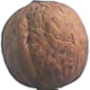

Original Dataset
Fruit360 Dataset
100*100 images
Labeled with 95 types of fruits
Apple
Walnut
Total
65,000
Training
48,000
Testing
17,000
Strawberry

Slide 7
Creating Randomized Video Sequences
We create video sequences from the fruits dataset
To achieve maximum generality, we introduce 6 levels of randomness in dataset preparation
STEP1: Create a white canvas of 100x100
STEP2: Resize the fruit image to a random size and place it at a random position in the canvas
STEP1
100
100
STEP2
Random Size
Random Position

Slide 8
Creating Randomized Video Sequences…
STEP3: Create black-box of random size
STEP4: Determine a random trajectory
Left-to-right trajectory at a randomly picked angle (-45 to 45degree)
STEP5: Determine a random speed for the trajectory
Number of frames the obstacle takes to pass through the trajectory
STEP3
STEP4
⍬ = 0
⍬ = 30
⍬ = -35
STEP5
Slow
med
fast

Slide 9
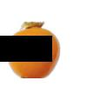
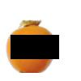
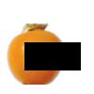
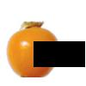
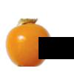
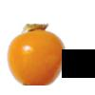
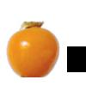
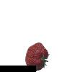
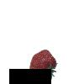
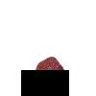

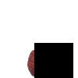
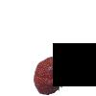
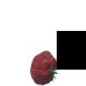
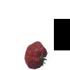
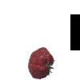
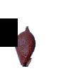
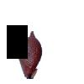
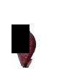
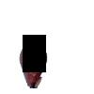
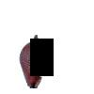
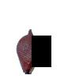
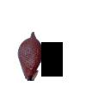
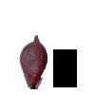
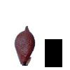
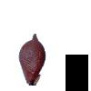
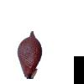
Creating Randomized Video Sequences…
STEP6: Move the black box of the trajectory to create the video
Fast and straight
Medium and upward
Slow and downward

Slide 10
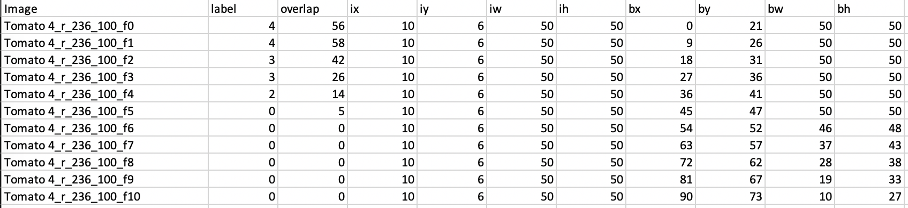
Labeling
Since, we know the positions of the image and black-box the % of overlap can be ascertained analytically
We label each frame based on the % of overlap
We also add meta data for positions of image and black-box
% overlap | Class Label
50 or more | 4
25 to 50 | 3
12.5 to 25 | 2
6 to 12.5 | 1
6 or less | 0

Slide 11
Classifier Design

Slide 12
Classifier
Given a frame with a black-box, the classifier predicts the degree of overlap between the object and the black-box
We split the video sequences into train and test sets
150*95 (from each class) images for training
17000 images for testing (entire set)
Since classification happens on a low-resolution image, we downsized the 100x100 input frame by 16 times
Intuitively, we felt random forest (or decision trees) would be better for such a dataset, as we need to identify boundaries where the colored pixels are covered by black pixels

Slide 13
Classifiers
Logistic Regression:
Training Dataset accuracy score : 60%
Testing Dataset accuracy score : 55%
SVC :
Training Dataset accuracy score : 69%
Testing Dataset accuracy score : 68%
Bagging Classifier :
Training Dataset accuracy score : 99%
Testing Dataset accuracy score : 74%
Decision Trees :
Training Dataset accuracy score : 59%
Testing Dataset accuracy score : 57%

Slide 14
Random Forest Classifier
Training Dataset:
Accuracy score = 0.9941547761923812
Confusion matrix
[[17954 8 2 2 0]
[ 66 4592 17 3 0]
[ 9 15 8966 23 0]
[ 0 2 38 9345 12]
[ 0 0 1 65 3874]]
Testing Dataset:
Accuracy score = 0.7563238705401525
Confusion matrix
[[3399 92 65 14 1]
[ 319 275 260 40 0]
[ 130 181 1130 359 16]
[ 15 12 322 1434 141]
[ 2 0 4 233 609]]
We looked at the confusion matrix for the test and train set
Although the accuracy is ~75%, we find that frames are misclassified only to neighboring class labels
Therefore, although the overlap % is incorrect, it is in the vicinity
The % overlap range is very small for class labels 0,1,2 → therefore we find more misclassifications for them

Slide 15
Sequence Predictor

Slide 16
Sequence Prediction
Given the overlap percentages of the previous frame(s), predict the % overlap of the next frame
We use online linear regression to achieve this
We maintain a linear model within the sequence predictor
As we get new points, we refit the linear model and predict the next frame
If the predicted overlap is less than a threshold, we click the next frame
Example:
Frame | % Overlap (Classifer) | Linear Model (Intercept, Slope) | % Ovl. Next Seq. Predictor
0 | 0.75 | (0.75,0) | 0.75
1 | 0.75 | (0.75,0) | 0.75
2 | 0.375 | (0.821,-0.053) | 0.5
3 | 0.1875 | (0.877,-0.087) | 0.26
4 | 0.09375 | (0.906,-0.101) | 0.09
5 | 0.03125 | (0.927,-0.122) | 0

Slide 17
Results
Best frame = Earliest frame with the least % overlap in the video
We look at 2 metrics:
Frame difference between the clicked frame and the best frame
Difference in % overlap between the clicked frame and best frame
PicknClick clicked within +/- 1 frame of the best frame for 74.9% of the videos
The average % overlap difference between best frame and frame clicked is 5%

Slide 18
Future Enhancements
More challenging trajectories
Second-order projectiles, sinusoids etc.
It takes a few frames for PicknClick to start accurately predicting %overlap of the next frame – if the least overlap occurs in the initial frames, how do we handle such scenarios?
LSTMs for sequence prediction

Slide 19

THANK YOU

