Slide 1
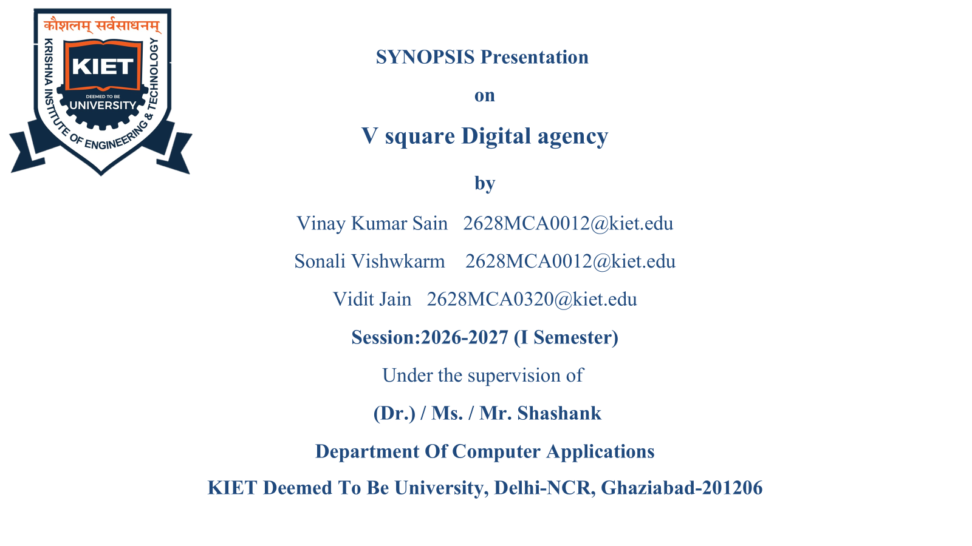
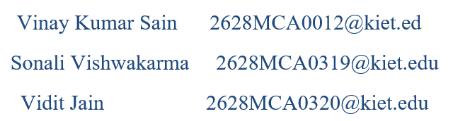

Slide 2
Project Overview
Why This Project Exists
1
2
01 — Problem
02 — Target Market
Agencies use scattered systems – separate websites, email
inquiries, and manual payment processors – creating
friction in customer acquisition.
Small and medium businesses needing digital services:
social media, web development, and online presence
management.
3
4
03 — Solution
04 — Impact
A unified platform consolidating service discovery, AI-
assisted consultation, and secure Razorpay payment
processing.
Reduced inquiry-to-conversion gap, secure PCI-compliant
transactions, and a seamless customer journey.

Slide 3
PROJECT OBJECTIVES
What We Aim to Achieve
Four practical objectives guide the platform from experience design to future scalability.
1
Responsive design
SUCCESS METRICS
Mobile + desktop experience
How success will be measured
Smart chatbot
01
02
2
Accuracy
Efficiency
4
Scalable architecture
Maps customer needs to services
Relevant service recommendations
Faster inquiry → payment flow
Ready for future database growth
PRIMARY
Build a secure
platform integrating
service discovery,
consultation &
payment.
03
04
User Satisfaction
Completion Rate
Clear, simple customer journey
More users finish key actions
3
Secure payments
PCI-aware flow via Razorpay API
Goal: measurable improvement, not just more features.

Slide 4
PROJECT SCOPE
What We Are Building
A focused digital service platform — clear boundaries, clear deliverables.
CORE BUILD
SCOPE BOUNDARY
IN SCOPE
5 MODULES
HOW THE PLATFORM FITS TOGETHER
1
Service Catalog
Six digital services with pricing
CATALOG
CHATBOT
Services + pricing
Intent + guidance
2
AI Chatbot
DIGITAL
SERVICE
PLATFORM
Intent-based service recommendations
PAYMENT
DASHBOARD
3
Razorpay Payment
Razorpay flow
Status + history
Secure order creation and verification
4
Contact Form
Validated lead capture
5
Customer Dashboard
OUT OF SCOPE
NOT IN THIS PHASE
Order status and service history
Database persistence • Admin dashboard & analytics
Machine-learning recommendation models
Scope principle • Build the customer-facing journey first; keep advanced data and ML capabilities outside the current phase.

Slide 5
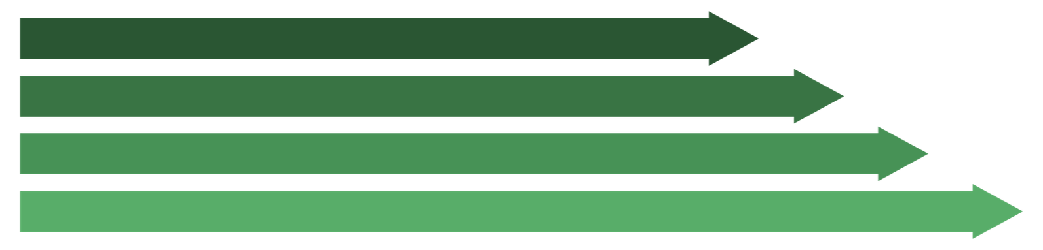


Methodology
Deployment
Render
How we will build it
Requirements
UI/UX
Frontend
Backend
Technology Stack
Testing Approach
Frontend
HTML5, Tailwind CSS, JS
Backend
Node.js, Express.js
  Functional — End-to-end payment and chatbot workflows
  Performance — Page load under 3 seconds on 4G
  User Testing — Cross-device responsiveness validation
Payment
Razorpay SDK
Tools
GitHub, VS Code, Postman, Figma
Deployment
Render

Slide 6
▌ Timeline
Project Schedule
Task
W1
W2
W3
W4
W5
W6
W7
W8
1
Research
2
Requirements
3
Design
4
Development
5
Testing
6
Deployment
7
Documentation
Requirements
Prototype
Development
Testing
Final
M1
Complete
M2
Ready
Complete
M4
Complete
Delivery
M3
M5
M1 — Requirements Complete
M2 — Prototype Ready
M3 — Development Complete
M4 — Testing Complete
M5 — Final Delivery

Slide 7
Hardware & Software Requirements
What We Need to Build It
▣
Hardware
⚙
Software
⊞
</>
Operating System
Language
▣
▤
Windows 10 / Ubuntu 20.04+
JavaScript (ES6+)
Processor
RAM
Intel Core i5 or equivalent
8 GB minimum
▱
▣
▥
◎
Frameworks
Payment SDK
Storage
Network
Express.js, Tailwind CSS
Razorpay Node.js SDK
256 GB SSD
Broadband internet for deployment
⚒
Dev Tools
VS Code, Postman, GitHub,Figma

Slide 8

Project Outcome
What We Will Deliver
Final Deliverables
▣
Web Application
1
Fully responsive, multi-device
compatible platform with service catalog and chatbot.
⚙
Technical Output
2
Node.js backend, Razorpay integration,RESTful API endpoints, verified payment flow.
☁
Deployment
3
Live deployment on Render with environment-based secure configuration.
▤
Documentation
4
Project report, system design documents, and user guide.
♢
Expected Impact
Streamlined Service Discovery
♡
Secure Payment Processing
▟
Scalable Architecture for Future Enhancement

