Slide 1
Milky-Chain
A way to smart home delivery services

Slide 2
Contents :
Introduction
Aim
Modules
Technologies Used
Use Case Diagram
ER Diagram
Test Cases
Advantages

Slide 3
Introduction :-
Milky-Chain is a web based application to automate the operations of milk distribution & order management this brings ease between supplier , admin,& customers.
This online platform is useful for customer to see the milk supplier list as per the customer area.
Supplier can manage product order details , customer subscription , undelivered records by keeping the track of product delivery , customer order , order transaction which helps to reduce the manual work & time consumption by keeping DB management , security.

Slide 4
Aim:-
To develop a customer handy web application.
To have easy communication between customer and supplier.
To provide subscription based services.
To provide hassle free delivery of quality milk at reasonable price right at customers doorstep.
Location wise delivery to avoid time conflicts.

Slide 5
Modules:-
Admin
Supplier
Customer

Slide 6
Technologies Used:-
Java Spring Boot MVC
J2EE
React-JS
My-SQL

Slide 7
Use Case diagram:-

Slide 8
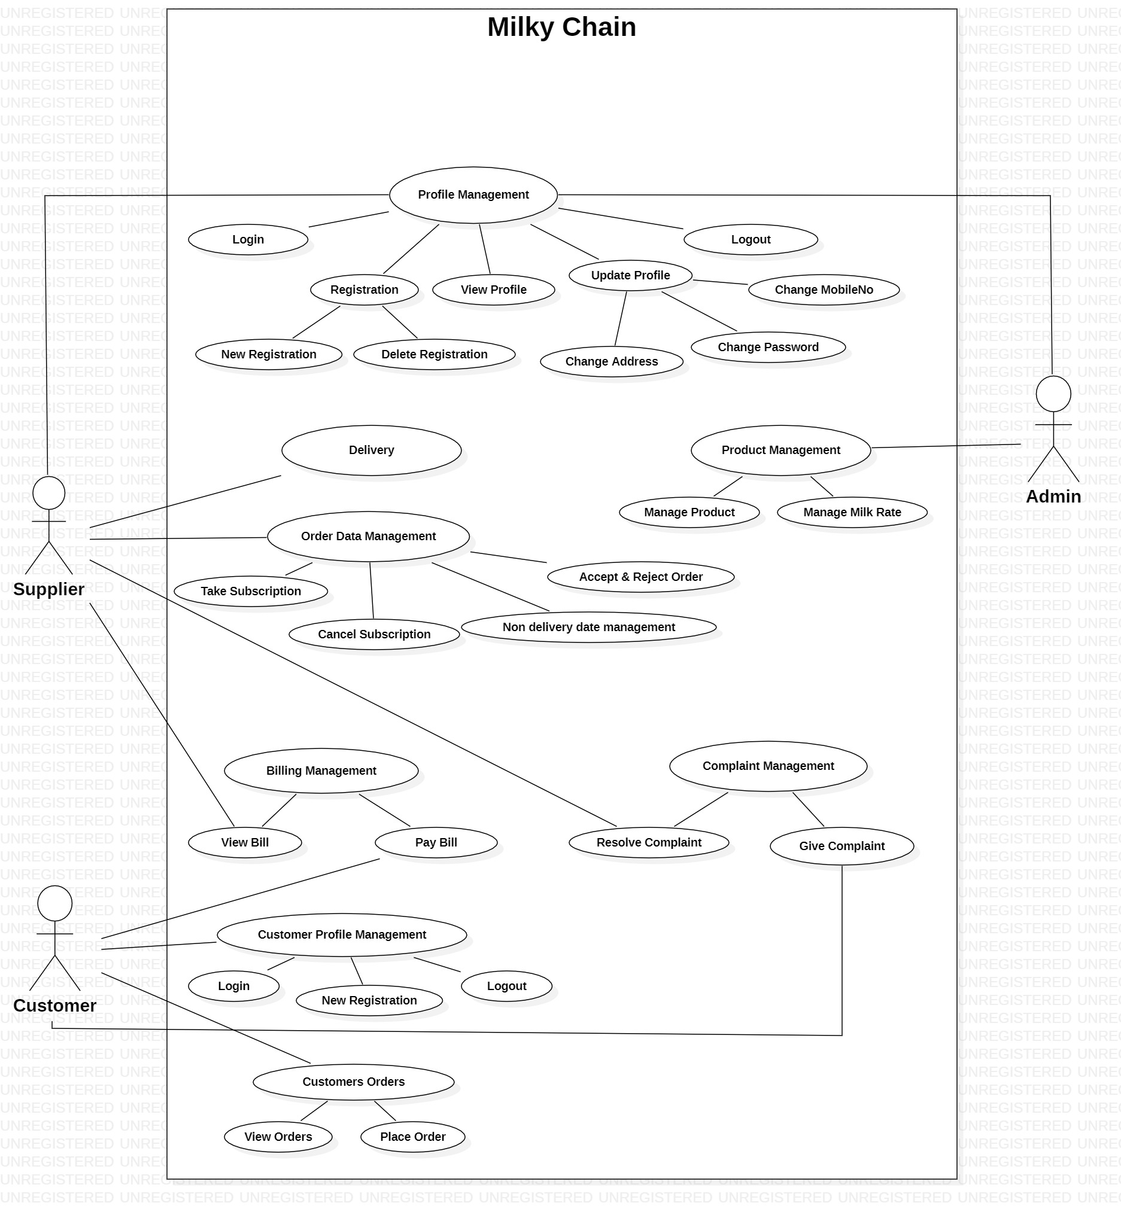

Slide 9
Er Diagram :-

Slide 10
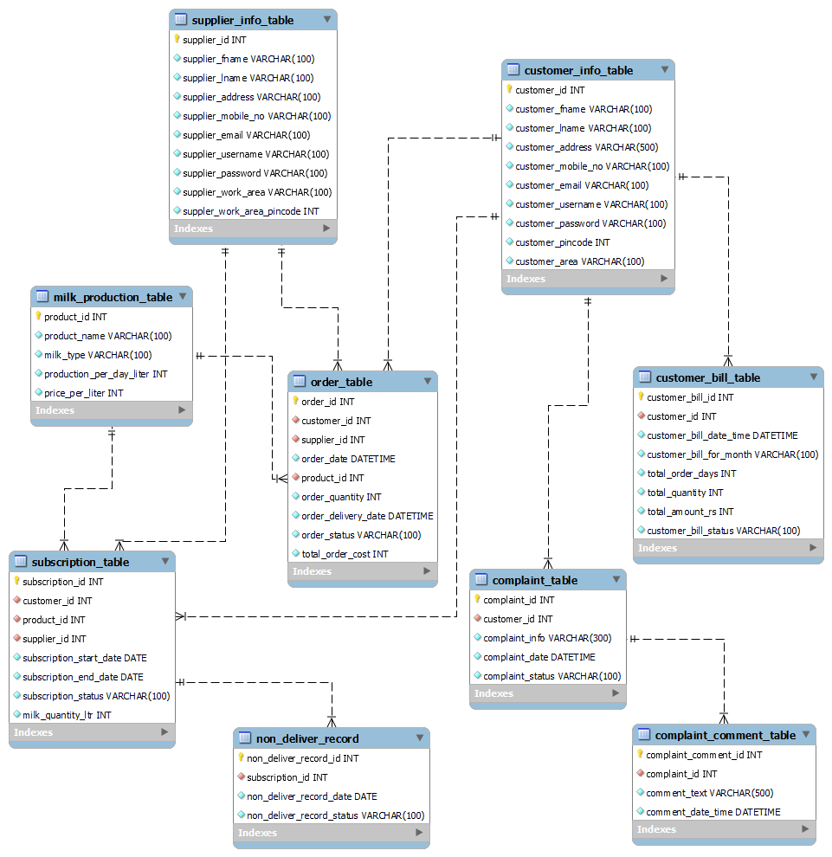

Slide 11
Login Test Case:-
No | Test Cases | Case Type | Expected Result | Actual Result | Pass/Fail
1) | Login | Invalid Username | The system will not accept invalid username and will throws error | The system will not allow to login into system | Pass
 |  | Invalid Password | The system will not accept invalid password and will throws error | The system will not allow to login into system | Pass

Slide 12
No | Test Cases | Case Type | Expected Result | Actual Result | Pass/Fail
2) | Validation Test Cases | Required Field Validation | Field should not be empty | Users have to enter the value | Pass

Slide 13
Supplier Test Cases:-
No | Test Cases | Case Type | Expected Result | Actual Result | Pass/Fail
1) | Supplier | Invalid Supplier Id | The System will not accept invalid supplier id | The system will not allow to access data | Pass
 |  | Valid Supplier Id | The System will accept only valid supplier id | The system will allow to access data | Pass

Slide 14
Advantages:-
The system is user friendly.
The system is time saving and reduces manpower.
The system works very smoothly .
The security is achieved.

