Slide 1
Content
Definition
Syntax
Need of constructor
Example
Type of constructor
Characteristics of constructor
Question

Slide 2
Constructor
A member function with the same name as its class is called constructor.
Used to initialized the object s of that class type with a legal initial value.
Have no return type, not even void.
They cannot be inherited
They may not be static
Syntax:
class_name(data type variable, data type variable, …….)
{
// statements
}

Slide 3
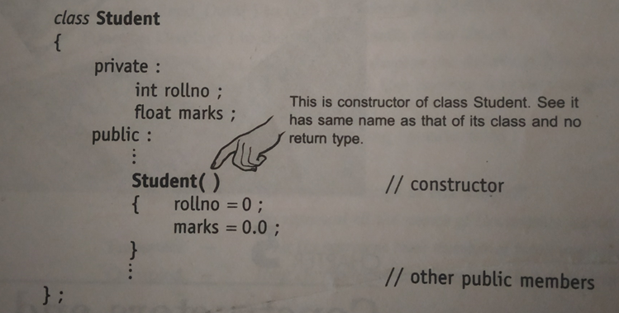
Constructor cont….
Example.

Slide 4
Need of Constructor
Class Student
{
private:
int rollno;
public:
………….
};
int main()
{
student s={123}; // illegal data member are not accessible.
}
But such initialization
does not work because the class member
have their associated access specifies

Slide 5
Need of Constructor cont….
Alternative solution
Class Student
{
private:
int rollno;
public:
void init()
{ rollno=123 }
};
int main()
{ student s; // Create an object
s.init(); // Initialize it.
What if programmer
fail to invoke init()?
The object in such
case if full of garbage
A constructor for a class is needed so that the compiler
automatically initializes an object as soon as it is created.

Slide 6
Example of Constructor
//To demonstrate a constructor
#include <iostram.h>
#include <conio.h>
Class rectangle
{
private :
float length, breadth;
public:
rectangle ()//constructor definition
{
cout<<”I am in the constructor”;
length-10.0;
breadth=20.5;
}
float area()
{
return (length*breadth);
}
};
void main()
{
clrscr();
rectangle rect; //object declared
cout<<”\nThe area of the rectangle with default parameters is:”<<rect.area()<<”sq.units\n”;
getch();
}

Slide 7
Characteristic of construction
i) These are called automatically when the objects are created.
(ii) All objects of the class having a constructor are initialized before some use.
(iii) These should be declared in the public section for availability to all the functions.
(iv) Return type (not even void) cannot be specified for constructors.
(v) These cannot be inherited, but a derived class can call the base class constructor.
(vi) These cannot be static.
(vii) Default and copy constructors are generated by the compiler wherever required. Generated constructors are public.
(viii) These can have default arguments as other C++ functions.

Slide 8
Characteristic of construction cont…..
.
(ix) A constructor can call member functions of its class.
(x) An object of a class with a constructor cannot be used as a member of a union.
(xi) A constructor can call member functions of its class.
(xii) We can use a constructor to create new objects of its class type by using the syntax.

Slide 9
Type of constructor
There are different type of constructors in C++.
.Default Constructors: Default constructor is the constructor which doesn’t take any argument. It has no parameters.
#include <iostream>
using namespace std;
class construct { public:
int a, b;
// Default Constructor construct()
{
a =10;
b =20;
}
};
int main()
{
// Default constructor called automatically
// when the object is created construct c;
cout <<"a: "<< c.a << endl
<<"b: "<< c.b;
return 1;
}

Slide 10
Type of constructor cont….
2)Parameterized Constructors: It is possible to pass arguments to constructors. Typically, these arguments help initialize an object when it is created..
class Point { private:
int x, y;
public:
Point(int x1, int y1)
{
x = x1; y =y1;
}
intgetX()
{
return x;
}
int getY()
{
return y;
}
};
int main()
{
// Constructor called Point p1(10, 15);
// Access values assigned by constructor
cout <<"p1.x = "<< p1.getX() <<", p1.y = "<< p1.getY();
return 0;
}

Slide 11
Type of constructor cont….
3)Copy Constructor: A copy constructor is a member function which initializes an object using another object of the same class.
Syntax
ClassName (ClassName &old_obj);
Example:
Class Student
{ public:
int i;
Student(int a){i=a;} // constructor
Student(Student & s){i=s.i;} // copy constructor
};
Void main()
{ Student s(4);
Student s1=s;
Student s2(s1);
}
When Object is passed by value
When a function return an object

Slide 12
Question for homework
Explain constructor with example?
Explain type of constructor?
Explain copy constructor?

