Slide 1

Efficient Fine-Tuning of Large Language Models DistilBERT for Emotion Classification
Presented by: Alpha Neurons
Sonal Shreya
Sumit Kumar Singh
Santhoshini Bhojanpally
Sai Naga Saujanya Gullapally

Slide 2

Introduction
Why Fine-Tuning Pretrained LLMs Matters.
Emotions are fundamental to communication, influencing context, understanding, and user engagement.
Goal: Predict the emotional category of a given text (sadness, joy, love, anger, fear, surprise).
Building emotionally intelligent systems is essential for the next generation of smart applications.

Slide 3
Problem
Why Fine-Tuning Pretrained LLMs Matters.
Businesses need scalable text generation.
Training from scratch is prohibitively expensive.
Adapt pretrained models efficiently.

Slide 4
Objective
Fine-tune a large pretrained model efficiently.
Reduce compute/memory cost.
Maintain or enhance output quality.
Faster AI product deployment.
Lower infrastructure expenses.

Slide 5
Our Approach
Dataset : dair-ai/emotion from Hugging Face datasets
Model: DistilBERT-base-uncased
Stratified Data Splitting
Techniques: Full Fine-Tuning.
Weighted Cross-Entropy Loss and Early Stopping

Slide 6

Dataset Overview
Dataset Used: dair-ai/emotion from Hugging Face Hub.
Content: Short English sentences labeled with one of six emotions: sadness, joy, love, anger, fear, surprise.
Size after Stratified Split:
Train: ~16,000 samples
Validation: ~2,000 samples
Test: ~2,000 samples
Purpose: Benchmark dataset for training emotion-aware NLP models beyond basic sentiment analysis.
Applications: Chatbots, mental health detection, market analysis, content creation.

Slide 7
Data Preprocessing
Stratified Splitting:
70% Training, 15% Validation, 15% Test
Ensures all emotion classes are proportionally represented.
Tokenization:
Used DistilBERT tokenizer.
Max sequence length: 128 tokens.
Padding: "max_length"
Truncation: Enabled.
Label Handling:
Original label column mapped directly as labels for model compatibility.
Class Weights:
Computed inverse frequency weights for balanced loss function handling class imbalance.
DataLoaders:
Created train, validation, and test DataLoaders with appropriate batch sizes and collate_fn for PyTorch training.

Slide 8

Model Overview: DistilBERT-base-uncased
Overview
Type: Transformer-based encoder (smaller BERT).
Architecture: 6 layers (vs 12 in BERT), 40% smaller, 97% of performance.
Pretraining: Masked Language Modeling (MLM).
Why DistilBERT?
Lightweight & Fast: Ideal for limited compute (Colab free GPU).
Quick Fine-tuning: Converges in few epochs.
Strong Baseline: Excellent at capturing sentence-level emotions.

Slide 9
Fine-Tuning & Evaluation Steps
Fine-tuned DistilBERT-base-uncased for 6 emotion classes.
Used AdamW optimizer, trained for 3 epochs with batch size 16.
Evaluated using:
Accuracy, Weighted F1 Score, Precision, Recall
Confusion Matrix and ROC-AUC Curve
Logged all metrics and training curves on Weights & Biases (W&B).

Slide 10
Result Summary
Test Accuracy: 92.6%
Test Weighted F1 Score: 92.6%
Weighted ROC-AUC Score: 95.44%

Slide 11
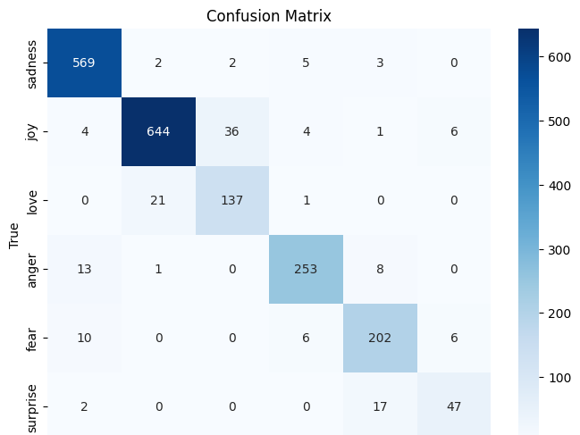

Slide 12
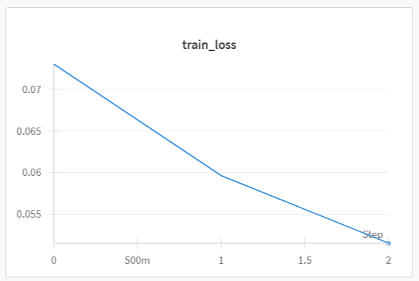
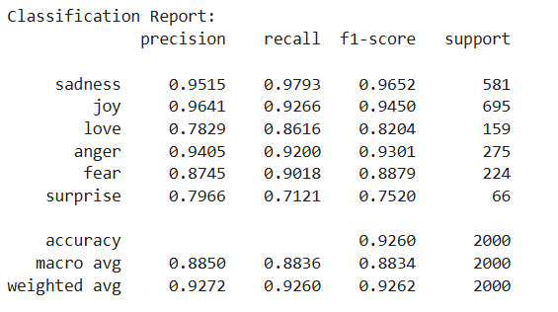

Slide 13
Test Result Overview
Confusion Matrix: Strong diagonal dominance ➔ Most predictions correct. Minor confusion between love ↔ joy and surprise ↔ fear, which is intuitively reasonable.
Classification Report Highlights:
Test Accuracy: 92.6%
Weighted Precision & Recall: 92.7% and 92.6% ➔ Very high reliability in predictions.
Weighted F1-Score: 92.6% ➔ Balanced performance across all classes.
Class-wise Insights:
Sadness and Joy are recognized with very high F1-scores (>94%).
Love and Surprise are slightly harder to classify due to overlap and fewer samples.
ROC-AUC Score:
95.44% Weighted ROC-AUC ➔ Model effectively separates emotional categories.

Slide 14

Attempt with Pythia Model and PEFT (LoRA)
Model Tried: Pythia-70M-Deduped (decoder-only LLM).
Fine-Tuning Approach: Instruction-based generation + LoRA (PEFT) for lightweight adaptation.
Challenges Faced:
Decoder-Only Model Issues: Required special left-padding, mismatch with classification task.
Output Nature: Generated text (not logits), harder to map cleanly to emotion labels.
Training Instability: Frequent NaN losses, unstable gradients even with LoRA.
Performance:
Test Accuracy: ~29%
Weighted F1 Score: ~7.5%
Decision:
Abandoned Pythia + LoRA setup.
Switched to DistilBERT (encoder model) for direct classification with stable, fast fine-tuning.

Slide 15
Achieved 92.6% accuracy, 92.6% weighted F1-score, and 95.44% ROC-AUC.
Stratified splitting and weighted loss ensured balanced learning across emotions.
Lightweight model generalized well with minimal overfitting.
Strong baseline established for future enhancements.
Conclusion

Slide 16
Future Scope
Model Improvements: Experiment with advanced architectures like RoBERTa, ALBERT, or DistilBERT variants for even better performance.
Deployment: Deploy the model via a web app, chatbot, or API for real-world emotion recognition tasks.
Multilingual Extension: Fine-tune multilingual models (like mBERT) to extend emotion detection to non-English texts.

Slide 17

Thank You!
Q&A

