Slide 1
ESB
Enterprise Service Bus

Slide 2
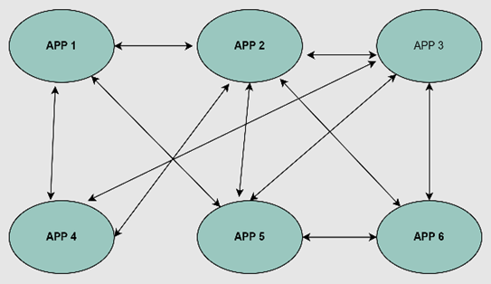
P2P integration
Rigidity is the drawback of point-to-point integration. The complexity increases with the increased number of connections and interfaces.

Slide 3
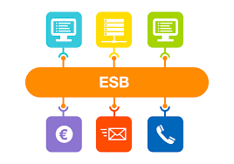
ESB integration
flexible approach to application integration. encapsulates and exposes each application functionality as a set of discrete reusable capabilities.
No application directly integrates with other, instead they integrate through an ESB

Slide 4
What is an ESB?
ESB (Enterpise Service Bus) is a Bus based architecture to enable integration of multiple heterogeneous systems in an efficient manner. ESB architecture is a sophistication over traditional P2P (Point to Point) and Hub/Spoke integration styles.
ESB acts as an intelligent middleware to enable communication among different systems & applications analogous to a traditional bus transit system where all nearby areas are connected to central bus stations to transport passengers to connected destinations.

Slide 5
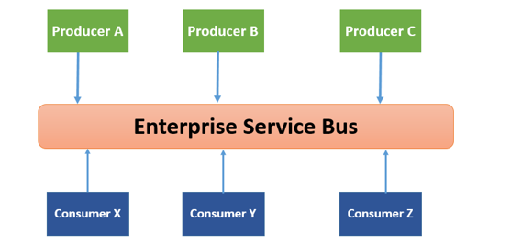
ESB architecture

Slide 6
ESB Functionality
VETRO abbreviation is generally used to summarize the functionality of ESB.
V(Validate) − As the name implies, it validates the schema validation. It requires a validating parser and up-to-date schema. One example is an XML document confirming to an up-to-date schema.
E(Enrich) − It adds additional data to a message. The purpose is to make message more meaningful and useful to a target service.
T(Transform) − It converts the data structure to a canonical format or from a canonical format. Examples are conversion of date/time, currency, etc.
R(Routing) − It will route the message and act as a gatekeeper of the endpoint of a service.
O(Operate) − The main job of this function is to invoke the target service or interacts with the target app. They run at the backend.

Slide 7
Capabilities of an ESB
ESB
Routing
Orchestration
Transformation
Mediation
Transportation
Non-Functional Consistency

Slide 8
Why ESB is Important for Any Organization?
Plays a role of a central layer as middleware
Rightly decouples (or loosely couples) different systems in an organization with all routing, transformation, translation, orchestration responsibilities
Available in the market provide a rich set of pre-built, ready to use connectors, plugins, adapters
Acting as an integration backbone in any organization, upgrades, maintenance and scaling of the environment

Slide 9
What are the Challenges with ESBs?
ESB as a middleware with all integrated parties relying on it heavily for integration flows, It can itself become a single point of failure or a bottleneck.
Performance issues with ESB layer can directly affect business functionalities
Regression risk.

Slide 10
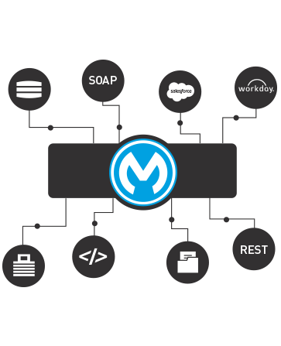
Why use an ESB?
Increasing organizational agility by reducing time to market for new initiatives is one of the most common reasons that companies implement an ESB as the backbone of their IT infrastructure. An ESB architecture facilitates this by providing a simple, well defined, "pluggable" system that scales really well. Additionally, an ESB provides a way to leverage your existing systems and expose them to new applications using its communication and transformation capabilities.
ESB

Slide 11
Implementing ESB
The main focus of ESB architecture is to decouple the systems from each other and allow them to communicate in a steady and controllable way.
ESB’s implementation can be done with the help of ‘Bus’ and ‘Adapter’
Ways:
The concept of “bus”, which is achieved through a messaging server like JMS or AMQP, is used to decouple different applications from one another.
The concept of “adapter”, responsible for communicating with backend application and transforming data from application format to bus format, is used between applications and bus.

Slide 12
Implementing ESB
The data or message passing from one application to another through the bus is in a canonical format which means there would be one consistent message format.
The adapter can also perform other activities like security, monitoring, error handling and message routing management.

Slide 13
ESB’s Guiding Principles
Orchestration − Integration of two or more services to achieve synchronization between data and process.
Transformation − Transforming data from canonical format to application specific format.
Transportation − Handling protocol negotiation between formats like FTP, HTTP, JMS, etc.
Mediation − Providing multiple interfaces to support multiple versions of a service.
Non-functional consistency − Providing mechanism for managing transactions and security also.

Slide 14
Best Enterprise Service Bus (ESB) Solutions
Web Methods Integration Server
Mule ESB
IBM Integration Bus
TIBCO cloud Integration
Red Hat Fuse
Oracle Service Bus

Slide 15
Why Mule ESB?
It Scales Effectively, Both Up and Down
It Perfectly Integrates All Components, Irrespective of the Technology Used
It's Highly Accessible, Supporting a Wide Variety of Code Languages
It Enables You to Reuse Your Components
It's Ideally Lightweight

