Slide 1

HTTP in Angular
JAVA FSD/MERN/MEAN (Expert & Instructor)
By Sonam Soni(B.E.I.T.)

Slide 2
HTTP
HTTP is a separate model in Angular available under the @angular/common/http package.
To use HTTP in Angular:
Import the @angular/common/http package and inject it into the component or service
Use get method to send an HTTP request and subscribe to the response asynchronously
When the response arrives, map it to the desired object and display the result

Slide 3
Setup HTTP in Angular
To use the new HTTP module in the components, you have to import HTTPClientModule.
Then, inject HTTPClient dependency in the constructor in your service.
Using http reference we can call any method like get, post, put, delete, patch etc..

Slide 4
Learning RxJs
The RxJS JavaScript library is designed for reactive programming using observables.
With observables, you "watch" the data stream, passively listening for an event.
Applications can detect changes instantly—in real time—without unnecessary network calls.

Slide 5
Async and Reactive Basics
Understanding Asynchronous JavaScript.
Asynchronous: not occurring at a same time.
Function1 ()
Function2 () ✓
Function3 () ✓
Function4 () ✓

Slide 6
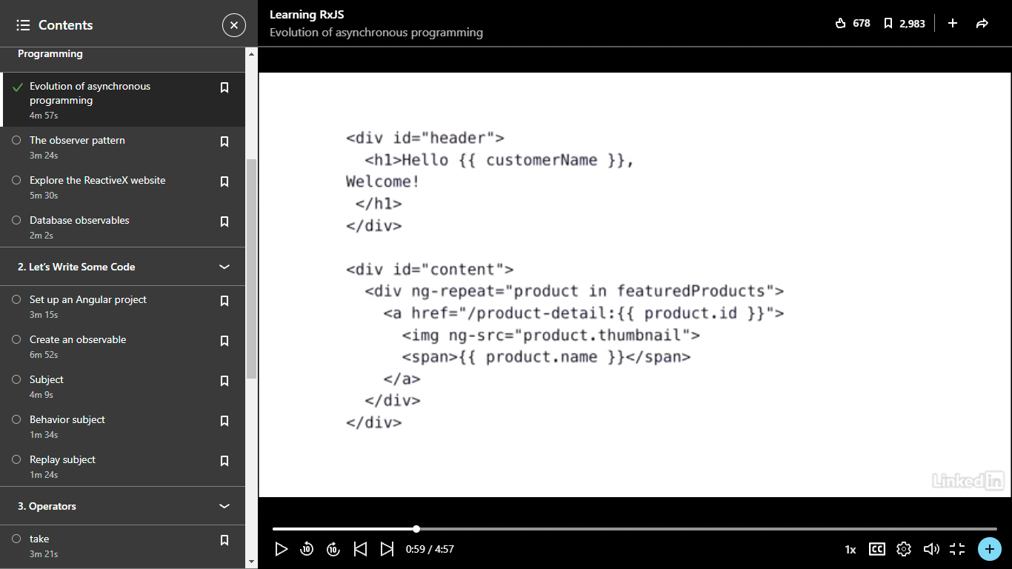
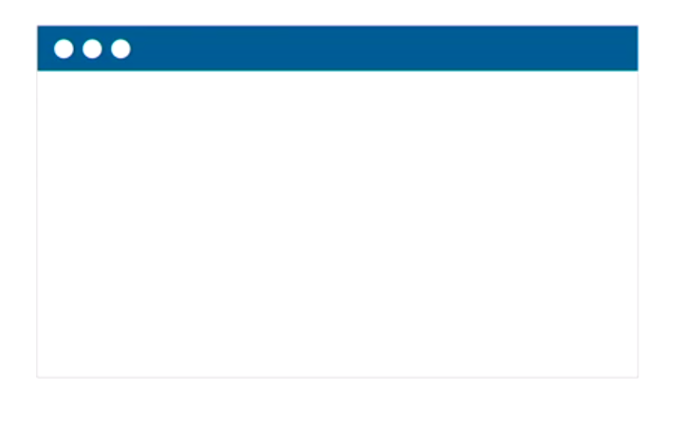
Angular Two way binding
Resultant page is Empty

Slide 7
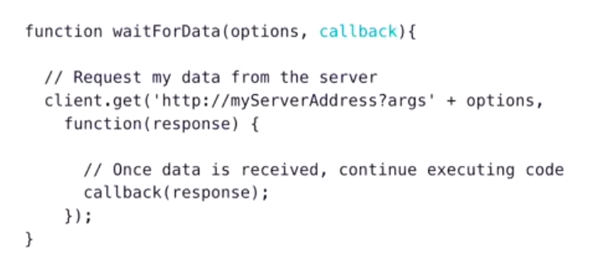
What is the solution?
Callbacks: wait for this code to complete before continuing.

Slide 8
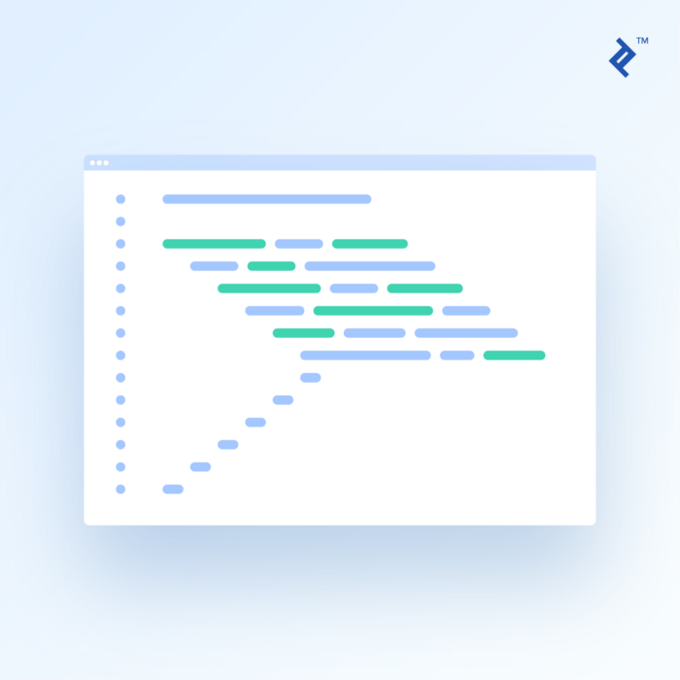
Callback Hell
Disadvantages:
We couldn't return values from a callback
Error handling was very difficult

Slide 9
Promises
callbacks
Promises
Error handling very easy
We can return values
We can chain promises
Promises
Promises
Promises

Slide 10
Real Time
Updates
Analytics
Data
Send messages instantly
Absolute latest data
Constant updates on all devices

Slide 11
Observables
Provide support to handle asynchronous tasks or operations.
Can be thought of as a data source like user input events, or HTTP requests.
Are objects we import from a third-party package: rxjs
Follow Observable pattern
Stream: Multiple events or data packages emitted by the observable, depending on the data source
Observer: your code
The three ways of handling data packages:
Handle Data
Handle Error
Handle Completion

Slide 12
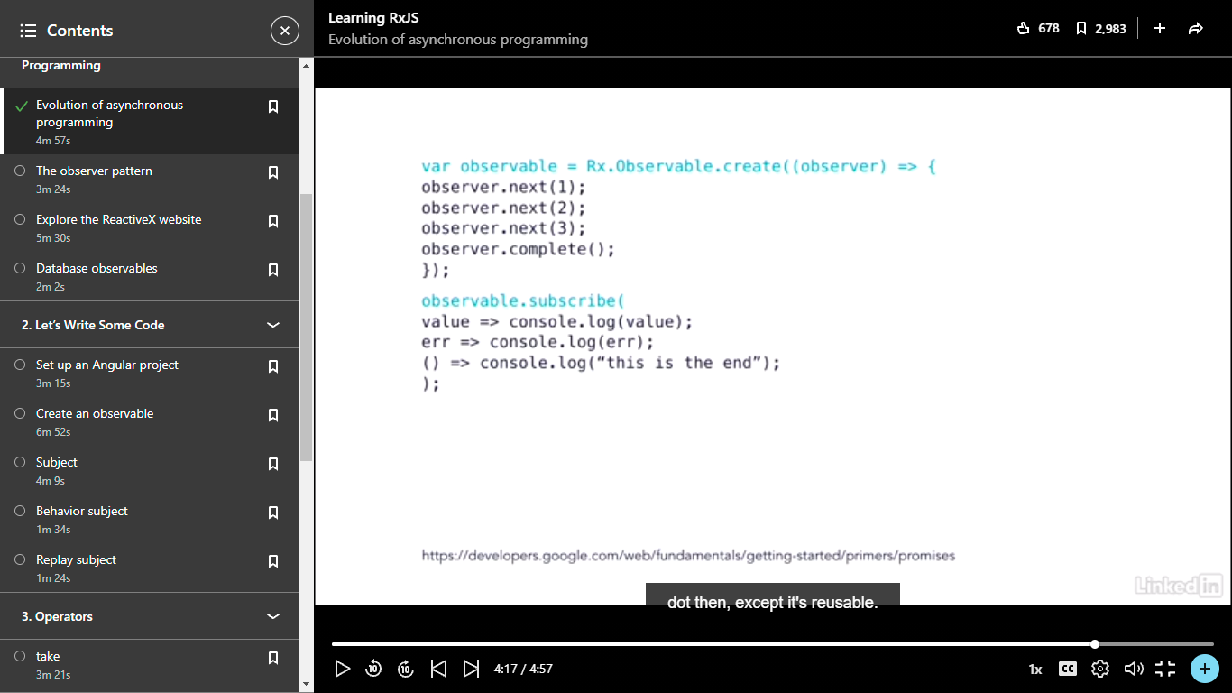
Observable

Slide 13
Observer Pattern
It is a software pattern in which object called as subject which maintains the list of dependencies called Observers, and notify them automatically when its state changes.
Event Driven Design
Observer
Observer
Subject
Observer
Observer
Observer

Slide 14
Reactive X
To understand lets explore: http://reactivex.io/
Debounce: Discard emitted values that take less than the specified time, based on selector function, between output
We can explore more on: http://reactivex.io/rxjs
Database Observable
Real time data
Database notify us when anything is going to change.
Data Stream: we are listening for dynamic data

