Slide 1
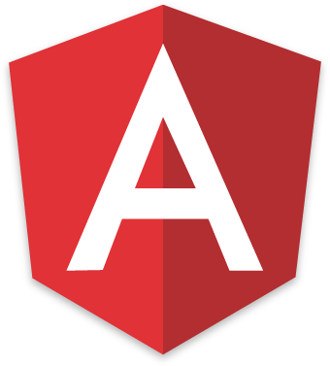
Routing in Angular
JAVA FSD/MERN/MEAN (Expert & Instructor)
By Sonam Soni(B.E.I.T.)

Slide 2

Need of Routing?
Usually we have different pages in application.
How do we have different pages in SPA?
Here routing comes in a picture.

Slide 3
How angular routing works?
It will open About
Component
It will open AddExp Component
It will open Home
Component
It will open Report
Component

Slide 4
How to add routing module
Import RoutingModule.
Ng new routing-app –routing
This will add routing module by default your application

Slide 5
To work with routing
Unserstand 3 things:
Create routes in app-routing.module.ts file
Create link using routerLink attribute not href
To render the component must add <router-outlet></router-outlet>

Slide 6
Let’s understand Routing

