Slide 1
Typescript
JAVA FSD/MERN/MEAN (Expert & Instructor)
By Sonam Soni(B.E.I.T.)

Slide 2
Content
What is TypeScript
Why do we need TypeScript

Slide 3
INTRODUCTION
Free and open source, strongly supported by Microsoft
Based on ecmascript 4 + ecmascript 6
Created by the father of C# Anders Hejlsberg
A superset of JavaScript
To answer why we need JavaScript+, we need to understand what's wrong with vanilla JavaScript

Slide 4
What is the problem with JS?
JS is designed for small things
We now use to do big things
AJAX and REST = never refresh the page
But JavaScript is not suited for building large applications
Your JavaScript code gets complex; it becomes extremely unwieldy

Slide 5
Problem - dynamic types
Variables are untyped and dynamic. They are flexible
Bad because it is so easy to get wrong
var x = 1; var y = x + 1; // OK, type is inferred. can assume x and y are both numbers.
var x = 1; x = "hello"; // NOT OK, type is mixed up. We can't assume what type is x.
// I am most guilty too - var i, j, k, x, y, z, a, b, c, i1, i2; // JS is interpreted. There are no design-time intellisense or compile-time assistance to help you point out errors

Slide 6
Problem with parameters
Define a function with arguments. That is your contract with your caller. Unfortunately, in JavaScript, function parameters are more like guidelines, because callers don't take them seriously
function f(x) { return x + 1; }
f("hello"); f(1234); f(); f(function(){}); f([4]); f("hello", "world");
// and then we have this magic object. function f() { console.log(arguments.length); } f(1,1,2,2);
// Where did arguments come from? // Caller can still do whatever they want. Callee has to be defensive and check everything.
// It is so easy to get wrong

Slide 7
Problem Scope
JavaScript's scope looks like C#, but does not work at a block level.
It is at the function level.
It is so easy to get wrong
var i = 1; if (i == 1) { var i = 2; } function x() { var i = 3; } x(); console.log(i);
var foo = 1; var y; function x() { var foo = 2; y = function(){ foo = 3; } } x(); y(); console.log(foo);

Slide 8
Problem - object inheritance is hard
Based on object extension. Not class inheritance (at a syntax level)
var animal = { var name; }; var cat = jQuery.extend( animal, var claw = function() { /*claw*/ }; });
//Syntax complicated, so nobody really does it.

Slide 9
Problem - hoisting
Hoisting is essentially a scoping problem,
nearly all cases, the behaviour is completely wrong.
var foo = 1; function x() { foo = 2; var foo = 3; } console.log(foo); // what is foo? // what is x.foo?
var foo = 1; function x() { var foo; foo = 2; foo = 3; }
// example of where Javascript just give you weird results

Slide 10
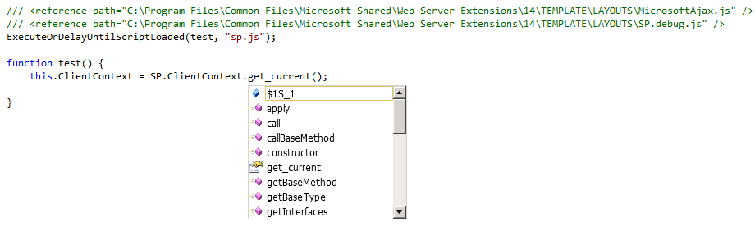
Problem - multiple files
Last problem for today.
JavaScript doesn't understand multiple files.
VS.NET helps with <reference>, but doesn't help you check the correctness of your reference code

Slide 11
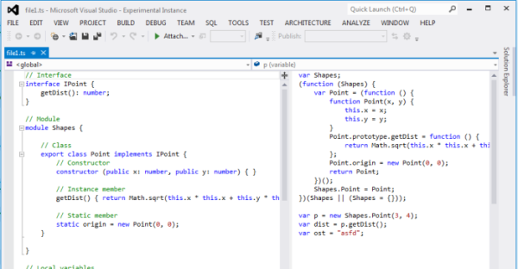
Let's look at TypeScript
To get started with TypeScript, grab it from http://typescriptlang.org this includes VS2012 extensions
Next, grab Web Essentials 2012 VS Extension. http://visualstudiogallery.msdn.microsoft.com/07d54d12-7133-4e15-becb-6f451ea3bea6
Notes:
Some of you might find these examples interesting… Just wait until you had to fix someone else bug in their script
You can do it with VS.NET 2010, but there are manual bits involved. Installer doesn't help you.

Slide 12
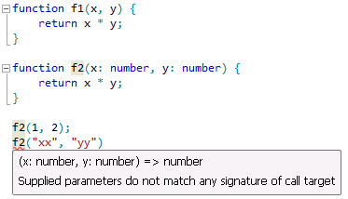
TypeScript - first glance - optional strong type checking
// js function f(x, y) { return x * y; }
// ts function f(x : number, y : number) : number { return x * y; }
// Type information is enforced in design and
// compile time, but removed at runtime

Slide 13
TypeScript - demo.ts
Let's go see demo.ts in Visual Studio

Slide 14
TypeScript features
Static Type Checking
Modules and Export
Interface and Class for traditional Object Oriented Programming
Works with all your existing JavaScript libraries
Low learning overhead compared to similar JavaScript systems (CoffeeScript or Dart)
Outstanding team and refactoring scenarios

Slide 15
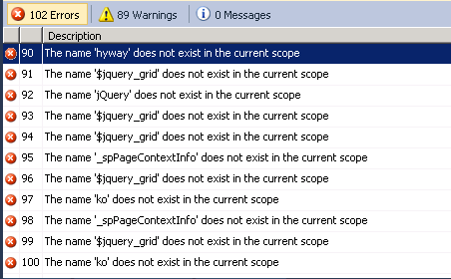
How - existing projects
#1 copy the JS file and paste into a TS file. Remember: JS is subset of TS
Notes:
This is my largest, 1500 line file
. TS will complain though, because it thinks you can be more specific

Slide 16
Summary - why TypeScript
Have to learn one more thing - there is a learning curve, very easy if you already know JavaScript.
You still have to learn JavaScript - Understanding how TypeScript converts to JavaScript will teach you better JavaScript
Some definition files don't exist or incomplete, but I think this will vanish very quickly. These aren't hard to write if you really need something.
Modules and classes enable large projects and code reuse
Compile-time checking prevents errors
Definition files for common JavaScript libraries makes them very easy to work with, and provides strong type checking
Source map debugging makes debug easy

Slide 17
Conclusion - if I have to make a decision for you…
If you see yourself using more JavaScript. You have to look at TypeScript.
If you and your team has to work on JavaScript together, you have to look at TypeScript.
Once you've done the initial hard work and converted a project. You can't stand going back.
TypeScript is currently in beta. There are occasionally bugs. But the forums and support (in Stack Overflow) is very good.
But they are moving very quickly. v0.9 will give us generics! I expect to see strong take-up of TypeScript in MS community.
You can use TypeScript for JAVA / MVC / SharePoint as well as Windows Apps
Notes:
If you are already using JavaScript, and you see yourself using more JavaScript. You have to look at TypeScript.
The strong tooling in Visual Studio is a key differentiator for Microsoft. TS will be here at least until ECMAScript v6 comes out, whenever that is. Even then, old browsers won't support most of it so you'll still need a way to compile down to plain-old-JavaScript
Once you've done the initial hard work and converted a project. There is no going back. It'd be like going back to the dark ages.
TypeScript is currently in beta. v0.9 will give us generics! I expect as TS matures and more and more Microsoft teams migrate to it internally, we'll see a lot more TS in one year than now.
You can use TypeScript for ASP.NET / MVC / SharePoint as well as Windows Apps

