Slide 1

BitVault4
Member 1 | Shreesha Kavya Prakash
Member 2 | Sahan H A
Member 3 | Sonam Prashant Shetiya
Member 4 | Shiva Kumar
Team Leader Email: shreesha165@gmail.com
Team Leader Phone:9353438718
College Name: Canara Engineering College
Problem Statement ID: 4.1

Slide 2
Problem Statement
Issues like flight delays or cancellations, train delays or cancellations and hotel delays or cancellations may limit the time available for the traveler and increase the number of decisions to be made. Finding a proper solution for the travel problem might be quite difficult due to constraints on time, budget, destination, and dependencies between various bookings.
The problem is to create an AI-based travel recovery agent, which would be capable of:
• Recognizing or generating travel issues and identifying impacted bookings.
• Understanding traveler constraints such as budget, time, and destination.
• Searching and assessing alternative travel solutions.
• Choosing and justifying the best recovery solution.
• Creating a new travel itinerary with required actions.

Slide 3
Solution Overview
In case of travel disruption, travellers usually need to:
- Research different sources for alternative flights, trains, or hotel options.
- Compare prices, times, stops, and availability manually.
- Re-plan linked trips like hotel stays and airport transfers.
- Pick one constraint to drop off when there is no way to satisfy all.
- Coordinate everything themselves.
The Key Issue
The existing approach to solving travel disruptions tends to fix the disrupted trip itself but not to solve the overall traveller’s trip.
The Opportunity
Develop an AI agent that can evaluate the disruption, its impact on the rest of the trip, compare alternatives, and build a disruption recovery plan.

Slide 4




Technical Approach
Frontend — React + Tailwind CSS
Backend — Node.js + Express
AI Agent — LLM + Agentic Workflow
Database — MySQL
Decision Engine — Constraint & Disruption Scoring

Slide 5
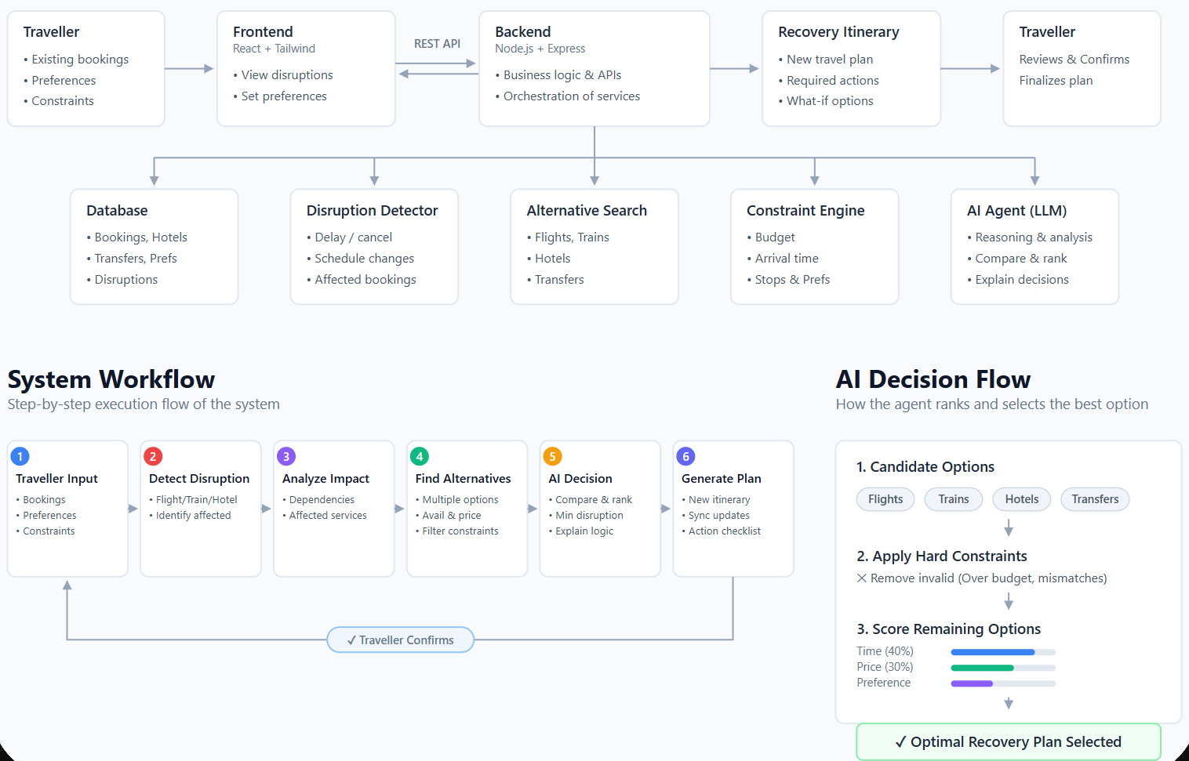
Diagrams/Flow Charts/Visuals

Slide 6
Impacts and Benefits
For Travelers
Faster recovery: Transforms a disruption into a recovery plan in seconds.
Effort savings: Automatically compares various alternatives instead of manually searching them.
Customized decision: Takes into account budget, arrival time, stops, destination, traveller preferences.
Minimizing cascading effect: Detects any conflict with related bookings like hotels and transfers.
Transparency of suggestions: Explains which alternative is chosen and why others are not.
For Travelers & Service Providers
Automation of disruptions management: Eliminates repeated manual work with common disruption scenarios.
Consistency of decisions: Systematically uses predefined constraints and rules of recovering from a disruption.
Visibility: Gives an overall picture of affected bookings and necessary actions.
Overall Effect
From “My trip is disrupted” → “This is my recovery plan and exactly what I have to do.”

Slide 7
Business Impact & Scalability
Value for Business
Reduces efforts involved by automating disruption detection, alternative evaluation, and recovery planning.
Reduces efforts needed to provide traveller support by offering self-service recovery advice.
Enhances customer experience by providing fast and personal disruption resolution.
Provides an extra layer of services for airlines, travel agencies, OTAs, railway operators and corporate travel services.
Market Potential
The product will address the overall **travel disruption management market** where airlines, rail operators, hotels, travel agencies and corporate travel services require to manage their delays, cancellations, or itinerary changes.
Scalability
Users: Travellers → Corporate travellers → Big travel platforms
Locations: One city → Countrywide → Worldwide
Transport: Flights → Trains → Bus → Multimodal
Use Cases: Delay → Cancellation → Missed connection → Weather disruption → Hotel/Transfer conflicts
Vision for the Future
One AI recovery layer that will connect to multiple travel service providers and will automate the process of recovery throughout the whole journey.

Slide 8
Additional links
GitHub Repo link
Demo Video Link (YouTube or Google Drive, maximum duration: 4 minutes)
Deployment link ( optional )

