Slide 1



Analysis of England’s Water Quality
based on Statutory Reports
- By Sonam Chavan

Slide 2

Table of Contents
Introduction
Motivation
Objectives
Methodology
Progress and Achievements
Risk Analysis
Critical Evaluation
Conclusion
References

Slide 3
Introduction
Critical Environmental Concerns
Impact on public health and ecosystems.
Economic implications of water pollution.
England’s Water Quality Standards
Essential due to dense population and industrial activities.
Importance of maintaining high standards.
Research Aims
Comprehensive understanding of water quality and pollution.
Examination of data from water companies and government sources
Analytical Approach
Identification of key concerns and trend analysis.
Assessment of pollution management effectiveness.
References: [1,2,7,8]

Slide 4
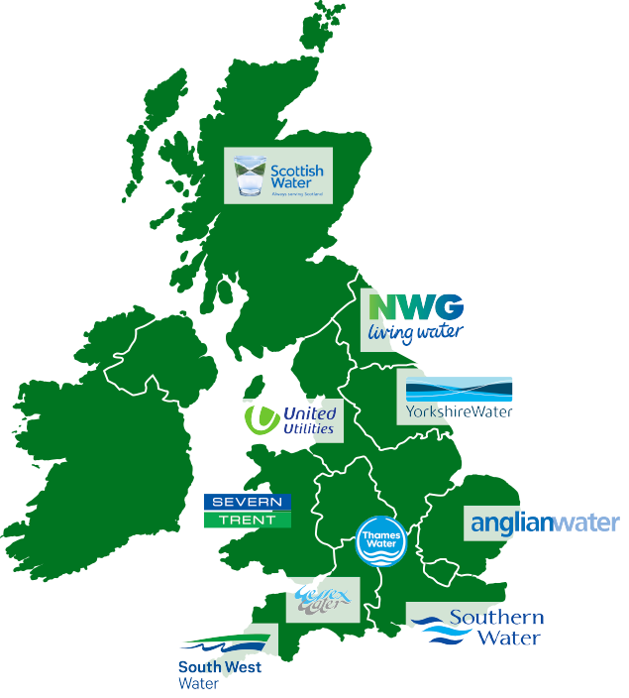
Motivation
Research Background
Evolution of water service management in England
Formation of Regional Water Authorities
Relevant Literature
Treated wastewater and storm overflows
Increasing pollution incidents and serious pollution cases
Addressing Challenges
Pollution, outdated infrastructure, and increasing water demand
DEFRA’s Plan for Water addressing these challenges
Understanding Basic Principles
Water Quality Importance
Water Companies' Role
References: [2,3,4]

Slide 5

Objectives
Pollution Inventory Assessment
Analyze pollution inventory data of year 2022
Pollution Incident Data Analysis
Identify patterns, trends, and hotspots
Examine Pollution Incident data spanning the last 23 years.
Assess the severity and impact of incidents on water quality
Dashboard Development
Build a comprehensive dashboard integrating data
Visualize pollution incidents, water quality metrics, and trends.
Provide an accessible and user-friendly interface for decision-makers.
References: [4,5,6]

Slide 6
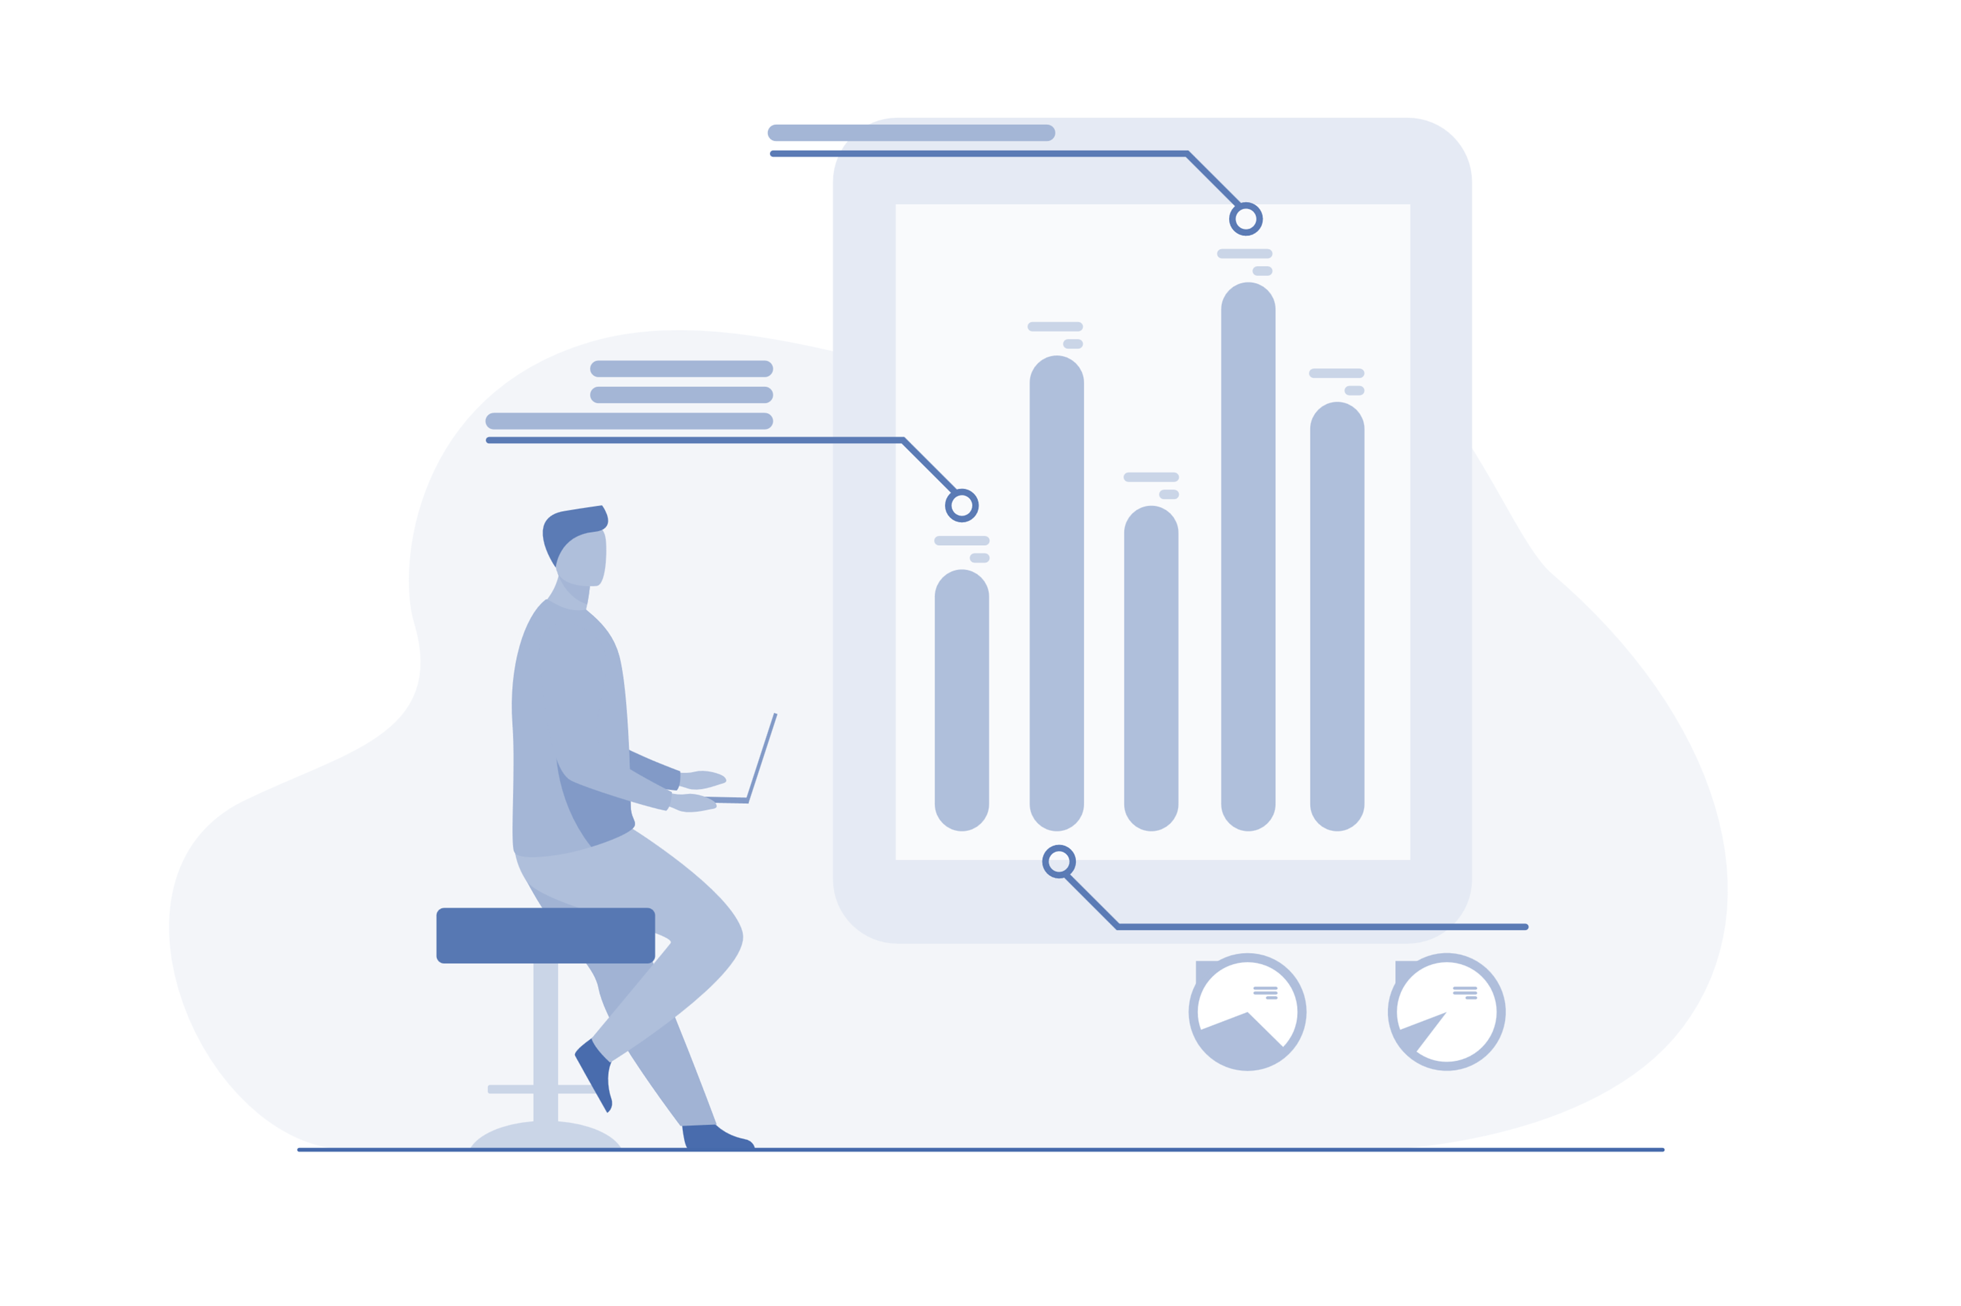
Methodology
Data Collection
Statutory reports, government databases, documentaries
Data Visualization
Using Excel, R and shiny model for analysis
Test and Evaluation
Usability and accessibility testing for visualizations
References: [5]

Slide 7
Methodology
Issues:
Legal Compliance
Adherence to data privacy laws
Compliance with environmental regulations
Ethical Considerations
Ensuring informed consent in data collection
Maintaining honesty and transparency in reporting
Professional Standards
Accuracy and fairness in presenting findings
Upholding journalistic standards
Risk Management
Cross-referencing data for accuracy
Regular software updates and maintenance
References: [2]

Slide 8
Progress and Achievements
Development Work
Created a comprehensive analysis of water pollution incidents using a multi-faceted approach.
Developed an interactive Shiny application incorporating map and two additional graphs to visualize data
Upholding journalistic standards
Results and Implications of Work
Heatmap
Incidents Per Year Graph
Correlation Plot

Slide 9
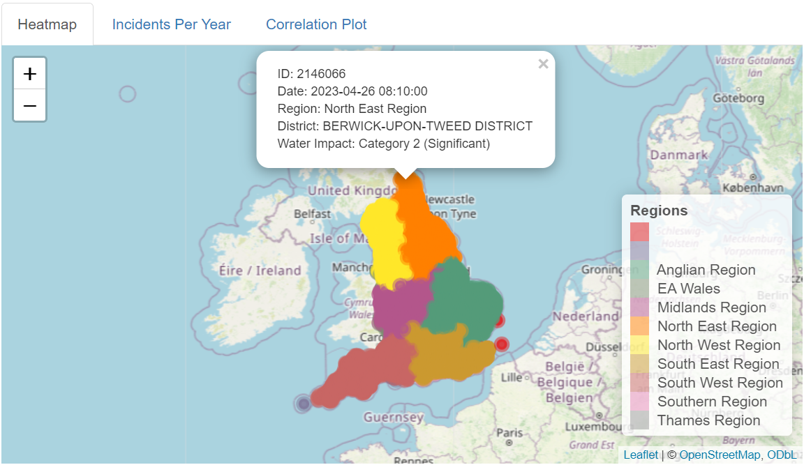
Progress and Achievements
Results and Implications of Work
Heatmap: Displaying geographic distribution of pollution incidents provides insights into regional hotspots
Follow the link to see the graph live . click here

Slide 10
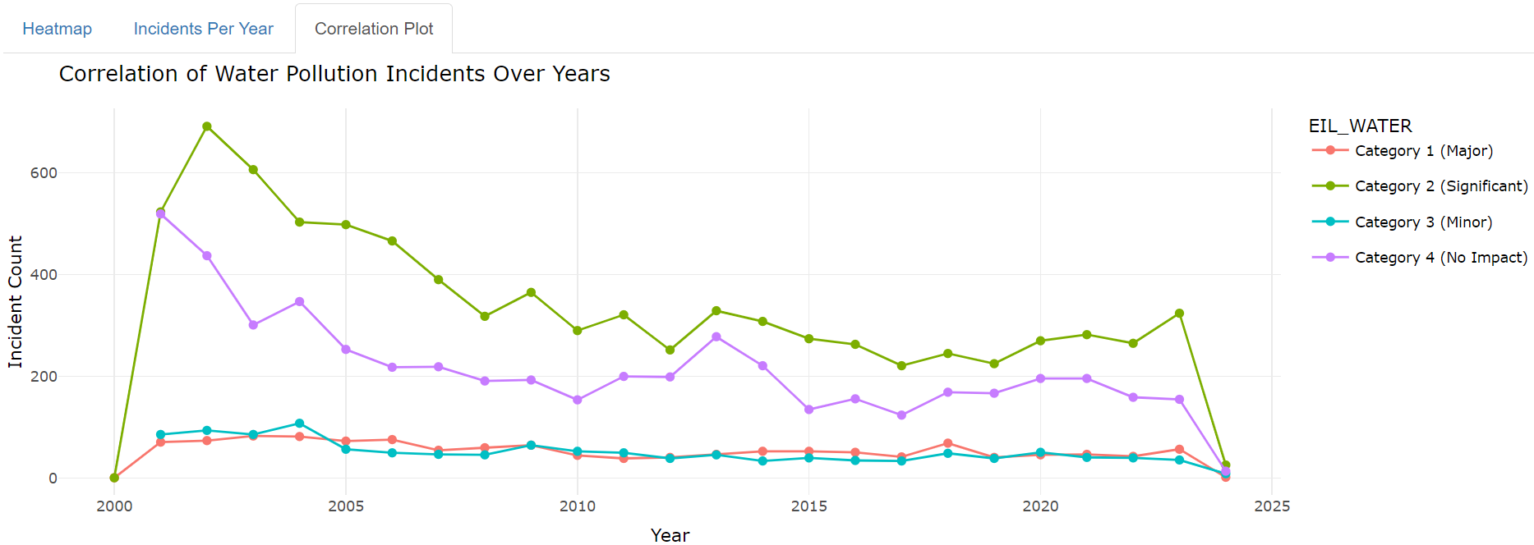
Progress and Achievements
Results and Implications of Work
Correlation Plot

Slide 11
Risk Analysis
Category | Details
Assets | Water Quality Data, Water Treatment Infrastructure, Environmental Reports
Threats | Pollution Incidents , Climate Change , Aging Infrastructure
Safeguards | Strict Regulatory Compliance (Environment Act 2021) , Regular Monitoring and Reporting
Vulnerabilities | Outdated Technology , Inconsistent Data Quality
Consequences | Deterioration of Water Quality , Public Health Risks , Legal Penalties and Fines

Slide 12
Critical Evaluation
Risk Owner | Risk | Likelihood | Severity | Score | Mitigation
Water Companies | Non-compliance with regulations | 4 | 5 | 9 | Implement stricter compliance checks and regular audits. Conduct training for staff on regulations.
Government | Ineffective policy implementation | 3 | 4 | 7 | Develop a robust monitoring framework. Engage stakeholders for feedback and improvement.
Researchers | Data privacy breaches (GDPR) | 3 | 3 | 6 | Use encrypted data storage and transfer methods. Regularly update and patch software. Implement strict access controls.
Environmental | Pollution incidents | 4 | 5 | 9 | Increase monitoring and rapid response teams. Invest in pollution control technologies.
Public Health | Contaminated water affecting health | 3 | 5 | 8 | Conduct regular water quality testing. Develop and enforce strict contamination control measures.
Technical Teams | Outdated infrastructure | 4 | 4 | 8 | Allocate budget for infrastructure modernization. Schedule phased upgrades and maintenance.
Policy Makers | Failure to meet sustainability goals | 3 | 5 | 8 | Develop and implement comprehensive sustainability policies. Monitor progress and adjust policies as needed.
(8-10) - High
(5-7) - Moderate
(1-4) - Low

Slide 13
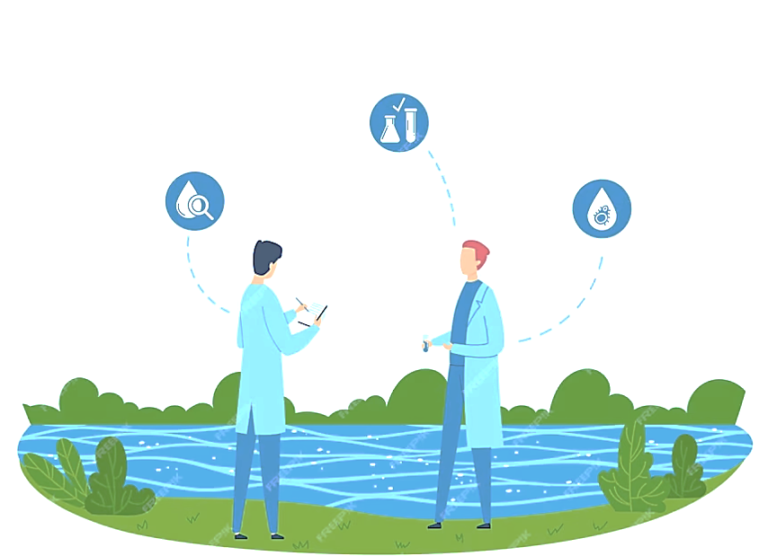

Conclusion
Current Challenges
Water Companies' Role
Research Focus
Risk and Mitigation

Slide 14
References
[1] Hall, D. and Lobina, E., 2008. ‘Water privatisation’. PSIRU Reports.
[2] Available at: Gov.uk. (2020). Plan for Water: Our integrated plan for delivering clean and plentiful water. Available at: https://www.gov.uk/government/publications/plan-for-water-our-integrated-plan-for-deliveringclean-and-plentiful-water/plan-for-water-our-integrated-plan-for-delivering-clean-andplentiful-water
[3] https://jsrenergyconsultancy.co.uk/water-management/
[4] Lobina, E. and Hall, D., 2001. ‘UK water privatisation: A briefing’.
[5] Available at: UK Government. (n.d.). Pollution inventory. Available at: https://www.data.gov.uk/dataset/cfd94301-a2f2-48a2-9915-e477ca6d8b7e/pollutioninventory
[6] Available at: Environment Agency (2020) Water and sewerage companies in England: environmental performance report 2020. Available at: https://www.gov.uk/government/publications/water-andsewerage-companies-in-england-environmental-performance-report-2020
[7] Available at: National Farmers' Union (NFU), 2023. DEFRA's Plan for Water. Available at: https://www.nfuonline.com/news/latest-news/defras-plan-for-water-announced/
[8] Available at: Environmental Audit Committee, 2022. Water Quality in Rivers. Available at: https://publications.parliament.uk/pa/cm5802/cmselect/cmenvaud/74/7402.
[9] Ellis, J.B., 2013. Sustainable surface water management and green infrastructure in UK urban catchment planning. Journal of Environmental Planning and Management, 56(1), pp.24-41.
[10] Spiller, M., 2010. ‘EU Water Policy: Pollution source control by water companies in England and Wales’.
[11] Available at: BBC panorama (2023) https://www.bbc.co.uk/iplayer/episode/m001t4g5/panoramathe-water-pollution-coverup
[12] Available at: channel 4 dispatches (2022) https://www.youtube.com/watch?v=ilhC5Ekp3eo

Slide 15
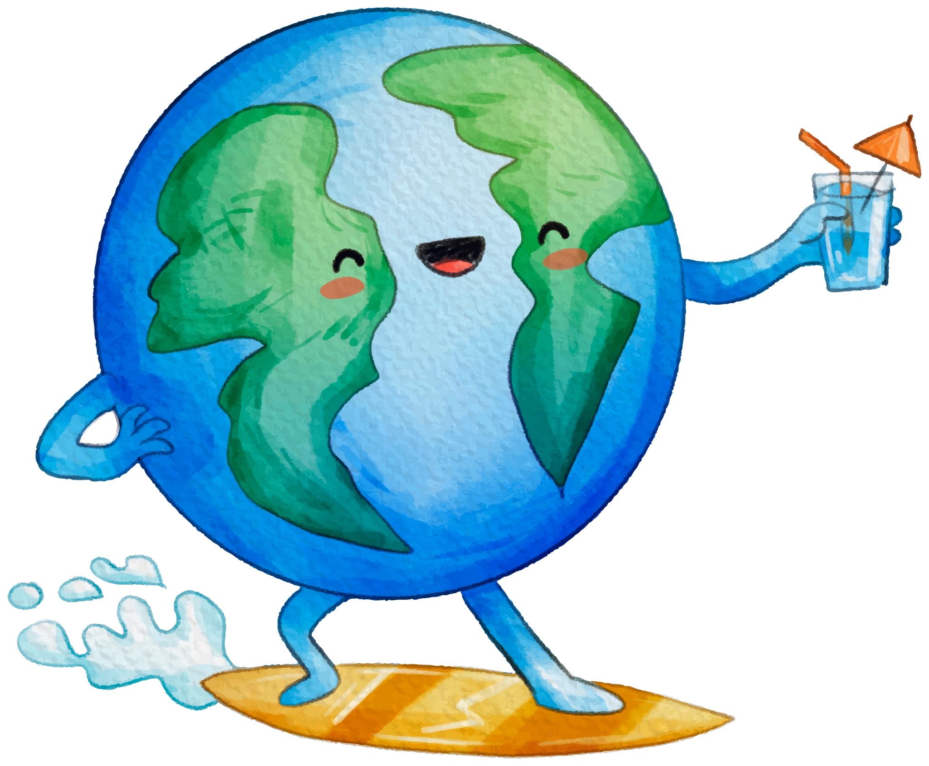
Thank you for your time

