Slide 1
Exercises

Slide 2
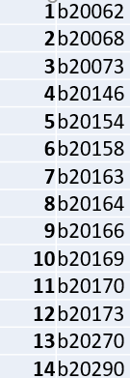
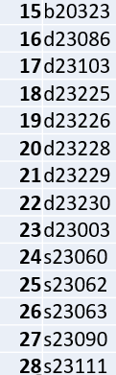
Students-ID

Slide 3
Exercise 1-Data generation (1500 subjects)
Variables
SubjectID- continuous number
Gender-male=1;female=2
Age-continuous variable (19 to 70 years)
Group-Yoga-1; Exercise-2
ModeOfClass-1=online; 2=offline; 3=both
StressLevelBaseline-continuous variable (1-100)
StressLevelOneMonth-continuous variable (1-100)
StressLevelTwoMonths-continuous variable (1-50)
HappinessBaseline-continuous variable (1-100)
HappinessOneMonth-continuous variable (1-100)
HappinessTwoMonths-continuous variable (1-10)
Export the data on your desktop as CSV file(name it as Exercise1_YourRollNumber)

Slide 4
Exercise 2- Data wrangling
Filter only 50 data as per your roll number
For example- if your serial number is 20, leave 19x50 data and 50 subjects from 951 onwards
Do Z transformation for stress and happiness scores for 2nd month
Recode z transformed scores – all positive values as ‘better’’; all negative values as ‘worse’
Export the result as pdf (name it as Exercise2_YourRollNumber)

Slide 5
Exercise 3
Normality & creating graphs
Find if the stress scores(Baseline & one month) are normally distributed
Happiness scores(Baseline & one month) are normally distributed
Create a Box plot for the above mentioned data
Create a scatter plot for stress scores and Happiness scores for baseline data split by group
Create a side by side bar chart for group split by gender
Create a box plot for stress scores and Happiness scores split by gender
Export the result as pdf(name it as Exercise3_YourRollNumber)

Slide 6
Exercise 4
Run one sample t test for baseline stress scores. Test value=40
Run paired t test for stress scores (baseline and one month)
Run independent t test for baseline happiness scores
Test if there is an association between gender and mode of class
Test if females are participating more than males in this research data
Export the result as pdf(name it as Exercise4_YourRollNumber)

Slide 7
Exercise 5
Test if there is a difference in stress scores between groups from baseline to one month- using independent t test
Test if there is a difference in stress scores between groups from baseline to one month-using RMANOVA (generate a line graph as well)
Export the result as pdf(name it as Exercise5_YourRollNumber)

Slide 8
Exercise 6
Test if stress scores are associated with happiness scores irrespective of groups
Assuming stress scores and happiness scores are correlated, run a simple linear regression to predict happiness from stress scores
Export the results as pdf(name it as Exercise6_YourRollNumber)

