Slide 1

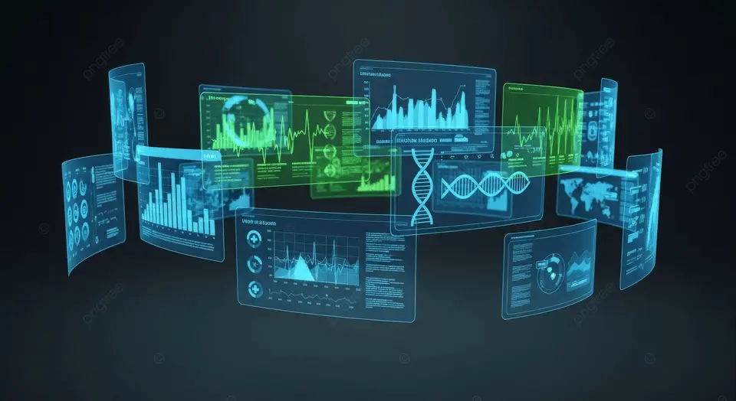

PBL
Machine Learning – 22CSE62
VI Sem
DEPARTMENT OF COMPUTER SCIENCE AND ENGINEERING
ST JOSEPH ENGINEERING COLLEGE
Healytics: A Patient-Centric Digital Health Record and Analytics Platform
Submitted by:
Sneha AS - 4SO23CS224
Sona Maria P S - 4SO23CS227
Palak Prakash Talekar - 4SO24CS413
Rachita Rajesh Damsadekar - 4SO24CS415
Under the Guidance of
Ms Rakshitha Naresh
Assistant Professor, Department of CSE

Slide 2
Background
Healthcare systems generate large volumes of digital medical data such as lab reports, prescriptions, and diagnostic records.
These records are stored across different hospitals and platforms, resulting in fragmented and isolated information.
Lack of integration makes it difficult to obtain a complete and continuous view of a person’s medical history.
The growing use of electronic health records highlights the need for unified and data-driven healthcare systems.

Slide 3
Problem Statement
In today's healthcare system, patients store medical reports in paper or digital formats such as PDFs and images. These records are unstructured, scattered, and difficult to analyze. Patients often struggle to track past medical values, identify health trends, or interpret their reports effectively. Existing digital health platforms mainly provide storage or appointment services but do not convert reports into structured data or provide analytical insights. Therefore, there is a need for a patient-centric system that can digitize medical reports, extract key health parameters, and provide basic predictive insights to support proactive health management.

Slide 4
Proposed Solution: Healytics
Healytics is a centralized digital health record and analytics platform.
It aggregates medical records from multiple healthcare sources.
It applies analytical and predictive models to generate actionable health insights.
It converts unstructured reports into structured medical data.

Slide 5
Objectives
01
02
03
To develop a patient-centric platform for securely storing and managing medical records from multiple healthcare providers.
To extract, organize, and standardize data from reports, prescriptions, and diagnostic documents into a unified format.
To apply data analytics to track health trends and generate personalized health insights.
04
05
To provide an intuitive interface for patients and authorized providers to access and interpret medical data and analytical results.
To ensure data privacy, security, and controlled access through authentication and authorization.

Slide 6
Primary Research - Existing Platforms
Apple Health / Google Health
Hospital Portals (MyChart type)
Practo / Apollo 24|7
Report storage only
Focus on wearable data
Only record viewing
Limitations:
No OCR-based value extraction
No structured data analytics
No ML-based analytics from uploaded reports

Slide 7
Primary Research - Empathy Map Summary
The empathy map focuses on patients who receive medical reports from hospitals or labs.
Users want an easy way to understand and organize their medical reports.
The system allows users to upload reports (PDF or images) and extract important medical values.
Current problems include difficulty understanding reports and scattered storage of records.
The solution aims to provide organized digital storage, data visualization, and basic health risk prediction using machine learning.

Slide 8
Primary Research - Summary
Patients receive medical reports mainly as PDFs or images, which are hard to manage.
Many users cannot easily understand medical values in reports.
Apple Health / Google Health focus mostly on wearable device data.
Hospital portals (MyChart type) mainly allow record viewing.
Practo / Apollo apps mostly provide report storage only.
Existing systems do not extract values automatically from reports.
Most platforms lack structured health data analytics.
Patients often store reports in phone folders or galleries.
Users need a simple system to organize and understand reports.
This shows the need for a patient-centric platform like Healytics for report extraction and health analysis.

Slide 9
Secondary Research - Key Points
❓ Are people currently using digital platforms to store medical records?
According to our survey, 80% of respondents reported that they are not currently using any digital platform to manage medical records. Most medical reports are stored as physical documents or scattered files, making it difficult to maintain a centralized health history.
❓ Do people regularly monitor their health through checkups?
Survey responses indicate that regular health monitoring is not consistently practiced by many individuals. Without proper tracking of previous reports, it becomes difficult to observe changes in health indicators over time.
❓ Do users find it difficult to organize or track medical reports?
Around 66.7% of respondents reported difficulty in organizing or tracking their medical records. Managing multiple reports from different hospitals or laboratories can become confusing and time-consuming.
❓ Would an automated system that analyzes medical reports be useful?
The survey shows that 100% of respondents believe that an automated system capable of analyzing medical reports and providing health insights would be useful.

Slide 10
Secondary Research - Summary
Medical reports are often stored physically, making access difficult.
Loss or misplacement of records is common.
Health data is scattered across multiple hospitals and labs.
Patients lack a centralized platform for medical records.
Medical reports are hard for patients to understand.
OCR can digitize scanned medical reports.
Machine learning can detect health patterns and risks.
Digital platforms improve health data access and tracking.
Security measures are required to protect medical data.
Patient-centric systems help users manage their health better.

Slide 11
Technology Stack
Frontend:
Analytics & ML:
HTML, CSS, JavaScript, React
Pandas, NumPy, Scikit-learn, TensorFlow
Backend:
OCR:
Python, Flask or FastAPI
Tesseract OCR, OpenCV
Database:
Visualization:
MySQL or PostgreSQL
Chart.js or Matplotlib

Slide 12






Expected Outcomes
A functional Healytics web application.
Secure storage and management of medical records.
OCR-based extraction of medical data.
Health analytics dashboard showing trends and insights.
Predictive model for health risk estimation.
Secure user authentication and access control.

Slide 13
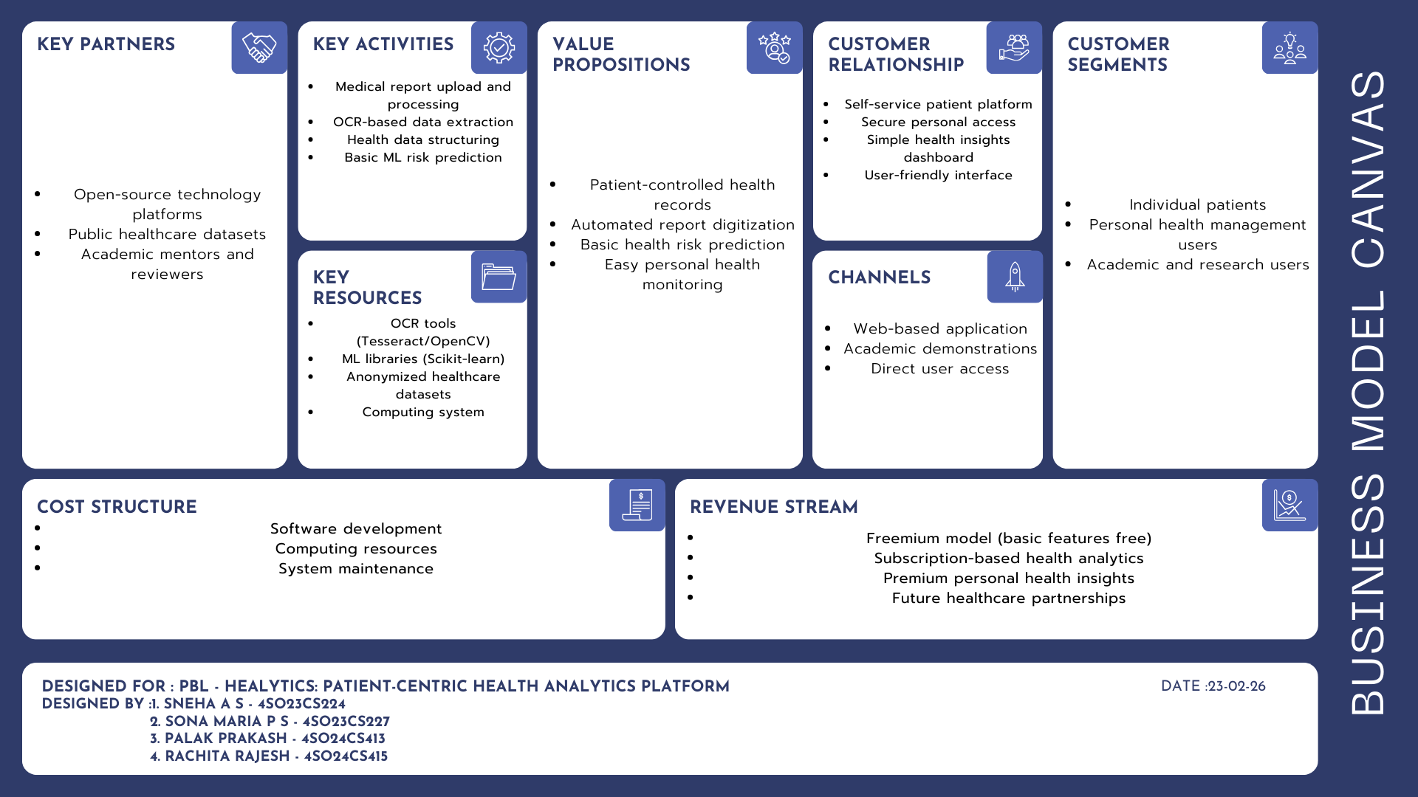

Slide 14
References
[1] Hsiu-An Lee1, MS; Hsin-Hua Kung, BS; Jai Ganesh Udayasankaran, Boonchai Kijsanayotin, Alvin B Marcelo, Louis R Chao1, Chien-Yeh Hsu2, “An Architecture and Management Platform for Blockchain-Based Personal Health Record Exchange: Development and Usability Study,” 2020.
[2] C. N. Vorisek, M. Lehne, S. A. I. Klopfenstein, P. J. Mayer, A. Bartschke, T. Haese, and S. Thun, “Fast Healthcare Interoperability Resources (FHIR) for interoperability in health research: A systematic review,” JMIR Medical Informatics, vol. 10, no. 7, e35724, 2022.
[3] M. Badawy, N. Ramadan, and H. A. Hefny, “Healthcare predictive analytics using machine learning and deep learning techniques: a survey,” Journal of Electrical Systems and Information Technology, vol.10, no.40, 2023.
[4] C. V. Ibeh, O. A. Elufioye, T. Olorunsogo, O. F. Asuzu, N. L. Nduubuisi, and A. I. Daraojimba, “Data analytics in healthcare: A review of patient-centric approaches and healthcare delivery,” World Journal of Advanced Research and Reviews, vol. 21, no. 2, pp. 1750–1760, 2024.
[5] F. G.Serra, “A Secure AI and Machine Learning–Enabled Cloud-Native Framework for Scalable Healthcare Analytics and API Interoperability,” International Journal of Research and Applied Innovations, vol.7, no.2, pp.1–8, 2024.

