Slide 1
Analysis of Tesla’s Sales Performance
ANLY 500 50
Spring 2016
Ahien Djouka
Namrata Kakade
Sonam Gupta
Suparna Dawalkar
Yash Bhaiyya
Notes:
Sonam – 3
Suparna – 3
Namrata - 4
Yash - 3
Clem - 3

Slide 2
Introduction
Government make efforts to let people adapt to the culture of electric vehicles
Elon Musk, CEO of Tesla Motors Inc., thinks of Tesla setting a legacy in future
Musk’s speculation about Tesla sustainability
Elon Musk wants to make an action plan for Tesla’s success
Potential factors for Tesla’s sales performance → Research question
Notes:
Sonam
Musk’s speculates about Tesla if the business pattern is sustainable with the increase in competition in electric vehicle market
Factors that are potential to affect the sales performance of Tesla cars, leads to our research question
Government making efforts to let people adapt to the culture of electric vehicles
Elon Musk, CEO of Tesla Motors Inc., thinks of Tesla setting a legacy in future
Musk’s speculation about Tesla sustainability
Elon Musk wants to make an action plan to be sure of Tesla’s success
Potential Factors for tesla’s sales performance → Research question

Slide 3
Research Question
Will the fluctuations in oil prices affect the sales performance of Tesla?
How significant is the relationship Tesla Sales / Substitute Unit Price?
Notes:
Sonam

Slide 4
Related Work
Fall of oil prices → fuss in electric vehicles market
Along with Tesla, other companies like Nissan, Ford, Toyota began to worry
Review of sales of these companies was done
Mostly hurt by oil price decrease: hybrid and other plugin electric vehicles
Notes:
Suparna
Points to cover in the slide/talk: mention what’s in the case study
Fall of oil prices → fuss in electric vehicles market
Along with Tesla, other companies like Nissan, Ford, Toyota began to worry
Review of sales of these companies was done
Mostly the hybrid and other plugin electric vehicles were mostly hurt due to the decrease in oil prices.

Slide 5
Data Collection
Cost of Oil and Oil products by month
Number of units of electric cars sold from conception in December 2010 to March 2016
Price of electric cars
Yahoo Finance: tesla stock price
Notes:
Suparna
Names of
: We obtained the stock prices of Tesla Motors Inc. (Nasdaq Code- TSLA) for the time period starting from January 2011 through March 2016 from Yahoo Finance. The raw data contained daily data with a few missing data points. The raw data consists of the following fields (all prices are in US dollars):
data sets, and we can explain what dataset has what

Slide 6
Normalization
Normalization (oil prices) = Mean of all months’ oil prices
Average of 6 years’ oil prices
Normalization (Prices Per Unit of Car) = Σ (Number of Unit of each car sold * Price of the car)
Σ car sold in that month
Notes:
Namrata

Slide 7
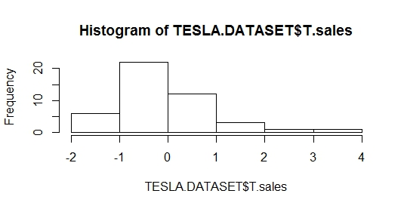
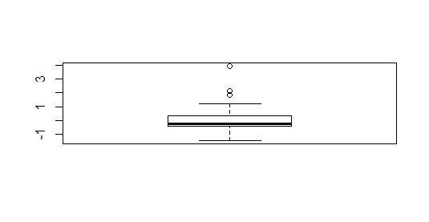
Boxplot of TESLA.DATASET$T.sales
Test and Evaluation
Notes:
Namrata
Dataset = entire population: sales for every month available
Distribution : slightly right skewed with 3 outliers
Chose to keep outliers: recent sales numbers
Indicative of future upwards trend for Tesla Sales
Large enough size and no extreme outliers → nearly normal distribution
Tesla sales: nearly normal with a recent upwards trend

Slide 8
Model and Results
Analyze Tesla’s sales – impact of external factors
Fluctuations in oil prices and money spent on other electric cars in general
Linear Regression Model
Final Dataset – 45 standardized monthly observations from June 2012 to March 2016:
Sales of Tesla
Oil Prices
Substitute Unit Price
Notes:
Namrata
Specify our null and alternate hypotheses – we have hypotheses in the hypothesis testing part not where we define the model (please confirm)

Slide 9
Model and Results (Contd.)
1st Iteration
T.Sales = -1.055e-10 – 0.14 x oil price + 0.48 x substitute.unit.price
model significant as a whole
Oil price valriable is not significant
Adj R-sq: 33.82%
2nd iteration
T.Sales = -9.812e-11 + 0.6 x substitute.unit.price
Model significant as a whole
No non-significant variables
Adj R-sq: 34.98% (increase from 1st iteration)
FINAL MODEL
Notes:
Clem

Slide 10
Model Conclusion
1 unit increase in the standardized substitute unit prices → increase of 0.6 units in the standardized Tesla monthly sales on average
35% of the variability in the Tesla monthly sales is explained by the model.
Adj R-sq < 40%
Safe assumption: Several other factors not present in this analysis cause for Tesla monthly sales fluctuations.
Notes:
Clem

Slide 11
Hypothesis Testing
Is the relationship between substitute unit prices and tesla Sales significant?
H₀: slope = 0
H_{a}: slope ≠ 0
95% Confidence Interval (CI): [0.35 ; 0.85]
We are 95% confident that one-unit increase in the standardized substitute unit price leads to an increase ranging from 0.35 to 0.85 units in standardized Tesla sales on average.
95% CI is above 0 → positive relationship between Tesla sales and substitute unit prices
Notes:
Clem

Slide 12
Conclusion
Tesla sales are nearly normal with a very recent upward trend.
Analysis supports our hypothesis
Significant positive relationship between substitute unit price and Tesla sales
Good start but incomplete:
low R-squared
Lacking other variables that could improve the model.
Notes:
Sonam
So final conclusion should talk about what affected the sales of Tesla cars, if we could have used different dataset, would we have different results..

Slide 13
Future Work
Sound model
Small Adj R-sq: other relevant variables
Potential relevant variables:
Sales of Tesla’s competitors according to Tesla: other luxury cars
Example: Audi A7-A8
Notes:
Suparna

Slide 14
Appendix and Models Developed
Price Paid Per Unit of Car by Months
Secondary Data – monthly sales normalized to create the input data by months
Original cost of were removed from the calculation – too expensive
Three values obtained using same formula:
Price Paid per unit of Tesla,
Price per Unit of Electric Cars minus outliers (including tesla) and
Price Paid per Electric Cars minus Outliers and Tesla
Notes:
Yash
Price Paid Per Unit of Car by Months
One of our inputs in the Regression and correlation analysis was the price paid per unit of electric cars. The data can be seen below and this would make it difficult to use the data.
The data obtained was secondary data that gave sale by months and below table is the aggregate of the Year this data was then normalized to create the input data by months
The original cost of all cars the outliers such as the Porsche 918 Spyder and Others were removed from the calculation as they were outliers too expensive or undeterminable mix not given
Values
Three values were deciphered using same formula the values were
Price Paid per unit of Tesla,
Price per Unit of Electric Cars minus outliers (including tesla) and
Price Paid per Electric Cars Minus Outliers and Tesla

Slide 15
Appendix and Models Developed
Notes:
Yash

Slide 16
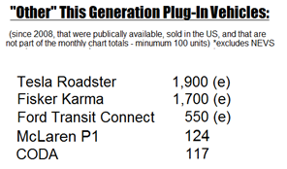
Exclusions
Outliers and early data for 2010 not included: no breakdowns available and risk of distortion from early adopters.
Notes:
Yash
Outliers and early data for 2010 not included: no breakdowns available and the early industry trends would distort the data due to the novelty sales to early adopters.

Slide 17



