Slide 1
NETFLIX
Content Analytics Dashboard
An end-to-end Power BI project: Power Query • DAX • Interactive Visuals • Data Storytelling
Sonam Gupta | Aspiring Data Analyst | Power BI • SQL • Python • ML
Notes:
Introduce yourself, then one line: I turned a raw Netflix titles CSV into an interactive dashboard that answers catalog questions.

Slide 2
Project Objective & Dataset
Business questions
Dataset: netflix_titles.csv
Movies vs TV Shows balance?
How does content vary by release year?
Which ratings are most frequent?
How is content spread across countries?
How complete is director information?
How do metrics change with filters?
show_id, type, title, director, cast
country, date_added, release_year
rating, duration, listed_in, description
Prepared fields: Country_new, Director_new
Source: Netflix titles dataset (CSV)
2

Slide 3
End-to-End Workflow
Raw CSV
Power Query
(M)
Clean &
Shape
DAX
Measures
Visuals &
Slicers
Business
Insights
›
›
›
›
›
Power Query prepares the data; DAX and visuals analyse and present it.
3

Slide 4
Data Preparation & DAX
Power Query (M)
DAX measures
Validated column data types
Handled blank / categorical values
Built Country_new for the map
Built Director_new for director analysis
Result: clean, analysis-ready model
Total Shows
Movies
TV Shows
Total director (non-blank count)
Measures react to filter context, so KPIs, donuts, trend, ratings and map all update together
4

Slide 5
Executive Overview: KPIs & Content Mix
8,086
Total Shows
5,486
Movies
2,600
TV Shows
4,198
Director-linked
Insight: the catalog is clearly movie-heavy.
5

Slide 6
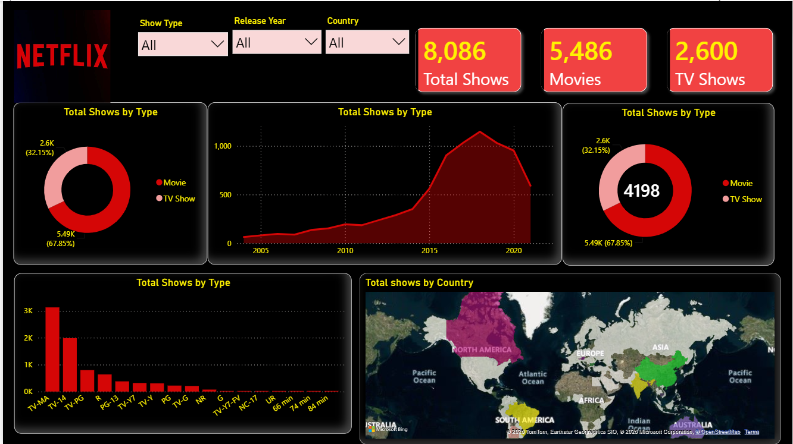
Release-Year Trend (Area Chart)
Paste your dashboard screenshot here
(Area chart: release_year vs title count)
What it shows
Low volume in older years
Strong rise through the 2010s
Peak concentration in late 2010s
Area chart = trend + volume over time
6

Slide 7
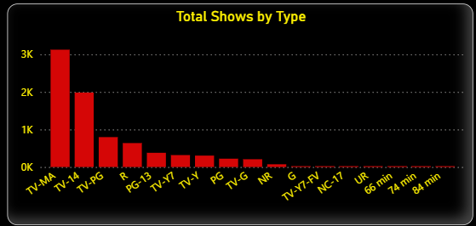
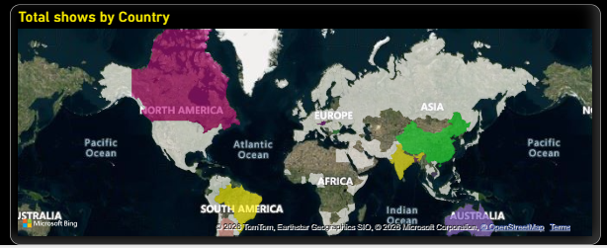
Ratings & Geography
Paste your dashboard screenshot here
(Rating column chart)
Paste your dashboard screenshot here
(Filled map: Country_new)
Ratings
Countries
TV-MA is the largest rating, followed by TV-14; other ratings are smaller.
Titles are spread across many regions, so the catalog is not tied to one market.
7

Slide 8
Director Coverage
Interview point
About 52% of records have director info (4,198 of 8,086)
The metric counts non-blank records, not unique directors
Count of records ≠ count of unique directors
Shows care in interpreting a measure
8

Slide 9
Interactivity & Design Choices
Slicers
Visual | Purpose
KPI card | Fast executive summary
Donut | Composition / share
Area chart | Trend over time
Column chart | Category comparison
Filled map | Geographic spread
Show Type (All / Movie / TV Show), Release Year, Country. One report answers many questions.
Filter context
Pick a country → KPIs, mix, trend, ratings and map all recalculate.
Dark Netflix theme • red accents • KPI-first layout • 1280×720 single page
9

Slide 10
Key Insights & Learnings
Insights
What I learned
Movies dominate: 5,486 vs 2,600 (67.85%)
Content concentrated in newer release years
TV-MA is the leading rating
Catalog is geographically broad
Filters change the story, so context matters
These describe the dataset, not Netflix strategy
Power Query cleaning before visualising
Writing DAX measures for filter context
Choosing a visual by the question
Dashboard UX and storytelling
Next: add genre analysis and duration, plus SQL/Python prep
10

