Slide 1

Southeast airline analysis -Final Presentation
Sonamgyalpo Sherpa
39849433
sosherpa@syr.edu

Slide 2

The purpose of the project is to decrease the customer churn for passengers by understanding the metrics presented in the dataset. Nps score(1-10) is the primary metric described as a measure of customer satisfaction in this project. visualizations and machine learning models are implemented to assist the analysis of customer behavior
OBJECTIVE

Slide 3

Business questions
1)What behavioral and geographical market segments can be selected from a passenger data to determine their Likelihood to recommend the airline to other potential customers?
2)What are the customer sentiments for the passengers with highest loyalty to the airline?
3)Does Price of airline services, gender, purposes for travel ( Personal, business) affect the NPS scores of the customer?
4)How satisfied are the customers who have high airline flyer status as compared to customers who have low airline flyer status?
5)Are there any patterns in NPS score, when two or more customer behaviors are brought into consideration?
6)How well are the Partner Airlines performing and which Airlines provide low customer satisfaction?
7)What kind of passenger is most likely to be a promoter or a detractor?
8)What are the lowest satisfaction routes( lowest nps) in the dataset?
9)Which states have the Highest and lowest NPS scores?

Slide 4
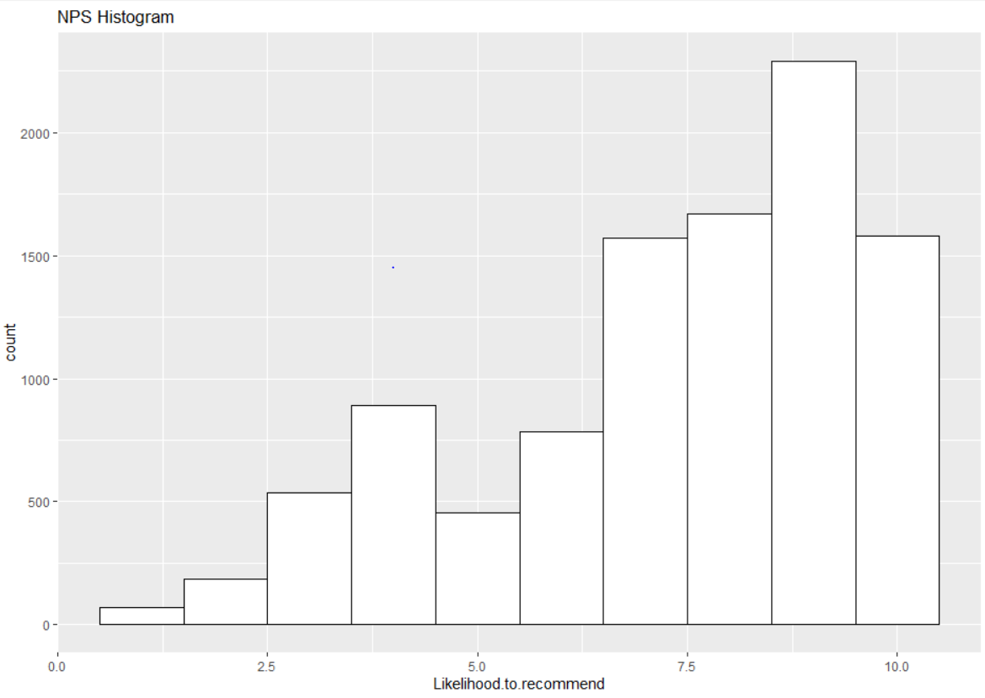
NPS scores
The chart explains the spread of NPS scores across the entire sample(dataset).
The spread suggests that most of the customers have higher NPS scores.
Hence, most customers are highly approving of South East Airline.
However, near the NPS score 4, there is a slight increase. How does that occur?

Slide 5
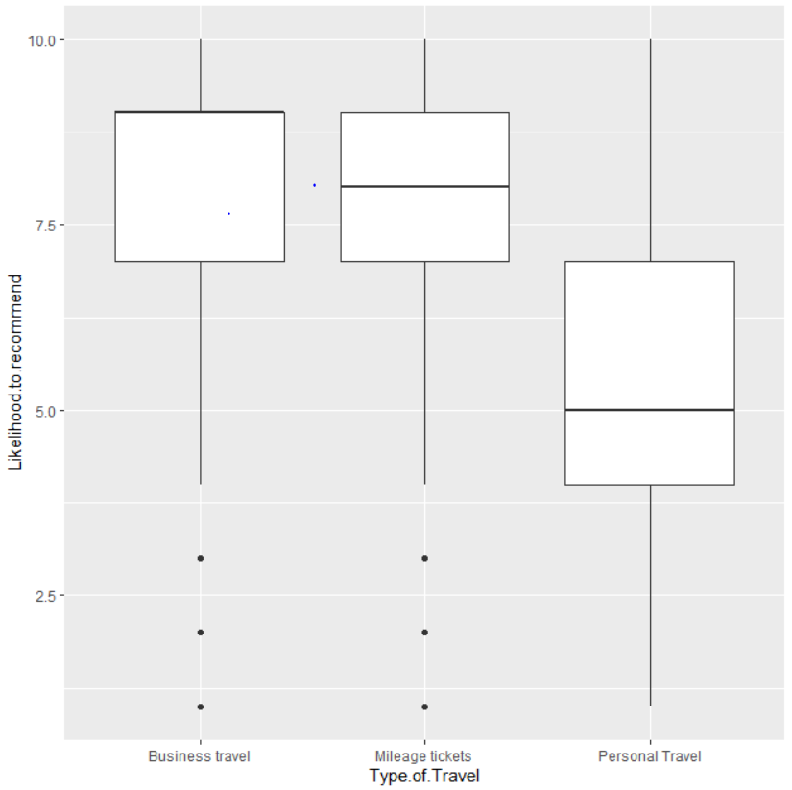
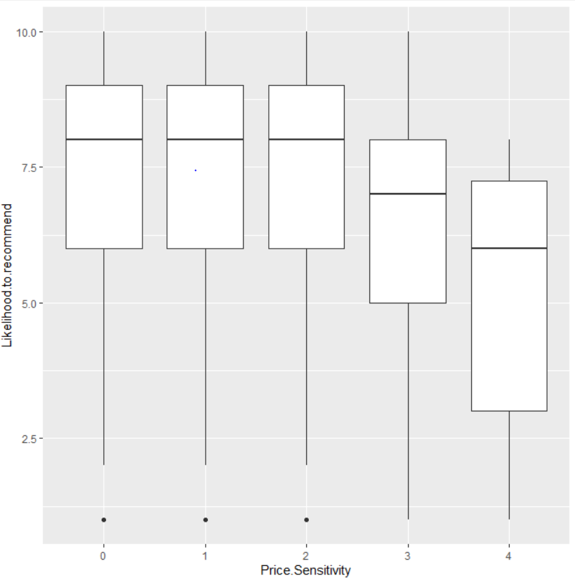
Explanations for peak in low nps scores
To explain the Low NPS scores in the previous diagram, the spread of passengers in the basis of type of travel and Airline Flyer Status are visualized.
In the top diagram, 50%(2200/3041) passengers travelling for personal reasons and provide a score of less than 5.
Hence, low – cost airline packages or coupons can be offered for passengers who generally travel for personal reasons.
In the below diagram, the customers who are not affected by price of an airline service provide high nps scores. Customers who find south east expensive provide lesser scores.
Since, a majority of customers (10000/10282) are unaffected by prices, the company can increase the cost of services by a small factor to increase net profits.

Slide 6
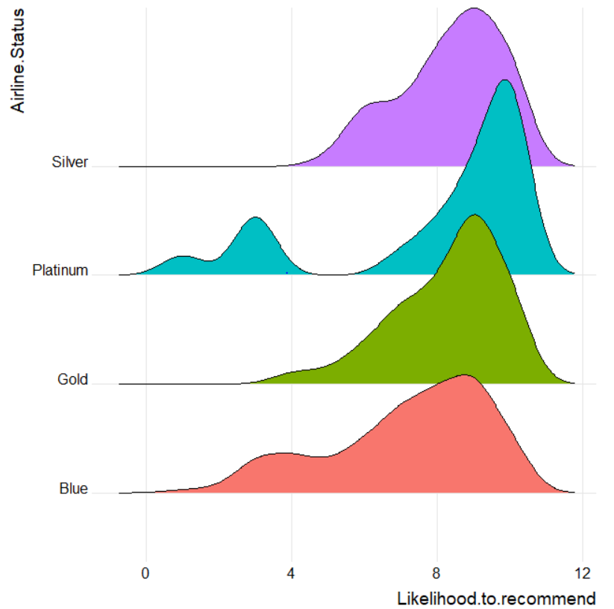
Customer sentiments – passengers with 100% loyalty
The ridge plot explains that there is a spike of low scores(NPS <4) for Passengers with “Platinum” status.
Most Loyal Customers(600/10392) with platinum status are unsatisfied.
“Platinum” is the highest Flyer Status. Policy plans and offers must be reviewed to detect fallacies and comparisons with platinum packages offered by competitor airlines can be conducted

Slide 7
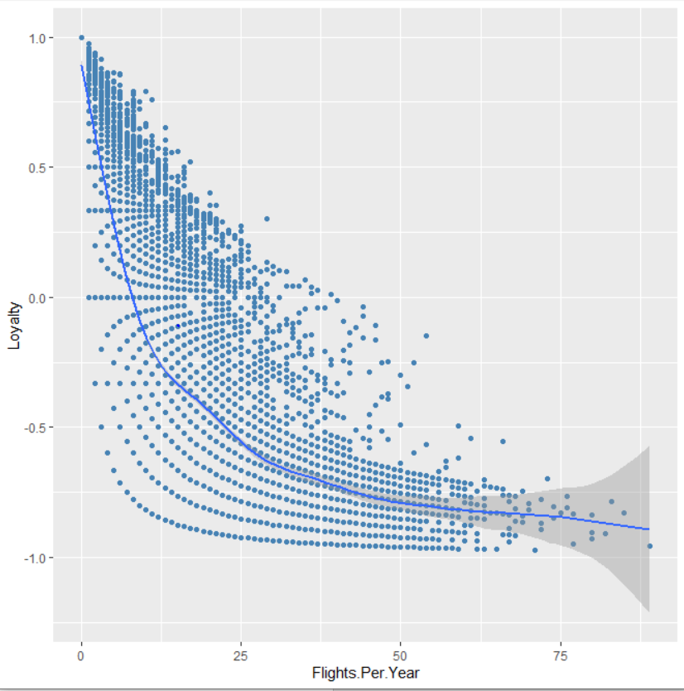
Loyalty of Customers
If the loyalty rate of a customer increases(closer to 1), he is more likely to use the services of the airline or it’s partners.
In this figure, a negative power curve indicates as a customer takes more flights in a year the loyalty decreases and vice-versa.
Hence, less frequent flyers ( according to year) can be targeted by the airline. They should be provided with lucrative deals and offers to be more loyal customers while keeping competitors in check.

Slide 8
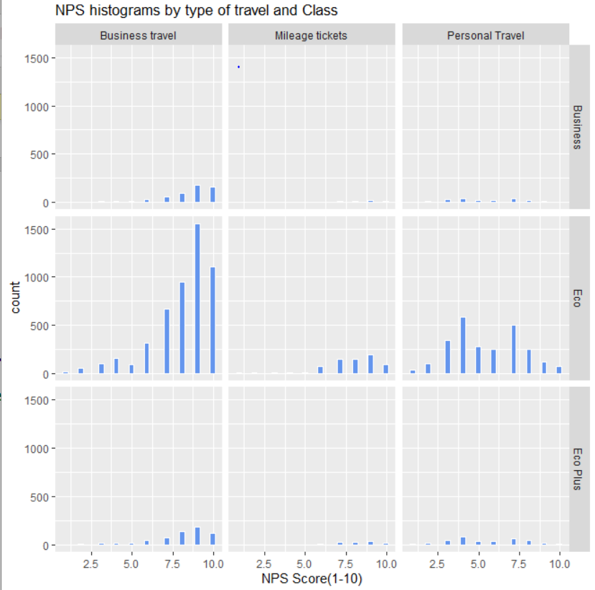
Are there any patterns in NPS score, when two or more customer Metrics are brought into consideration?
In this fig., the count of passengers are visualized by type of travel and class.
Maximum passengers travel in “economy” class for “business” purposes. The distribution indicates, these customers are highly satisfied with services of the airline
In the previous boxplot, it had been noticed passengers who travelled for personal reasons were unsatisfied.
This fig, indicates a high proportion of these passengers travel in the economy class.
Therefore, to gain NPS scores for these demographic of people certain discount offers or mileage tickets can be introduced in lucky draws. Ticket prices can also be decreased.

Slide 9
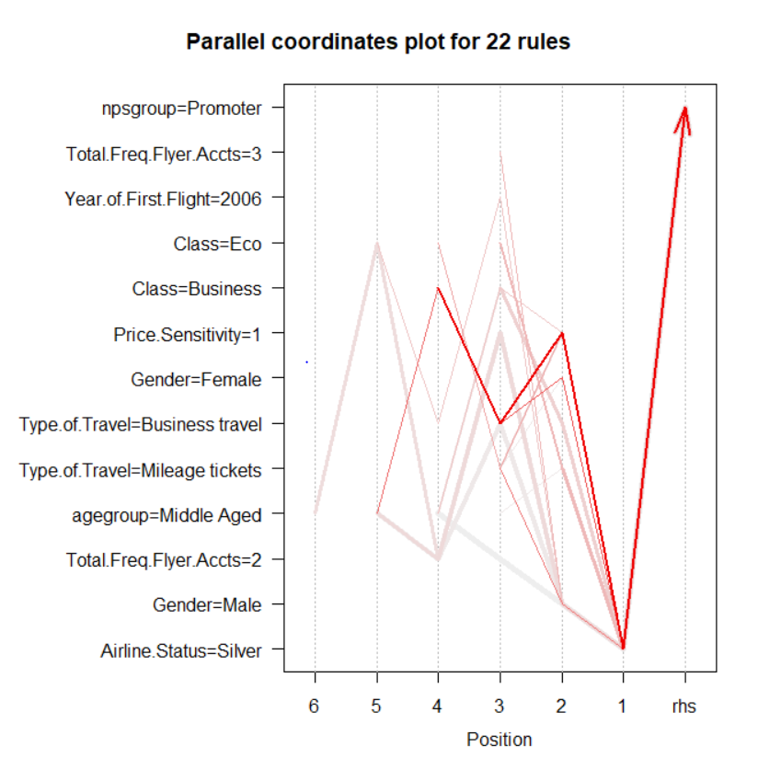
Data mining - PROMOTERS
Data is trained in a data mining model and valuable trends are discovered through Machine Learning
For the promoters, the dark red line indicates the trend that is most likely to occur given the dataset.
If a passenger travels in “business class for a business travel, is not sensitive to price and Airline status is sliver” is most likely to be a promoter.
Therefore, upper middle class corporate employees can be targeted by the marketing team

Slide 10
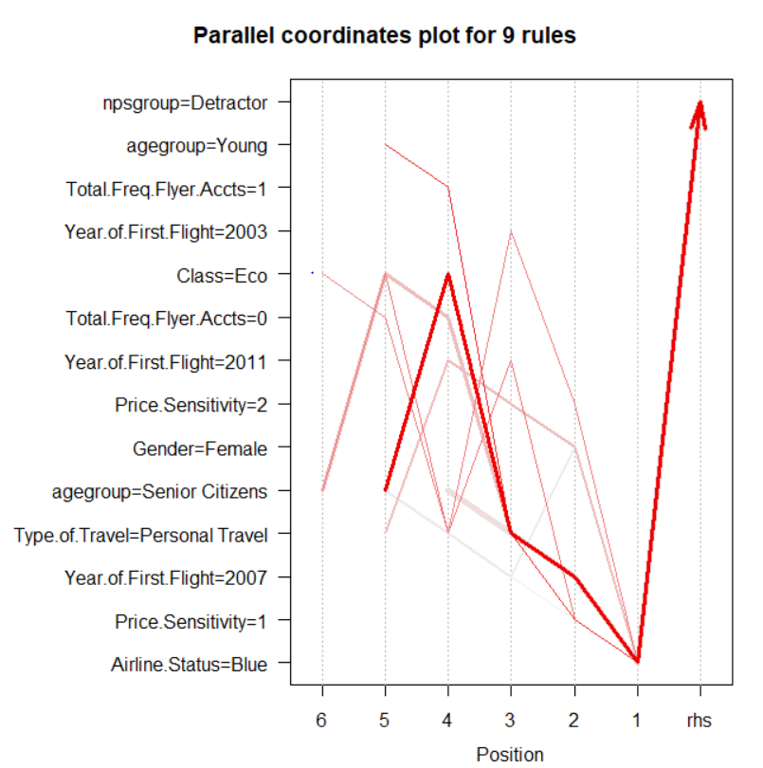
Data mining - Detractors
For the detractors, the dark red line indicates the trend that is most likely to occur given the dataset.
If a passenger is a senior citizen (60-80 years) flying in economy class(airline status = Blue) for personal reasons. The passenger is most likely to be a detractor.
Therefore, the previous visualizations have now been validated by the apriori model
In the previous slides, it was proven, that a passenger with blue airline status or travelling for personal reasons or in economy class have low NPS scores.
Furthermore, a senior citizen is also highly likely to be a detractor

Slide 11
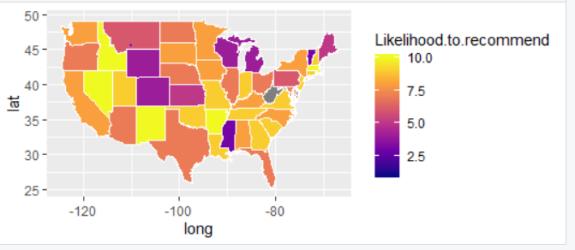
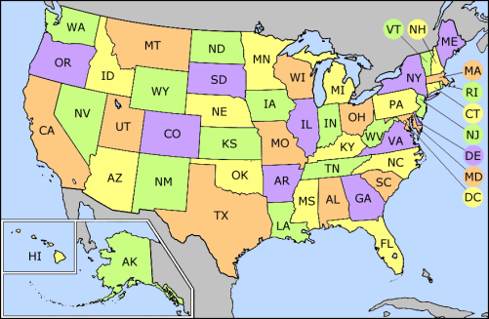
Statewise comparison of nps
In the above map, the states marked in violet have low NPS scores while those marked in yellow have high NPS scores.
Wyoming, Colorado and Kansas are the most unsatisfied in the central region(region in purple). While the neighboring states of Idaho, Nevada and New Mexico have the highest NPS.
This can indicate the fact that neighboring states often share a mutual dislike towards each other and often these dislikes affect customer sentiments.
Therefore, niche marketing plans should be implemented for these low NPS states to generate quality leads.

Slide 12
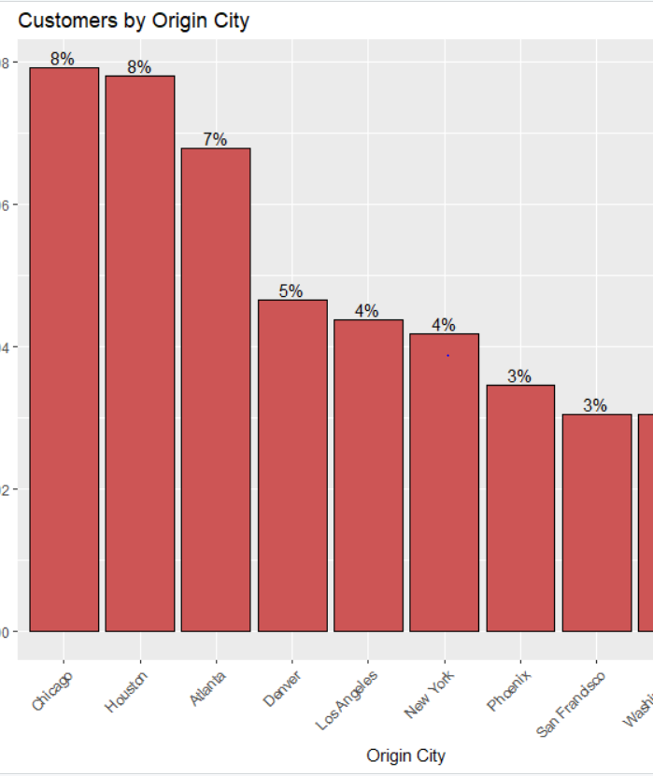
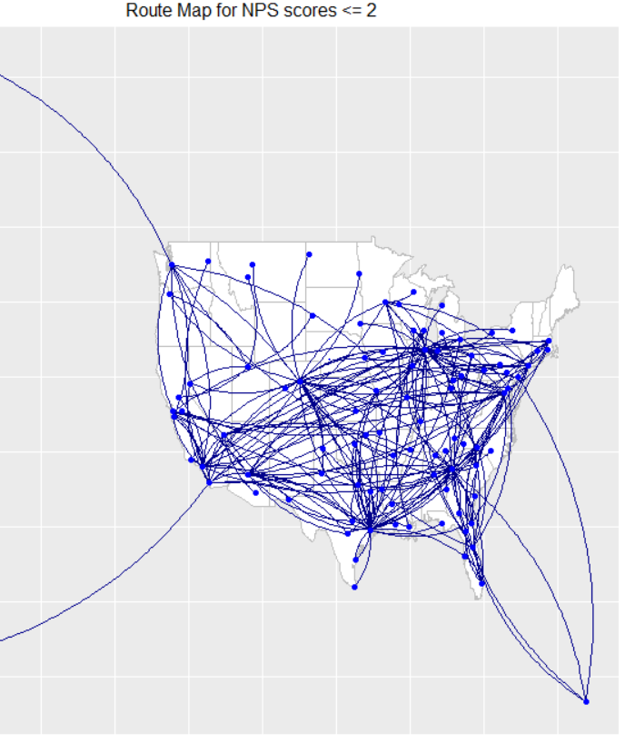
Low Satisfaction routes and map
The US map shows the flight routes for NPS scores less than 2.
The northwest region has low routes. Therefore passengers with flights originating in northwest USA are happier.
The east region has high number of routes, indicating customers are not satisfied as compared.
On the left, the cities with highest NPS scores are sorted in descending order.
The Customers in Chicago, Houston and Atlanta (Tri-City) are the most unsatisfied.

Slide 13
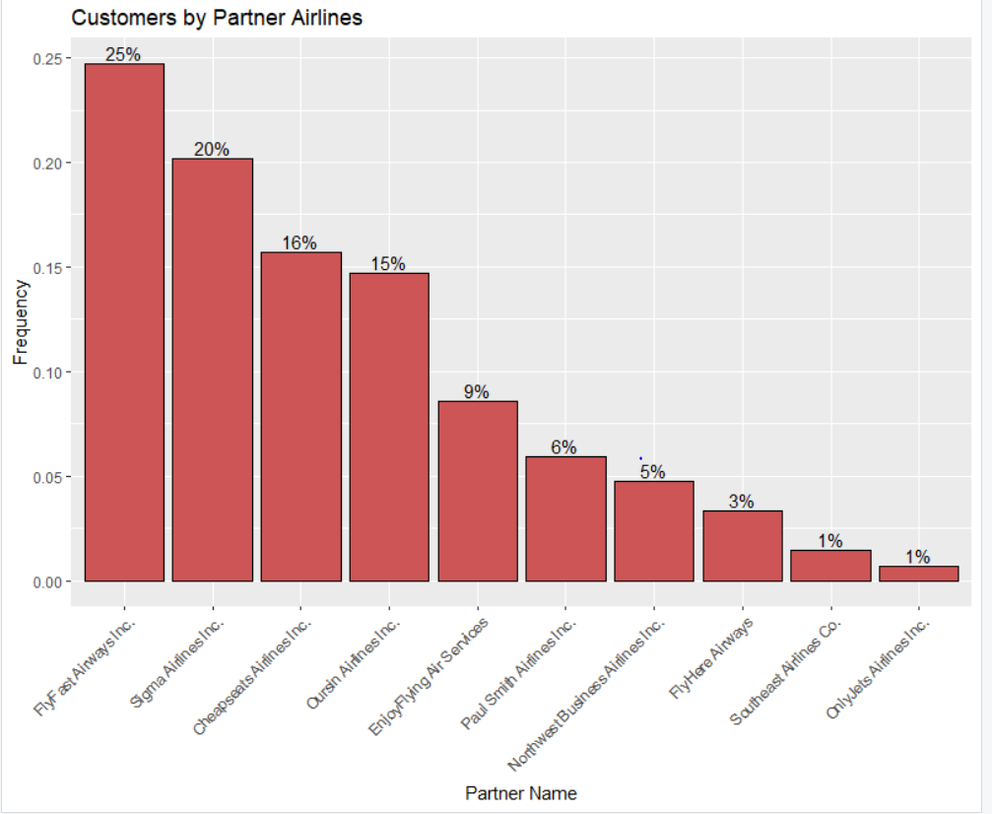
Partner airlines for low satisfaction routes (NPS <=6 )
From the entire dataset, it was observed that the Partner Airline – Cheapseats had the greatest number of passengers for any partner airline.
But in this fig., the highest number of passengers(25% of total detractors) who are detractors, travel by the Partner Airline – “FlyFast Airways Inc”, followed by Sigma Airlines in the tri_city area.(Chicago, Houston, Atlanta)
Therefore, the employee output and customer service of FlyFast Airways in these three cities can be improved to gain more promoter leads.

