Slide 1
YCSB
YCSB being a tool to compare the performance of NoSQL databases, we have split our analysis into multiple sections:
Analysis 1: Observing the variation of parameters for the databases by varying the record count each time and summing up the behavior using Latency vs throughput graphs.
Analysis 2: Comparing the parameters of the databases keeping the record count, operation count and number of threads constant.
Analysis 3: Comparing the parameters of the databases at Workload A by varying the number of threads.
Analysis 4: Comparing the effect of varying throughput on read and write latencies of the databases at Workload A.

Slide 2
MONGODB
VS
COUCHBASE

Slide 3
Analysis 1

Slide 4
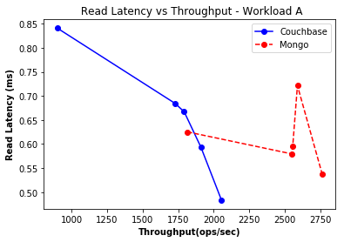
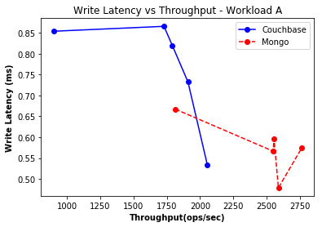
Workload A
The dip in read and write latencies of Couchbase is greater than that of MongoDB for increasing throughput values. Also, for the same value of throughput, the latencies of MongoDB are clearly greater than that of Couchbase. However, since the latency values of MongoDB are more or less constant, the latency remains the same even for low throughput values thus maintaining stable performance for varying throughputs.

Slide 5
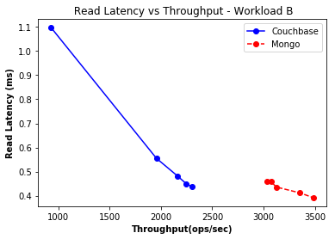
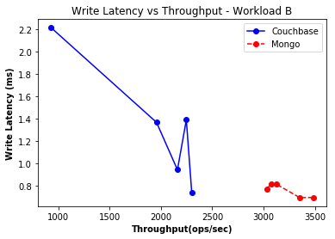
Workload B
There is a steep fall in the latency values of Couchbase with increasing throughput when compared to the gradual fall in the case of MongoDB. This however means that Couchbase performs poorly for low throughput values. While the performance of MongoDB is constant for varying throughput.

Slide 6
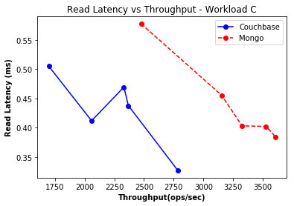
Workload C
Again we see that the read latency of Couchbase is much lesser than that of MongoDB for particular values of throughput (say, 2750 ops/sec in this graph), thus proving the efficiency of Couchbase over MongoDB in reading. This has also been proved later where it is seen that Couchbase has lower latencies when compared to MongoDB.

Slide 7
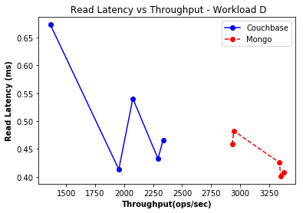
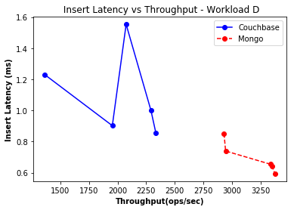
Workload D
We see a steeper decline in latencies in the case of Couchbase initially but it is followed by a steep incline. The decline is steadier for Mongo and continuous. MongoDB gives stable performance at higher throughput whereas couchbase is unstable at lower throughput.

Slide 8
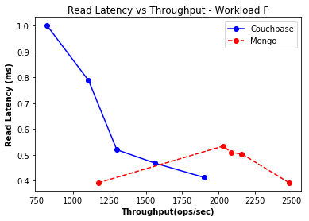
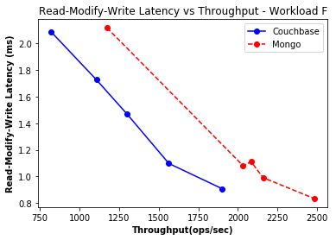
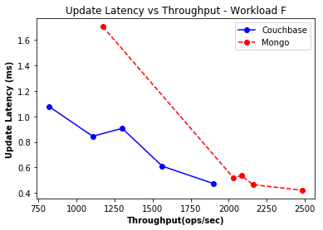
Workload F
Couchbase sees steep decline in case of read latency. Initially MongoDB exhibits better performance but MongoDB sees an increase in read latency and fall in performance. Furthermore, Couchbase has lower modify and write latencies throughout.

Slide 9
Analysis 2
(number of records = 100K)

Slide 10
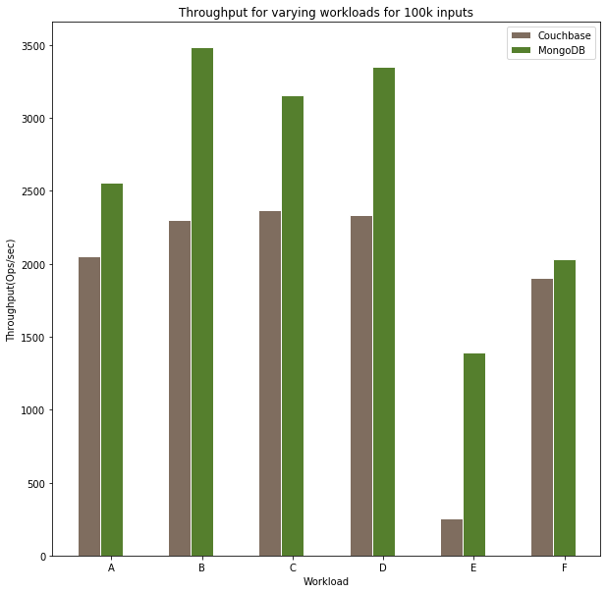
Throughput
Evidently, MongoDB had a higher throughput when compared to Couchbase for all the workloads.
The difference between the throughputs increases gradually from workload A to D before a steep difference is visible at workload E. Couchbase catches up in workload F and the difference is smaller.
MongoDB performs better than Couchbase in this aspect.

Slide 11
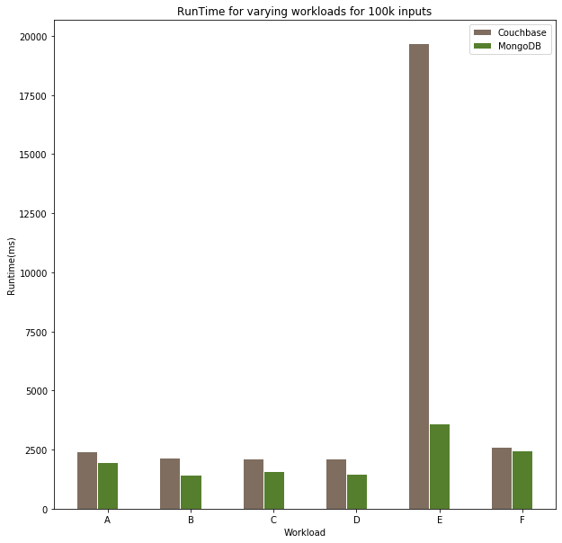
Runtime
Couchbase takes higher runtime than MongoDB for all the workloads.
The time taken to run workloads A-D does not vary much for both the databases. However, Couchbase takes considerably higher runtime when compared to MongoDB for workload E. The runtimes are extremely close for workload F.
Mongo performs better than Couchbase in this aspect as well.

Slide 12
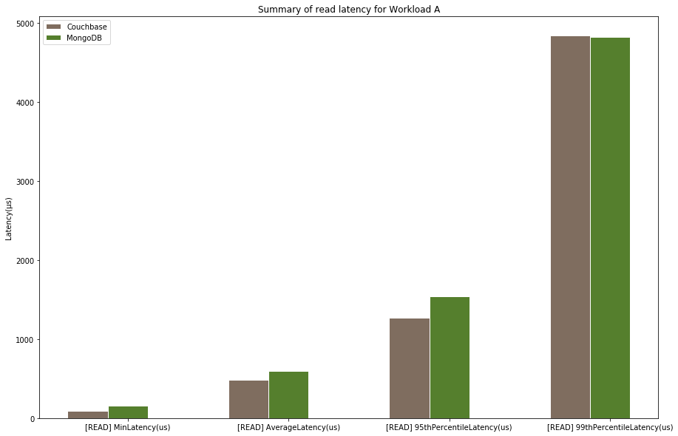
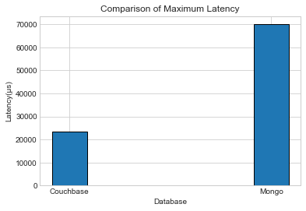
Workload A : Read Latency Plots
The read latencies of MongoDB are slightly greater than those of Couchbase when it comes to average, min, 95th and 99th percentile. The max. Latency in case of MongoDB is significantly higher than that of Couchbase.

Slide 13
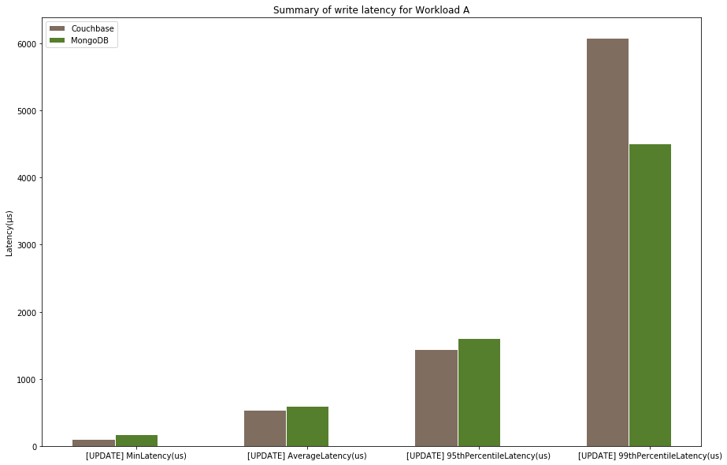
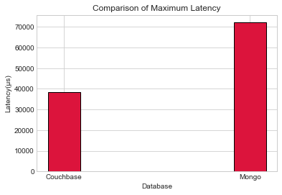
Workload A : Write Latency Plots
The write latencies also show a similar behaviour like the read latencies. MongoDB’s are slightly greater than those of Couchbase when it comes to average, min., 95th. Furthermore, the Max. Latency in case of MongoDB is significantly higher than that of Couchbase. However, the 99th Percentile latency of Couchbase is larger than that of MongoDB.

Slide 14
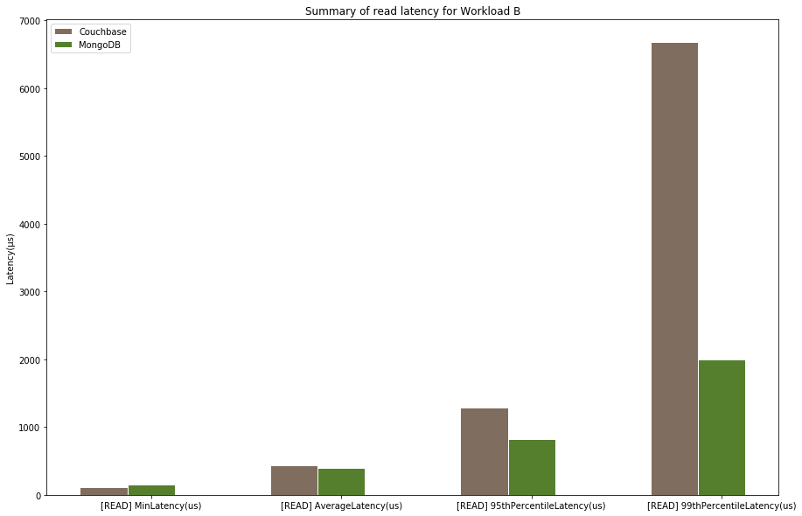
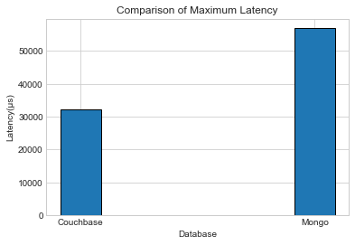
Workload B : Read Latency Plots
The min read latency of MongoDB is greater than that of Couchbase. The latencies grow gradually in the case of MongoDB whereas the latencies grow steeply in the case of couchbase. The average latency , 95th and 99th latency of couchbase are larger. However, the max latency of mongo is considerably larger.

Slide 15
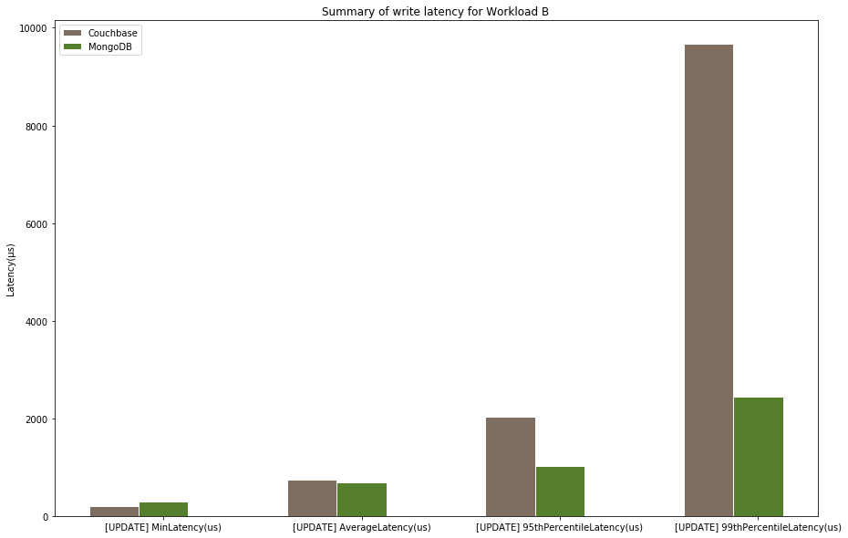
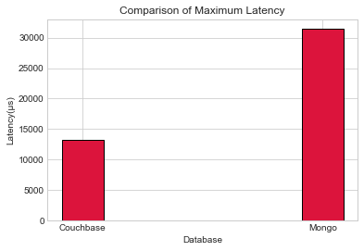
Workload B : Write Latency Plots
The 95th, 99th and min latencies for MongoDB are lesser than those of Couchbase. However the trend for max. latency remains same where that of MongoDB is much higher. Yet note that unlike Workload A the latencies of other parameters are less for MongoDB confirming that MongoDB is more efficient at reading than writing. Yet not as good as Couchbase in terms of latency.

Slide 16
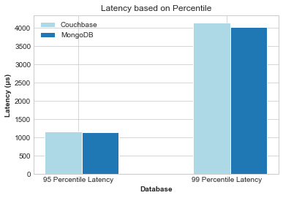
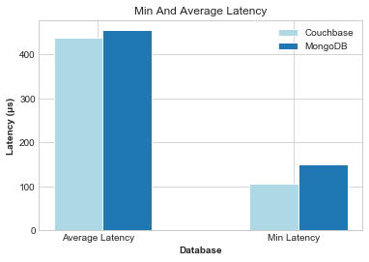
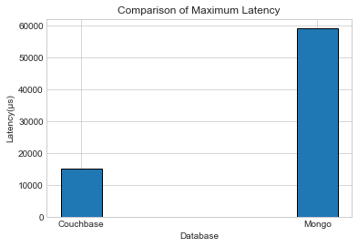
Workload C : Read Latency Plots
Couchbase wins in terms of latency again!

Slide 17
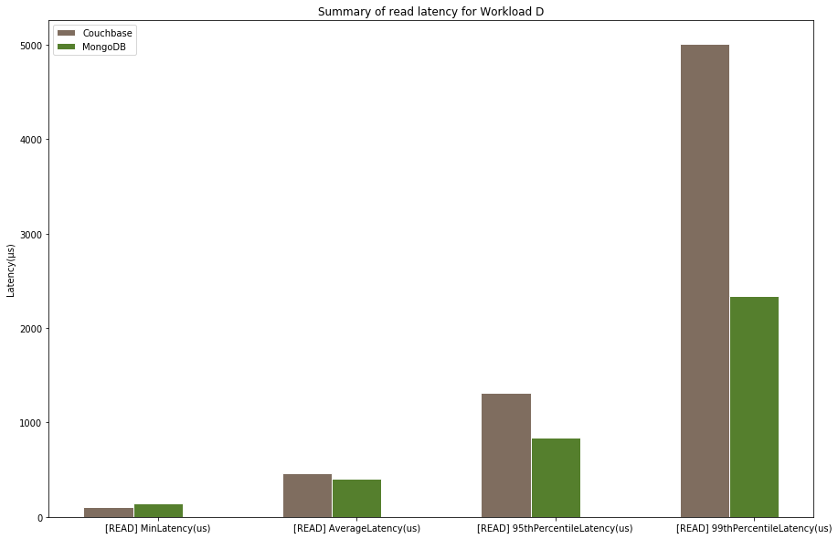
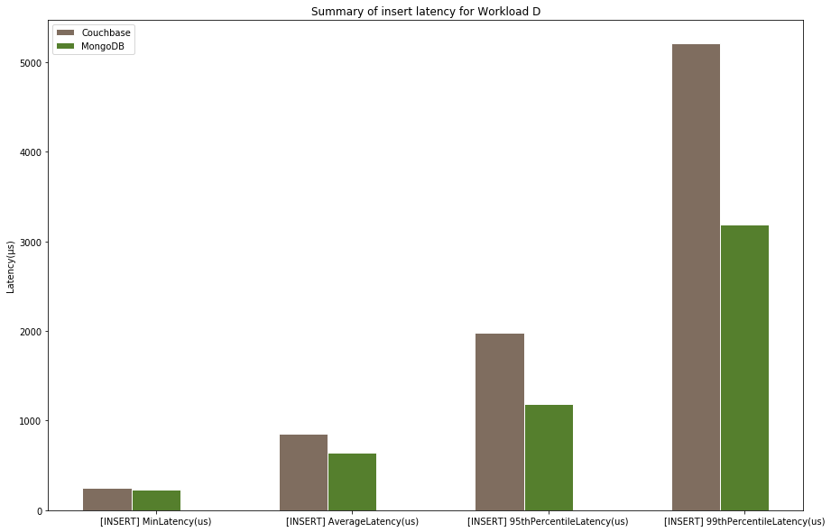
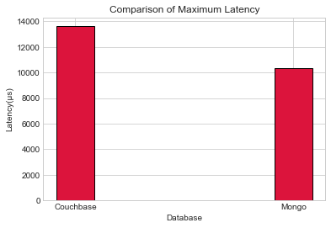
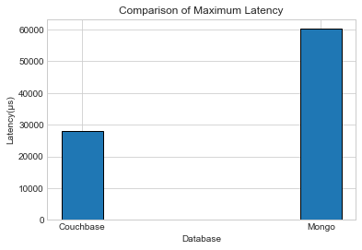
Workload D :
Read and
Insert Latency
Plots
Workload D sees a shift in the recurring pattern of the read latencies. Though the gradual increase of latencies for MongoDB and steep increase for that of Couchbase remains, the maximum latency of MongoDB is less than that of Couchbase for reads in this case. Insert latencies show similar pattern to that of write latencies in workloads A and B but the values are lesser in magnitude which implies both the databases are more adept at inserting than at writing.

Slide 18
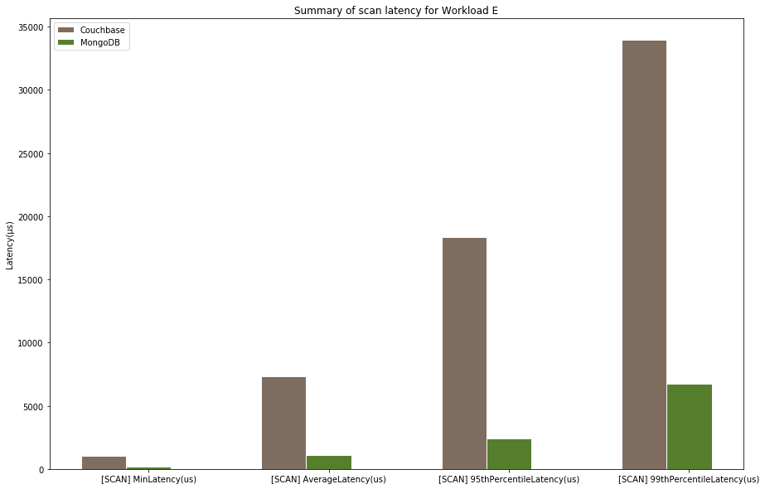
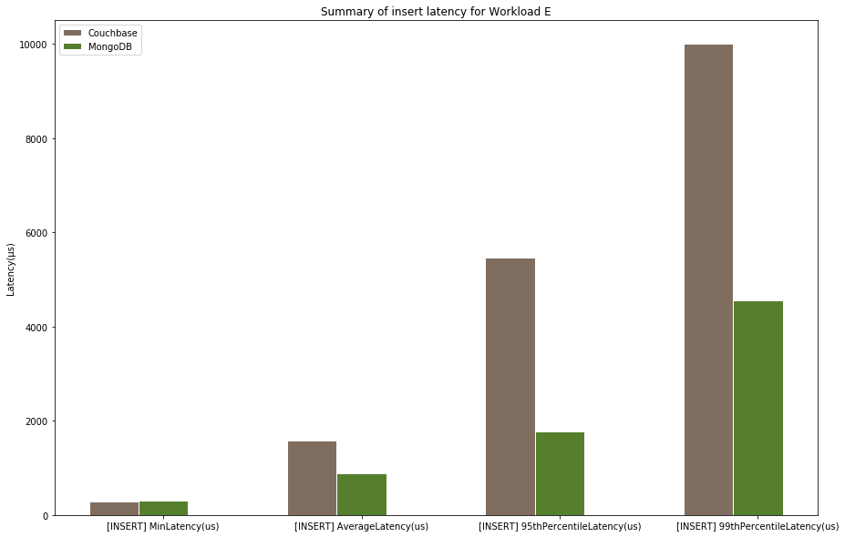
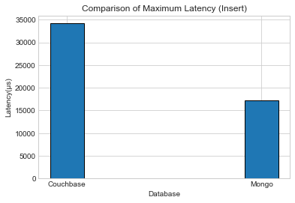
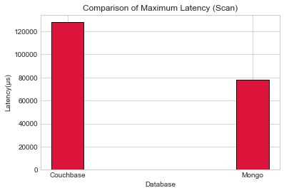
Workload E :
Scan and
Insert Latency
Plots
The above graph for Workload E proves the exceptional efficiency of MongoDB in scanning and inserting records again. Such is the better performance that, the max. latency which was so long higher for MongoDB for the first time turns out to be way lesser than that of Couchbase.

Slide 19
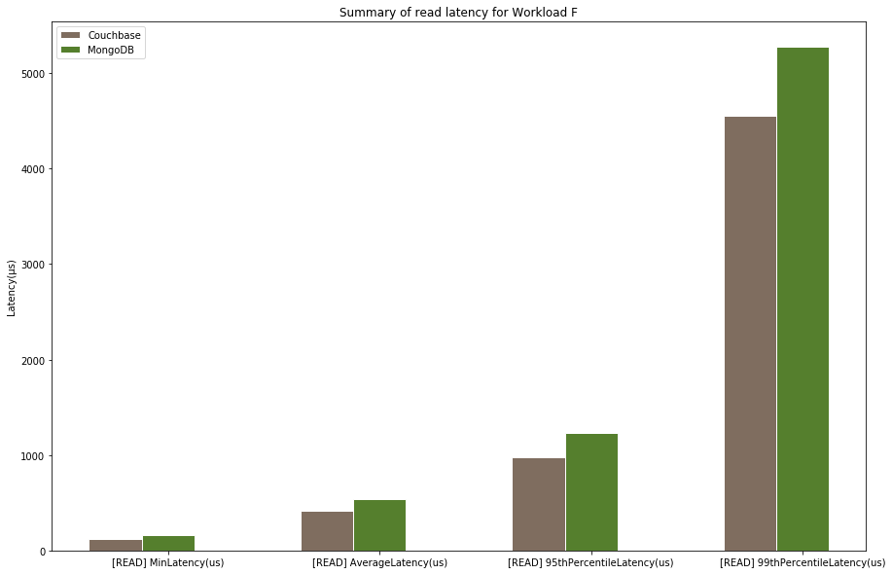
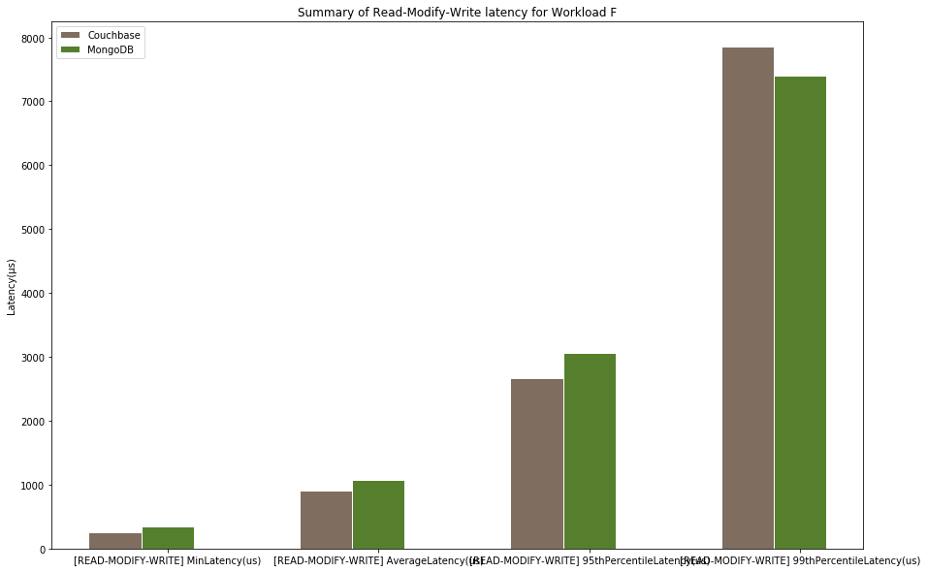
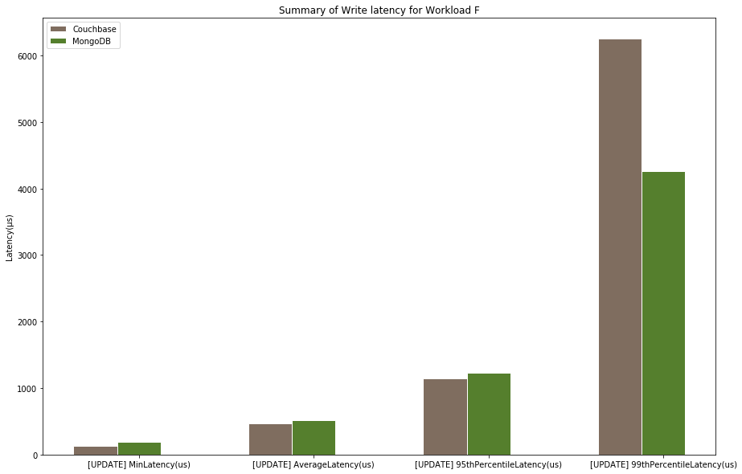
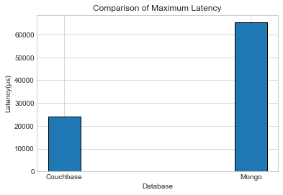
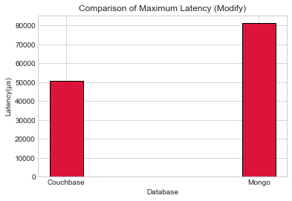
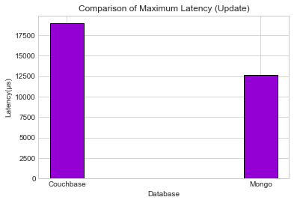
Workload F : Read-Modify-Write Latencies
Read latency of Couchbase is less than MongoDB’s
Write latency of Couchbase is less than MongoDB’s
Update latency of MongoDB is less than that of Couchbase

Slide 20
Analysis 3

Slide 21
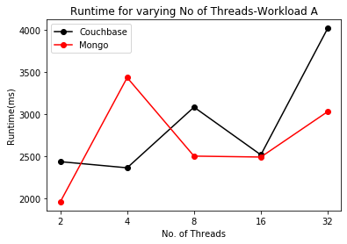
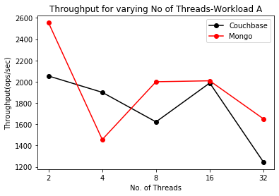
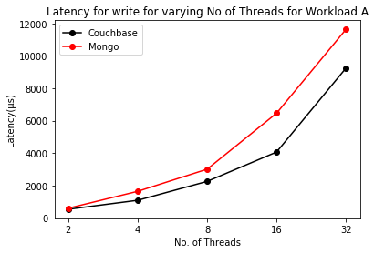
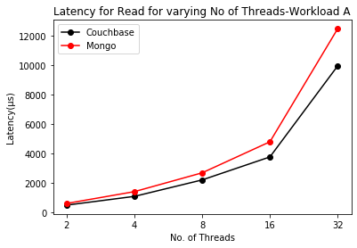
Workload A : Throughput Runtime and Read Write Latencies
for varying number of threads.
MongoDB shows an initial steep increase and steep decrease in runtime and throughput respectively. However, as we further increase the number of threads MongoDB seems to stabilise its performance whereas Couchbase sees steep increase in runtime and steep decrease in throughput.
MongoDB gives better values of runtime and throughput at higher number of threads.
The Average read and write latencies for both the databases are very similar initially. However as we further increase the number of threads, MongoDB’s latencies grow more steeply than those of Couchbase.
Couchbase gives better values of read and write latencies at higher number of threads.

Slide 22
Analysis 4

Slide 23
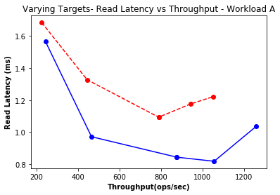
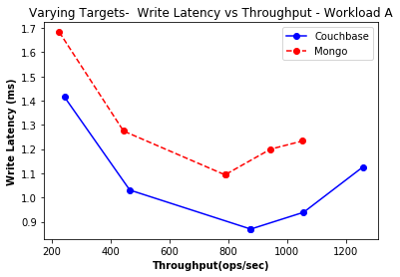
Workload A
This time the “target” parameter was varied to get latency values of both the databases for specific values of throughputs. It is observed that initially the values of the latencies are close but grow apart as the target throughput increase. MongoDB has higher values of latencies throughout.

Slide 24
Conclusion (MongoDB vs Couchbase)
We can draw the following conclusions from all the workloads we have seen so far:
Performance (in terms of throughput and runtime):
Was higher for MongoDB in all the cases
Latency
Read latency of Couchbase is less than MongoDB’s
Write latency of Couchbase is less than MongoDB’s
Update latency of MongoDB is less than that of Couchbase
Scan latency of MongoDB is tremendously less than that of Couchbase
We can conclude that both databases perform fairly good, wherein the high throughput of one makes up for the low latency of the other. However, MongoDB is no doubt a more suitable choice considering its constantly outperforming Couchbase in terms of overall runtime.

