Slide 1
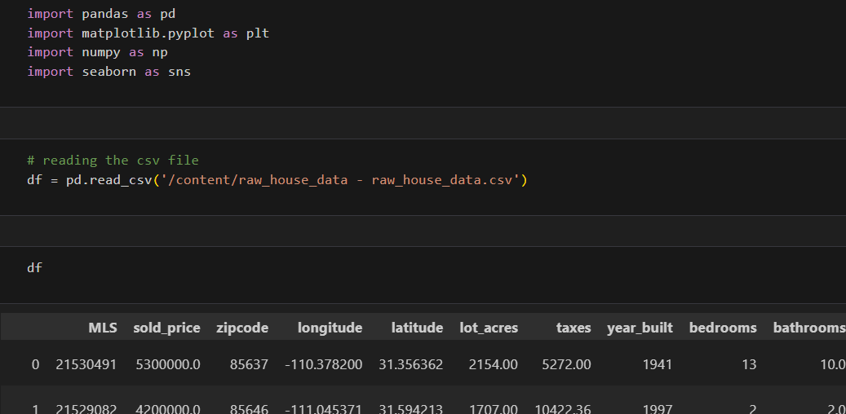
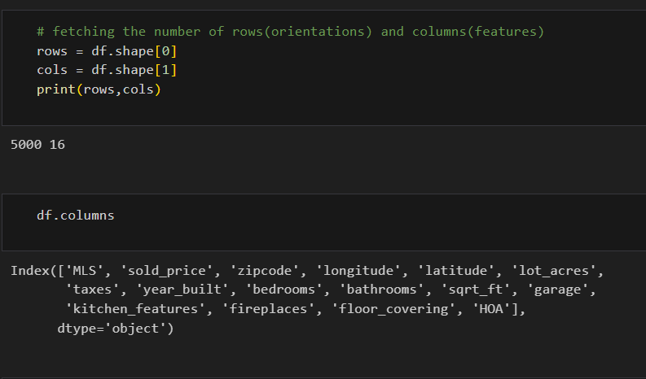
EDA for raw dataset
After reading this raw dataset noticed it has 5000
observations and 16 features. Please find the snapshots
below:

Slide 2
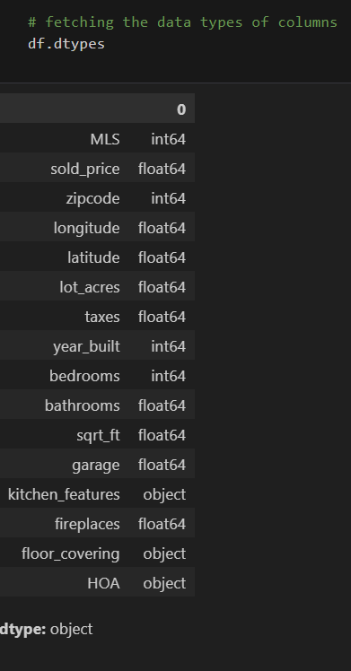
Done the data types analysis and describing the
statistics for more clarity:

Slide 3
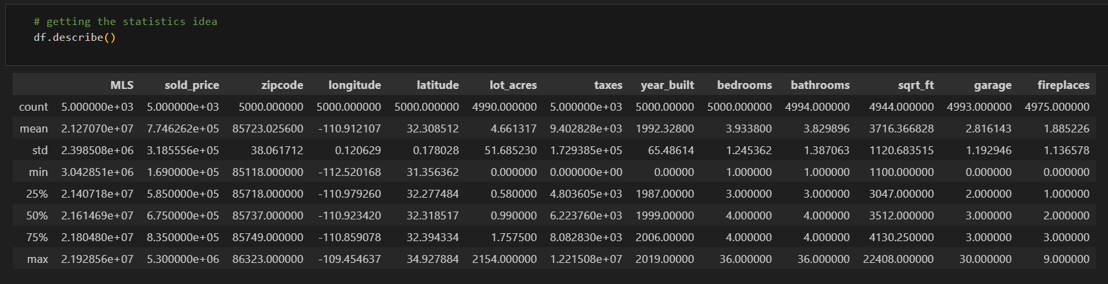
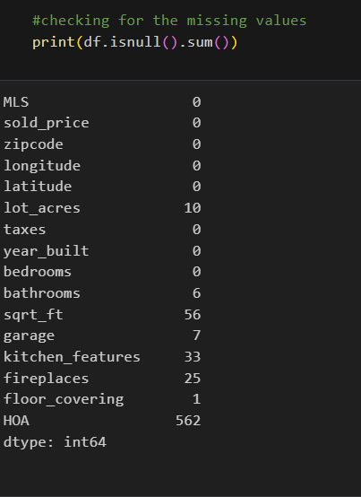
Checking for the missing values:

Slide 4
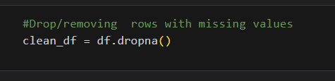
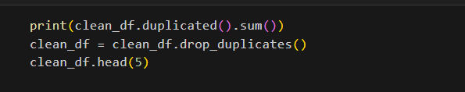
Dropping the rows with missing values:
After dropping missing values, the observations and
features are:
4370 rows × 16 columns
Checked if any duplicate items present, then dropped
the duplicates ones:
For this dataset no duplicate items found.

Slide 5
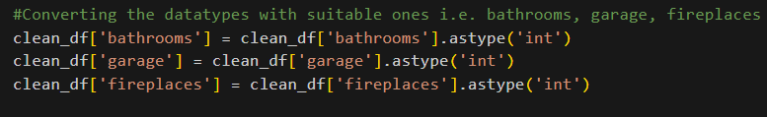
As per my analysis of features, I observed some of
them were not in appropriate data types.
Updated the data types for mentioned features:
Bathrooms (float type to int type)
Garage (float type to int type)
Fireplaces (float type to int type)
Made these changes for further calculation purposes
when needed to increase the efficiency.

Slide 6
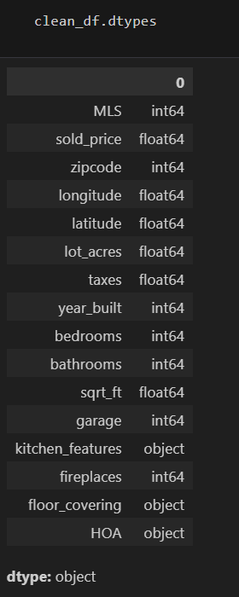
Now after changing the types here is the current data
types for data frame:

Slide 7
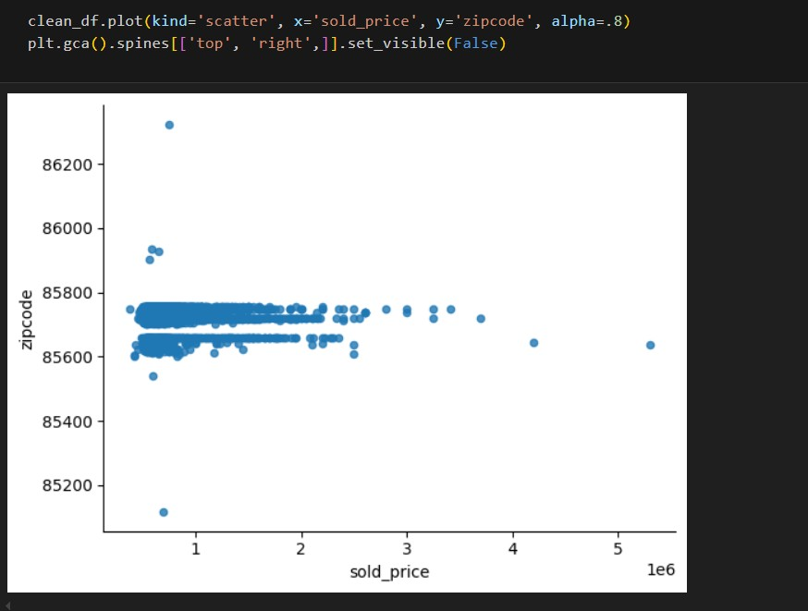
For estimation purpose created scattered graph
between sold_price and zipcode. Which areas has
maximum properties sold. And which among them are
the outlier one.

Slide 8
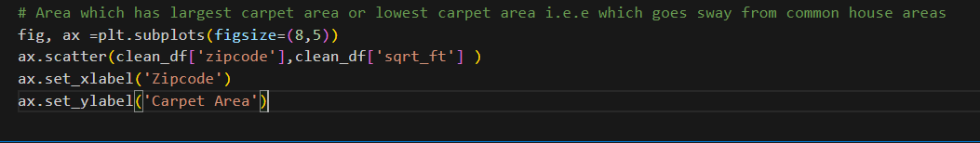
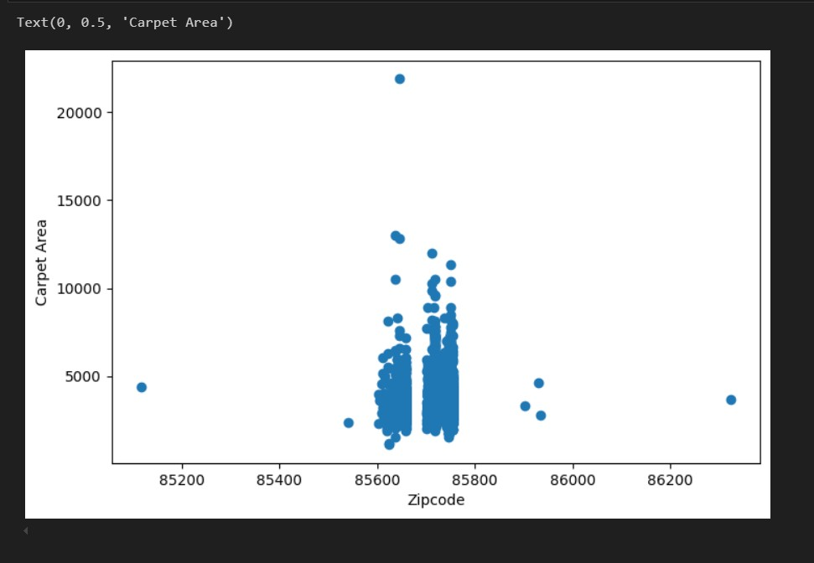
Area which has largest carpet area or lowest carpet
area. To find out which areas has largest carpet area for
selling purposes or investing purposes.

Slide 9
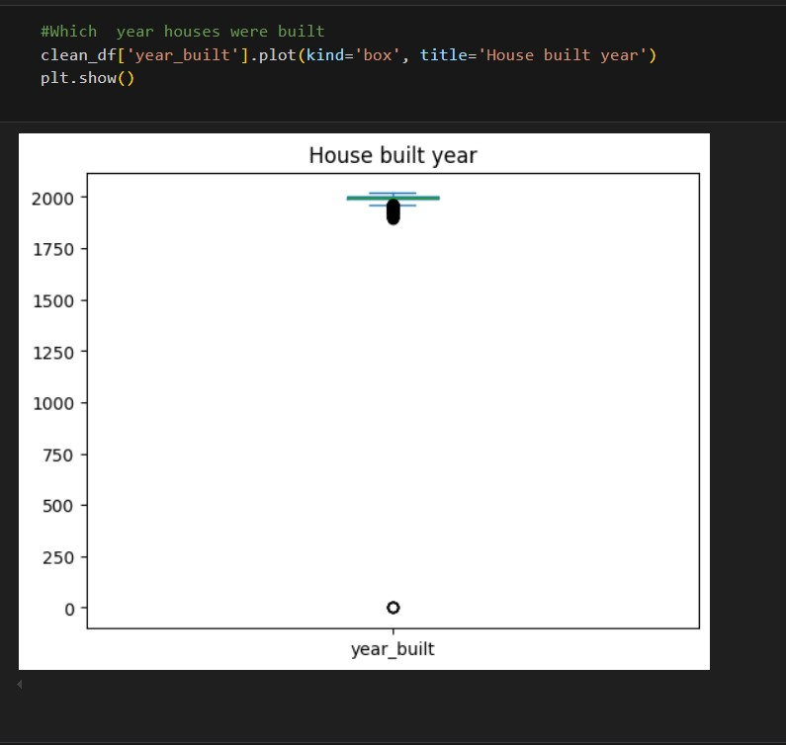
Another box plot chart for estimation of which year the
houses were built majorly:

Slide 10
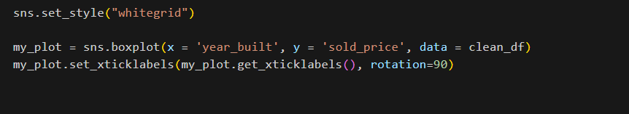
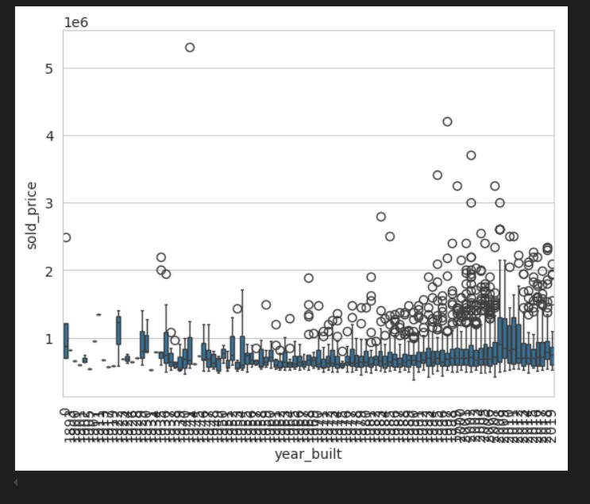
Another box plot chart between sold_price and
year_built , to find out which year had the most people
purchasing the houses.

Slide 11

At the last converted the clean data frame to csv
format and saved it in local.

