Slide 1


SMART INDIA HACKATHON 2025
TITLE PAGE
Problem Statement ID - 25022
Problem Statement Title - Maximizing Section Throughput Using AI-Powered Precise Train Traffic Control.
Theme - Transportation & Logistics
PS Category- Software
Team ID- 50575
Team Name- The Avalanche

Slide 2

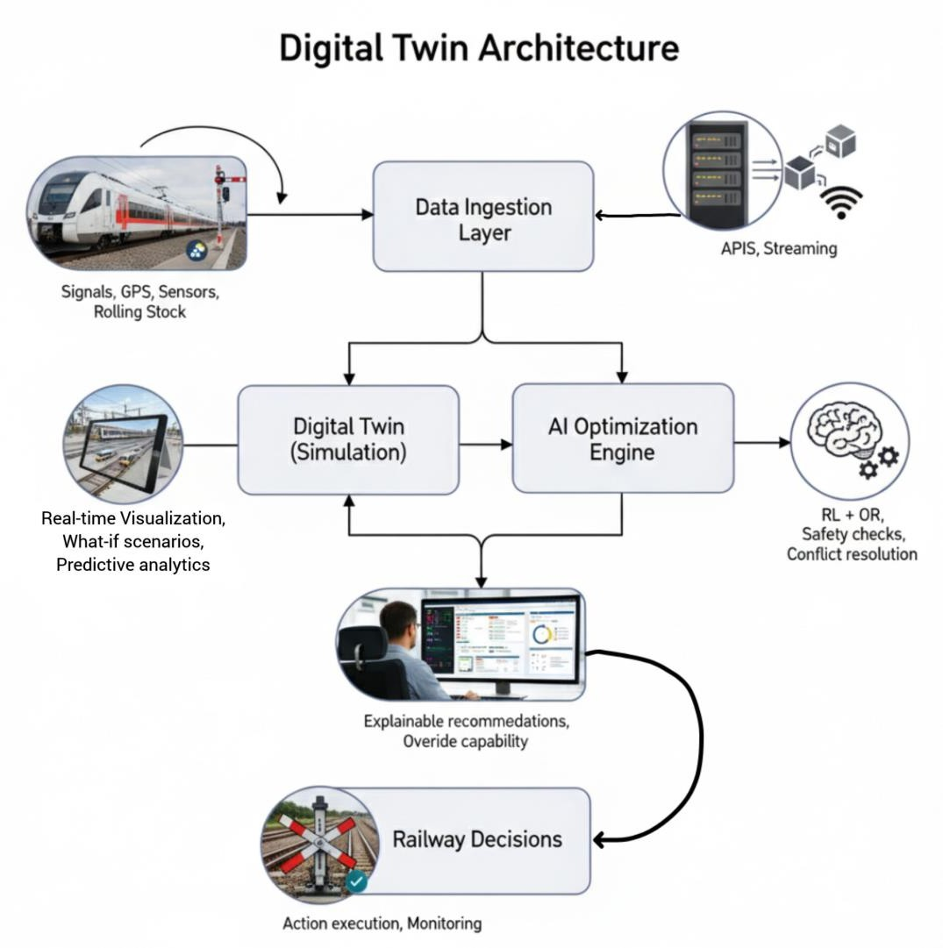
PROPOSED SOLUTION
The Avalanche
RailAnukriti: AI-Powered Smart Train Traffic Optimizer
Decision-Support System as a digital co-pilot for section controllers.
Hybrid AI (RL + OR + GNNs) for real-time train precedence, crossings & platform allocation.
Digital Twin for safe simulation & disruption handling.
Explainable AI: recommendations with why & how, building controller trust.
Adaptive learning from human overrides, delays, and past
disruptions.
Innovation & Uniqueness:
Hybrid Intelligence: Deep RL + Constraint Programming + Graph Neural Networks.
Generative AI-powered Scenario Assistant to simulate alternate plans.
Human-in-the-loop: AI supports, controllers decide → ensures
adoption & trust.
Edge + Cloud AI for <1s responsiveness.

Slide 3
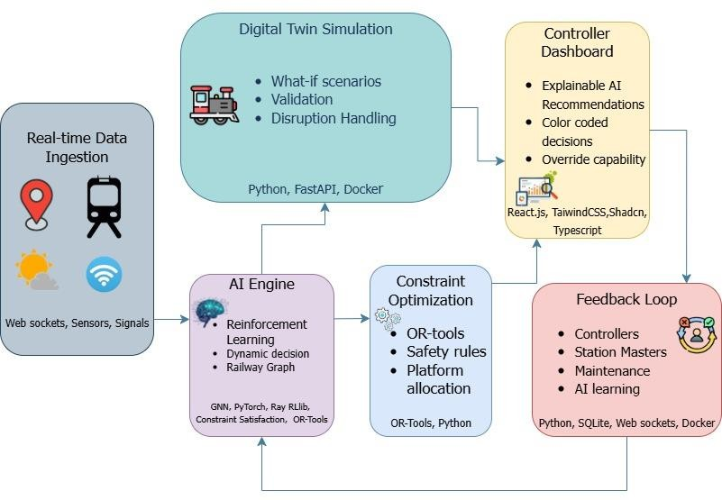
TECHNICAL APPROACH
The Avalanche

Slide 4
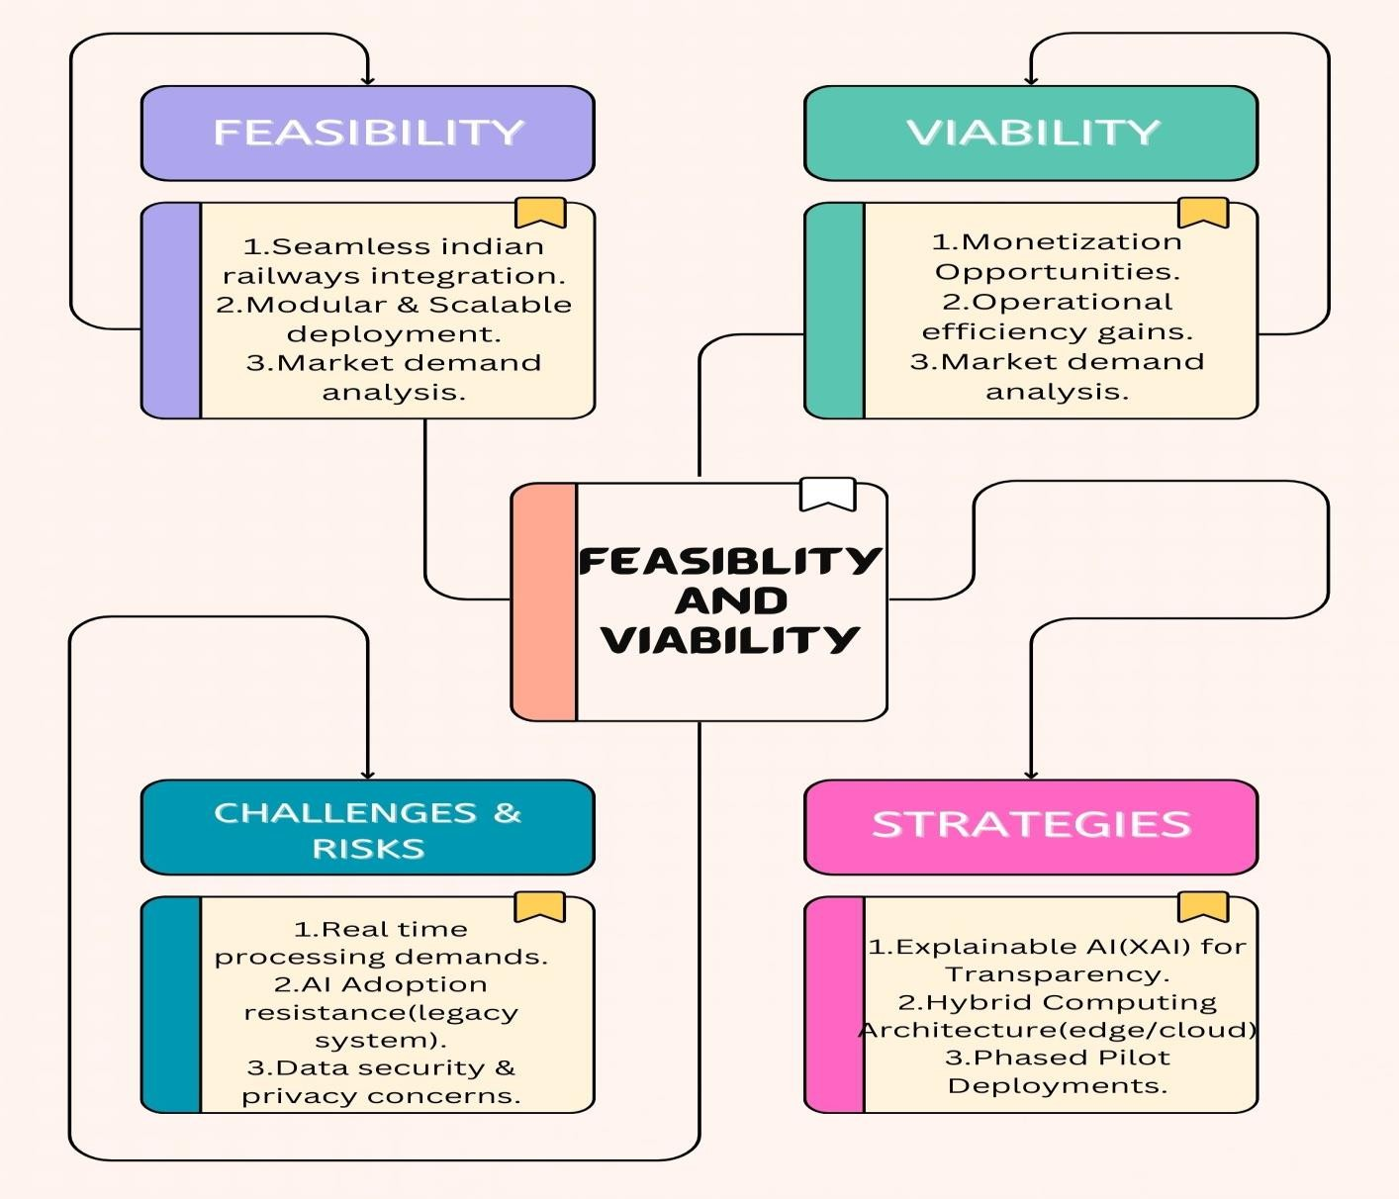
FEASIBILITY AND VIABILITY
The Avalanche

Slide 5
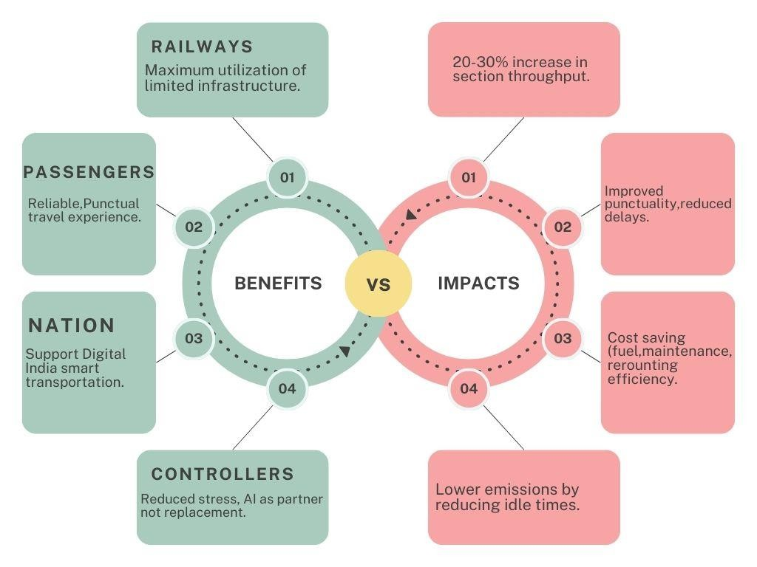
IMPACT AND BENEFITS
The Avalanche

Slide 6
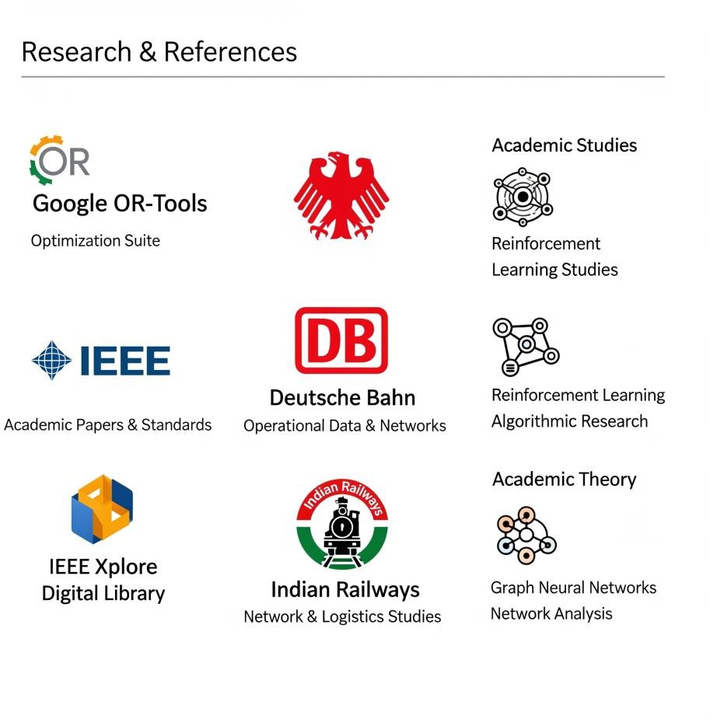



RESEARCH AND REFERENCES
The Avalanche
Google OR-Tools (Combinatorial Optimization).
IEEE 2023 – AI for Train Scheduling under
Uncertainty.
Deutsche Bahn AI Rail Traffic Research.
Indian Railways TMS & Signaling System docs.
Reinforcement Learning + GNN studies
(Elsevier, IEEE).
Youtube link GitHub Repository Live Link
@SIH Idea submission- Template
6

