Slide 1

PROJECT: BATTLE OF NEIGHBORHOODS
WHERE TO OPEN AN ITALIAN RESTAURANT IN MANHATTAN ?
Serkan ONAR, Nov 2020

Slide 2
AGENDA
Introduction (WK4)
Data (WK4)
Methodology (WK5)
Results (WK5)
Discussion (WK5)
Conclusion (WK5)

Slide 3
Introduction (WK4)
With its metropolitan property New York City -mostly spelled as New York- is one of the most popular cities in the world. As a metropolitan, New York hosts people from several nations. About 65.2 millions tourists every year visit New York and its magnificient monuments.
Over 1.3 million Italians and Italian-Americans live in the greater New York metro area, with about 800,000 living within one of the five New York City boroughs.There is even a neighborhood called Little Italy (Italian: Piccola Italia) is in Lower Manhattan in New York City, once known for its large Italian population(Wikipedia:Italian Americans in New York City,Little Italy, Manhattan)
Italian cuisine such as Pizza,Pasta,Fettuccine,Rizotto,Lasagna with aromatic hause wine and a delicious slice of Tiramisu are very famous actors in gastronomy world.Then what about opening a new fine-dine Italian Restaurant in New York , especially in Manhattan, among skyscrappers or near Central Park ? As an investor, where to choose the best location in Manhattan ? (Business problem)

Slide 4
Data (WK4)
Based on the business problem , we need following data ;
1-New York City data including the boroughs, neighborhoods, geographical coordinates.
Data source: https://geo.nyu.edu/catalog/nyu_2451_34572
Description : We will get New York districts (Borough-Neighborhood) table and get geographical coordinates.
2-Polygon file of Manhattan boundaries.
Data source:
https://raw.githubusercontent.com/codeforamerica/click_that_hood/master/public/data/manhattan.geojson (I have modified it a little bit)
Description : We will get Manhattan neighborhood map to visualize potential places.
3-Venue information in each neighborhood of New York:
Data source: Foursquare developer-API
Description : By using this API we will collect all venue information in each neighborhood.

Slide 5
Methodology (WK5)
Borough, neighborhood data to be collected from NewYork Dataset file. (Web scrapping)
Pandas and Numpy library to process the data. (Data wrangling)
Geopy library to be used to collect geographical coordinates , data will be collected, cleaned and processed into a dataframe. (Map visualization)
Foursquare to be used to locate all venues and then filtered by Italian restaurants. Venue , venue coordinates, venue categories to be extracted and added to the dataframe. (Working with API)
Scikit-learn library to cluster venues data. (Machine learning)
Folium library to be used to visualize the neighborhood,venue,clustering data. (Map visualization)
Matplotlib library to be used to visualize restaurants data-statistical approach. (Data visualization)

Slide 6
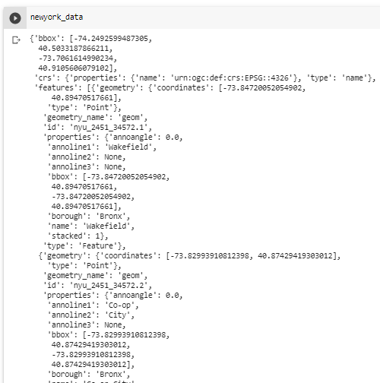
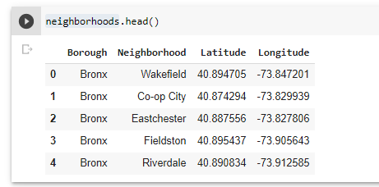
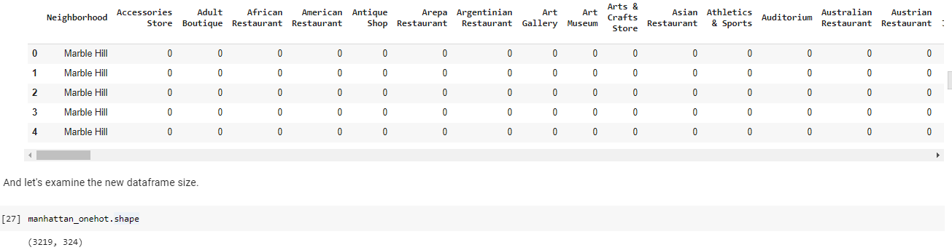
Results (WK5)
Borough, neighborhood data to be collected from NewYork Dataset file. (Web scrapping)

Slide 7
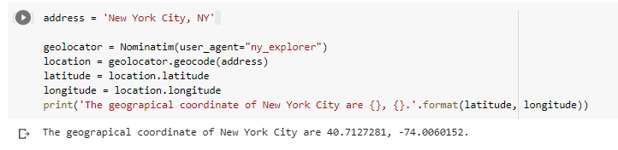
Results (WK5)
Geopy library is very useful collect geographical coordinates

Slide 8
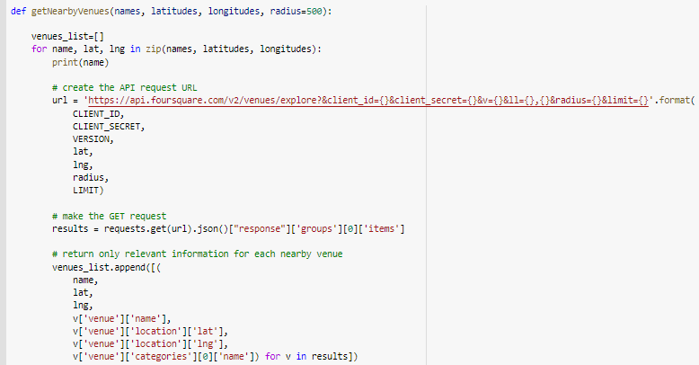
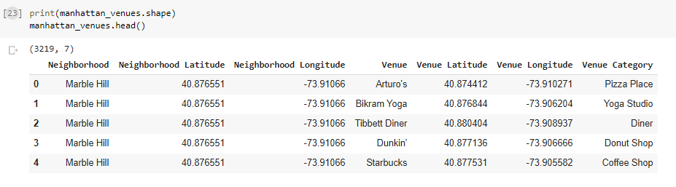
Results (WK5)
Foursquare API usage.

Slide 9
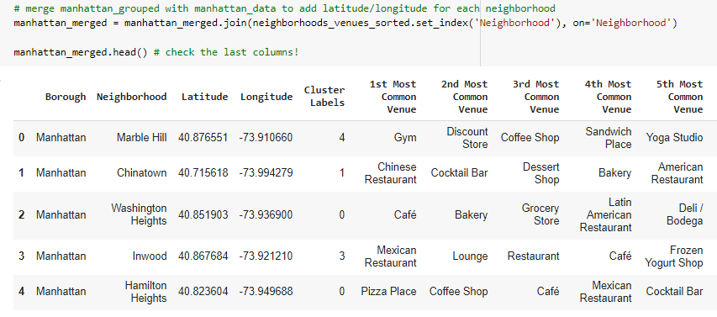
Results (WK5)
Scikit-learn library to cluster venues data. (Machine learning). Clustering of neighborhoods which have similar characteristics.

Slide 10
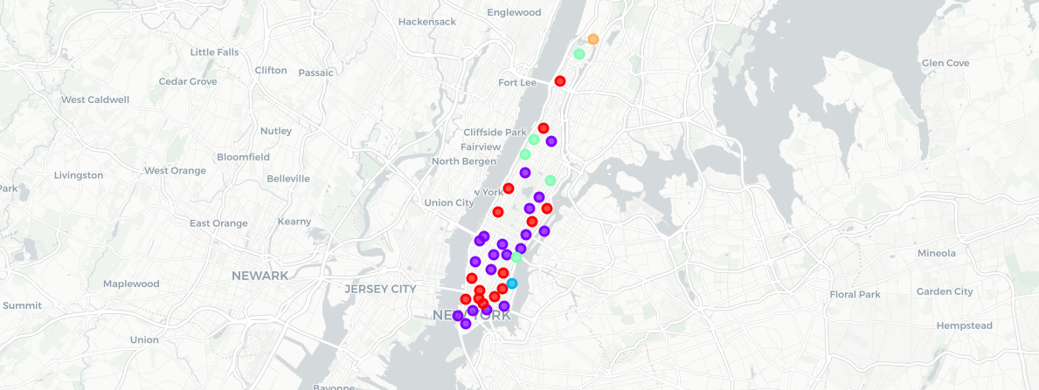
Results (WK5)
Cluster1
Cluster2
Cluster3
Cluster4
Cluster5
Machine learning algorithm does process clustering of neighborhoods which have similar characteristics. Folium to visualize cluster data.
Based on the defining categories, I assign Cluster 1 as 'Restaurants Area'.

Slide 11
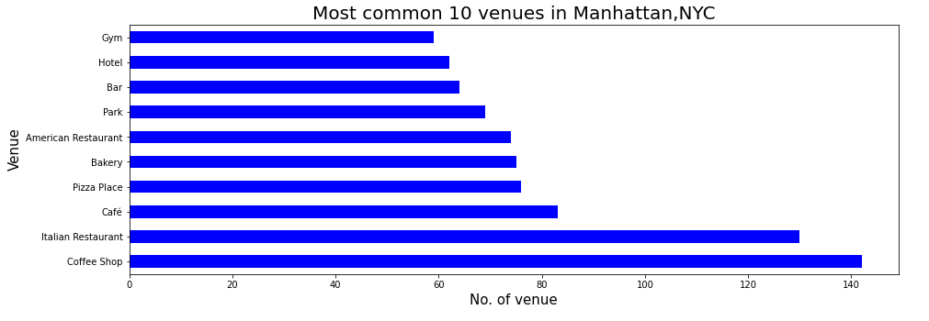
Results (WK5)
This chart gives us the idea of Italian Restaurant investment is a good option. It’s the 1st most common in restaurants category and 2nd most common among all venue categories in Manhattan.

Slide 12
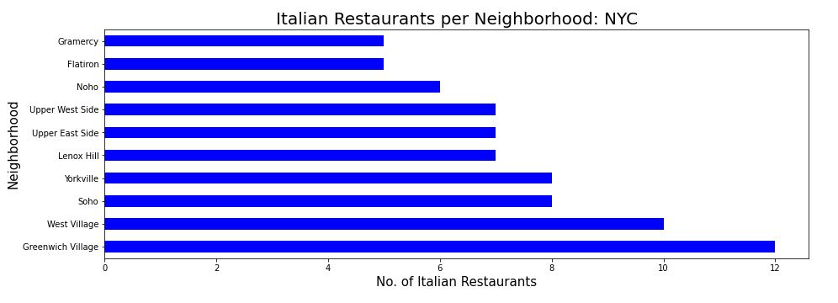
Results (WK5)
This chart support our decision for Cluster1 area. Most of Italian restaurants are located in Cluster 1 areas (Greenwich Village, West Village, Soho, Yorkville)

Slide 13
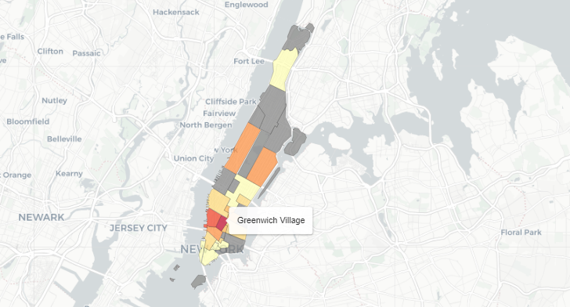
Discussion (WK5)
Based on result of my analysis, I would strongly suggest following neighborhoods for new investment : Greenwich Village, West Village, Soho, Yorkville
Which one of the neighborhood to choose can be chosen according to other criterias such as rental prices, transportation opportunities etc. In this project rental prices or other investment costs is not considered.
South regions would be a better option as tourist population is higher in these areas. Customer rating and other foursquare features can be useful in selection.
Although I have modified the geojson file, it still needs further studies. Some of neighborhoods are not visible to user or does’t match with JSON file. (For ex: Lenox Hill)
Potential restaurant locations are with darker fill color.

Slide 14
Conclusion (WK5)
In this project I have studied an investment opportunity in Manhattan by using data and data science methods. To provide a better visibility I have reflected the data to map.
With much more data from other external databases or data sources , study can be expanded with other criterias specified in discussion section Whole process can be combined with decision making techniques.
At the end of the day, playing with data and learning different techniques is very exciting. Thanks to data providers and reviewers of this project.
Please feel free to give your feedback.

