Slide 1
Doctors Referral Breakdown
Full dataset (2,472 rows) | Threshold: >5 referrals

Slide 2
Executive Summary
A focused group of consistently active doctors (>5 referrals) drives most volume.
The 5 group represents a broad, low-volume base for targeted engagement.
Standardized facility names improve reporting clarity and reduce fragmentation.

Slide 3
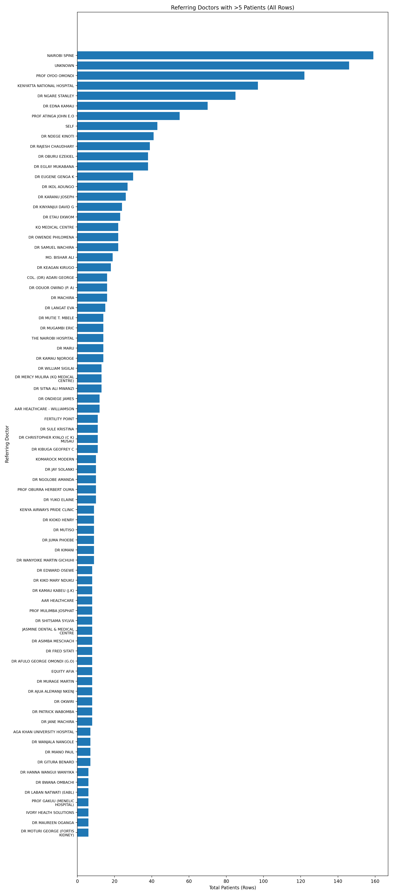
Doctors with >5 Referrals

Slide 4
Active Doctors (Sample)
Referring Doctor | Total Patients (Rows)
NAIROBI SPINE | 159
UNKNOWN | 146
PROF OYOO OMONDI | 122
KENYATTA NATIONAL HOSPITAL | 97
DR NGARE STANLEY | 85
DR EDNA KAMAU | 70
PROF ATINGA JOHN E.O | 55
SELF | 43
DR NDEGE KINOTI | 41
DR RAJESH CHAUDHARY | 39
DR OBURU EZEKIEL | 38
DR EGLAY MUKABANA | 38
DR EUGENE GENGA K | 30
DR IKOL ADUNGO | 27
DR KARANU JOSEPH | 26
DR KINYANJUI DAVID G | 24
DR ETAU EKWOM | 23
KQ MEDICAL CENTRE | 22
DR OWENDE PHILOMENA | 22
DR SAMUEL WACHIRA | 22

Slide 5
Remaining Doctors (5 Referrals)
Doctors in remaining group: 481
Total patients (rows) in remaining group: 764
Use targeted outreach to move doctors above the >5 threshold.

Slide 6
Recommendations
Prioritize retention of consistently active referrers.
Segment low-volume referrers by facility or specialty for tailored support.
Track monthly transitions across the >5 threshold to measure engagement impact.

