Slide 1
Online Book Store System
Presented By: 1.Priyanka Satpute.
2.Meghana Sonawale.
3.Jagruti Patil.
4.Sanika Keni.
5.Sonali Thule.
6.Ankita Dalvi.
7.Sneha Mokal.
Guided By: Pooja Mehta.

Slide 2
Contents
Introduction/ Objective.
Existing vs Proprosed System.
Software and Hardware Requirement.
Introduction About Software.
Modules.
Rest API.
Back End And Frond End Connection.
Diagrams.
Screenshots.
Conclusion.

Slide 3
Introduction
Online bookstore project can manage all the working of Online shopping website and it also manage the back office process whenever we buy books online
The main objective of the project is to create an online book store that allows users to search and purchase a book based on title, author and Category.
The Administrator will have additional functionality when compared to the common user. Admin can add, delete and update the author, book categories.

Slide 4
Existing vs proposed system
Existing system | Proposed system
Amazon | To get the knownledge and to develop my skills I had develop this system. In this system only admin can add,delete,update and store the details of books.

Slide 5
Requirements:
Hardware requirement:
Software requirement:
Processor: | Core i3 or more
RAM: | 2GB
Hardisk: | 60GB
Input device: | KEYBOARD,MOUSE
Output device: | MONITOR
Operating system: | Windows 10
Language: | Java
Front-end: | Angular,html,css
Back-end: | Mysql

Slide 6
Introduction about software
Eclipse:
The Eclipse IDE is famous for our Java Integrated Development Environment (IDE), but we have a number of pretty cool IDEs, including our C/C++ IDE, JavaScript/TypeScript IDE, PHP IDE, and more.
Spring:
The Spring Framework (Spring) is an open-source application framework that provides infrastructure support for developing Java applications. One of the most popular Java Enterprise Edition (Java EE) frameworks, Spring helps developers create high performing applications using plain old Java objects (POJOs).

Slide 7
Vs code
Visual Studio Code is a free coding editor that helps you start coding quickly. Use it to code in any programming language, without switching editors. Visual Studio Code has support for many languages, including Python, Java, C++, JavaScript, and more.
Angular is a popular web development platform developed by Google. The Visual Studio Code editor supports Angular IntelliSense and code navigation out of the box.

Slide 8
MySql
MySQL is a database management system.
It may be anything from a to a picture gallery or the vast amounts of information in a corporate network. To add, access, and process data stored in a computer database, you need a database management system such as MySQL Server.

Slide 9
Modules:
Login
Create Book
Search Book
Edit Book
Sale Book
Delete Book

Slide 10
Rest API.
http://localhost:8085/api/book-list
Add new book:
http://localhost:8085/api/add-new-book
Book Get by id:
http://localhost:8085/api/book/1
Count :
http://localhost:8085/api/number-of-books/2
Update :
http://localhost:8085/api/books/2
Delete:
http://localhost:8085/api/book/2
Sale:
http://localhost:8085/api/sell-book/1

Slide 11
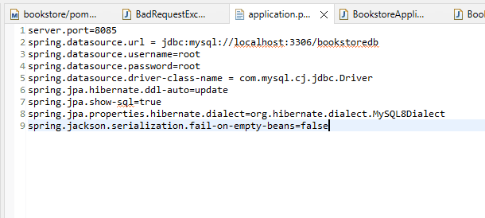
Front-end and Back-end Connection:

Slide 12
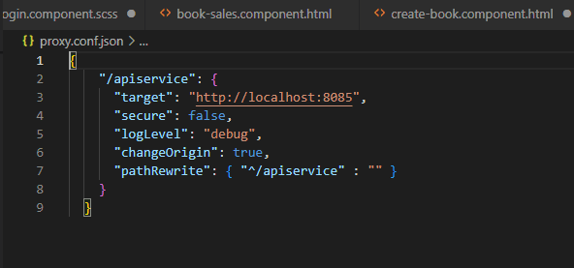
Vs code

Slide 13
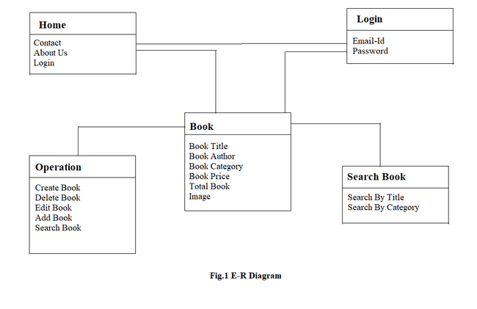
Diagrams: 1)E-r diagram

Slide 14
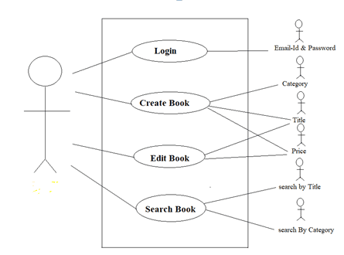
2)Use case diagram:
admin

Slide 15
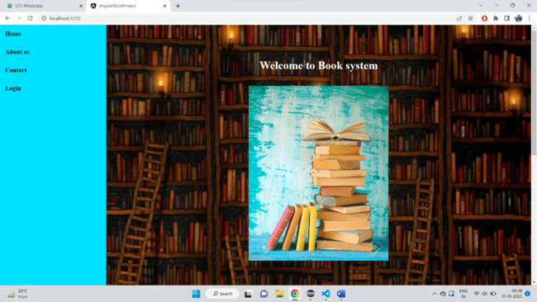
Welcome Page:

Slide 16
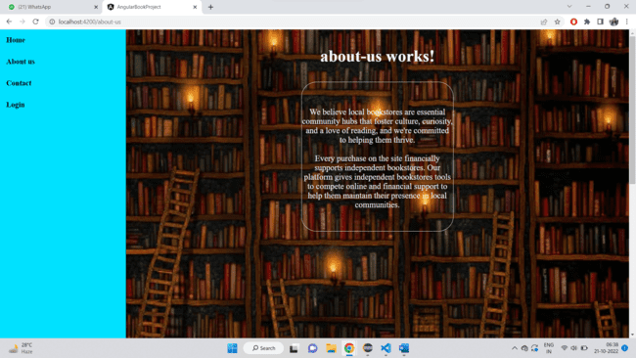
About us:

Slide 17
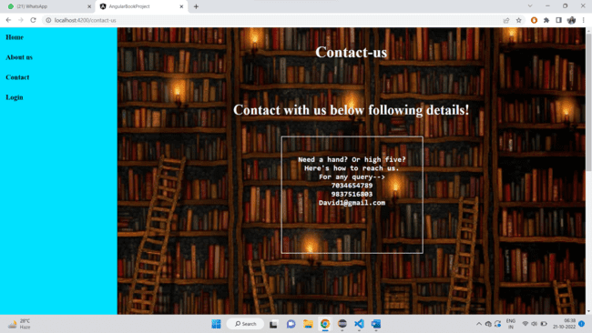
Contact us:

Slide 18
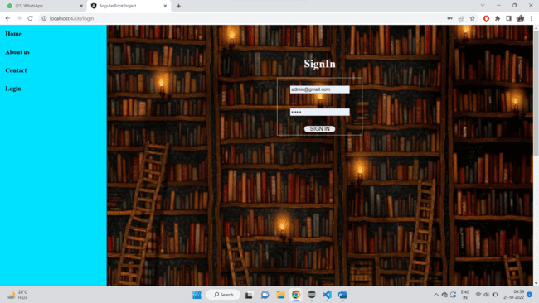
Login Page:

Slide 19
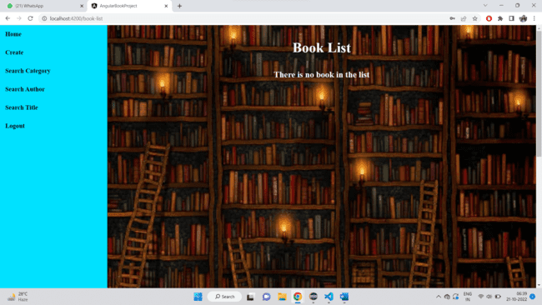
Home Page:

Slide 20
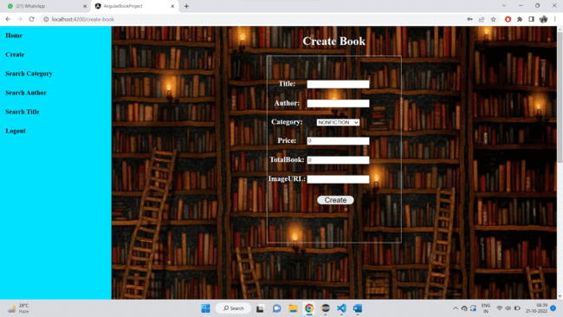
Create a book page:

Slide 21
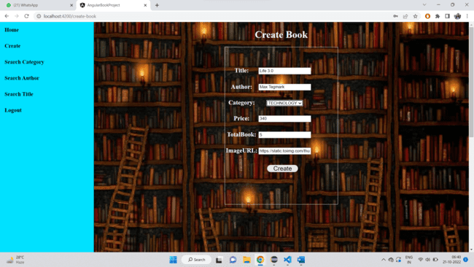
Filled information of book:

Slide 22
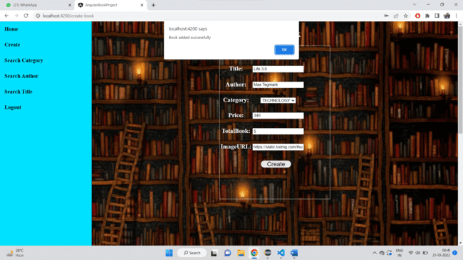
Book is added:

Slide 23
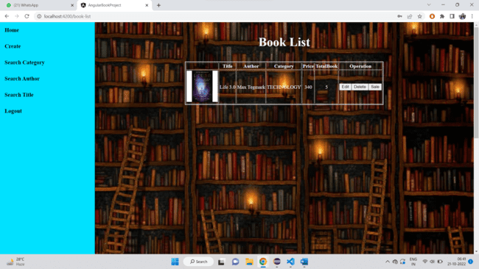
Display book:

Slide 24
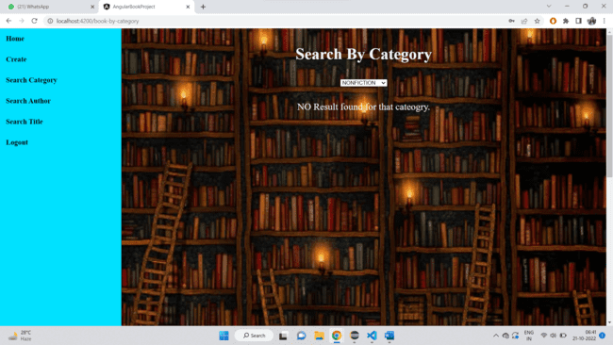
Before search category:

Slide 25
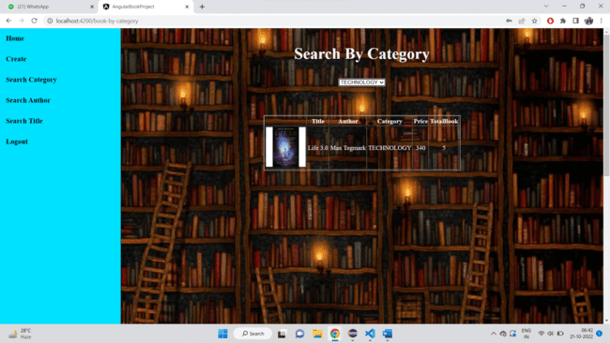
After search category:

Slide 26
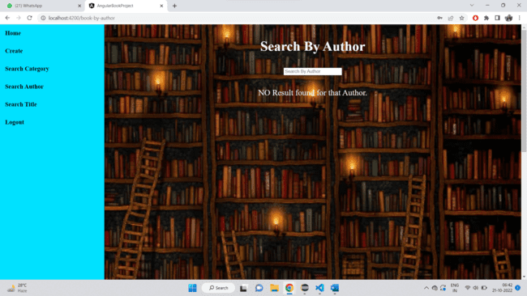
Search by author:

Slide 27
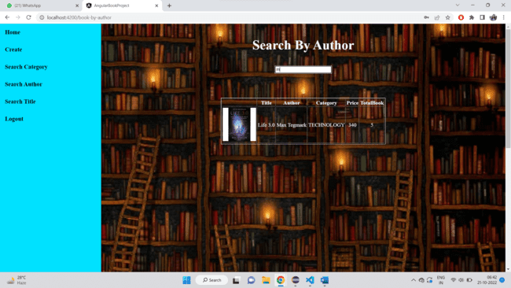
After searching author:

Slide 28
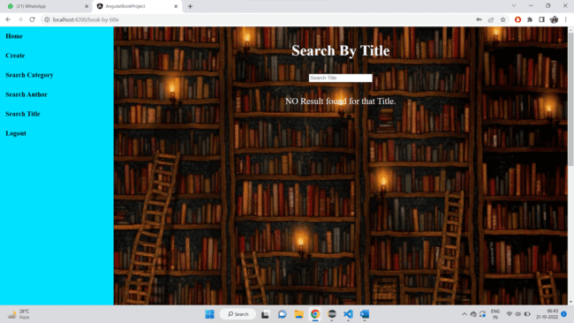
Search by title:

Slide 29

After searching title:

Slide 30
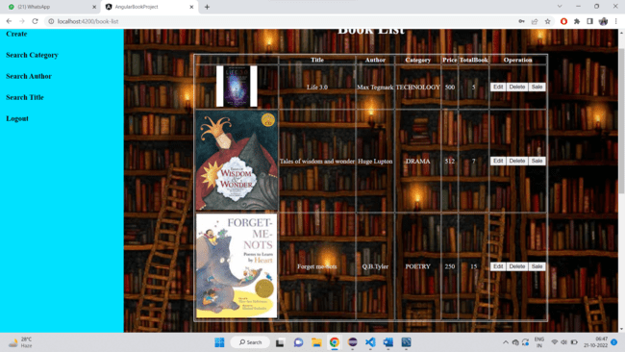
Another books added:

Slide 31
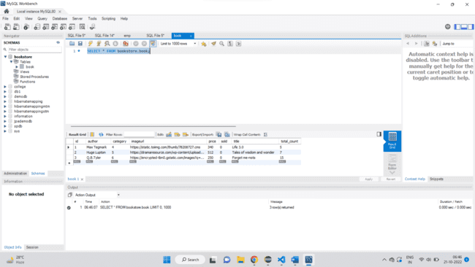
Added books in database:

Slide 32
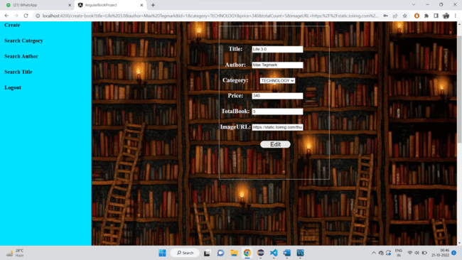
Before editing:

Slide 33
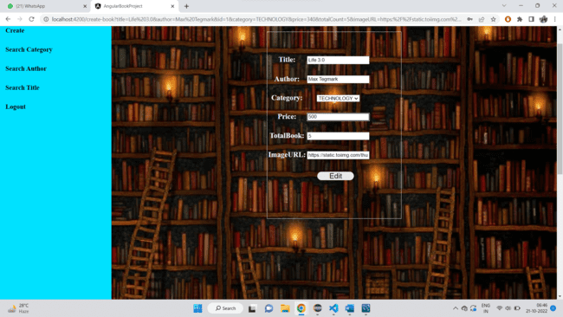
After editing:

Slide 34
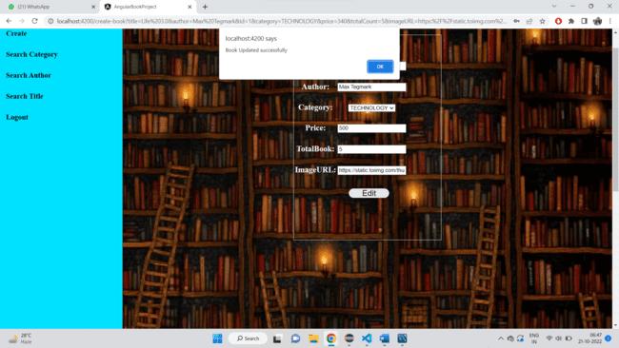
Book is updated:

Slide 35
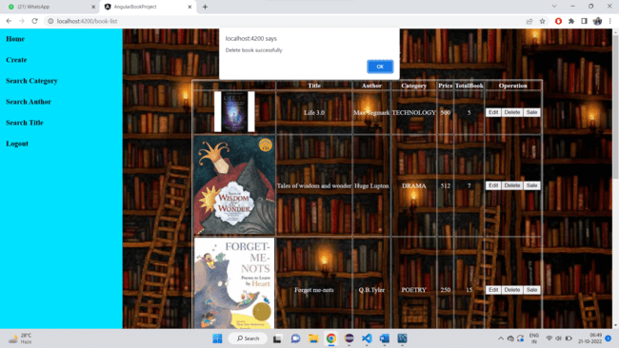
For deleting:

Slide 36
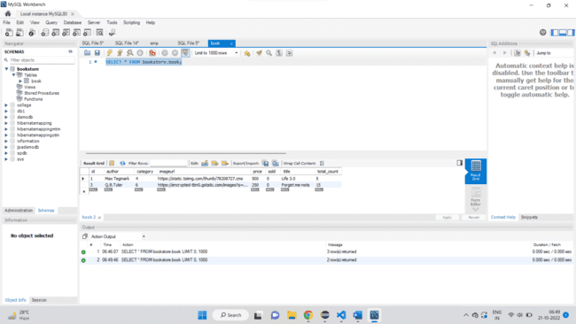
Data is deleted from database:

Slide 37
Conclusion
Automatic Book Store has Many Advantages compare to Manual. This Book Store is time consuming or easy to use .This does not need to wait for shop keeper for purchases book or sold.
Admin can add, delete and update the author, book categories.

Slide 38
Thank you

