Slide 1
Network Programming Project
Battleship online game
Lê Thanh Sơn
Trần Phi Hùng
Đào Cao Duy

Slide 2
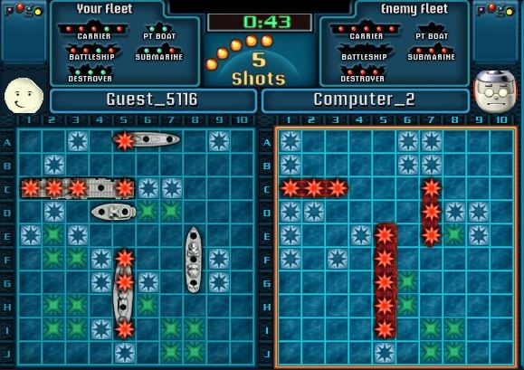
About Battleship game project
How the game works:
+ An user login the game and find another online user to challenge.
+ Game server matches two players playing against each other.
+ The two players are connected through the game’s network and get in a battleship match.
(The image is for illustration, not presented for the final product)

Slide 3
About Battleship game project
How the game works:
+ At the start of the match, each player set up their own ship formation on a 10x10 board. (Hidden to the opponent)
+ The game begins and the two players will take turn to shoot cell by cell to each other’s board until all of one player’s ships are sunk.
(The image is for illustration, not presented for the final product)

Slide 4
Detailed game rule
Starting a New Game
Each player places the a same set of ships somewhere on their 10 x 10 board. The ships can only be placed vertically or horizontally. Diagonal placement is not allowed. No part of a ship may hang off the edge of the board. Ships may not overlap each other. No ships may be placed on another ship or adjacent to each other.
Once the guessing begins, the players may not move the ships.
Playing the Game
Player's take turns guessing by calling out the coordinates. The opponent responds with "hit" or "miss" as appropriate. Both players should mark their board with pegs: red for hit, white for miss. For example, if you call out F6 and your opponent does not have any ship located at F6, your opponent would respond with "miss". You record the miss F6 by placing a white peg on the lower part of your board at F6. Your opponent records the miss by placing.
When all of the squares that one your ships occupies have been hit, the ship will be sunk. You should announce "hit and sunk".

Slide 5

Application protocol
Architecture: Client / Server
Message type: string
fire : 5-5-miss
(header) (data)
Server
Client
Client
Client

Slide 6
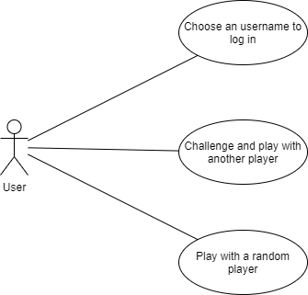
Usecase diagram

Slide 7
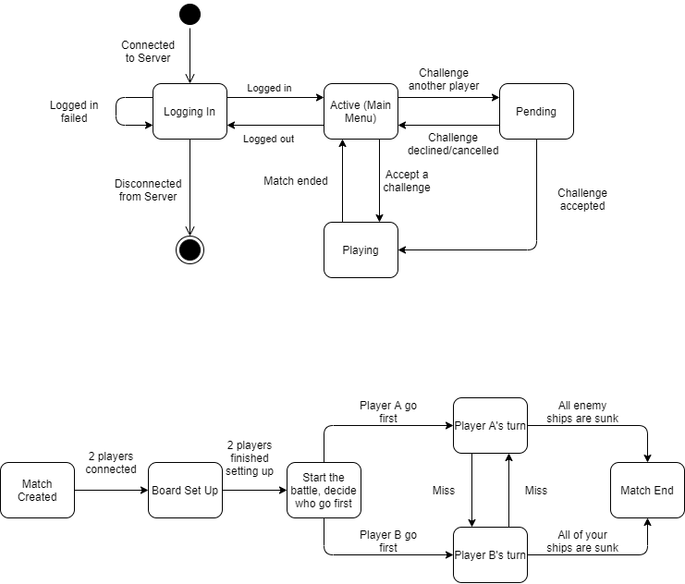
State Diagram

Slide 8
Message Protocol
Client connects to Server and input an username and sends to Server
C: login : [username]
Server receives and check [username] (which only included alphabet characters and digits)
(valid username) → S: login : 1
(invalid username) → S: login : 0

Slide 9
Message Protocol
Server will send the list of online users to Clients so they can invite each others.
The Server will add a nametag after usernames to distinguish between similar ones.
S: userlist : [username1]#[tag]/[state] , [username2]#[tag]/[state] .
(example: userlist : Josh#20/A, Paimon#33/P, Josh#69/A, Steve#20/P. )
(User state: Active (A), Playing (P) )

Slide 10
Message Protocol
Client logged in successfully and active in game lobby. In this state Client may: log out, challenge another user, accept/decline a challenge, randomly matching.
C: logout
C: challenge : [username]#[tag]
C: accept : [username]#[tag]
C: decline : [username]#[tag]
Server sends the invitation to the challenged user:
S: invite : [username]#[tag]

Slide 11
Message Protocol
When a challenge is accepted, Server sends a message to both clients to start a match: S: matchstart: [opponent]
2 players set up ship formation and send to server, server then decide who go first and start the game:
2 Clients → Server: setup : V-4-3-10 , H-3-5-2 , … , H-1-8-8 .
Ship info ( [Horizontal/Vertical]–[Ship length]–[Coordinate X]–[Coordinate Y] )
S: gamestart : 1 ( 1: go first, 2: go second )

Slide 12
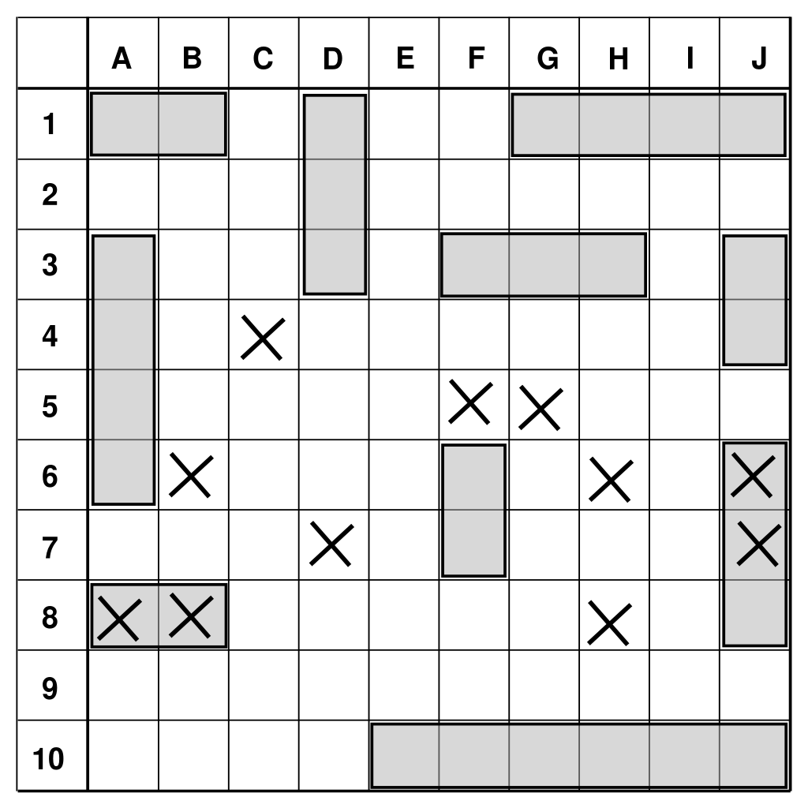
Message Protocol
In-game: Players in their turn send coordinate information to shoot each other’s board to Server, Server process and send result to both players.
Client 1: fire : 4-4 ( fire : [Coordinate X]-[Coordinate Y] )
Server → Client 1: miss
Server → Client 2: fire : 4-4-miss

Slide 13
Message Protocol
When all the ships of a player sunk, Server sends result message to 2 players. Then both players return to lobby.
Server → Client 1: matchend : win
Server → Client 2: matchend : lose

Slide 14
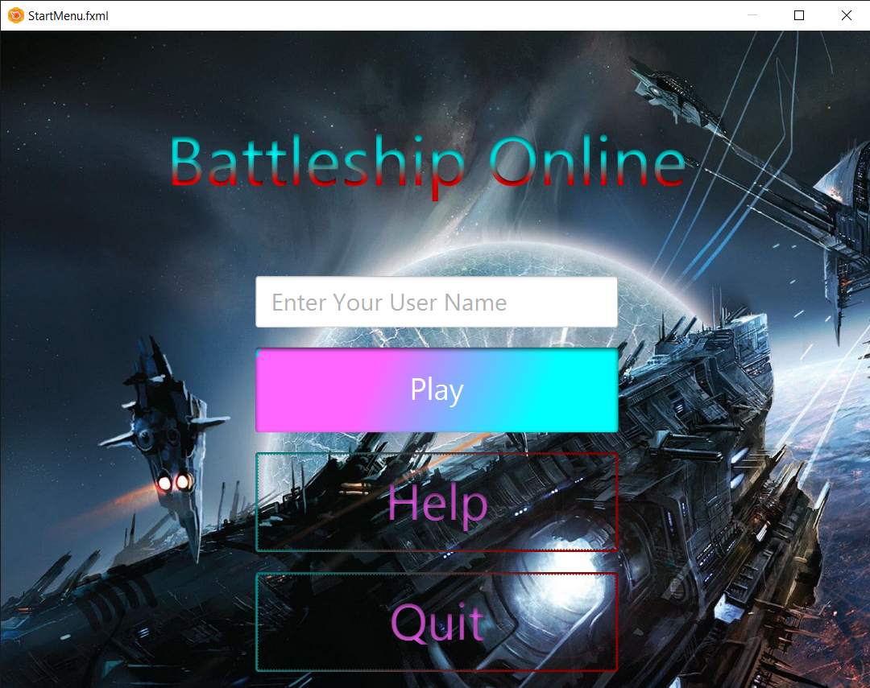
GUI
(The picture is taken from the application developing process, not presented for the final product)

Slide 15
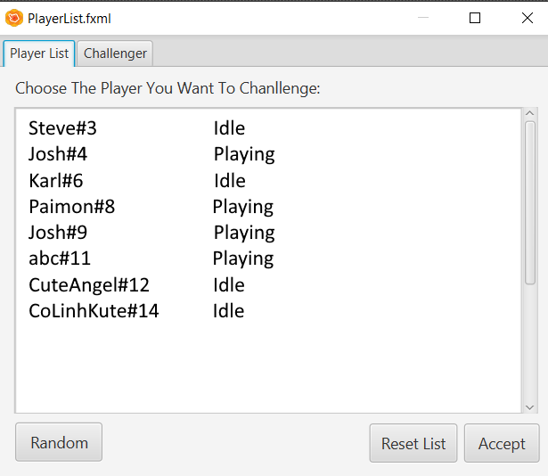
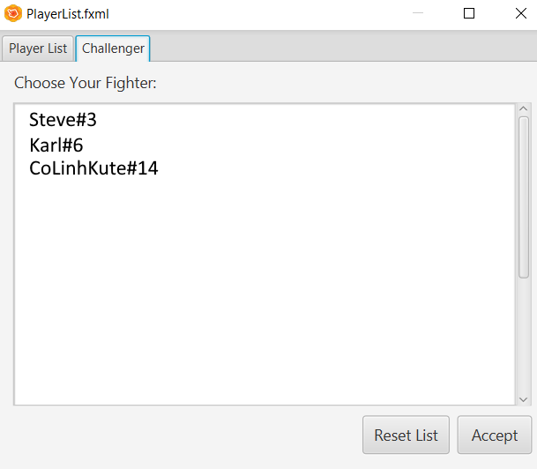
GUI
(The pictures is taken from the application developing process, not presented for the final product)

Slide 16
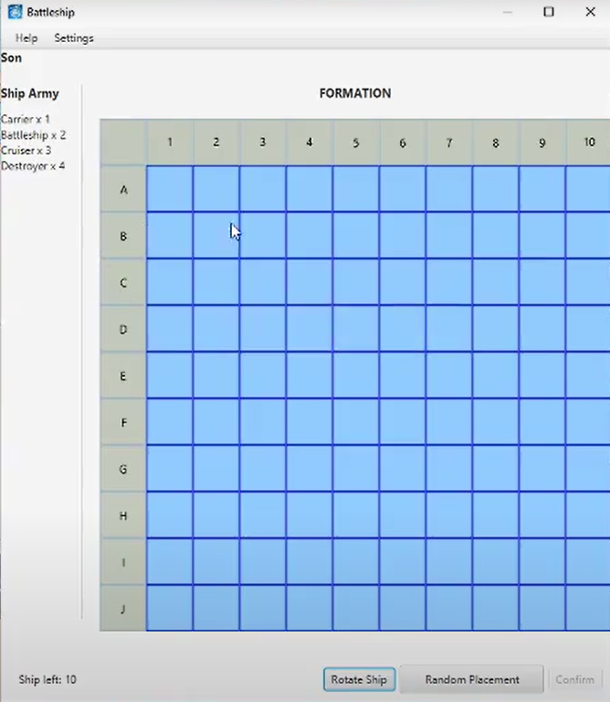
GUI
(The picture is taken from the application developing process, not presented for the final product)

Slide 17
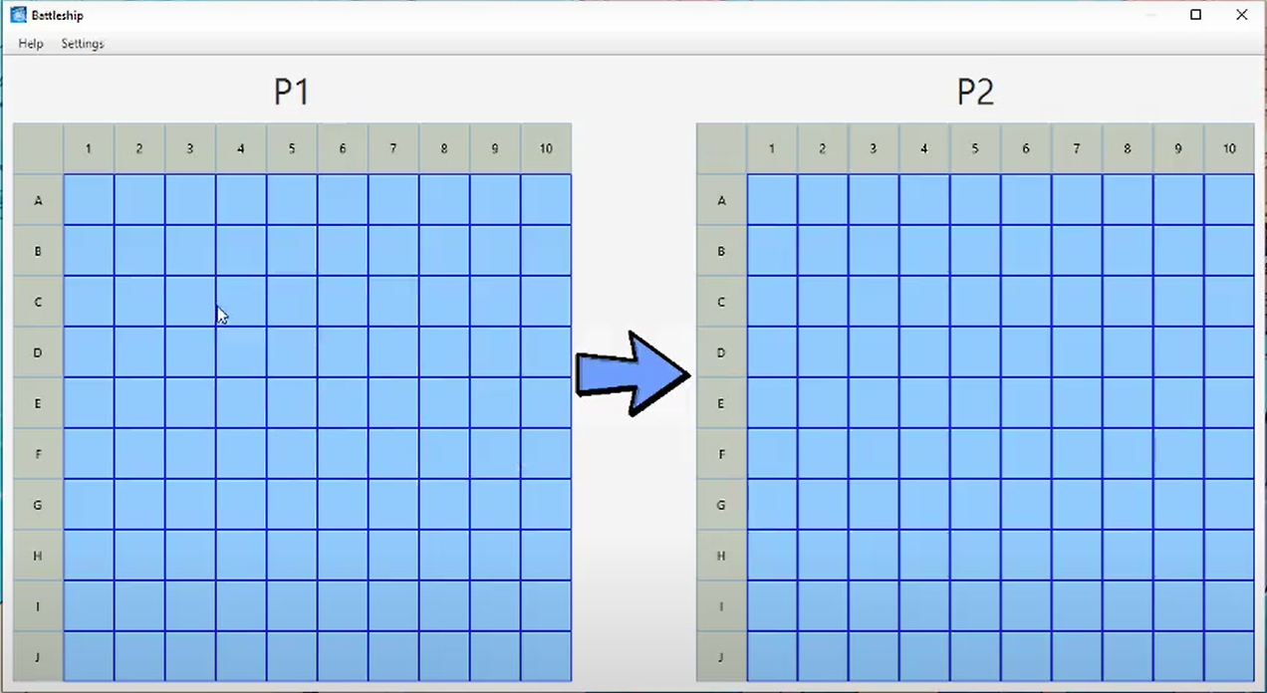
GUI
(The pictures is taken from the application developing process, not presented for the final product)

Slide 18
Functions implemented so far
Log in with a valid username
Show / update the list of current online players
Match 2 random players together
Gameplay (including set up phase and battle phase) implemented, but in offline mode

Slide 19
Remaining work
Enable users to directly challenge each others
Play the game online
Handle as many potential errors as possible
(Optional) Advanced Game mode

Slide 20
Thanks for listening :3

