Slide 1




MIND CONTROL
DATA
PREPROCESSING
SYSTEM DESIGN
CONCLUSION
INTRODUCTION
CONTRIBUTION
OUTLINE
Done by:
Alksandra Aljabery 20200129
Sondos Ali 20200438
Hamzeh Hatamleh 20201150
Supervised by: Dr. Serin Atiani

Slide 2



MIND CONTROL
INTRODUCTION
CONTRIBUTION
SYSTEM DESIGN
DATA
PREPROCESSING
CONCLUSION
OUTLINE
Done by:
Alksandra Aljabery 20200129
Sondos Ali 20200438
Hamzeh Hatamleh 20201150
Supervised by: Dr. Serin Atiani

Slide 3
INTRODUCTION
The goal of our system is to decode the imagined speech by subject and based on their choice of imagined word (forward, backward, right, and left) the system will output a control signal that will control an electric motor of a device.
Solution
Problem
Motivation

Slide 4



EEG Based BCI System
Solution
Problem
Motivation

Slide 5

Solution
Motivation
Problem
Not Available for all Forms of Paralysis
No Previous Application

Slide 6



Solution
Problem
Motivation
Portability
Low cost
Imagined Speech BCI

Slide 7
CONTRIBUTION
Pipeline
Audience
Idea
Our novelty lies in three main components

Slide 8


Pipeline
Idea
Audience
Motor Imaginary
Imagined Speech

Slide 9


Pipeline
Idea
Audience
Quadriplegia
Dysarthria
People that seek independence in mobility
Affect mobility from neck down
Affect mobility and speech

Slide 10




Pipeline
Idea
Audience
Low computational resources
Low memory/ low processors
Electric Motor (small demo car)

Slide 11





SYSTEM DESIGN
Representing our system’s description, component design and sequence diagram
---
Input
Processing
Decoding
Classification
Device Control

Slide 12
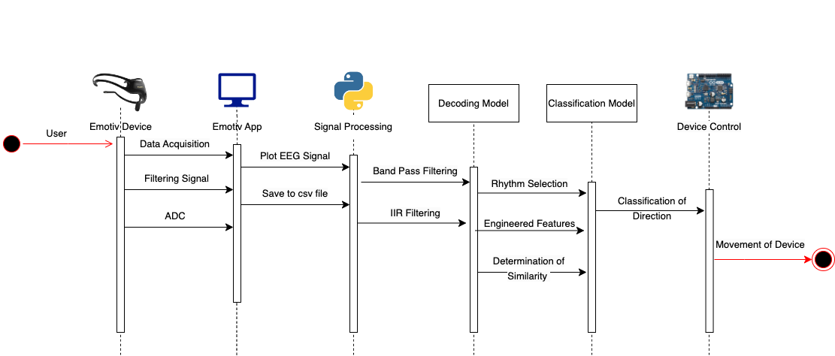

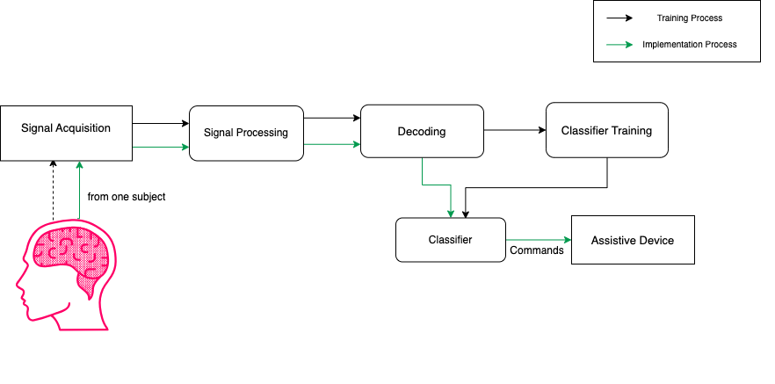
System Sequence Diagram
Component Diagram
Architectural Diagram
---

Slide 13
Component Diagram
System Sequence Diagram
Architectural Diagram
---

Slide 14
Architectural Diagram
Component Diagram
System Sequence Diagram
---

Slide 15
Component Diagram
Architectural Diagram
System Sequence Diagram
---

Slide 16
System Sequence Diagram
Component Diagram
Architectural Diagram
---

Slide 17
DATA PREPROCESSING
Methods
Artifact
DC Offset
EEG data preprocessing defines a procedure to reconstruct raw EEG data into clean EEG data by removing noise and unwanted objects and thus converting it into a suitable format for further analysis.

Slide 18
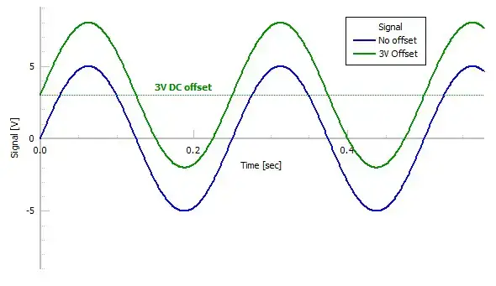
DC offset : constant voltage level that is present in the signal. This offset arises due to various factors, including electronic components, electrode contact issues, environmental conditions ,or baseline shifts in the recording equipment
Methods
Artifact
DC Offset
This centers the EEG signals around zero, making them more suitable for analysis.

Slide 19



Methods
Artifact
DC Offset
Muscle Movement
Eye Movement
Power Line

Slide 20

Our data preprocessing method contains removing Dc offset and the artifacts from the EEG signals Extracted from the user By using one of the methods below
01
High-pass filtering
02
IIR filtering
Methods
Artifact
DC Offset

Slide 21
CONCLUSION
Thank You
In conclusion, our project makes an important step towards addressing the challenges faced by individuals with paralysis and disorders. By leveraging innovative EEG technology and imagined speech classification system, we aim to make a meaningful impact on the lives of people with these disorders.

Slide 22


Thank You
Thank You

Slide 23


Thank You
Thank You

