Slide 1
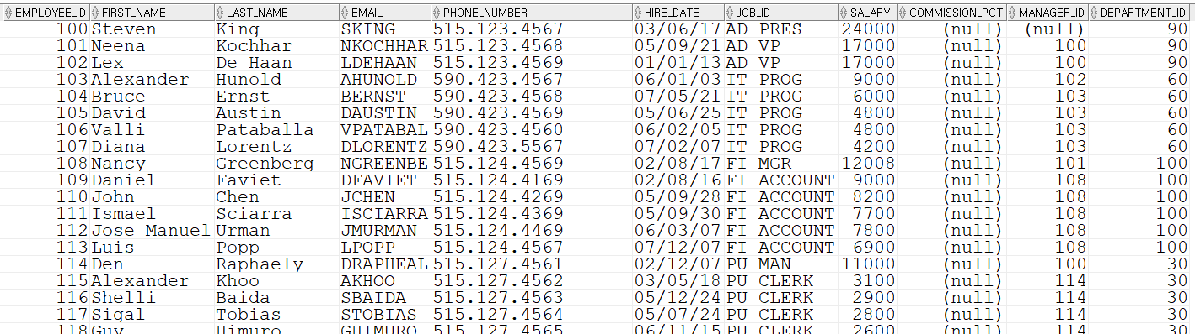
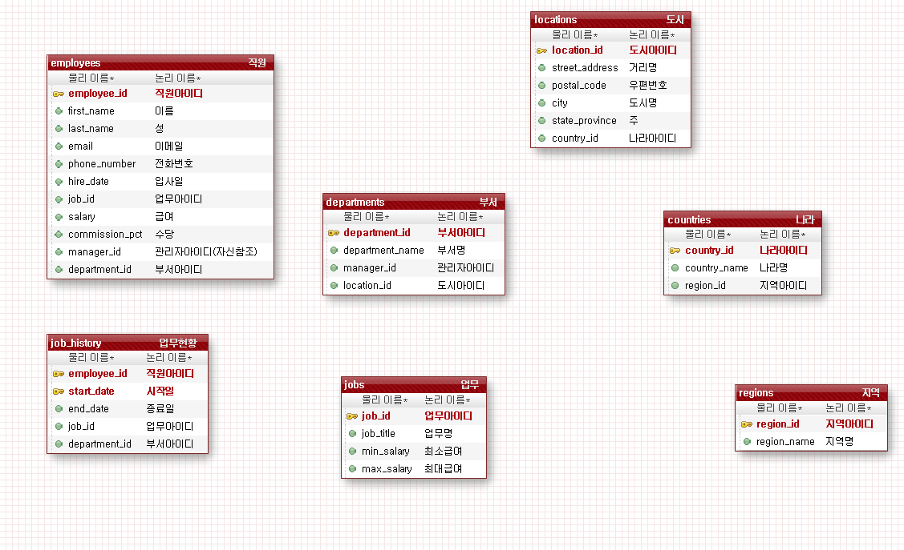
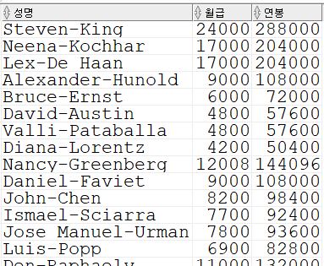
select first_name || '-' || last_name 성명,
salary 월급,
salary*12 연봉
from employees;
hr/
hr
ip
오라클
sql developer
hr/
hr
select first_name || '-' || last_name 성명,
salary 월급,
salary*12 연봉
from employees;

Slide 2
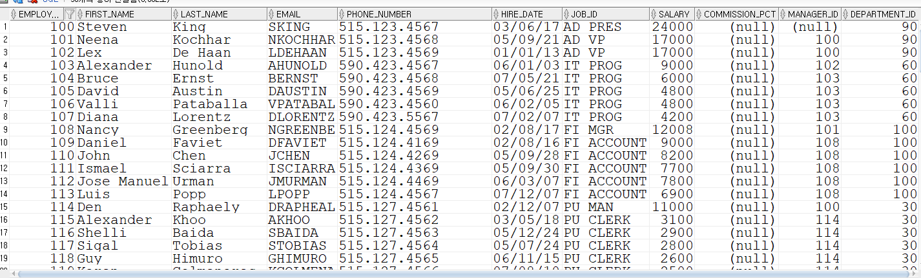
황일영
프로그램
sys/
manager
data
오라클
system/
manager
sql문
sqlplus
hr/
hr
정우성
select * from employees;
sql문
data
system/ manager
ip
sql developer
hr/
hr
ip
select first_name from employees;

Slide 3
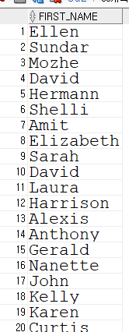
황일영
프로그램
sys/
manager
data
오라클
system/
manager
sql문
sqlplus
hr/
hr
정우성
sql문
select first_name from employees;
data
system/ manager
ip
sql developer
hr/
hr
ip

Slide 4
select first_name || '-' || last_name 성명,
salary 월급,
salary*12 연봉
from employees;
hr/
hr
ip
오라클
sql developer
hr/
hr

Slide 5
select first_name || '-' || last_name 성명,
salary 월급,
salary*12 연봉
from employees;

Slide 6
14000
17000
14000
17000

