Slide 1
Introduction
Boxi Wu / Xiaofei He
Zhejiang University

Slide 2
Computer Courses Organization
编译系统
计算机网络
嵌入式系统
操作系统
计算机体系结构
汇编与接口
计算机组成
数据库系统
高级数据结构与算法分析
数字逻辑设计
数据结构基础
计算机系统概论
C语言程序设计
大学计算机基础
Notes:
计算机学院的课程设置，左边是软件课程，右边是硬件课程。箭头表示高级课程对基础课程的前提要求。可以看出计算机组成是软硬件系列课程的基础，非常重要！

Slide 3
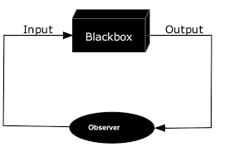
Computer Science: The Big Picture
黑盒原理-现代科技分工发展的基础概念

Slide 4
Computer Science: The Big Picture
计算机网络
理论基础
操作系统
编程语言
数据库
应用软件
硬件
计算图形学
人工智能
Notes:
计算机学院的课程设置，左边是软件课程，右边是硬件课程。箭头表示高级课程对基础课程的前提要求。可以看出计算机组成是软硬件系列课程的基础，非常重要！

Slide 5
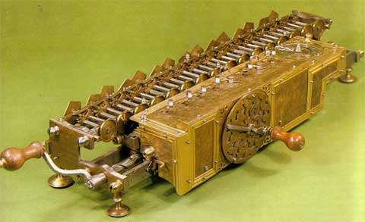
Computer Science: The Big Picture
计算自动化-1673-莱布尼兹
Notes:
计算机学院的课程设置，左边是软件课程，右边是硬件课程。箭头表示高级课程对基础课程的前提要求。可以看出计算机组成是软硬件系列课程的基础，非常重要！

Slide 6
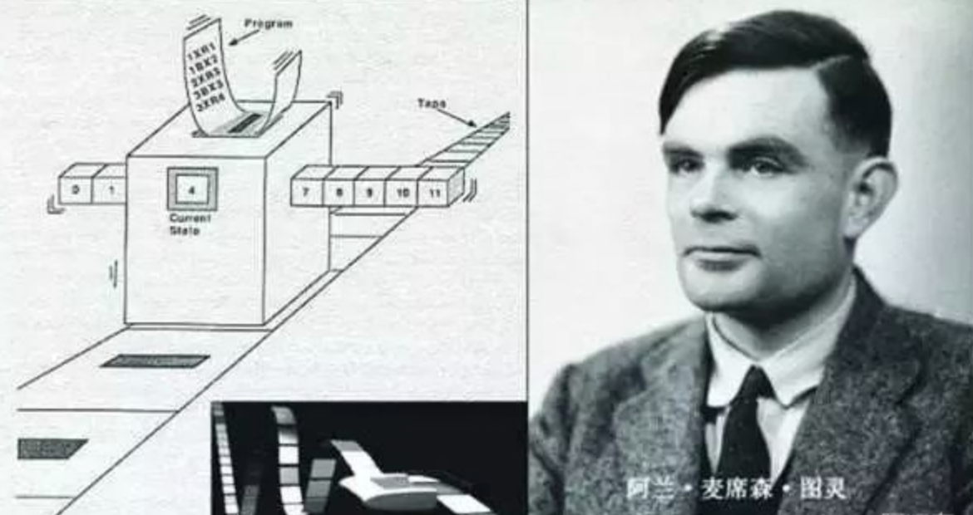
Computer Science: The Big Picture
图灵机 1936
Notes:
计算机学院的课程设置，左边是软件课程，右边是硬件课程。箭头表示高级课程对基础课程的前提要求。可以看出计算机组成是软硬件系列课程的基础，非常重要！

Slide 7
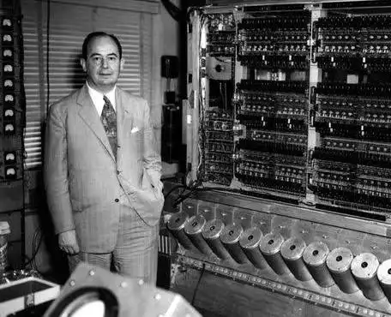
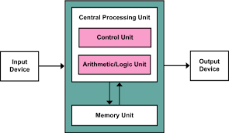
Computer Science: The Big Picture
冯诺依曼架构

Slide 8
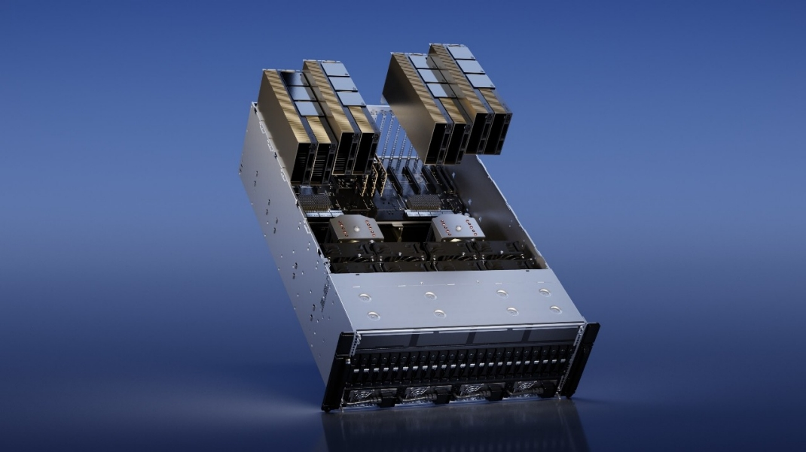
Computer Science: The Big Picture
AI Infrastructure

Slide 9
Abstract Layers of A COMPUTER SYSTEM
Application
Compiler / Libraries of Macros and Procedures
Software
Operating System
Operating System (OS)
Computer Architecture
Instruction Set Architecture (ISA)
Computer Organization
Computer Organization (Micro Architecture)
Digital Logic
Register Transfer Level (RTL)
Hardware
Digital Logic Circuit (DLC)
Device Technology

Slide 10
Covered in System Courses
Application
Compiler / Libraries of Macros and Procedures
Software
Operating System (OS)
System-II&III
Instruction Set Architecture (ISA)
Computer Organization (Micro Architecture)
System-I
Register Transfer Level (RTL)
Hardware
Digital Logic Circuit (DLC)
Device Technology

Slide 11
System Courses
System I
System II
System III
Operating System
Computer Organization
Computer Architecture
Digital Logic
Notes:
Add security

Slide 12
编译器
System Call
Code
(C...)
进程调度
进程管理
CPU调度
系统
软件
解释器
……
进程通信
同步、互斥、死锁
中断与时钟
RISC-V 指令系统
软硬件协同（OS加载）
体系
结构
程序执行的基本原理
流水线实现与性能分析
流水线冲突与处理
Disk
控制器
中断
控制
寄存器组
MUX
BUS
运算器
PC
系统
硬件
Memory
MUX
MUX
Forwarding
Unit
系统1
4
ADD
ADD
CSR
I/O Device
系统2
CPU
时序逻辑电路
计算机硬件组成（硬件模块设计）
门级
电路
门电路与组合逻辑
12

Slide 13
编译器
System Call
Code
(C...)
进程调度
进程管理
CPU调度
文件系统
内存管理
系统
软件
解释器
进程通信
同步、互斥、死锁
中断与时钟
设备管理
虚拟内存
……
RISC-V 指令系统
软硬件协同（OS加载）
定量分析方法
虚拟存储器设计
体系
结构
程序执行的基本原理
流水线实现与性能分析
ILP
DLP
TLP
Cache设计与性能分析
流水线冲突与处理
Disk
控制器
RAT
ROB
中断
控制
寄存器组
MUX
BUS
运算器
PC
RS
系统
硬件
Memory
MUX
运算器-2
TLB/MMU
MUX
Cache
Forwarding
Unit
系统1
ADD
ADD
BPU
CSR
I/O Device
4
系统2
CPU
时序逻辑电路
计算机硬件组成（硬件模块设计）
门级
电路
系统3
门电路与组合逻辑
13

Slide 14
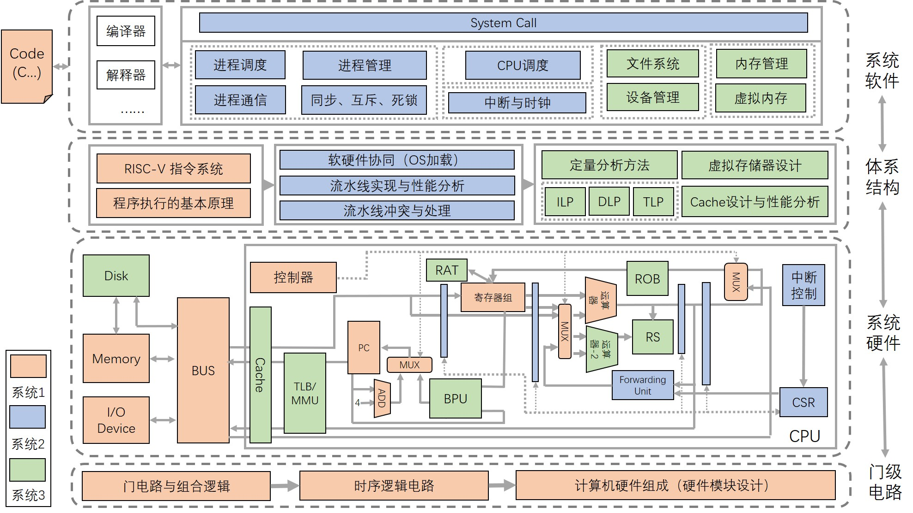
软件安全
系统安全
系统安全分析
系统
安全
RISC-V单周期CPU
(简单指令)
RISC-V流水线CPU
(简单指令)+简易kernel
RISC-V CPU
(基本指令)+kernel
14
Notes:
打破课程之间的壁垒，以系统观角度给学生展示如何从软硬件协同的角度来认识、分析计算机系统的工作原理

Slide 15
System Courses
System Security
YOUR ADVANCED KERNEL based on YOUR OWN CPU!
System I
System II
System III
YOUR FIRST KERNEL based on YOUR OWN CPU!
YOUR OWN CPU!
Operating System
Computer Organization
Computer Architecture
Digital Logic
15
Notes:
Add security

Slide 16
Why Take System Courses?
Basic knowledge needed for many other areas of CS
  Compiler
  Parallel Computing
  …
Understand where the world is going
  Delve into the underlying implementation
  Address bug or performance issues
  Become more effective programmers
The Mysteries of Computing will be revealed!

Slide 17
Course Objective
Understand the HW / SW interface
  How a processor works
  How a computer is organized
Establish a foundation for building applications
  How to write a good program
    Good = correct, fast, and secure
  How to understand where the world is going
Understand technology (past, present, future)

Slide 18
Course Topics
Information Representation ~ 1 weeks
Foundations of Digital Logic ~ 2 week
Combinational Logic Circuit ~ 1.5 week
Computational Operations & Units ~ 1.5 week
Sequential Logic Circuit ~ 2 week
Instruction Set Architecture (ISA) ~ 1 weeks
Assembly Language ~ 2 weeks
CPU Design ~ 2 weeks
Performance and others ~ 1 weeks

Slide 19
实验课 | 预期发布时间 | 预期持续时间
setup：一些介绍
Lab0-1: SPICE+LogSim | 第一周 | 1 week
Lab0-2: Vivado | 第二周 | 2 week
Lab1-1：多路选择器 | 第四周 | 1 week
Lab1-2：七段数码管 | 第五周 | 1 week
Lab2-1：全加减法器 | 第六周 | 1 week
Lab3-1：有限状态机 | 第七周 | 1 week
Lab3-2：计数器/定时器 | 第八周 | 1 week
Lab3-3：乘法器 | 第九周 | 2 week
Lab4-1：卷积加速器 （bonus）
Lab4-2：串口（bonus） | 第十周 | 2 week
Lab5-1：汇编语法 | 第十一周 | 1 week
Lab5-2：汇编调试 | 第十二周 | 1 week
Project：SCPU | 第十三周 | 4 week

Slide 20
Prerequisites
Courses
  C Programming Language - required
  Assembly Language - optional
Skills
  Basic programming experience
  The more, the better

Slide 21
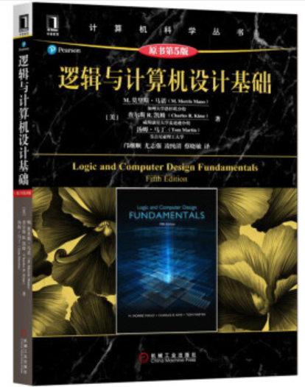

Course Material
Lecture Notes
  Will be posted
Textbook
  Logic and Computer Design Fundamentals
    Fifth Edition
References
  《数字逻辑与计算机组成》
    编者：袁春风、武港山、吴海军、余子濠
  Computer Organization and Design
    RISC-V Edition 1st Edition

Slide 22
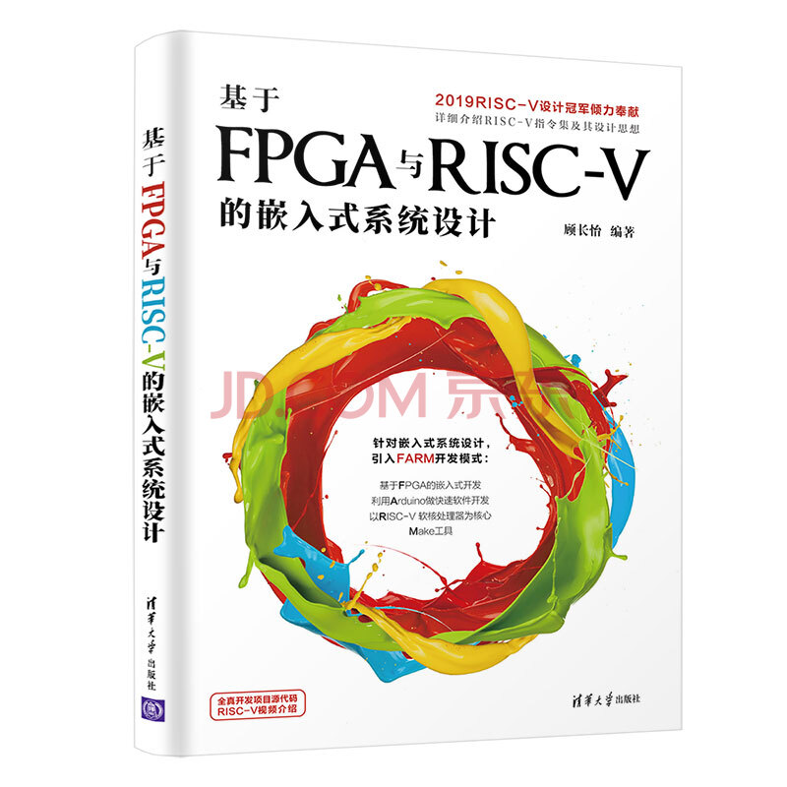
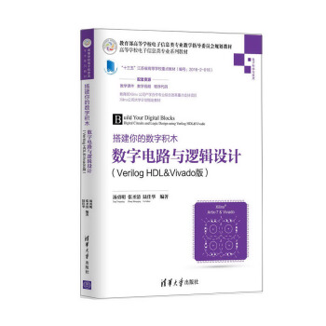
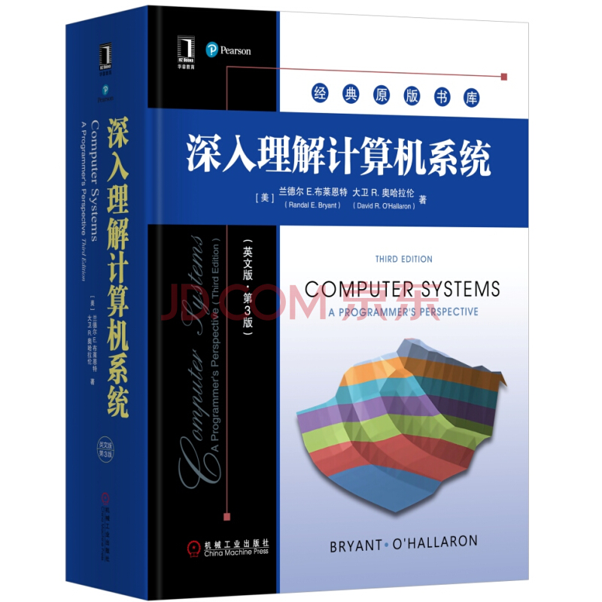
Some Other References (Optional)

Slide 23
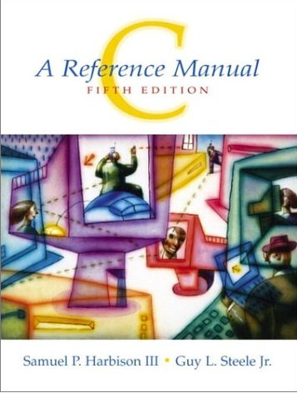
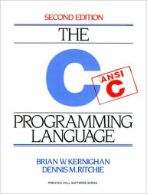
C Resources (Optional)

Slide 24
Class Grading
Class participation, Assignment, quiz 15%
Lab 50%
  Lab 1 – 组合逻辑模块 (10%)
  Lab 2 - ALU (10%)
  Lab 3 – 时序逻辑模块 (10%)
  Lab 4 – bonus
  Lab 5 – 汇编 (10%)
  Lab 6 – 单周期 (10%)
Final Exam 35%

Slide 25
Course Policies
Academic integrity
  We will strictly enforce the university, college, and department policies against academic dishonesty
  Plagiarism in any form will not be tolerated!
Unless otherwise noted, assignment and lab reports should reflect your independent capabilities
  If unsure, note / cite sources and help
Late work penalized 5%/day
  No penalty for documented emergency or by prior arrangement in special circumstances

