Slide 1
Instruction Set Architecture
Boxi Wu / Xiaofei He
Zhejiang University

Slide 2
Overview
Introduction to ISA
About ISA design

Slide 3
Overview
Introduction to ISA
About ISA design

Slide 4
Instruction Set Architecture (ISA)
Application
Compiler / Libraries of Macros and Procedures
Software
Operating System (OS)
Instruction Set Architecture (ISA)
Computer Organization (Micro Architecture)
Register Transfer Level (RTL)
Hardware
Digital Logic Circuit (DLC)
Device Technology
Notes:
Computer organization includes the high-level aspects of a design, such as the memory system, the bus structure, and the design of the internal CPU (where arithmetic, logic, branching and data transfers are implemented).
Computer hardware refers to the specifics of a machine, included the detailed logic design and the packaging technology of the machine.
Computer architects must design a computer to meet functional requirements as well as price, power, and performance goals. Often, they also have to determine what the functional requirements are, which can be a major task.
Desktop computers: focus on optimizing cost-performance as measured by a single user, with little regard for program size or power consumption,
Server computers – focus on availability, scalability, and throughput cost-performance,
Embedded computers – driven by price and often power issues, plus code size is important.

Slide 5
What is An Instruction?
Instruction = opcode + operands
Elements of an instruction
  Operation code (Opcode)
    Do this
  Source Operand reference(s)
    To this
  Result Operand reference(s)
    Put the answer here
  Next Instruction Reference
    When you are done, do this instruction next
Notes:
操作数和地址码

Slide 6
Where Are the Operands?
Main memory
CPU register
I/O device
In instruction itself
To specify which register, which memory location, or which I/O device, we’ll need some addressing scheme for each
Notes:
Stack also belongs to the memory

Slide 7
Instruction Formats
Instruction length
  Whether short, long, or variable
Number of operands
  3/2/1/0
Number of addressable registers
Memory organization
  Whether byte- or word addressable
Addressing modes
  Choose any or all: direct, indirect or indexed

Slide 8
Instruction Set
The complete collection of instructions that are understood by a CPU
The instruction set is ultimately represented in binary machine code also referred to as object code
  Usually represented by assembly code to human programmer

Slide 9
Instruction Set Architecture (ISA)
The physical hardware that is controlled by the instructions is referred to as the Instruction Set Architecture (ISA)
  One can think of an ISA as a hardware functionality of a given computer.
  ISA refers to the actual programmer visible machine interface such as instruction set, registers, memory organization and exception (i.e., interrupt) handling.
Also called (computer) architecture
  Implementation --> actual realization of ISA
  ISA can have multiple implementations
  ISA allows software to direct hardware
  ISA defines machine language
Notes:
指令集体系结构是一台计算机的抽象模型（即计算机的“功能规范说明书“），可简称为指令系统：
1. 从硬件设计角度看，指令系统规定了一台计算机需要具备的基本功能，软件将使用这些功能对计算机的行为进行控制；
2. 从软件编程角度看，指令系统定义了系统程序员为了对计算机硬件进行编程而需要了解的所有内容。

Slide 10
Instruction Set Architecture (ISA)
Specification of a microprocessor design
  The ISA defines the CPU, or a CPU family (e.g., x86)
    Not only a collection of instructions,
    Includes the CPU view of memory, registers number and roles, etc.
  ISA ≠ CPU architecture (μ-architecture)
    E.g., x86: Xeon ≠ Celeron, same ISA
Interface between user and machine’s functionality
  The ISA is the contract between s/w and h/w
High level language code : C, C++, Java, Fortran,
compiler
Assembly language code: architecture specific statements
assembler
Machine language code: architecture specific bit patterns
software
instruction set
hardware
Notes:
指令系统位于软硬件之间的交界，是构成程序的基本元素，也是硬件设计的依据，衡量硬件的性能，反映硬件对软件的支持程度，其设计的好坏直接决定计算机的性能和成本，极其重要。
Serves as an interface between software and hardware.
Provides a mechanism by which the software tells the hardware what should be done.
The word “µarch” with ‘µ’ is a Greek letter pronounced as “mu” which scientifically represents the term “micro”. Thus, it combinedly formed micro + architecture. However, some keyboard doesn’t have ‘µ’ letter in it, so for sake of easiness, it is also called as “uarch”

Slide 11
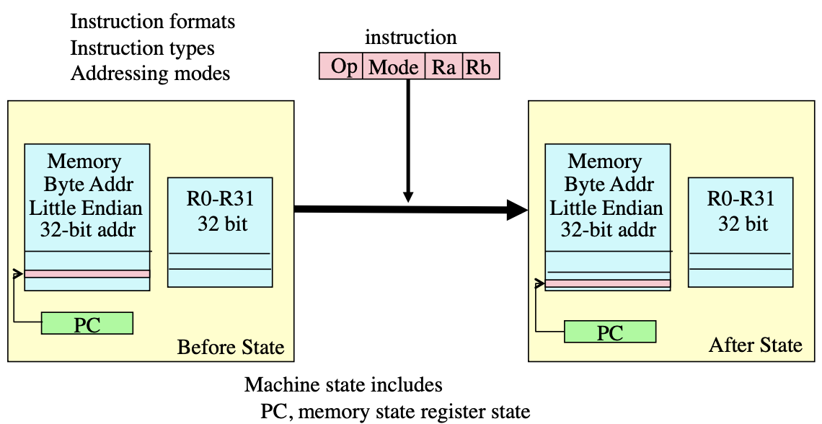
ISA Specifies How the Computer Changes State

Slide 12
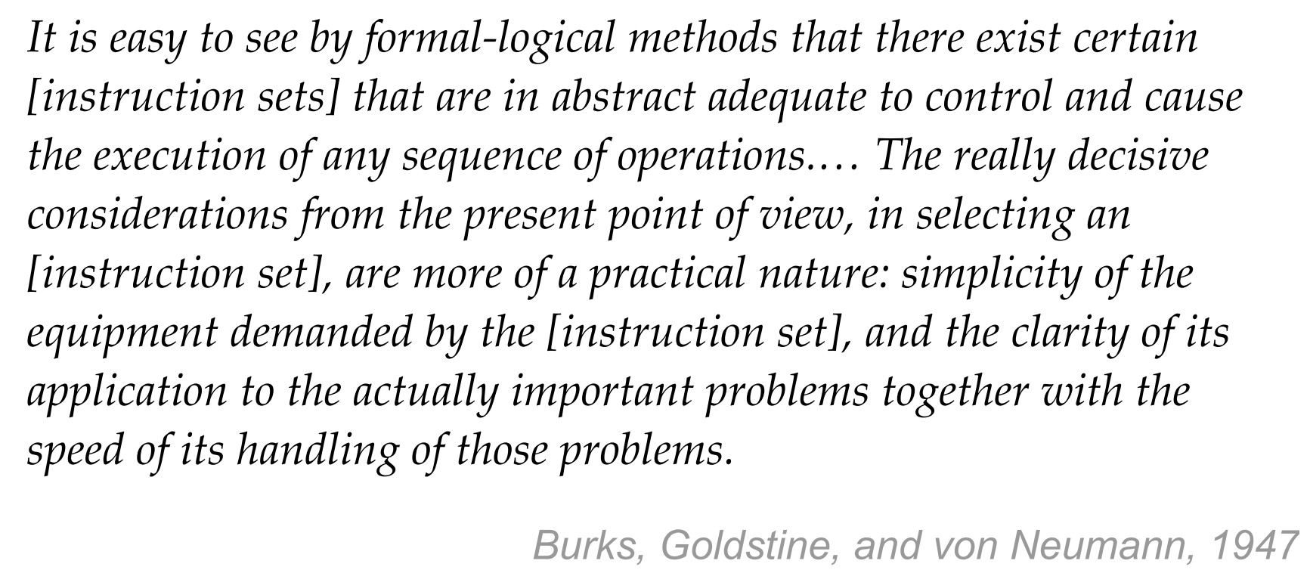
Different ISAs: More Like Regional Dialects

Slide 13
Some Thoughts of Instruction Formats
Short instruction length
Enough bits reserved for new opcodes
Distinct encoding and the illustration
Number of operands
Instruction alignment
  Byte-/word- level alignment
Always keep regularity
  Fixed instruction length
  Fixed bits of opcodes
  Fixed placement of operands
  …

Slide 14
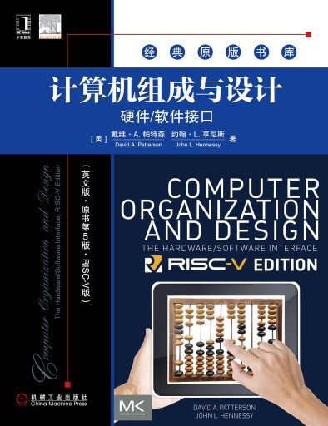
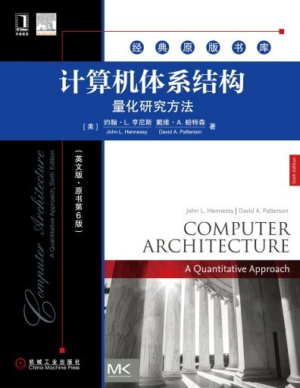
Design Principles
Underlying design principles, as articulated by Hennessy and Patterson:
  Simplicity favors regularity
  Make the common case fast
  Smaller is faster
  Good design demands good compromises

Slide 15
Design Principles
Simplicity favors regularity
  E.g., instruction size, instruction formats, data formats
  Eases implementation by simplifying hardware
Make the common case fast
  Fewer bits to read, move, & write
  Use/reuse the register file instead of memory
Smaller is faster
  E.g., small constants are common, thus immediate fields can be small
Good design demands good compromises
  Special formats for important exceptions
  E.g., a jump far away (beyond a small constant)

Slide 16
Overview
Introduction to ISA
About ISA design
  Issues in the design
  Operands and addressing modes
  Types of operations and encodings
  Evolution and classification

Slide 17
About ISA Design
Issues in the design
Operands and addressing modes
Types of operations and encodings
Evolution and classification

Slide 18
Basic Design Issues
What data types are supported and what size
What operations (and how many) should be provided
  LD/ST/INC/BRN sufficient to encode any computation, or just Sub and Branch!
  But not useful because programs too long!
How (and how many) operands are specified
  Most operations are dyadic (e.g., A <- B + C)
  Some are monadic (e.g., A <- ~B)
Location of operands and result
  Where other than memory?
  How many explicit operands?
  How are memory operands located?
  Which can or cannot be in memory?
  How are they addressed
How to encode these into consistent instruction formats
  Instructions should be multiples of basic data/address widths
  Encoding
Typical instruction set:
32-bit word
Basic operand addresses are 32 bits long
Basic operands, like integers, are 32 bits long
In general case, instruction could reference 3 operands (A := B + C)
Typical challenge:
Encode operations in a small number of bits
Notes:
Instruction set design issues include:
Where are operands stored?
registers, memory, stack, accumulator
How many explicit operands are there?
0, 1, 2, or 3
How is the operand location specified?
register, immediate, indirect, . . .
What type & size of operands are supported?
byte, int, float, double, string, vector. . .
What operations are supported?
add, sub, mul, move, compare . . .

Slide 19
About ISA Design
Issues in the design
Operands and addressing modes
Types of operations and encodings
Evolution and classification

Slide 20
Operands
One important design factor is the number of operands contained in each instruction
  Has a significant impact on the word size and complexity of the CPU
  E.g., lots of operands generally implies longer word size needed for an instruction
Consider how many operands we need for an ADD instruction
  If we want to add the contents of two memory locations together, then we need to be able to handle at least two memory addresses
  Where does the result of the add go? We need a third operand to specify the destination
  What instruction should be executed next?
    Usually the next instruction, but sometimes we might want to jump or branch somewhere else
    Do we need a fourth operand to specify the next instruction to execute?
If all of these operands are memory addresses, we need a really long instruction!

Slide 21
Number of Operands
In practice, we won’t really see a four-address instruction.
  Too much additional complexity in the CPU
  Long instruction word
  All operands won’t be used very frequently
Most instructions have one, two, or three operand addresses
  The next instruction is obtained by incrementing the program counter, with the exception of branch instructions
Let’s describe a hypothetical set of instructions to carry out the computation for:
Y = (A-B) / (C + (D * E))

Slide 22
Three-Operand Instructions
If we had a three-operand instruction, we could specify two source operands and a destination to store the result.
Here is a possible sequence of instructions for our equation:
Y = (A-B) / (C + (D * E))
  SUB R1, A, B ; Register R1 ← A - B
  MUL R2, D, E ; Register R2 ← D * E
  ADD R2, R2, C ; Register R2 ← R2 + C
  DIV R1, R1, R2 ; Register R1 ← R1 / R2
The three-address format is fairly convenient because we have the flexibility to dictate where the result of computations should go. Note that after this calculation is done, we haven’t changed the contents of any of our original locations A, B, C, D, or E.

Slide 23
Two-Operand Instructions
How can we cut down the number of operands?
  Might want to make the instruction shorter
Typical method is to assign a default destination operand to hold the results of the computation
  Result always goes into this operand
  Overwrites and old data in that location
Let’s say that the default destination is the first operand in the instruction
  First operand might be a register, memory, etc.

Slide 24
Two-Operand Instructions
Here is a possible sequence of instructions for our equation (say the operands are registers):
Y = (A-B) / (C + (D * E))
  SUB A, B ; Register A ← A - B
  MUL D, E ; Register D ← D * E
  ADD D, C ; Register D ← D + C
  DIV A, D ; Register A ← A / D
Get same end result as before, but we changed the contents of registers A and D
If we had some later processing that wanted to use the original contents of those registers, we must make a copy of them before performing the computation
  MOV R1, A ; Copy A to register R1
  MOV R2, D ; Copy D to register R2
  SUB R1, B ; Register R1 ← R1 - B
  MUL R2, E ; Register R2 ← R2 * E
  ADD R2, C ; Register R2 ← R2 + C
  DIV R1, R2 ; Register R1 ← R1 / R2
Now the original registers for A-E remain the same as before, but at the cost of some extra instructions to save the results.

Slide 25
One-Operand Instructions
Can use the same idea to get rid of the second operand, leaving only one operand
The second operand is left implicit; e.g., could assume that the second operand will always be in a register such as the Accumulator:
Y = (A-B) / (C + (D * E))
  LDA D ; Load ACC with D
  MUL E ; Acc ← Acc * E
  ADD C ; Acc ← Acc + C
  STO R1 ; Store Acc to R1
  LDA A ; Acc ← A
  SUB B ; Acc ← A-B
  DIV R1 ; Acc ← Acc / R1
Many early computers relied heavily on one-address based instructions, as it makes the CPU much simpler to design. As you can see, it does become somewhat more unwieldy to program.

Slide 26
Zero-Operand Instructions
In some cases, we can have zero-operand instructions
Uses the Stack
  Section of memory where we can add and remove items in LIFO order
    Last In, First Out
  Envision a stack of trays in a cafeteria; the last tray placed on the stack is the first one someone takes out
  The stack in the computer behaves the same way, but with data values
    PUSH A ; Places A on top of stack
    POP A ; Removes value on top of stack and puts result in A
    ADD ; Pops top two values off stack, pushes result back on
Notes:
Java VM vs. DalVik VM

Slide 27
Stack-Based Instructions
Y = (A-B) / (C + (D * E))
Instruction Stack Contents (stack increase ->)
PUSH B ; B
PUSH A ; B, A
SUB ; (A-B)
PUSH E ; (A-B), E
PUSH D ; (A-B), E, D
MUL ; (A-B), (E*D)
PUSH C ; (A-B), (E*D), C
ADD ; (A-B), (E*D+C)
DIV ; (A-B) / (E*D+C)

Slide 28
How many operands are best?
More operands
  More complex (powerful?) instructions
  Fewer instructions per program
More registers
  Inter-register operations are quicker
Fewer operands
  Less complex (powerful?) instructions
  More instructions per program
  Faster fetch/execution of instructions

Slide 29
Design Tradeoff Decisions
Operation repertoire
  How many ops?
  What can they do?
  How complex are they?
Data types
  What types of data should ops perform on?
Registers
  Number of registers, what ops on what registers?
Addressing
  Mode by which an address is specified (more on this later)

Slide 30
Addressing
Addressing modes specify where an operand is located.
They can specify a constant, a register, or a memory location.
The actual location of an operand is its effective address.
Certain addressing modes allow us to determine the address of an operand dynamically.

Slide 31
Addressing Modes
Addressing refers to how an operand refers to the data we are interested in for a particular instruction
In the Fetch part of the instruction cycle, there are several common ways to handle addressing in the instruction
  Immediate
  Direct
  Indirect
  Register Direct/Indirect
  Relative, Indexed and Based

Slide 32
Immediate Addressing
The operand directly contains the value we are interested in working with
  E.g., ADD #5
    Means add the number 5 to something
  This uses immediate addressing for the value 5
  The two’s complement representation for the number 5 is directly stored in the ADD instruction
  Must know value at assembly time

Slide 33
Direct Addressing
The operand contains an address with the data
  E.g., ADD 100
    Means to add (Contents of Memory Location 100) to something
  Downside: Need to fit entire address in the instruction, may limit address space
    E.g., 32-bit word size and 32-bit addresses. Do we have a problem here?
    Some solutions: specify offset only, use implied segment
  Must know address at assembly time

Slide 34
Indirect Addressing
The operand contains an address, and that address contains the address of the data
  E.g., Add [100]
    Means “The data at memory location 100 is an address. Go to the address stored there and get that data and add it to the Accumulator”
  Downside: Requires additional memory access
  Upside: Can store a full address at memory location 100
    First address must be fixed at assembly time, but second address can change during runtime! This is very useful for dynamically accessing different addresses in memory (e.g., traversing an array)
Indirect Addressing can be thought of as additional instruction subcycle

Slide 35
Register Direct/Indirect Addressing
Can do direct addressing with registers
  E.g., ADD R5
    Means to add (Contents of Register 5) to something
  Upside: Not that many registers, don’t have previous problem of the direct addressing
Can also do indirect addressing with registers
  E.g., Add [R3]
    Means “The data in register 3 is an address. Go to that address in memory, get the data, and add it to the Accumulator”

Slide 36
Other Addressing Modes
Relative addressing uses the PC register as an offset, which is added to the address in the operand to determine the effective address of the data.
Indexed addressing uses a register (implicitly or explicitly) as an offset, which is added to the address in the operand to determine the effective address of the data.
Based addressing is similar except that a base register is used instead of an index register.
The difference between Indexed addressing and Based addressing is that an index register holds an offset relative to the address given in the instruction, a base register holds a base address where the address field represents a displacement from this base.
Notes:
变址寻址（Indexed Addressing）‌是一种在计算机科学中常用的寻址方式，主要用于访问数组或类似结构的数据。变址寻址通过索引寄存器（如BX、SI、DI等）和偏移量来确定内存地址，从而访问数据。
变址寻址通过索引寄存器和偏移量来计算内存地址。具体过程如下：
‌索引寄存器‌：这些寄存器（如BX、SI、DI）通常用于存储数组的索引。
‌偏移量‌：这是一个附加的数值，用于调整索引寄存器的值。
‌地址计算‌：最终的数据地址是索引寄存器的值加上偏移量。例如，MOV AX, [BX+SI+10H]表示将内存地址计算为BX寄存器值加上SI寄存器值再加上偏移量10H的位置的数据加载到AX寄存器中‌12。
‌优点‌：
‌灵活性高‌：变址寻址允许动态地计算内存地址，特别适用于处理数组和复杂数据结构。
‌效率高‌：在处理大量数据时，变址寻址可以减少CPU访问内存的次数，提高数据处理的效率。
‌缺点‌：
‌地址计算复杂‌：需要额外的计算来确定内存地址，可能会增加CPU的负担。
‌寄存器限制‌：索引寄存器的数量有限，可能会限制操作的灵活性。
指令寻址的基本方式有七种，而不是两种。以下是每种寻址方式的具体定义和例子： 1. 直接寻址（Direct Addressing）： - 定义：指令中的地址码字段直接给出了操作数的有效地址。 - 例子：`LDA 1000`（假设`LDA`是加载指令，该指令将地址1000处的数据加载到某个寄存器或内存位置）。 2. 间接寻址（Indirect Addressing）： - 定义：指令中的地址码字段给出的是操作数有效地址所在的存储单元的地址，而不是操作数的直接地址。 - 例子：若A单元的内容是操作数的地址，则通过间接寻址访问A单元得到操作数的地址。 3. 立即寻址（Immediate Addressing）： - 定义：操作数直接包含在指令中，紧跟在地址码字段之后。 - 例子：`ADD 10, R1`（将立即数10与寄存器R1的内容相加）。 4. 寄存器寻址（Register Addressing）： - 定义：指令中的地址码字段直接给出寄存器编号，操作数存放在该寄存器中。 - 例子：`ADD R1, R2`（将寄存器R1和R2的内容相加）。 5. 寄存器间接寻址（Register Indirect Addressing）： - 定义：寄存器中的内容是操作数的地址。 - 例子：若寄存器R3的内容是操作数的地址，则通过寄存器间接寻址访问R3得到操作数的地址。 6. 基址寻址（Base Addressing）： - 定义：将基址寄存器（Base Register, BR）的内容与指令中给出的偏移量（Displacement）相加，得到操作数的有效地址。 - 例子：`LD BR+D, R1`（将基址寄存器BR的内容与偏移量D相加，得到的地址处的数据加载到寄存器R1）。 7. 变址寻址（Indexed Addressing）： - 定义：将变址寄存器（Index Register, IX）的内容与指令中给出的偏移量相加，得到操作数的有效地址。通常用于数组元素的访问。 - 例子：`LD IX+D, R1`（将变址寄存器IX的内容与偏移量D相加，得到的地址处的数据加载到寄存器R1

Slide 37
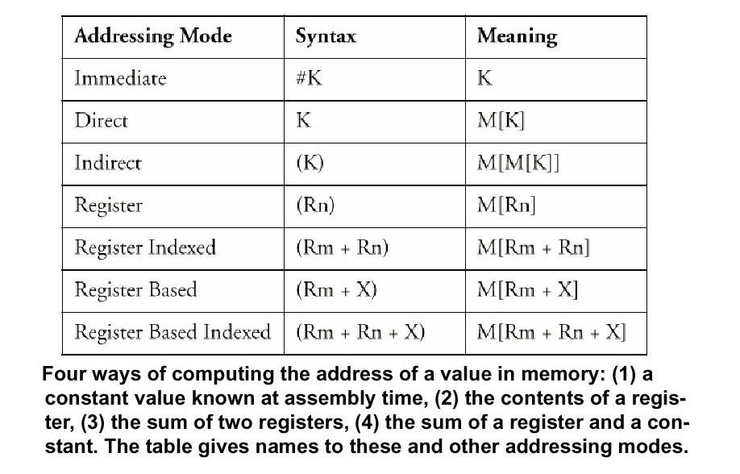
Summary - Addressing Modes

Slide 38
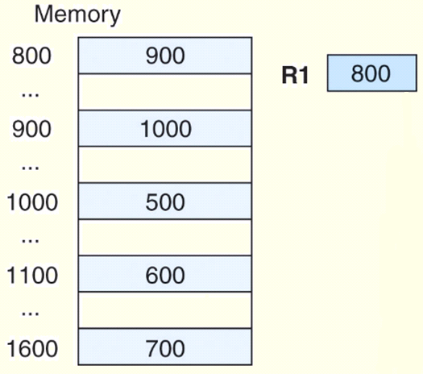
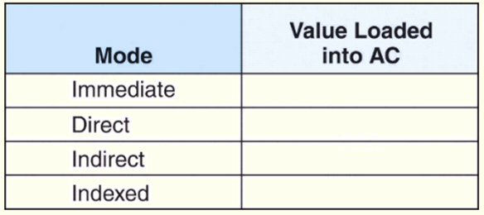
Addressing Example
What value is loaded into the accumulator for each addressing mode?
Load 800
Load 800
Load 800
Load R1[800]

Slide 39
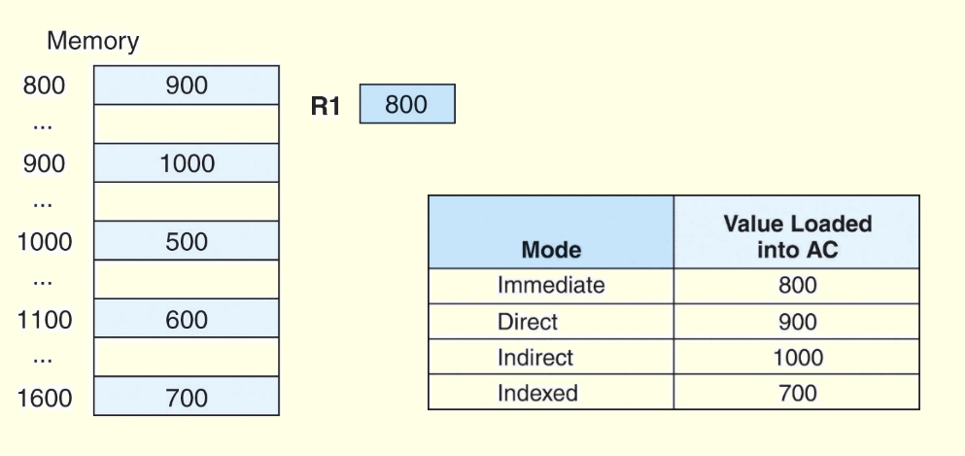
Addressing Example
These are the values loaded into the accumulator for each addressing mode.
Load 800
Load 800
Load 800
Load R1[800]
Load R1 Using Indirect Addressing?

Slide 40
About ISA Design
Issues in the design
Operands and addressing modes
Types of operations and encodings
Evolution and classification

Slide 41
Types of Operations
Arithmetic and Logic
Shift
Data Transfer
  E.g., MOV/LOAD/STORE
String
Control
  BRANCH/JMP/CALL/RET/…
System
  HALT/INTERRUPT ON/INTERRUPT OFF/SWITCH…
Input/Output
…

Slide 42
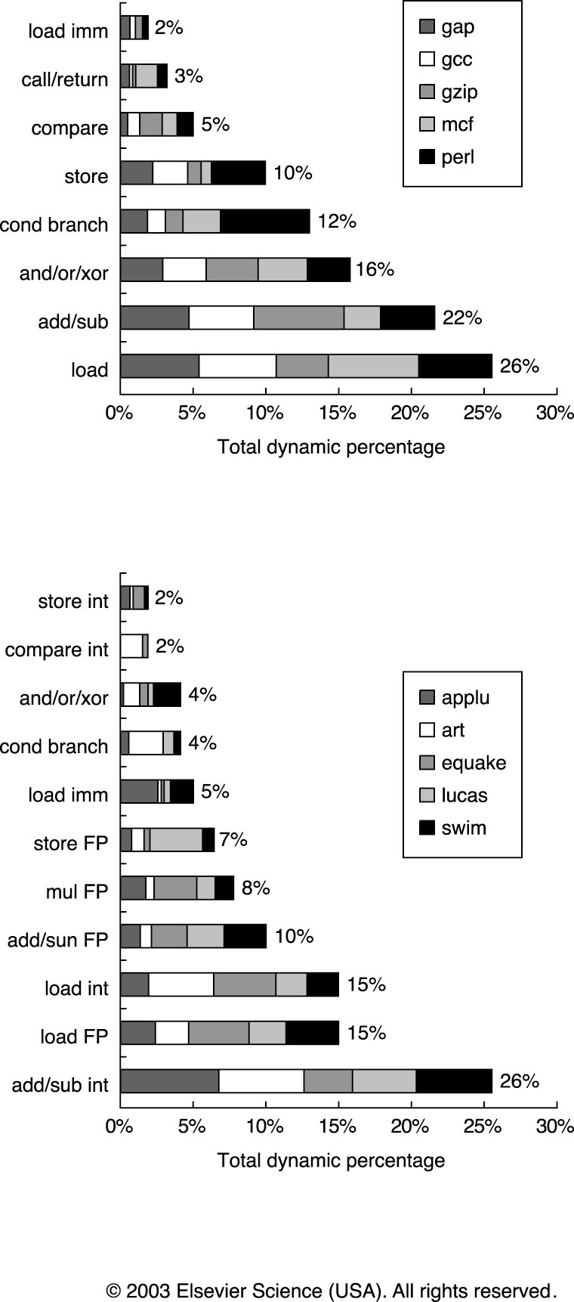
Typical Operations (little change since 1960)
Data Movement
Load (from memory)
Store (to memory)
memory-to-memory move
register-to-register move
input (from I/O device)
output (to I/O device)
push, pop (to/from stack)
Arithmetic
integer (binary + decimal) or FP
Add, Subtract, Multiply, Divide
Shift
shift left/right, rotate left/right
Logical
not, and, or, set, clear
Control (Jump/Branch)
unconditional, conditional
Subroutine Linkage
call, return
Interrupt
trap, return
Synchronization
test & set (atomic r-m-w)
String
search, translate
Graphics (MMX)
parallel subword ops (4 16bit add)

Slide 43
Types of Encodings
If code size is most important, use variable length instructions
If performance is most important, use fixed length instructions
Recent embedded machines (ARM, MIPS) added optional mode to execute subset of 16-bit wide instructions (Thumb, MIPS16); per procedure decide performance or density
Some architectures actually exploring on-the-fly decompression for more density.
Variable:
Fixed:
Hybrid:
…
…

Slide 44
About ISA Design
Issues in the design
Operands and addressing modes
Types of operations and encodings
Evolution and classification

Slide 45
Evolution of Instruction Sets
Single Accumulator (EDSAC 1950, Maurice Wilkes)
Accumulator + Index Registers
(Manchester Mark I, IBM 700 series 1953)
Separation of Programming Model
from Implementation
High-level Language Based
Concept of a Family
(B5000 1963)
(IBM 360 1964)
General Purpose Register Machines
Complex Instruction Sets
Load/Store Architecture
(Vax, Intel 432 1977-80)
(CDC 6600, Cray 1 1963-76)
CISC
RISC
Intel x86, Pentium
(MIPS,Sparc,HP-PA,IBM RS6000,PowerPC . . .1987)

Slide 46
CISC
Complex Instruction Set Computers
Close “semantic gap” between programming and execution
  Smaller code size (memory was expensive!)
  Simplify compilation
Another state machine (controlled by microcode) inside the machine
Example: x86, Intel 432, IBM 360, DEC VAX

Slide 47
CISC Example: x86
MOVSD ;; move a double word, 1-byte instruction
  MOVSD // m32[DS:EDI] = m32[DS:ESI]
REP;; 1-byte prefix to repeat string operations
REP MOVSD // count set up in ECX
LOCK ADD ds:[esi+ecx*2+0x67452301], 0xEFCDAB89 // 13-byte
F0 3E 81 84 4E 01 23 45 67 89 AB CD EF
prefix
[--][--]+disp32
ESI+ECX*2

Slide 48
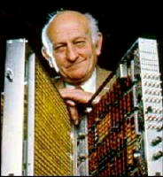
RISC
Observation made by IBM (John Cocke, Eckert-Mauchly Award’85, Turing Award’87,…)
  Few of the available instructions are used
CISC : “n+1” phenomenon
  Adding an instruction requiring an extra level of decoding logic can slow down the entire ISA
Reduced Instruction Set Computer
  Originated at IBM in 1975, a telephone project
  To achieve 12 MIPS (300 calls per sec, 20k inst per call)
  Simple instructions
  IBM 801 in 1978
  More compiler effort to gain performance
Notes:
ACM 图灵奖（1987）
IEEE 计算机先驱奖 （1989）
美国国家技术奖章（1991）
美国国家科学奖章（1994）
IEEE 约翰·冯诺依曼奖（1994）
RISC的概念由John Cocke提出，他发现计算机中约20%的指令承担了80%的工作量。RISC的设计理念是通过减少指令集的数量和复杂性，使微处理器能够以更快的速度执行操作。这种设计减少了每个指令类型所需的额外晶体管和电路元件，从而简化了硬件结构，提高了执行速度‌。

Slide 49
A Typical RISC
Smaller number of instructions
Fixed format instruction (e.g., 32 bits)
3-address, reg-to-reg arithmetic instructions
Single cycle operation for execution
Load-store architecture
Simple address modes
  Base + displacement
No indirection
Simple branch conditions
Hardwired control (No microcode)
More compiler effort
Examples:
  RISC I and RISC II at Berkeley
  MIPS (Microprocessors without Interlocked Pipe Stage) at Stanford
  IBM RISC Technology, Sun Sparc, HP PA-RISC, ARM

Slide 50
RISC Example: MIPS
R-format (Register-Register)
31
26
25
21
20
16
15
11
10
6
5
0
Op
Rs
Rt
Rd
Shamt
Funct
add $1, $2, $3
I-format (Register-Immediate)
31
26
25
21
20
16
15
0
immediate
addi $1, $2, -5
Op
Rs
Rt
I-format (Load/Store)
31
26
25
21
20
16
15
0
immediate
lw $1, 24($9)
Op
Base
Dest
I-format (Branch)
31
26
25
21
20
16
15
0
Op
Rs
Rt
immediate
beq L1, $4, $0
J-format (Jump / Call)
31
26
25
0
Op
target
j L2

Slide 51
CISC vs. RISC
CISC | RISC
Variable length instructions | Fixed-length instructions, single-cycle operation
Abundant instructions and addressing modes | Fewer instructions and addressing modes
Long, complex decoding | Simple decoding
Contain mem-to-mem operations | Load/store architecture
Use microcode | No microinstructions, directly decoded and executed by HW logic
Closer semantic gap (shift complexity to microcode) | Needs smart compilers, or intelligent hardware to reorder instructions
IBM 360, DEC VAX, x86, Moto 68030 | IBM 801, MIPS, RISC I, IBM POWER, Sun Sparc
Some definitions were from the paper by Colwell et al. in 1985

Slide 52
CISC vs. RISC (Reality)
CISC
RISC
 | IBM 370/168 | VAX 11/780 | Xerox Dorado | IBM 801 | Berkeley RISC1 | Stanford MIPS
Year introduced | 1973 | 1978 | 1978 | 1980 | 1981 | 1983
# instructions | 208 | 303 | 270 | 120 | 39 | 55
Microcode | 54KB | 61KB | 17KB | 0 | 0 | 0
Instruction size | 2 to 6 B | 2 to 57 B | 1 to 3 B | 4B | 4B | 4B
Execution model | Reg-reg Reg-mem Mem-mem | Reg-reg Reg-mem Mem-mem | Stack | Reg-reg | Reg-reg | Reg-reg

Slide 53
Observation and Controversy
“Instruction Set and Beyond: Computers, Complexity and Controversy” by Bob Colwell (Eckert-Mauchly Award, 2005) and gang from CMU, also see response from RISC camp: Patterson (Eckert-Mauchly Award, 2008) and Hennessy (Eckert-Mauchly Award, 2001)
CISC/RISC classification should *NOT* be a dichotomy!
Case in point: MicroVAX-32 by DEC, a single chip implementation
  Subsetting VAX instructions (but still, 175 instructions!)
  Emulate complex instructions
  A RISC or a CISC? (Well, it has variable length instructions, not a ld/st machine, with a microcode control, have all VAX addressing mode)

Slide 54
Observation and Controversy
Effective processor design = CISC experiences + RISC tenets
RISC features are not incompatible or mutually exclusive
  Large register file (w/ register windows)
RISC/CISC issues are best considered in light of their function-to-implementation level assignment

Slide 55
Modern X86 Machine Design
CISC outfit + RISC inside
E.g., Intel P6/Netburst/Core, AMD Athlon/Phenom/Opteron
Each x86 instruction is decoded into “micro-op” (μ op) or “RISC-op” on-the-fly
Internal microarchitecture resembles RISC design philosophy
Processor dynamically schedules “μ ops”
Compiler’s scheduling is still beneficial

Slide 56
Recent ISA Design Trend
Look at this instruction in MIPS (CISC or RISC?)
CABS.LE.PS $fcc0, $f8, $f10 ;; |y|≤|w| , |x| ≤ |w|?
Many complex instructions emerged for new apps
  Viterbi instruction for wireless communication/DSP
  Sum of absolute differences in SSE (PSAD) or other DSP: C = ∑|A-B| for MPEG (motion estimation)
In embedded domain, code size is critical
Reducing programming efforts
Optimizing performance via
  Specialized hardware (accelerator-based)
  Co-processor (controlled by main processor)
  ISA plug-in (flexible)

Slide 57
Classification of ISAs
Accumulator (before 1960, e.g., 68HC11):
  1-address add A acc ← acc + mem[A]
Stack (1960s to 1970s):
  0-address add tos ← tos + next
Memory-Memory (1970s to 1980s):
  2-address add A, B mem[A] ← mem[A] + mem[B]
  3-address add A, B, C mem[A] ← mem[B] + mem[C]
Register-Memory (1970s to present, e.g., 80x86):
  2-address add R1, A R1 ← R1 + mem[A]
load R1, A R1 ← mem[A]
Register-Register (Load/Store) (1960s to present, e.g., MIPS):
  3-address add R1, R2, R3 R1 ← R2 + R3
load R1, R2 R1 ← mem[R2]
store R1, R2 mem[R1] ← R2

Slide 58
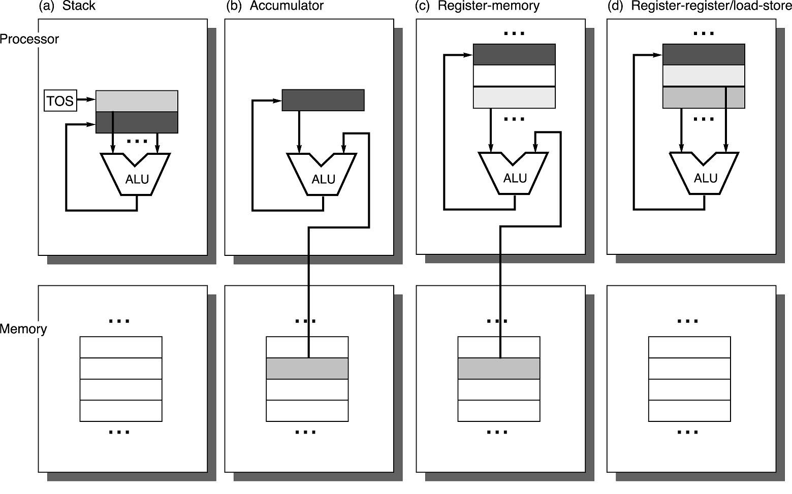
Operand Locations in Four ISA Classes
GPR

Slide 59
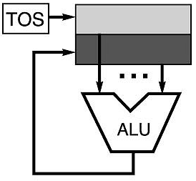
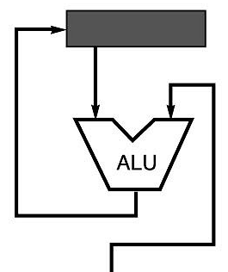
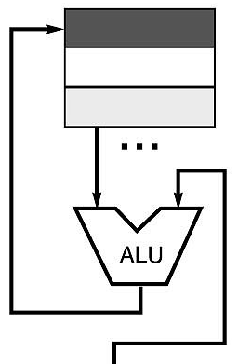
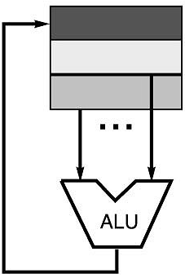
Code Sequence C = A + B for Four Instruction Sets
Stack | Accumulator | Register (register-memory) | Register (load-store)
Push A Push B Add Pop C | Load A Add B Store C | Load R1, A Add R1, B Store C, R1 | Load R1,A Load R2, B Add R3, R1, R2 Store C, R3
memory
memory
acc = acc + mem[C]
R1 = R1 + mem[C]
R3 = R1 + R2

Slide 60
More About General Purpose Registers
Why do almost all new architectures use GPRs?
  Registers are much faster than memory (even cache)
    Register values are available immediately
    When memory isn’t ready, processor must wait (“stall”)
Registers are convenient for variable storage
    Compiler assigns some variables just to registers
    More compact code since small fields specify registers
    (compared to memory addresses)
Processor
Memory
Disk
Registers
Cache

Slide 61
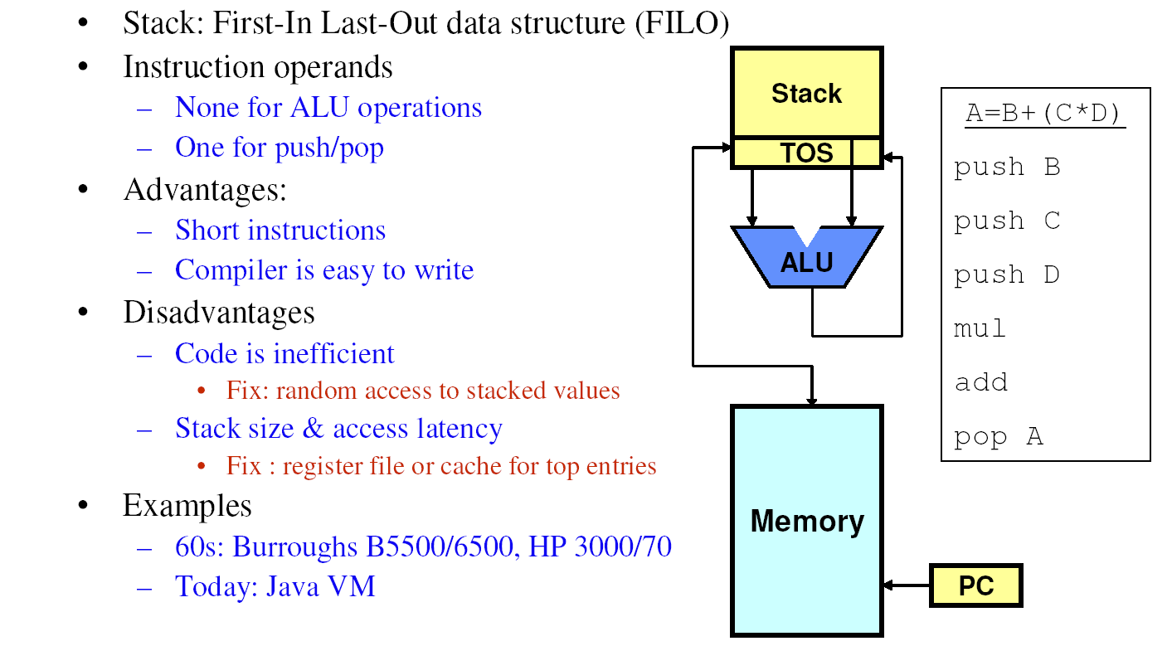
Stack Architectures

Slide 62
Stacks: Pros and Cons
Pros
  Good code density (implicit top of stack)
  Low hardware requirements
  Easy to write a simpler compiler for stack architectures
Cons
  Stack becomes the bottleneck
  Little ability for parallelism or pipelining
  Data is not always at the top of stack when need, so additional instructions like TOP and SWAP are needed
  Difficult to write an optimizing compiler for stack architectures

Slide 63
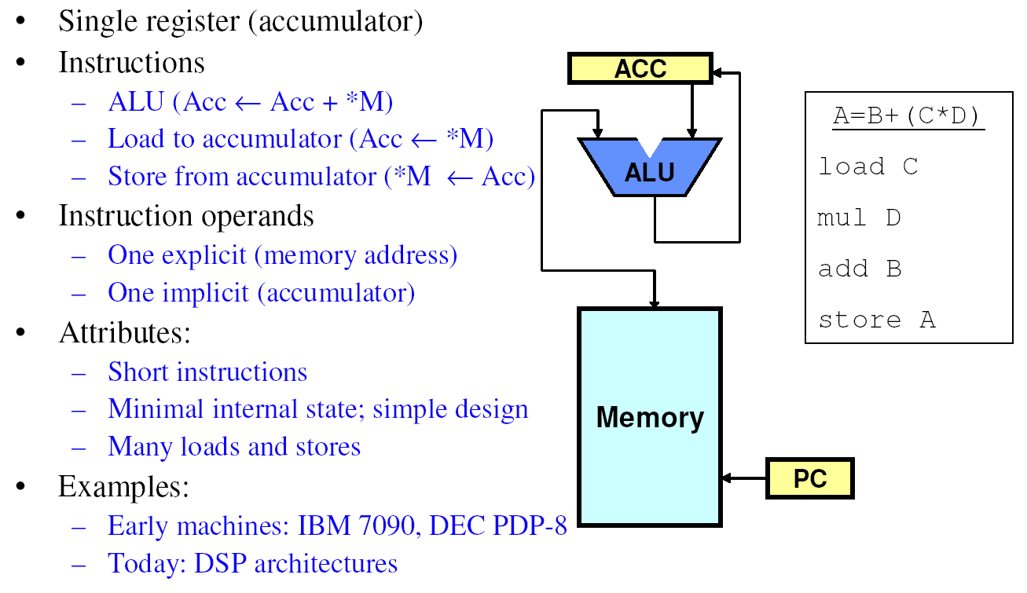
Accumulator Architectures

Slide 64
Accumulators: Pros and Cons
Pros
  Very low hardware requirements
  Easy to design and understand
Cons
  Accumulator becomes the bottleneck
  Little ability for parallelism or pipelining
  High memory traffic

Slide 65
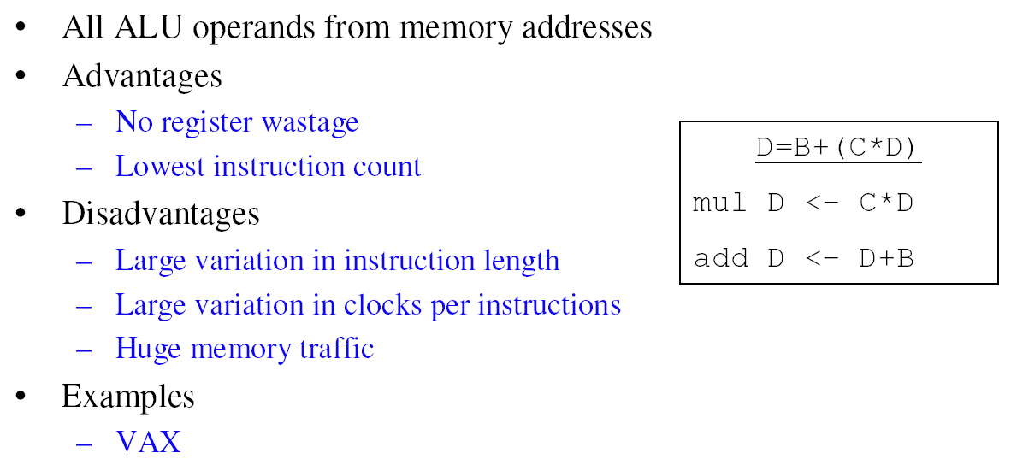
Memory-Memory Architectures

Slide 66
Memory-Memory: Pros and Cons
Pros
  Requires fewer instructions (especially if 3 operands)
  Easy to write compilers for (especially if 3 operands)
Cons
  Very high memory traffic (especially if 3 operands)
  Variable number of clocks per instruction
  With two operands, more data movements are required

Slide 67
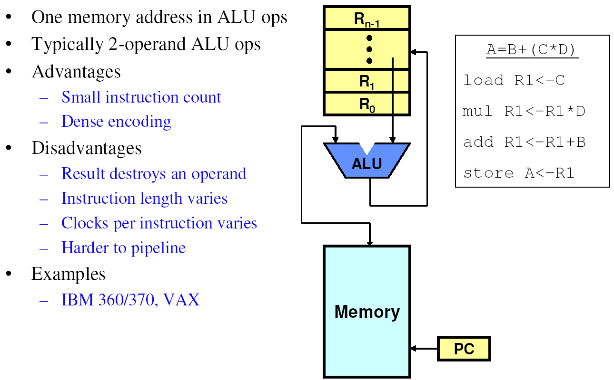
Register-Memory Architectures

Slide 68
Register-Memory: Pros and Cons
Pros
  Some data can be accessed without loading first
  Instruction format easy to encode
  Good code density
Cons
  Operands are not equivalent (poor orthogonal)
  Variable number of clocks per instruction
  May limit number of registers

Slide 69
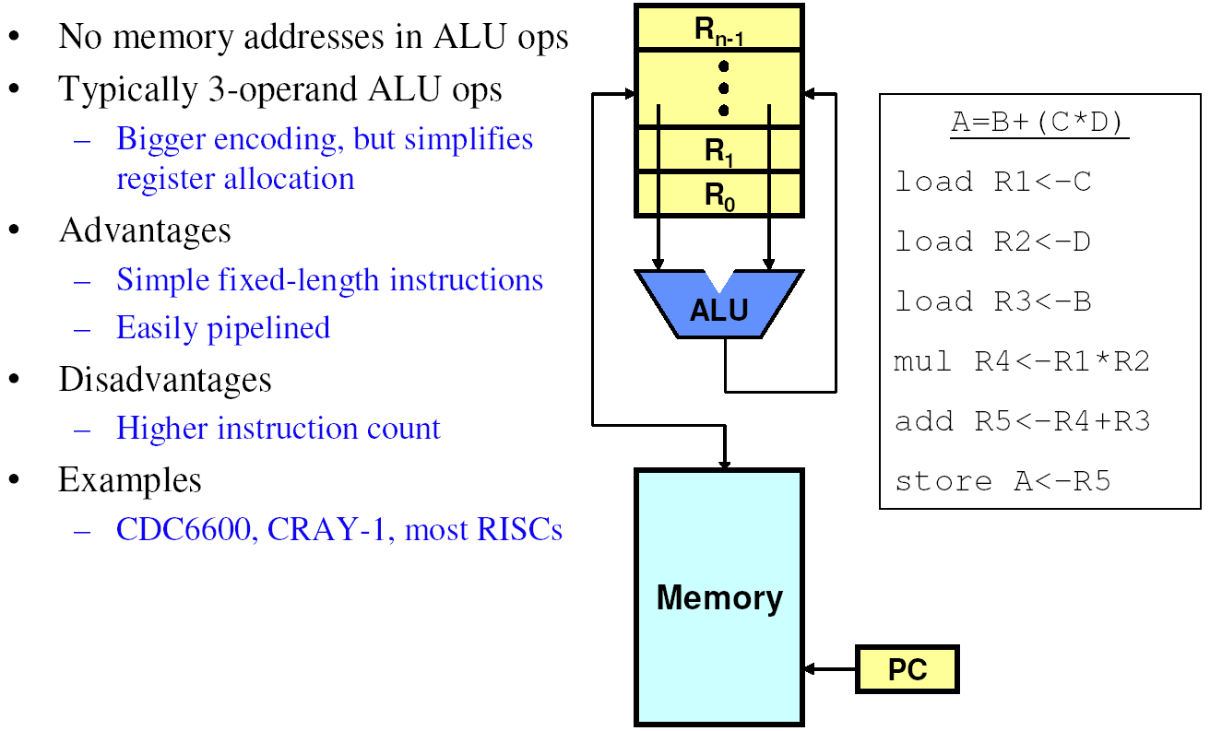
Load-Store Architectures

Slide 70
Load-Store: Pros and Cons
Pros
  Simple, fixed length instruction encodings
  Instructions take similar number of cycles
  Relatively easy to pipeline and make superscalar
Cons
  Higher instruction count
  Not all instructions need three operands
  Dependent on good compiler

Slide 71
Registers:
Advantages and Disadvantages
Advantages
  Faster than cache or main memory (no addressing mode or tags)
  Deterministic (no misses)
  Can replicate (multiple read ports)
  Short identifier (typically 3 to 8 bits)
  Reduce memory traffic
Disadvantages
  Need to save and restore on procedure calls and context switch
  Can’t take the address of a register (for pointers)
  Fixed size (can’t store strings or structures efficiently)
  Compiler must manage
  Limited number
Every ISA designed after 1980 uses a load-store ISA (i.e., RISC, to simplify CPU design).

