Slide 1
RISCV ISA
Boxi Wu / Xiaofei He
Zhejiang University

Slide 2
Overview
RISC-V ISA
RISC-V Assembly Language

Slide 3

What is RISC-V?
RISC-V (pronounced "risk-five”) is an ISA standard
  An open-source implementation of a reduced instruction set computing (RISC) based instruction set architecture (ISA)
  There was RISC-I, II, III, IV before
Most ISAs: X86, ARM, Power, MIPS, SPARC
  Commercially protected by patents
  Preventing practical efforts to reproduce the computer systems.
RISC-V is open
  Permitting any person or group to construct compatible computers
  Use associated software
Originated in 2010 by researchers at UC Berkeley
  Krste Asanović, David Patterson and students
ISA Specifications
  Unprivileged specification version 20191213 (v2.2)
  Privileged specification version 20211203 (v1.11)
  More on github: https://github.com/riscv/riscv-isa-manual
https://riscv.org/
Notes:
操作数和地址码

Slide 4
Goals in Defining RISC-V
A completely open ISA that is freely available to academia and industry
A real ISA suitable for direct native hardware implementation, not just simulation nor binary translation
An ISA that avoids “over-architecting” for
  A particular microarchitecture style (e.g., microcoded, in-order, decoupled, out-of-order) or
  Implementation technology (e.g., full-custom, ASIC, FPGA), but which allows efficient implementation in any of these
RISC-V ISA includes
  A small base integer ISA, usable by itself as a base for customized accelerators or for educational purposes, and
  Optional standard extensions, to support general-purpose software development
  Optional customer extensions
Support for the revised 2008 IEEE-754 floating-point standard
Notes:
The goal for RISC-V (“RISC five”) is to become a universal instruction set architecture (ISA):
• It should suit all sizes of processors, from the tiniest embedded controller to the fastest high-performance computer.
• It should work well with a wide variety of popular software stacks and programming languages.
• It should accommodate all implementation technologies: Field-Programmable Gate Arrays (FPGAs), Application-Specific Integrated Circuits (ASICs), full-custom chips, and even future device technologies.
• It should be efficient for all microarchitecture styles: microcoded or hardwired control; in-order, decoupled, or out-of-order pipelines; single or superscalar instruction issue; and so on.
• It should support extensive specialization to act as a base for customized accelerators, which rise in importance as Moore’s Law fades.
• It should be stable, in that the base ISA should not change. More importantly, the ISA cannot be discontinued, as has happened in the past to proprietary ISAs such as the AMD Am29000, the Digital Alpha, the Digital VAX, the Hewlett Packard PA-RISC, the Intel i860, the Intel i960, the Motorola 88000, and the Zilog Z8000.

Slide 5
RISC-V Principles
Generally kept very simple and extendable
  Whether short, long, or variable
Separated into multiple specifications
  User-level ISA spec (compute instructions)
  Compressed ISA spec (16-bit instructions)
  Privileged ISA spec (supervisor-mode instructions)
  More…
ISA support is given by RV + word-width + extensions supported
  E.g., RV32I means 32-bit RISC-V with support for the I (integer) instruction set

Slide 6
User-Level ISA
Defines the normal instructions needed for computation
  A mandatory base integer ISA
    I: Integer instructions:
      ALU
      Branches/jumps
      Loads/stores
  Standard extensions
    M: Integer Multiplication and Division
    A: Atomic Instructions
    F: Single-Precision Floating-Point
    D: Double-Precision Floating-Point
    C: Compressed Instructions (16 bit)
    G = IMAFD: integer base + four standard extensions
  Optional extensions

Slide 7
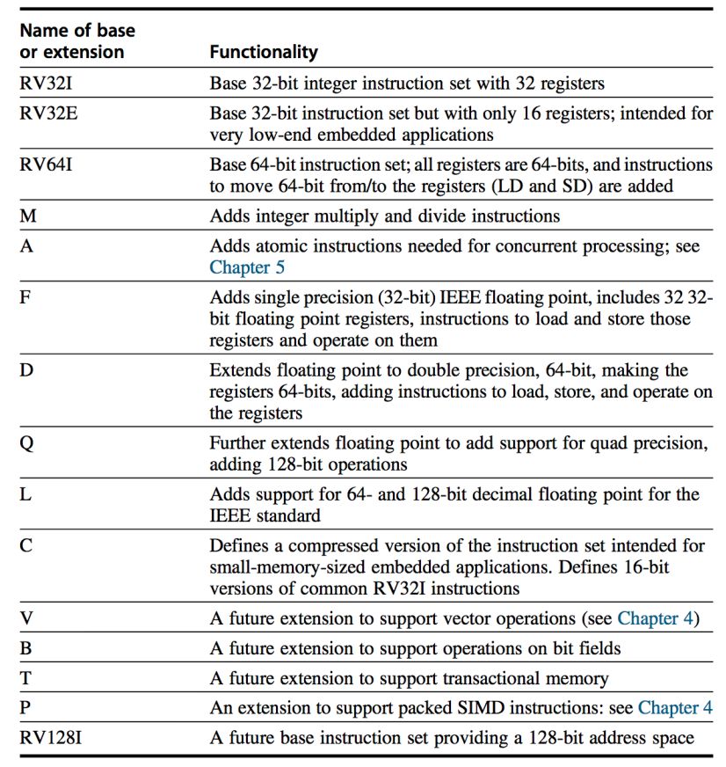
Basic RISC-V ISA
Both 32-bit and 64-bit address space variants
  RV32 and RV64
Easy to subset/extend for education/research
  RV32IM, RV32IMA, RV32IMAFD, RV32G
SPEC on the website
  www.riscv.org

Slide 8
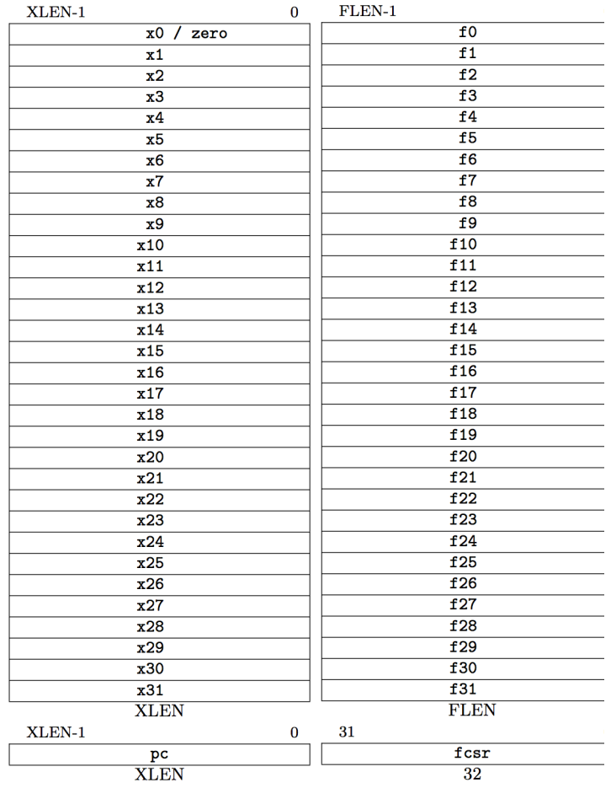
RISC-V Processor State
Program counter (PC)
32 32/64-bit integer registers (x0-x31)
  x0 always contains a 0
  x1 to hold the return address on a call.
32 floating-point (FP) registers (f0-f31)
  Each can contain a single- or double-precision FP value (32-bit or 64-bit IEEE FP)
FP status register (fsr), used for FP rounding mode & exception reporting

Slide 9
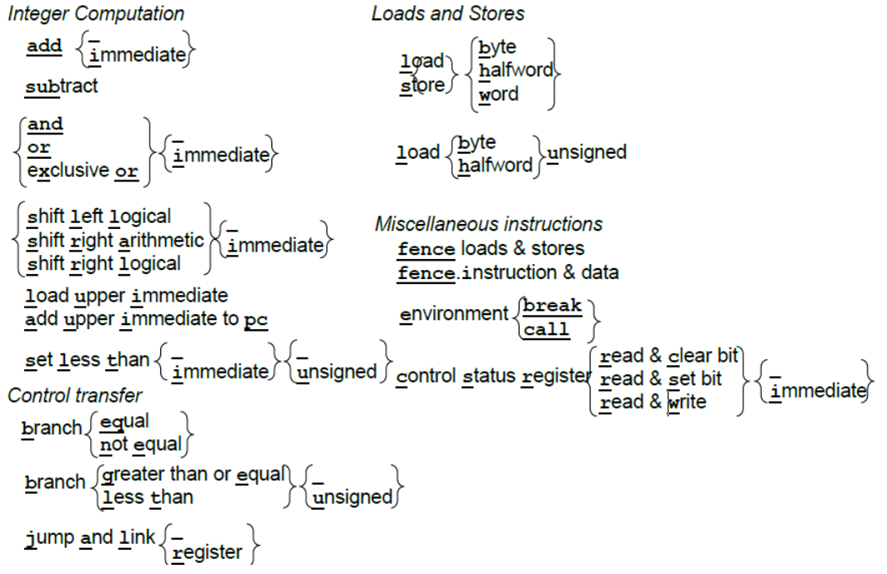
RV32I

Slide 10
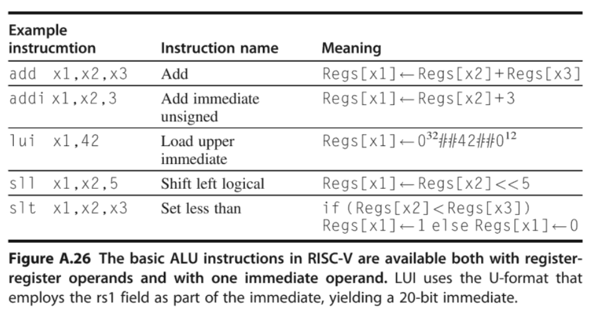
ALU Instructions

Slide 11
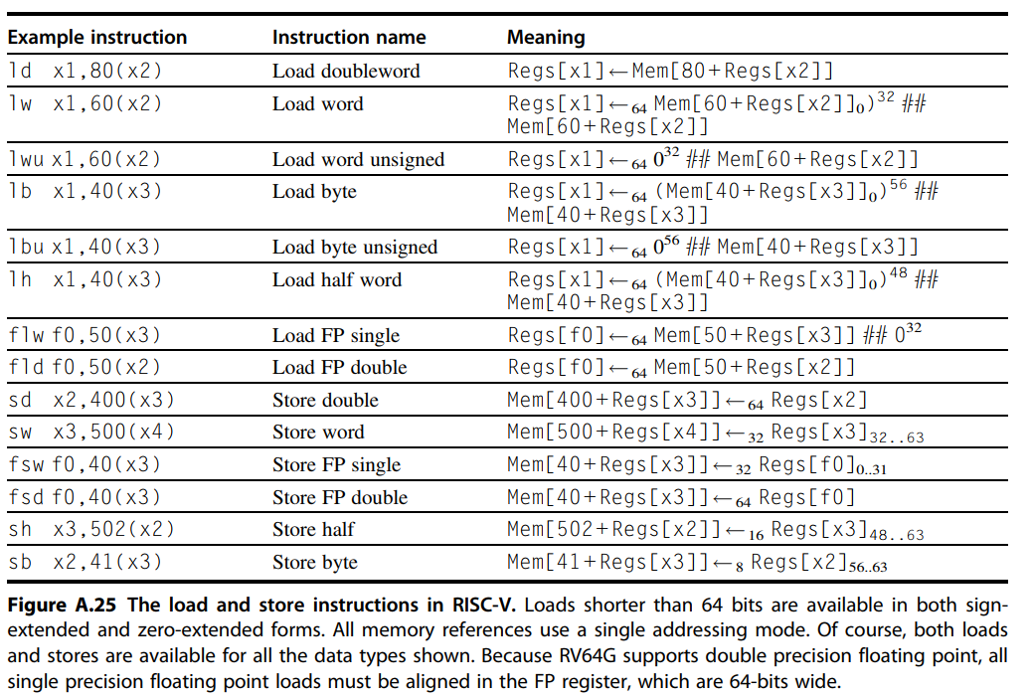
Load/Store Instructions

Slide 12
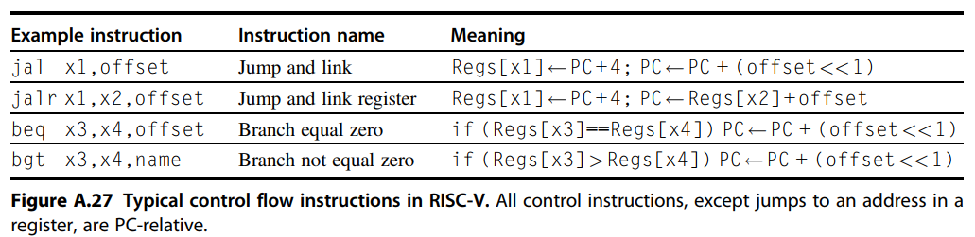
Control Transfer Instructions

Slide 13
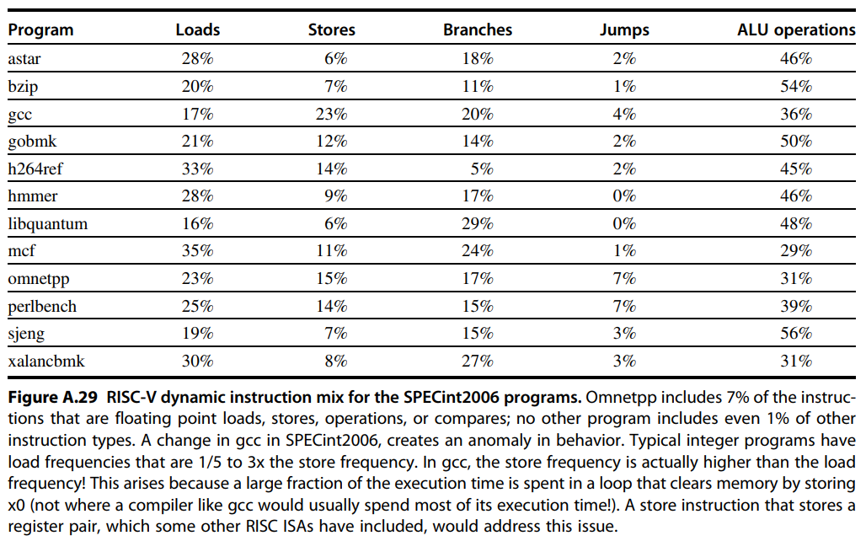
RISC-V Dynamic Instruction Mix for SPECint2006

Slide 14
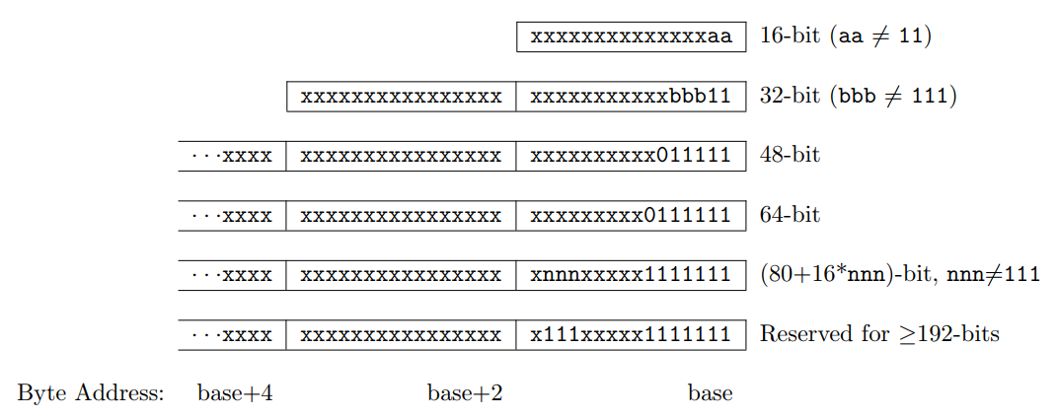
RISC-V Hybrid Instruction Encoding
16, 32, 48, 64, … bits length encoding
Base instruction set (RV32) always has fixed 32-bit instructions with lowest two bits = 11₂
All branches and jumps have targets at 16-bit granularity (even in base ISA where all instructions are fixed 32 bits)
Notes:
The base RISC-V ISA has fixed-length 32-bit instructions that must be naturally aligned on 32-bit
boundaries. However, the standard RISC-V encoding scheme is designed to support ISA extensions
with variable-length instructions, where each instruction can be any number of 16-bit instruction
parcels in length and parcels are naturally aligned on 16-bit boundaries. The standard compressed
ISA extension described in Chapter 16 reduces code size by providing compressed 16-bit instructions
and relaxes the alignment constraints to allow all instructions (16 bit and 32 bit) to be aligned on
any 16-bit boundary to improve code density.
We use the term IALIGN (measured in bits) to refer to the instruction-address alignment constraint
the implementation enforces. IALIGN is 32 bits in the base ISA, but some ISA extensions, including
the compressed ISA extension, relax IALIGN to 16 bits. IALIGN may not take on any value other
than 16 or 32.
We use the term ILEN (measured in bits) to refer to the maximum instruction length supported
by an implementation, and which is always a multiple of IALIGN. For implementations supporting
only a base instruction set, ILEN is 32 bits. Implementations supporting longer instructions have
larger values of ILEN.
Only the 16-bit and 32-bit encodings are considered frozen at this time.

Slide 15
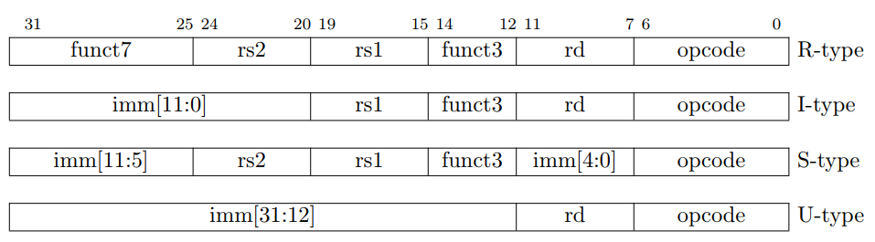
Four Core RISC-V Instruction Formats
https://github.com/riscv/riscv-opcodes/
Additional opcode bits/immediate
Additional opcode bits
7-bit opcode field
(but low 2 bits = 112)
Reg. Source 2
Reg. Source 1
Destination Reg.
Aligned on a four-byte boundary in memory. There are variants!
Sign bit of immediates always on bit 31 of instruction. Register fields never move.

Slide 16
RISC-V Encoding Summary
Name | Field |  |  |  |  |  | Comments
Field size | 7 bits | 5 bits | 5 bits | 3 bits | 5 bits | 7 bits
R-type | funct7 | rs2 | rs1 | funct3 | rd | opcode | Arithmetic instruction format
I-type | imm[11:0] |  | rs1 | funct3 | rd | opcode | Loads & immediate arithmetic
S-type | imm[11:5] | rs2 | rs1 | funct3 | imm[4:0] | opcode | Stores
B-type | imm[12,10:5] | rs2 | rs1 | funct3 | imm[4:1,11] | opcode | Conditional branch format
J-type | imm[20,10:1,11,19:12] |  |  |  | rd | opcode | Unconditional jump format
U-type | imm[31:12] |  |  |  | rd | opcode | Upper immediate format
Notes:
用于寄存器-寄存器操作的 R 类型指令
用于短立即数和访存 load 操作的 I 型指令
用于访存 store 操作的 S 型指令
用于条件跳转操 作的 B 类型指令
用于长立即数的 U 型指令
用于无条件跳转的 J 型指令

Slide 17
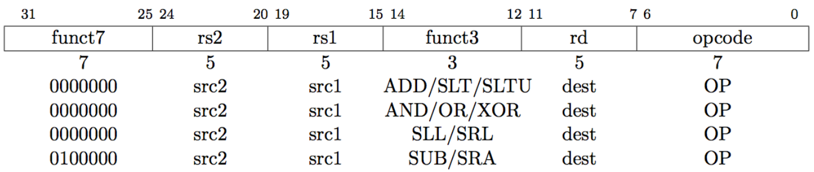
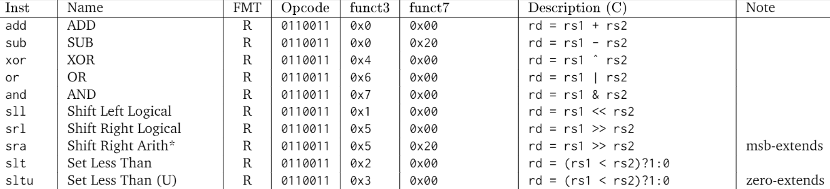
ALU Instructions: R-Type
R-type (Register)
  rs1 and rs2 are the source register, rd is the destination
  ADD/SUB
  SLT, SLTU: set less than
  SRL, SLL, SRA: shift logic or arithmetic left or right
Notes:
Not只有一个操作数，为了保持双操作数的模式，用xor代替
Not(A)= = A xor 111…..111

Slide 18
RISC-V code
  add x9, x20, x21
  Decimal version of machine code
  | 0 | 21 | 20 | 0 | 9 | 51 |
  Binary version of machine code
  | 0000000 | 10101 | 10100 | 000 | 01001 | 0110011 |
  7 bits 5 bits 5 bits 3 bits 5 bits 7 bits
0000 0001 0101 1010 0000 0100 1011 0011_{two} = 0x 015A04B3
Notes:
一条指令的每一段称为一个字段。每个字段有固定的长度。指令的这种分段设计叫做指令格式 (format)
0，0，51这三个字段组合起来指明要进行加法操作。
指令的符号表示叫汇编语言，数字表示叫机器语言（机器码），
二进制字串太冗长，我们通常用16进制表示。

Slide 19
And Operations
AND operator
Useful to mask bits in a word
  Select some bits, clear others to 0
  It is bit-by-bit (bitwise-AND)
    Result=1 : both bits of the operands are 1
and x9,x10,x11
x10
00000000 00000000 00000000 00000000 00000000 00000000 00001101 11000000
x11
00000000 00000000 00000000 00000000 00000000 00000000 00111100 00000000
x9
00000000 00000000 00000000 00000000 00000000 00000000 00001100 00000000
Notes:
掩码：当源操作数某位是0，可以将目标数对应位设置为0
Or: Set some bits to 1, leave others unchanged

Slide 20
XOR Operations
Differencing operation
  Set some bits to 1, leave others unchanged
xor x9,x10,x12 // NOT operation
x10
00000000 00000000 00000000 00000000 00000000 00000000 00001101 11000000
x12
11111111 11111111 11111111 11111111 11111111 11111111 11111111 11111111
x9
11111111 11111111 11111111 11111111 11111111 11111111 11110010 00111111
Notes:
Not只有一个操作数，为了保持双操作数的模式，用xor代替
Not(A)= = A xor 111…..111
在与立即数进行逻辑操作时，立即数的高位补0，
而addi，立即数进行符号扩展。

Slide 21
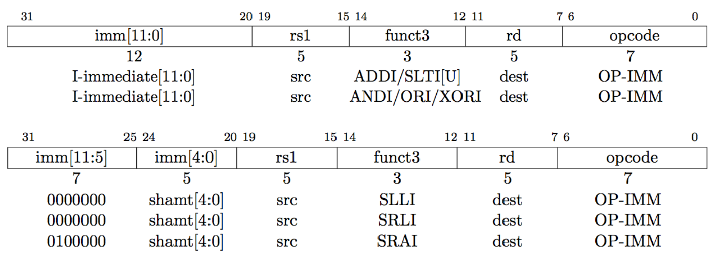
ALU Instructions: I-Type
I-type (immediate), all immediates in all instructions are sign extended
  ADDI: adds sign extended 12-bit immediate to rs1
  SLTI(U): set less than immediate
  ANDI/ORI/XORI: logical operations
  SLLI/SRLI/SRAI: shifts by constants
I-type instructions end with I
Notes:
No SUB here.
Immediate arithmetic and load instructions
rs1: source or base address register number
immediate: constant operand, or offset added to base address
2’s-complement, sign extended
Design principle: good design demands good compromises
Different formats complicate decoding, but allow 32-bit instructions uniformly
Keep formats as similar as possible
在与立即数进行逻辑操作时，立即数的高位补0，
而addi，立即数进行符号扩展。
shamt: shift amount

Slide 22
Shift Operations
Shift operator
  Move all the bits in a word to left or right, filling emptied bits with 0
  Shifting left by i is same result as multiplying by 2^{i}
  0000 0000 0000 0000 0000 0000 0000 1001 (9)₁₀
  Shift left 4
  0000 0000 0000 0000 0000 0000 1001 0000 (9×16=144)₁₀
  slli x11, x19, 4 // reg x11=reg x19 << 4 bit
6 bits
6 bits
Funct6 | immediate | rs1 | funct3 | rd | opcode
0 | 4 | 19 | 1 | 11 | 19
Notes:
这些移位指令使用I型格式。因为寄存器64位，最多移动63位，所以12位的immediate字段只有低6位被使用，高6位被重新用作额外的操作码，funct6

Slide 23
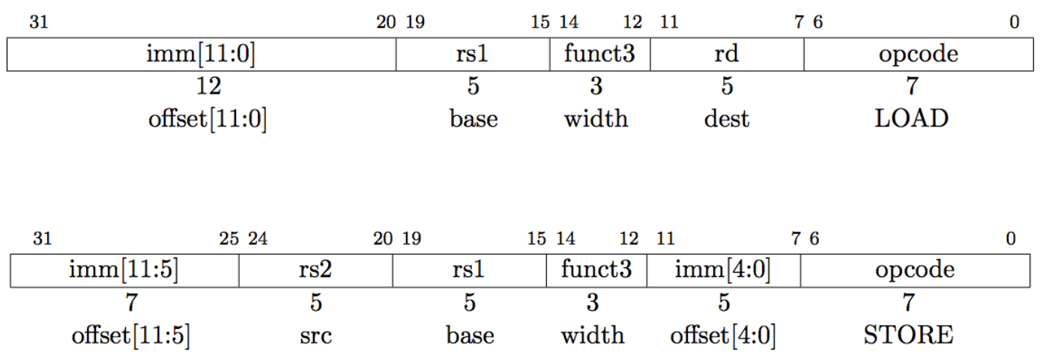
Load/Store Instructions: I/S-Type
Load instruction (I-type)
  rd = MEM (rs1 + imm)
Store instruction (S-type)
  MEM (rs1 + imm) = rs2
Notes:
Different immediate format for store instructions
rs1: base address register number
rs2: source operand register number
immediate: offset added to base address
Split so that rs1 and rs2 fields always in the same place

Slide 24
I-format
  ld x9, 64(x22)
| 64 | 22 | 011 | 9 | 0000011 |
  12 bits 5 bits 3 bits 5 bits 7 bits
S-format
  sd x9, 64(x22)
| 2 | 9 | 22 | 011 | 0 | 0100011 |
  7 bits 5 bits 5 bits 3 bits 5 bits 7 bits
S_imm = {{20{inst[31]}}, Inst[31:25], inst[11:7]};

Slide 25
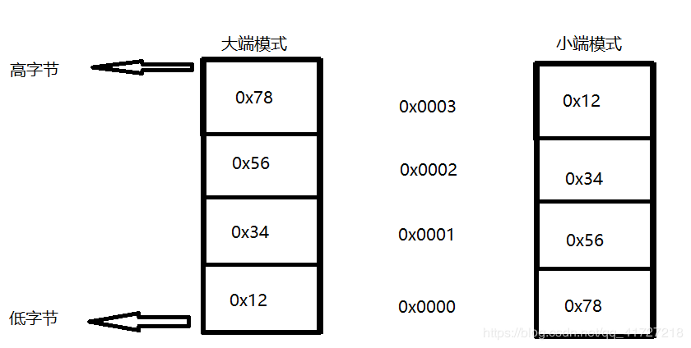
Endianness/byte order
Big endian：
  数据的高字节存放在低地址；
  数据的低字节存放在高地址
  PowerPC
Little endian：
  数据的高字节存放在高地址；
  数据的低字节存放在低地址
  RISC-V
E.g. : 32位机器上存放0x12345678，其大小端模式存储如下：
Notes:
小端模式便于机器处理, 大端模式方便人阅读
C/C++语言编写的程序里数据存储顺序是跟编译平台所在的CPU相关的，现在比较普遍的x86是小端
而JAVA编写的程序则唯一采用big endian方式来存储数据。
所有网络协议也都是采用big endian的方式来传输数据的。所以有时我们也会把big endian方式称之为网络字节序。
目前应该little endian是主流，因为在数据类型转换的时候（尤其是指针转换）不用考虑地址问题。

Slide 26
Memory Alignment
struct {
int a;
char b;
char c[2];
char d[3]
float e;
}
Alignment restriction
e
d[1]
d[2]
No use
No use
b
c[0]
c[1]
d[0]
a
No alignment restriction
e
No use
No use
因为一次只能读出4字节内存中的一行
这样布局，e变量不能一次读出
d[1]
d[2]
e
b
c[0]
c[1]
d[0]
a
Notes:
When a word (4 bytes) is loaded or stored the memory address must be a multiple of four. This is called an alignment restriction. Addresses that are a multiple of four are called word aligned. This restriction makes the hardware simpler and faster.
The lw instruction loads a word into a register from memory. The sw instruction stores a word from a register into memory. Each instruction specifies a register and a memory address (details in a few pages).
如果边界不对齐，需要两个时钟周期去访问，MIPS不支持，会产生中断。
有的是支持访问两个字节，半字，load half word

Slide 27
g = h + A[i]
Compiling using a variable array index
  C code:
  g = h + A[i] ; // A is an array of 100 doublewords
  ( Assume: g, h, i -- x1, x2, x4 base address of A -- x3 )
  RISC-V code:
  add x5, x4, x4 # temp reg x5 = 2 * i
  add x5, x5, x5 # temp reg x5 = 4 * i
  add x5, x5, x5 # temp reg x5 = 8 * i
  add x5, x5, x3 # x5 = address of A[i] (8 * i + x3)
  ld x6, 0(x5) # temp reg x6 = A[i]
  add x1, x2, x6 # g = h + A[i]
Notes:
所以我们也知道机器语言是怎么样支持数组的，对数组一定会分配连续的一段空间，一定会有一个首地址，数组的基地址。存取数据的时候需要计算偏移量。

Slide 28
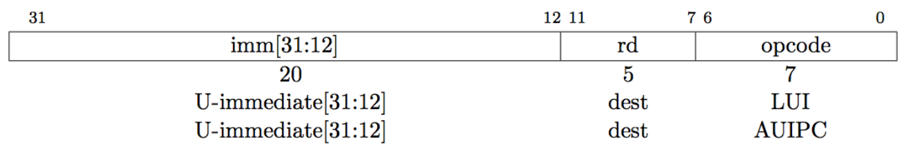
ALU Instructions: U-Type
LUI/AUIPC: load upper immediate/add upper immediate to PC
Writes 20-bit immediate to top of destination register
Used to build large immediates
12-bit immediates are signed, so have to account for sign when building 32-bit immediates in 2-instruction sequence (LUI high-20 bits, ADDI low-12 bits)
Notes:
lui rd,imm[31:12]
addi rd,rd,imm[11:0]
Here lui places a (sign-extended) 20-bit immediate into register rd and fills the lowest 12 bits with zeros, and addi adds a sign-extended 12-bit immediate to register rd.
https://kqueue.org/blog/2020/08/22/shifting-range/

Slide 29
RISC-V Addressing for Wide Immediate and Addresses
Most constants are small
  12-bit immediate is sufficient
For the occasional 32-bit constant
lui rd, constant
  Copies 20-bit constant to bits [31:12] of rd
  Extends bit 31 to bits [63:32]
  Clears bits [11:0] of rd to 0
| imm[31:12] | rd | opcode |
  20bits 5 bits 7 bits
lui x19, 976 // 0x003D0
31 12 | 11 7 | 6 0
0000 0000 0011 1101 0000 | 10011 | 011 0111
Instruction
Filling zero
Register
0000 0000 0011 1101 0000 | 00000 | 0000000
Notes:
Lui用于将20位常数加载到寄存器的第31位到第12位，低12位填充0

Slide 30
Example of Loading a 32-bit constant
The 32-bit constant:
  0000 0000 0011 1101 0000 1001 0000 0000 (=976*16³+ 2304)₁₀
  RISC V code:
  lui s3, 976
  addi s3, s3, 2304
  The value of s3 afterward is:
00000000000000000000000000000000 0000 0000 0011 1101 0000 1001 0000 0000
Note：Why does it need two steps?
Notes:
用addi, 把16位立即数按照有符号数拓展，所以最高位是0没有问题，最高位是1就不对了，可以用addiu，或者先用lui 在第12位添加1，然后再用addi加上低16位。

Slide 31
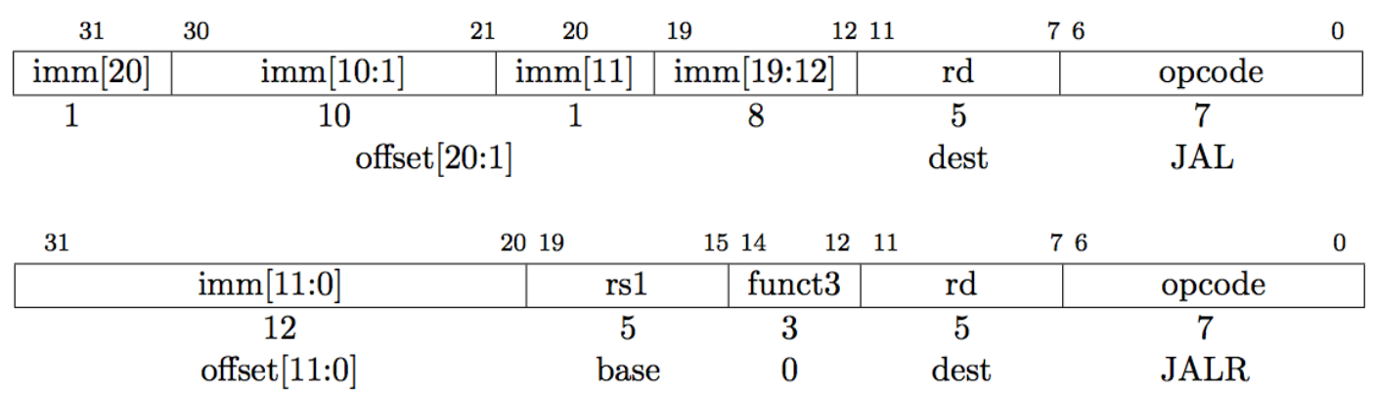
Control Transfer Instructions: J-Type
No architecturally visible delay slots
Unconditional jumps: PC + offset target
  JAL: jump and link, also writes PC + 4 to x1, J-type
    Offset scaled by 1-bit left shift – can jump to 16-bit instruction boundary (same for branches)
  JLAR: jump and link register where imm (12bits) + rs1 = target

Slide 32
Jump Addressing
Jump and link (jal) target uses 20-bit immediate for larger range
J type: jal x0, 2000, //2000 = 0111 1101 0000
For long jumps, eg, to 32-bit absolute address
  lui: load address[31:12] to temp register
  jalr: add address[11:0] and jump to target
0 | 1111101000 | 0 | 00000000 | 00000 | 1101111
imm[20] | imm[10:1] | imm[11] | imm[19:12] | rd | opcode
inst[31:0]
Inst[31] signextension | Inst[19:12] | Inst[20] | Inst[30:21] | 1’B0
imme[31:0]
Notes:
Jal 是唯一的一条UJ-type指令 （the unconditional jump-and-link instruction）
后面的必须是偶数

Slide 33
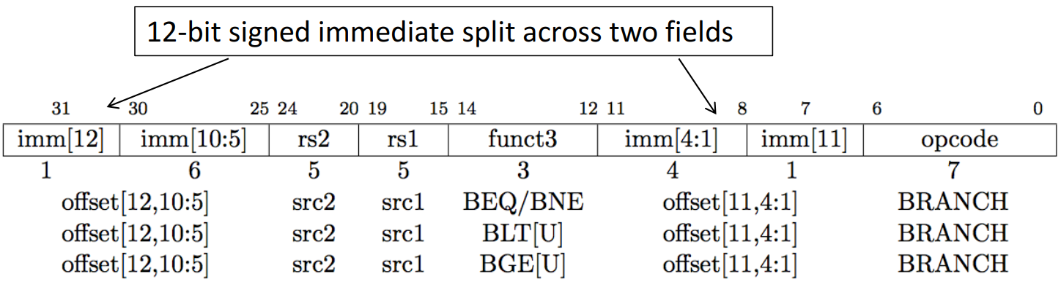
Control Transfer Instructions: B-Type
No architecturally visible delay slots
Conditional branches: B-type and PC + offset target
Branches, compare two registers, PC + (immediate << 1) target (signed offset in multiples of two). Branches do not have delay slot.

Slide 34
Branch Addressing
Most branch targets are near branch
  Forward or backward
B-type: bne x10, x11, 2000 //2000 = 0111 1101 0000
PC-relative addressing
  Target address = PC + branch offset
PC-relative addressing
  Target address = PC + branch offset
0 | 111110 | 01011 | 01010 | 001 | 1000 | 0 | 1100011
imm[12] | imm[10:5] | rs2 | rs1 | funct3 | imm[4:1] | imm[11] | opcode
inst[31:0]
Inst[31] signextension | Inst[7] | Inst[30:25] | Inst[11:8] | 1’B0
imm[31:0]
Notes:
SB-type:
Bne, 后面的必须是偶数。 The address uses unusual encoding
PC 相对偏移表示分支和目标指令之间的半字数。
Jal指令中的20位地址字段可以寻址当前指令的前后1M字节范围，条件分支指令的12位字段可以寻址当前指令的前后4K字节范围。

Slide 35
Compiling an if statement to a branch
( Assume: f ~ j ---- x19 ~ x23 )
  C code:
  if ( i = = j ) f = g + h ; else f = g – h;
  RISC-V assembly code:
  bne x22, x23, ELSE // go to ELSE if i != j
  add x19, x20, x21 // f = g + h ( skipped if i not equals j )
  beq x0, x0, EXIT
  ELSE: sub x19, x20, x21 // f = g - h ( skipped if i equals j )
  EXIT:
Notes:
计算机与计算器不同的地方就在于他能进行决策，根据输入的数据或者中间计算结果执行不同的指令。
高级语言一般用if语句表示分支，再加上goto和label配合使用，risc-v包括两条分支指令，beq, bne，相当于带goto的if语句。
条件转移指令：beq, bne, slt
下面我们就看一个例子，if语句编译后形成的汇编代码是什么
无条件分支：beq x0, x0, exit
编译器产生分支指令和标号，但它们在高级语言中并不出现。这也是高级语言编码效率高的原因之一。
像lw, sw指令计算数据地址一样，分支地址也要进行计算，是由汇编器完成的。
有没有可能减少一个branch呢

Slide 36
More Conditional Operations
blt rs1, rs2, L1
  if (rs1 < rs2) branch to instruction labeled L1
bge rs1, rs2, L1
  if (rs1 >= rs2) branch to instruction labeled L1
Example
  if (a > b) a += 1; (a in x22, b in x23)
  bge x23, x22, Exit // branch if b >= a
  addi x22, x22, 1
  Exit:
Notes:
除了判断相等或者不等之外，判断一个变量是否小于另一个变量也很有用。比如一个for循环需要判断下标变量是否小于0

Slide 37
Bounds check Shortcut
Reduce an index-out-of-bounds check
  If (x20>=x11 & x20<0) goto IndexOutofBounds
  RISC-V version:
    bgeu x20, x11, IndexOutofBounds
Notes:
index-out-of-bounds：索引越界
将有符号数当作无符号数处理，给我们提供了一种低成本的方式检查是否0<=x<y，常用于检查数组下标是否越界。
无符号数比较x<y，在检测x<y的同时，也检测了x是否为负数。

Slide 38
Compiling a while loop
C language: ( Assume: i and k---- x22 and x24 base of save ---- x25 )
  while (save[i]==k) i=i+1;
RISC-V assembler code
  Loop: slli x10, x22, 3 // temp reg x10 = 8 * i
  add x10, x10, x25 // x10 = address of save[i]
  ld x9, 0(x10) // temp reg x9 = save[i]
  bne x9, x24, Exit // go to Exit if save[i] != k
  addi x22, x22, 1 // i = i + 1
  beq x0, x0, Loop // go to Loop
  Exit:

Slide 39
Show branch offset in machine language
 |  | instructions Code with Binary |  |  |  |  |  | Hex
 | Address | fun7 | rs2 | rs1 | fun3 | rd/offset | OP
Loop：slli | 80000 | 0000000 | 00011 | 10110 | 001 | 01010 | 0010011 | 003B1513
add | 80004 | 0000000 | 11001 | 01010 | 000 | 01010 | 0110011 | 01950533
ld | 80008 | 0000000 | 00000 | 01010 | 011 | 01001 | 0000011 | 00053483
bne | 80012 | 0000000 | 11000 | 01001 | 001 | 01100 | 1100011 | 01849663
addi | 80016 | 0000000 | 00001 | 10110 | 000 | 10110 | 0010011 | 001B0B13
beq | 80020 | 1111111 | 00000 | 00000 | 000 | 01101 | 1100011 | FE0006E3
Exit： | 80024 | ……
  Modification:
    All RISC-V instructions are 4 bytes long
    PC-relative addressing refers to the number of halfwords
      The address field at 80012 above should be 6 instead of 12
-10
6 =0110
-20 = 80000 - 80020
PC + offset ： 12 = 80024 - 80012
Notes:
前面的例子转成二进制
相对转移还有一个优点：程序放到哪里都可以执行，绝对地址就不行。
注意到用的是相对的offset （除非跳转到非常远的地方）

Slide 40
While branch target is far away
  Inserts an unconditional jump to target
  Invert the condition so that the branch decides whether to skip the jump
Example
  Given a branch:
  beq x10, x0, L1
  Rewrite it to offer a much greater branching distance:
    bne x10, x0, L2
    jal x0, L1
    L2:
Notes:
跳到一个12bit 地址长之外的 地址
X10 等于0， 然后跳转到 L1 Beq的地址空间是 12bit
如果X10 不等于0， 跳转到L2
如果X10 等于0， 就执行下一句。 下一句是 Jal 【Jal 的地址空间是 20 bit】

Slide 41
Case/Switch
Compiling a switch using jump address table
( Assume: f ~ k ---- x20 ~ x25 x5 contains 4 )
  C code:
  switch ( k ) {
  case 0 : f = i + j ; break ; /* k = 0 */
  case 1 : f = g + h ; break ; /* k = 1 */
  case 2 : f = g - h ; break ; /* k = 2 */
  case 3 : f = i - j ; break ; /* k = 3 */
  }
Notes:
Case/switch根据某个变量的不同取值，选择不同的分支。
实现switch的一种方法是借助一个条件判断序列,把switch转化为一系列的if-then-else
另一种更有效的方法是通过编码形成一个转移地址表，就是分支指令序列地址表；程序通过查找转移地址表来获取目标地址，并跳转到相应的分支指令序列。

Slide 42
Jump-and-link register
jalr x1,100(x6)
jump address table
 | …………
P1 address | Program 1
 | …………
P2 address | Program 2
 | …………
P3 address | Program 3
 | …………
P4 address | Program 4
 | …………
x6
K=0 | P1 address
K=1 | P2 address
K=2 | P3 address
K=3 | P4 address
Notes:
转移地址表就是一个字数组，数组中的元素对应于代码中各个标号的地址。
为支持这种情况，有一条间接跳转指令，jalr, 无条件地转移到某个寄存器指定的地址。
x6是地址转移表的起始地址

Slide 43
  RISC-V assembly code:
  blt x25, x0, Exit // test if k < 0
  bge x25, x5, Exit // if k >= 4, go to Exit
  slli x7, x25, 3 // temp reg x7 = 8 * k
  add x7, x7, x6 // x7 = address of JumpTable[k]
  ld x7, 0(x7) // x7 gets JumpTable[k]
  jalr x1, 0(x7) // jump entrance
  Exit:
jump address table
L0: add x20, x23, x24 // k = 0 so f gets i + j
  jalr x0, 0(x1) // end of this case so go to Exit
L1: add x20, x21, x22 // k = 1 so f gets g + h
  jalr x0, 0(x1) // end of this case so go to Exit
L2: sub x20, x21, x22 // k = 2 so f gets g - h
  jalr x0, 0(x1) // end of this case so go to Exit
L3: sub x20, x23, x24 // k = 3 so f gets i - j
  jalr x0, 0(x1) //end of switch statement
L0:address
L1:address
L2: address
L3:address
Notes:
jalr x0, 0(x1)

Slide 44
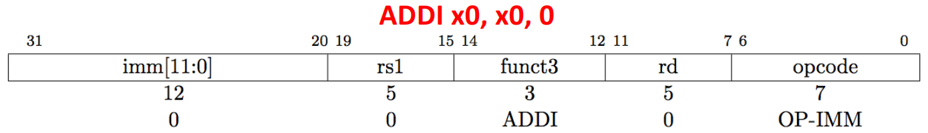
Where is NOP?

Slide 45
Decoding Machine Language
Machine instruction (0x00578833)
  0000 0000 0101 0111 1000 1000 0011 0011
  Decoding
    Determine the operation from opcode
    opcode: 0110011 → R-type arithmetic instruction
| funct7 | rs2 | rs1 | funct3 | rd | opcode |
  0000000 00101 01111 000 10000 0110011
  funct7 and funct3 are all 0 → add instruction
    Determine other fields
    rs2: x5; rs1: x15; rd: x16
    Show the assembly instruction
    add x16, x15, x5 (Note: add rd,rs1,rs2)

Slide 46
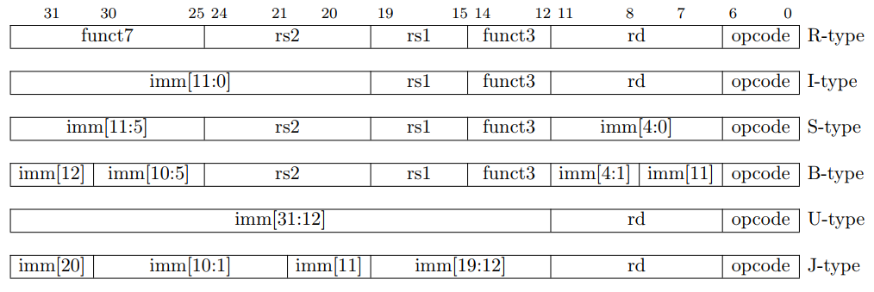
Immediate Encoding Variants
S-type vs. B-type
  The 12-bit immediate field is used to encode branch offsets in multiples of 2 in the B format. Instead of shifting all bits in the instruction-encoded immediate left by one in hardware as is conventionally done, the middle bits (imm[10:1]) and sign bit stay in fixed positions, while the lowest bit in S format (inst[7]) encodes a high-order bit in B format.
U-type vs. J-type
  Similarly, the 20-bit immediate is shifted left by 12 bits to form U immediates and by 1 bit to form J immediates. The location of instruction bits in the U and J format immediates is chosen to maximize overlap with the other formats and with each other.
Notes:
用于寄存器-寄存器操作的 R 类型指令
用于短立即数和访存 load 操作的 I 型指令
用于访存 store 操作的 S 型指令
用于条件跳转操 作的 B 类型指令
用于长立即数的 U 型指令
用于无条件跳转的 J 型指令

Slide 47
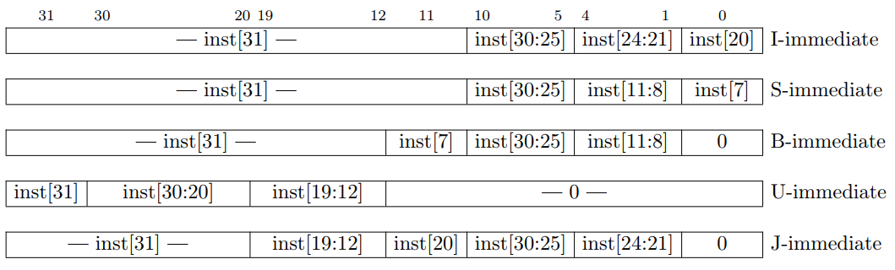
Immediate Encoding Variants
Notes:
Types of immediate produced by RISC-V instructions. The fields are labeled with the instruction bits used to construct their value. Sign extension always uses inst[31]

Slide 48
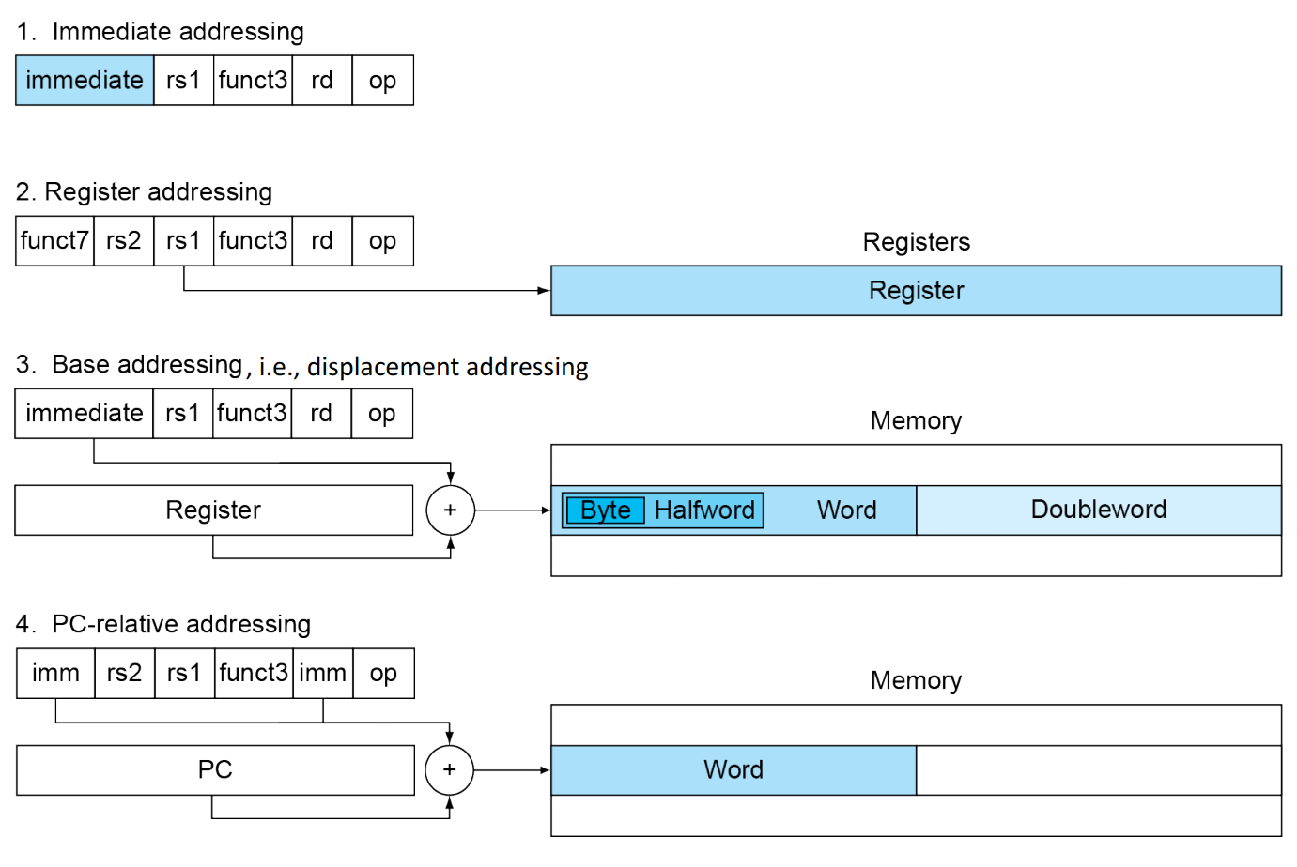
RISC-V Addressing Modes
Notes:
1. Immediate addressing, where the operand is a constant within the instruction itself.
2. Register addressing, where the operand is a register.
3. Base or displacement addressing, where the operand is at the memory location whose address is the sum of a register and a
constant in the instruction.
4. PC-relative addressing, where the branch address is the sum of the PC and a constant in the instruction.
Note that a single operation can use more than one addressing mode. Add, for example, uses both immediate (addi) and register (add) addressing.

Slide 49
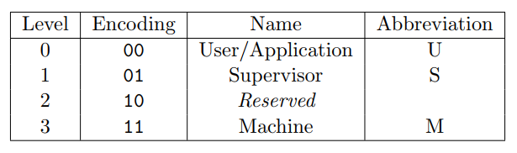
Privileged ISA: Modes
RISC-V privileged spec defines 3 levels of privilege, called modes
  Machine mode is the highest privileged mode and the only required mode
More-privileged modes generally have access to all of the features of less-privileged modes, and they add additional functionality not available to less-privileged modes, such as the ability to handle interrupts and perform I/O. Processors typically spend most of their execution time in their least-privileged mode; interrupts and exceptions transfer control to more-privileged modes.

Slide 50
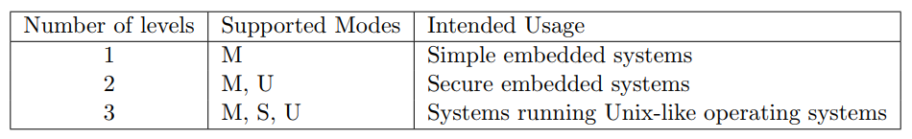
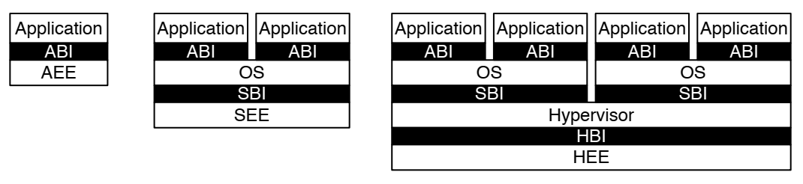
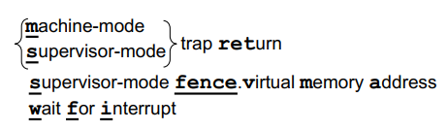
Software Stack and Instructions
Implementations might provide anywhere from 1 to 4 privilege modes trading off reduced isolation for lower implementation cost
RISC-V privileged software stack
RV32/64 privileged instructions
Notes:
AEE: Application Execution Environment; ABI: Application Binary Interface
SEE: Supervisor Execution Environment; …
HEE: Hypervisor Execution Environment; …
All hardware implementations must provide M-mode, as this is the only mode that has unfettered access to the whole machine. The simplest RISC-V implementations may provide only M-mode, though this will provide no protection against incorrect or malicious application code.
RISC-V架构中机器模式是必须具备的模式，因此必须具备机器模式的异常处理机制
每个权限级别都有一组核心与可选的扩展和变种特权ISA扩展
Provide protection between different components of the software stack.

Slide 51
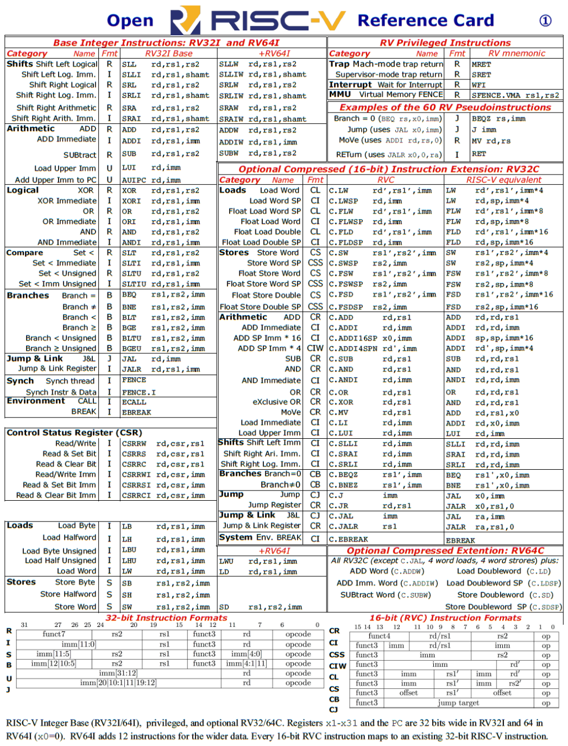
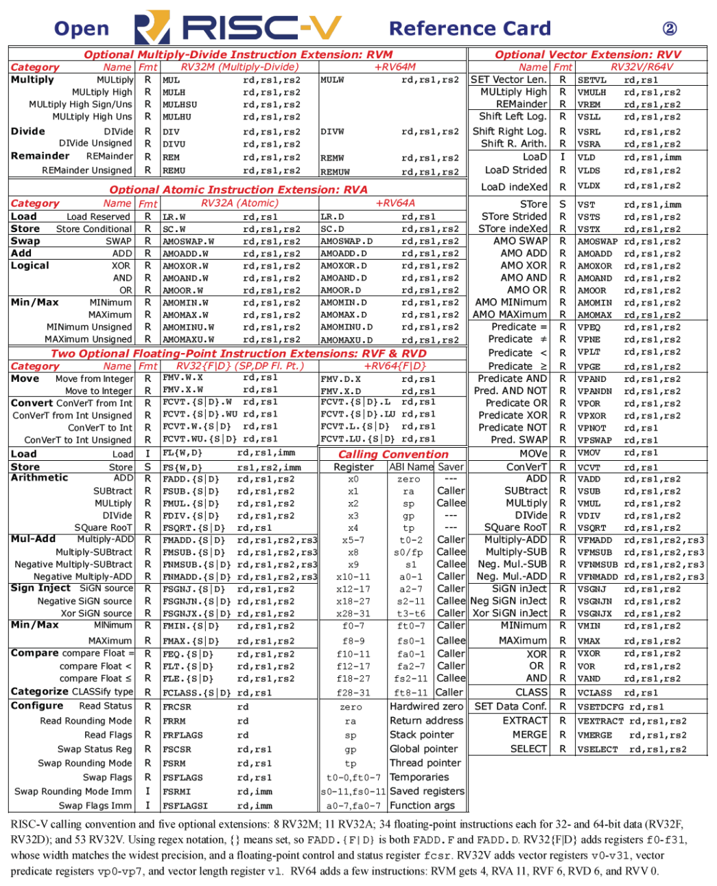
RISC-V Reference Card

Slide 52
RISC-V operands
Name | Example | Comments
32 registers | x0-x31 | Fast locations for data. In RISC-V, data must be in registers to perform arithmetic. Register x0 always equals 0.
2⁶¹ memory words | Memory[0], Memory[8], …, Memory[18,446,744,073,709,551,608]] | Accessed only by data transfer instructions. RISC-V uses byte addresses, so sequential double word accesses differ by 8. Memory holds data structures, arrays, and spilled registers.
Name | Register no. | Usage | Preserved on call
x0(zero) | 0 | The constant value 0 | n.a.
x1(ra) | 1 | Return address(link register) | yes
x2(sp) | 2 | Stack pointer | yes
x3(gp) | 3 | Global pointer | yes
x4(tp) | 4 | Thread pointer | yes
x5-x7(t0-t2) | 5-7 | Temporaries | no
x8(s0/fp) | 8 | Saved/frame point | Yes
x9(s1) | 9 | Saved | Yes
x10-x17(a0-a7) | 10-17 | Arguments/results | no
x18-x27(s2-s11) | 18-27 | Saved | yes
x28-x31(t3-t6) | 28-31 | Temporaries | No
PC | - | Auipc(Add Upper Immediate to PC) | Yes
Notes:
K0，k1：26-27

Slide 53
Summary of RISC-V instruction encoding
Format | Instruction | Opcode | Funct3 | Funct6/7
R-type | add | 0110011 | 000 | 0000000
 | sub | 0110011 | 000 | 0100000
 | sll | 0110011 | 001 | 0000000
 | xor | 0110011 | 100 | 0000000
 | srl | 0110011 | 101 | 0000000
 | sra | 0110011 | 101 | 0000000
 | or | 0110011 | 110 | 0000000
 | and | 0110011 | 111 | 0000000
 | lr.d | 0110011 | 011 | 0001000
 | sc.d | 0110011 | 011 | 0001100

Slide 54
Format | Instruction | Opcode | Funct3 | Funct6/7
I-type | lb | 0000011 | 000 | n.a.
 | lh | 0000011 | 001 | n.a.
 | lw | 0000011 | 010 | n.a.
 | ld | 0000011 | 011 | n.a.
 | lbu | 0000011 | 100 | n.a.
 | lhu | 0000011 | 101 | n.a.
 | lwu | 0000011 | 110 | n.a.
 | addi | 0010011 | 000 | n.a.
 | slli | 0010011 | 001 | 000000
 | xori | 0010011 | 100 | n.a.
 | srli | 0010011 | 101 | 000000
 | srai | 0010011 | 101 | 010000
 | ori | 0010011 | 110 | n.a.
 | andi | 0010011 | 111 | n.a.
 | jalr | 1100111 | 000 | n.a.

Slide 55
Format | Instruction | Opcode | Funct3 | Funct6/7
S-type | sb | 0100011 | 000 | n.a.
 | sh | 0100011 | 001 | n.a.
 | sw | 0100011 | 010 | n.a.
 | sd | 0100011 | 111 | n.a.
B-type | beq | 1100011 | 000 | n.a.
 | bne | 1100011 | 001 | n.a.
 | blt | 1100011 | 100 | n.a.
 | bge | 1100011 | 101 | n.a.
 | bltu | 1100011 | 110 | n.a.
 | bgeu | 1100011 | 111 | n.a.
U-type | lui | 0110111 | n.a. | n.a.
J-type | jal | 1101111 | n.a. | n.a.
Notes:
load upper immediate LUI

Slide 56
Specifications and Software
Specification from RISC-V website
  https://riscv.org/specifications/
RISC-V software includes
  Toolchain projects
    https://wiki.riscv.org/display/HOME/Toolchain+Projects
  A simulator (“spike”)
    https://github.com/riscv-software-src/riscv-isa-sim
  Standard simulator QEMU (Upstream now)
    https://github.com/riscv/riscv-qemu
Operating systems support exists for Linux (Upstream now)
  https://github.com/riscv/riscv-linux
A javascript ISA simulator to run a RISC-V Linux system on a web browser
  https://github.com/riscv/riscv-angel
Notes:
Basically, spike is the best simulator for hardware developers. qemu is the best simulator for software developers. The gdb sim is maybe best if you are familiar with other gdb sims, and want access to features that gdb sims support.

Slide 57
Overview
RISC-V ISA
RISC-V Assembly Language
  Some basic concepts
  From source code to a running program

Slide 58
Overview
RISC-V ISA
RISC-V Assembly Language
  Some basic concepts
  From source code to a running program

Slide 59
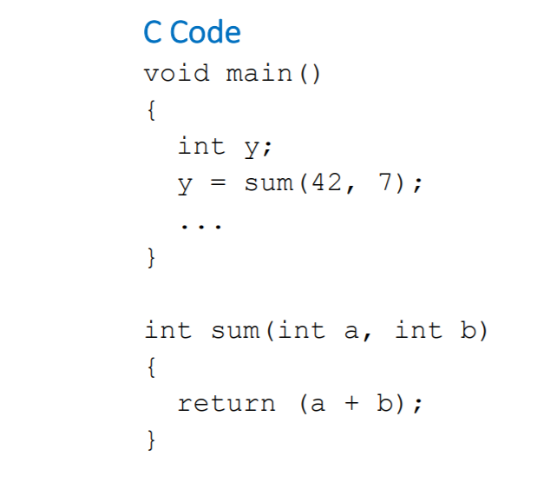
Function calls
Caller: calling function
  main in this case
Callee: called function
  sum in this case

Slide 60
Function calls
Caller: calling function
  main in this case
  Passes arguments to callee
  Jumps to callee
Callee: called function
  sum in this case
  Performs the function
  Returns result to caller
  Returns to point of call
Notes:
Must not overwrite registers or memory needed by caller

Slide 61
Calling Convention
Six general steps in calling a function
  Place the arguments where the function can access them.
  Jump to the function (using RV32I’s jal).
  Acquire local storage resources the function needs, saving registers as required.
  Perform the desired task of the function.
  Place the function result value where the calling program can access it, restore any registers, and release any local storage resources.
  Since a function can be called from several points in a program, return control to the point of origin (using ret).
Notes:
1. 将参数存储到函数能够访问到的位置；
2. 跳转到函数开始位置（使用 RV32I 的 jal 指令）；
3. 获取函数需要的局部存储资源，按需保存寄存器；
4. 执行函数中的指令；
5. 将返回值存储到调用者能够访问到的位置，恢复寄存器，释放局部存储资源；
6. 返回调用函数的位置（使用 ret 指令 ）。

Slide 62
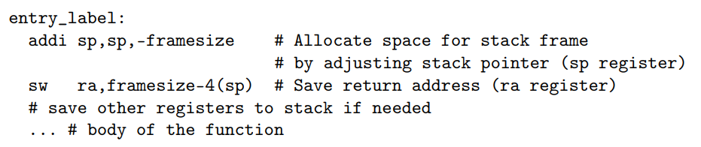
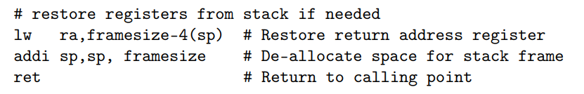
Function Entry and Exit
The function prologue
  If there are too many function arguments and variables to fit in the registers, the prologue allocates space on the stack for the function frame, as it is called.
The function epilogue
  Undoes the stack frame and returns to the point of origin.

Slide 63
Procedure Call Instructions
Procedure call: jump and link
jal x1, ProcedureLabel
  Address of following instruction put in x1
  Jumps to target address
Procedure return: jump and link register
jalr x0, 0(x1)
  Like jal, but jumps to 0 + address in x1
  Use x0 as rd (x0 cannot be changed)
  Can also be used for computed jumps
    e.g., for case/switch statements
PC+4→x1
Notes:
无条件跳转： jal x0, Label，因为x0硬连线到0，效果等同于丢弃返回地址。

Slide 64
Using More Registers
Registers for procedure calling
  x10~ x17: eight argument registers to pass parameters or return values
  x1: one return address register to return to origin point
Stack：Ideal data structure for spilling registers
  Push, pop
  Stack pointer (sp): x2
Stack grow from higher address to lower address
  Push: sp= sp-8
  Pop: sp = sp+8
Notes:
寄存器是保存数据最快的存储位置，在过程调用的时候尽量多的使用寄存器，
如果一个过程需要多于8个参数寄存器，就需要换出寄存器到存储器。并且在过程完成后，所用的寄存器必须恢复到调用之前的值。
最理想的数据结构就是栈—后进先出队列。把数据放入栈叫push，移除数据称为出栈,pop，栈指针，一个特殊的寄存器，sp（x2)，用于保存被调用者所需的寄存器。栈是内存里的一块存储结构，栈底是高地址，栈增长是地址从高到低，push的时候，sp减小，pop, sp增大

Slide 65
Leaf Procedure Example
C code:
long long int leaf_example (
long long int g, long long int h,
long long int i, long long int j) {
long long int f;
f = (g + h) - (i + j);
return f;
}
  Arguments g, …, j in x10, …, x13
  f in x20
  temporaries x5, x6
  Need to save x5, x6, x20 on stack
Notes:
在32位的系统中： `short`与`int`占两个字节， `long` 占四个字节， `long long` 占八个字节； 在64位的系统中： `short`占两个字节， `int` 与 `long` 占四个字节， `long long` 占八个字节。
4个参数所在的寄存器不用保存，过程体还需要两个临时寄存器，因此，需要保存3给寄存器，首先是保存过程中使用的寄存器

Slide 66
RISC-V code:
//Save x5, x6, x20 on stack
addi sp,sp,-24
sd x5,16(sp)
sd x6,8(sp)
sd x20,0(sp)
add x5,x10,x11
add x6,x12,x1
sub x20,x5,x6
addi x10,x20,0
ld x20,0(sp)
ld x6,8(sp)
ld x5,16(sp)
addi sp,sp,24
jalr x0,0(x1)
// x5 = g + h
// x6 = i + j
// f = x5 – x6
// copy f to return register
// Resore x5, x6, x20 from stack
// Return to caller
Notes:
x10：返回值

Slide 67
Local Data on the Stack
High address
sp
sp
Content of register x5
Content of register x6
sp
Content of register x20
Low address
a
.
b
.
c
.
Notes:
栈指针总是指向栈顶，或者说栈中的最后一个双字。

Slide 68
Register Usage
x5 – x7, x28 – x31: temporary registers
  Not preserved by the callee
x8 – x9, x18 – x27: saved registers
  If used, the callee saves and restores them
Notes:
先前使用了临时寄存器，并假设其旧值必须被保存和恢复。为了避免保存和恢复一个其值从未被使用过的寄存器（临时寄存器），RISC-V将19个寄存器分为2组。这样可以减少寄存器换出。
上诉例子中，x5, x6不需要保存，但是x20需要保存

Slide 69
Saved/temporary registers
69
父函数保证：子函数能随便使用temporary registers (x5-x7, x28-x31)，返回给父函数的时候，x5-x7, x28-x31的值可以被改变。
子函数保证：返回给父函数的时候，saved registers(x18-x27) 保持父函数调用子函数前的值。

Slide 70
Non-Leaf Procedures
Procedures that call other procedures
For nested call, caller needs to save on the stack:
  Its return address
  Any arguments and temporaries needed after the call
Restore from the stack after the call
Notes:
没有调用其他过程的过程叫做叶过程。实际上，很多时候过程还要调用其他过程。更进一步，过程调用自身，这就是递归。过程调用时，必须小心保存寄存器，一个解决方法是将其他所有必须保存的寄存器压栈，我们规定调用者将所有调用后还需要的参数寄存器（x10-x17）或临时寄存器（x5~x7, x28~x31）压栈。被调用者将返回地址寄存器（x1）和被调用者使用的保存寄存器（x8,x9,x18~x27）压栈。

Slide 71
Nested Procedure
  Example Compiling a recursive procedure that computes n!, suppose argument n is in x10, and results in x10
  long long fact ( long long n )
  {
  if ( n < 1 ) return ( 1 ) ;
  else return ( n * fact ( n - 1 ) ) ;
  }
  RISC-V assembly code
  fact: addi sp, sp, -16 // adjust stack for 2 items
  sd x1, 8(sp) // save the return address
  sd x10, 0(sp) // save the argument n
addi x5, x10, -1 // x5 = n - 1
bge x5, x0, L1 // if n >= 1, go to L1(else)
addi x10, x0, 1 // return 1 if n <1
addi sp, sp, 16 // Recover sp (Why not recover x1and x10 ?)
jalr x0, 0(x1) // return to caller
Notes:
X10存储了n， X1存了返回的地址
从栈中弹出两项之前，我们本应该载入x1和x10, 因为n<=1时，它们都没有发生变化，所有就跳过这两条指令。

Slide 72
    L1: addi x10, x10, -1 // n >= 1: argument gets ( n - 1 )
jal x1, fact // call fact with ( n - 1 )
add x6, x10, x0
ld x10, 0(sp) // restore argument n
ld x1, 8(sp) // restore the return address
addi sp, sp, 16 // adjust stack pointer to pop 2 items
mul x10, x10, x6 // return n*fact ( n - 1 )
jalr x0, 0(x1) // return to the caller
Why x10 is saved? Why x1 is saved?
Preserved things across a procedure call
Saved registers, stack pointer register( sp ),
return address register( x1 ), stack above the stack pointer
Not preserved things across a procedure call
Temporary registers, argument registers( x10 ~ x17),
return value registers ( x10 ~ x17), stack below the stack pointer
Notes:
下面是n>1的情况，n=n-1, 再次调用fact。因为再次调用fact的时候，x1和x10的值变了，当fact执行完返回时，我们需要把原先的参数和返回地址取出来。

Slide 73
Disadvantages of recursion
Use too much resource，to protect the processor status，recursion may result in stack overflow.
Need push and pop，takes a lot of memory space leading to inefficient usage of memory.
How to avoid ? use loop instead of recursion （tail call）.

Slide 74
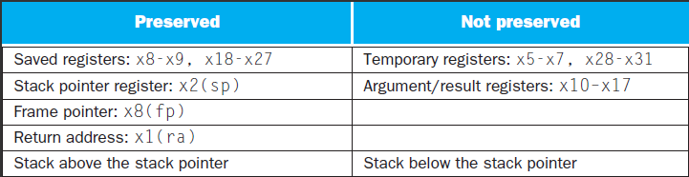
What is and what is not preserved across a procedure call
Notes:
有些方案也保存了栈，以确保调用者在弹栈时取回与压栈时相同的数据。Sp以上的栈通过确保被调用者不在其上进行写入来保存；sp本身就是由被调用者将其被减去的值重新加上来保存的，并且其他寄存器通过将它们保存到栈（若被使用）并从栈中将其恢复来进行保存。

Slide 75
Storage class of C variables
  automatic
  static
Procedure frame and frame pointer ( x8 or fp )
  The importance of fp
  automatic
Global pointer ( x3 or gp )
  static
Notes:
C变量通常指一个存储位置，其解释取决于其类型（type）和存储方式（storage class）。示例类型包括整型和字符型。C语言有两种存储方式：动态和静态的。
C变量的两种存储方式：动态（过程中的变量，过程结束就失效）和静态（始终存在，在过程之外声明，以及用static声明的变量）
静态数据用gp（x3)来访问
Type 和 storage class
There are four storage classes in C they are as follows:
Automatic Storage Class
Register Storage Class
Static Storage Class
External Storage Class
All variables defined within a function or block by default belong to automatic storage class if no storage class is mentioned.

Slide 76
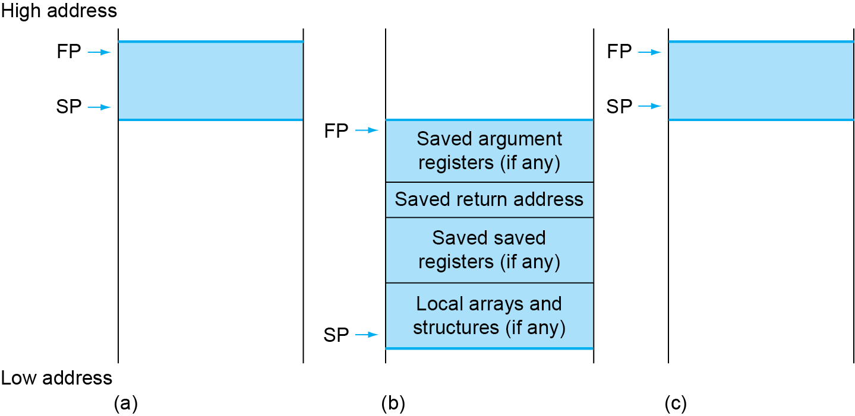
Local Data on the Stack
Local data allocated by callee
  e.g., C automatic variables
Procedure frame (activation record)
  Used by some compilers to manage stack storage
Notes:
栈还需要存储一些局部变量，例如局部数组或结构, 这些变量时局部于过程，不适用于寄存器，而是保存在栈中。栈中包含过程保存的寄存器和局部变量的段称为过程帧(frame)或者活动记录(activation record)。
在过程中栈指针可能改变，如果利用栈指针和地址运算来完成对局部变量的引用，非常不方便。因此，定义一个帧指针fp(x8)，指向过程帧的第一个双字，这样帧指针就提供了一个稳定的基寄存器，对局部变量的引用就变得非常简单。如果过程中栈内没有局部变量，编译器一般不设置和不恢复帧指针以节省时间。当使用帧指针时，在调用中使用sp来进行初始化，且可以使用fp恢复sp.
注意，不管是否使用显式的帧指针，栈上都会显示一条活动记录。我们可以通过维护稳定的sp来减少对fp的使用

Slide 77
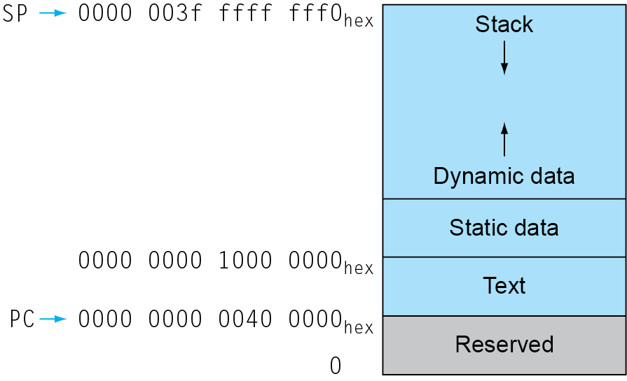
Memory Layout
Text: program code
Static data: global variables
  e.g., static variables in C, constant arrays and strings
  x3 (global pointer) initialized to address allowing ±offsets into this segment
Dynamic data: heap
  E.g., malloc in C, new in Java
Stack: automatic storage
gp → 0000 0000 1000 8000 hex
Notes:
除了动态变量，C程序员还需要为静态变量和动态数据结构分配内存空间。这个图展示了运行linux OS时程序和数据在RISC-V内存分配的约定。这些地址只是一种软件规定，并不是RISC-V体系结构的一部分。
栈由内存高地址开始，向下增长。内存低地址段先是保留区域，然后时机器代码的存储区域，称为正文段，之上是静态数据段，用于存储常量和其他静态变量的空间。
类似链表的数据结构通常会随着生命期增长或者缩短，这类数据结构对应的段称为堆(heap),它放在内存中。位于静态数据之后。
栈和堆相互增长，在两个段此消彼长的过程中达到内存的高效使用。
C语言通过显示函数malloc(), free()分配和释放空间，容易导致漏洞。忘记释放会导致“内存泄漏”（消耗掉太多内存导致操作系统崩溃），过早的释放会导致“悬空指针”（指针指向程序从未访问的位置）。Jave使用自动内存分配和垃圾回收机制来避免这类错误。

Slide 78
RISC-V register conventions
Name | Register name | Usage | Preserved On call?
x0 | 0 | The constant value 0 | n.a.
x1(ra) | 1 | Return address(link register) | yes
x2(sp) | 2 | Stack pointer | yes
x3(gp) | 3 | Global pointer | yes
x4(tp) | 4 | Thread pointer | yes
x5-x7 | 5-7 | Temporaries | no
x8-x9 | 8-9 | Saved | yes
x10-x17 | 10-17 | Arguments/results | no
x18-x27 | 18-27 | Saved | yes
x28-x31 | 28-31 | Temporaries | no
Notes:
这里总结了RISC-V中对寄存器的约定。这个规定也是体现“make the common case fast”的一个例子：大多数过程可以使用多达8个参数寄存器、12个保留寄存器和7个临时寄存器而无须进入内存。
如果参数超过8个怎么办？RISC-V约定将栈中额外的参数放在帧指针的上方。可以通过帧指针寻址。帧指针的方便性在于对过程中栈内变量的所有引用都具有相同的偏移。但是，帧指针不是必需的。RISC-V编译器仅在改变了栈指针的过程中使用帧指针。
The saved and temporary registers aren’t contiguous: to support RV32E, an embedded version of RISC-V that has only 16 registers. It simply uses register numbers x0 to x15, so some saved and temporary registers are in this range, and the rest are in the last 16 registers. RV32E is smaller, but has no compiler support yet, since it doesn’t match RV32I.

Slide 79
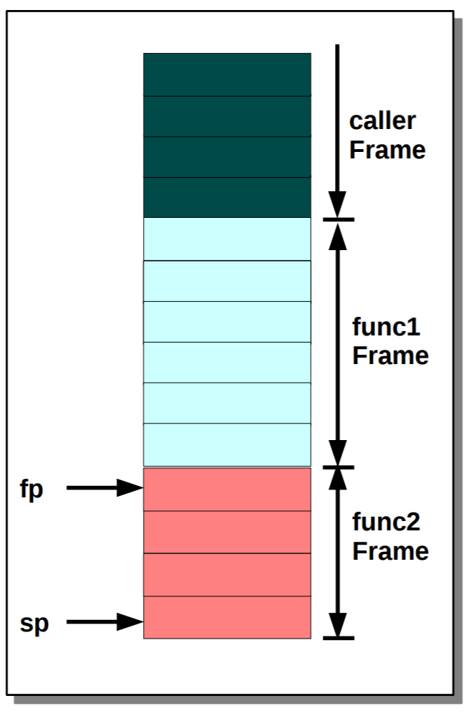
Stack Frame
Private space for a subroutine allocated on entry and deallocated on exit
Identified by a Frame Pointer (fp (x8))

Slide 80
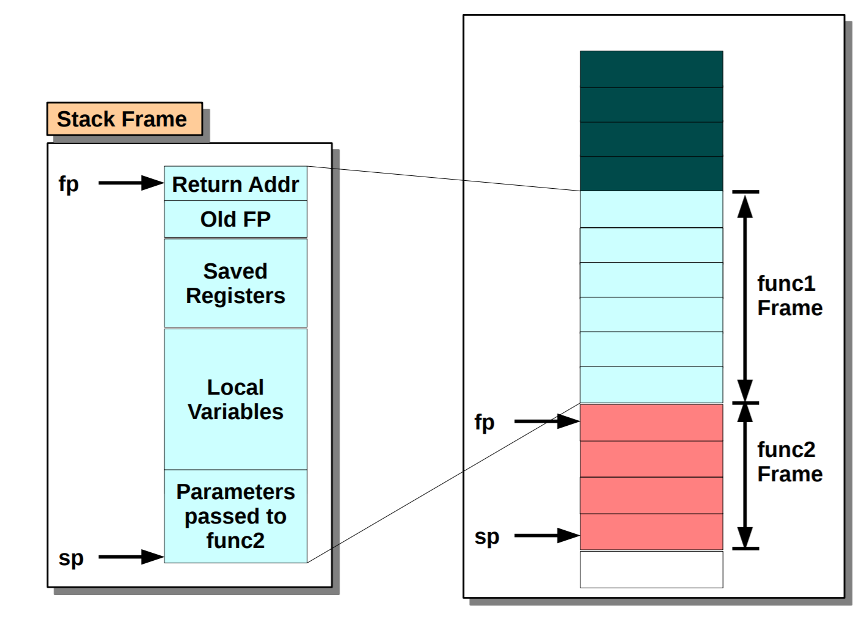
Stack Frame

Slide 81
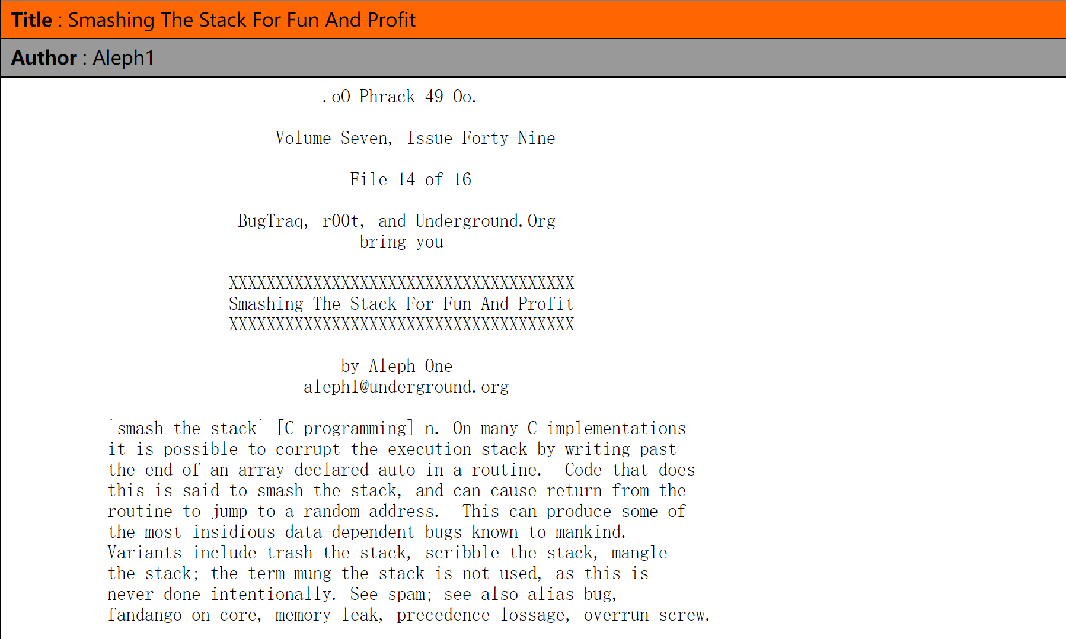
Stack Overflow
Smashing The Stack For Fun And Profit
  http://phrack.org/issues/49/14.html

Slide 82
Overview
RISC-V ISA
RISC-V Assembly Language
  Some basic concepts
  From source code to a running program

Slide 83
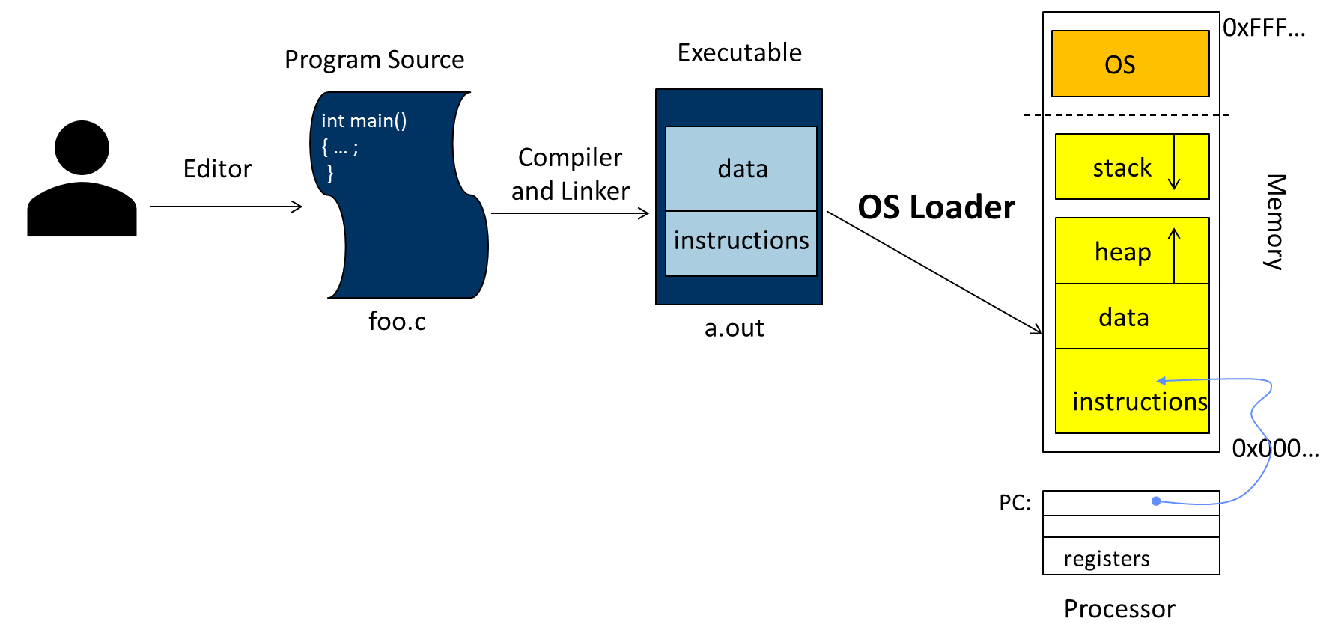
From Source Code to A Running Program
Write source code
Turn the source code into the executable program
Run it!

Slide 84
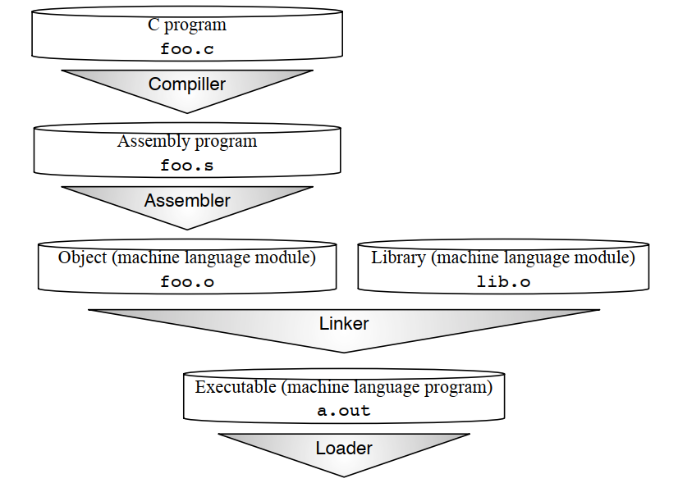
From C Source Code to A Running Program
Steps of translation from C source code to a running program. These are the logical steps, although some steps are combined to accelerate translation.
Notes:
We use the Unix file suffix name convention for each type of file. The equivalent suffixes in MS-DOS are .C, .ASM, .OBJ, .LIB, and .EXE.
1. Compiler output is assembly files
2. Assembler output is obj files
How does the assembler resolve references/labels?
How does the assembler resolve external references?
3. Linker joins object files into one executable
How does the linker combine separately compiled files?
How does linker resolve unresolved references?
How does linker relocate data and code segments
4. Loader brings it into memory and starts execution
How does the loader start executing a program?
How does the loader handle shared libraries?

Slide 85
Compiler: *.c -> *.s
Steps of translation from C source code to a running program. These are the logical steps, although some steps are combined to accelerate translation.

Slide 86
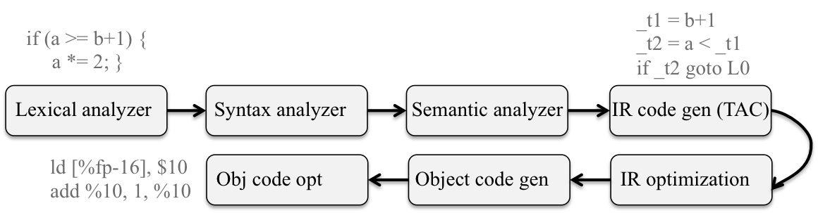
Compiler
Preprocessor (*.c -> *i)
  Expands all macro definitions and include statements (and anything else starting with a #) and passes the result to the actual compiler.
Compiler (*.i -> *.s)
https://people.cs.pitt.edu/~xianeizhang/notes/Linking.html

Slide 87
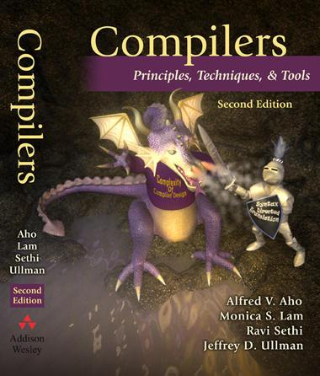
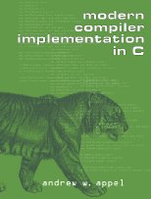
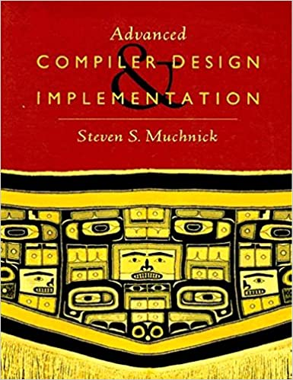
NOT Be Detailed in This Class…
Because You Deserve More!
Notes:
龙书，虎书，金书

Slide 88
Assembler: *.s -> *.o
Steps of translation from C source code to a running program. These are the logical steps, although some steps are combined to accelerate translation.
Notes:
We use the Unix file suffix name convention for each type of file. The equivalent suffixes in MS-DOS are .C, .ASM, .OBJ, .LIB, and .EXE.

Slide 89
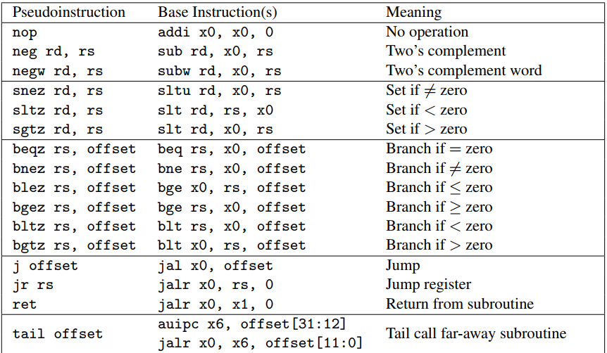
Assembler
Not simply to produce object code from the instructions that the processor understands, but to extend them to include operations useful for the assembly language programmer or the compiler writer. This category, based on clever configurations of regular instructions, is called pseudo-instructions.
Notes:
32 RISC-V pseudo-instructions that rely on x0

Slide 90
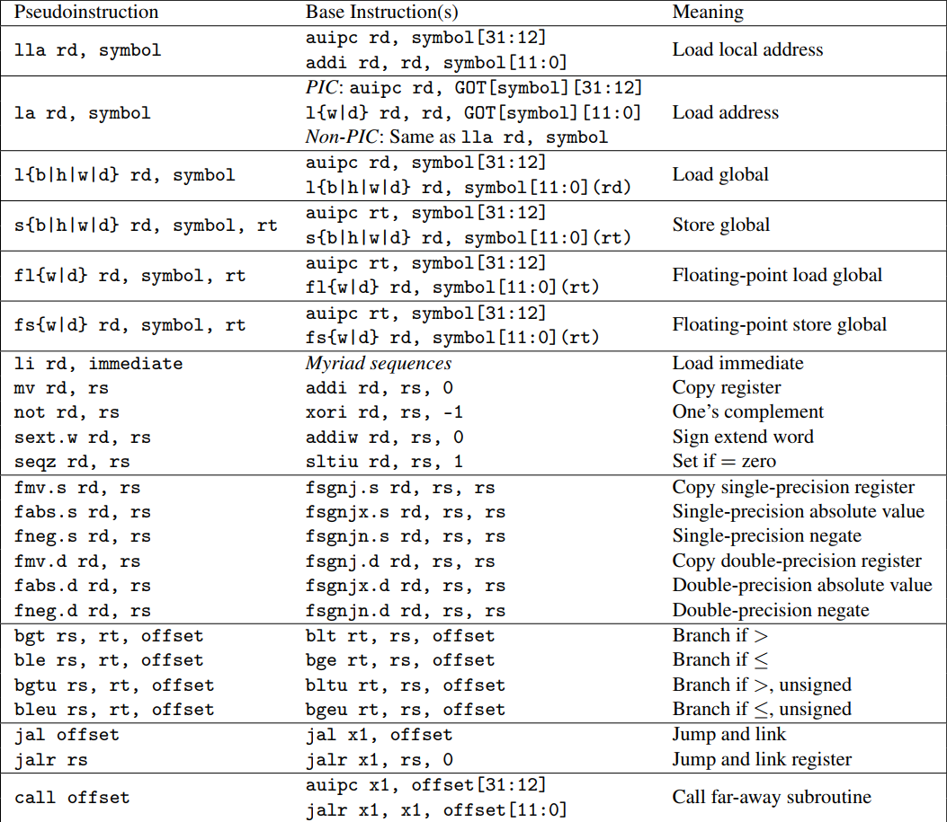
Assembler
Notes:
32 RISC-V pseudo-instructions that are independent of x0, the zero register.
For la, GOT stands for Global Offset Table, which holds the runtime address of symbols in dynamically linked libraries.

Slide 91
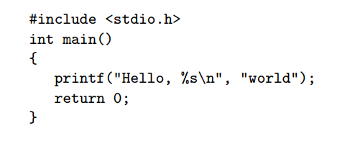
“Hello World” in C

Slide 92
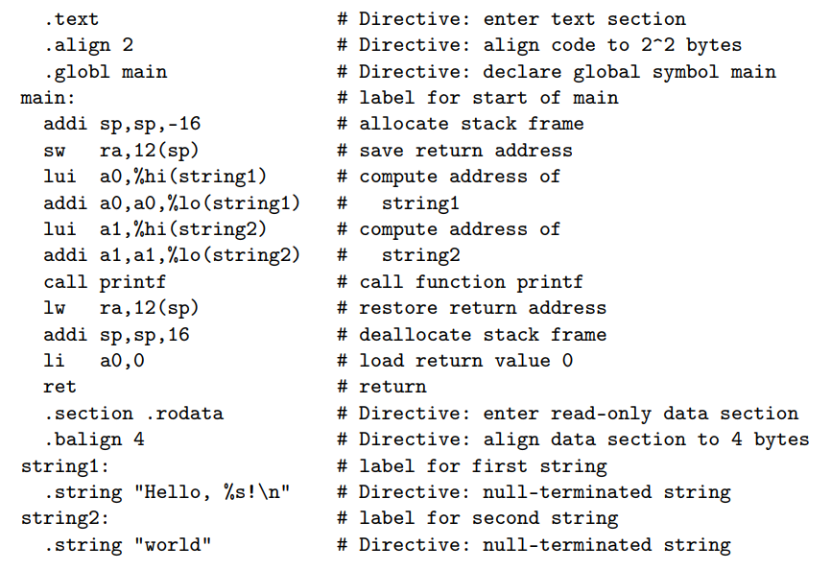
Input: in Assembly Language (*.s)

Slide 93
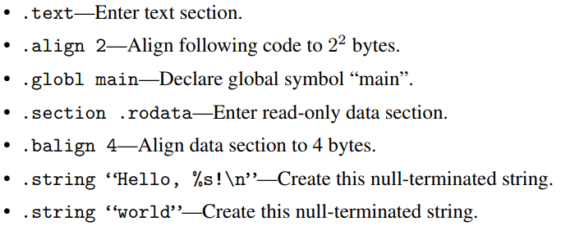
Assembler Directives

Slide 94
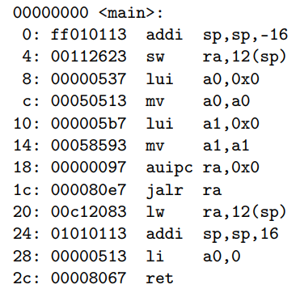
Output: in RISC-V Machine Language (*.o)
The assembler produces the object using the Executable and Linkable Format (ELF, formerly named Extensible Linking Format) standard format.
Notes:
The six instructions that are later patched by the linker (locations 8 to 1c) have zero in their address fields.
The symbol table included in the object file records the labels and addresses of all the instructions that need to be edited by the linker.

Slide 95
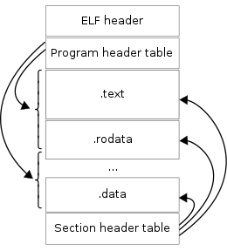
Executable and Linkable Format (ELF)
ELF is a common standard file format for executable files, object code, shared libraries, and core dumps.
The standard binary file format for Unix and Unix-like systems on x86 processors by the 86open project.
By design, the ELF format is flexible, extensible, and cross-platform. This has allowed it to be adopted by many different operating systems on many different hardware platforms.
An ELF file has two views: the program header shows the segments used at run time, whereas the section header lists the set of sections.
Notes:
ELF, formerly named Extensible Linking Format
Each ELF file is made up of one ELF header, followed by file data. The data can include:
Program header table, describing zero or more memory segments
Section header table, describing zero or more sections
Data referred to by entries in the program header table or section header table

Slide 96
ELF Object Files
Created by the assembler and the linker, object files are binary representations of programs intended to be executed directly on a processor.
  Programs that require other abstract machines, such as shell scripts, are excluded.
There are three main types of object files:
  A relocatable file holds code and data suitable for linking with other object files to create an executable or a shared object file.
  An executable file holds a program suitable for execution; the file specifies how exec creates a program's process image.
  A shared object file holds code and data suitable for linking in two contexts. First, the linker processes the shared object file with other relocatable and shared object files to create another object file. Second, the dynamic linker combines it with an executable file and other shared objects to create a process image.
Notes:
Relocatable File 可重定位文件未链接之前的ELF文件，可用于链接可执行文件或静态链接库Linux下的".o"文件，Windows下".obj"文件
Executable File 可执行文件最终的可执行程序如Linux下"/bin"目录下文件，Windows的".exe"文件
Shared Objected File 共享目标文件一种是可用于静态链接文件，另一种是程序运行中被动态链接文件如Linux下的".a"和".so"文件，Windows的dll文件
Core Dump File 核心转储文件进程意外终止时，保存进程地址空间的内容以及其他信息Linux下的core dump

Slide 97
Relocatable vs. Executable
ELF Header
ELF Header
Program-Header Table
(optional)
Program-Header Table
Section 1 Data
Segment 1 Data
Section 2 Data
Segment 2 Data
Section 3 Data
Segment 3 Data
…
Section n Data
…
Segment n Data
Section-Header Table
Section-Header Table
(optional)
Relocatable File
Executable File
Notes:
Object files participate in program linking (building a program) and program execution (running a program). For convenience and efficiency, the object file format provides parallel views of a file's contents, reflecting the differing needs of those activities. An ELF header resides at the beginning and holds a ``road map'' describing the file's organization. Sections hold the bulk of object file information for the linking view: instructions, data, symbol table, relocation information, and so on.
A program header table tells the system how to create a process image. Files used to build a process image (execute a program) must have a program header table; relocatable files do not need one.
A section header table contains information describing the file's sections.
Every section has an entry in the table; each entry gives information such as the section name, the section size, and so on. Files used during linking must have a section header table; other object files may or may not have one.

Slide 98
Relocatable Object File
As assembler’s output
  Binary machine code, but NOT executable
    E.g., .o for Linux, while .obj for Windows
  May refer to external symbols
    Need a symbol table
  Each object file has its own address space
    Addresses will need to be fixed later

Slide 99
Format of Relocatable Object File
Header
  Size and position of pieces of file
Text Section
  Instructions
Data Section
  Static data (local/global vars, strings, constants)
Debugging Information
  Line number -> code address map, etc.
Symbol Table
  External (exported) references
  Unresolved (imported) references

Slide 100
Object file
    object file header—size and position of the other pieces
    Text segment
    static data segment and dynamic data
    The relocation information ----identifies absolute addresses of instruction and data words when the program is loaded into memory
    symbol table
    Debugging information
Object file header
 | Name | Procedure A
 | Text size | 100_{hex}
 | Data size | 20_{hex}
Text segment | Address | instruction
 | 0 | ld x10, 0(gp)
 | 4 | jal x1, 0
 | …… | --
Data segment | 0 | (X)
 | …… | ……
Relocation information | Address | Instruction type | Dependency
 | 0 | ld | X
 | 4 | jal | B
Symbol table | label | Address
 | X | --
 | B | --
Notes:
.com文件没有文件头信息，约定必须从哪里开始执行。
Text:100, data:20，操作系统会申请120个空间
Lw指令有$gp，还有jal，都是需要重新定向

Slide 101
Linker: (multiple) *.o -> a.out
Steps of translation from C source code to a running program. These are the logical steps, although some steps are combined to accelerate translation.
Notes:
在操作系统发展早期，还没有形成链接器的概念，操作系统的加载器(Loader,LD) 完成了类似工作，后面由于系统越来越复杂，也就引入了链接器(Linker)，但是由于习惯问题，LD 还是链接器的代名词。
我们常见的链接文件也是以 ld 为后缀的。

Slide 102
Linker
Rather than compile all the source code every time one file changes, the linker allows individual files to be compiled and assembled separately.
Why separate compile/assemble and linking steps?
  Separately compiling modules and linking them together obviates the need to recompile the whole program every time something changes
    Need to just recompile a small module
    A linker coalesces object files together to create a complete program
The linker “stitches” the new object code together with existing machine language modules, such as libraries.
Notes:
It derives its name from one of its tasks, which is to all edit the links of the jump and link instructions in the object file.
In fact, linker is short for link editor, which was the historical name of this step in Figure.

Slide 103
Role of Linker
ELF Header
ELF Header
Section 1 Data
Section 2 Data
Program-Header Table
…
Section n Data
Segment 1 Data
Section-Header Table
Segment 2 Data
Relocatable File
…
Segment n Data
ELF Header
Section 1 Data
Section 2 Data
…
Section n Data
Executable File
Section-Header Table
Relocatable File

Slide 104
Issues Need to be Resolved
How does the linker combine separately compiled files?
How does linker resolve unresolved references?
How does linker relocate data and code segments
To combine object files into an executable file
  Relocate each object’s text and data segments
  Resolve as-yet-unresolved symbols
  Record top-level entry point in executable file

Slide 105
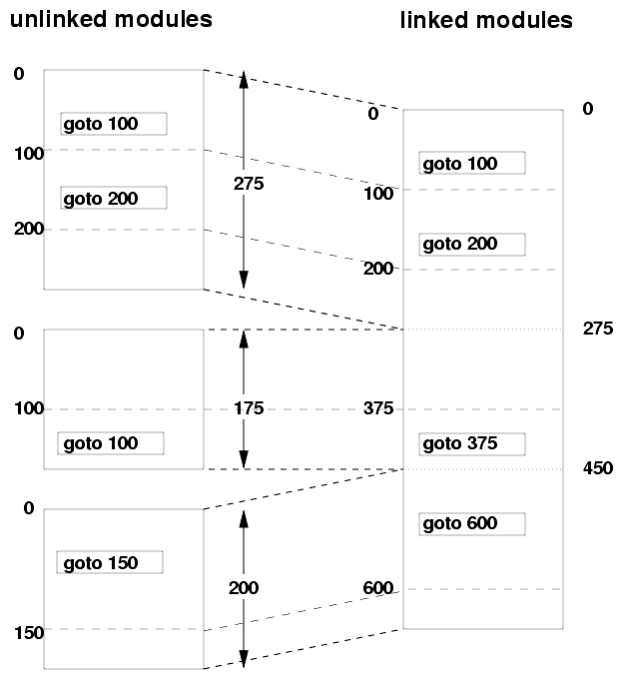
Linker Functions 1: Fixing Addresses
Addresses in an object file are usually relative to the start of the code or data segment in that file.
When different object files are combined:
  The same kind of segments (text, data, read-only data, etc.) from the different object files get merged.
  Addresses have to be “fixed up” to account for this merging.
  The fixing up is done by the linker, using information embedded in the executable for this purpose (“relocations”).

Slide 106

Linker Function 2: Symbol Resolution
Suppose:
  Module B defines a symbol x;
  Module A refers to x.
The linker must:
  Determine the location of x in the object module obtained from merging A and B; and
  Modify references to x (in both A and B) to refer to this location.
Each linkable module contains a symbol table, whose contents include:
  Global symbols defined (maybe referenced) in the module.
  Global symbols referenced but not defined in the module (these are generally called externals).
  Segment names (e.g., text, data, rodata).
  These are usually considered to be global symbols defined to be at the beginning of the segment.
  Non-global symbols and line number information (optional), for debuggers.

Slide 107
Linking Object modules
  Object modules(including library routine) → executable program
  3 step of Link
    Place code and data modules symbolically in memory
    Determine the addresses of data and instruction labels
    Patch both the internal and external references (Address of invoke)
  Could leave location dependencies for fixing by a relocating loader
    But with virtual memory, no need to do this
    Program can be loaded into absolute location in virtual memory space
Notes:
链接器使用每个目标模块的重定位信息和符号表，来解析所有的未定义标记，产生可执行文件。这个文件与目标文件具有相同的格式，但是不包含未解决的引用。
不过可能仍含有未解决的地址。
静态数据通过$gp访问，动态数据通过$sp访问
作业汇编器最终交上来的是可执行代码，必须是链接好的。

Slide 108


Example： Linking object files
108

Slide 109
Format of Executable Object File
Header
  Location of main entry point
Text Segment
  Instructions
Data Segment
  Static data (local/global vars, strings, constants)
Relocation Information
  Instructions and data that depend on actual addresses
  Linker patches these bits after relocating segments
Symbol Table
  Exported and imported references
Debugging Information

Slide 110

Output: a.out
In addition to the instructions, each object file contains a symbol table that includes all the labels in the program that must be given addresses as part of the linking process. This list includes labels to data as well as to code.
Notes:
a.out is a file format used in older versions of Unix-like computer operating systems for executables, object code, and, in later systems, shared libraries. This is an abbreviated form of "assembler output", the filename of the output of Ken Thompson's PDP-7 assembler. The term was subsequently applied to the format of the resulting file to contrast with other formats for object code.
"a.out" remains the default output file name for executables created by certain compilers and linkers when no output name is specified, even though the created files actually are not in the a.out format.

Slide 111
Static vs. Dynamic Linking
Static linking
  All potential library code is linked and then loaded together before execution.
  Such libraries can be relatively large, so linking a popular library into multiple programs wastes memory. Moreover, the libraries are bound when linked—even when they are updated later to fix bugs—forcing the statically-linked code to use the old, buggy version.
Dynamic linking
  The desired external function is loaded and linked to the program only after it is first called; if it’s never called, it’s never loaded and linked. Every call after the first one uses a fast link, so the dynamic overhead is only paid once.
  Each time a program starts it links in the current version of the library functions it needs, which is how it can get the newest version. Furthermore, if multiple programs use the same dynamically linked library, the code in the library need appear only once in memory.
  Instead of jumping to the real function, it jumps to a short (three-instruction) stub function.
Notes:
Static linking
1. Big executable files (all/most of needed libraries inside)
2. Don’t benefit from updates to library
3. No load-time linking
Dynamic linking
1. Small executable files (just point to shared library)
2. Library update benefits all programs that use it
3. Load-time cost to do final linking
But dll code is probably already in memory
And can do the linking incrementally, on-demand
The code that the compiler generates resembles that for static linking. Instead of jumping to the real function, it jumps to a short (three-instruction) stub function. The stub function loads the address of the real function from a table in memory, then jumps to it. However, on the first call, the table lacks the address of the real function, but instead contains the address of the dynamic-linking routine. When invoked, the dynamic linker uses the symbol table to find the real function, copies it into memory, and then updates the table to point to the real function. Each subsequent call pays only the three-instruction overhead of the stub function.

Slide 112
Static Libraries
Static Library: Collection of object files
(think: like a zip archive)
Q: Every program contains the entire library?
A: No, the linker picks only object files needed to resolve undefined references at link time
E.g., libc.a contains many objects:
  printf.o, fprintf.o, vprintf.o, sprintf.o, snprintf.o, …
  read.o, write.o, open.o, close.o, mkdir.o, readdir.o, …
  rand.o, exit.o, sleep.o, time.o, ….

Slide 113
Shared Libraries
Q: Every program contains parts of same library?
A: No, they can use shared libraries
  Executables all point to single shared library on disk
  Final linking (and relocations) done by the loader
Optimizations:
  Library compiled at fixed non-zero address
  Jump table in each program instead of relocations
  Can even patch jumps on-the-fly

Slide 114
Loader: Run a Program
Steps of translation from C source code to a running program. These are the logical steps, although some steps are combined to accelerate translation.

Slide 115
Loader
A program like the one in a.out is an executable file kept in the computer’s storage. When one is to be run, the loader’s job is to load it into memory and jump to the starting address.
  Initializes registers, stack, arguments to first function
  Jumps to entry-point
The “loader” today is the operating system; stated alternatively, loading a.out is one of many tasks of an operating system.
Notes:
exec first wipes out the mapping function for the process that called it, getting rid of all the memory. It then goes to the disk and finds whatever program file was requested.
Executable files are stored on disk in some executable file format; Linux uses ELF, while other operating systems may use Mach.o, COFF, a.out, or other formats. They all have a very similar purpose, though: they tell the loader what to do. Specifically, the header of the file includes instructions for loading various bytes from the file into memory at different addresses, information about how to set up the mapping function, what the initial value of the PC should be, and some other information about what libraries should be loaded. And, of course, the executable file has to include the text (remember, text is code) of the program plus any static data (e.g., string constants) that it uses.
Once the loader has read its instructions from the executable file, it goes about setting everything up, copying the bytes from the file into memory. It probably needs to alter the mapping function to do this. But it doesn't alter most of the other fields in the PCB - this is important, because it means the process calling exec(3) (the child copy of the shell, in this case) can set things up if it wants to, possibly changing the open files or other PCB fields

Slide 116
Loading Statically-linked Programs
Programs are usually loaded at a fixed address in a fresh address space (so can be linked for that address).
In such systems, loading involves the following actions:
  Determine how much address space is needed from the object file header;
  Allocate that address space;
  Read the program into the segments in the address space;
  Zero out any uninitialized data (“.bss” segment) if not done automatically by the virtual memory system.
  Create a stack segment;
  Set up any runtime information, e.g., program arguments or environment variables.
  Start the program executing.

Slide 117
Loading Dynamically-linked Programs
Loading is a little trickier for dynamically-linked programs. Instead of simply starting the program, the operating system starts the dynamic linker. It in turn starts the desired program, and then handles all first-time external calls, copies the functions into memory, and edits the program after each call to point it to the correct function.
  GOT & PLT

Slide 118
Position-Independent Code (PIC)
If the load address for a program is not fixed (e.g., shared libraries), we use position independent code.
Basic idea: separate code from data; generate code that doesn’t depend on where it is loaded.
PC-relative addressing can give position-independent code references.

Slide 119
PIC (cont’d): ELF Files
ELF executable file characteristics:
  Data pages follow code pages;
  The offset from the code to the data does not depend on where the program is loaded.
The linker creates a global offset table (GOT) that contains offsets to all global data used.
If a program can load its own address into a register, it can then use a fixed offset to access the GOT, and thence the data.

Slide 120

PIC on ELF: Example
Based on Linkers and Loaders, by J. R. Levine (Morgan Kaufman, 2000)

Slide 121
Dynamic Linking
Defers much of the linking process until the program starts running.
Easier to create, update than statically linked libraries.
Has higher runtime performance cost than statically linked libraries:
  Much of the linking process has to be redone each time a program runs.
  Every dynamically linked symbol has to be looked up in the symbol table and resolved at runtime.

Slide 122
Dynamic Linking: Basic Mechanism
A reference to a dynamically linked procedure p is mapped to code that invokes a handler.
At runtime, when p is called, the handler gets executed:
  The handler checks to see whether p has been loaded already (due to some other reference);
  If so, the current reference is linked in, and execution continues normally.
  Otherwise, the code for p is loaded and linked in.

Slide 123

Lazy Linkage
Indirection table
Stub: Loads routine ID,
Jump to linker/loader
Linker/loader code
Dynamically
mapped code

Slide 124
END

Slide 125

Evolution of Programming Languages

Slide 126

Bootstraping: Self-Compiling Compilers
A compiler (or assembler) written in the source programming language that it intends to compile.
An initial core version of the compiler (the bootstrap compiler) is generated in a different language (which could be assembly language); successive expanded versions of the compiler are developed using this minimal subset of the language.
The problem of compiling a self-compiling compiler has been called the chicken-or-egg problem in compiler design, and bootstrapping is a solution to this problem

Slide 127

Reflections on Trusting Trust

Slide 128
Actual Entry Point: _start and crt0
For most C and C++ programs, the true entry point is not main, it’s the _start function, which initializes the program runtime and invokes the program’s main function.
Conventionally, it is implemented as crt0 (also known as c0), a set of execution startup routines linked into a C program that performs any initialization work required before calling the program's main function.
crt0 generally takes the form of an object file called crt0.o, often written in assembly language (crt0.s), which is automatically included by the linker into every executable file it builds. "crt" stands for "C runtime", and the zero stands for "the very beginning".

Slide 129

An Example of crt0.s

Slide 130
Quiz
#include <stdio.h>
#include <stdlib.h>
#define ITEM_NUM 16
static int ITEM_SIZE = 4;
int main() {
size_t buf_size = ITEM_NUM * ITEM_SIZE * sizeof(char);
char* heap_buf = (char *) malloc(buf_size);
if (heap_buf) {
printf(“Succeed to allocate: %d!\n”, buf_size);
}
free(heap_buf);
return 0;
}
Where does the assembler place the following symbols in the object file that it creates?
A. Text Section
B. Data Section
C. Exported reference in symbol table
D. Imported reference in symbol table
E. None of the above
Q1: ITEM_NUM
Q2: ITEM_SIZE
Q3: malloc

