Slide 1
The Processor: Basic Principles
Boxi Wu / Xiaofei He
Zhejiang University

Slide 2
Overview
What is the architecture of computers?
What is the inside of processor (CPU)?
How to use CPU to solve problems?

Slide 3
What is the architecture of computers?
Notes:
ISA provides a software view to CPU design, now we come to the hardware design for CPU

Slide 4
Computer Architecture!
problem
algorithm
program
runtime system
(VM, OS, MM)
ISA (architecture)
microarchitecture
logic
logic
circuits
electrons
Notes:
This is the parts that will be covered in this course
Two major new parts beyond previous courses are ISA and microarchitecture;
Meanwhile, it highly couples with some background knowledge in previous courses,
Such as organization, os, and assembly language

Slide 5
Von Neumann Structure
What is the architecture of computers?
Data path
Storage
Control path
Control unit
Input
Output
CPU
Path: multiplexors
ALU
Registers
……
Memory
Memory
Datapath
Computer
CPU
Data Path
I/O interface
Controller
Von Neumann structure: data and programs are in memory.
CPU takes instructions and data from memory for operation and puts the results into memory.

Slide 6
What is the inside of Processor ?

Slide 7
What is the inside of Processor (CPU)?
Datapath: performs operations on data
Control: sequences datapath, memory, ...
Cache memory
  Small fast SRAM memory for immediate access to data

Slide 8
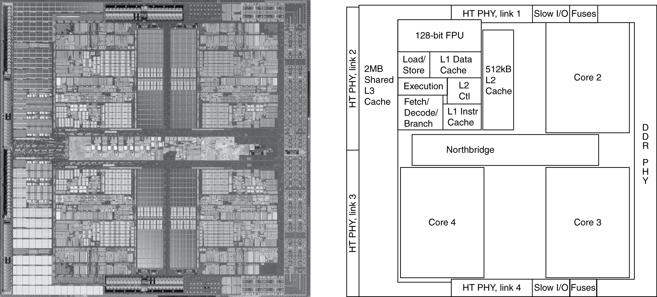
What is the inside of Processor (CPU)?
AMD Barcelona: 4 processor cores

Slide 9
How to use CPU to solve problems?

Slide 10
Design methodology 1: Common digital system
Finite state machine（FSM）
Combinational circuit
Output processing
Output
Input
Combinational circuit
Status transmission
conditions
State storage

Slide 11
Design methodology 2: Control of Register Transfers
Control of Register Transfers
  Register transfers performed on registers control that supervises the sequencing of the register transfers
Three essential elements
  Set of registers: mostly in Datapath with some in Control Unit
  Basic operation (micromanipulation): Register transfers performed
  Control: that supervises the sequencing of the register transfers
Register Transfer Language: RTL
Control signals
Control inputs
Control
unit
Status signals
Datapath
Data outputs
Data inputs
Control outputs
Notes:
Non-programmable
传输状态机：RSM
RTL: 寄存器传递语言被用于描述一个架构中寄存器传输级上的数据流

Slide 12
Design methodology 3: Control of Register Transfers
General system
  Program state machine （PSM）
Memory
Control
unit
Control signals
Datapath
I/O
Control Input
Status signals
Data Input
Data Input
Control Output
Control Input
Input/Output
Notes:
Programmable

Slide 13
Specific and general system
Non-programmable System: Specific System
  The control unit does not deal with fetching and executing instructions
  But contains all of the information for sequencing register transfers based on inputs and on status bits from the datapath
Programmable System : General system
  A portion of the input consists of a sequence of instructions called a program,
  Typically stored in a memory and addressed by a program counter.
  The Control Unit is responsible for fetching and executing these instructions.

Slide 14
Implementation of CPU
CPU
  General digital system
  A Turing Machine
    Implemented by Register Transmission Control Technology
      Datapath
        The component of processor that performs arithmetic operations
      Control
        The component of processor that commands the datapath, memory, and I/O device according to the instructions of the program

Slide 15
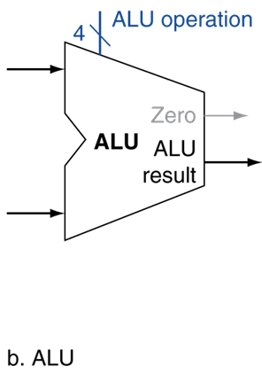
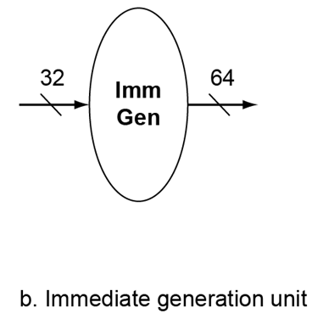
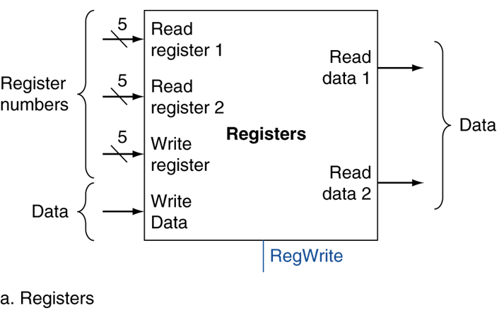
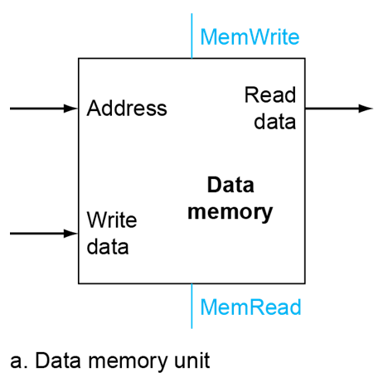
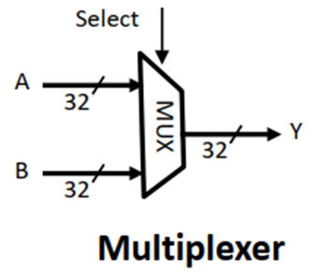
Simple Implementation
Notes:
先来看看构造数据通路需要哪些部件。

Slide 16
ALU
算术逻辑运算器ALU：即运算器
  5 Operations
  “Set on less than”：
  if A<B then Result=1；
  else Result=0。
Operation | Function
000 | And
001 | Or
010 | Add
110 | Sub
111 | Slt
Binvert
CarryIn
Operation
A
00
A
32
01
Result
Result
B
0
10
ALU
1
B
32
Less
11
3
CarryOut
Operation

Slide 17
Memory
存储器：
  可分为指令存储器与数据存储器；
  指令存储器设为只读；输入指令地址，输出指令。
  数据存储器可以读写，由MemRead和MemWrite控制。按地址读出数据输出，或将写数据写入地址所指存储器单元。
MemWrite
Instruction
Address
Address
Read
data
Instruction
Write
data
Data
memory
Instruction
memory
MemRead

Slide 18
REGISTER
Register
  State element。
  Can be controlled by Write signal.
置0，数据输出保持原状态不变
置1，在有效时钟边沿到来，数据输出为数据输入值
Write：
Register=In
Write
In
Out
Clock cycle
In
Out
Read：
Out=Register
Register
Register

Slide 19
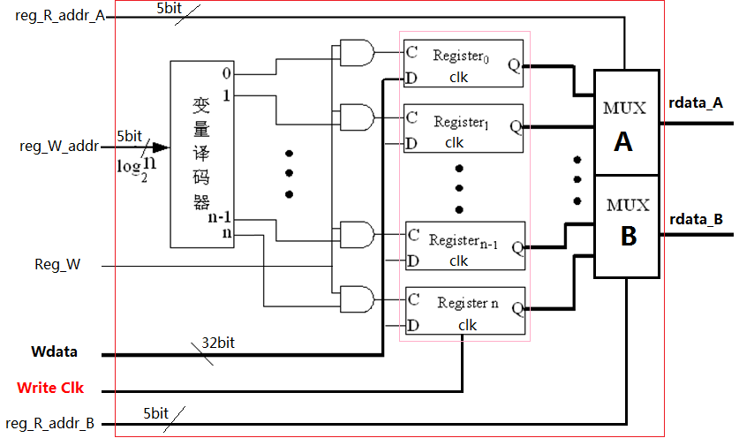
Register Files--Built using D flip-flops
  32 64-bit Registers；
  Input: 2 5-bit register number/ one 5-bit register number and 64-bit data;
  Output: 64-bit data;
  Register write control。
64 bits

Slide 20
Register File: Read-Output
Reg. address
  Output from the register
Data output
5 bits
64 bits
5 bits
5 bits
64 bits
64 bits
Reg. address
Notes:
处理器的32个通过寄存器位于一个叫作寄存器堆的结构中，就是一个寄存器的集合。
Register File--Built using D flip-flops
Mux: 32选1

Slide 21
Register File: Write-Input
  Written to the register
Write signals
rd
5 bits
Reg. address
64 bits
Notes:
写操作由写控制信号控制，还由时钟信号控制，写操作是边沿触发的
在写操作发生的时钟边沿，所有的写操作的输入，包括要写的值，寄存器号和写控制信号必须是有效的。
因为是边沿触发，可以在同一时钟周期内读出和写入同一寄存器：读出的是以前的时钟周期写入的内容，而本时钟周期写入的值在下一个时钟周期才可以读。

Slide 22
Description: 32×64bits Register files
Module regs( input clk, rst, RegWrite,
input [4:0] Rs1_addr, Rs2_addr, Wt_addr,
input [63:0] Wt_data,
output [63:0] Rs1_data, Rs2_data
);
reg [63:0] register [1:31]; // r1 - r31
integer i;
assign rdata_A = (Rs1_addr== 0) ? 0 : register[Rs1_addr]; // read
assign rdata_B = (Rs2_addr== 0) ? 0 : register[Rs2_addr]; // read
always @(posedge clk or posedge rst)
begin if (rst==1)
for (i=1; i<32; i=i+1) register[i] <= 0; // reset
else if ((Wt_addr != 0) && (RegWrite == 1))
register[Wt_addr] <= Wt_data; // write
end
endmodule

Slide 23
The other elements
Immediate generation unit：
  输入指令产生立即数的逻辑功能
    根据指令类型（加载，存储或者分支指令），产生相应的立即数
  转移指令偏移量左移位的功能
    立即数字段符号扩展为64位结果输出
ImmSel
Notes:
选择指令中要进行符号扩展的12位字段，不同的指令，12位字段是不同的。
由于输入是完整的32位指令，因此可以使用指令的操作码，funct3, funct5共同来进行选择。

Slide 24
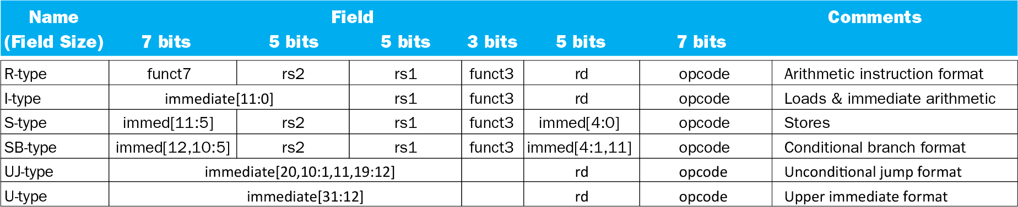
The other elements
Immediate generation
  Load:
  0000011
  Save:
  0100011
  Branch:
  1100011
  Jal:
  1101111
L_imm = {{52{inst[31]}}, Inst[31:20]};
S_imm = {{52{inst[31]}}, Inst[31:25], inst[11:7]};
SB_imm = {{51{inst [31]}}, inst[31], inst [7], inst[30:25], inst[11:8],1'b0};
UJ = {{43{inst[31]}}, inst [31], inst[19:12], inst[20], inst[30:21],1'b0};
Notes:
选择指令中要进行符号扩展的12位字段，不同的指令，12位字段是不同的。
由于输入是完整的32位指令，因此可以使用指令的操作码，funct3, funct5共同来进行选择。

Slide 25
ImmSel
Instruction type | Instruction opcode[6:0] | Instruction operation | (sign-extend)immediate | ImmSel
I-type | 0000011 | Lw;lbu;lh; lb;lhu | (sign-extend) instr[31:20] | 00
 | 0010011 | Addi;slti;sltiu;xori;ori;andi;
 | 1100111 | jalr
S-type | 0100011 | Sw;sb;sh | (sign-extend) instr[31:25],[11:7] | 01
B-type | 1100011 | Beq;bne;blt;bge;bltu;bgeu | (sign-extend) instr[31],[7],[30:25],[11:8],1'b0 | 10
J-type | 1101111 | jal | (sign-extend) instr[31],[19:12],[20],[30:21],1'b0 | 11

Slide 26
Logic Design Conventions
Information encoded in binary
  Low voltage = 0, High voltage = 1
  One wire per bit
  Multi-bit data encoded on multi-wire buses
Combinational element
  Operate on data
  Output is a function of input
State (sequential) elements
  Store information
Notes:
在进行计算机设计时，需要确定计算机的硬件逻辑以及这些逻辑如何定时。
状态单元至少有两个输入（要写入的数据和何时写的时钟信号）和一个输出（前一个时钟周期写入单元的数据）。

Slide 27
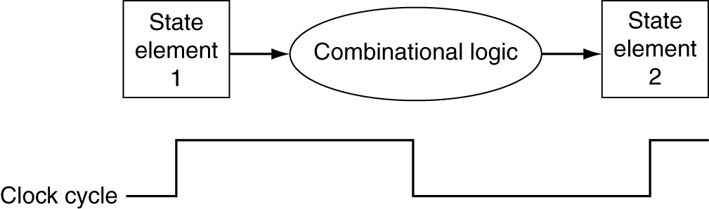
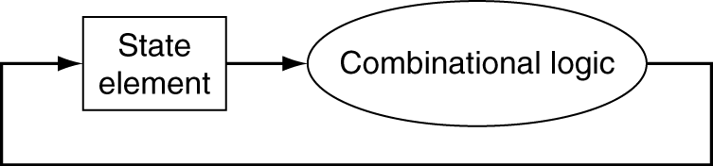
Clocking Methodology
An edge triggered methodology
Typical execution:
  read contents of some state elements,
  send values through some combinational logic
  write results to one or more state elements
Notes:
首先，我们讨论一个简单的实现方案：每条指令使用一个时钟周期，我们采用边沿触发的方法，即在一个时钟周期的边沿开始执行，在下一个时钟周期的边沿执行结束。
时钟同步方法规定了信号可以读出和写入的时刻，很重要！因为若一个信号同时被读出和写入，则读出的值是不确定的，定时方法即是为了避免这种不确定性。我们采用边沿触发。状态单元的值只有在时钟跳变的边沿发生改变。
因为只有状态单元能存储数据，所有组合逻辑都必须从状态单元接收输入，并将输出写到状态单元中。
一个时钟周期：信号从状态单元1经过组合逻辑到达状态2的时间。
只有当写控制信号有效并且时钟边沿到来时，状态单元才发生改变，不存在同一个时钟周期内的反馈。所以可以在一个时钟周期内读出一个寄存器的值，并经过组合逻辑，再次写入该寄存器。

Slide 28
Performance?

Slide 29
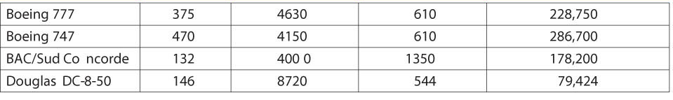
Defining Performance
Which airplane has the best performance?
Aircraft
type
Passenger
Capacity
Cruising Range(miles)
Cruising Speed(mph)
Passengers
*mph

Slide 30
Performance
Notes:
影响因素
如何定义衡量标准

Slide 31
Response Time and Throughput
Latency (Response time)
  is the time between the start and completion of an event
  How long it takes to do a task
Throughput (bandwidth)
  is the total amount of work done in a given period of time
  Total work done per unit time
    e.g., tasks/transactions/… per hour
How are response time and throughput affected by
  Replacing the processor in a computer with a faster processor
  Adding more processors?
We’ll focus on program response time for now

Slide 32
Performance

Slide 33
Performance
“X is n time faster than Y”
Example: time taken to run a program
  10s on A, 15s on B
  Execution Time_{B} / Execution Time_{A}
  = 15s / 10s = 1.5
  So A is 1.5 times faster than B

Slide 34
Measuring Execution Time
Elapsed time
  Total response time, including all aspects
    Processing, I/O, OS overhead, idle time
  Determines system performance
CPU time
  Time spent processing a given job
    Discounts I/O time, other jobs’ shares
  Comprises user CPU time and system CPU time
    User CPU time : CPU time spent in the program itself
    System CPU time: CPU time spent in the OS, performing tasks on behalf of the program.
  Different programs are affected differently by CPU and system performance
Notes:
Elapsed time：消逝时间

Slide 35
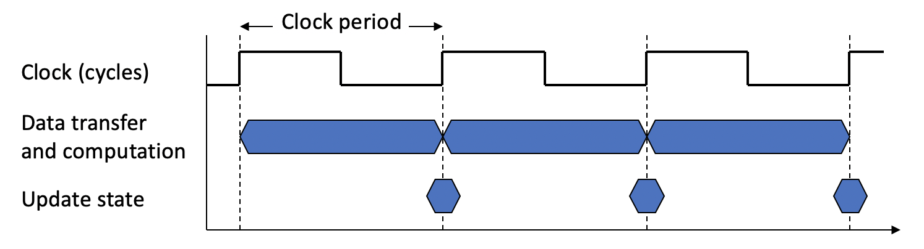
CPU Clocking
Operation of digital hardware governed by a constant-rate clock
Clock period: duration of a clock cycle
  e.g., 250ps = 0.25ns = 250×10^{–12}s
Clock frequency (rate): cycles per second
  e.g., 4.0GHz = 4000MHz = 4.0×10⁹Hz
Notes:
性能之前，CPU的运作方式：依赖固定周期的时钟

Slide 36
CPU Performance
Notes:
时钟周期数*时钟周期

Slide 37
CPU Time
Performance improved by
  Reducing number of clock cycles
  Increasing clock rate
  Hardware designer must often trade off clock rate against cycle count
Notes:
CPU时间的定义类似条件概率，是指在某个特定任务下的CPU时间
提高主频的代价，是相同程序需要更多的时钟周期去执行

Slide 38
CPU Time Example
Computer A: 2GHz clock, 10s CPU time
Designing Computer B
  Aim for 6s CPU time
  Can do faster clock, but causes 1.2 × clock cycles
How fast must Computer B clock be?
Notes:
提高主频的代价，是相同程序需要更多的时钟周期去执行

Slide 39
Metrics of CPU performance

Slide 40

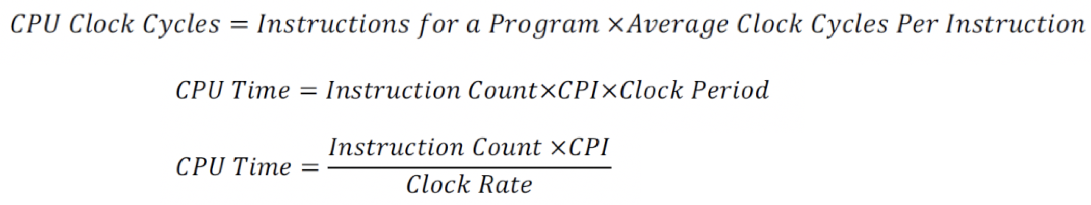
Instruction Count and CPI
Instruction Count for a program
  Determined by program, ISA and compiler
Average cycles per instruction (CPI)
  Determined by CPU hardware
  If different instructions have different CPI
    Average CPI affected by instruction mix
Notes:
CPI 执行一条指令所需的时钟周期数。
对于一条特定的指令，CPI指执行该指令所需的时钟周期数，CPI是个特定值；
对于一段程序或机器，CPI指执行该程序或机器指令集中的所有指令所需的平均时钟周期数，是一个平均值。
CPU time=CPI*指令条数*时钟周期

Slide 41
CPI Example
Computer A: Cycle Time = 250ps, CPI = 2.0
Computer B: Cycle Time = 500ps, CPI = 1.2
Same ISA
  Which is faster, and by how much?

Slide 42
CPI in More Detail
If different instruction classes take different numbers of cycles
Weighted average CPI
Relative frequency

Slide 43
Weighted CPI Example
Alternative compiled code sequences using instructions in classes A, B, C
Sequence 1: IC = 5 Clock Cycles = 2×1 + 1×2 + 2×3 = 10
  Avg. CPI = 10/5 = 2.0
Sequence 2: IC = 6 Clock Cycles = 4×1 + 1×2 + 1×3 = 9
  Avg. CPI = 9/6 = 1.5
Class | A | B | C
CPI for class | 1 | 2 | 3
IC in sequence 1 | 2 | 1 | 2
IC in sequence 2 | 4 | 1 | 1

Slide 44
Performance Summary
Performance depends on
  Algorithm: affects IC, possibly CPI
  Programming language: affects IC, CPI
  Compiler: affects IC, CPI
  Instruction set architecture: affects IC, CPI, T_{c}
The BIG Picture

Slide 45
Improvement
Improvement of input / output
The development of memory organization structure
  Associative memory and associated processor
  General register group
  Cache
Two directions of instruction set development：
  CISC
  RISC
Parallel processing technology
  How to develop parallelism in traditional machines?
  Develop parallel technologies at different levels.
  For example, micro operation level, instruction level, thread level, process level, task level, etc.

Slide 46
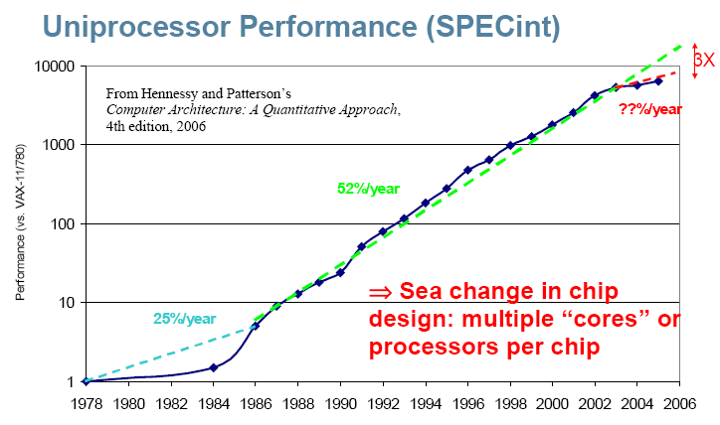
Incredible performance improvement
Three Walls !
Notes:
80年代以前，性能的增长靠技术驱动。
后面52%，归工于体系结构和组织方式的创新。
从2002年开始，单核处理器的性能增长放缓，主要受到3个限制：受到功耗，指令级并行程度和存储长延迟

Slide 47
Power Wall
Power efficiency decrease
  the trend of consuming double the power with each doubling of operating frequency
Hot-spot
Power leakage
Notes:
功率已达实际极限，无法再将普通商用处理器冷却下来。

Slide 48
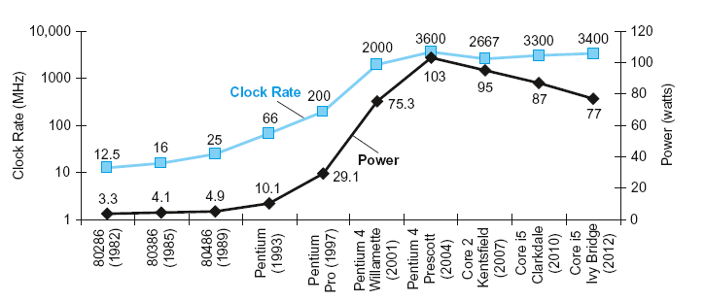
Power Trends
In CMOS IC technology
×30
5V → 1V
×1000
Notes:
Capacity load: 负载电容
时钟频率增长了1000倍，而功耗只增长30倍
Pentium 4的时钟频率和功耗提高很大，但是性能提升不大。Presscott发热问题导致奔4处理器的生产线被放弃，Core 2生产线恢复使用低时钟频率的简单流水线和片上多处理器。

Slide 49
Reducing Power
Suppose a new CPU has
  85% of capacitive load of old CPU
  15% voltage and 15% frequency reduction
The power wall
  We can’t reduce voltage further
  We can’t remove more heat
How else can we improve performance?
Notes:
如果电压继续下降，会使晶体管的泄露电流过大，就像水龙头不能被完全关闭一样。目前40% 的功耗都是由于泄露电流造成的，如果进一步增大，将难以处理。

Slide 50
Memory Wall
µProc
52%/yr.
µProc
20%/yr.
CPU
L2 cache is getting larger with less performance contribution
“Moore’s Law”
Processor-Memory
Performance Gap:
(grows 50% / year)
µProc
25%/yr.
“Less’ Law?”
DRAM
7%/yr.
DRAM
1980: no cache in µproc; 2001: 2-level cache on chip
(1989 first Intel µproc with a cache on chip)

Slide 51
ILP Wall
“ILP wall” refers to increasing difficulty to find enough parallelism in the instructions stream of a single process to keep higher performance processor cores busy.
20%: little ILP left to exploit due to power dissipation and memory gap
  ILP => TLP and DLP
Notes:
ILP :Instruction-Level-Parallelism 指令层并行。ILP wall指软件的并行性落后于硬件的并行性
TLP（Thread-Level Parallelism，线程级并行或者内部处理器并行运算)
DLP：data level parallelism

Slide 52
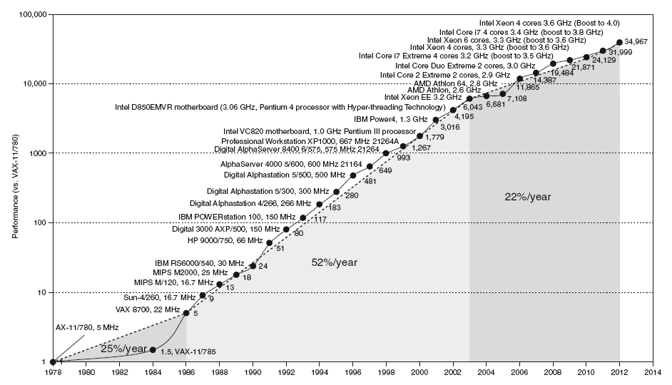
Uniprocessor Performance
Constrained by power, instruction-level parallelism, memory latency

Slide 53
Advanced - Multiprocessors
Multicore microprocessors
  More than one processor per chip
Requires explicitly parallel programming
  Compare with instruction level parallelism
    Hardware executes multiple instructions at once
    Hidden from the programmer
  Hard to do
    Programming for performance
    Load balancing
    Optimizing communication and synchronization

Slide 54
Amdahl’s Law

Slide 55
Amdahl’s Law
Improving an aspect of a computer and expecting a proportional improvement in overall performance
Example: multiply accounts for 80s/100s
  How much improvement in multiply performance to get 5× overall?
Can’t be done!

Slide 56
Amdahl’s Law
The system performance acceleration rate is limited by the percentage of the execution time of the component to the total execution time in the system.
Amdahl’s law defines the speedup that can be gained by using a particular feature.
Performance for entire task _{Using Enhancement}
Speedup =
=
Performance for entire task _{Without Enhancement}
Total Execution Time _{Without Enhancement}
Total Execution Time _{Using Enhancement}

Slide 57
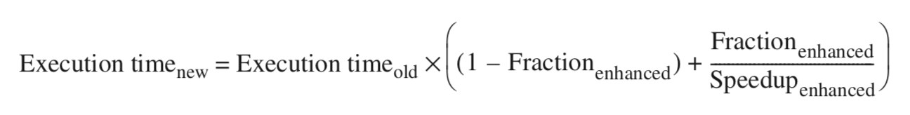
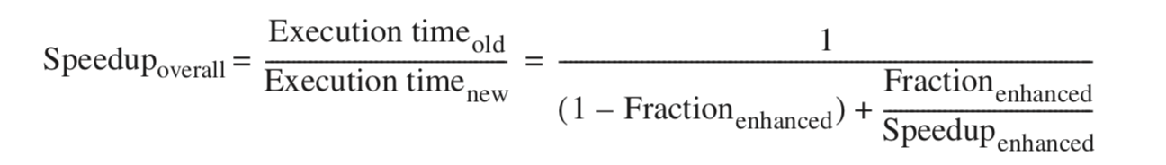
Amdahl’s Law
Based on the basic idea that:
  Execution time _{new} = Execution time _{can not be enhance}+ Execution time _{enhanced}

Slide 58
Amdahl’s Law
Improved ratio: In the system before the improvement, the ratio of the execution time of the improvement part to the total execution time.
  It is always less than or equal to 1.
  For example: a program that needs to run for 60 seconds has 20 seconds of calculation that can be accelerated,
  Then the ratio is 20/60.
Component speedup ratio: The multiple that can be improved after some improvements. It is the ratio of the execution time before the improvement to the execution time after the improvement.
  Under normal circumstances, the component acceleration ratio is greater than 1.
  For example: if the system is improved, the execution time of the improved part is 2 seconds,
  Before the improvement, its execution time was 5 seconds, and the component acceleration ratio was 5/2.

Slide 59
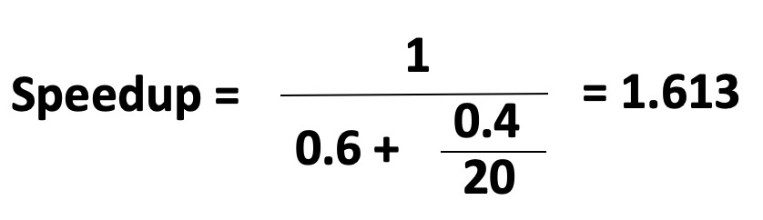
Amdahl’s Law
Example 1.1 Increasing the processing speed of a certain function in the computer system to 20 times the original, but the processing time of this function only accounts for 40% of the running time of the entire system. After adopting this method to improve performance, how much can the performance of the entire system improve?
Answer:
  Fraction _{enhanced} = 40%
  Speedup _{enhanced} = 20

Slide 60
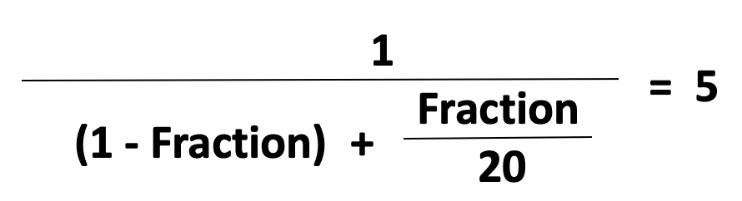
Amdahl’s Law
Example 1.2 After a computer system adopts floating-point arithmetic components, the floating-point arithmetic speed is increased by 20 times, and the overall performance of a certain program of the system is increased by 5 times. Try to calculate the proportion of the floating-point operations in this program.
Answer:
  Speedup _{overall} = 5
  Speedup _{enhanced} = 20
  Fraction = 84.2%

Slide 61
Amdahl’s Law
A decreasing rule for performance improvement
If only a part of the computing task is improved, the more the improvement, the more limited the overall performance improvement.
Important inference: If only a part of the whole task is improved and optimized, the speedup obtained will not exceed:
1/ (1-the ratio can be improved)

Slide 62
The Processor: Design
Haifeng Liu
Zhejiang University

Slide 63
_{CPU we will be doing}
We’ll look at an implementation of RISC-V
Simplified to contain only:
  memory-reference instructions: lw, sw
  arithmetic-logical instructions: add, sub, and, or, slt
  control flow instructions: beq, jal
An overview of the implementation
  For every instruction, the first two step are identical
    Fetch the instruction from the memory
    Decode and read the registers
  Next steps depend on the instruction class
    Memory-reference Arithmetic-logical branches
What are the steps?
How many functions

Slide 64
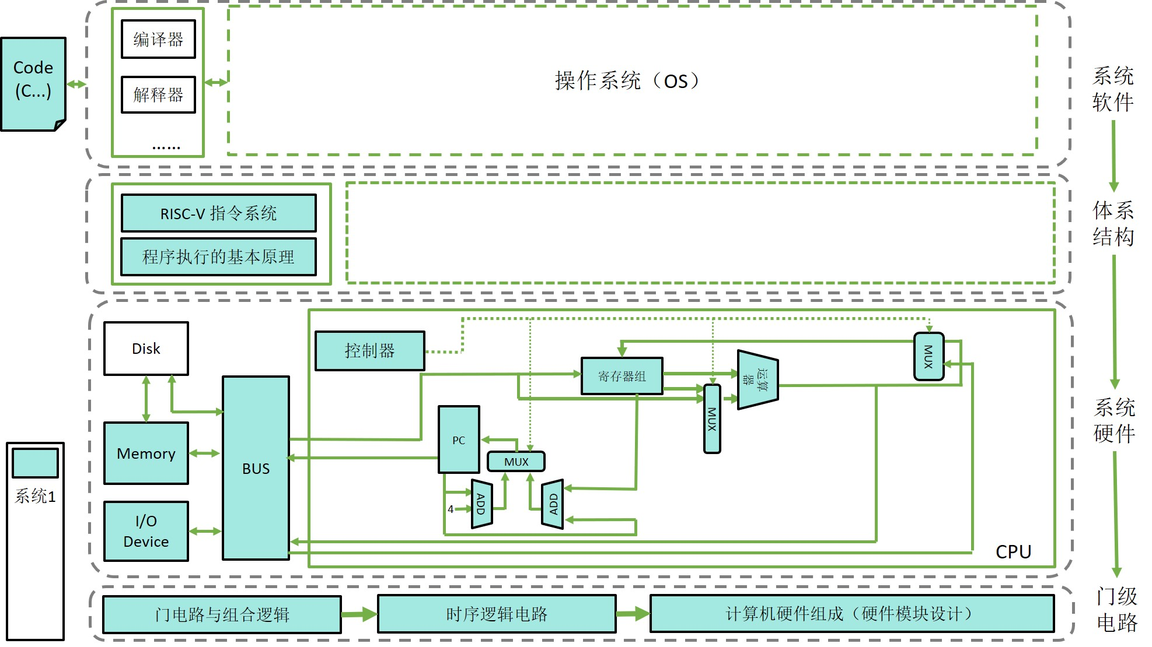
_{CPU we will be doing}

Slide 65
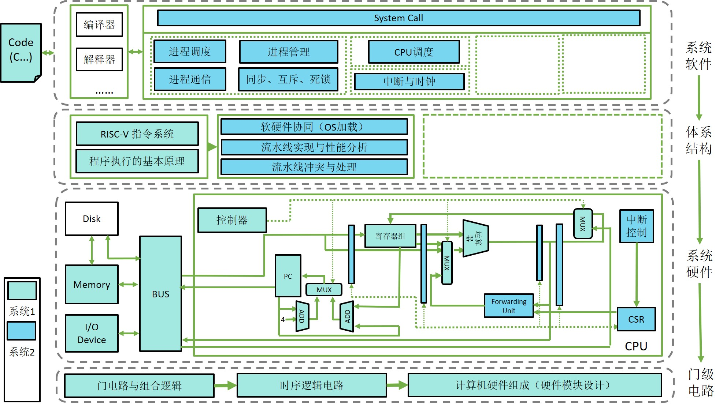
_{CPU we will be doing}

Slide 66
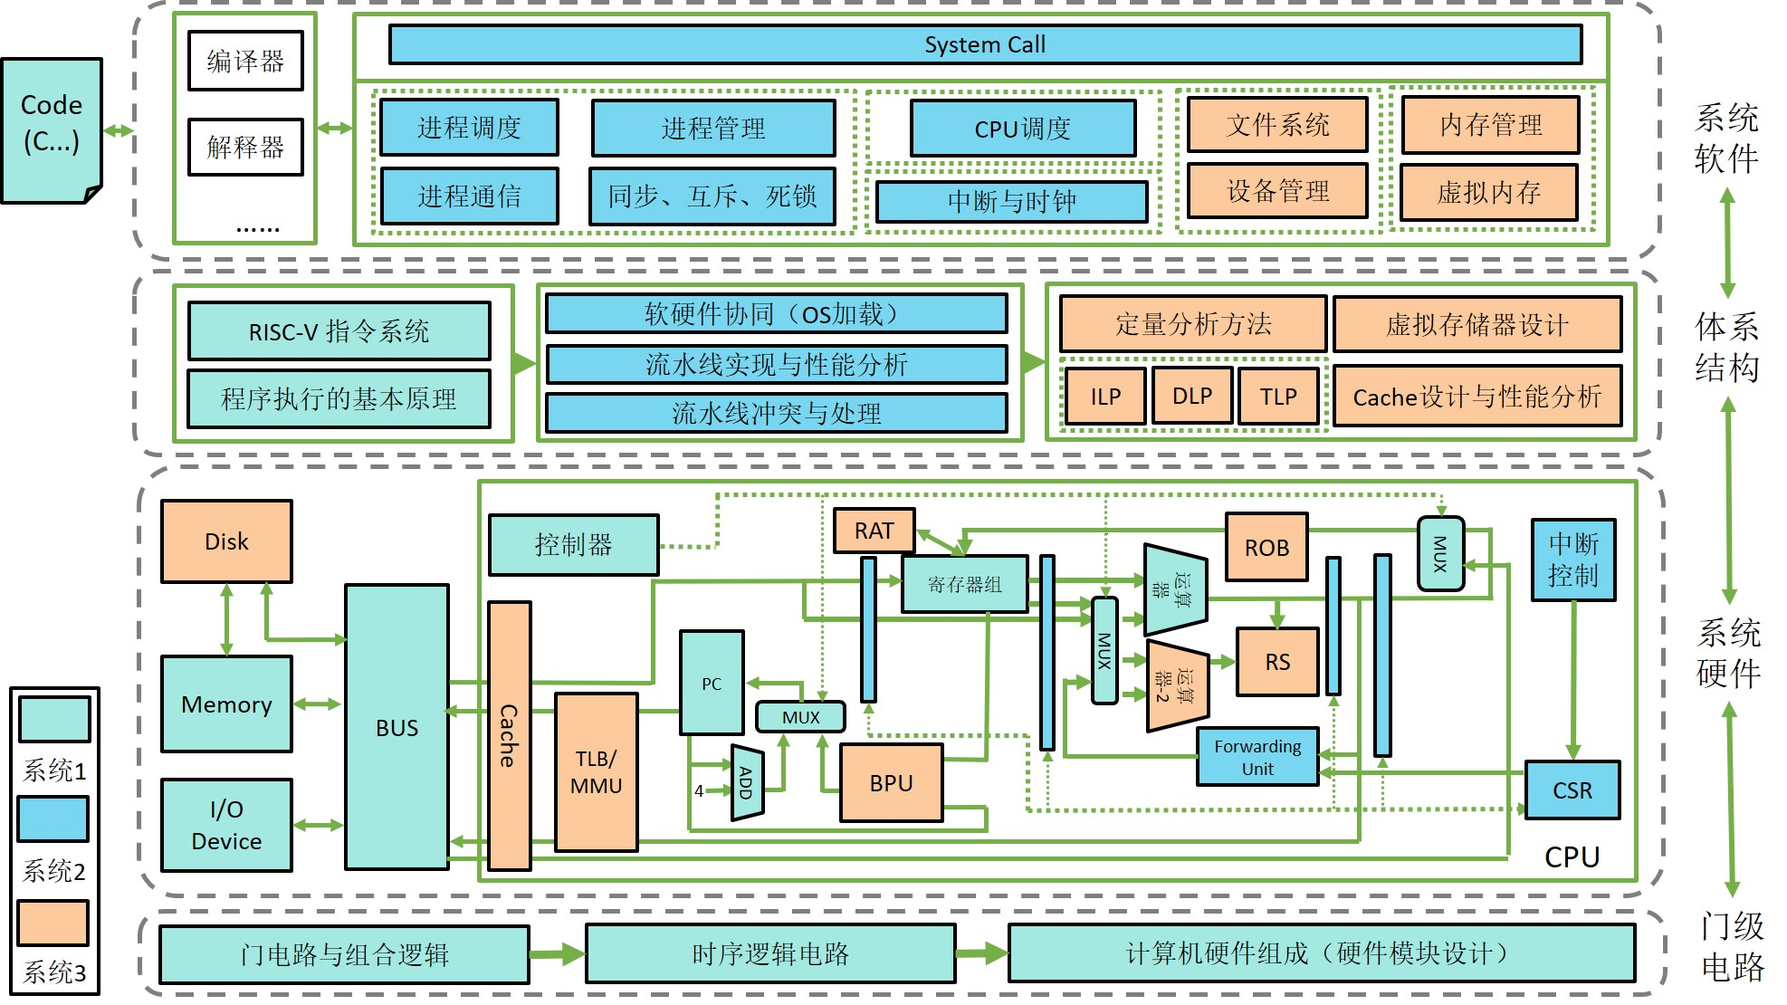
_{CPU we will be doing}

Slide 67
Instruction Execution Overview
For every instruction, the first two steps are identical
    Fetch the instruction from the memory
    Decode and read the registers
  Next steps depend on the instruction class
    Memory-reference Arithmetic-logical branches
Depending on instruction class
  Use ALU to calculate
    Arithmetic result
    Memory address for load/store
    Branch comparison
  Access data memory for load/store
  PC ← target address or PC + 4
Notes:
虽然指令有很多，执行这些指令所要做的大部分工作是相同的。具体来说，实现每条指令的前两个步骤是相同的：
5步：根据PC取指令，译码，执行，MEM，写回
指令同性：所有类型的指令在读取寄存器后，都要使用ALU。存储访问指令用ALU计算地址，算术逻辑指令用来执行运算，分支指令用ALU进行比较。这和指令的简洁规整分不开，规整使得指令的执行相似，从而简化了实现过程。
使用ALU之后不同指令有不同的操作。存储访问指令需要访问存储器以读取数据或者存储数据，算术指令需要将ALU的结果写回寄存器，分支指令需要根据比较结果更改下一条指令的地址；否则，下一条指令的地址是PC+4…

Slide 68
Contents
Building a datapath
A Simple Implementation Scheme
Notes:
详细分析采用单个时钟完成一条指令的简单控制器设计。强调单周期实现中指令间是时序电路，要保证在每个时钟的结束边沿（上升沿）来到前最耗时指令的工作已经完成，并在边沿触发下将结果写入目的操作数。
控制器设计方法不唯一，首先介绍控制器设计思想和分层结构，然后根据逻辑电路的事件特征化简方法，利用单周期指令间无重叠特征，简化为时钟内的组合逻辑设计。
主控制器设计分析采用组合逻辑的设计流程：定义变量、结合Datapath写出R、I、J三类指令的真值表，最后写出控制信号输出方程。此处可结合课堂讨论让学生来填写真值表内容。

Slide 69
Building a datapath
Datapath
  Elements that process data and addresses in the CPU
    Registers, ALUs, mux’s, memories, …
We will build a RISC-V datapath incrementally
  Refining the overview design
Notes:
我们会首先分析每类RISC-V指令需要哪些功能单元，然后逐渐细节化。

Slide 70
RISC-V fields (format)
opcode：basic operation of the instruction.
rs1： the first register source operand.
rs2： the second register source operand.
rd： the register destination operand.
funct： function,this field selects the specific variant of the operation in the op field.
Immediate: address or immediate

Slide 71
Name | Example | Comments
32 registers | x0-x31 | Fast locations for data. In RISC-V, data must be in registers to perform arithmetic. Register x0 always equals 0.
2⁶¹ memory words | Memory[0], Memory[8] , …… , Memory[18446744073709551608] | Accessed only by data transfer instructions. RISC-V uses byte addresses, so sequential doubleword accesses differ by 8. Memory holds data structures, arrays, and spilled registers.
Name | Register name | Usage | Preserved On call?
x0 | 0 | The constant value 0 | n.a.
x1(ra) | 1 | Return address(link register) | yes
x2(sp) | 2 | Stack pointer | yes
x3(gp) | 3 | Global pointer | yes
x4(tp) | 4 | Thread pointer | yes
x5-x7 | 5-7 | Temporaries | no
x8-x9 | 8-9 | Saved | yes
x10-x17 | 10-17 | Arguments/results | no
x18-x27 | 18-27 | Saved | yes
x28-x31 | 28-31 | Temporaries | no

Slide 72
RISC-V assembly language
Category | Instruction | Example | Meaning | Comments
Arithmetic | add | add x5,x6,x7 | x5=x6 + x7 | Add two source register operands
 | subtract | sub x5,x6,x7 | x5=x6 - x7 | First source register subtracts second one
 | add immediate | addi x5,x6,20 | x5=x6+20 | Used to add constants
Data transfer | load doubleword | ld x5, 40(x6) | x5=Memory[x6+40] | doubleword from memory to register
 | store doubleword | sd x5, 40(x6) | Memory[x6+40]=x5 | doubleword from register to memory
Logical | and | and x5, x6, 3 | x5=x6 & 3 | Arithmetic shift right by register
 | inclusive or | or x5,x6,x7 | x5=x6 | x7 | Bit-by-bit OR
Conditional Branch | branch if equal | beq x5, x6, 100 | if(x5 == x6) go to PC+100 | PC-relative branch if registers equal
 | branch if not equal | bne x5, x6, 100 | if(x5 != x6) go to PC+100 | PC-relative branch if registers not equal
Unconditional Branch | jump and link | jal x1, 100 | x1 = PC + 4; go to PC+100 | PC-relative procedure call
 | jump and link register | jalr x1, 100(x5) | x1 = PC + 4; go to x5+100 | procedure return; indirect call

Slide 73
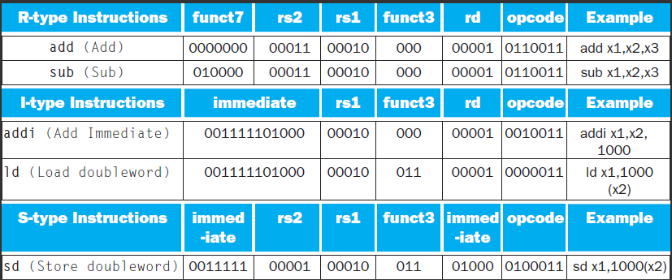
https://isisn.nsfc.gov.cn
SB-type instruction | 111110 | 01011 | 01010 | 001 | 10000 | 1100011
bne x10, x11, 2000
UJ-type instruction | 01111101000000000000 | 00000 | 1101111
jal x0, 2000

Slide 74
Instruction execution in RISC-V
Fetch :
  Take instructions from the instruction memory
  Modify PC to point the next instruction
Instruction decoding & Read Operand:
  Will be translated into machine control command
  Reading Register Operands, whether or not to use
Executive Control:
  Control the implementation of the corresponding ALU operation
Memory access:
  Write or Read data from memory
  Only ld/sd
Write results to register:
  If it is R-type instructions, ALU results are written to rd
  If it is I-type instructions, memory data are written to rd
Modify PC for branch instructions

Slide 75
Instruction fetching three elements
Data Stream of Instruction fetching
How to connect? Who?
Read address
PC
Add
Instruction
Instruction
Memory
Instruction memory
Program counter
Adder
Notes:
一个存储单元用来存储程序的指令, 由于指令存储器是只读的，任意时刻的输出都反映了输入地址处的内容，而不需要读控制信号。
当前指令的地址也必须存放在一个状态单元中，pc，pc是一个32位寄存器，它在每个时钟周期末都会被写入，所以也不需要写控制信号。
还需要一个加法器来增加PC的值以获得下一条指令的地址。

Slide 76
Instruction fetching unit
Instruction Register
  Can you omit it?
add
PC
4
CPU
Read address
Instruction
Instruction
Instruction
Memory
Notes:
执行任意一条指令，都要先从存储器中把指令取出来。取出的指令供数据通路其他部分使用。
为准备执行下一条指令，需要PC+4

Slide 77
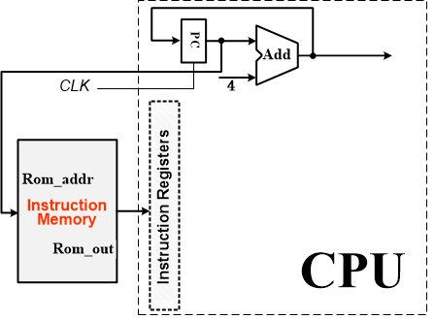
How simple is!
Why PC+4?

Slide 78
More Implementation Details
Abstract / Simplified View:
Notes:
数据通路部件包括指令和数据存储器，寄存器堆，ALU和加法器

Slide 79
Path Built using Multiplexer
Data Stream of Instruction executing
R-type instruction Datapath
I-type instruction Datapath
  For ALU
  For load
S-type (store) instruction Datapath
SB-type (branch) instruction Datapath
UJ-type instruction Datapath
  For Jump
First, Look at the data flow within instruction execution
Notes:
设计要点：利用寄存器传输技术，一定可以分解为data path和控制器这两部分
先把所有的操作理出来，这些操作都是由ALU来操作的，然后确定ALU的数据从哪里来，得到的结果往哪里去, 从而构造数据通路

Slide 80
R type Instruction & Data stream
op(7)
add x9, x20, x21
control
ALU operation
rd(5)
Read two register operands
Perform arithmetic/logical operation
Write register result
ALUC
ins₇₋₁₁
RegWrite
func3
rs1
Registers
4
Read reg. address1
ins₁₅₋₁₉
Read data1
rs1(5)
rs2
Read reg. address2
ALU
Zero
ins₂₀₋₂₄
rd
Write reg. address
ALU result
rs2(5)
Read data2
Write data
64bits data
func7
Notes:
R类型，寄存器4个输入，两个输入，就送到ALU，没有使能。写数据需要使能RegWrite。写信号很关键，写信号是0的时候，不管写地址和写数据是什么都不会写。所以有时候不写的时候，我们不用考虑写地址和写数据。
什么时候写是同步时钟控制。真正写是边沿触发，时钟上升沿。

Slide 81
I type (load) Instruction & Data stream
ld x1, 200(x2)
control
ALUop
Read register operands
Calculate address using 12-bit offset
  Use ALU, but sign-extend offset
Read memory and update register
Immediate(12)
ALUC
ins₇₋₁₁
RegWrite
4
ALU operation
rs1
Registers
Read reg. address1
rs1(5)
Read data1
rs2
Read reg. address2
ALU
Zero
MemWrite
ins₁₅₋₁₉
func3
rd
Write reg. address
ALU result
address
addi x1, x2，4？
Read data2
Write data
Read data
Data
Memory
rd(5)
ins₀₋₃₁
Imm
Gen
Write data
32
64
MemRead
op(7)
64bits data
Notes:
9条指令里面的I-type: lw, 实际上还有其他ALU立即数操作，addi etc
Lw R2, 4(R3): R2 <- M[4+R3], memread=1, memwrite=0, 数据读出，传给write data，写地址由rt给出
做实验的时候注意时间，存储器访问时间比较长，要注意在一个时钟周期内是不是能完成存储器访问。
ALU一般是10ns左右，存储器用片内存储器（工具做的存储器核，把数据初始化给.coe），存储访问时间可以在10ns左右，基本上100M的时钟理论上是没问题的，主频设的低一点25M足够用了。做实验的时候注意存储器有一个时钟做地址锁存的。当一个周期开始的时候，地址还没计算出来，所以是不能用指令周期的时钟上升沿做地址锁存的，要延迟一会儿再给一个锁存时钟。
lw的时候ALU做加法是由op直接得到的

Slide 82
S-type (store) Instruction & Data stream
sd x1, 200(x2)
op(7)
control
ALUop
Read register operands
Calculate address using 12-bit offset
  Use ALU, but sign-extend offset
Write register value to memory
imm5
ALUC
RegWrite
4
ALU operation
rs1
Registers
Read reg. address1
func3
Read data1
ins₁₅₋₁₉
rs2
Read reg. address2
ALU
Zero
MemWrite
rs1(5)
rd
Write reg. address
ALU result
address
ins₂₀₋₂₄
Read data2
Write data
Read data
Data
Memory
rs2(5)
Write data
Imm
Gen
ins₀₋₃₁
32
64
MemRead
imm7
Notes:
Sw： 写地址由ALU计算得出，写数据由rt从寄存器read data2读出, memread=0, memwrite=1,
如果写地址没有确定，数据没有确定，写信号千万不能是1，否则会破坏存储器的数据

Slide 83
SB type Instruction & Data stream of beq
PC+4
op(7)
PC
control
ADD
To PC
imm5
RegWrite
Branch
func3
rs1
Registers
beq x1, x2，200
Read reg. address1
ALUC
Read data1
ALUop
ins₁₅₋₁₉
rs2
Read reg. address2
4
Read register operands
Compare operands
  Use ALU, subtract and check Zero output
Calculate target address
  Sign-extend displacement
  Shift left 1 place (halfword displacement)
  Add to PC value
rs1(5)
ALU operation
Write reg. address
ALU
ins₂₀₋₂₄
Zero
Read data2
rs2(5)
Write data
ALU result
ins₀₋₃₁
Imm
Gen
32
64
imm7
Notes:
Beq r3,r2,L
offset是半字地址，立即数拓展后再x2，加上pc后得到跳转地址，这个加法可以用ALU来做，但是ALU还要做比较，所以我们再用一个ADD来计算跳转地址。
地址有了，用不用要比较r2和r3后才确定。这里ALU做减法也是由op决定的。
拓展bne也可以画在这里
在mips中，分支指令是延迟的，即无论分支条件是否满足，它之后的那条指令总被执行。条件不满足时，情况与一般的分支指令相同；条件满足时，延迟的分支指令先执行它下面的那条指令，然后再跳转到指定的分支目标地址。主要动机是流水线对分支指令的影响。简单起见，我们这里不考虑延迟。

Slide 84
UJ type Instruction
Op(7)
rd(5)
Target address(20)
PC+4
PC
To PC
control
ADD
Jump
ins₇₋₁₁
RegWrite
Branch
rs
Registers
Read reg. address1
jal x1, procedure
Read data1
rt
Read reg. address2
4
ALU operation
Write reg. address
ALU
Read data2
Zero
Write data
ALU result
Imm
Gen
ins₀₋₃₁
16
32

Slide 85
Composing the Elements
First-cut data path does an instruction in one clock cycle
  Each datapath element can only do one function at a time
  Hence, we need separate instruction and data memories
Use multiplexers where alternate data sources are used for different instructions

Slide 86
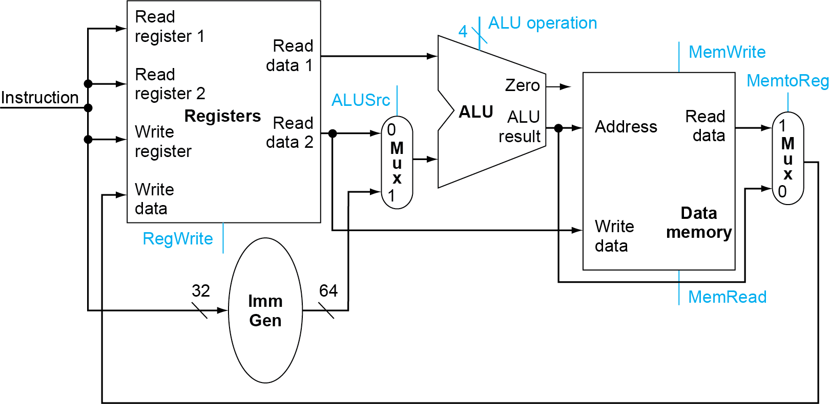
R-Type/Load/Store Datapath
Notes:
把不同类型指令的数据通路合起来，需要允许多个到功能单元输入端的连接，因此我们使用多路复用器和控制信号在多个输入之间选择。讲一下每个mux
指令本来需要存放到指令寄存器，但是单周期实现可以省略。因为CPU时钟信号没来，指令不变
所有指令都是在一个时钟周期执行完成，这就意味着对每条指令，数据通路资源不能重复使用，因此任何要使用不止一次的单元都要复制。

Slide 87
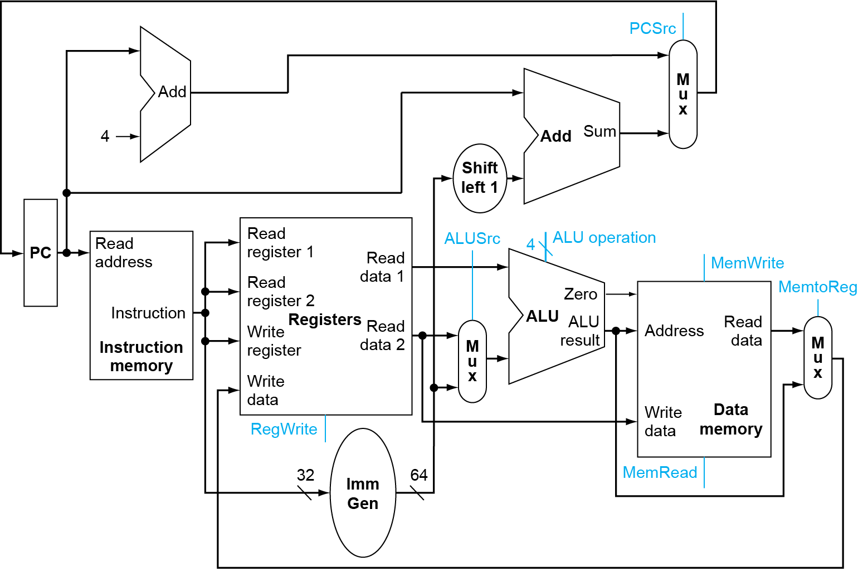
Full Datapath
Notes:
再加上分支指令，需要加上加法器，再多一个选择器，用来选择是分支目标地址，还是pc+4写入pc
再加上jal?

Slide 88
Full datapath
PC
ADD
MUX
ADD
4
Shift
left 1
RegWrite
Instruction
ins₁₅₋₁₉
Registers
Read address
Read address1
3
ALU operation
ins₂₀₋₂₄
Read data1
Read address2
ALU
Zero
MenWrite
Instruction
ins₇₋₁₁
Write address
ALU
result
address
Read data2
MUX
Read data
MUX
Instruction
Memory
Write data
Data
Memory
ins₀₋₃₁
Imm
Gen
Write data
64
MenRead
32
64bits data

Slide 89
Full datapath
R
PC
ADD
MUX
ADD
4
Shift
left 1
RegWrite
Instruction
ins₁₅₋₁₉
Registers
Read address
Read address1
3
ALU operation
ins₂₀₋₂₄
Read data1
Read address2
ALU
Zero
MenWrite
Instruction
ins₇₋₁₁
Write address
ALU
result
address
Read data2
MUX
Read data
MUX
Instruction
Memory
Write data
Data
Memory
ins₀₋₃₁
Imm
Gen
Write data
64
MenRead
32
64bits data

Slide 90
Full datapath
I-ld
PC
ADD
MUX
ADD
4
Shift
left 1
RegWrite
Instruction
ins₁₅₋₁₉
Registers
3
Read address
Read address1
ALU operation
ins₂₀₋₂₄
Read data1
Read address2
ALU
Zero
MenWrite
Instruction
ins₇₋₁₁
Write address
ALU
result
address
Read data2
MUX
Read data
MUX
Instruction
Memory
Write data
Data
Memory
ins₀₋₃₁
Imm
Gen
Write data
64
MenRead
32
64bits data
Notes:
立即数指令也是这种情况，addi

Slide 91
Full datapath
S-sd
PC
ADD
MUX
ADD
4
Shift
left 1
RegWrite
Instruction
ins₁₅₋₁₉
Registers
3
Read address
Read address1
ALU operation
ins₂₀₋₂₄
Read data1
Read address2
ALU
Zero
MenWrite
Instruction
ins₇₋₁₁
Write address
ALU
result
address
Read data2
MUX
Read data
MUX
Instruction
Memory
Write data
Data
Memory
ins₀₋₃₁
Imm
Gen
Write data
64
MenRead
32
64bits data

Slide 92
Full datapath
PC
ADD
MUX
SB-beq
ADD
4
Shift
left 1
RegWrite
Instruction
ins₁₅₋₁₉
Registers
3
Read address
Read address1
ALU operation
ins₂₀₋₂₄
Read data1
Read address2
ALU
Zero
MenWrite
Instruction
ins₇₋₁₁
Write address
ALU
result
address
Read data2
MUX
Read data
MUX
Instruction
Memory
Write data
Data
Memory
ins₀₋₃₁
Imm
Gen
Write data
64
MenRead
32
64bits data

Slide 93
Full datapath
UJ-jal
PC
ADD
MUX
MUX
ADD
4
Shift
left 1
RegWrite
Instruction
ins₁₅₋₁₉
Registers
3
Read address
Read address1
ALU operation
ins₂₀₋₂₄
Read data1
Read address2
ALU
Zero
MenWrite
Instruction
ins₇₋₁₁
Write address
ALU
result
address
Read data2
MUX
Read data
MUX
Instruction
Memory
Write data
Data
Memory
ins₀₋₃₁
Imm
Gen
Write data
64
MenRead
32
64bits data
Notes:
Lui指令也可以实现，这样6种指令类型就全了

Slide 94
单周期数据通路结构（add jalr)
0
PC
MUX
0
1
MUX
PC+4
Add
2
Add
1
CLK
4
Registers
file
0
Write
data
MUX
2
Instruction memory
Inst[11:7]
Write register
Read address
Reg[rs1]
1
Inst[19:15]
Read register1
Read data1
Zero
Instruction[31:0]
ALU
Read register2
Reg[rs2]
alu
Data
memory
Inst[24:20]
Read data2
0
ALU result
Address
MUX
Read data
1
Write data
CLK
Inst[31:7]
Imm
Gen
Imm[31:0]
Inst[31:0]
RegWrite
=0
ImmSel
=B
ALUsrc_B
=0
ALU_contrl
=sub
Jump
=0
MemToReg
=*
MemRW
=*
Notes:
Pc update: 0- pc+4
1- pc+imm (jal)
2- register+imm (jalr)

Slide 95
单周期数据通路结构 (add lui, bne)
0
PC
MUX
0
1
MUX
PC+4
Add
2
Add
1
OR
bne rs1,rs2,immediate
不相等则跳转
CLK
4
AND
AND
0
Registers
file
Write
data
MUX
2
Instruction memory
Inst[11:7]
Write register
3
Read address
Reg[rs1]
1
Inst[19:15]
Read register1
Read data1
Zero
Instruction[31:0]
ALU
Read register2
Reg[rs2]
alu
Data
memory
Inst[24:20]
Read data2
0
ALU result
Address
MUX
Read data
1
Write data
CLK
Inst[31:7]
Imm
Gen
Control Unit
Imm[31:0]
Inst[31:0]
RegWrite
=0
ImmSel
=B
ALUsrc_B
=0
BranchN
=1
ALU_contrl
=sub
Jump
=0
MemToReg
=*
MemRW
=*
Branch=*

Slide 96
Contents
Building a datapath
A Simple Implementation Scheme
Notes:
单周期的实现方式比较简单。但是状态只有一个，状态之间实际上是这一条指令和下一条指令。状态内实际上就是一个组合电路。

Slide 97
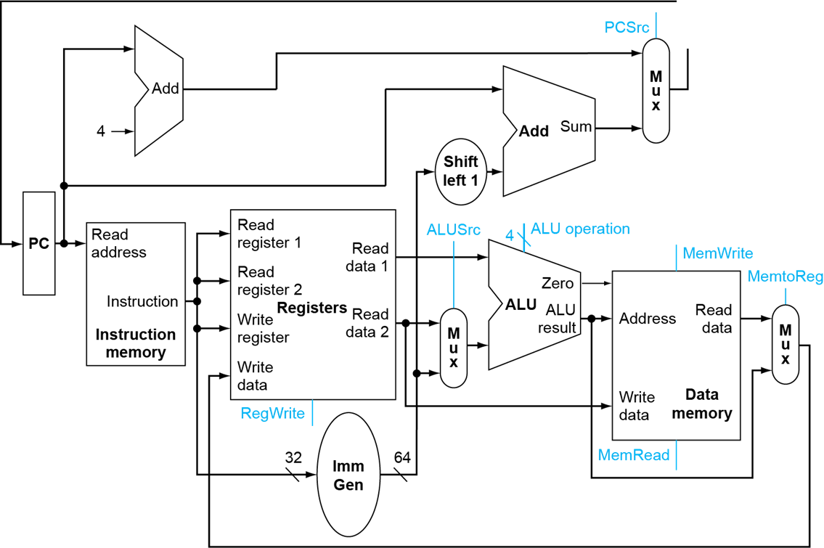

Building the Datapath & Controller
There are 7+4 signals
Branch
jump
Notes:
虚线内是控制通路
7个数据通路的控制信号(MemtoReg是2位的，其他)， 1个ALU的控制信号（3位的）。
后面要对这个图，这些控制信号非常熟悉。

Slide 98
Building Controller
Analyse for cause and effect
Information comes from the 32 bits of the instruction
Selecting the operations to perform (ALU, read/write, etc.)
Controlling the flow of data (multiplexor inputs)
ALU's operation based on instruction type and function code
Notes:
最关键的是6种指令的格式要牢记，Op常用的要记得。
根据指令格式来掌握数据通路的关系，关联。指令一部分到数据通路，一部分到控制器部分
蓝色部分到控制器，红色部分到数据通路部分

Slide 99
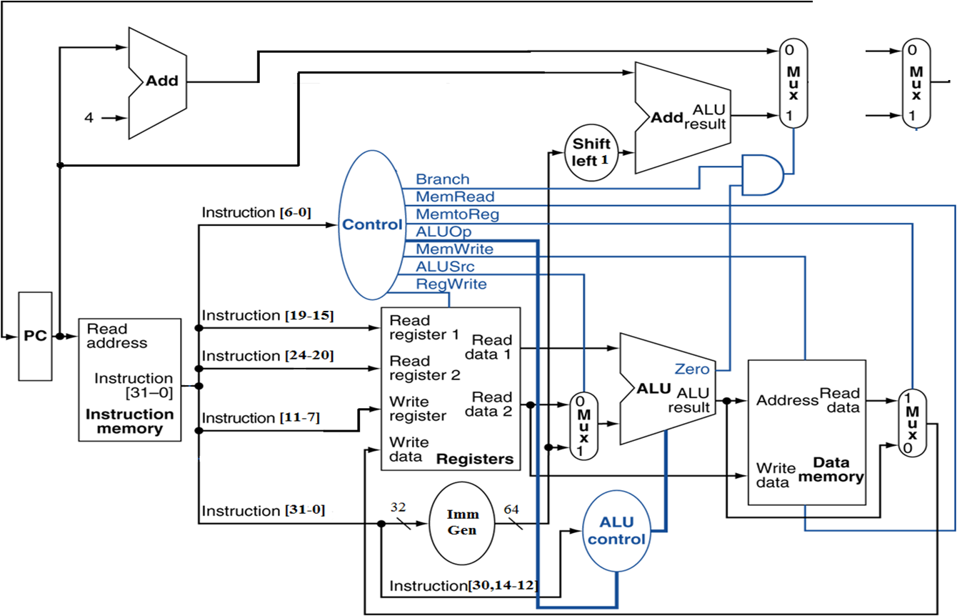
The ALU control is where and other signals(7)
Output signals
jump

Slide 100
Scheme of Controller
2-level decoder
opcode(7)
rd
funct(3)
rs1
rs2
funct(7)
ALU operation(4)
ALU
Decoder
Second
First
Main
decoder
ALU op(2)
Defined
instruction opcode
(7)
Control Signals (7)
Defined
Notes:
多层解码的方法是一种常用的实现技术。使用多层控制可以减少主控制单元的规模。使用多个小控制单元还可以提高控制单元的速度。
ALU的设计加和减的编码不能变。
教材是2级控制，实验中我们可以把它们合在一起。ALU的控制有2级控制，一个是OP，一个是func，OP指明要进行的操作是存/取数需要的加法（00），需要的减法 ( 01), 还是由指令的功能字段决定（10）.
如果是10, 那么第二级再由指令的func字段决定ALU的具体操作到底是什么
ALU的操作用了5个编码，扩展功能的时候首先用剩下的3个，不够再加上更多的位。
7个主控制信号和3个ALU信号
实际上用硬件描述语言，把ALU decoder放在main decoder更方便

Slide 101
What should ALU do ?
Operation | Function
000 | And
001 | Or
010 | Add
110 | Sub
111 | Slt
ALU used for
  Load/Store: F = add
  Branch: F = subtract
  R-type: F depends on opcode
Assume 2-bit ALUOp derived from opcode
  Combinational logic derives ALU control
opcode | ALUOp | Operation | Funct7 | funct3 | ALU function | ALU control
ld | 00 | load register | XXXXXXX | xxx | add | 0010
sd | 00 | store register | XXXXXXX | xxx | add | 0010
beq | 01 | branch on equal | XXXXXXX | xxx | subtract | 0110
R-type | 10 | add | 0000000 | 000 | add | 0010
 |  | subtract | 0100000 | 000 | subtract | 0110
 |  | AND | 0000000 | 111 | AND | 0000
 |  | OR | 0000000 | 110 | OR | 0001
 |  | SLT | 0000000 | 010 | Slt | 0111
Notes:
ALU的控制有2级控制，一个是OP，一个是func，OP指明要进行的操作是存/取数需要的加法（00），beq需要的减法 ( 01), 还是由指令的功能字段决定（10）.
如果是10, 那么第二级再由指令的func7和funct3字段决定ALU的具体操作到底是什么
ALU的操作用了5个编码，扩展功能的时候首先用剩下的3个，不够再加上更多的位。

Slide 102
Our Simple Control Structure
All of the logic is combinational
We wait for everything to settle down, and the right thing to be done
  ALU might not produce right answer? right away
  we use write signals along with clock to determine when to write
Cycle time determined by length of the longest path
时钟下触发下一条指令
控制器
Instruction n
Instruction n+1
Datapath
Memory
We are ignoring some details like setup and hold times
Notes:
指令和指令之间是时序电路，每条指令都是在一个周期之内完成，只要周期足够长，写数据是在下一个上升沿才会写进去，之前不会写

Slide 103
Designing the Main Control Unit
First level
Main Control Unit function
  ALU op (2)
  Divided 7 control signals into 2 groups
    4 Mux
    3 R/W
ld | 00
sd | 00
Beq | 01
R-type | 10
control
ALUScr
Branch
MemtoReg Jump
ALU op (2)
Instruction opcode (7)
Mux (4)
MemRead
MemWrite
RegWrite
R/W (3)
Notes:
第一级译码输出2位ALUop和7个控制信号

Slide 104
The ALU control is where and other signals(7)
Output signals
jump

Slide 105
Signals for datapath Defined 7 control signals
Signal name | Effect when deasserted(=0) | Effect when asserted(=1)
RegWrite | None | Register destination input is written with the value on the Write data input
ALUScr | The second ALU operand come from the second register file output (Read data 2) | The second ALU operand comes from the output of the Immediate Generator
Branch （PCSrc） | The PC is replaced by the output of the adder that computers the value PC+4 | The PC is replaced by the output of the adder that computers the branch target.
Jump | The PC is replaced by PC+4 or branch target | The PC is updated by jump address computed by adder
MemRead | None | Data memory contents designated by the address input are put on the Read data output.
MemWrite | None | Data memory contents designated by the address input are replaced by value on the Write data input.
MemtoReg (2位) | 00：The value fed to register Write data input comes from the Alu | 01：The value fed to the register Write data input comes from the data memory.
 |  | 10：The value fed to the register Write data input comes from PC+4
Notes:
信号上面加上一横，表示低电平是有效信号
指令拓展有的信号要变成两位，信号定义要根据真值表来定义，不是单纯的0和1

Slide 106
Truth Table for Main decoder
jump
Instruction | ALUSrc | MemtoReg | Reg Write | Mem Read | Mem Write | Branch | Jump | ALU Op1 | ALU Op2
R-format
Ld
Sd
beq
Jal
Notes:
真值表要学生填，每个格式指令给出具体指令：
R: add r2, r3, r4, 叫一个学生来分析指令执行过程， memtoReg是1
I： lw r3, 20(r4),
J： jump=1, memrite=0, regwrite=0, 其他无所谓，branch最好是0，
开始是基本指令，后面是拓展指令
实验分为4步：9条指令的datapath, 9条指令control, 18条指令，中断
习题中涉及其他指令，在设计时必须要兼容这9条指令。

Slide 107
Truth tables & Circuitry of main Controller
输入 |  | 输出
Instruction | OPCode | ALUSrcB | Memto-Reg | Reg Write | Mem Read | Mem Write | Branch | Jump | ALU_{Op1} | ALU _{Op0}
R-format | 0110011 | 0 | 00 | 1 | 0 | 0 | 0 | 0 | 1 | 0
Ld(I-Type) | 0000011 | 1 | 01 | 1 | 1 | 0 | 0 | 0 | 0 | 0
sd(S-Type) | 0100011 | 1 | X | 0 | 0 | 1 | 0 | 0 | 0 | 0
beq(SB-Type) | 1100111 | 0 | X | 0 | 0 | 0 | 1 | 0 | 0 | 1
Jal(UJ-Type) | 1101111 | X | 10 | 1 | 0 | 0 | 0 | 1 | X | X
Notes:
OPCode(4)=0, 只在R-format中用到了，其他没用

Slide 108
Main Controller Code
指令译码器参考描述
`define CPU_ctrl_signals {ALUSrc_B,MemtoReg,RegWR,MemWrite,Branch,Jump,ALUop}
always @* begin
case(OPcode)
5‘b01100: begin CPU_ctrl_signals = ?; end //ALU
5’b00000: begin CPU_ctrl_signals = ?; end //load
5’b01000: begin CPU_ctrl_signals = ?; end //store
5’b11000: begin CPU_ctrl_signals = ?; end //beq
5’b11011: begin CPU_ctrl_signals = ?; end //jump
5’b00100: begin CPU_ctrl_signals = ?; end //ALU(addi;;;;)
……
default: begin CPU_ctrl_signals = ?; end
endcase
end

Slide 109
Design the ALU Decoder second level
ALU operation is decided by 2-bit ALUOp derived from opcode, and funct7 & funct3 fields of the instruction
  Combinational logic derives ALU control
opcode | ALUOp | Operation | Funct7 | funct3 | ALU function | ALU control
ld | 00 | load register | XXXXXXX | xxx | add | 0010
sd | 00 | store register | XXXXXXX | xxx | add | 0010
beq | 01 | branch on equal | XXXXXXX | xxx | subtract | 0110
R-type | 10 | add | 0000000 | 000 | add | 0010
 |  | subtract | 0100000 | 000 | subtract | 0110
 |  | AND | 0000000 | 111 | AND | 0000
 |  | OR | 0000000 | 110 | OR | 0001
 |  | SLT | 0000000 | 010 | Slt | 0111

Slide 110
ALU Controller Code
ALU Control HDL Description
assign Fun = {Fun3,Fun7};
always @* begin
case(ALUop)
2’b00: ALU_Control = ? ; //add计算地址
2’b01: ALU_Control = ? ; //sub比较条件
2’b10:
case(Fun)
4'b0000: ALU_Control = 3'b010 ; //add
4’b0001: ALU_Control = ? ; //sub
4’b1110: ALU_Control = ? ; //and
4’b1100: ALU_Control = ? ; //or
4’b0100: ALU_Control = ? ; //slt
4’b1010: ALU_Control = ? ; //srl
4’b1000: ALU_Control = ? ; //xor
……
default: ALU_Control=3'bx;
endcase
2’b11:
case(Fun3)
………………………………………
endcase
Notes:
如果在第一级直接写ALU-control，这段可以省掉

Slide 111
R-Type Instruction
add x9, x20, x21
Read two register operands
Perform arithmetic/logical operation
Write register result
jump
Notes:
Add $t1, $t2, $t3, 执行分为4步：
1. The instruction is fetched, and the PC is incremented.
2. Two registers, $t2 and $t3, are read from the register file; also, the main control unit computes the setting of the control lines during this step.
3. The ALU operates on the data read from the register file, using the function code (bits 5:0, which is the funct field, of the instruction) to generate the ALU function.
4. The result from the ALU is written into the register file using bits 15:11 of the instruction to select the destination register ($t1).
slt也是R型

Slide 112
Load Instruction
ld x1, 200(x2)
Read register operands
Calculate address using 12-bit offset
  Use ALU, but sign-extend offset
Read memory and update register
jump
Notes:
1. An instruction is fetched from the instruction memory, and the PC is incremented.
2. A register ($t2) value is read from the register file.
3. The ALU computes the sum of the value read from the register file and the sign-extended, lower 16 bits of the instruction (offset).
4. The sum from the ALU is used as the address for the data memory.
5. The data from the memory unit is written into the register file; the register destination is given by bits 20:16 of the instruction ($t1) .

Slide 113
Save Instruction
sd x1, 200(x2)
Read register operands
Calculate address using 12-bit offset
  Use ALU, but sign-extend offset
Write register value to memory
jump
Notes:
1. An instruction is fetched from the instruction memory, and the PC is incremented.
2. A register ($t2) value is read from the register file.
3. The ALU computes the sum of the value read from the register file and the sign-extended, lower 16 bits of the instruction (offset).
4. The sum from the ALU is used as the address for the data memory and write the data from rs2 into it.

Slide 114
BEQ Instruction
imm[12] | imm[10:5] | rs2 | rs1 | funct3 | imm[4:1] | imm[11] | opcode
beq x1, x2，200
Read register operands
Compare operands
  Use ALU, subtract and check Zero output
Calculate target address
  Sign-extend displacement
  Shift left 1 place (halfword displacement)
  Add to PC value and update PC
jump
Notes:
1. An instruction is fetched from the instruction memory, and the PC is incremented.
2. Two registers, $t1 and $t2, are read from the register file.
3. The ALU performs a subtract on the data values read from the register file. The value of PC + 4 is added to the sign-extended, lower 16 bits of the instruction (offset) shifted left by two; the result is the branch target address.
4. The Zero result from the ALU is used to decide which adder result to store into the PC.

Slide 115
Jal Instruction
imm[20] | imm[10:1] | imm[11] | imm[19:12] | rd | opcode
jal x1, procedure
Write PC+4 to rd
Calculate target address
  Sign-extend displacement
  Shift left 1 place (halfword displacement)
  Add to PC value and update PC
jump

Slide 116
Single Cycle Implementation performance for lw
Calculate cycle time assuming negligible delays except:
  memory (200ps), ALU and adders (200ps), register file access (100ps)
jump
200ps
100+100=200ps
200ps
200ps

Slide 117
Performance in Single Cycle Implementation
Let’s see the following table:
Let’s see the following table:
Instr | Instr fetch | Register read | ALU op | Memory access | Register write | Total time
ld | 200ps | 100 ps | 200ps | 200ps | 100 ps | 800ps
sd | 200ps | 100 ps | 200ps | 200ps |  | 700ps
R-format | 200ps | 100 ps | 200ps |  | 100 ps | 600ps
beq | 200ps | 100 ps | 200ps |  |  | 500ps
The conclusion:
  Different instructions needs different time.
  The clock cycle must meet the need of the slowest instruction. So, some time will be wasted.

Slide 118
Performance Issues
Longest delay determines clock period
  Critical path: load instruction
  Instruction memory → register file → ALU → data memory → register file
Wasteful of area. If the instruction needs to use some functional unit multiple times.
  E.g., the instruction ‘mult’needs to use the ALU repeatedly. So, the CPU will be very large.
Violates design principle
  Making the common case fast
We will improve performance by pipelining
Notes:
时间浪费
资源浪费：比如访问memory的时候，ALU空闲，指令存储器都省掉了

Slide 119
END

