Slide 1
The Processor: Multi-cycle Design
Boxi Wu / Xiaofei He
Zhejiang University

Slide 2
How can I Make the Program Run Faster?
Reduce the number of instructions
  Make instructions that do more (CISC)
  Use better compilers
Use less cycles to perform the instruction
  Simpler instructions (RISC) – under multi-cycle and related techniques
  Use multiple units/ALUs/cores in parallel
Increase the clock frequency
  Find a newer technology to manufacture
  Redesign time critical components
  Adopt pipelining

Slide 3
Multi-Cycle CPU Design
Single-Cycle microarchitecture
  + Simple
  - Clock cycle time limited by longest instruction (lw)
  - Two adders/ALUs and two memories
Multi-Cycle microarchitecture
  + Shorter clock cycle period
  + Simpler instructions run faster
  + Reuse expensive hardware on multiple cycles
  - Sequencing overhead paid many times

Slide 4
Key Difference between Single-Cycle and Multi-Cycle
Single-Cycle microarchitecture
  One clock cycle for one instruction
Multi-Cycle microarchitecture
  One clock cycle for one stage!
But same design steps: datapath & controller

Slide 5
Basic Principles of Multi-Cycle CPU Design
Separate the execution of instructions into several stages with the same period
  Hard to achieve the same period, thus aims to be almost the same
Each stage occupies one clock cycle
Each clock cycle at most completes a memory access, register access, or ALU operation
Execution result of the previous clock cycle needs to be stored in specific sequential logic components
Clock cycle period depends on the most complex operation

Slide 6
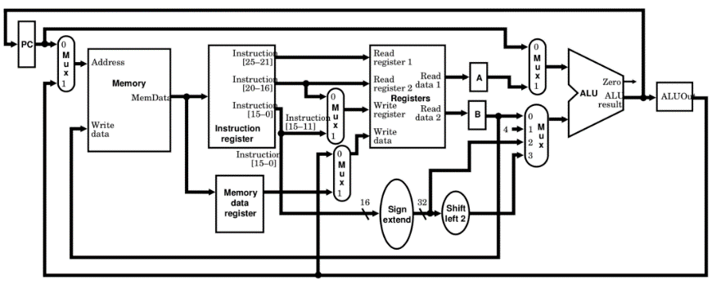
General Overview of Multi-Cycle Datapath
Only one memory interacts with both instructions and data
  Now feasible for Von Neumann architecture
Only one ALU unit without additional adders
But adding more registers

Slide 7
Same Components in the Datapath

Slide 8
New Components in the Datapath

Slide 9
New Components in the Datapath
New temporary registers
Instruction register (IR)
  Holds the instruction after its been pulled from memory
Memory data register (MDR)
  Temporarily holds data grabbed from memory until the next cycle
A
  Temporarily holds the contents of read register 1 until the next cycle
B
  Temporarily holds the contents of read register 2 until the next cycle
ALUout
  Temporarily holds the contents of the ALU until the next cycle

Slide 10
Stages for Instruction Execution
Fetch :
  Take instructions from the instruction memory
  Modify PC to point the next instruction
Instruction decoding & Read Operand:
  Will be translated into machine control command
  Reading Register Operands, whether or not to use
Executive Control:
  Control the implementation of the corresponding ALU operation
Memory access:
  Write or Read data from memory
  Only ld/sd
Write results to register:
  If it is R-type instructions, ALU results are written to rd
  If it is I-type instructions, memory data are written to rd
Modify PC for branch instructions

Slide 11
New Components in the Datapath
New temporary registers
Instruction register (IR)
  Holds the instruction after its been pulled from memory
Memory data register (MDR)
  Temporarily holds data grabbed from memory until the next cycle
A
  Temporarily holds the contents of read register 1 until the next cycle
B
  Temporarily holds the contents of read register 2 until the next cycle
ALUout
  Temporarily holds the contents of the ALU until the next cycle
All the temporary registers are used to separate the instruction execution into stages physically!

Slide 12
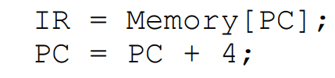
How does the Datapath Work?
Each instruction may take 3-5 of the steps to complete
Let’s look into the execution in terms of the steps
Instruction Fetch Operations
  1. Send contents of PC to the memory as the address
  2. Read instruction from memory
  3. Write instruction into IR for use in the next cycle
  4. Increase PC by 4

Slide 13
How does the Datapath Work? - IF

Slide 14
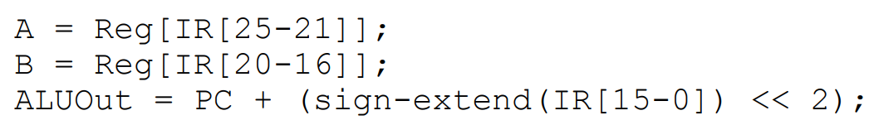
How does the Datapath Work? - ID
Instruction Decode and Register Fetch Operations
  1. Decode instruction
  2. Optimistically read registers
  3. Optimistically compute branch target

Slide 15
How does the Datapath Work? - ID
_{Why ALU works?}
Notes:
Compute the judgement result for branch instructions

Slide 16

How does the Datapath Work? - EX
Execution Operations
  Instructions diverge
Memory-related
R-type
Branch
Jump

Slide 17
How does the Datapath Work? - EX

Slide 18

How does the Datapath Work? - MEM
Execution Operations
  Instructions diverge
Memory-related
R-type

Slide 19
How does the Datapath Work? - MEM

Slide 20

How does the Datapath Work? - WB
Load operation
Notes:
指令编码不一样

Slide 21
How does the Datapath Work? – WB

Slide 22
Controller Design
Now we know how the datapath works after the new components involved
  Similar datapath with single-cycle CPU
  But temporary registers are required to store intermediates in each stage
_{How about the controller?}

Slide 23
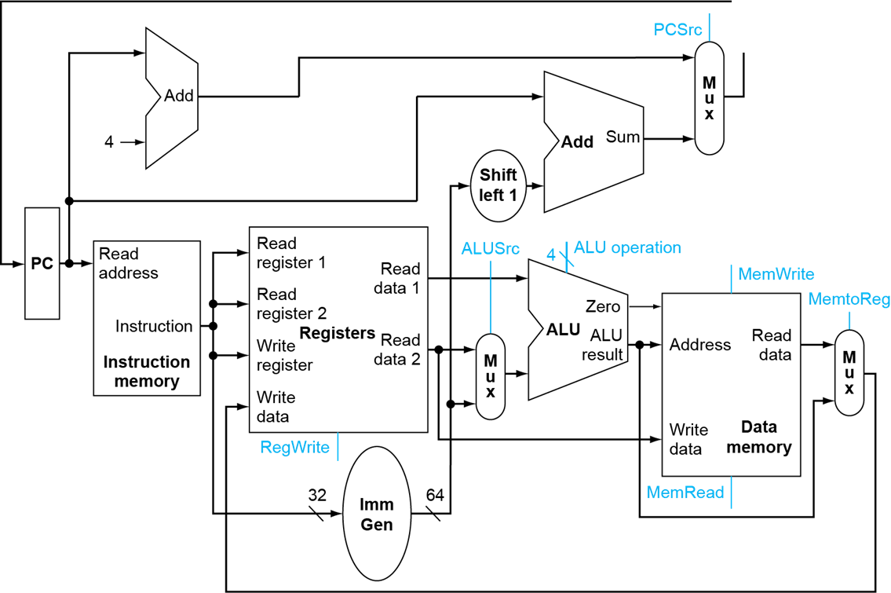

Revisit Controller Design Route
Analyses for cause and effect
  Information comes from the 32 bits of the instruction
  Selecting the operations to perform by sequential components (read/write, etc.)
  Controlling the flow of instruction (multiplexor inputs)
  Controlling the flow of data (multiplexor inputs)
  ALU's operation based on instruction type and function code
Branch
Jump
Any difference in multi-cycle CPU?

Slide 24
Controller Design
Of course, yes!
  In single-cycle CPU, the value of each control signal is fixed for each clock cycle
  But in multi-cycle CPU, they are different for different clock cycle
  Example: let’s look at the execution of
    add x10, x12, x14
    whose machine code is 0000000 01110 01100 000 01010 0110011
    i.e., the opcode = 0110011
    the funct3 = 000 & funct7 = 0000000
    rd = 01010
    rs1 = 01100 & rs2 = 01110

Slide 25
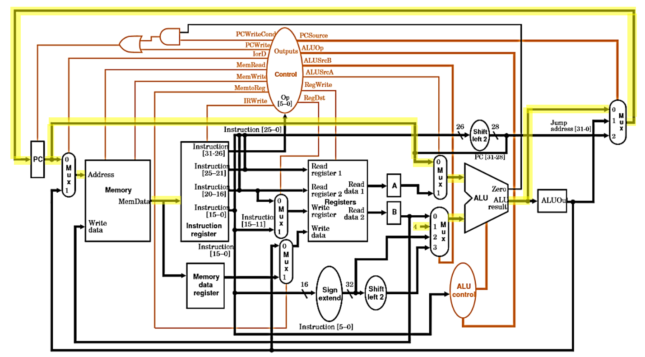
Controller Design
Cycle 1
Signal | Value
PCWrite | 1
IorD | 0
MemRead | 1
MemWrite | 0
IRWrite | 1
PCSource | 00
ALUOp | 00
ALUSrcB | 01
ALUSrcA | 0
RegWrite | 0

Slide 26
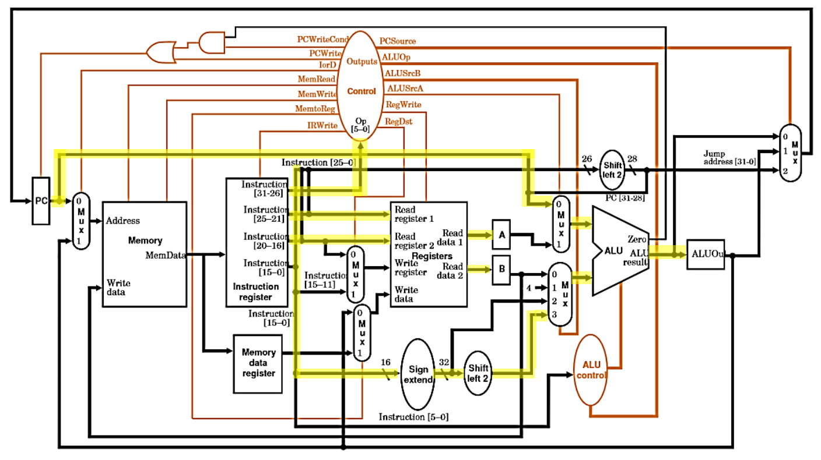
Controller Design
Cycle 2
Signal | Value
ALUOp | 00
ALUSrcB | 11
ALUSrcA | 0
Note that we compute the speculative branching target in this step even though we will not need it. We have nothing better to do while we decode the instruction so we might as well.

Slide 27
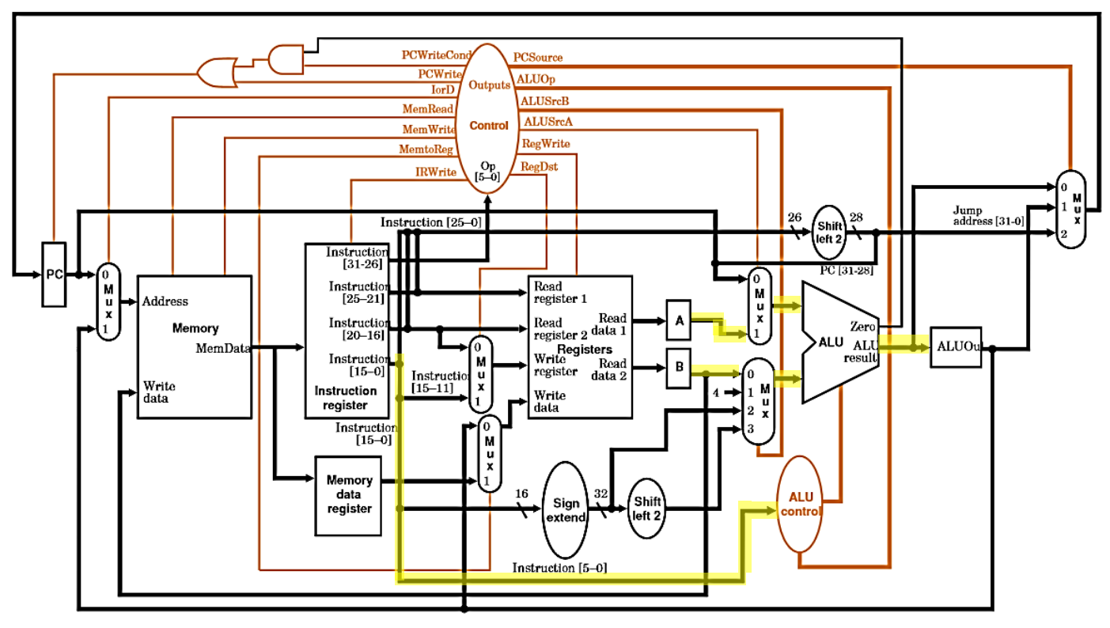
Controller Design
Cycle 3
Signal | Value
ALUOp | 10
ALUSrcB | 00
ALUSrcA | 1

Slide 28
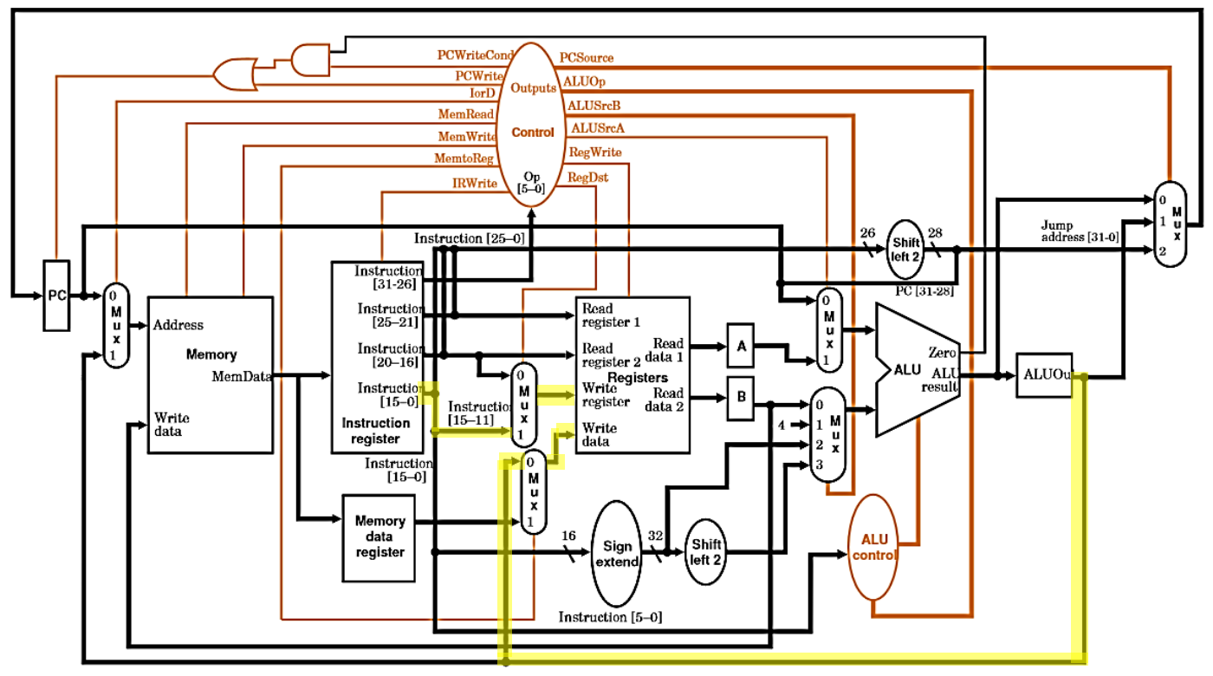
Controller Design
Cycle 4
Signal | Value
MemtoReg | 0
RegWrite | 1
RegDst | 1

Slide 29
What we can find?
In Cycle 2
  Note that we compute the speculative branching target in this step even though we will not need it. We have nothing better to do while we decode the instruction so we might as well
Cycle 2 vs. 3
  In different cycles, even the same signal has different values!
Signal | Value
ALUOp | 00
ALUSrcB | 11
ALUSrcA | 0
Signal | Value
ALUOp | 10
ALUSrcB | 00
ALUSrcA | 1
We cannot directly apply controller design method in single-cycle CPU for multi-cycle one!

Slide 30
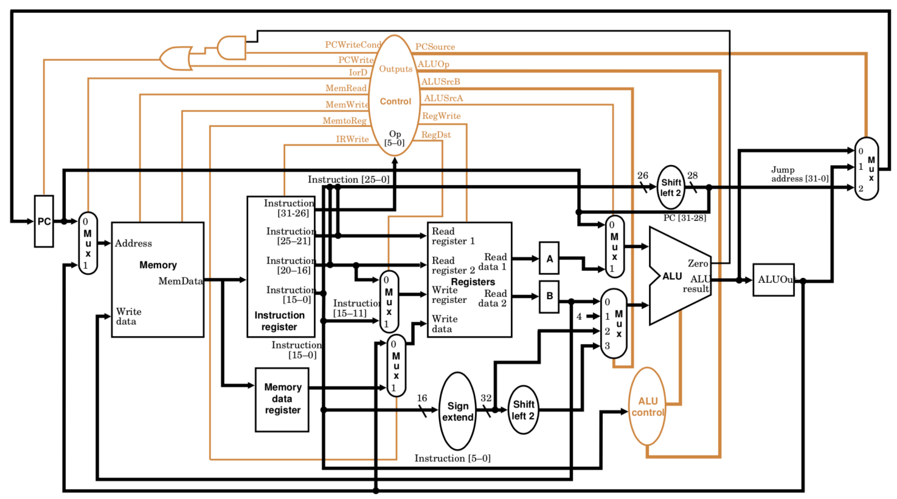
Controller Design

Slide 31
Control Signals
1-Bit Signal | Effect When Deasserted | Effect When Asserted
RegDst | The register file destination number for the Write register comes from rt | The register file destination number for the Write register comes from rd
RegWrite | None | Write register is written with the value of the Write data input
ALUSrcA | The first ALU operand is PC | The first ALU operand is A register
MemRead | None | Content of memory at the location specified by the Address input is put on the Memory data output
MemWrite | None | Memory contents of the location specified by the Address input is replaced by the value on the Write data input

Slide 32
Control Signals
1-Bit Signal | Effect When Deasserted | Effect When Asserted
MemToReg | The value fed to the register file input is ALUout | The value fed to the register file input comes from Memory data register
IorD | The PC supplies the Address to the Memory element | ALUOut is used to supply the address to the memory unit
IRWrite | None | The output of the memory is written into the Instruction Register (IR)
PCWrite | None | The PC is written; the source is controlled by PC-Source
PCWriteCond | None | The PC is written if the Zero output from the ALU is also active

Slide 33
Control Signals
2-Bit Signal | Value | Effect
ALUOp | 00 | The ALU performs an add operation
IorD | 01 | The ALU performs a subtract operation
IRWrite | 10 | The funct field of the instruction determines the operation
ALUSrcB | 00 | The second input to ALU comes from the B register
ALUSrcB | 01 | The second input to ALU is 4
 | 10 | The second input to the ALU is the sign-extended, lower 16 bits of the Instruction Register (IR)
 | 11 | The second input to the ALU is the sign-extended, lower 16 bits of the IR shifted left by 2 bits
PCSrc | 00 | Output of the ALU (PC+4) is sent to the PC for writing
 | 01 | The contents of ALUOut (the branch target address) are sent to the PC for writing
 | 10 | The jump target address (IR[25-0] shifted left 2 bits and concatenated with PC + 4[31-28]) is sent to the PC for writing

Slide 34
How to Implement the Controller?
Hardwired Controller
  Based on Finite State Machine (FSM)
  Implement by PLA circuit and state register
  Usually design for RISC
Micro-program Controller
  Implement by control storage with micro-instructions
  Usually design for CISC
Notes:
PLA:可编程序逻辑阵列 programmable logic array

Slide 35
Hardwired Controller
Based on FSM
  Let’s plot the FSM following the stages of instruction execution
S0: IF
IorD=0
ALUSrcA=0
ALUSrcB=01
ALUOp=00
PCSrc=0
IRWrite
PCWrite
Reset

Slide 36
Hardwired Controller
Based on FSM
  Let’s plot the FSM following the stages of instruction execution
S0: IF
IorD=0
ALUSrcA=0
ALUSrcB=01
ALUOp=00
PCSrc=0
IRWrite
PCWrite
S1: ID
Reset

Slide 37
Hardwired Controller
S0: IF
IorD=0
ALUSrcA=0
ALUSrcB=01
ALUOp=00
PCSrc=0
IRWrite
PCWrite
S1: ID
Reset
Op=LW
or
Op=SW
S2: MemAdr
ALUSrcA=1
ALUSrcB=10
ALUOp=00

Slide 38
Hardwired Controller - lw
S0: IF
S1: ID
IorD=0
ALUSrcA=0
ALUSrcB=01
ALUOp=00
PCSrc=0
IRWrite
PCWrite
Reset
Op=LW
or
Op=SW
S2: MemAdr
ALUSrcA=1
ALUSrcB=10
ALUOp=00
Op=LW
S3: MemRead
IorD=1
RegDst=0
MemtoReg=1
RegWrite
S4: MemWriteback

Slide 39
Hardwired Controller - sw
S0: IF
S1: ID
IorD=0
ALUSrcA=0
ALUSrcB=01
ALUOp=00
PCSrc=0
IRWrite
PCWrite
Reset
Op=LW
or
Op=SW
S2: MemAdr
ALUSrcA=1
ALUSrcB=10
ALUOp=00
Op=SW
S5: MemWrite
Op=LW
S3: MemRead
IorD=1
MemWrite
IorD=1
RegDst=0
MemtoReg=1
RegWrite
S4: MemWriteback

Slide 40
Hardwired Controller – R-type
S0: IF
S1: ID
IorD=0
ALUSrcA=0
ALUSrcB=01
ALUOp=00
PCSrc=0
IRWrite
PCWrite
Reset
Op=R-type
Op=LW
or
Op=SW
S6: Execute
S2: MemAdr
ALUSrcA=1
ALUSrcB=00
ALUOp=10
ALUSrcA=1
ALUSrcB=10
ALUOp=00
Op=SW
S5: MemWrite
S7: ALUWriteback
Op=LW
S3: MemRead
RegDst=1
MemtoReg=0
RegWrite
IorD=1
MemWrite
IorD=1
RegDst=0
MemtoReg=1
RegWrite
S4: MemWriteback

Slide 41
Hardwired Controller – beq
S0: IF
S1: ID
IorD=0
ALUSrcA=0
ALUSrcB=01
ALUOp=00
PCSrc=0
IRWrite
PCWrite
Reset
ALUSrcA=0
ALUSrcB=11
ALUOp=00
Op=beq
Op=R-type
S8: Branch
Op=LW
or
Op=SW
S6: Execute
ALUSrcA=1
ALUSrcB=00
ALUOp=01
PCSrc=1
Branch
S2: MemAdr
ALUSrcA=1
ALUSrcB=00
ALUOp=10
ALUSrcA=1
ALUSrcB=10
ALUOp=00
Op=SW
S5: MemWrite
S7: ALUWriteback
Op=LW
S3: MemRead
RegDst=1
MemtoReg=0
RegWrite
IorD=1
MemWrite
IorD=1
RegDst=0
MemtoReg=1
RegWrite
S4: MemWriteback

Slide 42
Hardwired Controller – addi
S0: IF
S1: ID
IorD=0
ALUSrcA=0
ALUSrcB=01
ALUOp=00
PCSrc=0
IRWrite
PCWrite
Reset
ALUSrcA=0
ALUSrcB=11
ALUOp=00
Op=addi
S9: AddiExecute
Op=beq
Op=R-type
Op=LW
or
Op=SW
S6: Execute
ALUSrcA=1
ALUSrcB=00
ALUOp=01
PCSrc=1
Branch
S2: MemAdr
ALUSrcA=1
ALUSrcB=00
ALUOp=10
ALUSrcA=1
ALUSrcB=10
ALUOp=00
ALUSrcA=1
ALUSrcB=10
ALUOp=00
S8: Branch
Op=SW
S5: MemWrite
S7: ALUWriteback
Op=LW
S3: MemRead
RegDst=1
MemtoReg=0
RegWrite
RegDst=0
MemtoReg=0
RegWrite
IorD=1
MemWrite
IorD=1
S10: AddiWriteback
RegDst=0
MemtoReg=1
RegWrite
S4: MemWriteback

Slide 43
Hardwired Controller – J
S0: IF
S1: ID
S11: Jump
IorD=0
ALUSrcA=0
ALUSrcB=01
ALUOp=00
PCSrc=00
IRWrite
PCWrite
Op=J
Reset
PCSrc=10
PCWrite
ALUSrcA=0
ALUSrcB=11
ALUOp=00
Op=addi
Op=beq
S9: AddiExecute
Op=R-type
Op=LW
or
Op=SW
S6: Execute
ALUSrcA=1
ALUSrcB=00
ALUOp=01
PCSrc=01
Branch
S2: MemAdr
ALUSrcA=1
ALUSrcB=00
ALUOp=10
ALUSrcA=1
ALUSrcB=10
ALUOp=00
ALUSrcA=1
ALUSrcB=10
ALUOp=00
S8: Branch
Op=SW
S5: MemWrite
S7: ALUWriteback
Op=LW
S3: MemRead
RegDst=1
MemtoReg=0
RegWrite
RegDst=0
MemtoReg=0
RegWrite
IorD=1
MemWrite
IorD=1
S10: AddiWriteback
RegDst=0
MemtoReg=1
RegWrite
S4: MemWriteback

Slide 44
Hardwired Controller Implementation
PLA and state register
  Based on Finite State Machine (FSM)
_{Hardwired}
_{Controller}
Multi-cycle
Datapath
Output
Input
Next State
Op code
State Register
Clk

Slide 45
Micro-program Controller
Pros & cons of hardwired controller
  Pros: generation time of control signals is short
  Cons: if ISA is complex, it is hard to update and maintain the hardwired controller
How about CISC?
  Obviously, hardwired controller is not appropriate
  Hence comes to micro-program controller

Slide 46
Micro-program Controller
History
  Proposed by M. V. Wilkes in 1951
  First deployed by IBM 360 series in 1964
  Since 1970s, as the development of VLSI, micro-program design has achieved significant development and application
  Currently, most CISC computers widely apply micro-program design
Basic principle
  Represent the execution of each instruction with a micro program
  Consist of several micro-instructions, each of which is one state in FSM
  All micro-programs are stored in a ROM, which is called Control Storage (CS)

Slide 47
Micro-program Controller
Micro-program
  A micro-instruction sequence
  Correspond to each instruction in ISA
Micro-instruction
  A 0/1 sequence
  Consist of several micro-command
  aka. Control Word (CW)

Slide 48
Micro-program Controller
Micro-command
  Control command sent by control component to execution component
  Unit of control sequence
    E.g., clock signal for register, 0 or 1 signal
Micro-operation
  Correspond to micro-command one to one
  Detailed operations for micro-command
Similar to control signals and operations in datapath

Slide 49
Micro-program Controller
Micro-command & micro-operation
_{Execution component}
Micro-operation
Micro-command
_{Control component}
Micro-command
_{Execution component}
Micro-operation
Micro-command
Feedback: state test
_{Execution component}
Micro-operation

Slide 50
Micro-program Controller Implementation
Basic architecture
_{Micro-command}
……
_{Decoding}
From Memory
_{μIR}
……
_{Branch Control}
IR
_{Control Storage}
Start and branch address generator
Condition Code
CLK
_{μPC}

Slide 51
Micro-program Controller Implementation
Two problems:
  Format of micro-instruction and coding of micro-command
  Determination of next micro-instruction address
Solutions:
  Long micro-instruction word and its format refers to instruction format
  Program counter or explicit address in instruction format

Slide 52
Pros & Cons of Micro-program Controller
Pros:
  Significantly lower the difficulty of controller design
  Improving the flexibility for ISA and CPU design
Cons:
  Longer execution time than hardwired controller
  Lower efficiency

Slide 53
Performance of Multi-cycle CPU
Instructions take different number of cycles:
  3 cycles: beq, j
  4 cycles: R-type, sw
  5 cycles: lw
CPI is weighted average:
  25% loads
  10% stores
  11% branches
  2% jumps
  52% R-type
Average CPI = (0.11+0.02)*3+(0.52+0.1)*4+0.25*5 = 4.12

Slide 54
Performance of Multi-cycle CPU
Multi-cycle critical path:
  Tc =

Slide 55
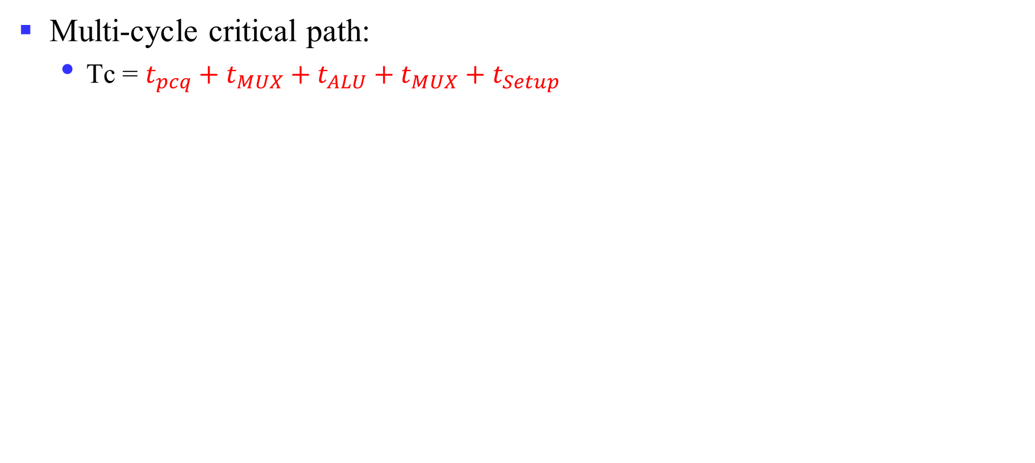
Performance of Multi-cycle CPU
Multi-cycle critical path:
  Tc = $t_{pcq}+t_{MUX}+t_{ALU}+t_{MUX}+t_{Setup}$

Slide 56
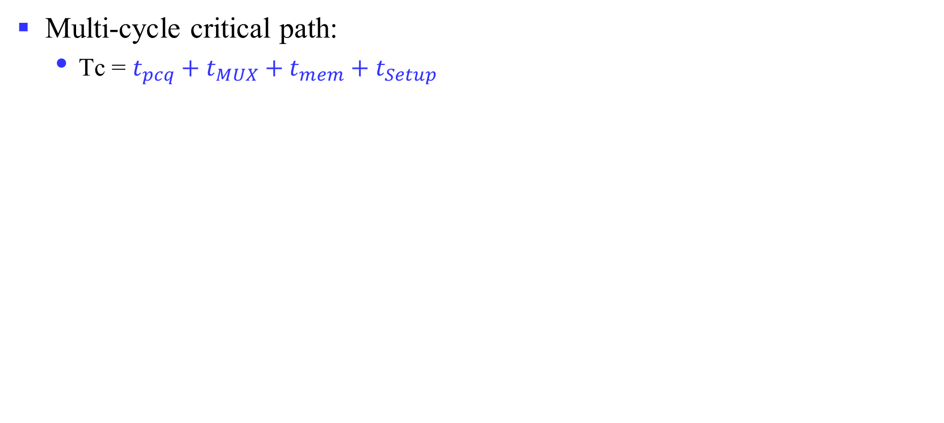
Performance of Multi-cycle CPU
Multi-cycle critical path:
  Tc = $t_{pcq}+t_{MUX}+t_{mem}+t_{Setup}$

Slide 57
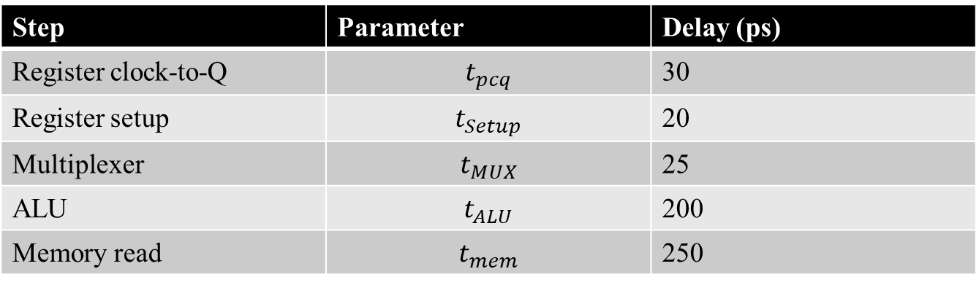
Performance of Multi-cycle CPU
Time for each step:
Step | Parameter | Delay (ps)
Register clock-to-Q | $$t_{pcq}$$ | 30
Register setup | $$t_{Setup}$$ | 20
Multiplexer | $$t_{MUX}$$ | 25
ALU | $$t_{ALU}$$ | 200
Memory read | $$t_{mem}$$ | 250
Memory read dominates the critical path!
Tc = $t_{pcq}+t_{MUX}+t_{ALU}+t_{MUX}+t_{Setup}$= 30+25+200+25+20 = 300ps
Tc = $t_{pcq}+t_{MUX}+t_{mem}+t_{Setup}$= 30+25+250+20 = 325ps

Slide 58
Performance of Multi-cycle CPU
Example:
  For a program with 100 billion instructions executing on a multi-cycle RISC-V CPU
    CPI = 4.12
    Tc = 325 ps
  Execution Time = ?
  Execution Time = 100*10⁹ * 4.12 * 325*10⁻¹² = 133.9 s
  How about single-cycle CPU?
  92.5s < 133.9s

Slide 59
Performance Issues
Even Longer Time for Instruction Execution
  Cannot achieve expected performance compared with single-cycle
But provide a new perspective for CPU design
  Finer-grained execution in one clock cycle
We will improve performance by pipelining
System II

