Slide 1
Homework & Solution
Boxi Wu / Xiaofei He

Slide 2
Problems 1-1
1-1. *Convert the following numbers from the given base to the other three bases listed in the table:
Solution ：
Decimal | Binary | Octal | Hexadecimal
369.3125 | 101110001.0101 | 561.24 | 171.5
189.625 | 10111101.101 | 275.5 | BD.A
214.625 | 11010110.101 | 326.5 | D6.A
62407.625 | 1111001111000111.101 | 171707.5 | F3C7.A

Slide 3
Problems 1-2
In each of the following cases, determine the radix r:
(a) (BEE)r = (2699)₁₀
(b) (365)r = (194)₁₀
Solution ：
(a) for (BEE)r = (2699)₁₀
get：11×r² +14×r¹ + 14×r⁰=2699
and 11×r² +14×r - 2685 = 0
square root ：r = 15 or r ≈ –16.27
Deserve ： r = 15
(b) for (365)r = (194)₁₀
get 3×r² + 6×r¹+5×r⁰=194
and 3×r² + 6×r – 189 = 0
square root ：r = – 9 or r =7
choose：r = 7

Slide 4
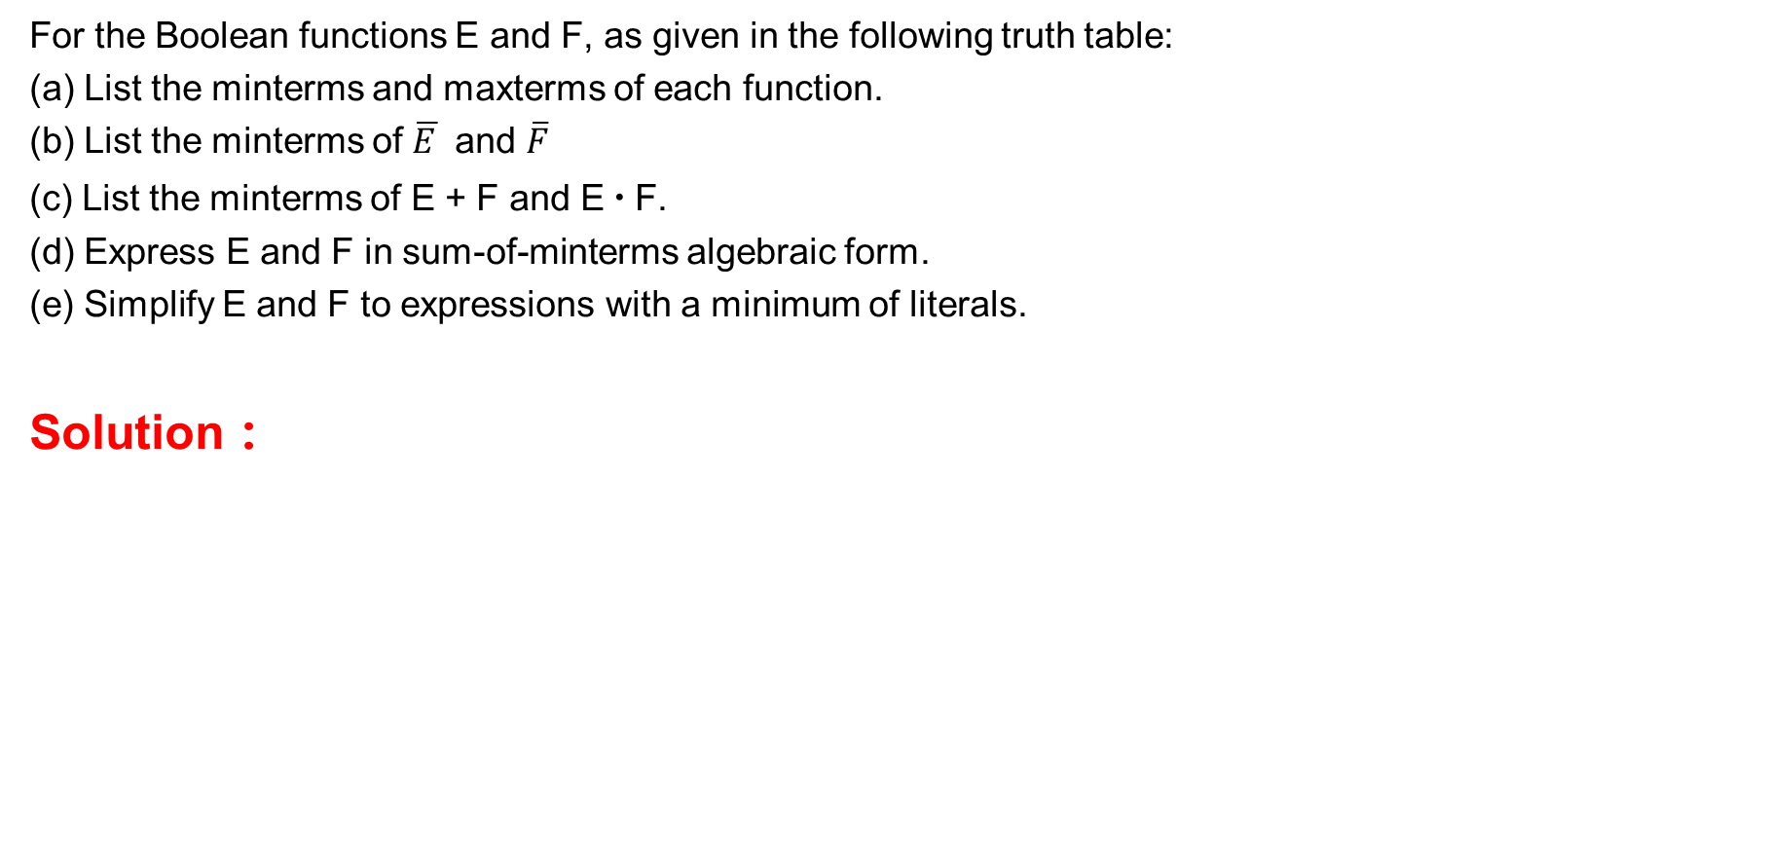
Problems 2.1
XYZ | E | F
0 0 0 | 0 | 1
0 0 1 | 1 | 0
0 1 0 | 1 | 1
0 1 1 | 0 | 0
1 0 0 | 1 | 1
1 0 1 | 0 | 0
1 1 0 | 1 | 0
1 1 1 | 0 | 1
For the Boolean functions E and F, as given in the following truth table:
List the minterms and maxterms of each function.
List the minterms of $\overline{E }$ and $\overline{F}$
(c) List the minterms of E + F and E ∙ F.
(d) Express E and F in sum-of-minterms algebraic form.
(e) Simplify E and F to expressions with a minimum of literals.
Solution ：

Slide 5
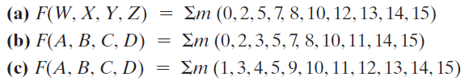







Problems 2-2
*Find all the prime implicants for the following Boolean functions, and determine which are essential:
Solution ：
$$XZ$$
WX
YZ
$$\overline{X}\overline{Z}$$
1 |  |  | 1
 | 1 | 1
1 | 1 | 1 | 1
1 |  |  | 1
$$WX$$
$$W\overline{Z}$$

Slide 6
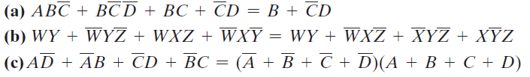
Problems 2.3
2-3. +Prove the identity of each of the following Boolean equations, using algebraic manipulation:
Solution 2.3：
(a) (c)

Slide 7


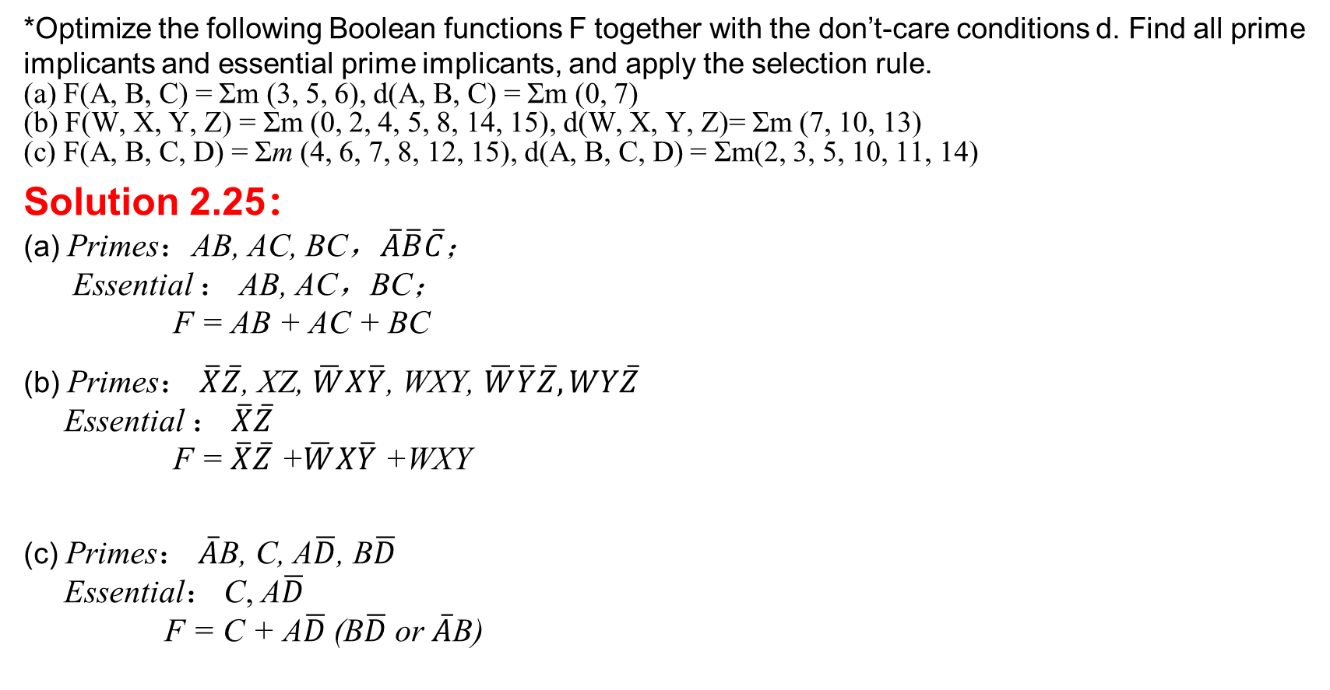



Problems 2-4
*Optimize the following Boolean functions F together with the don’t-care conditions d. Find all prime implicants and essential prime implicants, and apply the selection rule.
(a) F(A, B, C) = Σm (3, 5, 6), d(A, B, C) = Σm (0, 7)
(b) F(W, X, Y, Z) = Σm (0, 2, 4, 5, 8, 14, 15), d(W, X, Y, Z)= Σm (7, 10, 13)
(c) F(A, B, C, D) = Σm (4, 6, 7, 8, 12, 15), d(A, B, C, D) = Σm(2, 3, 5, 10, 11, 14)
Solution 2.25：
(a) Primes：AB, AC, BC，$\overline{A}\overline{B}\overline{C}$；
Essential ： AB, AC，BC；
F = AB + AC + BC
(b) Primes： $\overline{X}\overline{Z}$, XZ, $\overline{W}X\overline{Y}$, WXY, $\overline{W}\overline{Y}\overline{Z}, WY\overline{Z}$
Essential ： $\overline{X}\overline{Z}$
F = $\overline{X}\overline{Z}$ +$\overline{W}X\overline{Y}$ +WXY
(c) Primes： $\overline{A}$B, C, A$\overline{D}$, B$\overline{D}$
Essential： C, A$\overline{D}$
F = C + A$\overline{D}$(B$\overline{D}$ or $\overline{A}$B)
BC
 | 00 | 01 | 11 | 10
0 | x |  | 1
1 |  | 1 | x | 1
BC
A
AB
AC
WX
YZ
$$\overline{X}\overline{Z}$$
1 |  |  | 1
1 | 1 | x
 | x | 1 | 1
1 |  |  | x
$$\overline{W}\overline{Y}\overline{Z}$$
$$\overline{W}X\overline{Y}$$
$$WXY$$
$$XZ$$

Slide 8
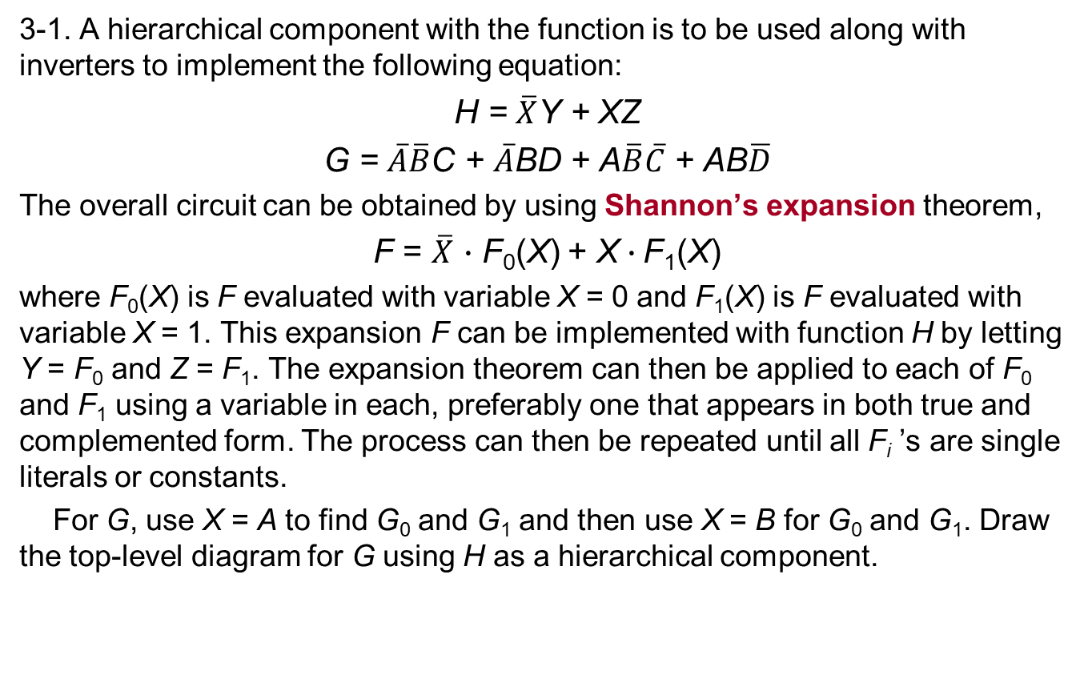
Problems 3-1
3-1. A hierarchical component with the function is to be used along with inverters to implement the following equation:
H = $\overline{X}$Y + XZ
G = $\overline{A}\overline{B}$C + $\overline{A}$BD + A$\overline{B}\overline{C}$ + AB$\overline{D}$
The overall circuit can be obtained by using Shannon’s expansion theorem,
F = $\overline{X}$ $∙$ F₀(X) + X$∙$F₁(X)
where F₀(X) is F evaluated with variable X = 0 and F₁(X) is F evaluated with variable X = 1. This expansion F can be implemented with function H by letting Y = F₀ and Z = F₁. The expansion theorem can then be applied to each of F₀ and F₁ using a variable in each, preferably one that appears in both true and complemented form. The process can then be repeated until all F_{i} ’s are single literals or constants.
For G, use X = A to find G₀ and G₁ and then use X = B for G₀ and G₁. Draw the top-level diagram for G using H as a hierarchical component.
Notes:
在函数H中令Y=F0,Z=F1就可以得到扩展后的F。在每一个F0和F1中使都用一个变量，就可以将扩展定理应用于每一个F0和F1。如果一个变量既以原变量又以反变量的形式出现，则优先取该变量。重复此过程，直到所有的Fi都只是单因子项或常量项为止。对于函数G。令X=A，求出G0和G1，然后对G0和G1，令X=B。画出G的顶层逻辑图，其中，把H作为它的一个层次化组件使用。

Slide 9
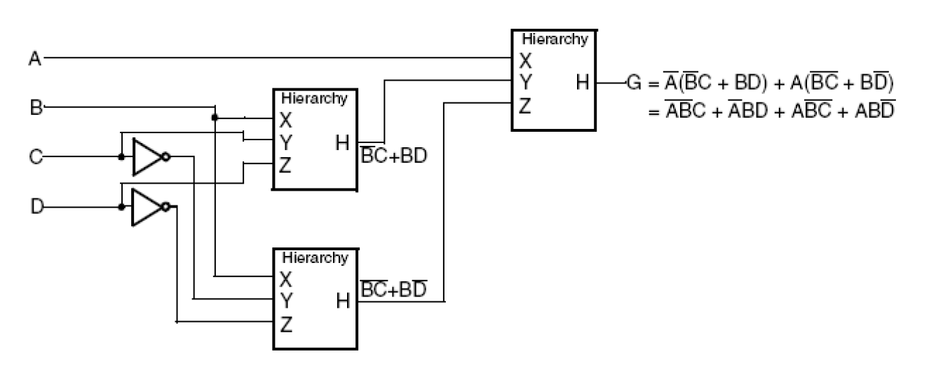
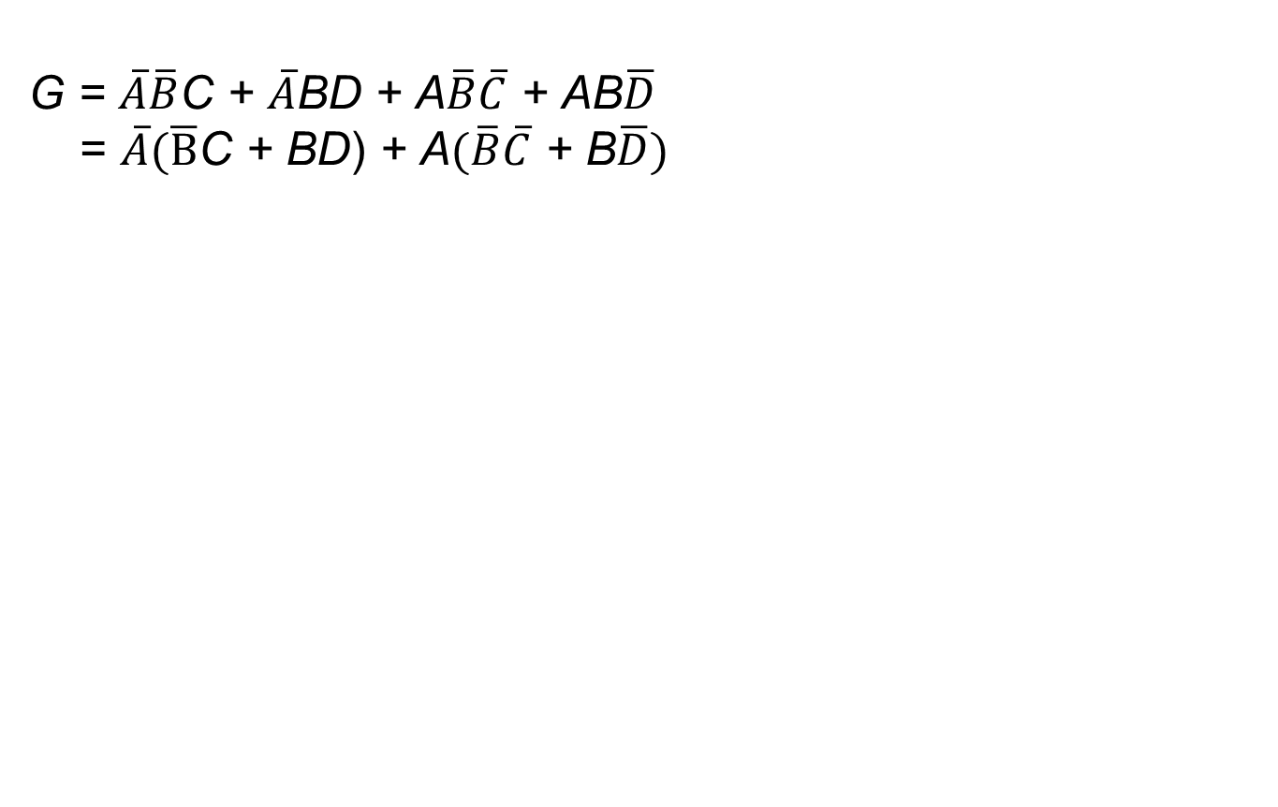

Solution 3-1：
G = $\overline{A}\overline{B}$C + $\overline{A}$BD + A$\overline{B}\overline{C}$ + AB$\overline{D}$
= $\overline{A}(\overline{B}$C + BD) + A$(\overline{B}\overline{C}$ + B$\overline{D})$
H = $\overline{X}$Y + XZ

Slide 10
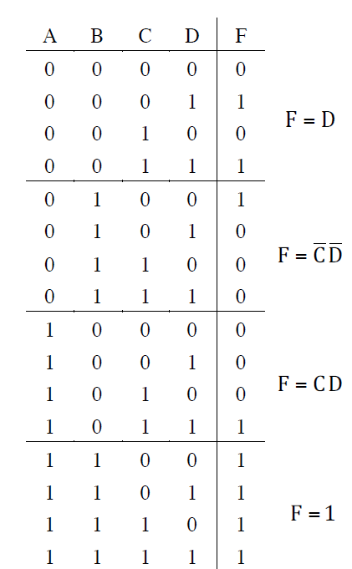
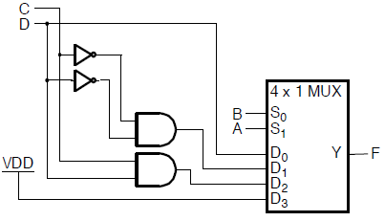
Problems 3-2
3-2. *Implement the Boolean function
F(A, B, C, D) = Σm(1, 3, 4, 11, 12, 13, 14, 15)
with a 4–to–1-line multiplexer and external gates. Connect inputs A and B to the selection lines. The input requirements for the four data lines will be a function of the variables C and D. The values of these variables are obtained by expressing F as a function of C and D for each of the four cases when AB = 0 0 , 0 1 , 1 0 , and 11. These functions must be implemented with external gates.
Solution 3.44：

Slide 11
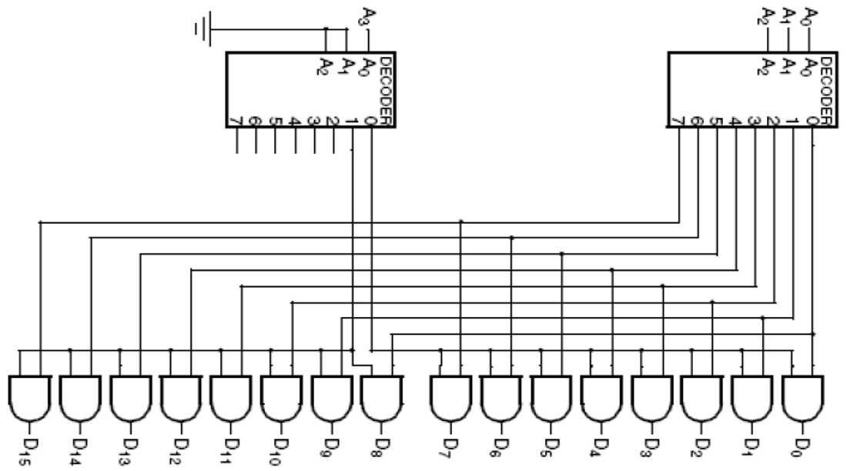
Problems 3-3
3-3. （a) Design a 4–to–16-line decoder using two 3–to–8-line decoders and 16 2-input AND gates.
Solution ：

Slide 12
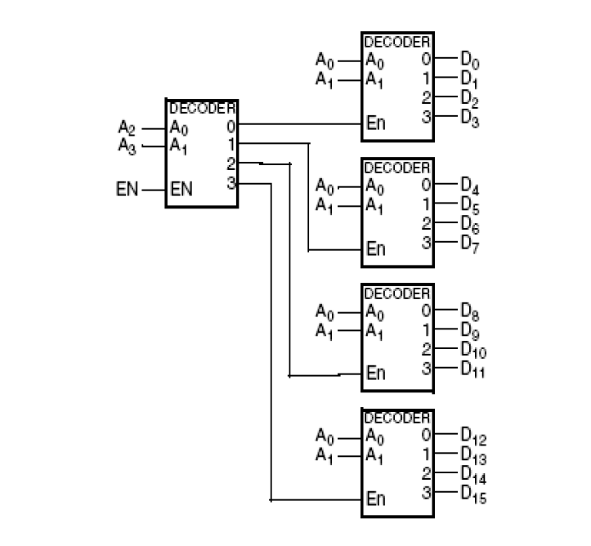
Problems 3-3
（b) Design a 4–to–16-line decoder with enable using five 2–to–4-line decoders with enable as shown in Figure 3-16.
Solution ：

Slide 13
Problems 3-4
3-4. Design a combinational circuit that compares two 4-bit unsigned numbers A and B to see whether B is greater than A. The circuit has one output X, so that X = 1 if A < B and X = 0 if A ≥ B.
Solution ：
a. Design 1 bit comparator：
b. 4-bit comparator compares from most significant to lower with bit-by-bit processing:
A3 < B3 | A3=B3 & A2 < B2 | A3 = B3， A2 = B2 & A1 < B1 | A3 = B3，A2 = B2，A1=1 & A0 < B0 | X
1 | x | x | x | 1
 | 1 | x | x | 1
 |  | 1 | x | 1
 |  |  | 1 | 1
 |  |  |  | 0

Slide 14
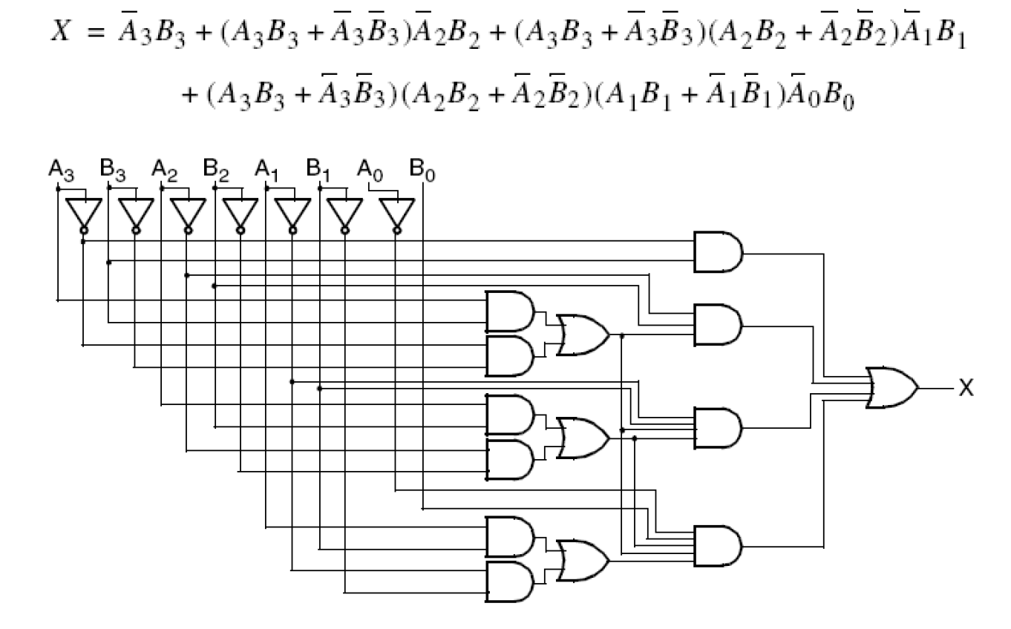
Solution 3-4
c. expression
d. Circuit diagram
Notes:
解法二：用串行加法器构造电路A-B，即在B上加非门，C₀接1，在C₄上加非门作为X。
解法三：用串行加法器构造电路B-A-1，即在A上加非门，C₀接0，将C₄作为X。

Slide 15
解法二：用串行加法器构造电路A-B，即在B上加非门，C₀接1，在C₄上加非门作为X。
解法三：用串行加法器构造电路B-A-1，即在A上加非门，C₀接0，将C₄作为X。

Slide 16
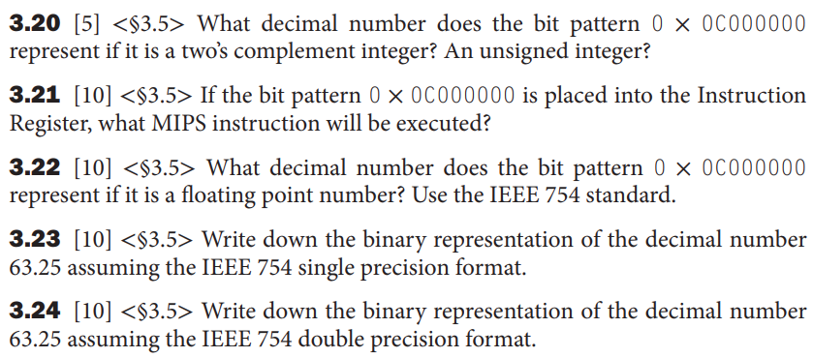
Problem 4-1
Solution:
3.20 12*16⁶ = 201326592 in both cases.
3.21 jal 0x00000000
3.22 0x0C000000 = 0000 1100 0000 0000 0000 0000 0000 0000
sign is positive, exp = 24 − 127 = − 103, fraction = 0, so answer = 1.0 × 2 ⁻¹⁰³
3.23 63.25 = 111111.01 = 1.1111101 × 2⁵
sign = positive, exp = 127 + 5 = 132
so IEEE 754 single format = 0 1000 0100 1111 1010 0000 0000 0000 000 = 0x427D0000
3.24 sign = positive, exp = 1023 + 5 = 1028
so IEEE 754 double format = 0 100 0000 0100 1111 1010 0000 0000 0000 0000 0000 0000 0000 0000 0000 0000 0000
= 0x404FA00000000000

Slide 17
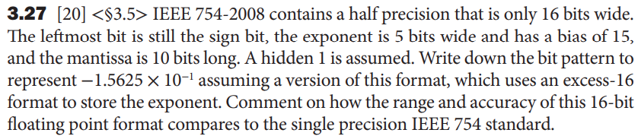
Problem 4-2
Solution:
−1.5625 × 10⁻¹ = − 0.00101 = −1.01 × 2⁻³
exponent = −3 + 15 = 12 : 01100,
fraction = − 0.0100000000
answer: 1 01100 0100000000

Slide 18
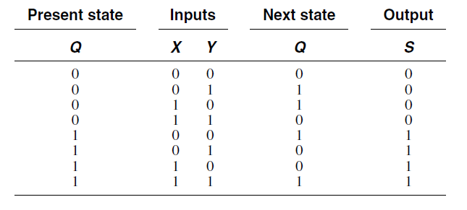
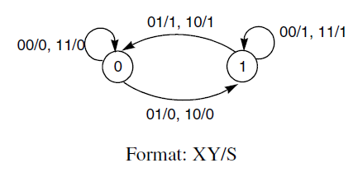
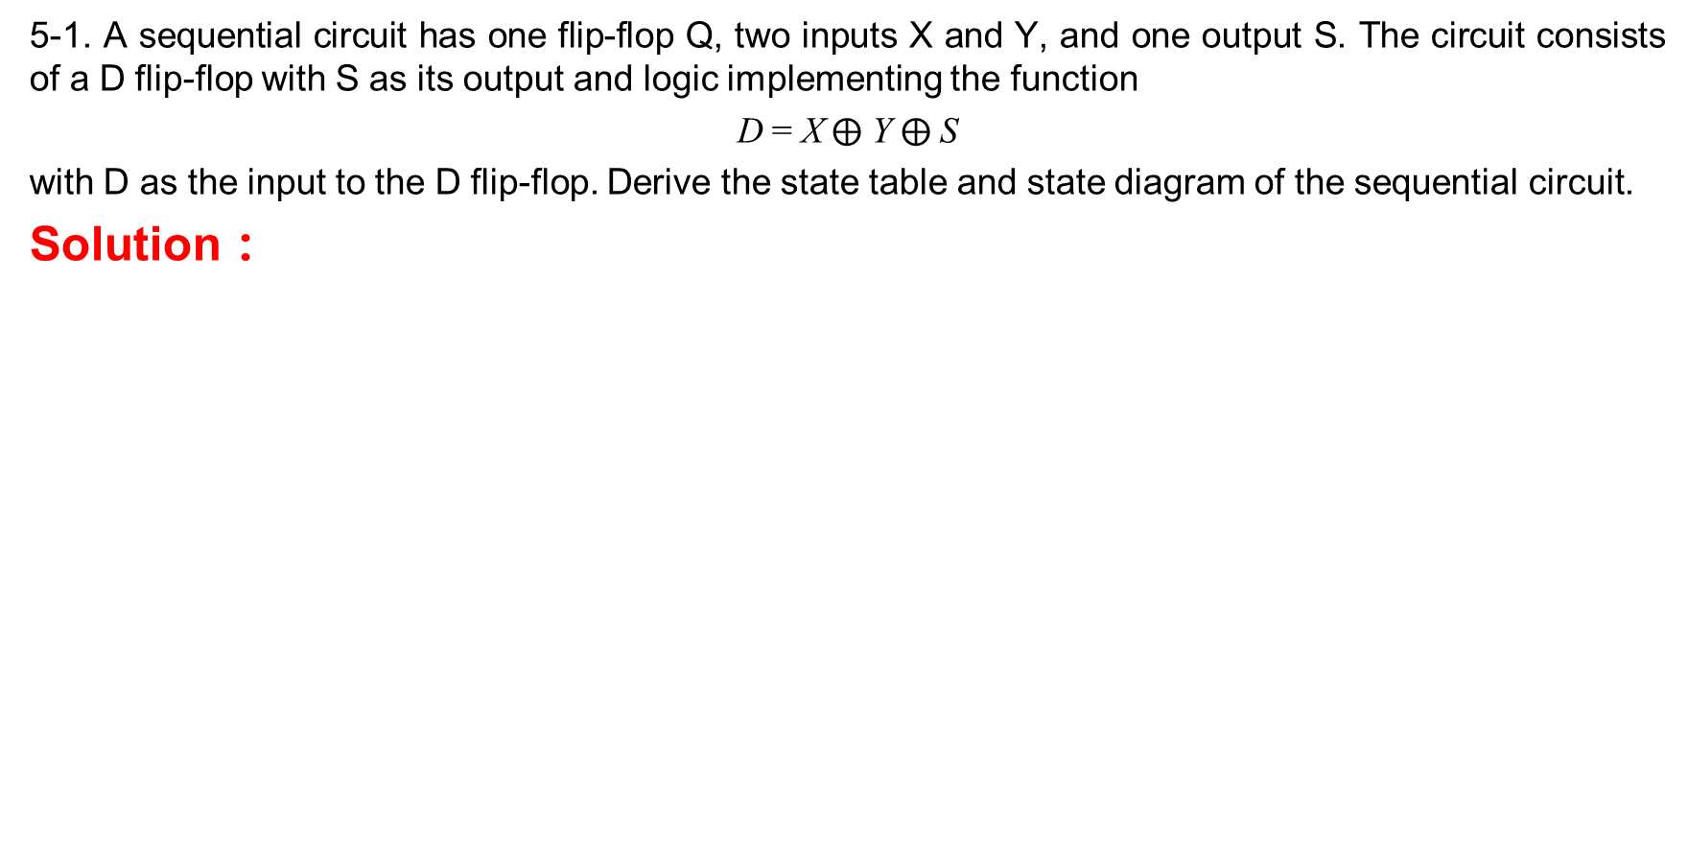
Problems 5-1
5-1. A sequential circuit has one flip-flop Q, two inputs X and Y, and one output S. The circuit consists of a D flip-flop with S as its output and logic implementing the function
D = X$⨁$ Y $⨁$S
with D as the input to the D flip-flop. Derive the state table and state diagram of the sequential circuit.
Solution ：

Slide 19
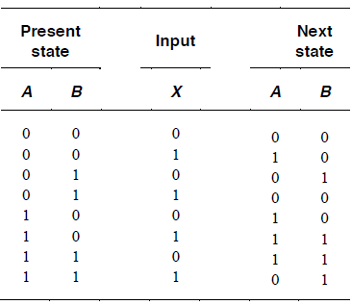
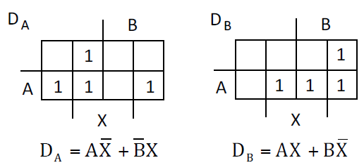
Problems 5-2
*Design a sequential circuit with two D flip-flops A and B and one input X. When X = 0, the state of the circuit remains the same. When X = 1, the circuit goes through the state transitions from 00 to 10 to 11 to 01, back to 00, and then repeats.
Solution：
(a) State diagrams ：
(b) State table ：
(c) State/Input equations：
（d) Logic diagram：
Skip， Draw your own.
X = 1
00
10
11
01

Slide 20
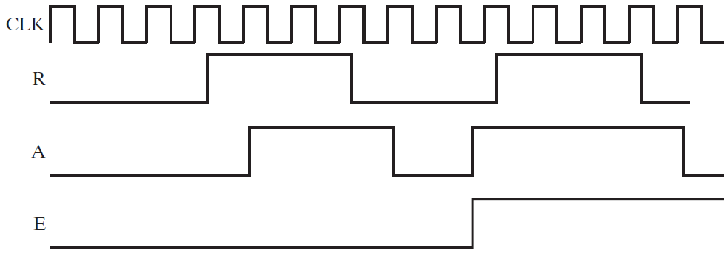
Problems 5-3
A pair of signals Request (R) and Acknowledge (A) is used to coordinate transactions between a CPU and its I/O system. The interaction of these signals is often referred to as a “handshake.” These signals are synchronous with the clock and, for a transaction, are to have their transitions always appear in the order shown in Figure 4-53. A handshake checker is to be designed that will verify the transition order. The checker has inputs, R and A, asynchronous reset signal, RESET, and output, Error (E). If the transitions in a handshake are in order, E = 0. If the transitions are out of order, then E becomes 1 and remains at 1 until the asynchronous reset signal (RESET = 1) is applied to the CPU.
(a) Find the state diagram for the handshake checker.
(b) Find the state table for the handshake checker.

Slide 21
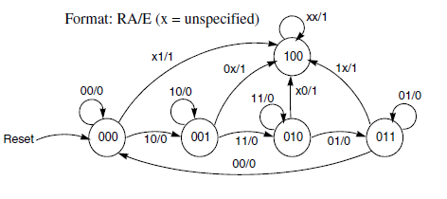
Solution 5-3
(a) State diagram
= 00 10 11 01 is right
× Errors
Right
Notes:
按照输入RA=00、10、11、01的顺序设立4个状态，表示正常工作时的状态循环，再设立一个异常状态，当出现错误输入时就转到异常状态去。

Slide 22
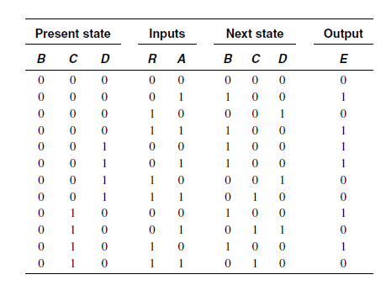
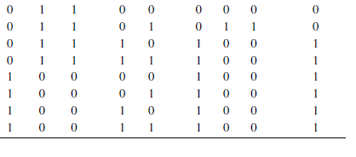
Solution Continue before：
(b) State table

Slide 23
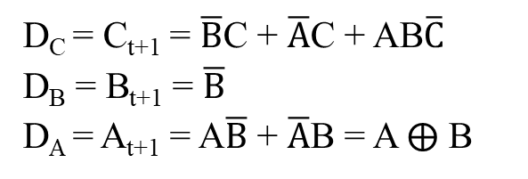
Problems 5-4
Use D-type flip-flops and gates to design a counter with the following repeated binary sequence: 0, 2, 1, 3, 4, 6, 5, 7.
Solution :
State diagram：
State Table：
  (c) State equation and input equation
0
2
1
3
D_{C} = C_{t+1} = $\overline{B}$C + $\overline{A}$C + AB$\overline{C}$
D_{B} = B_{t+1} = $\overline{B}$
D_{A} = A_{t+1} = A$\overline{B}$ + $\overline{A}$B = A $⨁$ B
7
5
6
4
Present state | Nest state
C B A | C B A
0 0 0 | 0 1 0
0 0 1 | 0 1 1
0 1 0 | 0 0 1
0 1 1 | 1 0 0
1 0 0 | 1 1 0
1 0 1 | 1 1 1
1 1 0 | 1 0 1
1 1 1 | 0 0 0
  (d) The circuit diagram
Skip， Do it yourself!

Slide 24
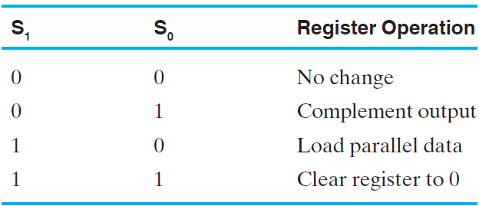
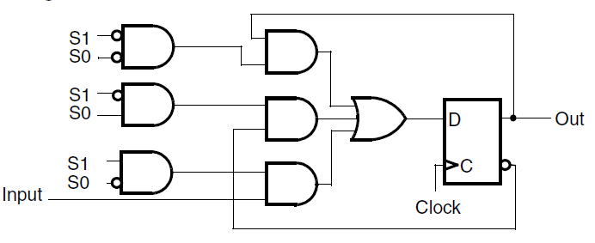
Problems 5-5
Draw the logic diagram of a 4-bit register with mode selection inputs S1 and S0. The register is to be operated according to the function table below.
Solution:
“与”门使能直接构成多路选择器，选择控制是S₁S₀ ：The basic cell of the register is as follows

Slide 25
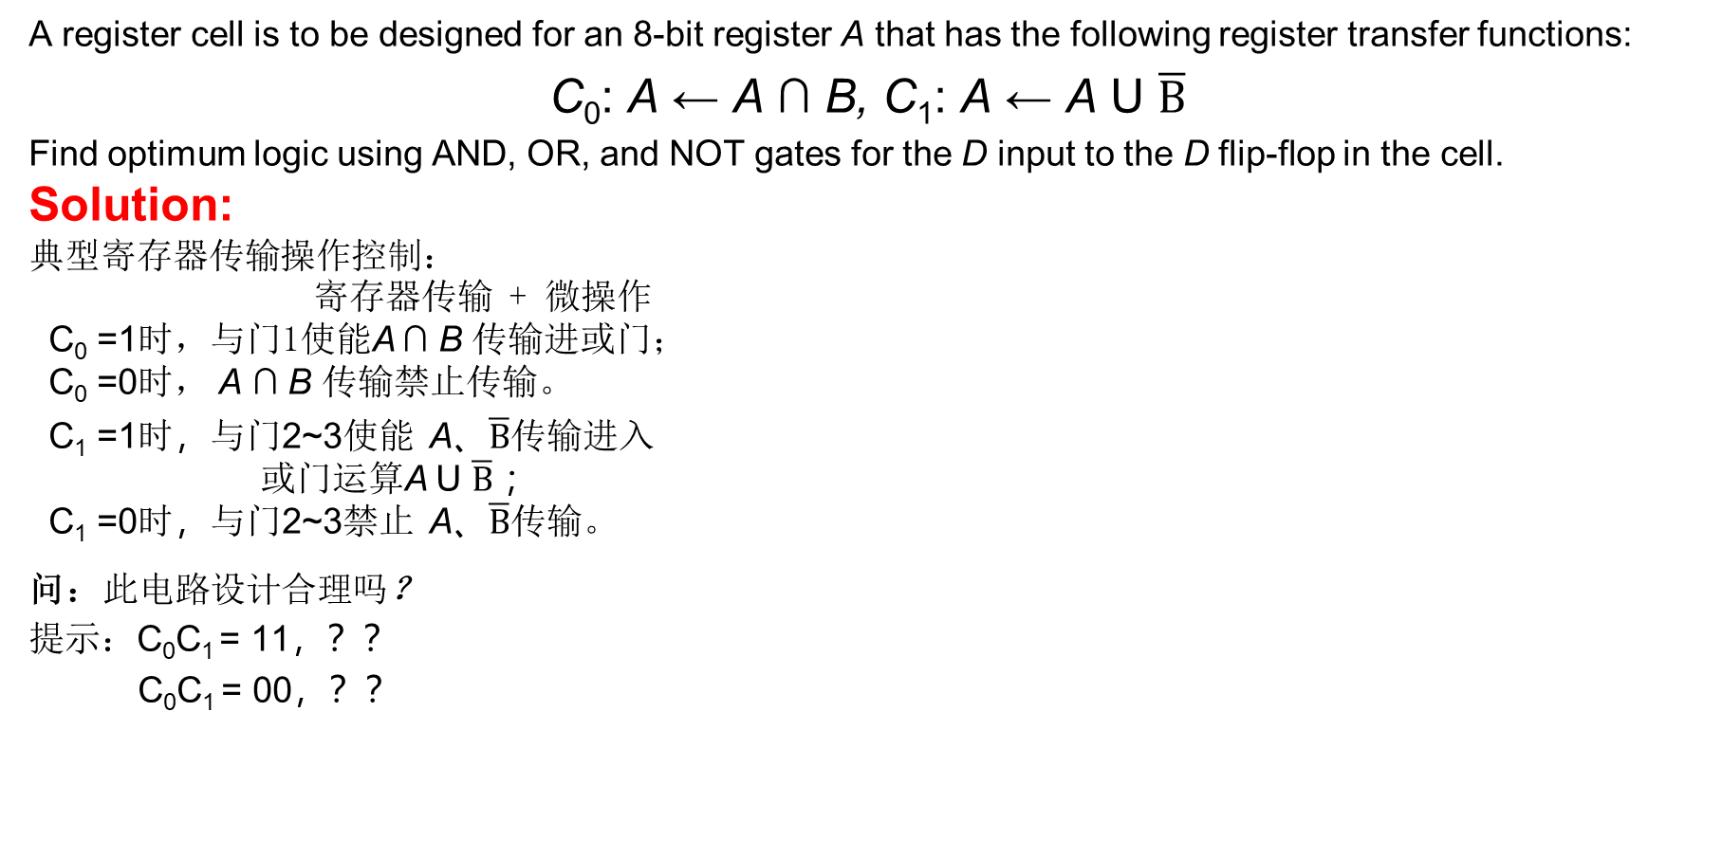
Problems 5-6
A register cell is to be designed for an 8-bit register A that has the following register transfer functions:
C₀: A ← A ∩ B, C₁: A ← A U $\overline{B}$
Find optimum logic using AND, OR, and NOT gates for the D input to the D flip-flop in the cell.
Solution:
典型寄存器传输操作控制：
寄存器传输 + 微操作
C₀ =1时，与门1使能A ∩ B 传输进或门；
C₀ =0时， A ∩ B 传输禁止传输。
C₁ =1时，与门2~3使能 A、$\overline{B}$传输进入
或门运算A U $\overline{B}$ ；
C₁ =0时，与门2~3禁止 A、$\overline{B}$传输。
问：此电路设计合理吗？
提示：C₀C₁ = 11，？？
C₀C₁ = 00，？？
1
2
3
Notes:
运算结果传输到B，与题意不符；
C₀C₁=00时，B被清零
C₀C₁=11时：AB + A + $\overline{B}$ =A + $\overline{B}$，B被破坏
修改：C₀$⨁$C₁控制寄存器Load加载

Slide 26




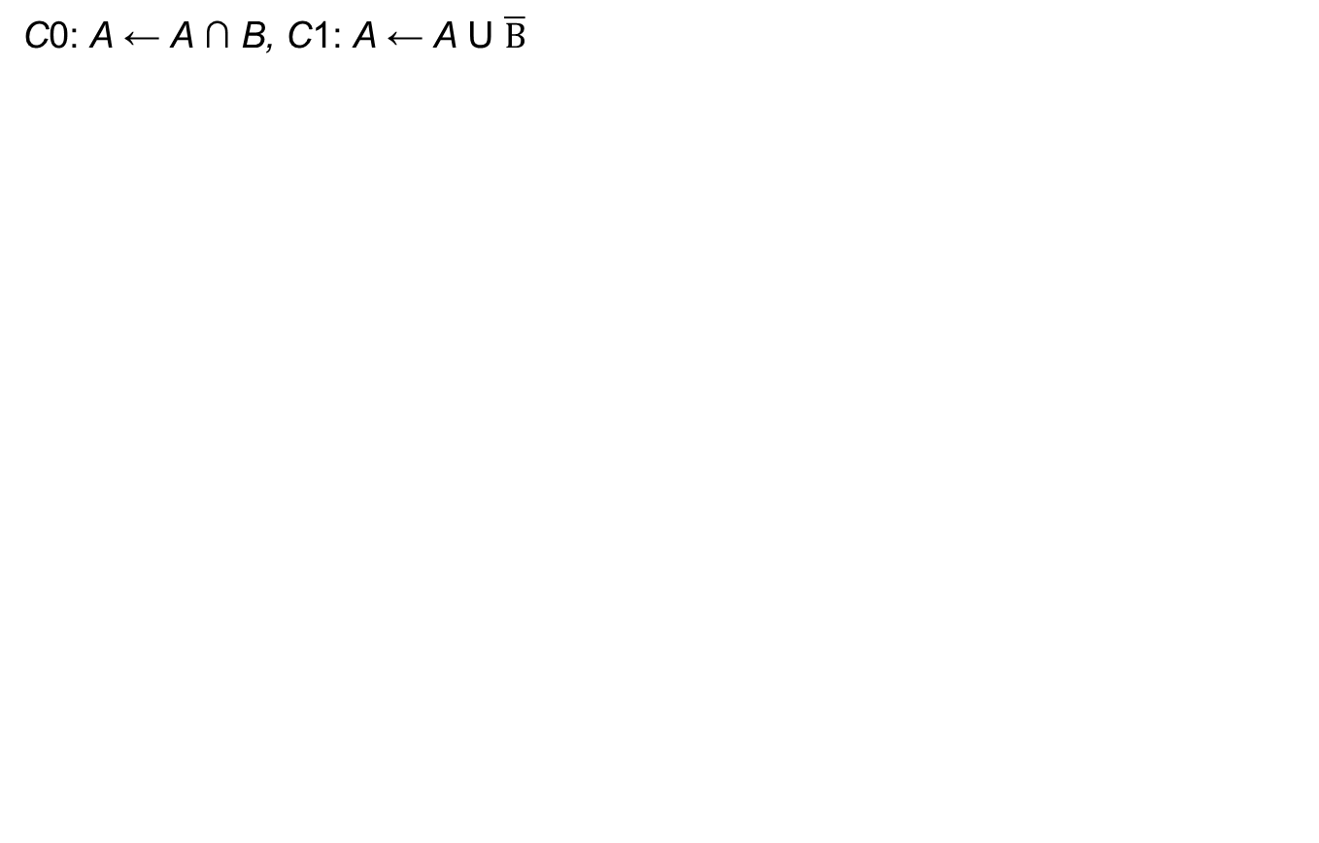

改进
C0: A ← A ∩ B, C1: A ← A U $\overline{B}$
C₀ C₁ | A B | A_{(t+1)}
0 0 | 0 0 | 0
0 0 | 0 1 | 0
0 0 | 1 0 | 1
0 0 | 1 1 | 1
0 1 | 0 0 | 1
0 1 | 0 1 | 0
0 1 | 1 0 | 1
0 1 | 1 1 | 1
1 0 | 0 0 | 0
1 0 | 0 1 | 0
1 0 | 1 0 | 0
1 0 | 1 1 | 1
1 1 | 0 0 | 0
1 1 | 0 1 | 0
1 1 | 1 0 | 1
1 1 | 1 1 | 1
D_{A}
A B
C₀C₁
00 01 11 10
0 | 0 | 1 | 1
1 | 0 | 1 | 1
0 | 0 | 1 | 1
0 | 0 | 1 | 0
A $\overline{C0}$
$$\overline{C0}C1\overline{B}$$
00
01
11
10
A $C1$
D_{A} = AB$+ \overline{C0}C1\overline{B}$ + C₁A + $\overline{C0}A$
A $B$
Notes:
C₀$⨁$C₁ A
$$\overline{C0}C1\overline{B}$$
AB

Slide 27
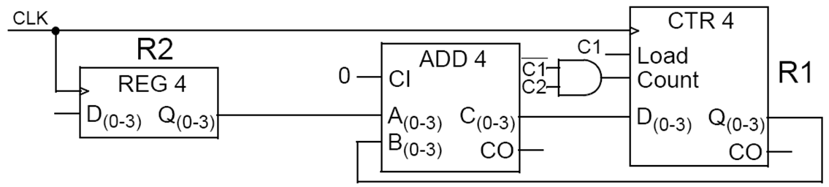
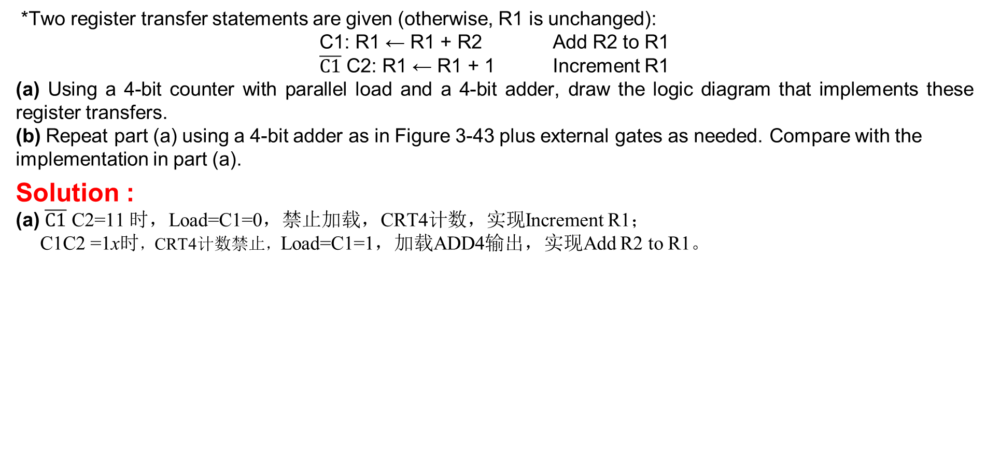
Problems 5-7
*Two register transfer statements are given (otherwise, R1 is unchanged):
C1: R1 ← R1 + R2 Add R2 to R1
$\overline{C1}$ C2: R1 ← R1 + 1 Increment R1
(a) Using a 4-bit counter with parallel load and a 4-bit adder, draw the logic diagram that implements these register transfers.
(b) Repeat part (a) using a 4-bit adder as in Figure 3-43 plus external gates as needed. Compare with the implementation in part (a).
Solution :
(a) $\overline{C1}$ C2=11 时，Load=C1=0，禁止加载，CRT4计数，实现Increment R1；
C1C2 =1x时，CRT4计数禁止，Load=C1=1，加载ADD4输出，实现Add R2 to R1。
Notes:
Figure 4-5=Figure 3-43？

Slide 28
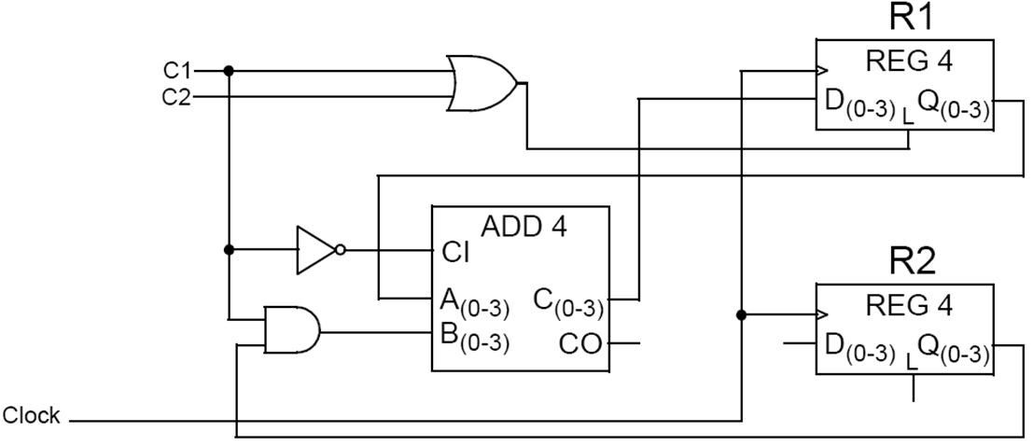
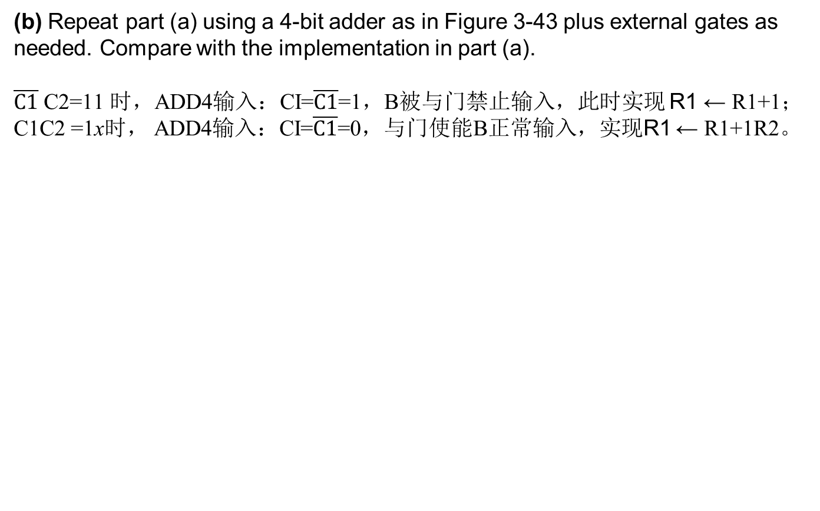

Solution Continue before：
(b) Repeat part (a) using a 4-bit adder as in Figure 3-43 plus external gates as needed. Compare with the implementation in part (a).
$\overline{C1}$ C2=11 时，ADD4输入：CI=$\overline{C1}$=1，B被与门禁止输入，此时实现 R1 ← R1+1；
C1C2 =1x时， ADD4输入：CI=$\overline{C1}$=0，与门使能B正常输入，实现R1 ← R1+1R2。
$\overline{C1}$=1时，A+0+$\overline{C1}$
C1使能B输入

Slide 29
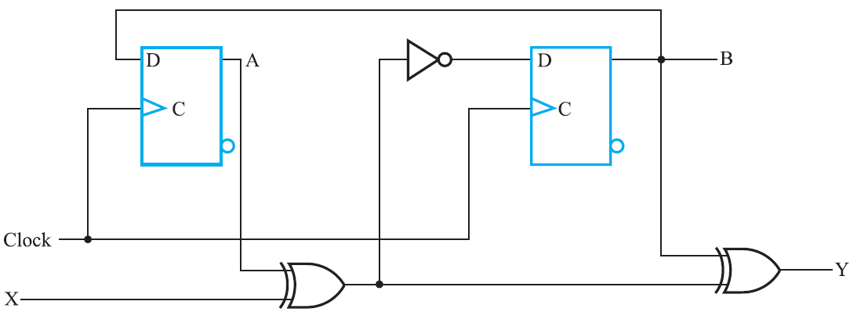
Problems 5-8
*A sequential circuit is shown in Figure 4-49. The timing parameters for the gates and flip-flops are as follows:
Inverter：t_{pd} = 0.01 ns; XOR gate：t_{pd} = 0.04 ns
Flip-flop：t_{pd} = 0 .08 ns, t_{s} = 0 .02 ns, and t_{h} = 0 .01 ns
(a)Find the longest path delay from an external circuit input passing through gates only to an external circuit output.
(b) Find the longest path delay in the circuit from an external input to positive clock edge.
(c) Find the longest path delay from positive clock edge to output.
(d) Find the longest path delay from positive clock edge to positive clock edge.
(e) Determine the maximum frequency of operation of the circuit in megahertz (MHz).
Figure 4-49

Slide 30
D
Q
D
Q
C
Q'
C
Q'
D
Q
D
Q
C
Q'
C
Q'
D
Q
D
Q
C
Q'
C
Q'
t
p
D
Q
D
Q
C
Q'
C
Q'
C
D
Q
D
Q
t
t
t
t
C
Q'
C
Q'
pd,FF
pd,COMB
slack
s
(a) Edge-triggered (positive edge)
CLOCK
CLOCK
t
p
C
t
pd,FF
t
pd,COMB
t
slack
t
s
(b) Pulse-triggered (negative pulse)

Slide 31
Solution
0.01ns
t_{pd} =0.08
t_{s} =0.02
t_{h} =0.01
t_{delay}= t_{pdXOR} + t_{pdXOR} = 0.04 + 0.04 = 0.08 ns
t_{delay} = t_{pdXOR} + t_{pdINV} + t_{sFF} = 0.04 + 0.01+ 0.02 = 0.07 ns
t_{delay} = t_{pdFF} +2 t_{pdXOR} = 0.08 + 2(0.04) = 0.16 ns
t_{delay-clock edge to clock edge} = t_{pdFF} + t_{pdXOR} +t_{pdINV} + t_{sFF}
= 0.08+ 0.04 + 0.01+ 0.02 = 0.15 ns
f_{max} = 1/tdelay- clock edge to clock edge = 1/0.15 ns = 6.67 GHz
Comment: The clock frequency may need to be lower due to other delay paths that pass outside of the circuit into its environment. Calculation of this frequency cannot be performed in this case since data for paths through the environment is not provided.
0.08ns
0.08ns
0.04ns
0.04ns
Notes:
a) The longest direct path delay is from input X through the two XOR gates to the output Y.
b) The longest path from an external input to a positive clock edge is from input X through the XOR gate and the inverter to the B Flip-flop.
c) The longest path delay from the positive clock edge is from Flip-flop A through the two XOR gates to the output Y.
d) The longest path delay from positive clock edge to positive clock edge is from clock on Flip-flop A through the XOR gate and inverter to clock on Flip-flop B.
e) The maximum frequency is 1/tdelay- clock edge to clock edge

Slide 32
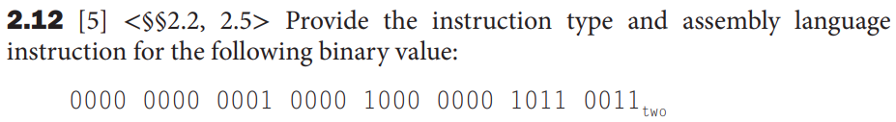
Problem 6-1
Solution:
R-type: add x1, x1, x1

Slide 33
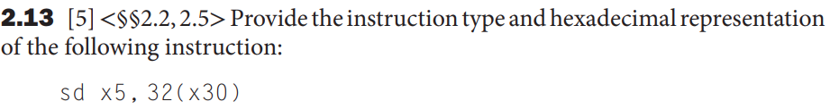
Problem 6-2
Solution:
S-type: 0x25F3023 (0000001 00101 11110 011 00000 0100011)

Slide 34
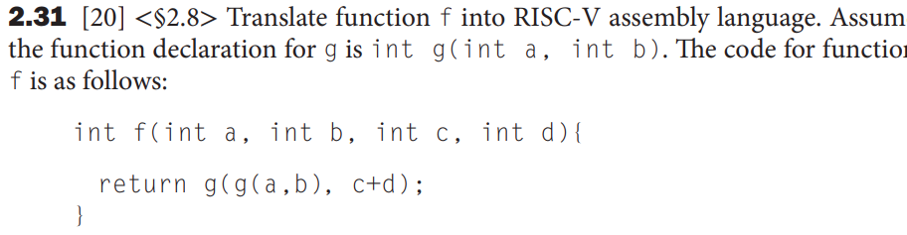
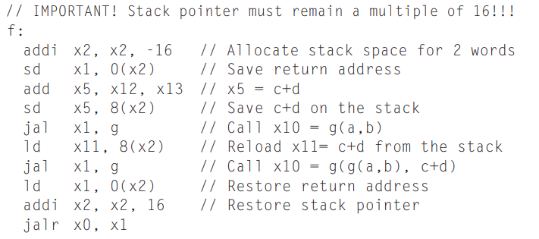
Problem 6-3
Solution:

Slide 35
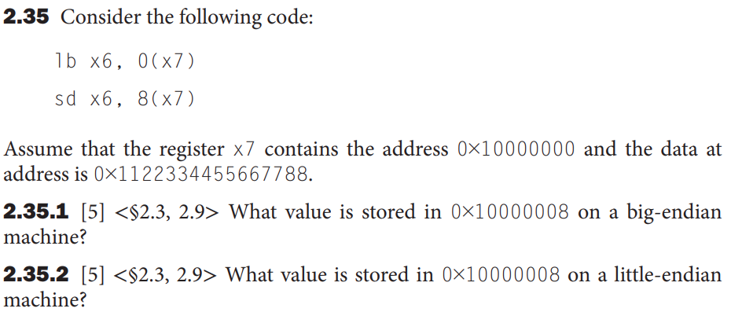
Problem 6-4
Solution:
  2.35.1 0x11
  2.35.2 0x88

Slide 36
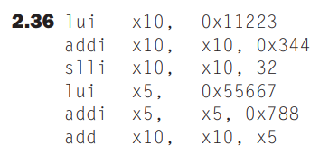
Problem 6-5
Solution:

Slide 37
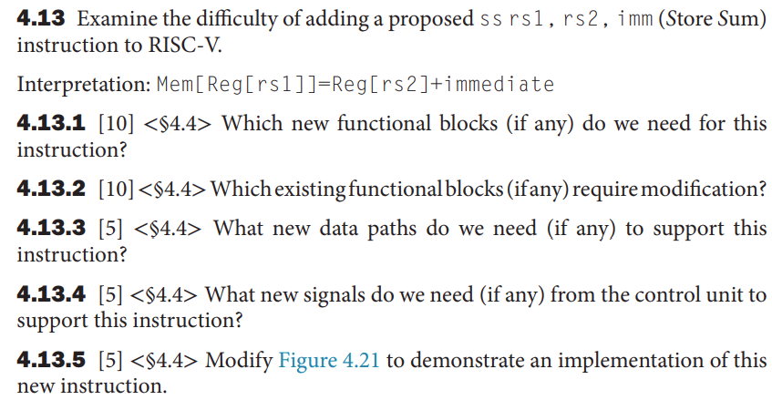
Problem 7-1

Slide 38
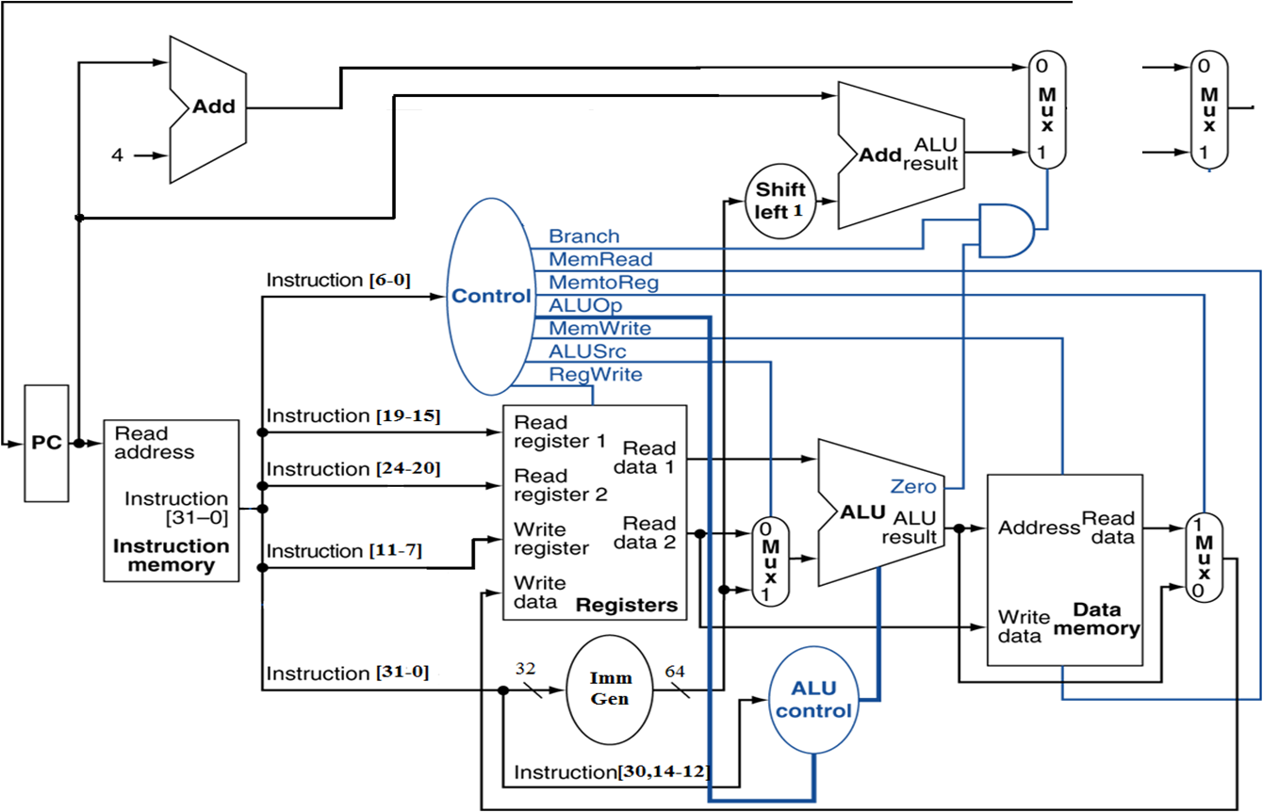
jump
输入 |  | 输出
Instruction | OPCode | ALUSrcB | Memto-Reg | Reg Write | Mem Read | Mem Write | Branch | Jump | ALU_{Op1} | ALU _{Op0}
ss

Slide 39
ThAnkS!

