Slide 1
What is RDBMS ?
A relational database management system (RDBMS) is a program that allows you to create, update, and administer a relational database. Most relational database management systems use the SQL language to access the database.

Slide 2
What is MySQL?
MySQL is a relational database management system (RDBMS) based on the SQL (Structured Query Language) queries. It is one of the most popular languages for accessing and managing the records in the table. MySQL is open-source and free software under the GNU license. Oracle Company supports it.

Slide 3
The functionality of the mySQL database application
The application is used for a wide range of purposes, including data warehousing, e-commerce, and logging applications.
The most common use for mySQL however, is for the purpose of a web database. It can be used to store anything from a single record of information to an entire inventory of available products for an online store.
In association with a scripting language such as PHP or Perl (both offered on our hosting accounts) it is possible to create websites which will interact in real-time with a mySQL database to rapidly display categorised and searchable information to a website user.

Slide 4
What is PostgreSQL ?
PostgreSQL is an advanced, enterprise-class, and open-source relational database system. PostgreSQL supports both SQL (relational) and JSON (non-relational) querying.
PostgreSQL is a highly stable database backed by more than 20 years of development by the open-source community.
PostgreSQL is used as a primary database for many web applications as well as mobile and analytics applications.

Slide 5
The functionality of PostgreSQL
A PostgreSQL function or a stored procedure is a set of SQL and procedural commands such as declarations, assignments, loops, flow-of-control etc. stored on the database server and can be involved using the SQL interface. And it is also known as PostgreSQL stored procedures.

Slide 6
What is SQL Server ?
SQL Server is a database server by Microsoft.
The Microsoft relational database management system is a software product which primarily stores and retrieves data requested by other applications. These applications may run on the same or a different computer.
Going more in-depth, in order to understand what a SQL Server is, you must first understand what SQL is.
SQL is a special-purpose programming language designed to handle data in a relational database management system. A database server is a computer program that provides database services to other programs or computers, as defined by the client-server model. Therefore, a SQL Server is a database server that implements the Structured Query Language (SQL).

Slide 7
The functionality of SQL server
The core component of Microsoft SQL Server is the SQL Server Database Engine, which controls data storage, processing and security. It includes a relational engine that processes commands and queries and a storage engine that manages database files, tables, pages, indexes, data buffers and transactions.

Slide 8
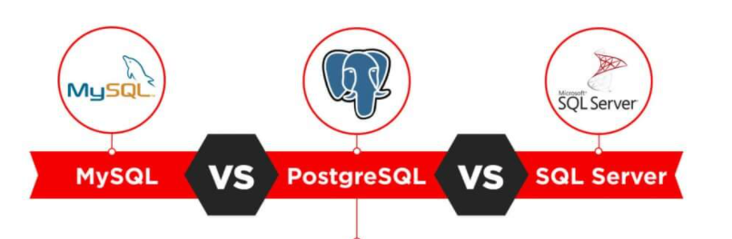
Difference Between MySQL , SQL server and PostgreSQL

Slide 9
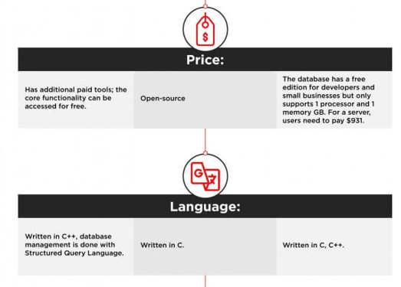

Slide 10
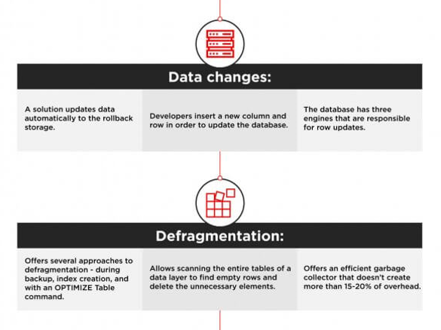

Slide 11
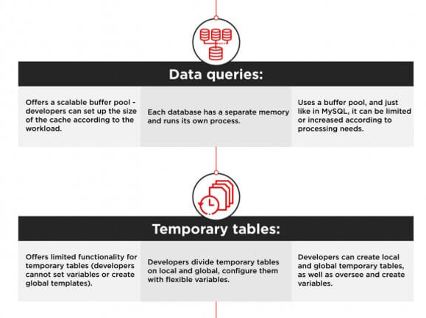

Slide 12
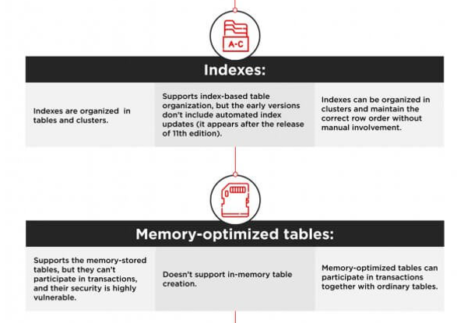

Slide 13
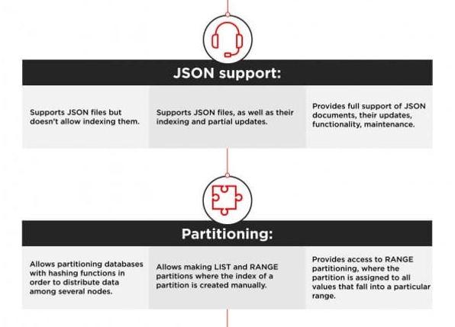

Slide 14
