Slide 1

Flight Price Prediction
SONDOS AHMED

Slide 2

OUR BIG IDEA
Analyze the flight booking dataset obtained from "Ease My Trip" website to derive valuable insights for passengers and stakeholders in the aviation industry.

Slide 3
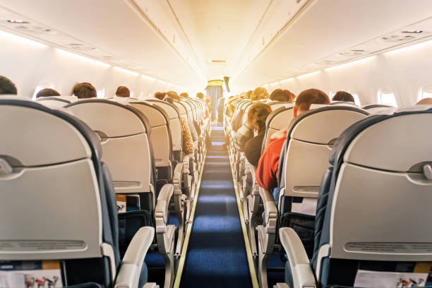
OUR AGENDA
Introduction
Data Description
Business Question
Answer to some business questions about relation between features and price will help us to analyze data
Overview of the significance of flight price prediction.
Objectives of the analysis.
Quick Review about data
Identify problem in dataset
Handle the issue in the data
Models training and evaluation
Identify the specific problem or inconsistency in the dataset.
Take appropriate steps to clean and preprocess the data.
Try to use some models.

Slide 4

introduction
Empowering Travelers with Data Analytics
Travelers today face a multitude of challenges, from fluctuating prices to unpredictable schedules. By harnessing the power of data analytics, we aim to provide travelers with the information they need to make informed decisions and seize opportunities
Objectives of the Analysis
Understanding Traveler Needs
Prediction and Forecasting
Optimization of Travel Planning
Enhancing User Experience
Supporting Decision-Making
Contributing to Industry Innovation

Slide 5

Data Description

Slide 6
DATASET
Dataset contains information about flight booking options from the website Ease my trip for flight travel between India's top 6 metro cities. There are 300261 datapoints and 11 features in the cleaned dataset.
FEATURES
Airline
Flight
Source City
Departure Time
Stops
Arrival Time
Destination City
Class
Duration
Days Left
Price

Slide 7
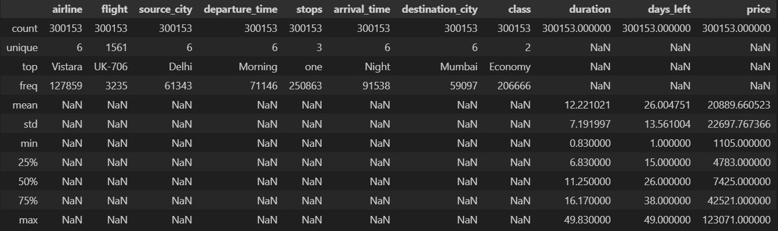
describe of data
The dataset is complete with no missing values in any column and no duplicated.
There are 2 class of ticket:
Business
Economy
The data types vary across columns:
Categorical (object): airline, flight, source city, departure time, stops, arrival time, destination city, class.
Numerical (integer): Unnamed: 0, days left, price.
Numerical (floating point): duration.
Data shape : 300153 rows & 12 columns

Slide 8
Business question

Slide 9
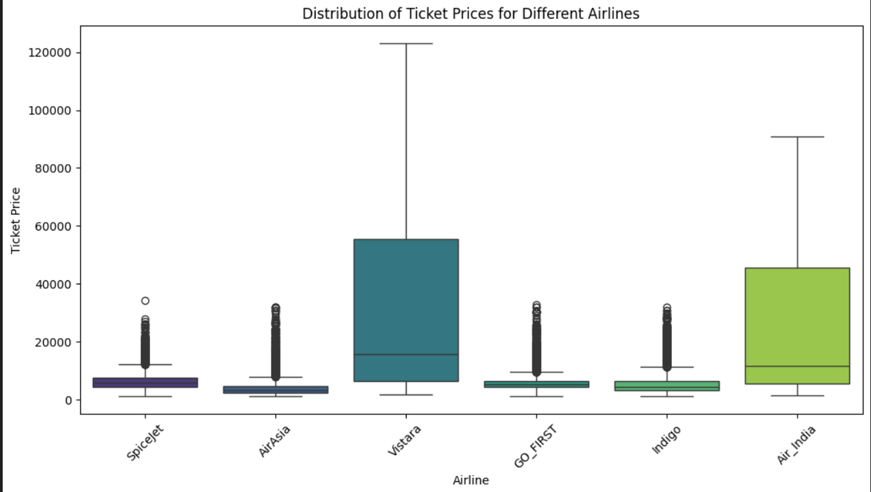
first question
Does price vary with Airlines?
When analyzing the flight booking dataset, we observed significant variations in ticket prices across different airlines.
Airlines like Air India and Vistara have higher average prices compared to budget airlines like AirAsia and GO FIRST.
Mean Price:
AirAsia: $4091.07
Air India: $23507.02
GO FIRST: $5652.01
Indigo: $5324.22
SpiceJet: $6179.28
Vistara:$30396.54

Slide 10
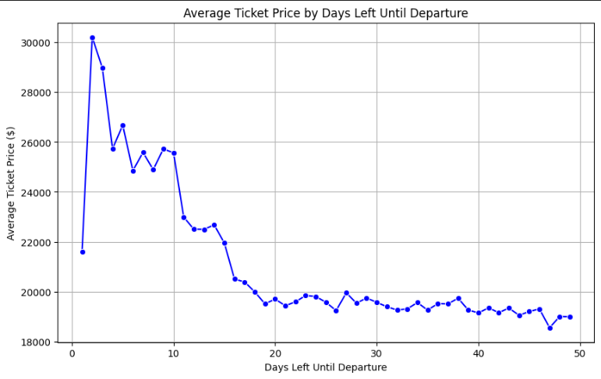
How is the price affected when tickets are bought 1 or 2 days before departure?
second question
To understand how ticket prices are affected by the timing of booking, we grouped the data based on the number of days left until departure. Here's what we found:
As the departure date approaches, the average ticket price tends to increase.
Tickets booked closer to the departure date (1 or 2 days before) tend to have higher average prices compared to those booked farther in advance.
This trend suggests that last-minute bookings may incur higher costs due to increased demand or limited availability.

Slide 11
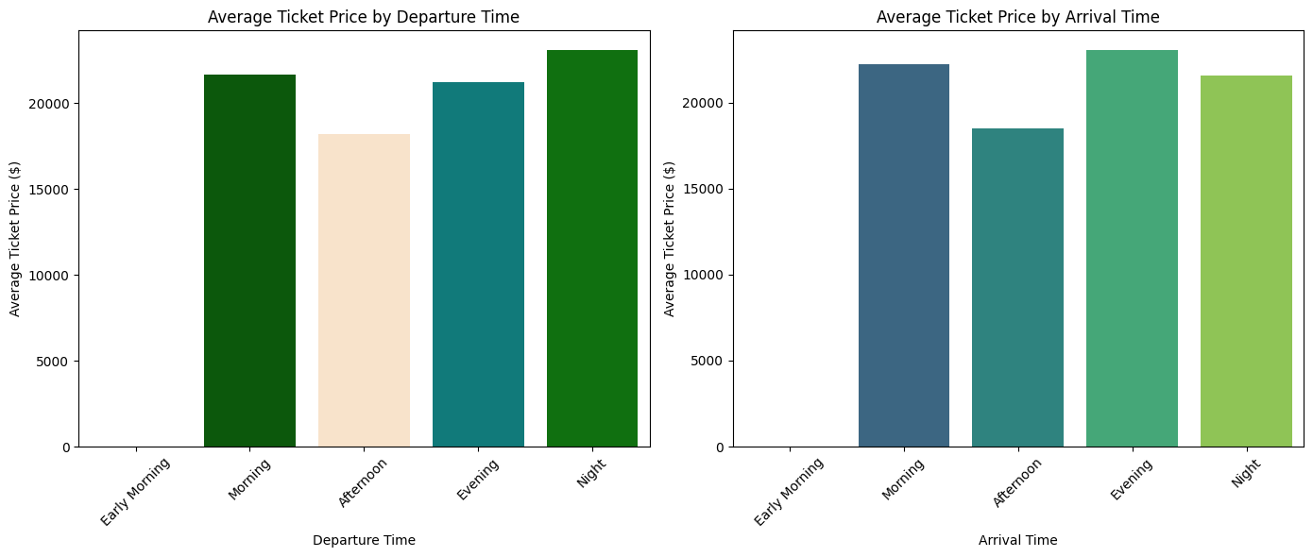
third question
Does ticket price change based on the departure time and arrival time?
The highest average ticket prices for both departure and arrival times are observed during the night.
Morning and evening departures also tend to have relatively high average ticket prices.
Average ticket prices are slightly lower for afternoon departures and arrivals.
These findings suggest that airlines may adjust ticket prices based on demand and travel preferences during different times of the day.

Slide 12
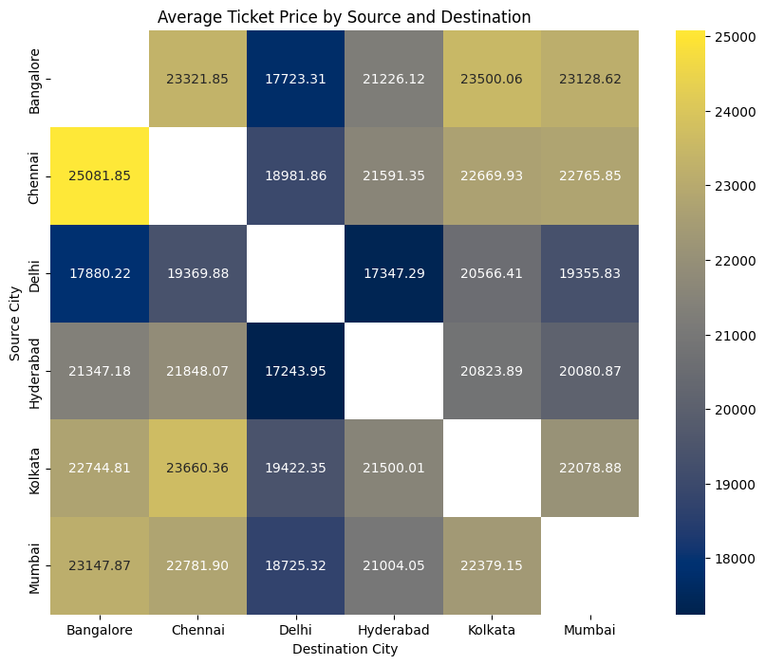
fourth question
How does the price change with change in Source and Destination?
The heatmap illustrates the average ticket price for different source-destination combinations.
Prices may vary depending on the origin and destination cities, reflecting factors such as distance, demand, and route popularity.
Travelers can use this information to compare ticket prices and make informed decisions when planning their trips.

Slide 13
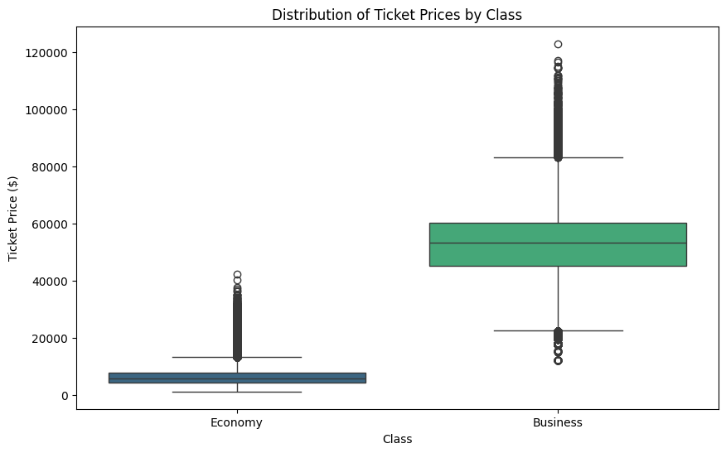
fifth question
How does the ticket price vary between Economy and Business class?
Economy class tickets have a significantly lower average price compared to Business class.
Business class tickets exhibit higher variability in prices.
Travelers may opt for Economy class to save on ticket costs while still enjoying essential travel services.
Business class may be preferred for those seeking luxury amenities and premium services, albeit at a higher price point.

Slide 14
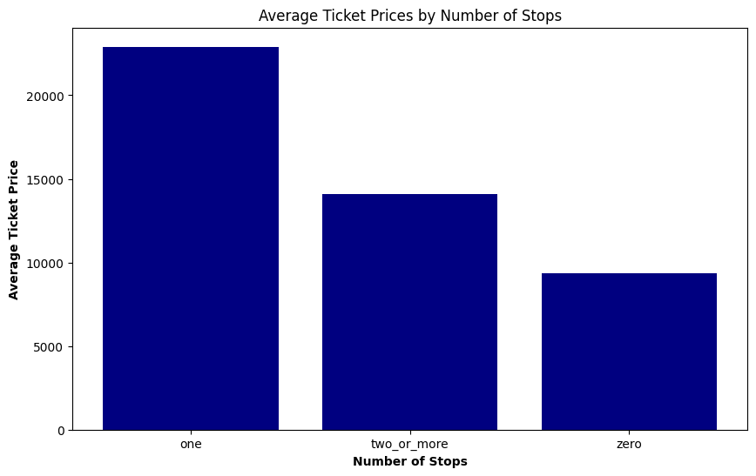
sixth question
How does the ticket price vary based on the number of stops?
The analysis reveals that ticket prices vary depending on the number of stops during the journey.
This insight underscores the importance of considering the number of stops when booking flights, as it can significantly impact the overall cost of travel.

Slide 15
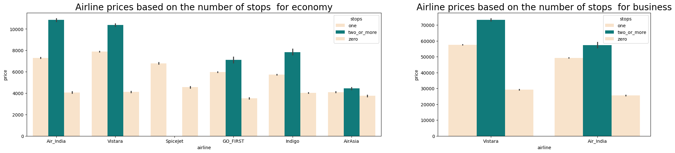
Airline prices based on the number of stops for business

Slide 16
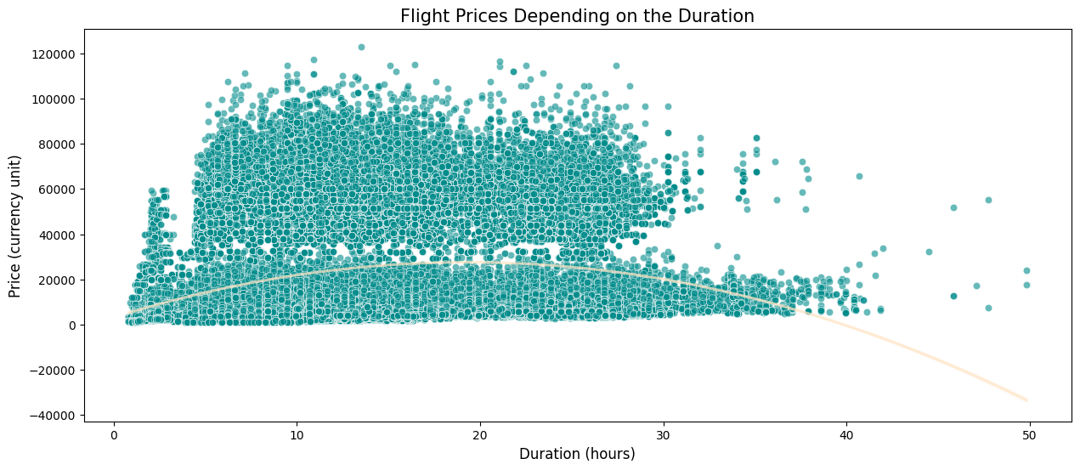
seventh question
What is the impact of the duration of the flight on ticket prices?

Slide 17
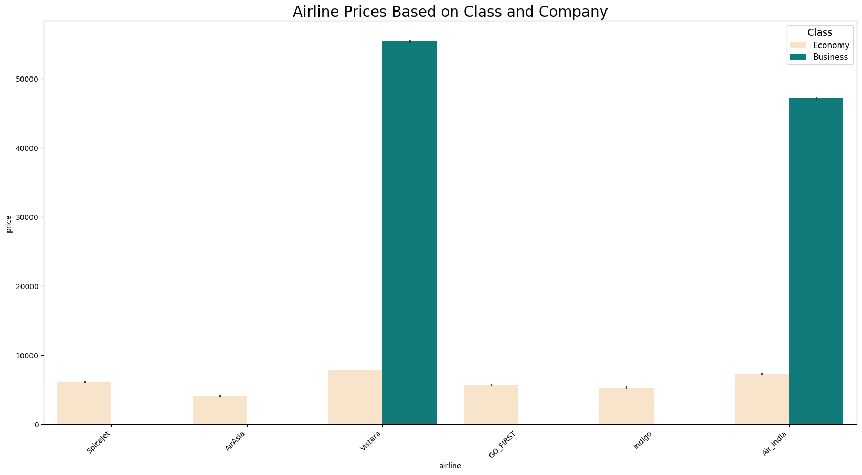
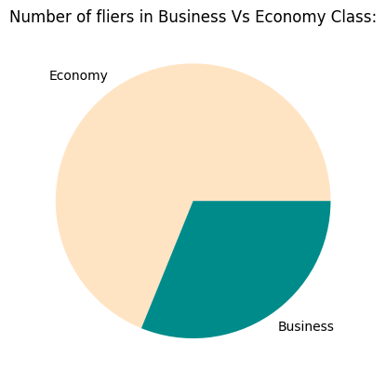
eighth question
Does the choice of airline have a greater impact on ticket prices for economy or business class?
As we show this is airplanes don't have business class, people travel in economy class more than travel in business

Slide 18
Identify the problem in dataset

Slide 19
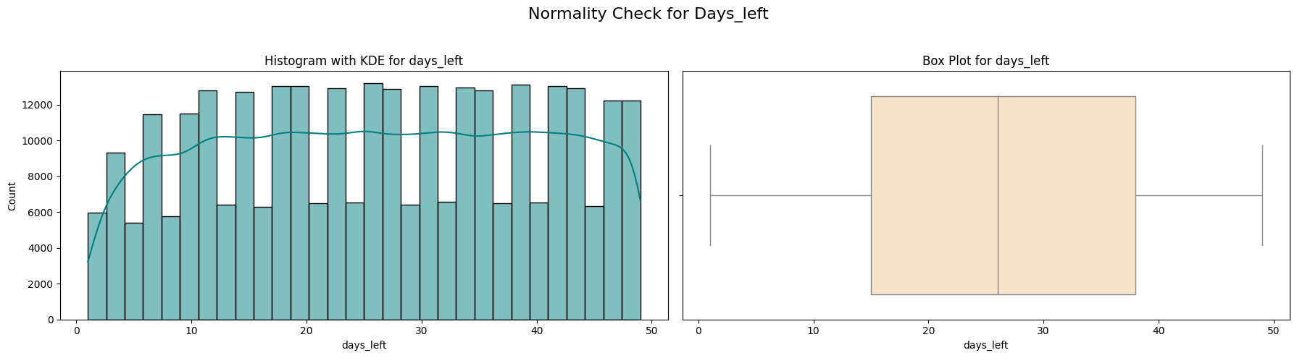
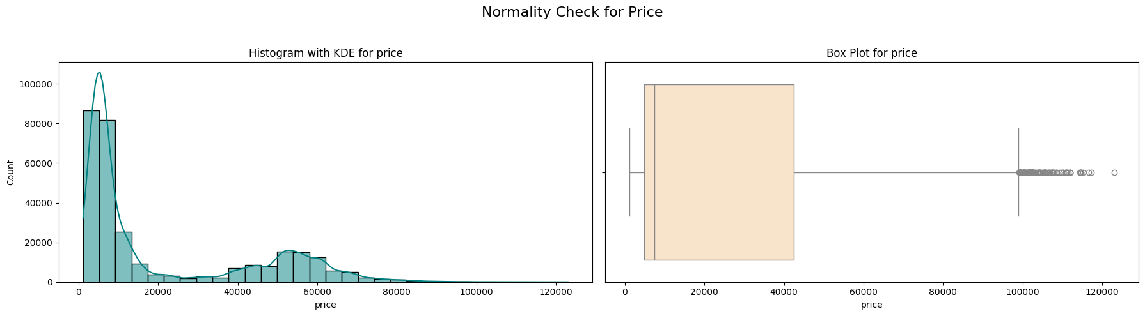
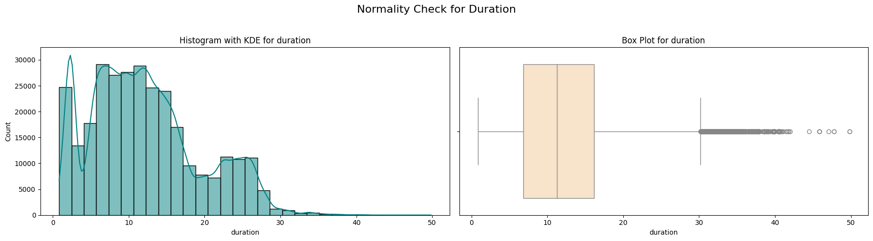
Check data in normal distribution There exists outliers or not
Missing values are instances where data is not recorded or unavailable for certain observations in the dataset.
Identifying and handling missing values is crucial for ensuring the accuracy and reliability of our analysis.
We conducted a thorough examination of the dataset to identify missing values across all variables..
All Columns indicates non-normality.

Slide 20
Handle the issue in the data

Slide 21
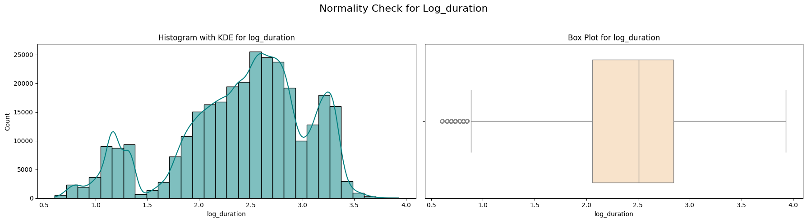

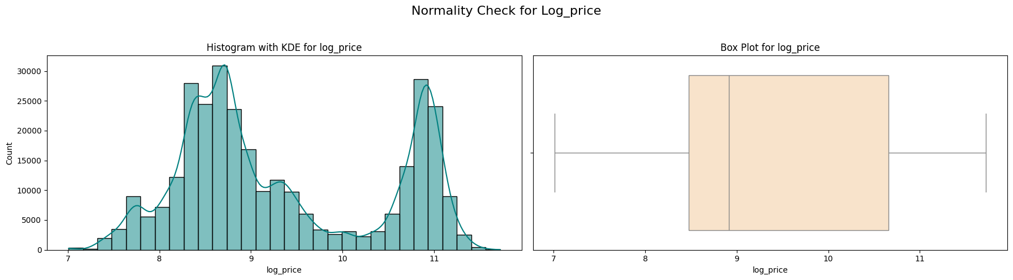
Handle outliers and transformation data
Price and Duration: Applying a log transformation can help normalize the data.
Days lefts: Applying a scaling technique Min-Max scaling helps standardize the range of values.

Slide 22
Models training and evaluation

Slide 23
Models
We do some preprocessing and after try to use four Algorithms.
Algorithms
Linear Regression
MSE: 0.1032149507904805
RMSE: 0.32127083713041943
R²: 0.9166641579433464
MAE: 0.25307680578980046
Random Forest
MSE: 0.01716565885838273
RMSE: 0.1310177806955328
R²: 0.986140431938737
MAE: 0.06364271645534973
Neural Network
MSE: 0.04151616289475953
RMSE: 0.20375515427777413
R²: 0.9664798135609335
MAE: 0.14517379800383126
Gradient Boosting
MSE: 0.056981873189573866
RMSE: 0.2387087622806793
R²: 0.9539927854651794
MAE: 0.17822017229935555

Slide 24

Thank You
Sondos Ahmed
sondosahmed72@gmail.com
01276611078

