Slide 1
world
Population

Slide 2
Agenda
Dataset info
Power BI
Analysis
Modeling
Results

Slide 3
Dataset information
This dataset contains historical and current world population data for each country from 1970 to 2022.
it contains:
Population by year
Continent and area (km²)
Population density
Growth rate
Percentage of world population

Slide 4
Power bi

Slide 5
Techquices
Data Cleaning.
Converted year columns into a single “Year” column and a corresponding “Population” column.
Handled missing values.

Slide 6
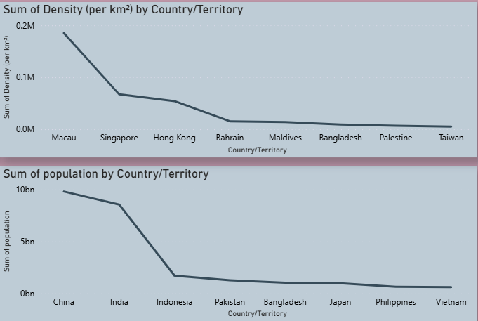
Insights
The countries with the highest population density are not the same as those with the highest population in each continent.
Example: Asia

Slide 7
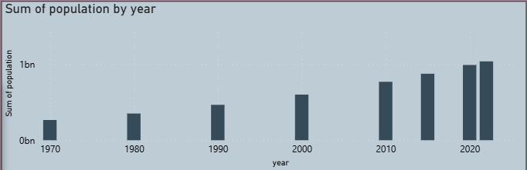
Insights
Population growth over the years in each continent.
Example: Africa

Slide 8
Analysis & Modeling

Slide 9
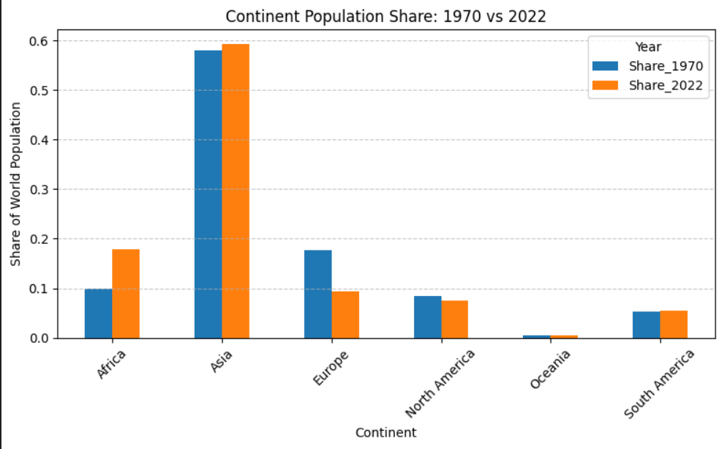
Analysis Insights
We identified the countries with the highest population density and the countries with the largest populations worldwide. We also analyzed population changes across continents over the years and found that Africa experienced the greatest growth among them all.

Slide 10
modeling
Built a linear regression model using lagged population values (Pop_lag1) and growth-related features.
Trained the model on historical data (≤ 2015) and validated it on recent years (≥ 2020) to assess accuracy.
Evaluated performance using metrics such as R², MAE, and MAPE.
Built linear regression model using lagged population values (Pop_lag1) and growth features.
Trained on historical data (≤ 2015) and validated on recent years (≥ 2020) to assess accuracy
Evaluated performance using metrics such as R², MAE, and MAPE.

Slide 11
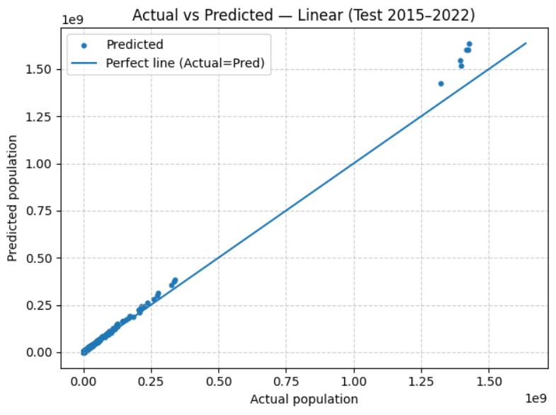
results
The best performing model for this dataset was the linear regression model.

Slide 12
THANK YOU

