Slide 1
Group: 94
Topic: T1/T2
TDT4265
2018
Participants:
Andresen, Jon Eirik Lisle
Foslien, Sondre

Slide 2
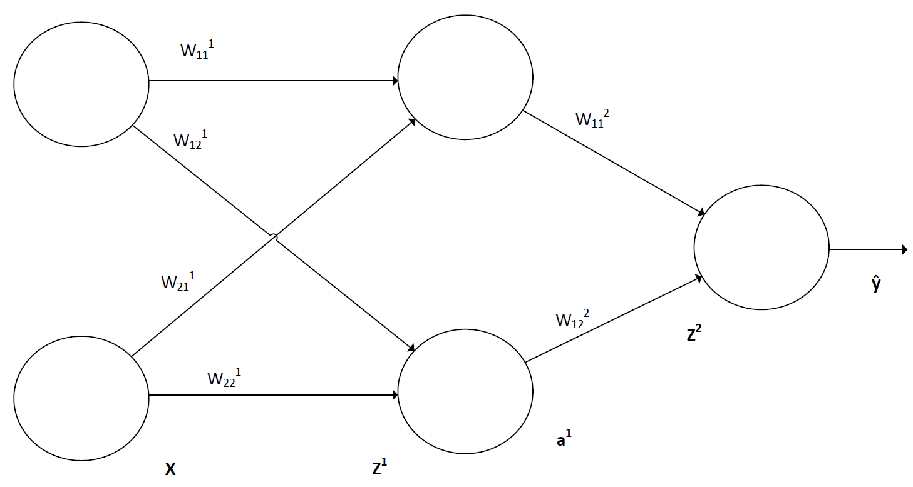
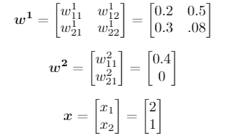
Qs
TDT4265
2018
1) Perceptron VS Sigmoid neuron
1a) Explain the different activation functions
1b) Why are sigmoid neurons better suited for NNs used for classification?
2) What do we use a cost function for? Give an example of such a function.
Figure 1: Neural network for task 5
3) What is the key difference between CL and classical programming?
4) Why is the ReLU-function often preferred as a activation function over the sigmoid-function?
5) Complete a forward pass in the network in figure 1. The activation function is the sigmoid function and the weights and input is given in figure 2.
Figure 2: Values for task 5
Group: 94, Andresen and Foslien
Topic: T1/T2

Slide 3
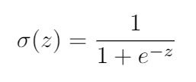

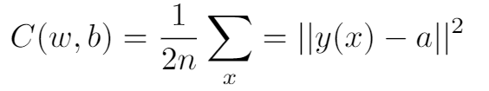
Q&As
TDT4265
2018
1) Question one
1a) Question one a
Perceptron: Sigmoid:
1b) Question one b
When changing the weights in a network consisting of perceptrons the flipping of a single neuron might uncontrollably flip many other neurons in the network, giving a very unpredictable response. A sigmoid neuron will change much more gradually.
2) Question two
The cost function is used in an optimization algorithm, for example gradient descent, as a basis for minimizing the error the NN makes. An example of a cost function is the Mean Square Error(MSE)
3) Question three
In classical programming you supply data and rules to get answers. In CL you supply data and answers to get rules.
Group: 94, Andresen and Foslien
Topic: T1/T2

Slide 4
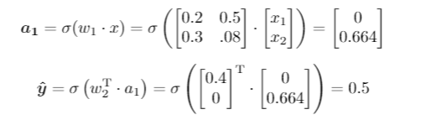
Q&As (2)
TDT4265
2018
4) Question four
The sigmoid function has two flatter parts at its end and beginning. These are areas where its derivative approaches zero. When backpropagating through the network the resulting multiplication of close-to-zero-terms when using the chain rule will cause the weights and biases of the network to change slowly. The ReLu function on the other hand has a smaller area with a small derivative, but still has a non linearity for capturing non-linear behaviour.
5) Question five
Forward pass:
Group: 94, Andresen and Foslien
Topic: T1/T2

