Slide 1
Application of Machine Learning techniques for the prediction of the gas-uptake capacity of nanoporous materials
George S. Fanourgakis
Department of Chemistry, University of Crete

Slide 2
Machine learning
Arthur Samuel (1959)
“ … ML is a field of study that gives computers the ability to learn without being explicitly programmed…”
Tom M. Mitchell (1997)
“… A computer program is said to learn from experience E with respect to some class of tasks T and performance measure P, if its performance at tasks in T, as measured by P, improves with the experience E….”
ML affects everyday life in a plethora of ways
character recognition software
voice recognition software
fingerprint identification
e-mail spam filtering
autonomously driving cars
computer game opponents
credit card fraud detection
.
Notes:
With the launch ofthe Materials Genome Initiative (MGI) [15] in
2011 and the coming of the “big data” era, a large effort has been made in the materials science community to collect extensive datasets of materials properties to provide materials engineers with ready access to the properties of known materials, such as the

Slide 3
Idea: use a large set of data to train a ML algorithm
Inorganic Crystal Structure Database (ICSD)
the super- conducting critical temperatures (SuperCon)
the Open Quantum Materials Database (OQMD)
the Cambridge Structural Databases
the Harvard Clean Energy Project (HCEP)
the Materials Project (MP)
the Materials Commons
and the Materials Data Facility

Slide 4
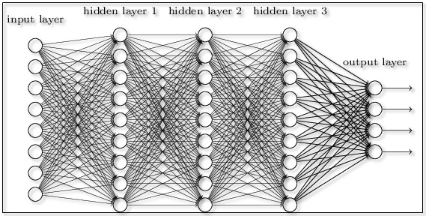
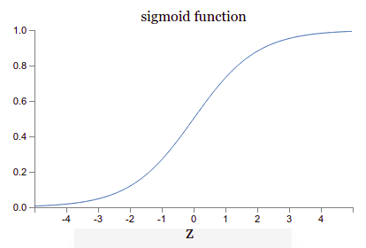
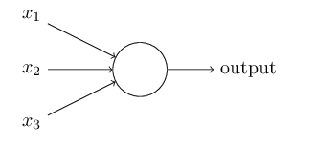

Artificial Neural Networks

Slide 5
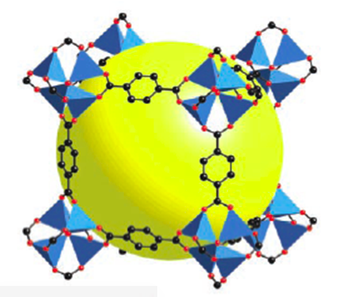
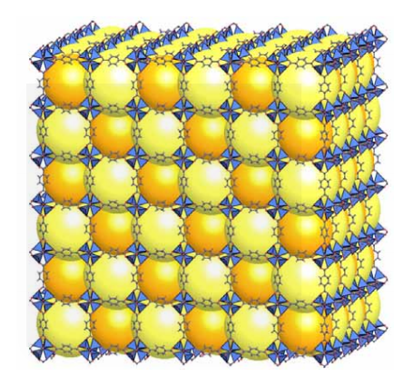
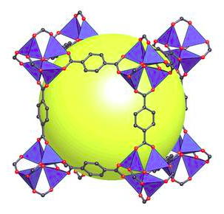
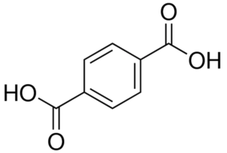
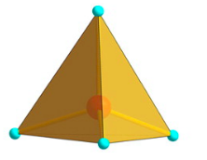
Metal-organic framework (MOF)
Prof. G. Froudakis (UoC)
Goal: Prediction of methane adsorption
MOFS are the most promising porous materials, for high-density methane storage because of their
high porosity,
tunable pores,
Large voids,
Very low density,
versatile chemistry
.
.

Slide 6
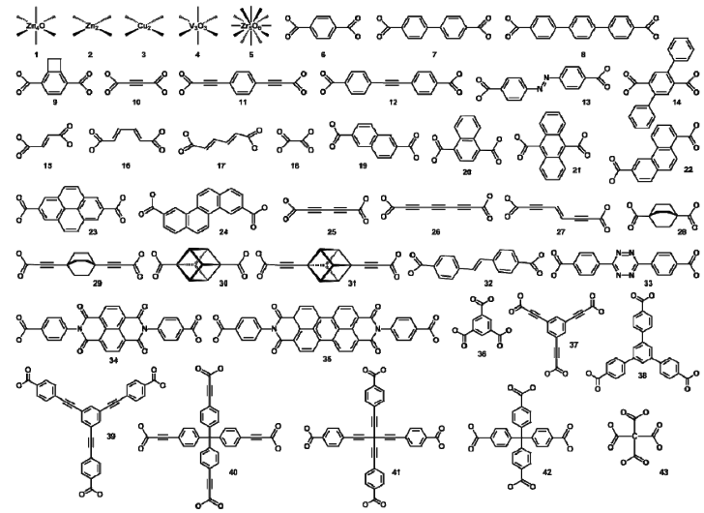
Hypothetical MOFs
More than 137,000 MOFs were theoretically studied by C. E. Wilmer et al. [Nature Chemistry, v. 4 p. 83-89 (2012)]
Geometrical features (void fraction, surface area, PSD, density etc) computed
Methane absorption was computed by GCMC simulations (high accuracy only for the most promising materials)
Only four metals were used (V, Zn, Zr, Cu)

Slide 7
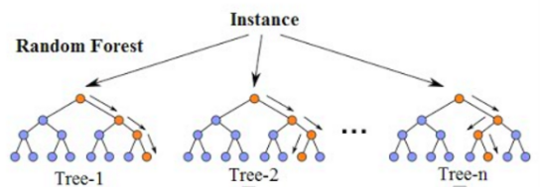
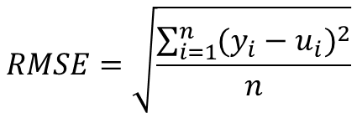
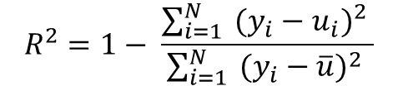
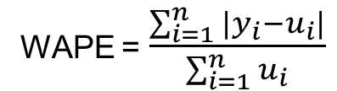

Random forests are an ensemble learning method for classification, regression and other tasks, that operate by constructing a multitude of decision trees at training time and outputting the class that is the mode of the classes (classification) or mean prediction (regression) of the individual trees.
$$RMSE=\sqrt{\frac{\sum_{i=1}^{n}{{(y_{i}−u_{i})}^{2}}}{n}}$$
$$MAE=\frac{\sum_{i=1}^{n}{|y_{i}−u_{i}|}}{n}$$
$$R^{2}=1− \frac{\sum_{i=1}^{N}{ {(y_{i}−u_{i})}^{2} }}{\sum_{i=1}^{N}{ {(y_{i}−\overline{u})}^{2} }}$$
WAPE = $\frac{\sum_{i=1}^{n}{|y_{i}−u_{i}|}}{\sum_{i=1}^{n}{u_{i}}}$
For the results presented here, for a given Training size [50 – 10K] 100 different training sets were randomly chosen and for each of them prediction for the remaining MOFs were made which were evaluated with the R2, MAE, WAPE and RMSE.

Slide 8
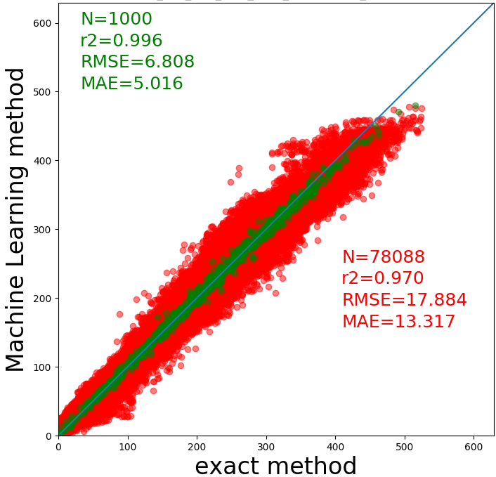
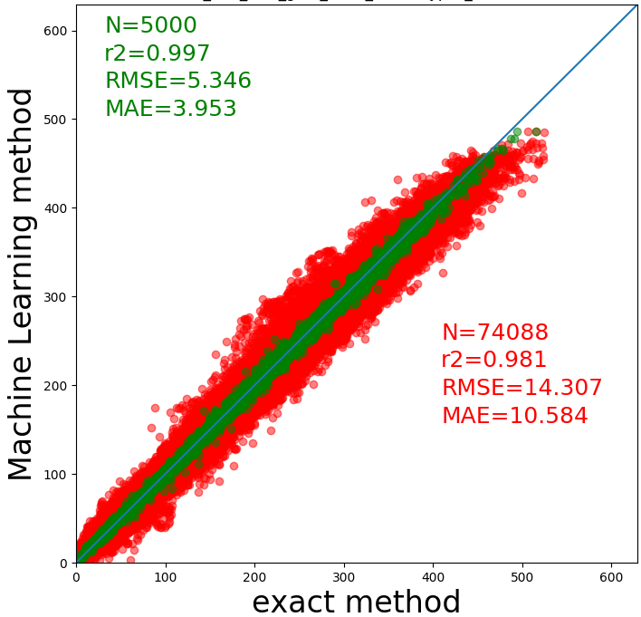
Training an Validation of the model
Random Forest algorithm
Descriptors
Geometrical
Void fraction
Surface area
…
Hypothetical MOFs (~137,000)
Wilmer, C. E.; et al. Nat. Chem. 4, 83 (2012)

Slide 9
Descriptors
Geometrical Features
Geometrical features
Void fraction
Surface area [m2/g]
Density [g/cm3]
Dominant pore diameter
Maximum pore diameter
Interpenetration capacity
Number of interpenetration framework
Atom groups
Atom groups
(Building blocks)
Corners
Linkers
Functional groups
Atom groups
Zn: Zn3f2, Zn4+2
Zr
Cu
V
O : O_3_f, O_2, O_3, O_R
C : C_1, C_2, C_3, C_R
N : N_1, N_2, N_3, N_R
H : H
F : F
Cl: Cl
Br: Br

Slide 10
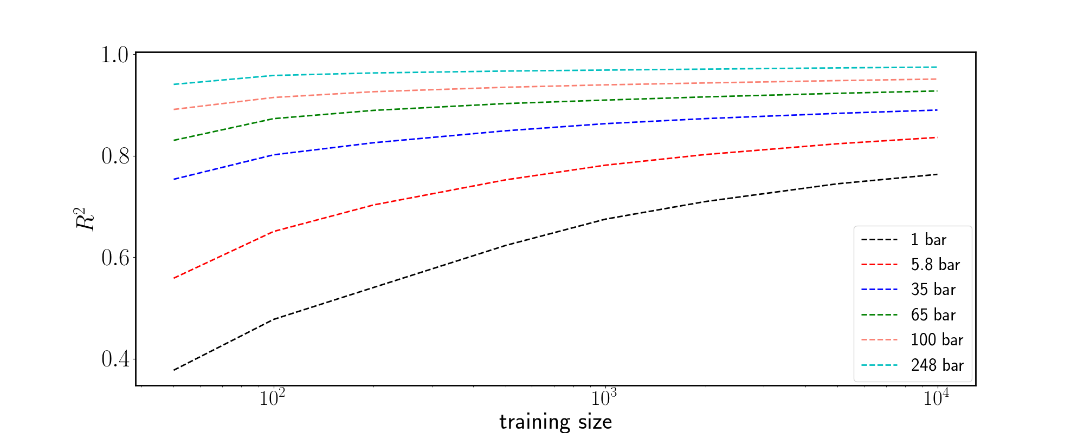
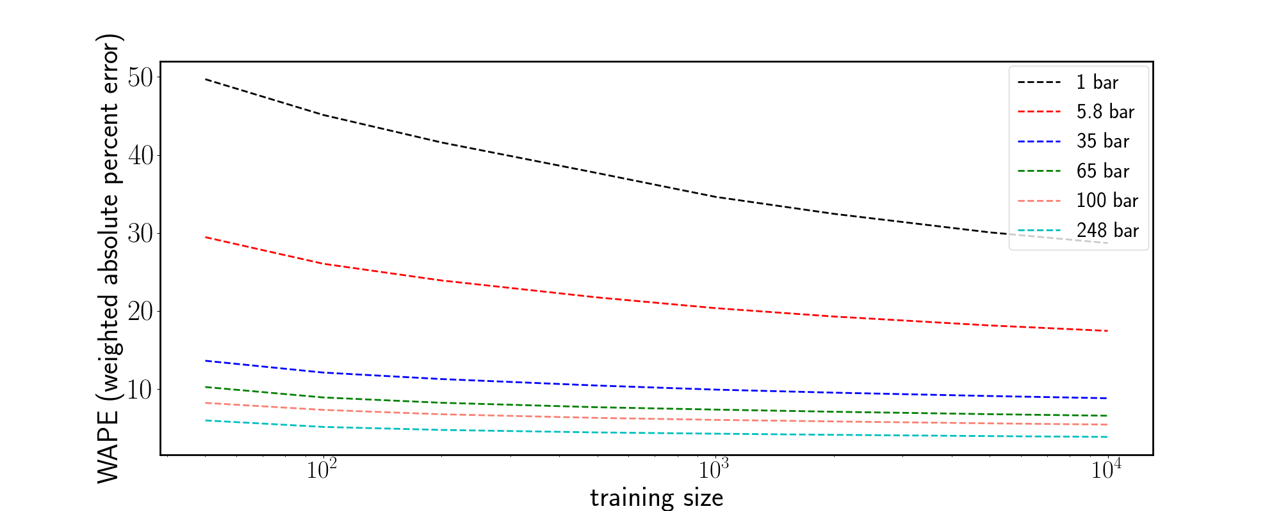
Structural properties

Slide 11
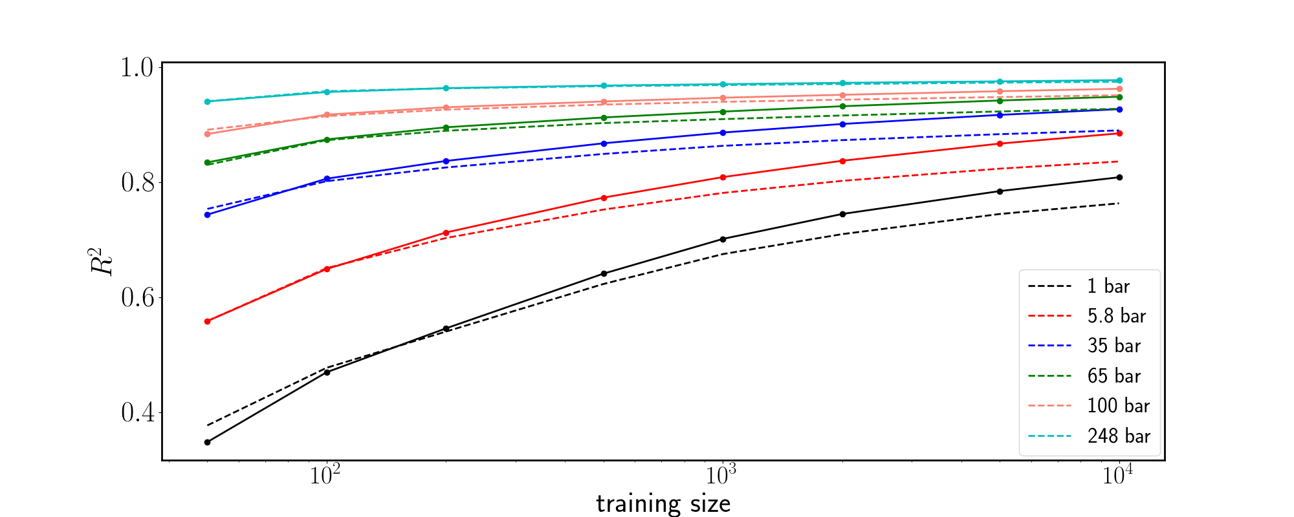
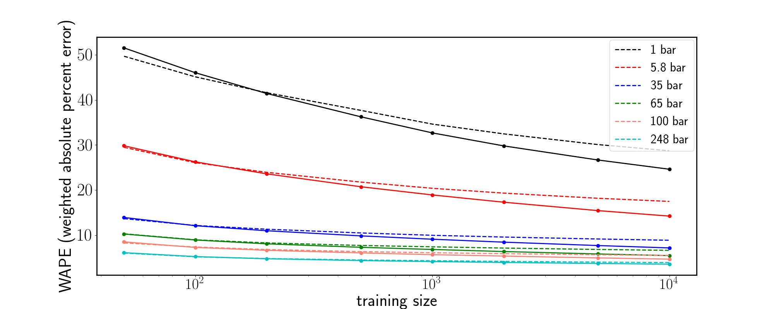
Structural properties + building blocks

Slide 12
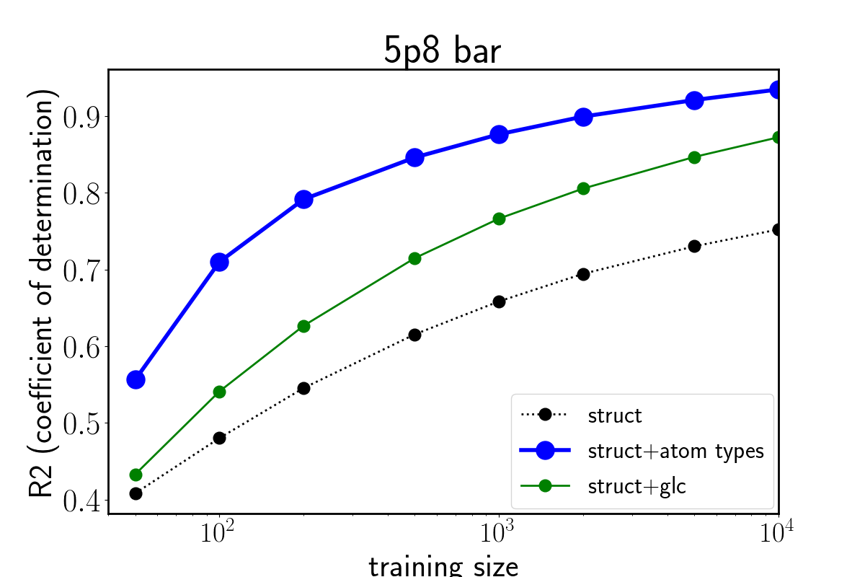
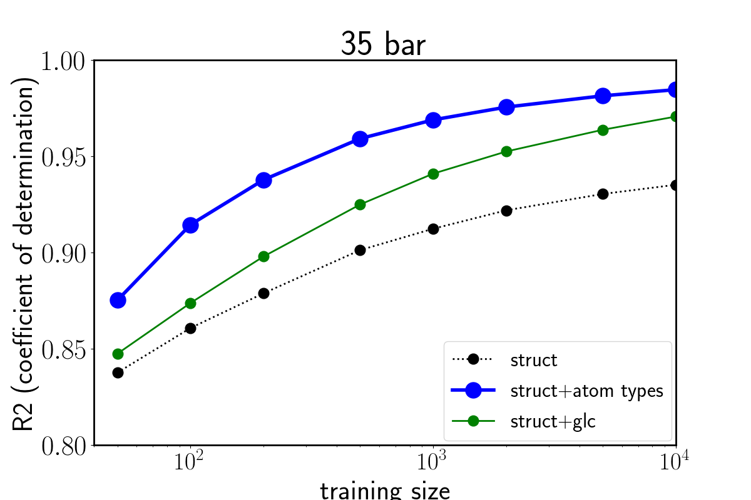
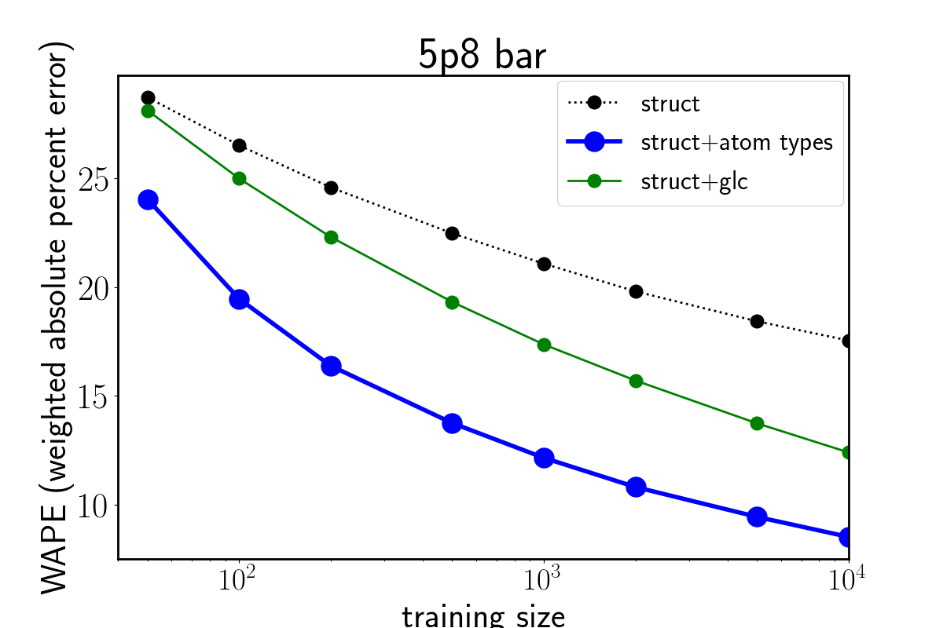
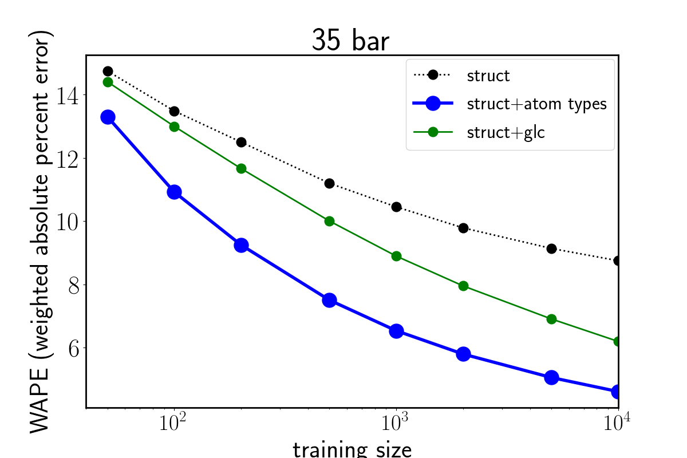
Structural properties + atom types

Slide 13
Problems and Limitations encountered
For very low pressures (1 bar) adsorption is mainly determined by the interactions of CH4 with the MOFs’ atoms. The fact that for all descriptors the R2, MAE, RMSE do not vary smoothly with the size of the training set, indicates that critical descriptors (e.g. positions of atoms) are missing.
A large number of MOFs is needed during the training
Only few metals were included.
The hmof database (Snurr group ~137,000 MOFs) has several inaccurate values for several MOFs (tenths, hundreds, thousands???). More accurate calculations are needed.
A more general approach is needed that could be applied in any nanoporous material
The chemical composition should be taken into account more accurately

Slide 14
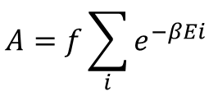

Additional descriptors
Descriptors used so far are physical observables and/or have a clear physical meaning.
However, this does not guarantee accuracy in the ML predictions
Create a unique fingerprint for each crystal based on the PES
For example consider various particles (therefore different σ, ε) and compute the LJ energy of each one with the MOF for all positions.
$$V_{LJ}=4ε[{\left(\frac{σ}{r}\right)}^{12}−{\left(\frac{σ}{r}\right)}^{6}]$$
$${A=f\sum_{i}{e^{−βEi}}}^{ }$$
For each of the N possible positions of the particle inside the MOF.
No MOF ==> E_{i}=0 ==> A=1
No free space inside the MOF ==> E_{i}=Infinity==> A=0

Slide 15
Dataset
The CoRE database (~4700 different MOFs) was used [1]
There are more than 40 metals
We performed very accurate GCMC simulations for the calculation of methane adsorption at various pressures and T=298 K.
The quantity A was computed for 4 different particle sizes.
In total 9 descriptors were used (5 geometrical + 4 A) for the training of the ML algorithm
[1] Y. G. Chung, et. al. Chemistry of Materials, 26, 6185−6192 (2014)

Slide 16
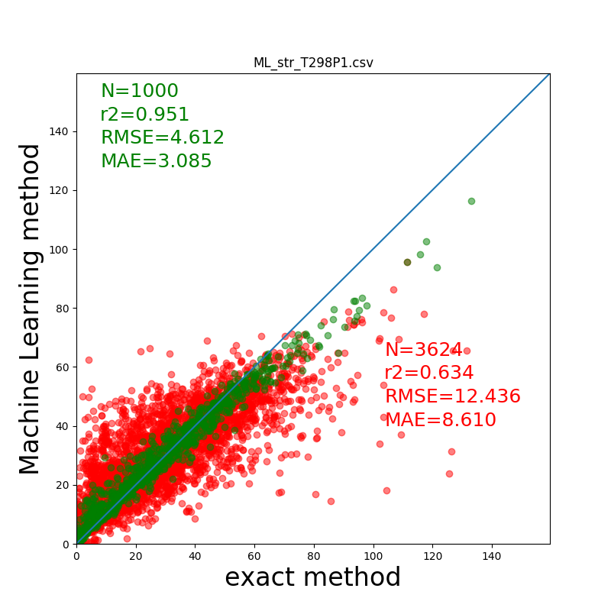
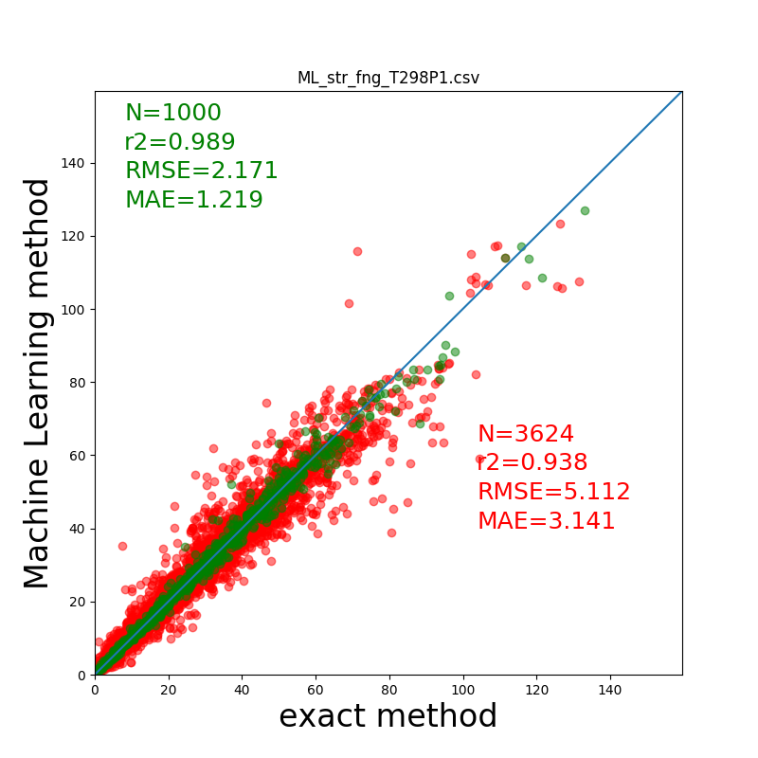
Results
structure
structure + probes

Slide 17
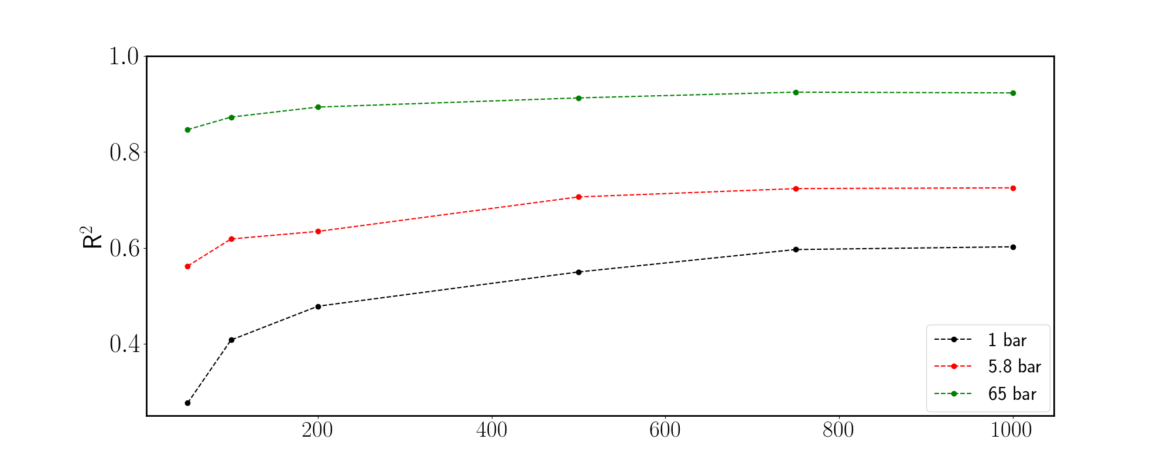
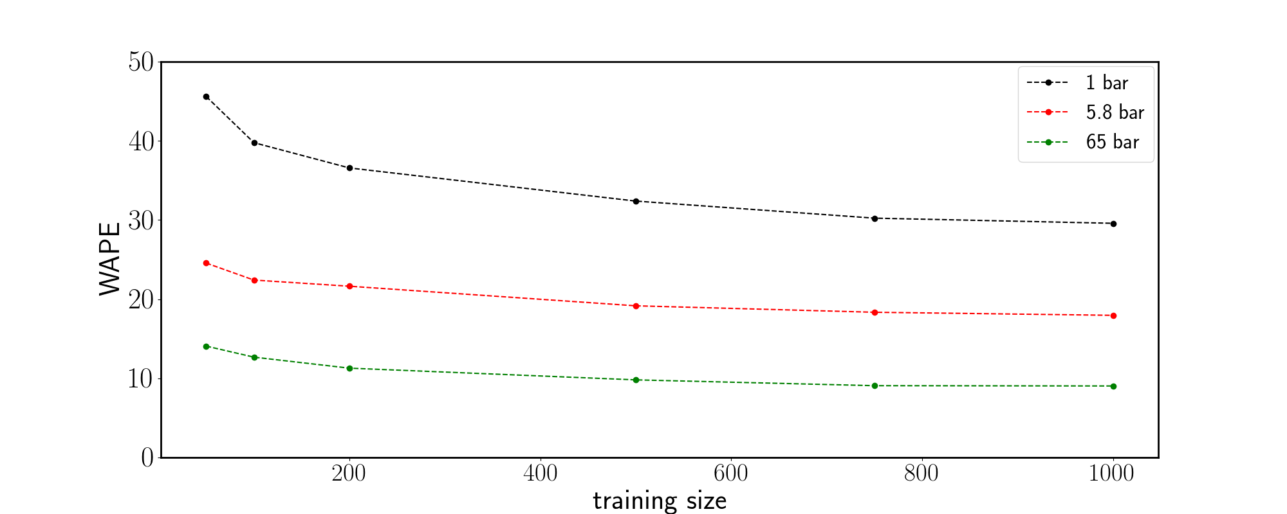
Structural properties

Slide 18
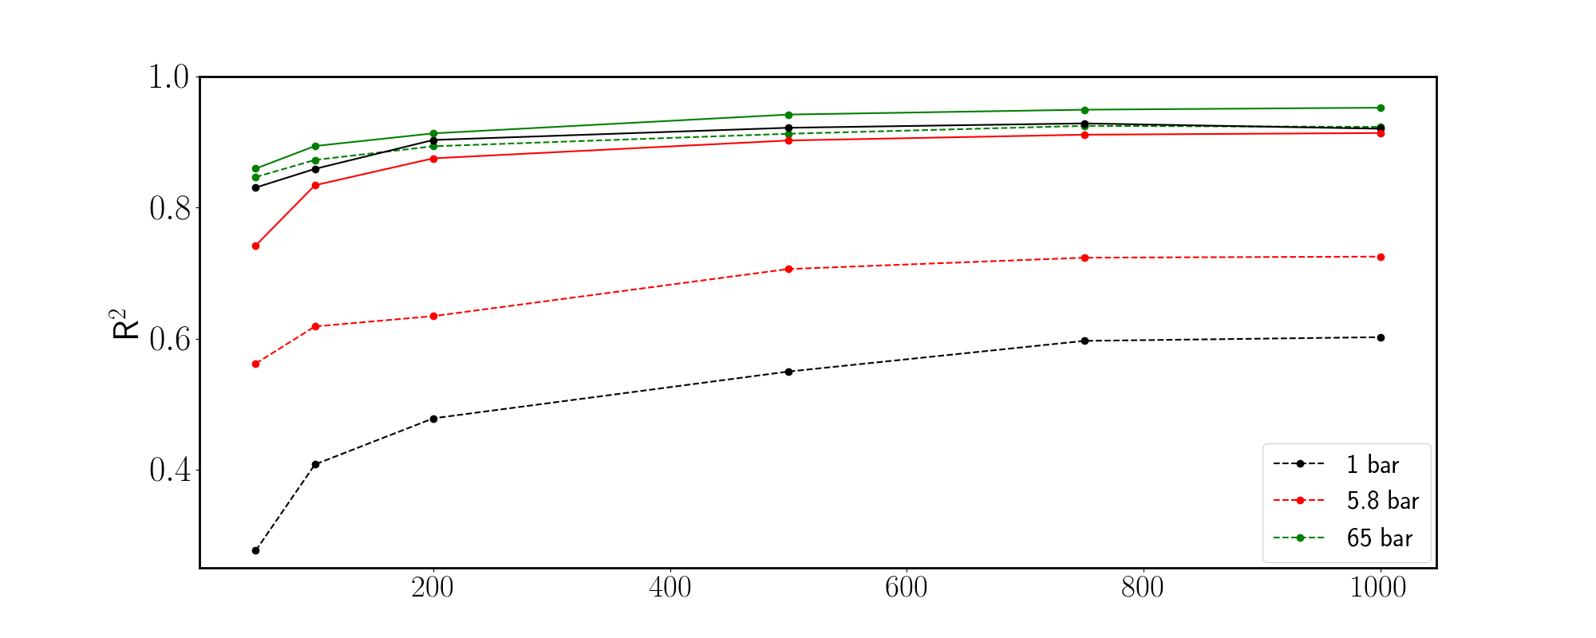
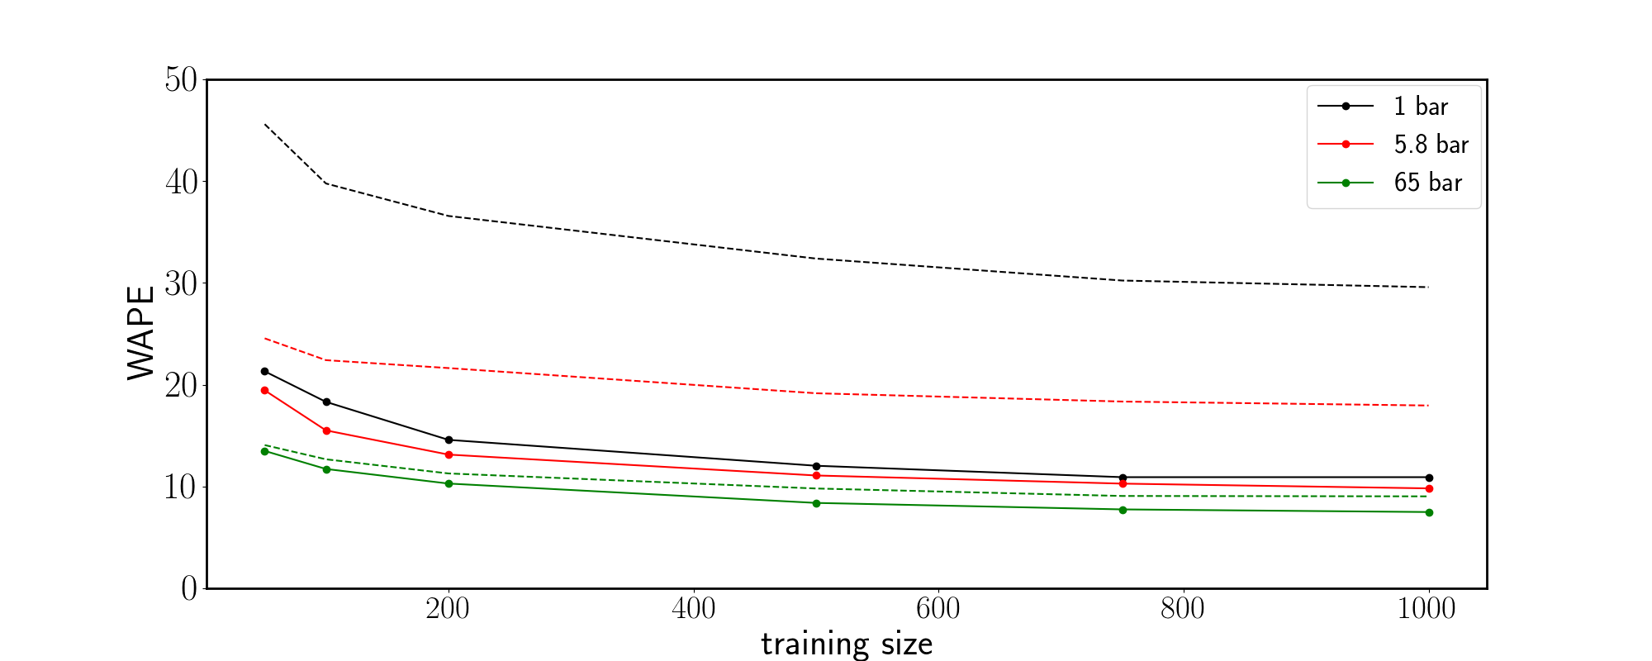
Structural properties + probes

Slide 19
Conclusions and Future Plans
We performed numerical experiments looking for the appropriate descriptors that will provide accurate predictions for the methane adsorption in MOFs.
Using only Geometrical features as descriptors in the ML method does not provide accurate results for the adsorption of methane, in particular at low pressures.
Using single atoms of various sizes for mapping the PES of the material seems to provide accurate descriptors.
In the Future
Further Analysis in more details the present results
Validation of the proposed approach using different type of nanoporous materials
Generalization of the present approach for more complicated interactions (e.g. electrostatic interactions) in order to study the adsorption of various other gases (e.g. H₂, CO₂, H₂S)

