Slide 1
Screening of electrodes with machine learning
Sondre Torp
Master of science,
Material science for Energy and Nanotechnology
UOC, 9/4/19
Supervisors:
University of Oslo
Sabrina Sartori
University of Crete;
George E. Froudakis
George Fanourgakis
Notes:
Diversification of energy sources and rapidly growing implementation of renewable options worldwide create a new challenges for technological energy storage and conversion solutions. From this perspective, materials that would secure effective implementation of future energy strategies are indispensable. This includes discovery of new compounds with enhanced properties, on one hand, and reinvestigation of new functionalities of already recognized materials, with well known characteristics on the other hand.
Electrochemical energy storage in batteries is one of the most important technological solution in the new energy paradigm. Over the past decades, nickel metal hydride, lead-acid, and Li-ion batteries have triggered a revolution in small personal electronic devices, hybrid, plug-in hybrid, and electric vehicles, and in large-scale stationary applications. However, continuous growth in energy demand and shift into “green” electricity in the global energy landscape require constant progress on the materials side, which is expected to provide prompt answers to the market needs and ensure implementation of appropriate energy storage options.
The rechargeable LIBs, with reasonable high energy density, reliability, and durability, have become the main players in the commercialized battery technology. A battery consists of two electrodes immersed in an electrolyte. The storage of electrical charge in electrodes occurs via three types of electrochemical reactions: alloying, conversion, and intercalation. The first one offers the highest specific capacity, but it is associate with a large volume change. The conversion reactions involve chemical transoframtions and are often limited by their irreversibility. Thus, the electrochemical intercalation reaction are the most common applied in LIBs. In such a cell, the anode(a negative electrode) is typically made of graphite, while the cathode(a positive electrode) is usually a transition metal oxide, with layered, spinel, or olivine crystal structure. The thermodynamically favored redux reaction allows for reversible transport of Li between electrodes, which, in this case, act as ionic intercalation hosts.
Magnesium- ion batteries and sodium-ion batteries which recently have been identified as appealing, more element abundant and less expensive alternatives to LIBs, shave very similar architectures and are subject of extensive studies expected to accelerate their commercial implementation. **
Despite the fact that significant improvements in performance of these secondary batteries have been demonstrated there are still challenges to be addressed. One of them is the identification of new characteristics, or rather, the best candidates for working electrodes.
Hydrides are an important class of compounds and over the years have inspired the development of many practical and environmentally friendly technologies. They have been proven to work in an efficient and a reliable way in many energy-related applications, of which Ni-MH batteries are the most prominent example. Although the higher requirements in energy density demand in transportation and poratable electronics lessened the commercial importance of hydrides, the continuous research in the last decade brought them back into focus by discoveries of novel, latent properties and new potential applications. Complex metal hydrides (CMHs), with the general formula M_m^\delta+[M’H_n]^\delta -, consist of a metal cation stabilized by a complex anion. In a lightweight metal hydride the later is formed by light elements such as boron or aluminum, or nitrogen, coordinated by hydrogen atoms. Over the years, these compounds have been mostly investigated due to their high hydrogen storage capacity. However, recent studies revealed their yet unexplored potential, which goes beyond their original applications. One of the essential new functionalities addresses an integration of LWCMHs in rechargeable batteries, either as solid-state electrolytes and/or elextrode materials, and by that opens novel possibilities for broad applications of these compounds in the future electrochemical energy storage technologies.
Metal hydrides.
Metal hydrides are a class of hydrogen compounds formed between hydrogen and metal, and the nature of the hydrogen-metal bonding gives metal hydrides unique properties that places them in the focus of industrial technologies and advanced research.
Metal hydrides are metals which have been bonded to hydrogen to form a new compound. Any hydrogen compound that is bonded to another metal element can effectively be called a metal hydride. Generally, the bond is covalent in nature, but some hydrides are formed from ionic bonds. The hydrogen has an oxidation number of -1. The metal absorbs the gas, which forms the hydrides.
Most common examples of metal hydrides include; aluminum, boron, lithium borohydrides and various salts.
Why better batteries?
Initial idea: Better batteries -> Batteries are complicated ☹ -> Better electrolytes - § > no database.
Better electrodes! → MATERIALSPROJECT!
Exploring the possibilities of using ML to predict different characteristics for batteries with Mg-, Na-, or Li- as the working ion.
Limitations on limitations: only looking at Mg-, as of now.
Planing to expand to Li, Ca, Zn, maybe Al with materialsproject database.
Ca- 464, Zn- 395, Al-108.
No bs: What did you do?:
Produsert en ML’s model som kan predikere forskjellige “mål” for et batteri med langt forskjellige “prediktorer”, og observert hva slags resultater en har fått fra det.

Slide 2
Outline
Why
Methodology
Random forest
Results
Conclusion

Slide 3
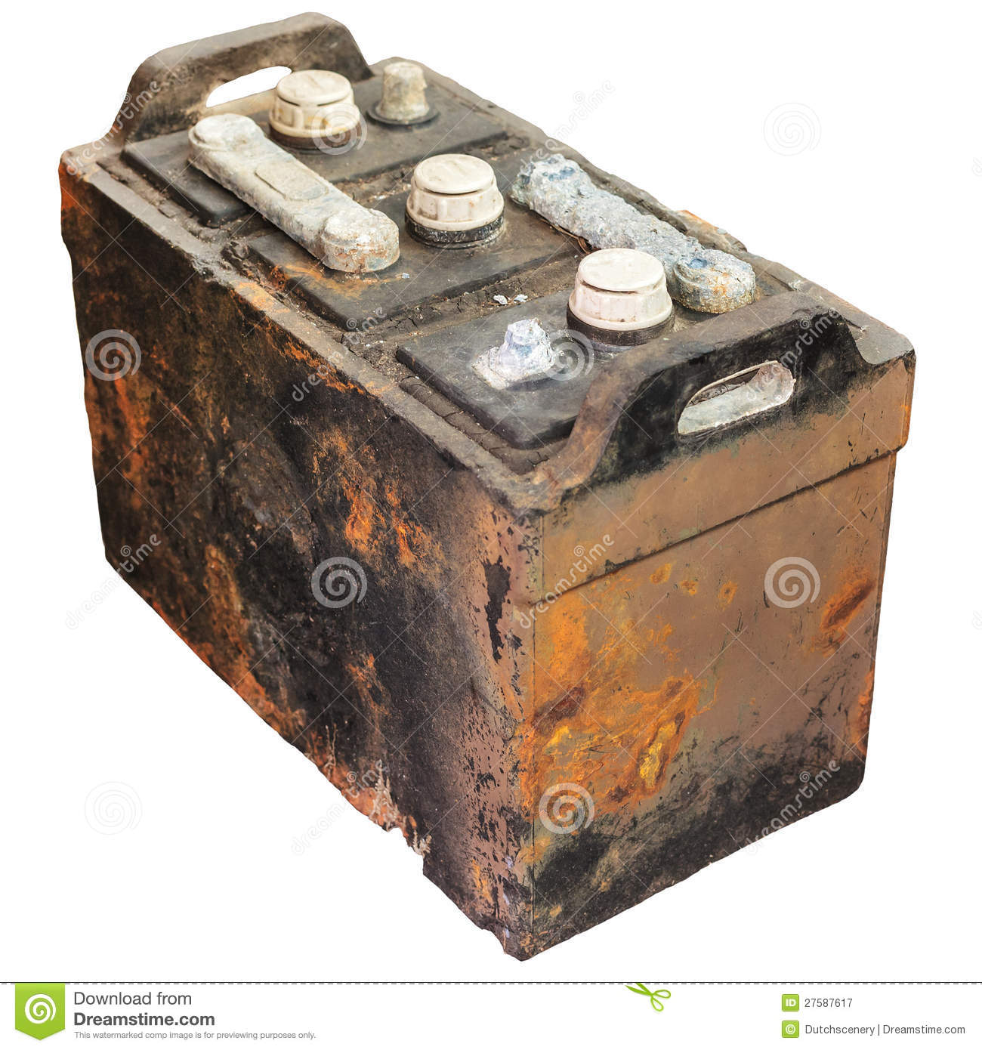
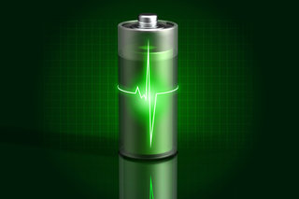

A new challenge!
Diversification
Renewable options
Materials!
Notes:
A new challenge?
Diversification of energy sources, and rapidly growing implementation of renewable options worldwide creates a new challenge for technological energy storage and conversion solutions. From this perspective, materials that would secure effective implementation of future energy strategies are indispensable. This includes discovery of new compounds with enhanced properties, on one hand, and reinvestigation of new functionalities of already recognized materials, with well known characteristics on the other hand.
Picture: Google!

Slide 4

Notes:
So for these reason, we have tried to create a computational methodology for screening of electrodes with the use of machine learning(ML) technologies. That can use information, already collected, to predict, both, the properties of old materials, as well as those of new materials.

Slide 5
Experimental method
Manually pick out batteries from Materialsproject.com
Download all materials that match a material_id correlated to a battid
Extract the CIF information
Calculations of the number density for all materials
Extract void fraction with ab initio calculations through Poreblazer, using only the CIF files
Select predictors and targets for ML
Run The Random Forrest algorithm
???
Profit!

Slide 6
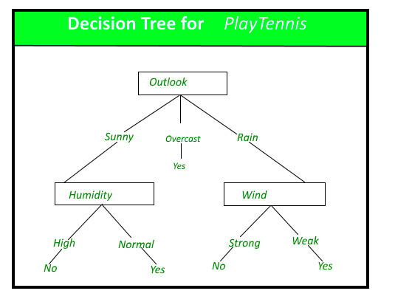
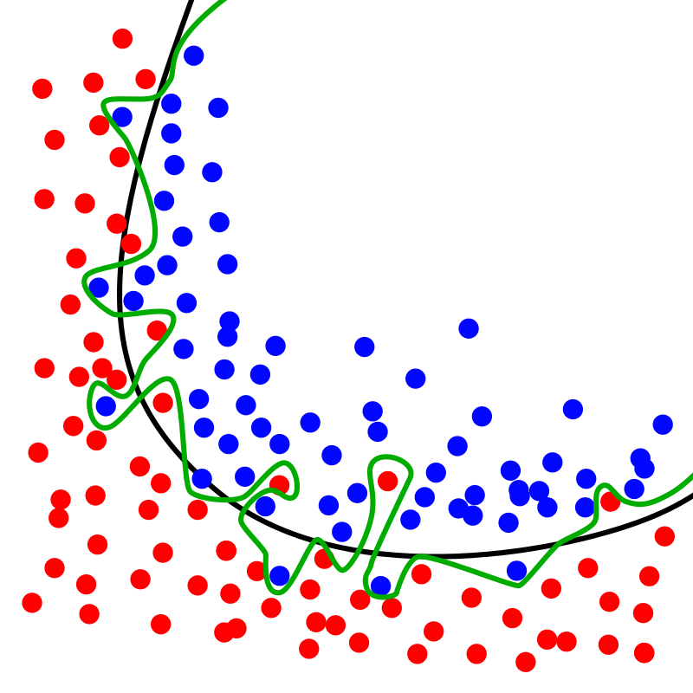
Random forest
Ensemble learning method
Decision tree
Over-fitting
Cross-validation
Notes:
Ensemble learning method uses multiple learning algorithms to obtain better predictive performance than what could be obtained by any of the constituent learning methods alone.
Method witch operates by constructing a multitude of decision trees.
Outputs the mean prediction of the individual trees. This is done because it solves decision trees habit of overfitting to their traning set.

Slide 7
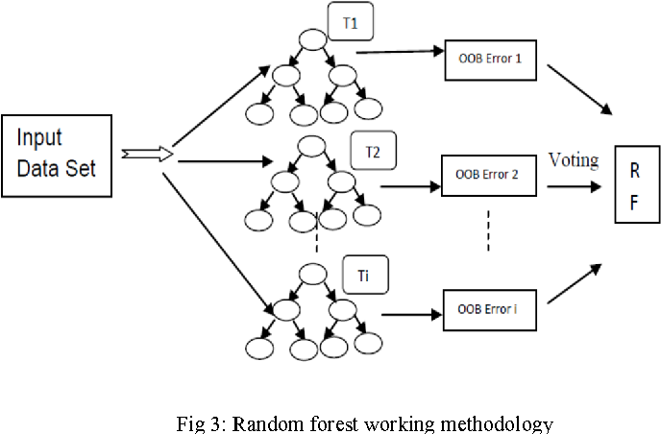


Slide 8
Predictors and Targets
Voltage pair properties / Targets:
Average Voltage
Capacity
Specific Energy Wh/kg
Energy Density Wh/l
Stability
Predictors
Targets
Number density
Void fraction
Energy per atom
Formation energy
Volume

Slide 9
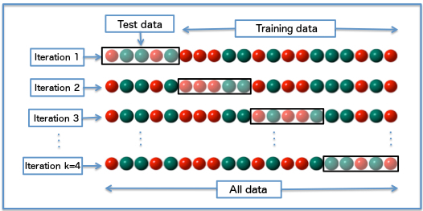
Results
Notes:
Cross-validation.
No correlation with stability.

Slide 10
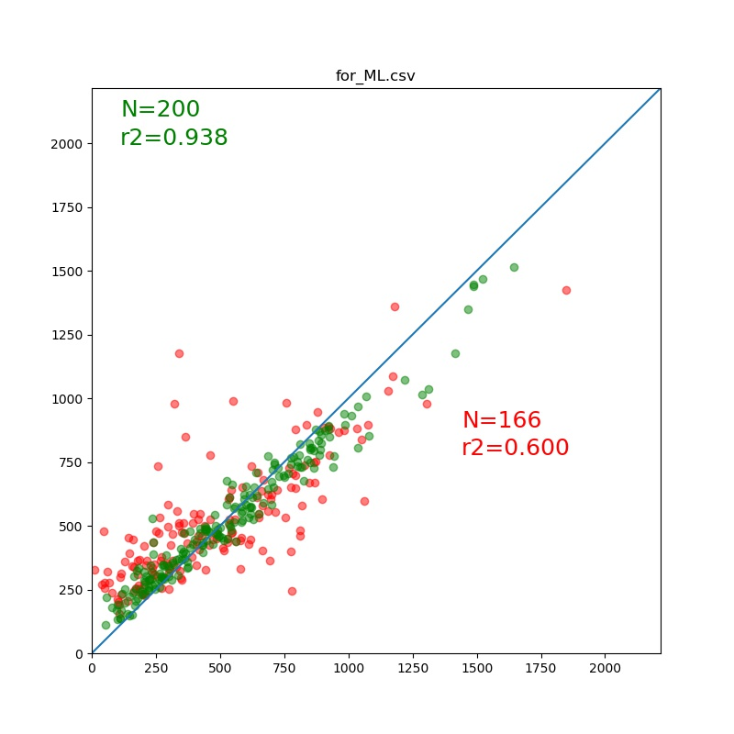
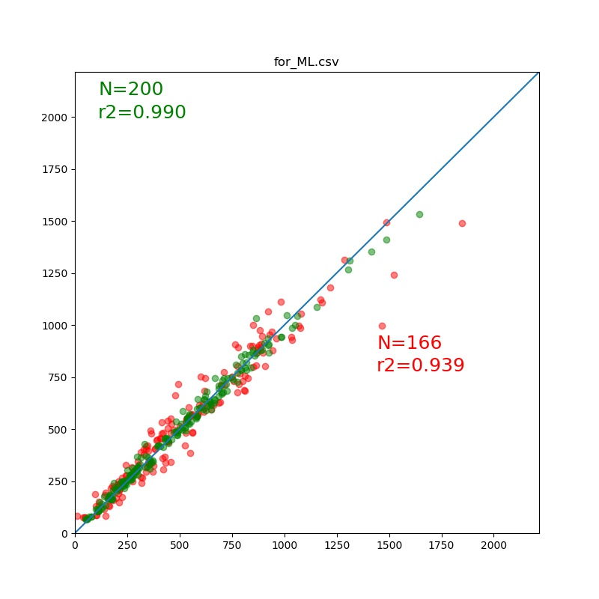
Notes:
Left: Prediction on Specific energy with only geometrical predictors.
Right: Prediction on Specific Energy with all predictors.
Would like the left one to be better. Need more data?

Slide 11
Conclusion and Future work
Conclusion
Can get accurate predictions(~90%)
Very easy to set up new experiments
Limitations:
Targets as predictors
Small Database?
Future features:
Electronegativity
Nearest neighbor
Planing to expand to Li-(~2100), and maybe; Ca-(464), Zn-(395), Al-(108), with the materialsproject database.
Notes:
Add a conclusion. We got this and that
In the future we will do this and that.

