Slide 1
Telecom Churn CASE STUDY
Presented By: Sonal Sharma

Slide 2
PROBLEM STATEMENT:
Objective: To predict customer churn in the telecom industry and develop strategies for customer retention.
Business Impact: Churn reduction helps maximize revenue by retaining high-value customers, leading to lower acquisition costs and improved customer satisfaction.

Slide 3
Workflow
Preprocess data (convert columns to appropriate formats, handle missing values, etc.)
Conduct appropriate exploratory analysis to extract useful insights (whether directly useful for business or for eventual modelling/feature engineering).
Derive new features.
Reduce the number of variables using PCA.

Slide 4
Train a variety of models, tune model hyperparameters, etc. (handle class imbalance using appropriate techniques).
Evaluate the models using appropriate evaluation metrics. Note that it is more important to identify churners than the non-churners accurately - choose an appropriate evaluation metric which reflects this business goal.
Finally, choose a model based on some evaluation metric.

Slide 5
Data Overview
The dataset includes over 100,000 customers with several features grouped into: Demographic Data: Age on network (tenure), customer type.
Service Usage: Call durations, internet data usage (2G, 3G, 4G).
Customer Behavior: Recharge patterns, service downgrades, customer complaints.
Churn Label: Binary indicator (0 = No churn, 1 = Churn).

Slide 6
Data Preprocessing
Reduce the number of variables using PCA.
Train a variety of models, tune model hyperparameters, etc. (handle class imbalance using appropriate techniques).
Evaluate the models using appropriate evaluation metrics. Note that is is more important to identify churners than the non-churners accurately - choose an appropriate evaluation metric which reflects this business goal.
Finally, choose a model based on some evaluation metric.

Slide 7
The above model will only be able to achieve one of the two goals - to predict customers who will churn. You can’t use the above model to identify the important features for churn. That’s because PCA usually creates components which are not easy to interpret.
Therefore, build another model with the main objective of identifying important predictor attributes which help the business understand indicators of churn. A good choice to identify important variables is a logistic regression model or a model from the tree family. In case of logistic regression, make sure to handle multi-collinearity.
After identifying important predictors, display them visually - you can use plots, summary tables etc. - whatever you think best conveys the importance of features.
Finally, recommend strategies to manage customer churn based on your observations

Slide 8
Key Metrics in the Data
Churn Rate: Approximately 8% of customers churned.
Call Usage Trends: Decrease in outgoing calls is common before churn.
Data Usage Patterns: Customers with low data usage show a higher likelihood of churn

Slide 9
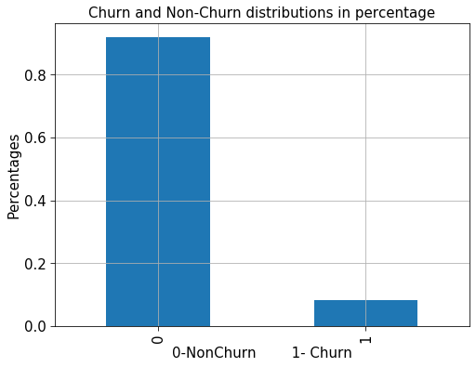
We have 92% customers belong non-churn and 8% customers belong to Churn type.

Slide 10
Data Preprocessing
Handling Missing Data:
Missing data primarily in features like internet usage and recharge amounts.
Techniques: Imputation with mean/mode for numerical variables, removal of highly sparse features.
Outlier Treatment:
Outliers in high-value users (e.g., extreme call/data usage) were capped at 95th percentile to prevent model distortion.

Slide 11
Data Exploration and Insights
Churn Distribution:
Significant imbalance in the dataset, with 8% churners and 92% non-churners.
Key Insight: Higher churn among new customers and those with declining data usage.

Slide 12
Feature Importance and Correlation Analysis
Correlation Heatmap: Shows relationships between numerical variables like:
High correlation between call drop rate and churn.
Data usage decline strongly correlates with churn likelihood.
Key Predictors:
Tenure (new customers more likely to churn).
Data Usage (low data users have higher churn rates).
Recharge Decline over the past 3 months.

Slide 13
Feature Engineering
Tenure Bucketing: Grouped customers based on their time with the company (e.g., 0–6 months, 7–12 months).
Data Decline Ratio: Created a feature indicating the percentage drop in data usage over the last 3 months
.
Recharge Patterns: Captured trends in recharge amounts (e.g., increasing or decreasing).

Slide 14
Model Building
Logistic Regression: A simple, interpretable model to identify churners.
Pros: Easy to implement, interpret coefficients, requires less computation.
Cons: Struggles with complex patterns.
Random Forest: Ensemble method used to handle non-linear relationships and interactions between features.
Pros: Captures complex behavior, robust to overfitting.
Cons: Less interpretable than logistic regression.

Slide 15
Model Evaluation Metrics
Logistic Regression:
Accuracy:0.575711
Precision: 0.091931
Recall: 0.560166
F1-Score:0.157941
Random Forest:
Accuracy: 0.924402%
Precision: 0.586271
Recall: 0.655602
F1-Score: 0.619001

Slide 16
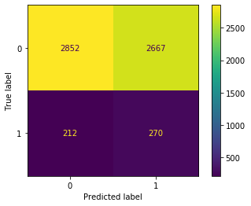
Confusion Matrix
Logistic Regression Confusion Matrix: High false negatives, indicating many churners were missed.

Slide 17
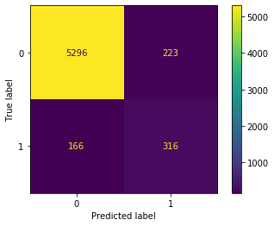
Random Forest Confusion Matrix: Better balance, with higher true positives and fewer false negatives.

Slide 18
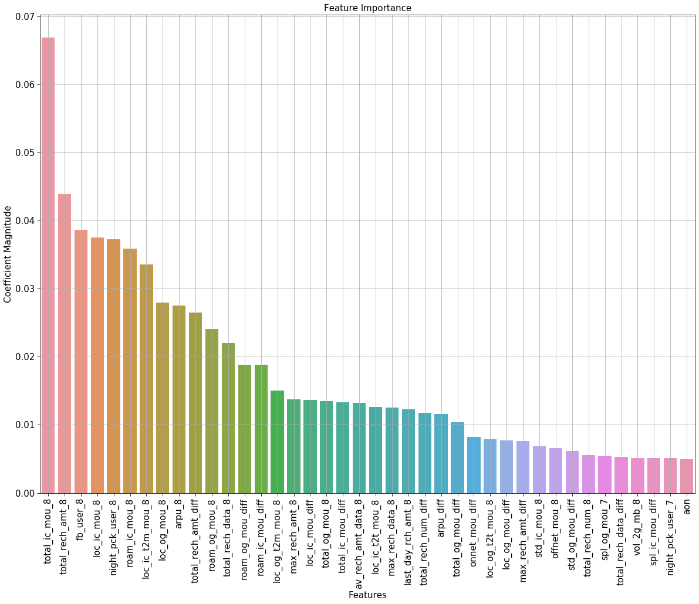

Slide 19
Conclusion:
The most important features are as shown in above graph.
Average revenue per user more, those are likely to churn if they are not happy with the network.
local calls minutes of usage has also has impact on churn .
Large difference between recharge amount between 6th and 7th month, also impact churn.
Users who are using more Roaminng in Outgoing and Incoming calls, are likely to churn.Compnay can focus on them too.

