Slide 1

Predicting Disease USING DATA SCIENCE
Songul Aslan

Slide 2

Problem Statement
How can a health insurance company predict if their customers will have Essential (Primary) Hypertension disease (I10) and/or Peripheral vascular disease (I739) in the coming year (2020) with a minimum accuracy rate of 85% based on the 2018-2019 ICD patient history?

Slide 3



ANALYZE THE POTENTIAL COSTS
Determine
determine the average cost of each new customer (patient)
Examine
examine existing health conditions to determine potential risks and/or new conditions
RAF
use HCC coding, along with demographic factors, to assign patients a risk adjustment factor (RAF) score

Slide 4
Datasets
Admissions Data
Disease Data
Labs Data
Patients Data
Prescription Data

Slide 5

DATA WRANGLING
Fix the abnormalities
Impute the missing values
Drop the records/columns that are irrelevant for the analysis

Slide 6
SUBSET ALL DATASETS
Subset
In order to avoid potential issues, we subset all the dataframes.
'I10' & 'I739'
Filter the disease dataset with respect to the patients who have illnesses 'I10' and/or 'I739’
Pick
Pick 2000 records at random.
Member IDs
Filter all other dataframes based on the member ids that appear in these 2000 records.

Slide 7

ONE RECORD PER MEMBER ID
Consider
Create
Results
Each resulting dataframe has one record per member ID. Original info is maintained.
Consider the feature(s) as appropriate for the category without any type of aggregation.
Create columns as necessary to reflect the features.

Slide 8
Prescriptions Data (for example)
We consider each medicine prescribed without any type of aggregation.
We create one column for each medicine called ndc#_number, where number is the ndc number of the medicine.
Two columns called ndc#_number_refill and ndc#_number_rate are created.
We have 21824 columns in total in the resulting dataframe.

Slide 9
Exploratory Data Analysis (EDA)
Discover patterns
Point out abnormalities
Test hypotheses
Use summary statistics and visual representations.

Slide 10
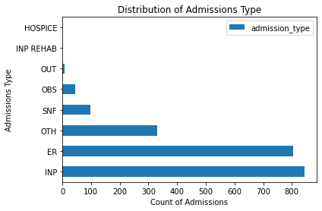
Data By Admission Type

Slide 11
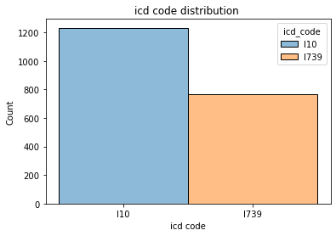
Proportional Comparison of the Diseases

Slide 12
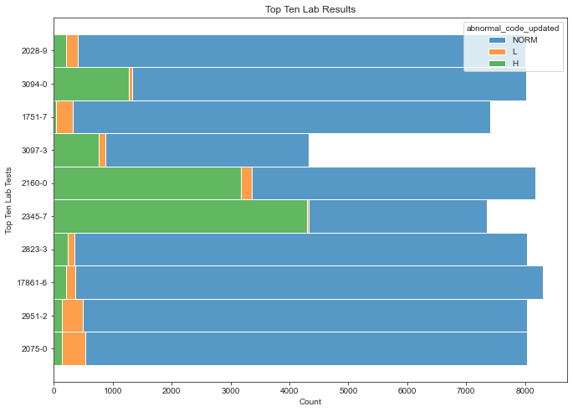
Top 10 lab results

Slide 13
most useful features
Created from days_to_prev_admission
Duration of the hospital visits
Drug quantity rates
Total number of hospital visits
Total number of lab tests administered
Total number of medicines prescribed
Type(s) of lab tests administered
Types(s) of medicines prescribed
Chronic verses acute

Slide 14
Random forest classification
 | Disease | Precision | Recall | f1 Score | Accuracy Score
Random Forest Tuned Model | I10 | 0.99 | 0.97 | 0.98 | 0.98
 | I739 | 1.00 | 1.00 | 1.00
Try cross-validation: define a pipeline to assess performance.
Best result is obtained when the number of trees (n_estimators) is approximately 30.
Average of the scores in grid search is 98%.

Slide 15
model – 50 features
Average of the accuracy scores is about 98%.
About 1% higher than the previous model's score.
Standard deviation of the scores is approximately 0.3% → less than the counterpart of the previous model.
Patients with 'I10' were classified correctly at a rate of 98%.
Patients with 'I739' were classified correctly at a rate of approximately 100%.

Slide 16
What is good about the model?
Accuracy score is very high.
Does well with respect to other metrics such as precision, recall and f1 score.
Original data is mostly preserved.
Uses a modest quantity of 50 features, which is helpful for computational effectiveness.

Slide 17
What is Bad about the Model?
Only considers 2 diseases.
Some medicines are given only to the patients with one of the two diseases.
Don’t want a model that relies on only a few attributes.
Having 2000 patients may not be representative of the population.

Slide 18

Future Projects
Increase
Increase the number of records gradually.
Classify
Classify patients with respect to more diseases.
Expand
Include all 26,559 patients in accordance with all 12,959 diseases.

