Slide 1



CLASSIFYING ASL IMAGES USING CNN
SONGUL ASLAN

Slide 2





DATA ARCHITECTURE
DATA WRANGLING AND EDA
PRE-PROCESSING
MODELING

Slide 3
problem statement
How can XConnect.ai classify American Sign Language (ASL) images with a minimum accuracy rate of 90% using a drop-in replacement for MNIST dataset recognition task?
DATA SOURCES
Kaggle: “Sign Language MNIST - Drop-In Replacement for MNIST for Hand Gesture Recognition Task”
contains 28x28 images of all the alphabet, except J and Z, of the standard ASL
27,455 samples

Slide 4
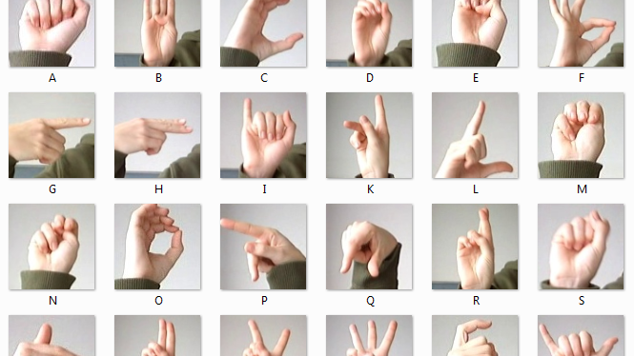
context
build a visual recognition algorithm
help the deaf and hard-of-hearing better communicate using computer vision applications.
implement computer vision in an inexpensive board computer
enable improved and automated translation of applications

Slide 5
Solution space
CONSTRAINTS
SCOPE
drop-in replacement for MNIST dataset for hand gesture recognition tasks
inspired by the Fashion-MNIST 2 and the machine learning pipeline for gestures by Sreehari 4
small images
28x28 gray level image
same hand direction and illumination
→ may not be generalizable and practical for applications

Slide 6
DATA WRANGLING AND EDA
Check
check whether classes are balanced
Convert
convert labels into categorical data type
Reshape
reshape the images
Use
use image augmentation technique to avoid overfitting problem

Slide 7

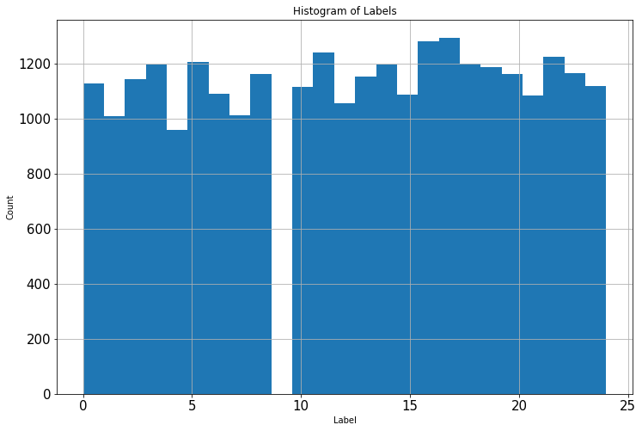
Classes are Balanced

Slide 8
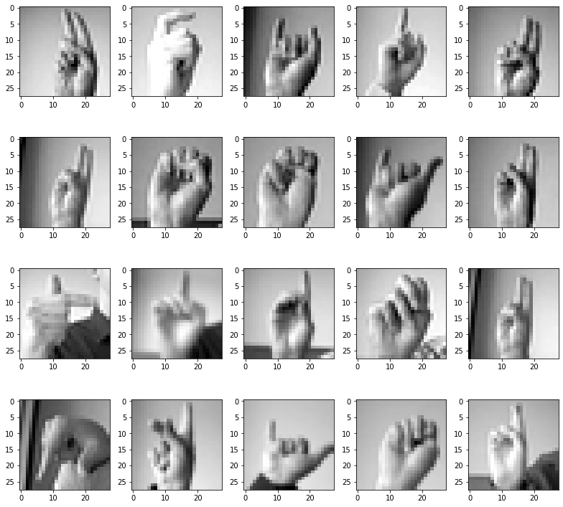
20 random images

Slide 9
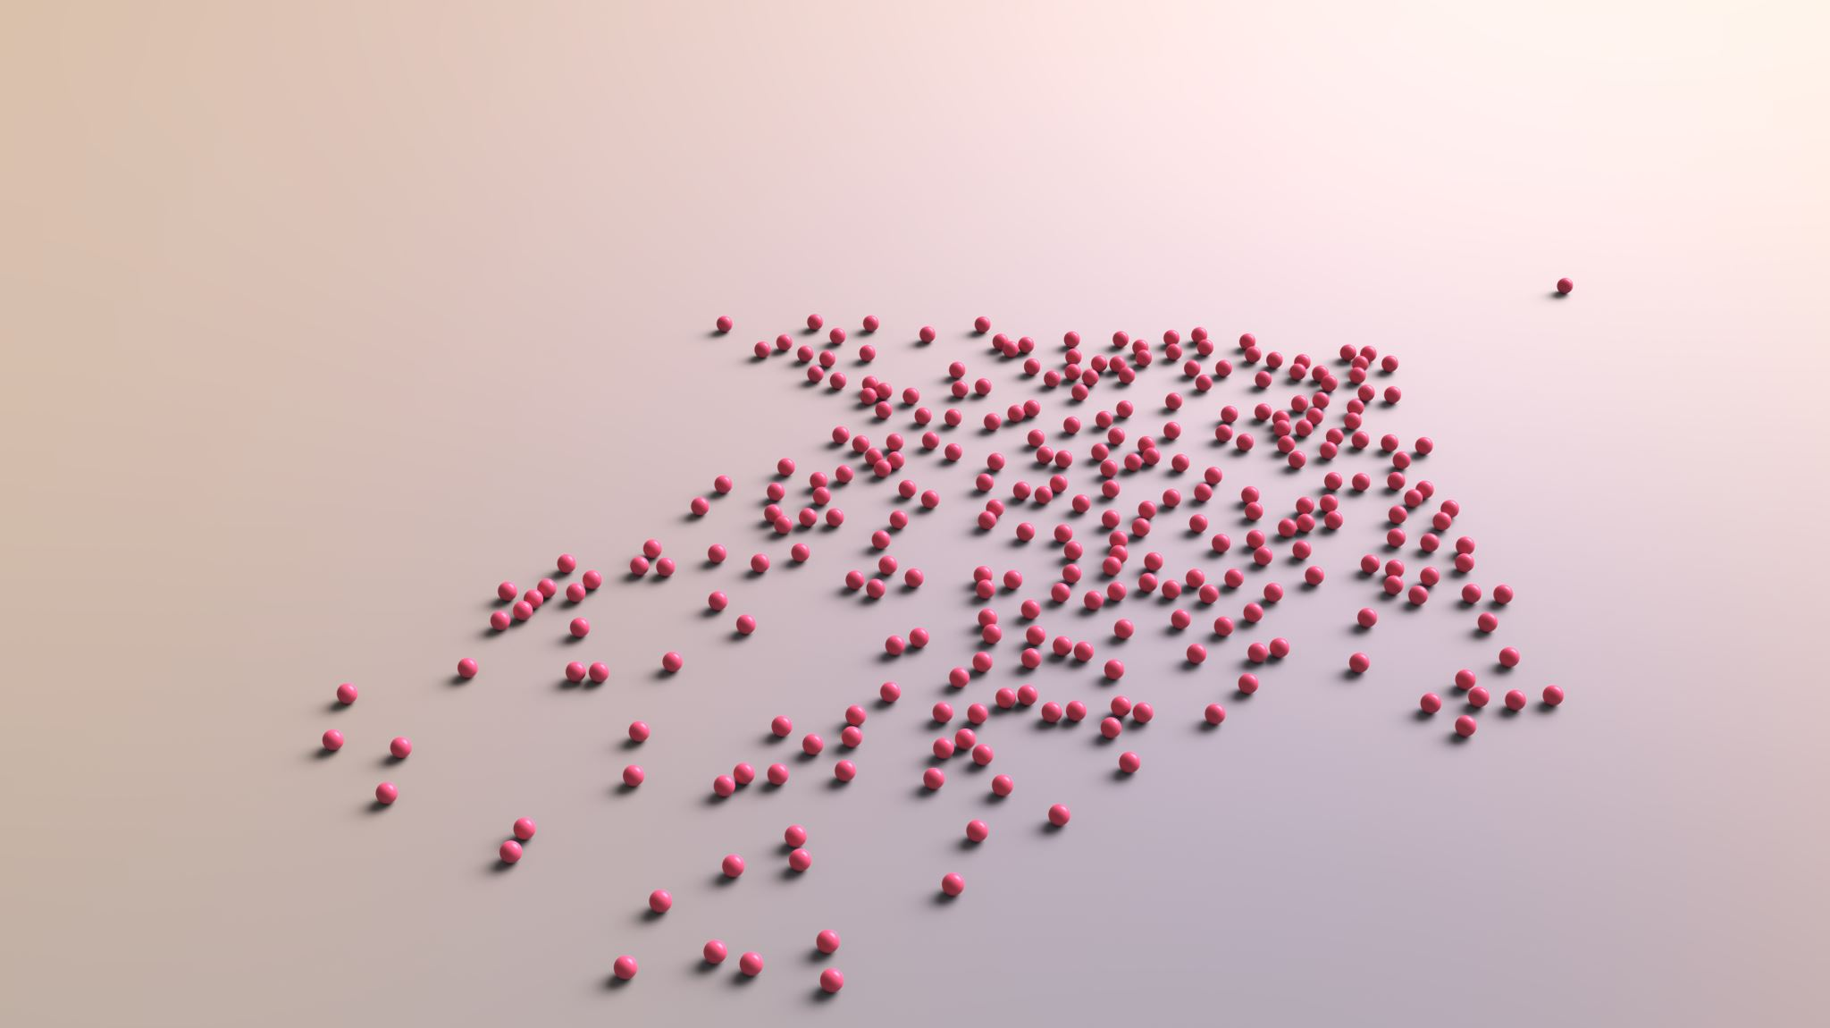
DATA AUGMENTATION
randomly rotate a subset of training images by 10 degrees
randomly zoom by 10% some of the training images
randomly shift images horizontally by 10% of the width
randomly shift images vertically by 10% of the height

Slide 10
PREPROCESSING AND MODELING
data pre-processing
build models with different optimizers
compare the performance
pick the best model

Slide 11
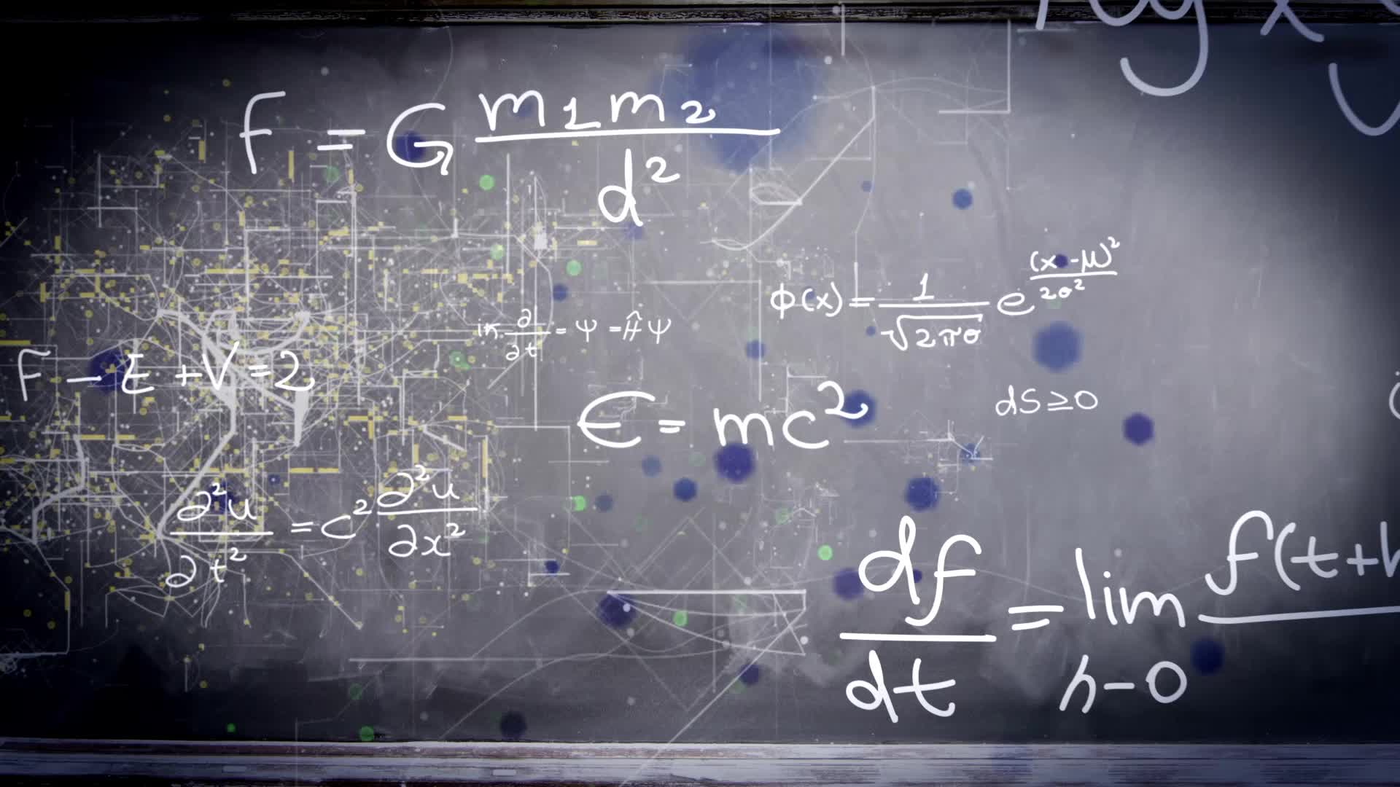
BUILD THE BASE MODEL
Conv2D layers with activation function "relu"
in the first and the last conv2D layer we set strides=1 and padding="same”
batch normalization
max pooling with 2×2 pixels applied with a stride of 2 pixels
dropout, a regularization technique
flatten layer
dense layers

Slide 12
DEFINE A CALLBACK OBJECT
performs actions at various stages of training in order to monitor a quantity
if no improvement is seen for a 'patience' number of epochs, the learning rate is reduced

Slide 13
MODEL WITH ADAM OPTIMIZER
batch_size=128
epochs=10
objective=val_accuracy
max_trials=5

Slide 14
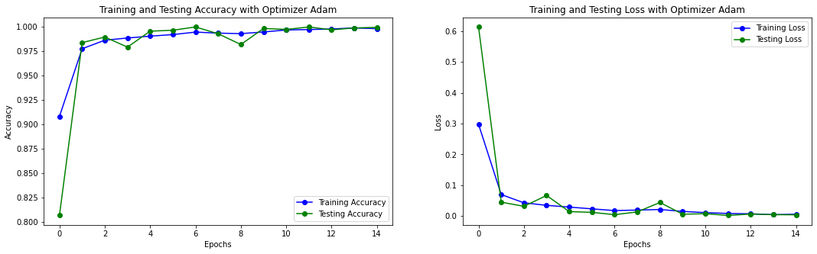
Adam Learning Curves

Slide 15
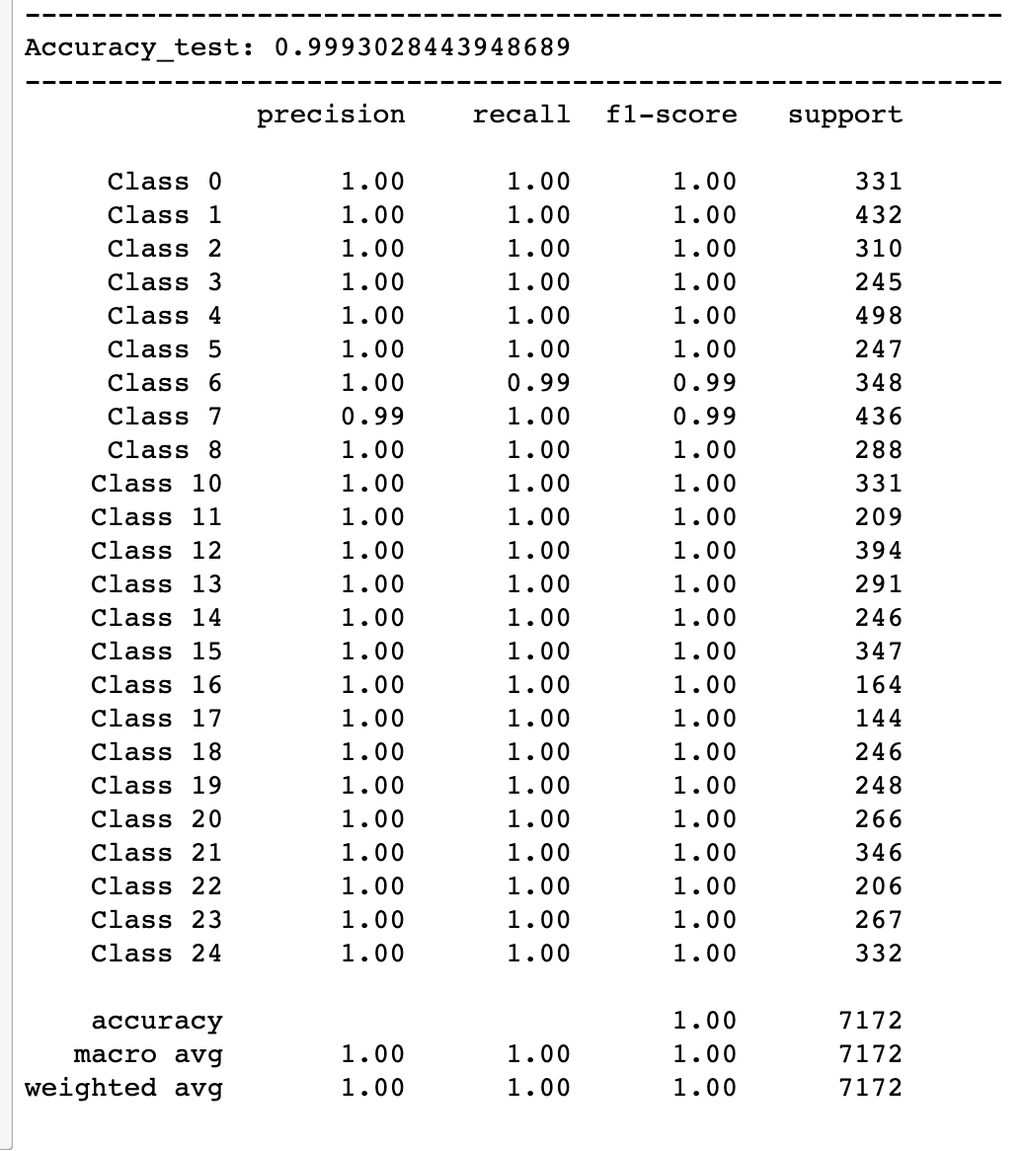
Adam Confusion Matrix

Slide 16
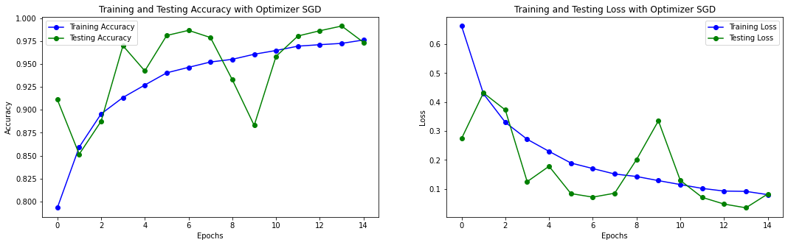
SGD Learning Curves

Slide 17
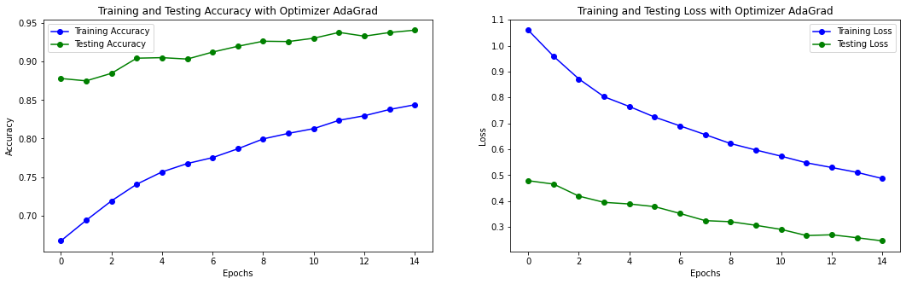
AdaGrad Learning Curves

Slide 18
final model selection
Adam optimizer
approximately 99% accuracy score, which is the best
highest score for precision, recall, and f1 across all classes
SGD optimizer
approximately 97% accuracy score
AdaGrad optimizer
approximately 94% accuracy score
lowest score among the 3 models
second-best score

Slide 19
CRITIQUES OF THE MODEL
The Good
The Bad
accuracy score is very high in general for classification models.
metrics such as precision, recall, and f1 score do well
small images
28x28 gray level image
same hand direction and illumination
→ may not be generalizable and practical for other applications

Slide 20
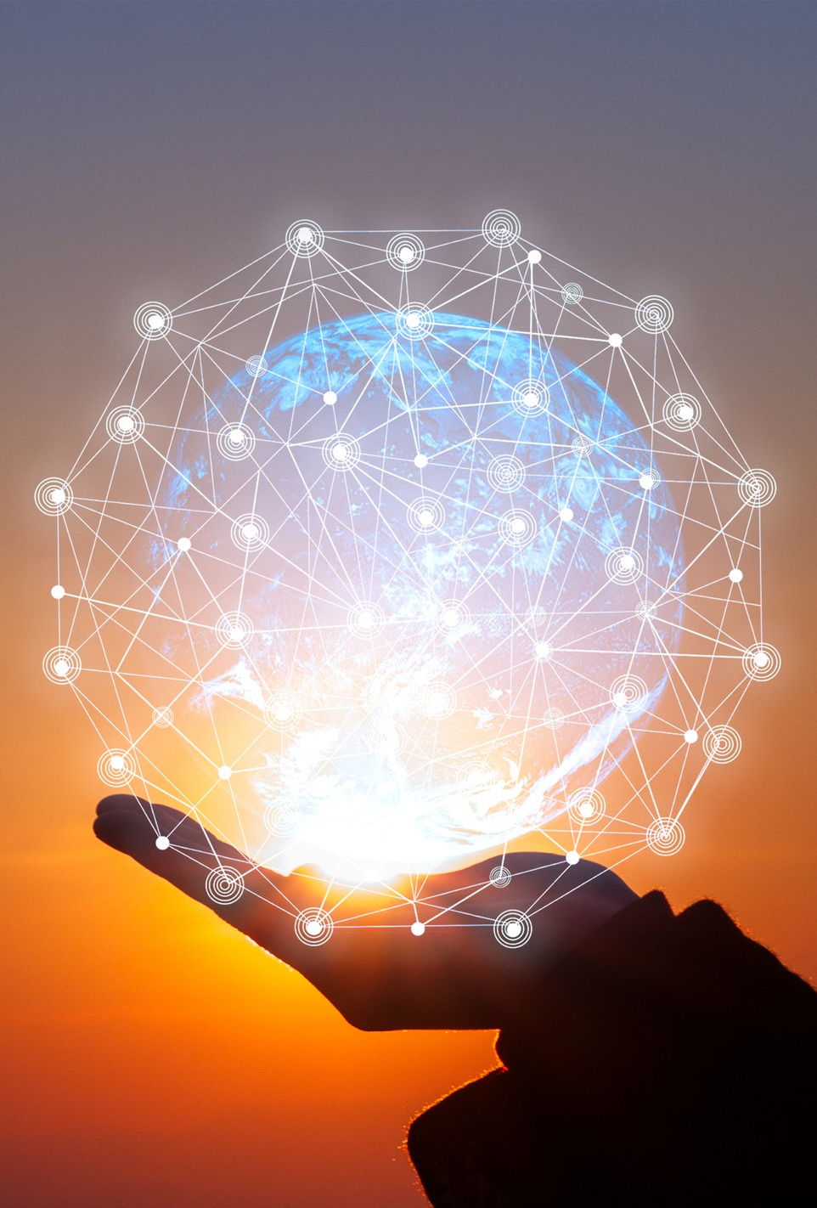
FUTURE PROJECTS
Increase
- systematically increase the number of images gradually
Compare
- compare the performance of the model with our project at each case
- allow us to see how much our model depends on the number of images and whether the model is viable on a larger scale
Consider
- consider other sign languages as well
- allow us to see whether our model is generalizable

