Slide 1
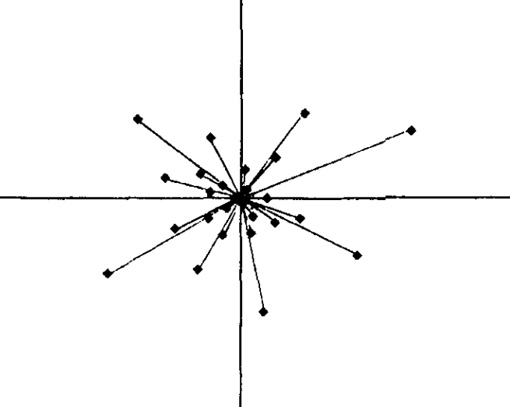
Category boundary
(new dimension)
Navigable
Color
Location
Materials
Layout
Season
…
Natural vs.
man-made
Temperature
Open
Indoor vs.
outdoor
Texture
Weather
Cluttered

