Slide 1
Language-Independent Class Instance Extraction Using the Web
Richard C. Wang
Thesis Committee:
William W. Cohen (Chair)
Robert E. Frederking
Tom M. Mitchell
Fernando Pereira (Google Research)

Slide 2
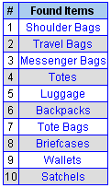

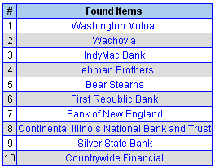
Challenge
Introduction to Class Instance Extraction
Discover class instances of any semantic class with minimum input from users
  x is an instance of class y if x is a (kind of) y
Class
“Bags”
“Hair Styles”
“Failed Banks”
Instances
These are real inputs and outputs from a system called ASIA described in this thesis
<number> / 69

Slide 3
Applications
Introduction to Class Instance Extraction
Concept and relation learning
  (Cohen, 2000)(Etzioni et al., 2005)(Cafarella et al., 2005)
Co-reference resolution
  (Mccarthy & Lehnert, 1995)
Weakly-supervised learning for NER
  (Nadeau et al., 2006)(Talukdar et al., 2008)
Query refinement in Web search
  (Pasca, 2004)
Improvements for Question Answering
  (Pantel & Ravichandran, 2004)(Wang et al., 2008)
Extensions to WordNet
  (Snow et al., 2006)(Wang & Cohen, 2009)
<number> / 69

Slide 4
Thesis Statement
Introduction to Class Instance Extraction
The World Wide Web is a vast and readily-available repository of factual information; such as semantic classes (e.g., fruits), their instances (e.g., orange, banana), and relations between them. There are many semi-structured documents on the Web that provide evidence about these facts. The thesis of this work is that many of these facts can be revealed using tools built on set expansion. More generally, we believe that statistics, aggregation, and simple analysis of the documents are enough to discover frequent common classes in not only English, but other languages as well.
<number> / 69

Slide 5
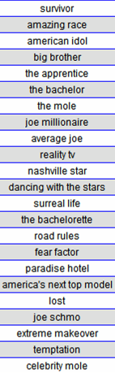

What is Set Expansion?
Introduction to Class Instance Extraction
seeds
For example,
  Given a query: { survivor, amazing race }
  Answer is: { american idol, big brother, ... }
More formally,
  Given a small number of seed instances:
    x₁, x₂, …, x_{k} where each x_{i} S
  Answer is a listing of other probable instances:
    e₁, e₂, …, e_{n} where each e_{i} S
A well-known system is Google Sets™
  http://labs.google.com/sets
<number> / 69
Notes:
Suppose there is a set expansion system, and someone inputs the words spit, boogers, and ear wax (which we’ll refer to them as seeds)
Then the system should return other disgusting words such as puke, toe jam, and sweat.
More formally, we assume there exist some target set S_t, and when given a small number of seeds where each is a member of the target set S_t,
Then the answer is a listing of other probable elements where each is also a member of that target set S_t.
A popular and famous example of a web-based set expansion system is Google Sets.

Slide 6
Outline
How to…
expand a set of instances?
expand noisy instances from QA systems?
bootstrap set expansion?
extract instances given only the class name?
improve accuracy by using two languages?
expand class-instance relations in pairs?
<number> / 69

Slide 7
How to expand a set of instances?
Our Set Expander – SEAL
Set Expander for Any Language
  (Wang & Cohen, ICDM 2007)
Features
  Independent of human & markup language
    Support seeds in English, Chinese, Japanese, Korean, ...
    Accept documents in HTML, XML, SGML, TeX, WikiML, …
  Does not require pre-annotated training data
    Utilize readily-available corpus: World Wide Web
Research contributions
  Auto-construct wrappers for extracting candidate instances
  Rank candidates using random walk
<number> / 69
<number> / 69
Notes:
We propose our set expansion system, called SEAL, which stands for Set Expander for Any Language.
As hinted by its name, SEAL is completely independent of human language.
Unlike Google Sets, which only supports English, SEAL supports English, Chinese, Japanese, Korean, and I’ve even seen Russian, Portuguese, and Spanish in the log file too, all produces decent results.
It is also completely independent of markup language, that means it can process documents written in HTML, XML, SGML, etc.
Another important feature is that it does not require any pre-annotated training data at all.
Since we already have a enormously huge and readily-available corpus on the Internet, why don’t we utilize it?
Based on this idea, we designed SEAL to learn wrappers from web documents on the fly, by using only a few input seeds.
SEAL is based on two research contributions.
The first one is that it can automatically construct wrappers to extract lists of entities from semi-structured web documents.
The second one is that it uses random graph walk to rank extracted entities such that the ones that are most probable to be in the target set are ranked higher.

Slide 8
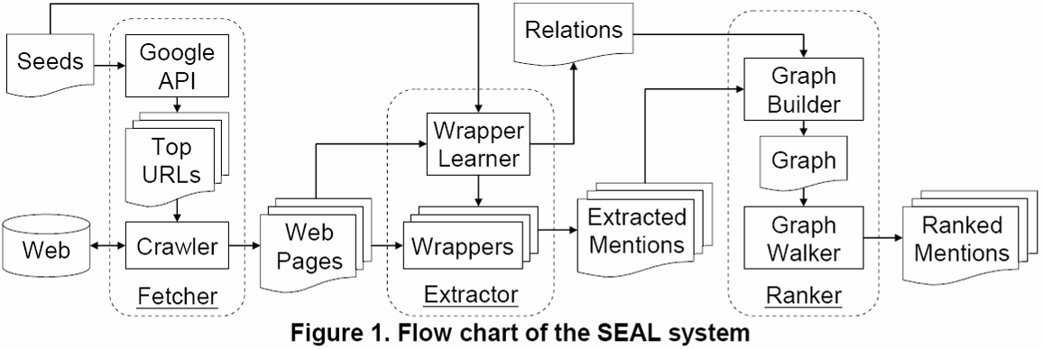
SEAL’s Pipeline
How to expand a set of instances?
Pentax
Sony
Kodak
Minolta
Panasonic
Casio
Leica
Fuji
Samsung
…
Canon
Nikon
Olympus
Fetcher: Download web pages containing all seeds
Extractor: Construct wrappers for extracting candidate items
Ranker: Rank candidate items using random walk
<number> / 69
<number> / 69
Notes:
SEAL is composed of three primary components.
<@> The first one is the Fetcher, which downloads web documents from the Internet
<@> The second one is the Extractor, which learns wrappers from those web documents.
<@> The third one is the Ranker, which ranks candidate entities extracted by those wrappers.
I will explain in detail what each component does.

Slide 9
The Fetcher
How to expand a set of instances?
Procedure:
  Compose a search query by concatenating all seeds
  Query Google to request top 100 URLs
  Fetch web pages and send to the Extractor
Seeds
Boston Seattle Carnegie-Mellon
Query
“Boston Seattle Carnegie-Mellon”
<number> / 69
Notes:
The Fetcher composes a Google search query by using all the seeds, and downloads some top N results from the Internet.
The results are then sent to the Extractor for further processing.

Slide 10
The Extractor
How to expand a set of instances?
A wrapper is a pair of L and R context string
  Maximally-long contextual strings that bracket at least one instance of every seed
  Extracts all strings between L and R
  A wrapper derived from page p is only applied to p
Learns character-level wrappers from semi-structured documents
  No tokenization required (language-independent)
<number> / 69
Notes:
The Extractor uses web document and seeds as training examples and construct wrappers on the fly.
It utilizes the semi-structure characteristics of web documents to learn wrappers.
The wrappers are defined at character level, which means no tokenization is required, so they are language independent.
However, they are very specific to the page where they were derived from, so they are page-dependent and can only be applied to that page only.

Slide 11

How to expand a set of instances?
…
…
Simple Extractor
finds maximally-long contexts that bracket
all instances of every seed
It seems to be working… but what if I add one more instance of “toyota”?
It seems to be working too… but how about a real example?
…
…
…
…
<number> / 69
Notes:
Lets try to learn some wrappers. Here is a simple demonstration that shows how our Extractor works.
Shown on the screen is a simple HTML source code with the seeds highlighted in blue-dotted line.
Those three dots are some text that are irrelevant for now.
We will start the demo with a very simple Extractor, which we will call it the Extractor E1.
<@> Extractor E1 finds maximally-long contexts that bracket all instances of every seed. Can you tell what those contexts are?
<@> Those contexts are the ones highlighted in blue, note that each seed instance has a left and a right context.
We then use this pair of left and right context to construct a wrapper.
When we apply this wrapper back to this example, we want to find other strings that goes between the wrapper’s left and right contexts.
<@> Now, we have some candidate entity mentions extracted by the wrapper, such as honda and acura.
<@> Now, what if we have one more instance of the seed toyota with a slightly different context?
<@> We can see that the maximally-long common contexts have become shorter.
<@> When we apply this new wrapper back to this example, we can still find honda and acura.
But how about a more complicated example?

Slide 12
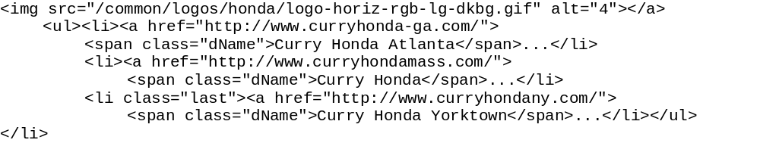
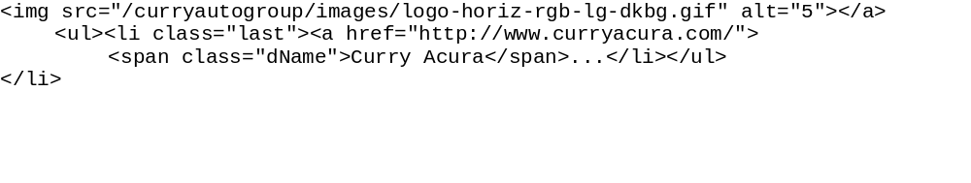
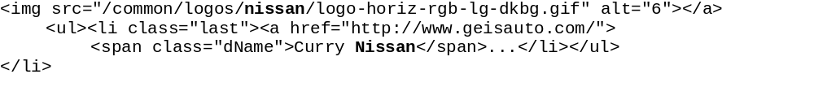
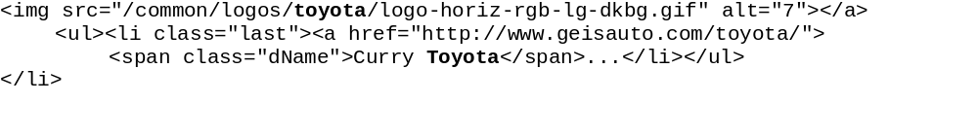
How to expand a set of instances?
I am a noisy instance
Can you find common contexts that bracket all instances of every seed?
Horray! It seems like PE works! But how do we get rid of those noisy instances?
I guess not!
Let’s try our
Proposed Extractor and see if it works…
PE finds maximally-long contexts that bracket at least one instance of every seed
Me too!
<number> / 69
Notes:
Can you find any common contexts that bracket all instances of every seed?
<@> Such common context does not exist in this example, so what should we do?
<@> We will now try our proposed extractor, which we will call it the Extractor E2.
<@> Extractor E2 finds maximally-long contexts that bracket at least one instance of every seed. What does that mean?
<@> As shown on the screen, the highlighted contexts surround at least one instance of every one of the three seeds.
<@> We construct a wrapper using these contexts and apply it back to this example to extract more candidate entity mentions; such as honda and acura.
We repeat this process until no more common contexts can be found.
<@><@><@><@> As shown on the screen, honda atlanta and honda yorktown are not what we want
<@><@> They are what we call the noisy entity mentions.
We will use the Ranker to try to push them down in the final resulting ranked list.

Slide 13
The Ranker
How to expand a set of instances?
Wrapper #2
extract
“honda”
26.1%
“chevrolet”
22.5%
contain
curryauto.com
contain
Wrapper #1
northpointcars.com
extract
Wrapper #4
Wrapper #3
“acura”
34.6%
“volvo”
8.4%
“bmw”
8.4%
Build a graph that consists of a fixed set of…
  Node Types: { document, wrapper, instance }
  Labeled Directed Edges: { contain, extract }
    Each edge asserts that a binary relation r holds
    Each edge has an inverse relation r⁻¹ (so graph is cyclic)
Perform Random Walk (RW) with restart (Tong et al., 2006)
<number> / 69
Notes:
I will go through the steps of building a graph that contains all elements of interest: seeds, document, wrapper, and mentions.
First, the seeds find some documents from the Web. <@>
Then the documents derive some wrappers; <@> they are also found by the seeds.
The wrappers then extract some entity mentions; <@> they are also derived by the documents.
<@> Lastly, the mentions are extracted by the wrappers.
In brief, a graph consists of a fixed set of node types: seeds, document, wrapper, mention, and a fixed set of labeled directed edges: find, derive, extract.
Each edge asserts that a binary relation holds, and also asserts that the inverse of that binary relation holds, with the edge directed in the opposite direction.
This also ensure that the graph is cyclic.
This framework for building graphs was previously published in Einat and William’s SIGIR 2006 paper.
The percentage on the mention nodes are the probabilities assigned due to graph walk.
As expected, noisy entity mentions volvo chicago and bmw pittsburgh are assigned the least weight.
One of many reasons is that they have fewer incoming edges.
I will explain to you how these probability weights are computed in the next slide.
Intuition
Good document derives good wrapper (and vice versa)
Good wrapper extracts good mention (and vice versa)

Slide 14
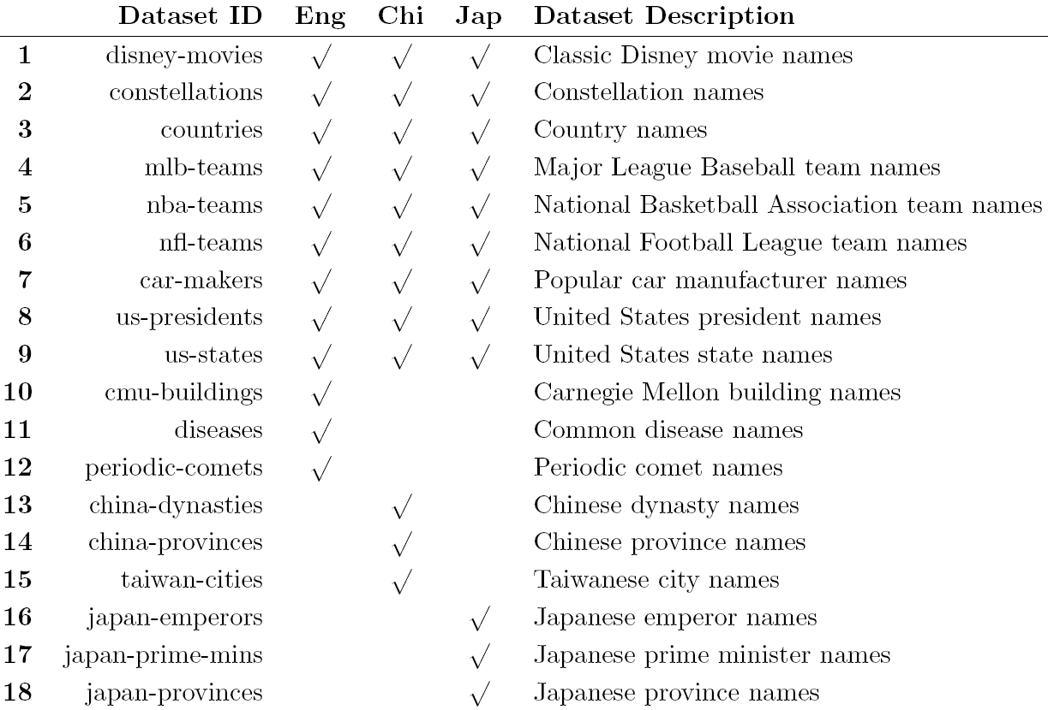
36 Evaluation Datasets
How to expand a set of instances?
<number> / 69
Notes:
Our evaluation datasets are presented here.
We constructed 36 datasets evenly over three languages: English, Chinese, and Japanese; so there are 12 datasets per language.
The datasets consists of 18 classes; such as…. Half of them were constructed in all three languages and the other half in just one language only.
The intention is to diversity the datasets such that some are culture-specific while some are not.
Note that each entity can be referred to by different mentions. For example America, United States of America, US, USA all refer to this country.

Slide 15
Initial Experiments
How to expand a set of instances?
Compare our proposed extractor (PE) to a simple extractor (SE)
  SE finds maximally-long contextual strings that bracket all seed occurrences
Compare random walk (RW) to a simple ranker based on wrapper frequency (WF)
  WF scores instance i by the number of wrappers that extract i
<number> / 69

Slide 16
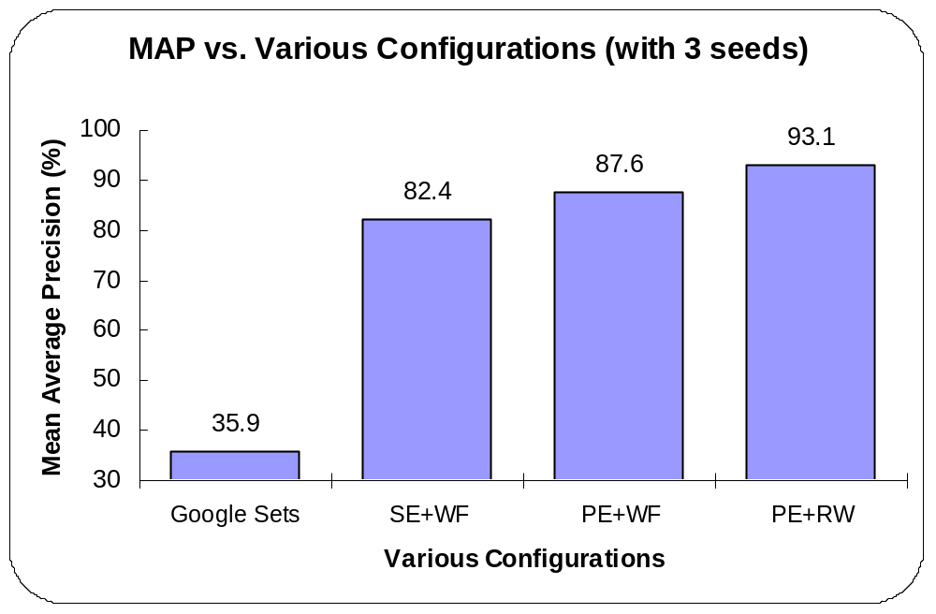
Initial Experiments (Wang & Cohen, ICDM 2007)
How to expand a set of instances?
<number> / 69
Notes:
Here are our experimental results. Just a quick reminder, Google Sets only works in English.
If we average G.Sets results over all 3 languages, then its MAP is only 15% because its MAP on Chinese and Japanese are all zeroes.
If we only consider the performance of G.Sets on English results, which is 44%, it is still far worse than our baseline performance 82% which uses Extractor E1 plus Extracted Frequency plus top 100 results.
<@>
Now, the baseline result is at the left most position.
We switch its extractor from the simple Extractor E1 to the more complicated Extractor E2, and we observed an improvement of more than 5% MAP (from 82% to 88%)
We then switch the second one’s Ranker from Extracted Frequency to Graph Walk, and we observed an improvement of more than 5% MAP again (from 88% to 93%)
<@>
Now, we want to experiment and see what would happen if we increase the Top N URLs.
As shown, when we increase the Top N URLs from 100 to 200, there is an improvement of almost 1% MAP.
But when we increase it further to 300, there is only a slight improvement of 0.15% MAP, which may suggest that it has reached a maximum.
Also, this result shows that by using only top 100 documents returned by Google, we are able to get most of the information we need.

Slide 17
Alternative Rankers
How to expand a set of instances?
Compare RW to the following four rankers:
  PR – PageRank (Page et al., 1998)
    Graph-based approach designed to rank web pages
  BS – Bayesian Sets (Ghahramani and Heller, 2005)
    Formulates set expansion as a Bayesian inference problem
  WL – Wrapper Length
    Scores instance i by the length of wrappers that extract i
  WF – Wrapper Frequency
    Scores instance i by the number of wrappers that extract i
<number> / 69
Notes:
The Ranker ranks candidate entity mentions based on how similar they are to the given seeds.
The goal is to rank noisy mentions lower and mentions similar to the seeds higher.
We compare two methods for ranking in our experimental results.
The first is a very simple ranking method based on the number of times an entity mention is extracted, we refer to it as Extracted Frequency.
The second is a slightly more complicated ranking method which ranks entity mention based on its probability of being reached in a graph due to graph walk, which I will explain in later slides.

Slide 18
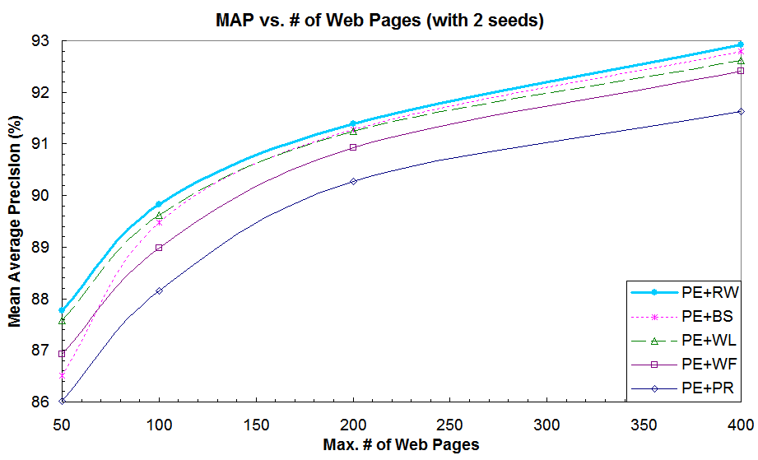
Alternative Rankers
How to expand a set of instances?
<number> / 69

Slide 19
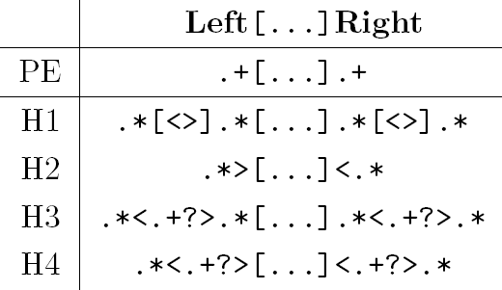
HTML Wrappers
How to expand a set of instances?
PE is the character-level wrapper for SEAL
Compare PE to 4 types of HTML wrappers
  H1 is least strict, but more strict than PE
  H4 is most strict, but less strict than any HTML wrapper
<number> / 69

Slide 20

HTML Wrappers (Wang & Cohen, EMNLP 2009)
How to expand a set of instances?
<number> / 69

Slide 21
Outline
How to…
expand a set of instances?
expand noisy instances from QA systems?
bootstrap set expansion?
extract instances given only the class name?
improve accuracy by using two languages?
expand class-instance relations in pairs?
<number> / 69

Slide 22
Task
How to expand noisy instances from QA systems?
Automatically expand (and improve) answers generated by Question Answering systems for list questions
An example of a list question:
  Name cities that have Starbucks
Better!
QA Answers | Expanded Answers
Boston Seattle Carnegie-Mellon Aquafina Google Logitech | Seattle Boston Chicago Pittsburgh Carnegie-Mellon Google
<number> / 69

Slide 23
Challenge
How to expand noisy instances from QA systems?
SEAL requires correct seeds, but answers produced by QA systems are often noisy
To integrate them together, we propose Noise-Resistant SEAL (Wang et al., EMNLP 2008)
  Three extensions to SEAL
    Aggressive Fetcher (AF)
    Lenient Extractor (LE)
    Hinted Expander (HE)
<number> / 69

Slide 24
Aggressive Fetcher
How to expand noisy instances from QA systems?
Sends a two-seed query for every possible pair of seeds to the search engines
More likely to compose queries containing only relevant seeds
Seeds
Boston Seattle Carnegie-Mellon
Queries
“Boston Seattle” “Boston Carnegie-Mellon” “Seattle Carnegie-Mellon”
<number> / 69

Slide 25
Lenient Extractor
How to expand noisy instances from QA systems?
Maximally-long contextual strings that bracket at least one instance of a minimum of two seeds
More likely to find useful contexts that bracket only relevant seeds
Text
... in Boston City Hall ... ... in Seattle City Hall ... ... at Boston University ... ... at Seattle University ... ... at Carnegie-Mellon University ...
Learned Wrapper (w/o LE)
at <blah> University
Learned Wrappers (w/ LE)
at <blah> University in <blah> City Hall
<number> / 69

Slide 26
Hinted Expander
How to expand noisy instances from QA systems?
Utilizes contexts in the question to constrain the search space of SEAL on the Web
  Extracts up to three keywords from the question
  Append the keywords to the search queries
For example,
  Question: Name cities that have Starbucks
  Query: “Boston Seattle cities Starbucks”
More likely to find documents containing desired set of answers
<number> / 69

Slide 27
Experiment #1: Ephyra
How to expand noisy instances from QA systems?
QA System: Ephyra (Schlaefer et al., TREC 2007)
Evaluate on TREC 13, 14, and 15 datasets
  55, 93, and 89 list questions respectively
Use SEAL to expand top four answers from Ephyra
  Outputs a list of answers ranked by confidence scores
For each dataset, we report:
  Mean Average Precision (MAP)
  Average F₁ with Optimal Per-Question Threshold
    For each question, cut off the list at a threshold which maximizes the F₁ score for that particular question
<number> / 69

Slide 28
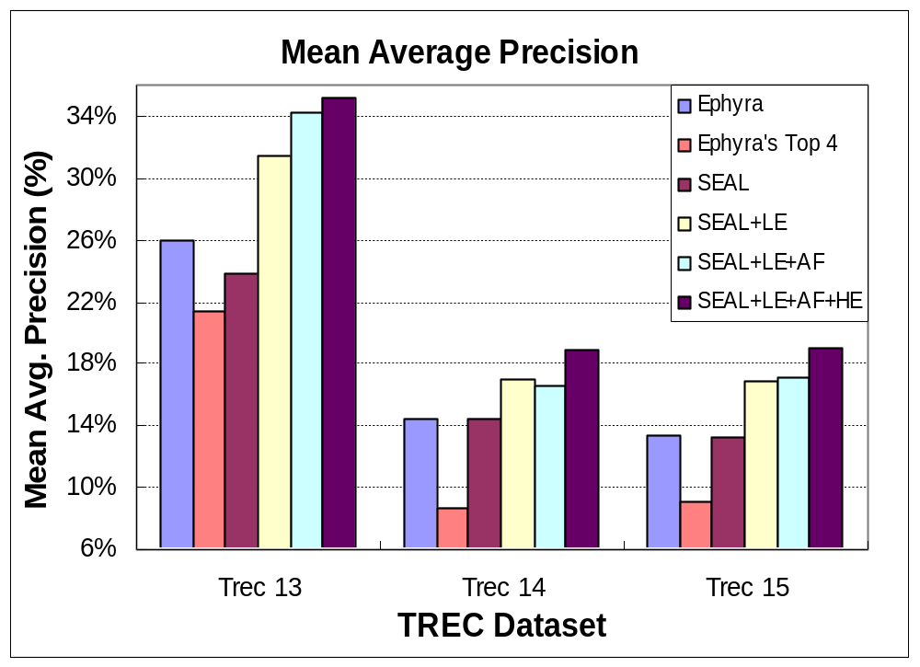
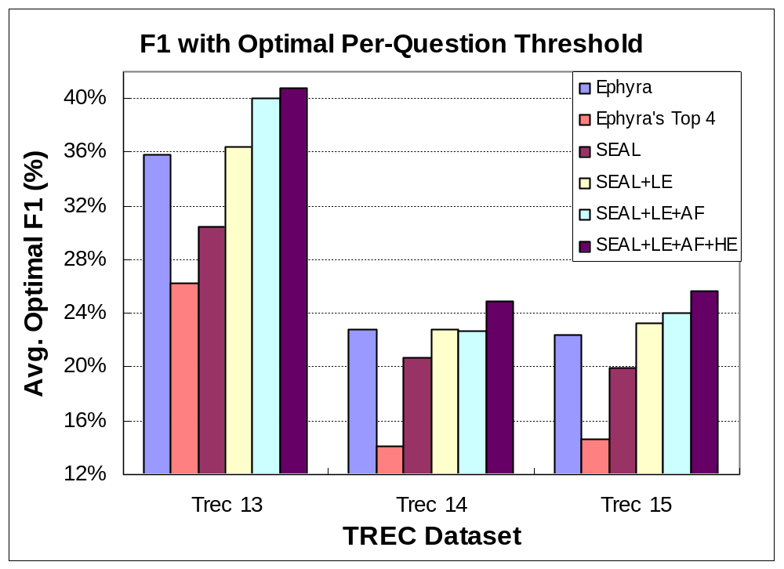
Experiment #1: Ephyra
(Wang et al., EMNLP 2008)
How to expand noisy instances from QA systems?
<number> / 69

Slide 29
Experiment #2: Ephyra
How to expand noisy instances from QA systems?
In practice, thresholds are unknown
For each dataset, do 5-fold cross validation:
  Train: Find one optimal threshold for all four folds
  Test: Use the threshold to evaluate the fifth fold
Introduce a fourth dataset: All
  Union of TREC 13, 14, and 15
Introduce another system: Hybrid
  Intersection of original answers from Ephyra and expanded answers from SEAL
<number> / 69
Notes:
Take SEAL output and remove answers not originally found by Ephyra

Slide 30
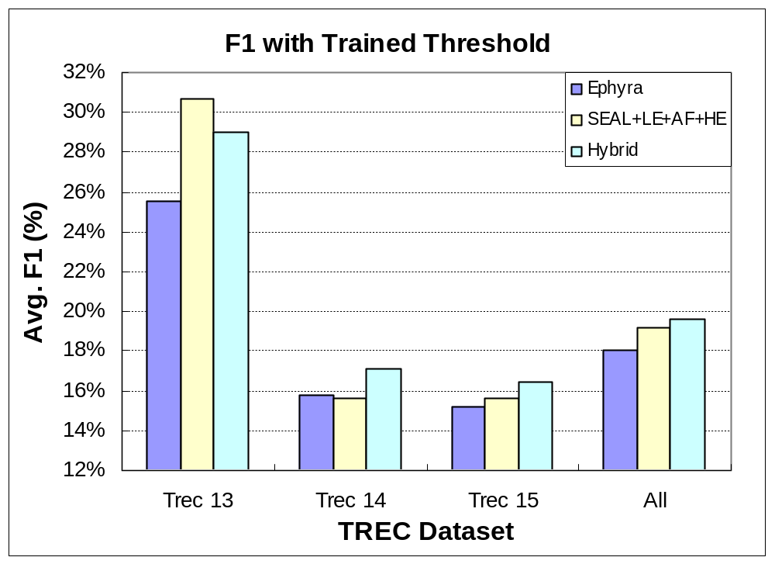
Experiment #2: Ephyra
(Wang et al., EMNLP 2008)
How to expand noisy instances from QA systems?
<number> / 69

Slide 31
Experiment: Top QA Systems
How to expand noisy instances from QA systems?
Top five QA systems that perform the best on list questions in TREC 15 evaluation
  Language Computer Corporation (lccPA06)
  The Chinese University of Hong Kong (cuhkqaepisto)
  National University of Singapore (NUSCHUAQA1)
  Fudan University (FDUQAT15A)
  National Security Agency (QACTIS06C)
For each QA system, train thresholds for SEAL and Hybrid on the union of TREC 13 and 14
  Expand top four answers from the QA systems on TREC 15, and apply the trained threshold
<number> / 69

Slide 32
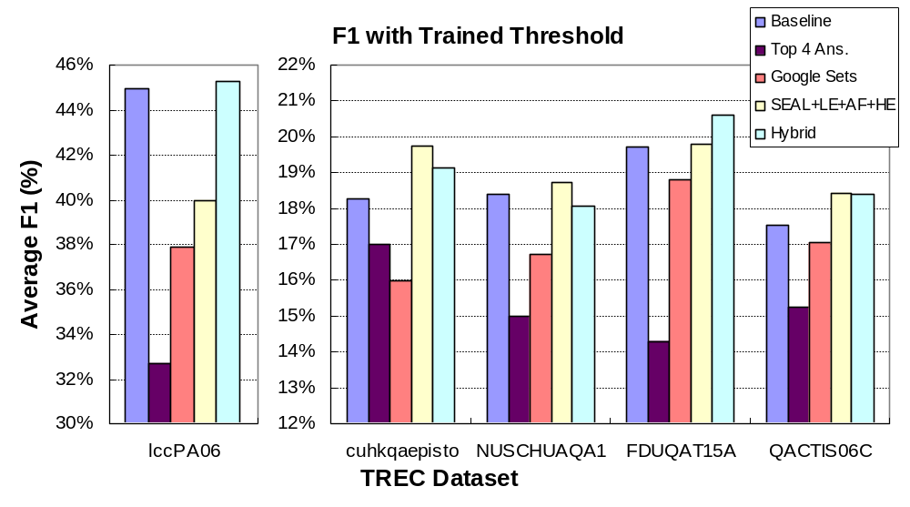
Experiment: Top QA Systems
(Wang et al., EMNLP 2008)
How to expand noisy instances from QA systems?
<number> / 69
Notes:
We didn’t extend the answer keys
We don’t have the full list of answers generated by the participants, only those submitted.

Slide 33
Outline
How to…
expand a set of instances?
expand noisy instances from QA systems?
bootstrap set expansion?
extract instances given only the class name?
improve accuracy by using two languages?
expand class-instance relations in pairs?
<number> / 69

Slide 34
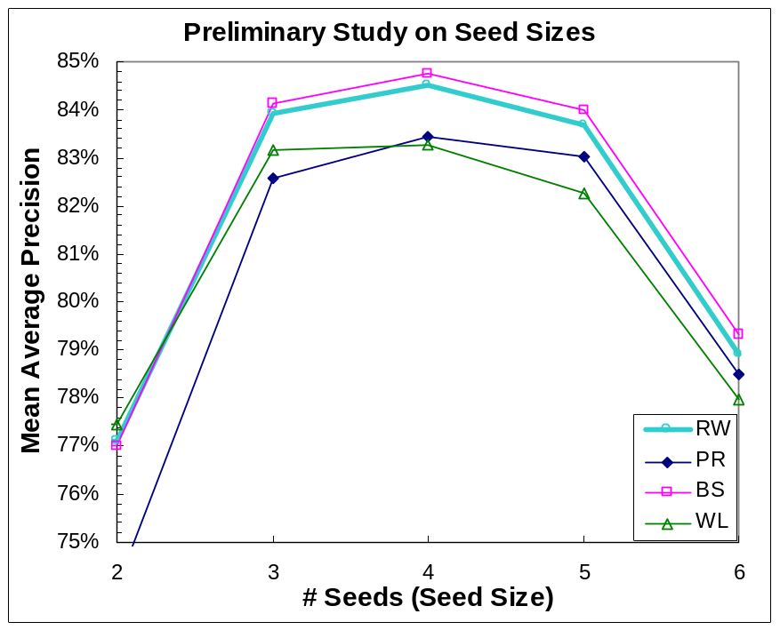
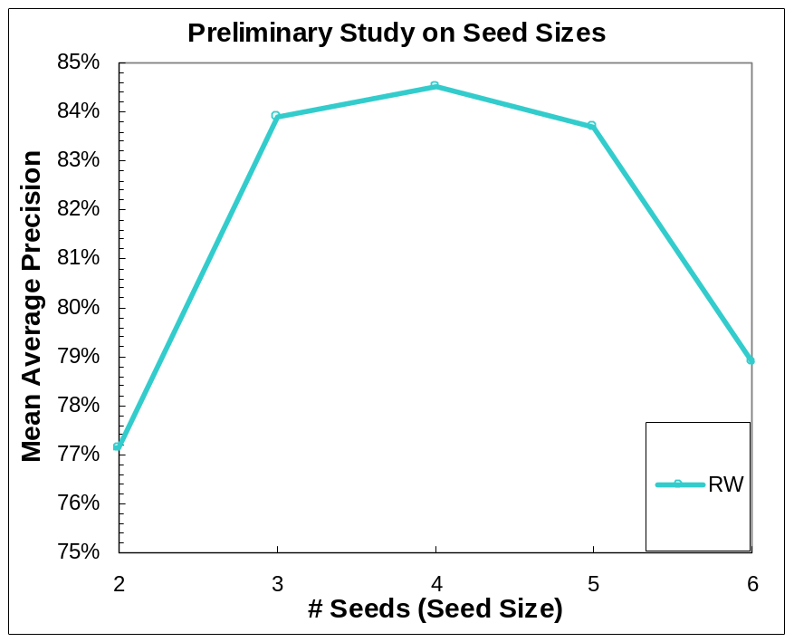
Limitation of SEAL
How to bootstrap set expansion?
Evaluated using Mean Average Precision on 36 datasets
For each dataset, we randomly pick n seeds (and repeat 3 times)
Performance drops significantly when given more than 5 seeds
  The Fetcher downloads web pages that contain all seeds
  However, not many pages have more than 5 seeds
<number> / 69

Slide 35
Proposed Solution – iSEAL
How to bootstrap set expansion?
iterative SEAL (Wang & Cohen, ICDM 2008)
  makes several calls to SEAL
  in each call (or iteration):
    Expands a few seeds
    Aggregates statistics
We evaluated iSEAL using…
  Two iterative processes
  Two seeding strategies
  Five ranking methods
<number> / 69

Slide 36
Iterative Process & Seeding Strategy
How to bootstrap set expansion?
Iterative Processes
  Supervised
    At every iteration, seeds are obtained from a reliable source (e.g. human)
  Bootstrapping
    At every iteration, seeds are selected from candidate items (except the 1st iteration)
Seeding Strategies
  Fixed Seed Size
    Uses 2 seeds at every iteration
  Increasing Seed Size
    Starts with 2 seeds, then 3 seeds for next iteration, and fixed at 4 seeds afterwards
<number> / 69

Slide 37
Fixed Seed Size (Supervised)
How to bootstrap set expansion?
Initial Seeds
<number> / 69

Slide 38
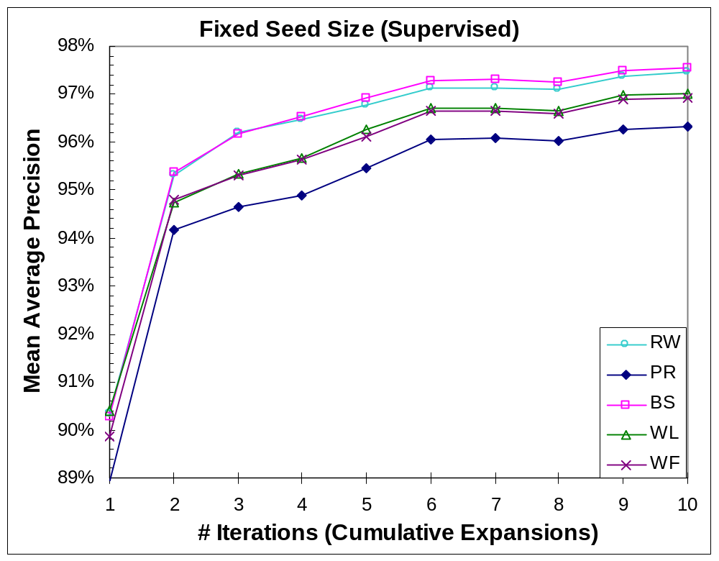
(Wang & Cohen, ICDM 2008)
How to bootstrap set expansion?
<number> / 69

Slide 39
Fixed Seed Size (Bootstrap)
How to bootstrap set expansion?
Initial Seeds
<number> / 69

Slide 40
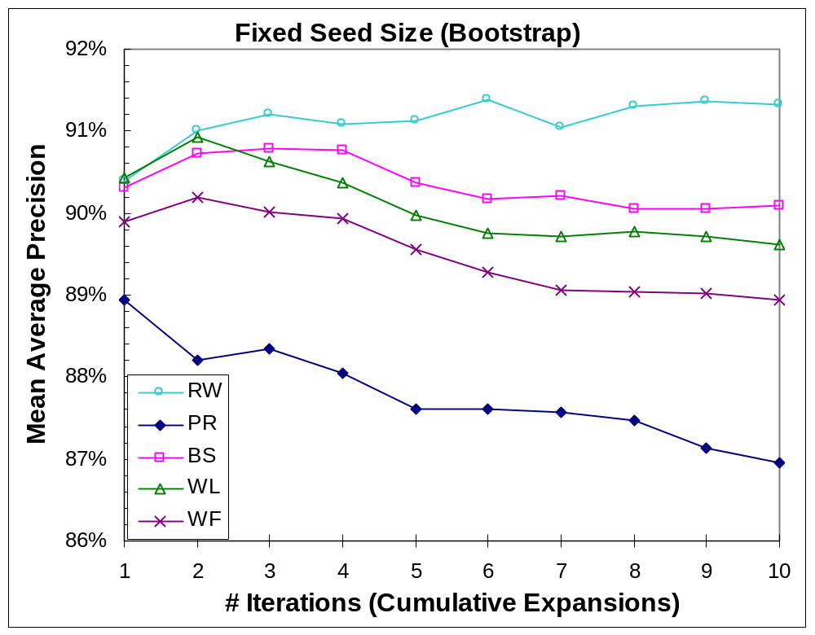
How to bootstrap set expansion?
(Wang & Cohen, ICDM 2008)
<number> / 69

Slide 41
Increasing Seed Size (Bootstrap)
How to bootstrap set expansion?
Initial Seeds
Used Seeds
<number> / 69

Slide 42
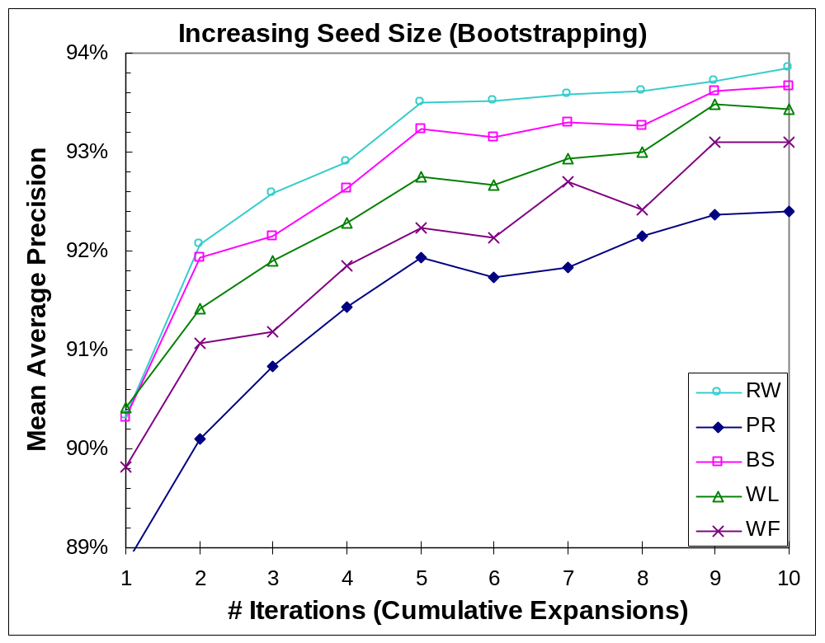
How to bootstrap set expansion?
(Wang & Cohen, ICDM 2008)
<number> / 69

Slide 43
Outline
How to…
expand a set of instances?
expand noisy instances from QA systems?
bootstrap set expansion?
extract instances given only the class name?
improve accuracy by using two languages?
expand class-instance relations in pairs?
<number> / 69

Slide 44
Proposed Approach – ASIA
How to extract instances given only the class name?
(Wang & Cohen, ACL 2009)
Automatic Set Instance Acquirer (ASIA)
Some Instances
Semantic Class Name
Noisy Instance Provider
Noisy Instance Expander
Bootstrapper
More Instances
Noisy Instances
<number> / 69

Slide 45
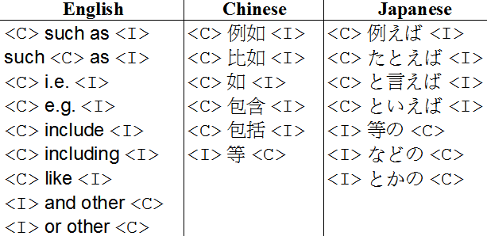
Noisy Instance Provider (NP)
How to extract instances given only the class name?
Manually constructed hyponym patterns
  based on Marti Hearst’s work in 1992
Query search engines for each hyponym pattern + a class name
  e.g. “car makers such as”
Extract all candidates I from returned web snippets
  A snippet often contains multiple excerpts
Rank each candidate i in I based on
  # of patterns, snippets, and excerpts containing i (more = better)
  # of characters between i and C in every excerpt (fewer = better)
<number> / 69

Slide 46
Noisy Instance Expander (NE)
How to extract instances given only the class name?
The Extractor in NE is a variation of that used in SEAL
Performs set expansion on web pages queried by a class name + some list words
  List words are words that often appear on list-containing pages
  Example query: “car makers” (list OR names OR famous OR common)
SEAL’s Extractor | NE’s Extractor
Requires the longest common contexts to bracket at least one instance of every seed per web page | Requires the common contexts that bracket the largest number of unique seeds to be as long as possible per web page
<number> / 69

Slide 47
Bootstrapper (BS)
How to extract instances given only the class name?
Utilizes iSEAL (Wang & Cohen, ICDM 2008)
  an iterative version of SEAL
iSEAL makes several calls to SEAL, where in each call, iSEAL…
  expands a few seeds, and
  aggregates statistics
Configured to bootstrap with increasing seed size
<number> / 69

Slide 48
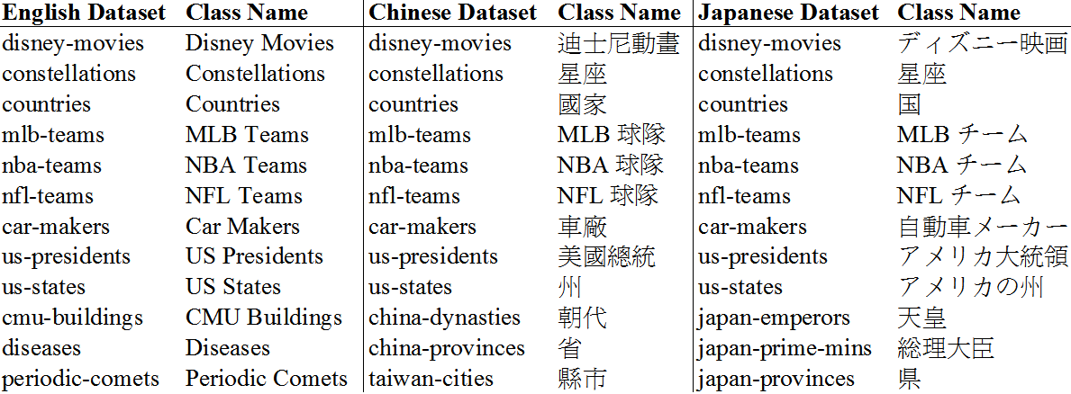
Evaluation Datasets
How to extract instances given only the class name?
36 datasets and each of their class names used as input to ASIA
<number> / 69

Slide 49
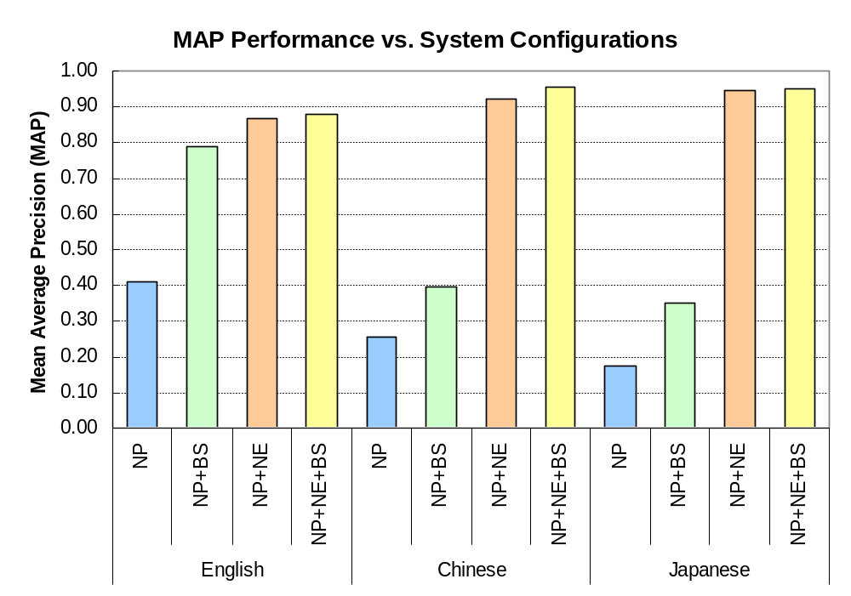
Evaluation Results (Wang & Cohen, ACL 2009)
How to extract instances given only the class name?
<number> / 69

Slide 50
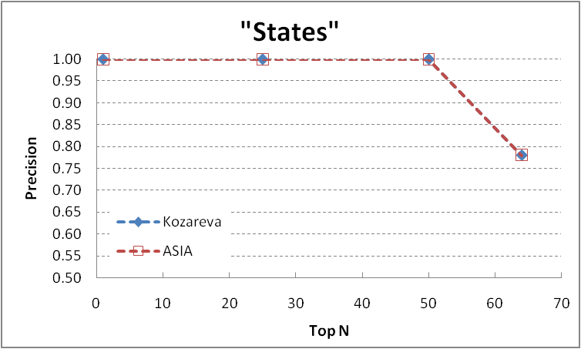
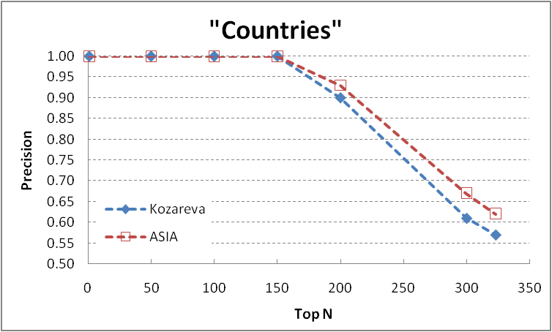
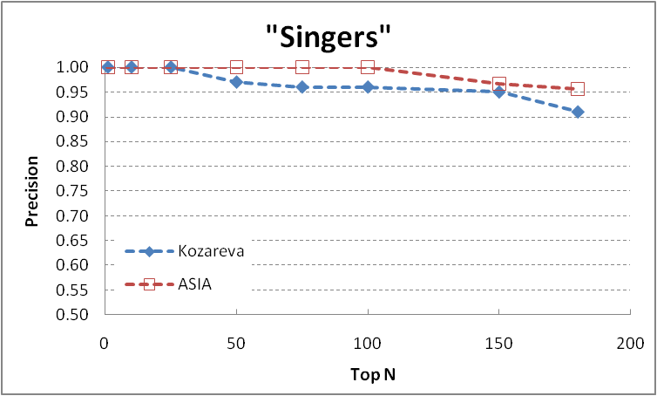
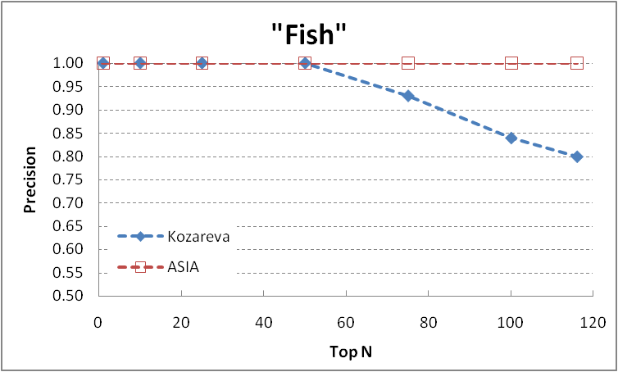
Comparison to:
Kozareva, Riloff, and Hovy, ACL 2008
How to extract instances given only the class name?
Input to Kozareva: a class name + a seed
<number> / 69

Slide 51
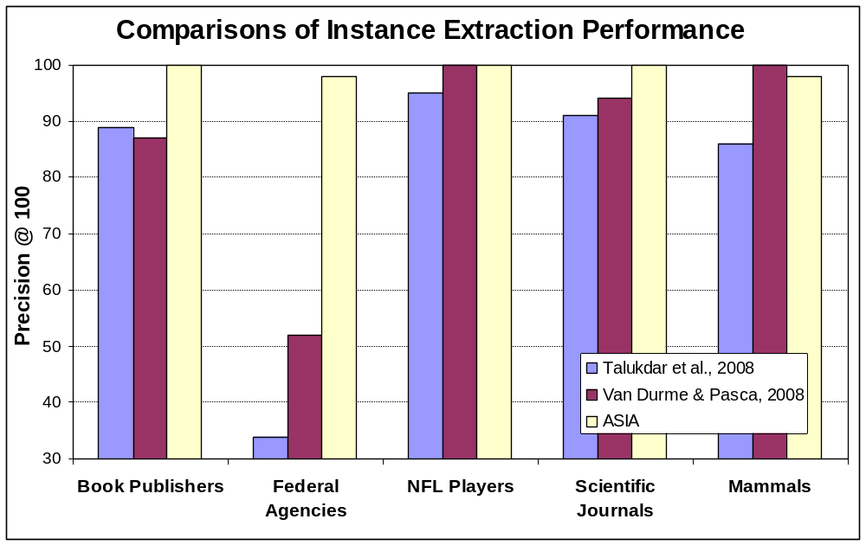
How to extract instances given only the class name?
Comparison to:
Talukdar et al., EMNLP 2008
Van Durme & Pasca, KI 2008
<number> / 69

Slide 52
Comparison to:
Snow et al., ACL 2006
How to extract instances given only the class name?
Definition:
  Original WN – WordNet 2.1
  Extended WN – Snow’s (+30K) extension of WN 2.1
Selecting semantic classes for evaluation:
  In Extended WN hierarchy, focus on leaf semantic classes extended by Snow that have ≥ 3 instances
  Filter out those classes if the instances from ASIA do not overlap with more than half of the instances in the Original WN
  Randomly select a dozen remaining classes
<number> / 69
<number> / 69

Slide 53
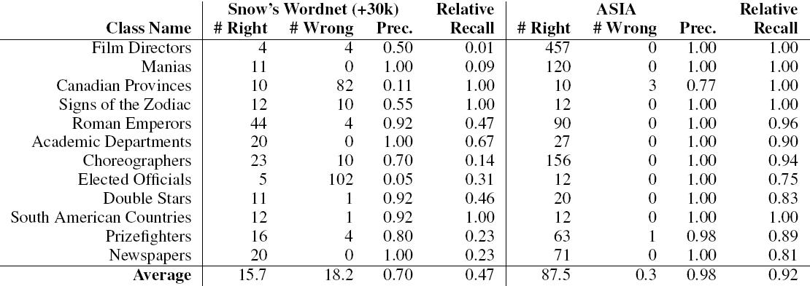
Comparison to:
Snow et al., ACL 2006
How to extract instances given only the class name?
<number> / 69

Slide 54
Outline
How to…
expand a set of instances?
expand noisy instances from QA systems?
bootstrap set expansion?
extract instances given only the class name?
improve accuracy by using two languages?
expand class-instance relations in pairs?
<number> / 69

Slide 55
Proposed Solution – Bilingual SEAL
How to improve accuracy by using two languages?
Utilizes redundant information to minimize the chance of choosing incorrect seeds when bootstrapping
Expands two sets of instances alternately by using two separate iSEAL, where both sets represent the same class but each in a different language
  e.g., Disney movies in English and Chinese
Verifies the correctness of a candidate instance by using ANET (Automatic Named Entity Translator)
<number> / 69

Slide 56
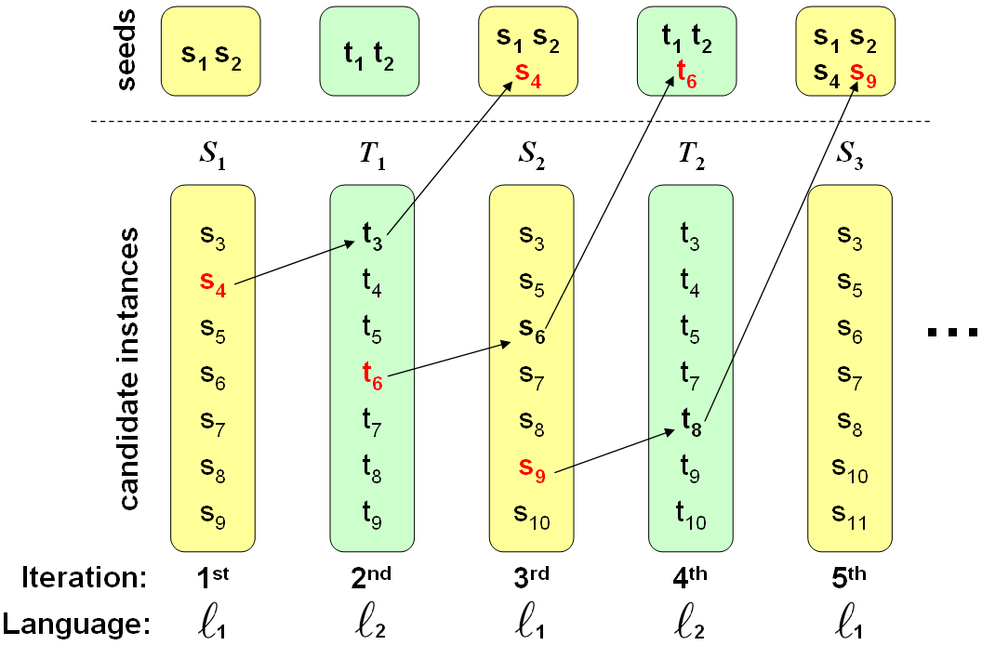
Picking a good seed
How to improve accuracy by using two languages?
We select an instance from (i-2)^{th} iteration, whose translation exist in (i-1)^{th} iteration, to be used as a seed for the i^{th} iteration
Use translations of instances to select high-quality seeds
Expansions are cumulative for each language
<number> / 69

Slide 57
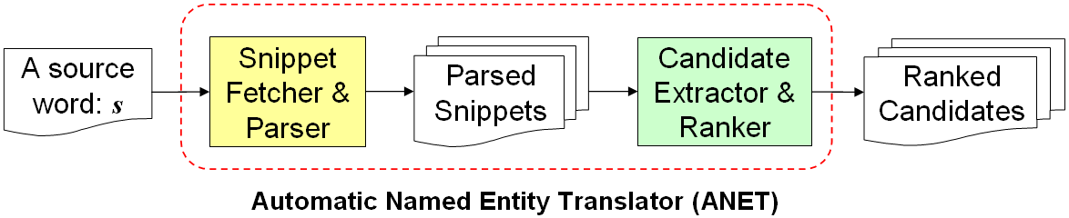
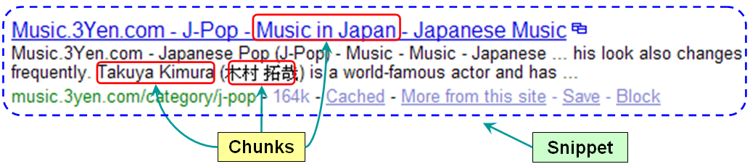

Translating instances
How to improve accuracy by using two languages?
Uses bilingual snippets as a resource
Ranks chunks in the target language based on how frequently and closely they co-occur with the input string
  A chunk is any sequence of characters surrounded by punctuations or foreign characters
Input:
<number> / 69

Slide 58
Experiments
Evaluate bilingual bootstrapping using…
  Chinese & English
  Japanese & English
Present MAP performance of: (e.g., Chinese & English)
  CBB – Chinese results of the bilingual bootstrapping
  EBB – English results of the bilingual bootstrapping
  CMB – (Monolingual) bootstrapping in only Chinese
  EMB – (Monolingual) bootstrapping in only English
<number> / 69

Slide 59
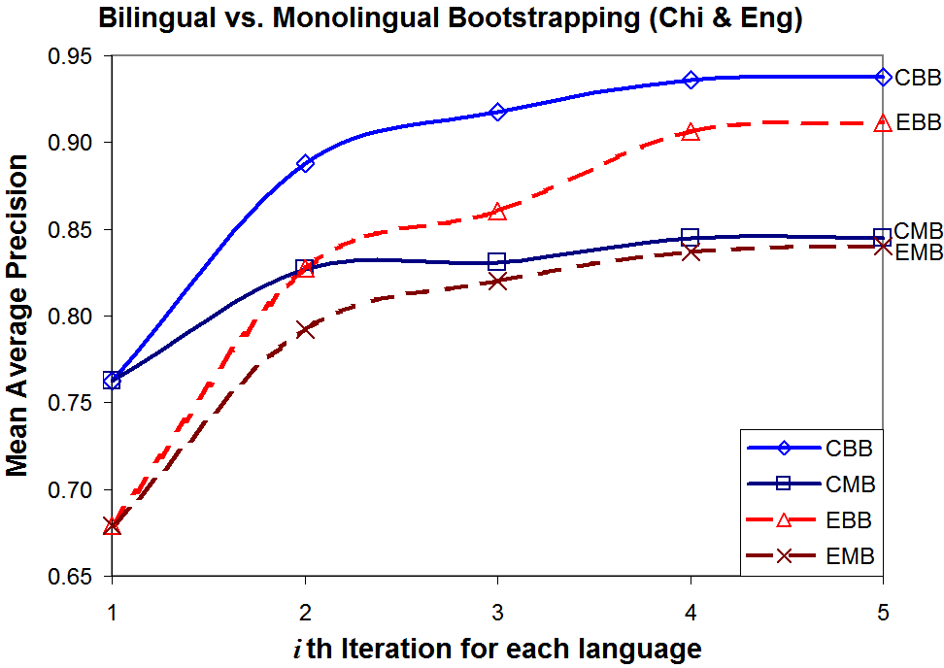
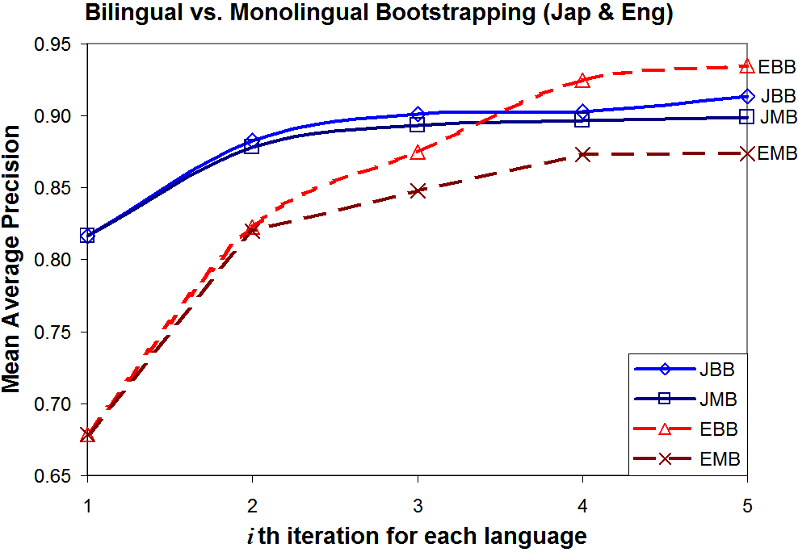
Experimental Results
How to improve accuracy by using two languages?
<number> / 69

Slide 60
Outline
How to…
expand a set of instances?
expand noisy instances from QA systems?
bootstrap set expansion?
extract instances given only the class name?
improve accuracy by using two languages?
expand class-instance relations in pairs?
<number> / 69

Slide 61
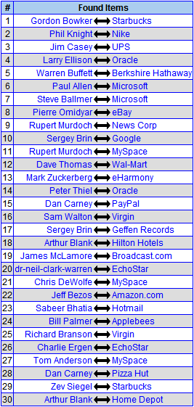
Proposed Solution – Binary SEAL
How to expand class-instance relations in pairs?
SEAL was designed to extract unary relations (e.g., x is a CEO)
Binary SEAL extracts binary relations (e.g., x is the CEO of company y)
  Discovers instance pairs having the same relation as the seed pairs
Real example (output shown at the right):
  Seed #1: Bill Gates <-> Microsoft
  Seed #2: Larry Page <-> Google
<number> / 69

Slide 62
Binary Extractor
How to expand class-instance relations in pairs?
Original Extractor learns unary wrappers
  A unary wrapper consists of left and right context string
  Extracts all instances that have the same left and right context as the seeds
Binary Extractor learns binary wrappers
  A binary wrapper has an additional middle context string
  Extracts all instance-pairs that have the same left, middle, and right context as the seed-pairs
  [left context] Bill Gates [middle context] Microsoft [right context]
  [left context] Sergey Brin [middle context] Google [right context]
<number> / 69

Slide 63
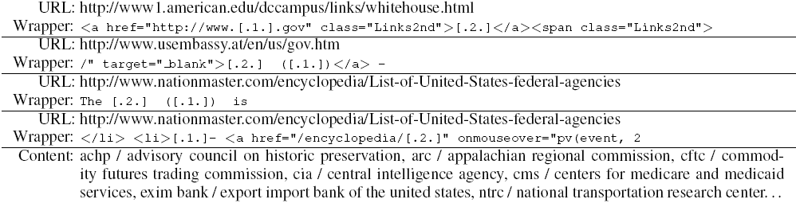
Real Binary Wrappers
How to expand class-instance relations in pairs?
Acronym vs. Full Name of Federal Agencies
  Seed #1: CIA <-> Central Intelligence Agency
  Seed #2: USPS <-> United States Postal Service
Left Context
Middle Context
Right Context
<number> / 69

Slide 64
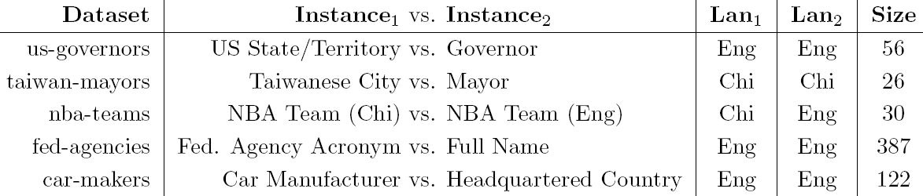
Experiments
How to expand class-instance relations in pairs?
Manually constructed five datasets:
Bootstrap results ten times using iSEAL
  the iterative version of SEAL
<number> / 69

Slide 65
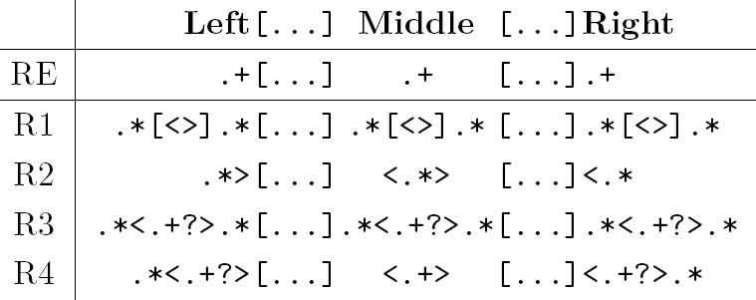
How to expand class-instance relations in pairs?
Experiments
RE is the character-level wrapper for Binary SEAL
Compare RE to 4 types of HTML wrappers
  R1 is least strict, but more strict than RE
  R4 is most strict, but less strict than any HTML wrapper
<number> / 69

Slide 66

How to expand class-instance relations in pairs?
Experimental Results
(Wang & Cohen, EMNLP 2009)
RE
R1
R2
R3
R4
<number> / 69

Slide 67
Conclusion
Conclusion and Future Work
Semi-structured documents provide substantial evidence for discovering class instances
Set expansion at the character-level performs better than at the HTML-level on semi-structured documents
Set expansion can be used as a tool for improving the accuracy of QA systems and for extending WordNet
Random walk is an effective ranker for set expansion
Expansion performance can be improved by exploiting redundant information of classes in different languages
Like unary relations, binary relations can be expanded using similar techniques
<number> / 69

Slide 68
Future Work
Conclusion and Future Work
Develop techniques to automatically…
verify correctness of candidate instances using distributional similarity in free text
classify candidate instances as either subclass or instance names
partition expanded instances into subclasses
identify concept names given example instances
<number> / 69

Slide 69
The End – Thank You!!!
Thank You, William, for your guidance since the SLIF project in the Summer of 2002
Thank You, Bob, for your guidance since the RADD project in the Spring of 2003
Thank You, Tom and Fernando, for all the comments and support during my thesis
<number> / 69

Slide 70
Background – System Inputs
Instance extraction systems require various inputs:
  Semantic class names (e.g., fruits), or
  Example instances (e.g., apple, banana), or
  Both (e.g., fruits, apple)
Some require hand-crafted patterns
  Scan through documents and extract all class-instance relational pairs
<number> / 69

Slide 71
Background - Corpora
Introduction to Class Instance Extraction
Many systems mine data from the Web – a corpus that contains:
  Semi-structured web pages, such as .html
  Unstructured free text, such as .txt
Other corpora include:
  Encyclopedia (Grolier)
  Newswire articles (MUC and TREC)
  Movie rating corpus (EachMovie)
  Web search query logs
  Retrieved text snippets from search engines
<number> / 69
<number> / 69

Slide 72
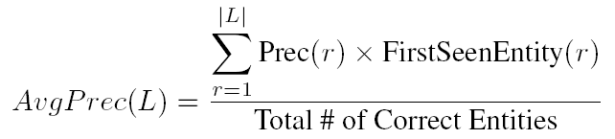
Evaluation Method
Mean Average Precision
  Commonly used for evaluating ranked lists in IR
  Contains recall and precision-oriented aspects
  Sensitive to the entire ranking
  Mean of average precisions for each ranked list
where L = ranked list of extracted items, r = rank
FirstSeenEntity(r) ensures that if a list contains multiple synonyms of an instance i, then we evaluate i only once.
A binary function that returns 1 iff (a) and (b) are true:
(a) Synonym at r is correct
(b) It’s the highest-ranked synonym of its entity in the list
<number> / 69
Notes:
We use Mean Average Precision to evaluate our ranked list.
Because it is commonly used for evaluating ranked results in the field of IR, and it contains recall and precision-oriented aspects.
MAP is defined as the mean of average precisions for each ranked list.
We calculate average precision using the formula shown, where L is the ranked list of extracted mentions, and r is the rank.
<@> Precision r is the precision at rank r
<@> NewEntity r is a binary function, which returns 1 if conditions (a) and (b) are true.
Basically, it ensures that, as we go down a ranked list, we are only evaluating the first encountered mention of every entity.
<@> True Entities is the total number of true entities in this particular dataset that is used for evaluation.
The evaluation procedure goes like this:

Slide 73
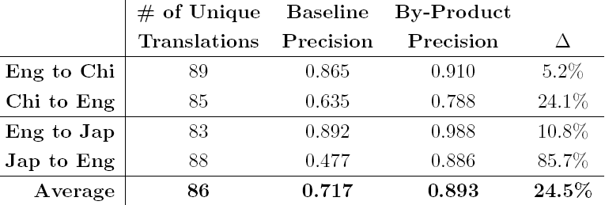
By-Product Dictionary
Precisions of translation pairs generated…
  as by-products from the bilingual bootstrapping, and
  by directly translating the source words in the by-product dictionaries using ANET to serve as baselines
<number> / 69

