Slide 1
Employee Analytics
2020-2023

Slide 2
Contents
Business Questions
Approach and Analysis
Technical Challenges
WorkFlow
Q1. Number of Employees, female-ratio
Q2. Employees rating vs. Salary
Q3. Salary distribution
Q4. Employee trending
Result

Slide 3
Business Questions
Current number of employees per country, and female ratio within the company’s workforce, any identified genders imbalances?
Is there a correlation between employees ratings and the overall average salary within the company?
How is the salary distribution spread across different positions and levels within your organization?
What is the trending in employee metrics from May 2020 to April 2023?

Slide 4
Approach and Analysis
1. Data tables received from Gill Timbers HR Department team
2. The column genders, rating, age, date joined, department, and salary will be considered to answer our questions.
3. Formatted, compiled and cleaned in one single dataset.
4. Statistical inference and graphical visualization will be employed.

Slide 5
Technical challenges
1. The dataset being clean enough, the dataset is not consolidated, I need to turn into Excel table format.
2. The dataset contains missing values in Genders column, inaccurate information in Date Joined columns, and the format needs to be updated on Dated Join and Salary Columns.
3. The dataset contains duplicate values that needs to be removed

Slide 6
WorkFlow
Data Cleansing
Quick Ad-hoc Analysis
Data pre-processing, combine two tables
Data Analysis
-Consolidate data
-Update format for Date Joined and Salary column
-Check for wrong, missing, and duplicate data
-Replace null values with “Other” in Genders column
-Summary analysis
- Enable total rows and average in salary, age to find suspicious values
-Combine tables together using Power Query
-Create custom column “Country” for India and New Zealand staff
-Create column to calculate Tenure, Bonus, and Rating as Number
-Create pivot, formula, and graphs to understand the data.
-Answer business Questions

Slide 7
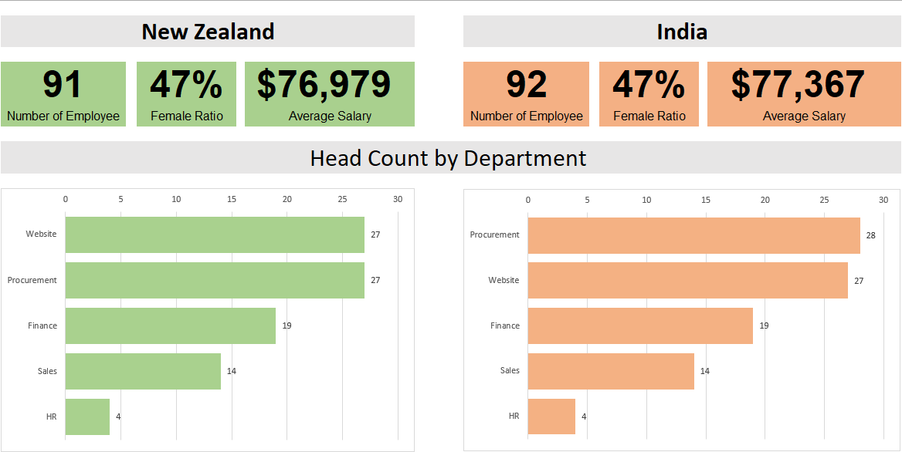
Q1. Number of employees, and female-ratio per country

Slide 8
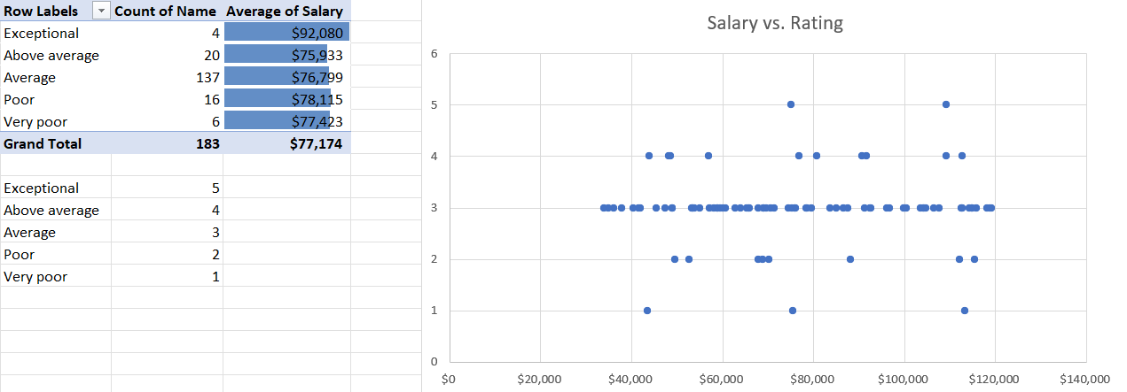
Q2. Correlation between rating and overall salary

Slide 9
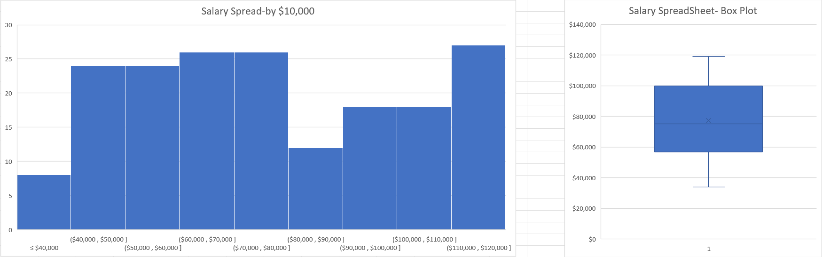
Q3. Salary Distribution across company

Slide 10
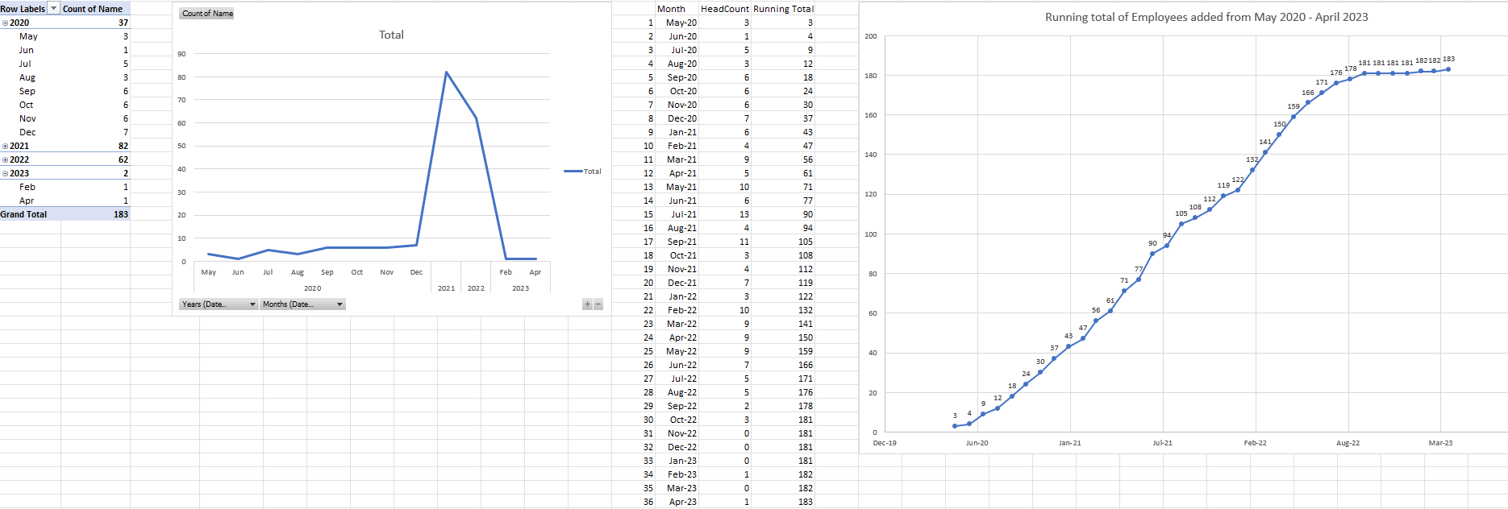
Q4. Trending employee 2020-2023

Slide 11
Conclusions
What is the current number of employees per country, and female ratio within the company’s workforce?
There are 91 employees in New Zealand, and female takes 47% of overall employees.
There are 92 employees in India, and female takes 47% of overall employees.
Is there a correlation between employees ratings and the overall average salary within the company?
Exceptional employees with highest rating will get the highest average salary overall (~$92,000), otherwise, other employees will get the same average range from $75,000-$77,000.
How is the salary distribution spread across different positions and levels within your organization?
Employees received the most in range from $60,000-$80,000, there are 2 exceptional employees received more than $100,000, which leads to the median being less than the average salary in the company
What is the trending in employee metrics from May 2020 to April 2023?
-Trending employees increase continuously from June 2020 to 2023, and in 2023, the recruiting processes is slowing down.

