Slide 1
Cloud Native Initialization Proof of concept

Slide 2
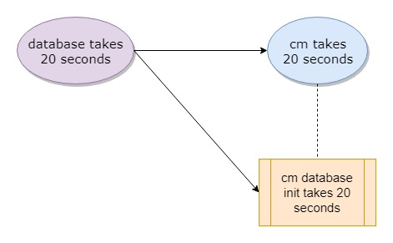
Kubernetes job for initialization – demo program

Slide 3
Kubernetes job for initialization– 2 charts - OK
2019-05-29T10:34:38+0000 [db] db starting ...
2019-05-29T10:35:02+0000 [db] db ready
2019-05-29T10:35:06+0000 [db] db (10.97.44.143:5432) open
2019-05-29T10:35:06+0000 [db] db-test-connection OK
2019-05-29T10:35:08+0000 [cm-db-init] db (10.97.44.143:5432) open
2019-05-29T10:35:08+0000 [cm-db-init] db is up
2019-05-29T10:35:08+0000 [cm] waiting for cm-db
2019-05-29T10:35:09+0000 [cm-db-init] cm job begin ...
CREATE ROLE
CREATE DATABASE
2019-05-29T10:35:19+0000 [cm-db-init] cm job finished
2019-05-29T10:35:23+0000 [cm] cm-db is ready
2019-05-29T10:35:25+0000 [cm] cm starting ...
2019-05-29T10:35:45+0000 [cm] cm ready
2019-05-29T10:36:24+0000 [cm] cm (10.99.43.12:80) open
2019-05-29T10:36:24+0000 [cm] cm-test-connection OK

Slide 4
Kubernetes job for initialization– 1 umbrella chart - OK
2019-05-29T10:44:34+0000 [cm] waiting for cm-db
2019-05-29T10:44:34+0000 [db] db starting ...
2019-05-29T10:44:58+0000 [cm-db-init] db (10.106.158.203:5432) open
2019-05-29T10:44:58+0000 [cm-db-init] db is up
2019-05-29T10:44:58+0000 [db] db ready
2019-05-29T10:44:59+0000 [cm-db-init] cm job begin ...
CREATE ROLE
CREATE DATABASE
2019-05-29T10:45:09+0000 [cm-db-init] cm job finished
2019-05-29T10:45:13+0000 [cm] cm-db is ready
2019-05-29T10:45:14+0000 [cm] cm starting ...
2019-05-29T10:45:34+0000 [cm] cm ready
2019-05-29T10:45:43+0000 [db] db (10.106.158.203:5432) open
2019-05-29T10:45:43+0000 [db] db-test-connection OK
2019-05-29T10:45:51+0000 [cm] cm (10.109.205.6:80) open
2019-05-29T10:45:51+0000 [cm] cm-test-connection OK

Slide 5
Kubernetes job for initialization – Summary
$ helm test cni-poc
RUNNING: cm-test-connection
PASSED: cm-test-connection
RUNNING: db-test-connection
PASSED: db-test-connection
Kubernetes job for initialization achieves the same goal as Helm post-hooks
But Kubernetes job can do better, it can run initialization tasks concurrently, reducing initialization time
The cost is no helm to clean up, only the data required for initialization will remain in the cluster, and the Kubernetes environment will looks a bit messy, or need clean up manually.

