Slide 1
Cloud Native Initialization Proof of concept

Slide 2
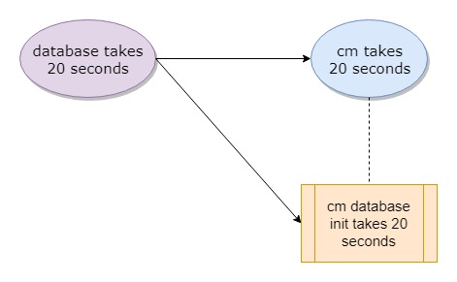
Helm post-install hook – demo program

Slide 3
Helm post-install hook – 2 charts - OK
2019-05-29T09:46:44+0000 [db] db starting ...
2019-05-29T09:47:08+0000 [db] db ready
2019-05-29T09:47:15+0000 [db] db (10.105.144.154:5432) open
2019-05-29T09:47:15+0000 [db] db-test-connection OK
2019-05-29T09:47:18+0000 [cm] waiting for cm-db
2019-05-29T09:47:18+0000 [cm-db-init] db (10.105.144.154:5432) open
2019-05-29T09:47:18+0000 [cm-db-init] db is up
2019-05-29T09:47:18+0000 [cm-db-init] cm job begin ...
CREATE ROLE
CREATE DATABASE
2019-05-29T09:47:29+0000 [cm-db-init] cm job finished
2019-05-29T09:47:33+0000 [cm] cm-db is ready
2019-05-29T09:47:34+0000 [cm] cm starting ...
2019-05-29T09:47:54+0000 [cm] cm ready
2019-05-29T09:48:09+0000 [cm] cm (10.97.116.46:80) open
2019-05-29T09:48:09+0000 [cm] cm-test-connection OK

Slide 4
Helm post-install hook – 1 umbrella chart - OK
2019-05-29T10:19:01+0000 [cm] waiting for cm-db
2019-05-29T10:19:01+0000 [db] db starting ...
2019-05-29T10:19:25+0000 [cm-db-init] db (10.107.164.156:5432) open
2019-05-29T10:19:25+0000 [cm-db-init] db is up
2019-05-29T10:19:25+0000 [db] db ready
2019-05-29T10:19:27+0000 [cm-db-init] cm job begin ...
CREATE ROLE
CREATE DATABASE
2019-05-29T10:19:37+0000 [cm-db-init] cm job finished
2019-05-29T10:19:40+0000 [cm] cm-db is ready
2019-05-29T10:19:41+0000 [cm] cm starting ...
2019-05-29T10:19:46+0000 [db] db (10.107.164.156:5432) open
2019-05-29T10:19:46+0000 [db] db-test-connection OK
2019-05-29T10:20:01+0000 [cm] cm ready
2019-05-29T10:20:06+0000 [cm] cm (10.106.100.214:80) open
2019-05-29T10:20:06+0000 [cm] cm-test-connection OK

