Slide 1
Cloud Native Initialization Proof of concept

Slide 2
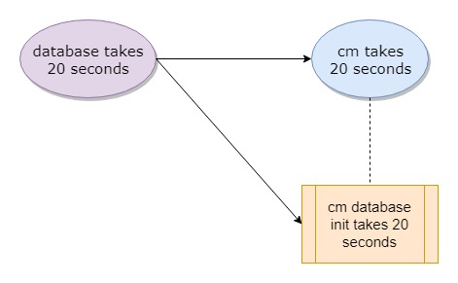
Helm pre-install hook – demo program

Slide 3
Helm pre-install hook – 2 charts - OK
2019-05-29T02:41:09+0000 [db] db starting ...
2019-05-29T02:41:32+0000 [db] db ready
2019-05-29T02:41:50+0000 [db] db (10.104.172.220:5432) open
2019-05-29T02:41:50+0000 [db] db-test-connection OK
2019-05-29T02:41:59+0000 [cm-db-init] db (10.104.172.220:5432) open
2019-05-29T02:41:59+0000 [cm-db-init] db is up
2019-05-29T02:41:59+0000 [cm-db-init] cm job begin ...
2019-05-29T02:42:21+0000 [cm-db-init] cm job finished
2019-05-29T02:42:37+0000 [cm] db is up
2019-05-29T02:42:43+0000 [cm] cm starting ...
2019-05-29T02:43:06+0000 [cm] cm ready
2019-05-29T02:43:33+0000 [cm] cm (10.109.48.73:80) open
2019-05-29T02:43:36+0000 [cm] cm-test-connection OK

Slide 4
Helm pre-install hook – 1 umbrella chart - deadlock
2019-05-29T02:54:30+0000 [cm-db-init] waiting for db
2019-05-29T02:54:32+0000 [cm-db-init] waiting for db
2019-05-29T02:54:34+0000 [cm-db-init] waiting for db
2019-05-29T02:54:40+0000 [cm-db-init] waiting for db
2019-05-29T02:54:42+0000 [cm-db-init] waiting for db
2019-05-29T02:54:44+0000 [cm-db-init] waiting for db
2019-05-29T02:54:47+0000 [cm-db-init] waiting for db
2019-05-29T02:54:49+0000 [cm-db-init] waiting for db
2019-05-29T02:54:51+0000 [cm-db-init] waiting for db
…

