Slide 1
OLAP : ConfigServer
宋恩杰

Slide 2
Contents
1
Deploy Need
2
Storage
3
Apollo
4
Role
5
UML
6
Struct
7
Demo

Slide 3
Deploy-Need
1 machine message(cluster,ip,cpu,mem,disk)
2 all use dir(/data*/jdolap/clickhouse{doris}
3 Lib (clickhouse , palo_be ,palo_fe)
4 Service (start service)

Slide 4
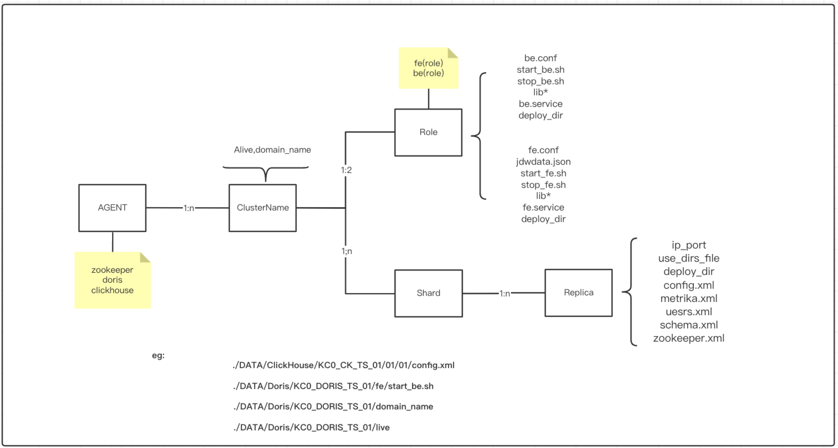
Storage

Slide 5
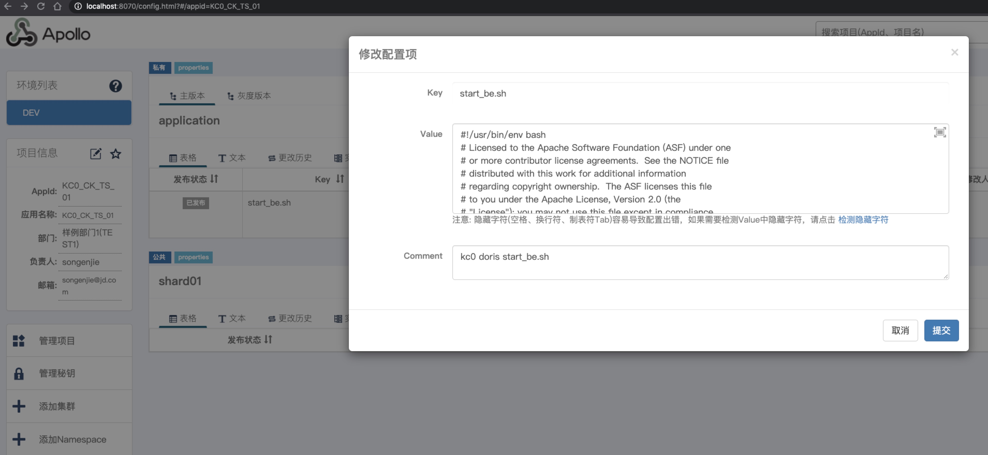
Apollo

Slide 6
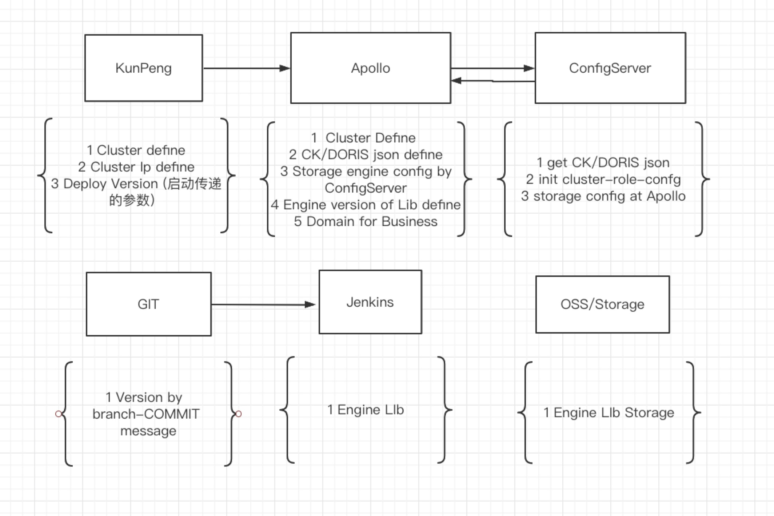
Role

Slide 7
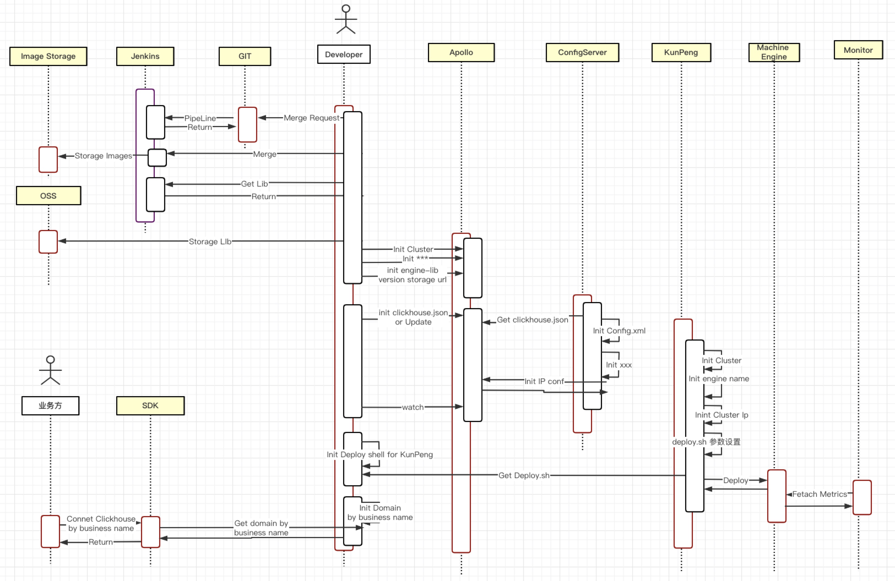
UML

Slide 8
Struct
package structure
type ClickHouse struct {
Cluster string `json:"cluster"`
Zookeeper struct {
Port int `json:"port"`
Ips []string `json:"ips"`
} `json:"zookeeper"`
Shard Shard `json:"shard"`
User struct {
LoadBalancing string `json:"load_balancing"`
MaxMemoryUsage string `json:"max_memory_usage"`
MaxMemoryUsageForAllQuery string `json:"max_memory_usage_for_all_query"`
SkipUnabvailiableShard bool `json:"skip_unabvailiable_shard"`
} `json:"user"`
Replicas []*Replica `json:"replicas"`
}
type Shard struct {
Port []int `json:"port"`
Groups []*Group `json:"groups"`
}
/*
Num1:shard = GroupNumber*3+1
Num2:shard = GroupNumber*3+2
Num3:shard = GroupNumber*3+3
*/
type Group struct {
GroupNumber int `json:"group_number"`
InterReplication bool `json:"inter_replication"`
Weight int `json:"weight"`
Ips struct {
Num1 string `json:"1"`
Num2 string `json:"2"`
Num3 string `json:"3"`
} `json:"ips"`
}
type Replica struct {
HTTPPort string `json:"http_port"`
TCPPort string `json:"tcp_port"`
MysqlPort string `json:"mysql_port"`
InterserverHTTPPort string `json:"interserver_http_port"`
PrometheusPort string `json:"prometheus_port"`
LogDir string `json:"log_dir"`
MetaDataDir string `json:"meta_data_dir"`
SslDir string `json:"ssl_dir"`
TmpDir string `json:"tmp_dir"`
ConfDir string `json:"conf_dir"`
Replica int `json:"replica"`
DataDir struct {
Hot struct {
Diska string `json:"diska"`
Diskb string `json:"diskb"`
} `json:"hot"`
Cold struct {
Diskc string `json:"diskc"`
Diskd string `json:"diskd"`
} `json:"cold"`
MaxDataPartSizeBytes string `json:"max_data_part_size_bytes"`
MoveFactor string `json:"move_factor"`
} `json:"data_dir"`
}

Slide 9
demo
type yandex struct {
StorageConfiguration StorageConfiguration `xml:"storage_configuration"`
}
type StorageConfiguration struct {
//Name xml.Name `xml:"storage_configuration"`
Disks *Disks `xml:"disks"`
Policies *Policies `xml:"policies"`
}
/*Disk*/
type Disks struct {
Disks *[]Disk `xml:",any"`
}
type Disk struct {
//diskname
XMLName xml.Name
Path string `xml:"path"`
}
/*Policies*/
type Policies struct {
Policies *[]Policie `xml:",any"`
}
type Policie struct {
XMLName xml.Name
Volumes *Volumes `xml:"volumns"`
}
type Volumes struct {
Volumes *[]Volume `xml:",any"`
}
type Volume struct {
XMLName xml.Name
Disks []string `xml:"disk"`
Max_data_part_size_bytes string `xml:"max_data_part_size_bytes"`
}
<yandex>
<storage_configuration>
<disks>
<disk>
<path>/data0/jdolap/clickhouse/data</path>
</disk>
<disk>
<path>/data1/jdolap/clickhouse/data</path>
</disk>
<disk>
<path>/data6/jdolap/clickhouse/data0</path>
</disk>
<disk>
<path>/data7/jdolap/clickhouse/data0</path>
</disk>
</disks>
<policies>
<jdob>
<volumns>
<hot>
<disk>disk0</disk>
<disk>disk1</disk>
<max_data_part_size_bytes>0.25</max_data_part_size_bytes>
</hot>
<cold>
<disk>disk6</disk>
<disk>disk7</disk>
<max_data_part_size_bytes>0.33</max_data_part_size_bytes>
</cold>
</volumns>
</jdob>
</policies>
</storage_configuration>
</yandex>

Slide 10
谢谢大家！

